Slide 1
PRE MARITAL COUNSELING &TESTS
Dr. Syed Irfan karim
Assistant Prof. & Consultant Family Physician
Dept of Family & Com. Medicine
King Saud University

Slide 2
Outline of presentation
What is premarital counseling.
Who are Carrier’s and their fates.
How to interpret the TESTS.
What is a successful counseling.
Notes:
CLT which aims to develop instructional design guidelines based on human cognitive architecture

Slide 3
What is premarital counseling
Premarital counseling is a type of advice that helps couples prepare for marriage. Premarital counseling can help ensure that both spouses would have a strong, healthy relationship — giving them a better chance for a stable and satisfying marriage.

Slide 4
What is the pre marital screening program
Back ground :
Genetic disorders particularly Hemoglobinopathies like Thalasemia & Sickle cell anaemia are fairly common in Saudi Arabia , particularly in eastern and southern region.
A high prevalence of Carrier status was reported predominantly in the eastern and south western regions of Saudi Arabia.
Notes:
Working memory is good for processing but not great for holding information.

Slide 5
pre marital screening program
In 2004 the Saudi Ministry of Health implemented a mandatory premarital screening program to decrease the incidence of these genetic disorders in future generations.
In 2008 this test was updated to include mandatory screening for HBV , HCV and HIV.
This new program was named “ program of healthy marriage”.

Slide 6
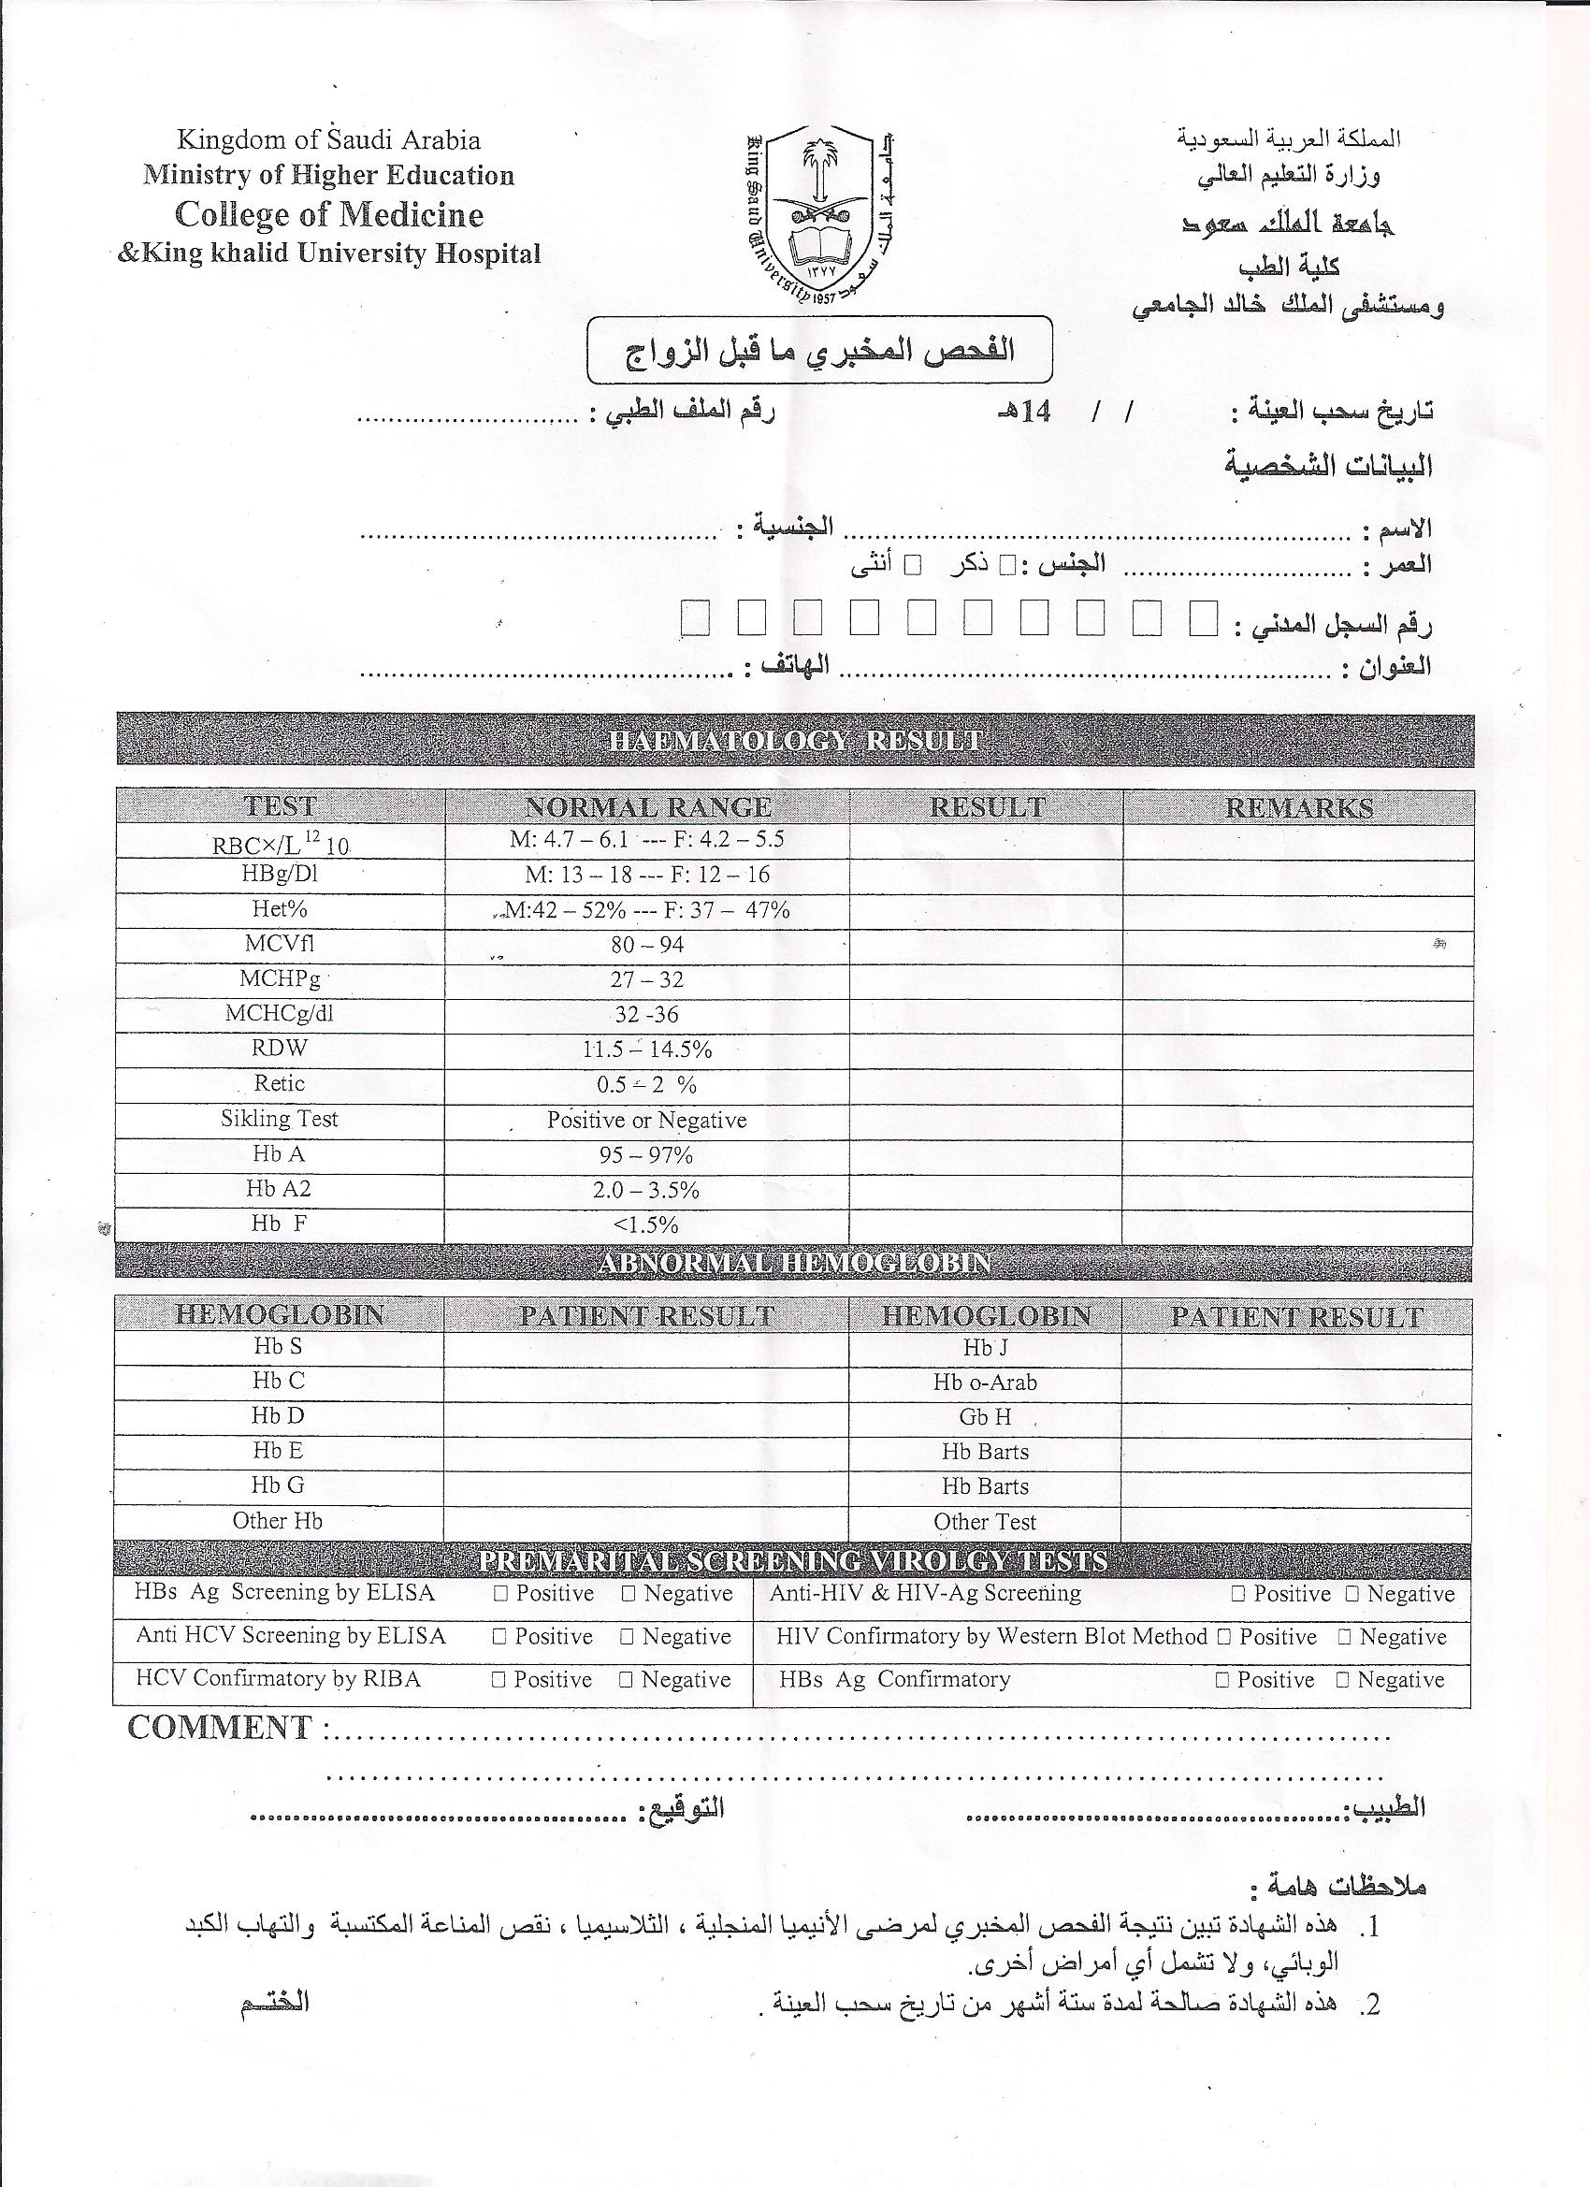

Slide 7
What are the TESTS Performed
Complete Blood Count.
Sickle cell test.
Hemoglobin electrophoresis.
HBs Ag.
Anti-HCV.
HBV screening by ELISA..
HCV screening by ELISA.
Anti-HIV.
HIV-Confirmation by Western blot Method.

Slide 8
Pre-requisite of a screening program
Any succussesful screening program must comply with :
prevailing culture
ethnic values.
Economic values .
Societal values.

Slide 9
Why to include hemoglobinopathies in premarital Screening Program
These are autosomal recessive inheritable haemoglobinopathies .
Common in some regions of Saudi Arabia.
These are incurable disorders and causes significant morbidity and mortality.
This imposes a heavy financial burden on the society.

Slide 10
How Screening tests can help
A simple blood test can detect CARRIERS of these disorders .
The future couples could be informed about their chances of producing affected children

Slide 11
Why to include HIV / HBV /HCV in premarital Screening Program
These diseases are now prevalent in epidemic proportion .
They can be easily transmitted to sexual partners and to new borns.
They are not curable .
The mortality and morbidity rates are high.

Slide 12
Laboratory Interpretation of Hemoglobinopathies
β -Thalassemia minor (Trait) : symptomless heterozygous carrier state.
β -Thalassemia Major : severe symptomatic homozygous Anemia.
Sickle cell anemia.
Sickle cell trait.
Notes:
Miller 1950’s, update on george work by sweller

Slide 13
Types of Normal Hemoglobin
1.Hb A -- comprises 92% of adult hemoglobin.
2. Hb A2 -- Comprises 2-3% of adult hemoglobin. Increased In β-Thalassemia.
3. Hb F -- Comprises less than 1% of hemoglobin in adults. Normal Hemoglobin in Fetus from 3-9th month of life .
Increased In β-Thalassemia.
Notes:
We will start by talking about cog load, them cog limit and the difference b/w the 2. COGNITIVE LOAD IS BASICALLY HOW HARD WE ARE THINKING

Slide 14
Types of Abnormal Hemoglobin Chain Production
Hb H -----found in α-Thalesemia.
It is mild to moderate anemia , when 2-3 genes are deleted.
Hb Barts --- found in α-Thalesemia.
It is severe form of anemia , when all 4 genes are deleted.
Hb Barts cannot carry oxygen and is incompatible with life.
Infants are still born or die immediately after birth (hydropsfetalis).
Notes:
It is extremely limited

Slide 15
Types of Abnormal Hemoglobin Chain Structure
Hb S -- Sickle Cell Hemoglobin.
In homozygous state both genes are abnormal – presents as Sickle cell Anemia.
Hb is b/w 6-8 gm /dl.
Reticulocyte count is 10-20%.
Hb electrophoresis Shows = Hb A : 0 % ,
Hb SS :95% ,
Hb F : 2-20% .
Sickling Solublity test: precipitation of Hb S gives a turbid appearance .
The parents of affected child will show sickle cell trait.
Hb AS ---Sickle cell trait.
In heterozygous state only one chromosome carries the gene.
Hb electrophoresis Shows = Hb A : 60 % , Hb SS :40% , Hb F : 2 % .

Slide 16
Abnormal Hemoglobin Chain Structure
Hb C disease ---may be associated with Hb S (Hb SC disease)
Increased likely hood of thrombosis with life threatening episodes.
Hb E ---combined defects of Globin chain production and structure.
It is combination of β -thalesemia triat and Sickle cell trait .
Hb E alone causes mild microcytic anemia .

Slide 17
Genetic Carrier
A person who carries an allele without exhibiting its effects. Such an allele is usually recessive, but it may also be dominant and latent, with symptoms that do not appear until adulthood

Slide 18
Who is a carrier of Thalessaemia
The βThalassemia Trait is indicated by the following :
Normal or slightly low Hemoglobin.
Decreased mean cell volume (MCV)
And/or reduced mean cell hemoglobin (MCH).
Hemoglobin A2Level >3.5% by Hemoglobin electrophoresis.
Microcytic hypochromic picture.

Slide 19
How will you interpret an Autosomal recessive disorder
This disorder manifests itself only when individual is homozygous for the disease Allele.
The parents are generally unaffected healthy carriers .
The offspring of an effected person will be healthy heterozygotes unless other parent is also a Carrier.

Slide 20
Possible Future Child’s faith
So when Carrier marry a Carrier ; the offspring could be either of the following :
homozygous and effected --25% chance
( 1 in 4 chance )
A Carrier ------ 50% chance .
Genetically Normal ------ 25% chance .

Slide 21
Who is a viral Carrier
One who harbors disease organisms in his body without manifesting any symptoms, thus acting as a distributor of infection.

Slide 22
A Viral carrier’s fate
HIV and Hepatitis B & C viruses can remain dormant for months or even years in CARRIERS without showing any symptoms.
With early diagnosis and treatment CARRIERS of HIV or hepatitis viruses can keep the symptoms under control and reduce the risk of serious complications.

Slide 23
Fate of HBV –Infection
85% of cases ----- Full recovery
5-10% of cases ----Chronic hepatitis/
cirrhosis/liver carcinoma
10% of cases ---- Carriers.

Slide 24
Screening for HBV ( double stranded DNA –Virus )
Who is HBV Carrier
Following an acute HBV infection , which may be sub-clinical 5-10% of patients will not clear the Virus and will become carrier’s of HbsAg.
Carriers are usually discovered incidentally on blood Test either Pre marital examination or routine health check-up or blood Donation.

Slide 25
Healthy HBsAg Carriers
HBsAg : positive.
HBeAg : negative.
HBe-antibody : positive.
HBV-DNA : Negative.

Slide 26
Screening for HCV
A single stranded RNA Virus.
It is 70-90 % of cases found in post-transfusion cases.
Again mostly found incidentally during
Pre marital screening OR routine check-up or Blood donation.
Not easily spread through sexual –contact.

Slide 27
Fate of HCV –Infection
No carrier state found .
Chronic liver disease --- 70-80 % of cases.
Cirrhosis of Liver ----- 5% of cases.
Hepatoma ------------ 15 % of cases

Slide 28
Screening for HIV
HIV is a Retrovirus infecting T-Helper cells bearing the CD4 receptors.
Transmission is sexual --- 60-70% of cases.
From mother to child ---- 90% of cases.

Slide 29
FATE OF HIV-Antibodies
Confirmed by Western blot Test.
Presence of HIV-antibodies gives no indication about disease progression. After exposure to HIV –infected person it may take upto 3months to become positive.
Consider repeating this test if exposure may have occurred < than 3 months prior to testing.

Slide 30
What will happen after the tests
Consult your Family Physician
What steps a Family Physician should take ?

Slide 31
In case of carrier for hemoglobinipathies:
The future couple should be advised that after marriage your children could suffer from Sickle Cell anemia or Thalassemia.
The physician will not issue the premarital fitness certificate.
The decision will be for the future couple whether to go ahead with the marriage or not.

Slide 32
In case of infection with HIV or Hepatits viruses:
The physician will repeat the test before confirming the diagnosis.
If still positive ; will not issue premarital fitness certificate.
HIV & HCV Positive are encouraged to avoid marriage(for now) – as there is much higher chance to transmit infection to your future spouse.

Slide 33
In HBV Carriers , the healthy partner is advised to be vaccinated.
The HIV ,HCV patient will be informed and referred to a Specialty Clinic for Follow-up.

Slide 34
What Ethical issues can arise
usually premarital screening comes too late for couples to change their opinions ABOUT marriage.
By this time they are already committed for this relationship.

Slide 35
Which Spouse would be affected the Most ?
Male
Female

Slide 36
Is it a stigma or dilemma for female ?

Slide 37
A TABOO FOR FEMALE
Rejecting marriage on these ground may effect her Social Life .
Sometimes this stigma may prevent her from
ever getting Married .

Slide 38
STIGMA FOR MALE or FEMALE
HIV-testing also has far-reaching social impact especially when someone is planning to marry.
In some communities certain values may clash with concept of premarital HIV-testing with major issues of confidentiality

Slide 39
What is the Family Physicians Role

Slide 40
Discuss Genetic counseling
Encourage individual or family to obtain information about a genetic condition that may effect them ,
so that they can make appropriate decisions about marriage , reproduction and health management.

Slide 41
Discuss Consanguinity :
Relationships by blood or common ancestry, in which the chances of offspring inheriting a recessive allele for a disease are increased .
The closer the relationship , the greater the risk.(especially cousin marriages)

Slide 42
Prevalence of Consanguineous marriages in Muslim Community
25-60% of all marriages in Arab regions are consanguineous , with a high incidence of first-cousin marriage.
In saudiarabia , 90% of couples detected as carriers did not follow the advice and went ahead with their marriages.
There are many teachings in Islamic Culture which promote healthy marriage and role of counseling.

Slide 43
Marriages between members of same tribe or extended family groups are favored in muslim communities.
Social and familial commitments make it difficult to ask partners to undergo pre marital testing.

Slide 44
Wrong religious beliefs could be obstacles to premarital screening success regardless of education level.

Slide 45
A SUCCESSFUL PRE MARITAL COUNSELING APPROACH
Education and attitude of the couples to be screened .
The meaning of the term “carrier Status” should be made known to the members of the public long before they get married.

Slide 46
Educational programs about the benefits of premarital examination should target unmarried males , so they can make informed choices about unmarried females and consanguineous marriages.
Active involvement of policy makers to establish and implement appropriate screening techniques and policies.

Slide 47
“Solution focused” pre marital counseling -Helping couples to develop a shared vision for the marriage.
Solution- oriented interventions .
Solution -oriented questions and feedback

Slide 48
Approach adopted by the counselor . Educate all members of the screening Team ( lab technologist;nurse practitioners; physicians;counselors;out-reach workers ; social workers. )
There should be good cooperation between community and religious leaders, school parent and health professionals.

Slide 49
Available choices after positive Test results :
Avoidance of marriage.
Those who proceed can be offered reproductive options after prenatal diagnosis.

Slide 50
CONCLUSION
Any mandatory screening program does have the potential to succeed as long as the TARGET POPULATION is clearly identified and all ethical issues (confidentiality of results) ,religious , cultural and human rights and concerns about post-diagnostic management are fully addressed.

