Slide 1
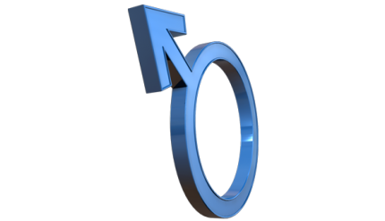
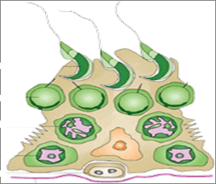
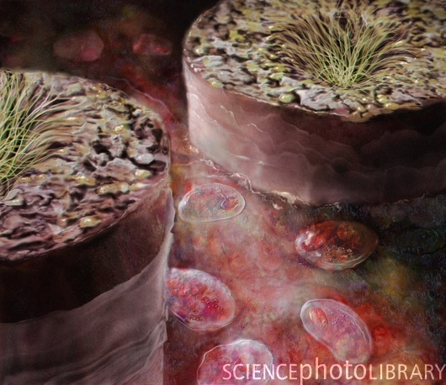
DRUGS USED IN
MALE INFERTILITY

Slide 2
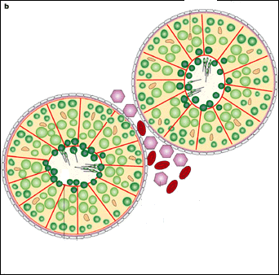
DRUGS USED IN
MALE INFERTILITY
ILOs
By the end of this lecture you will be able to:
Define male infertility
Recognize regulations contributing to male fertility & dysregulations leading to infertility
Classify hormonal & non-hormonal therapies used in male infertility whether being empirical or specific.
Expand on the mechanism of action, indications, preparations, side effects, contraindications & interactions of most hormonal therapies
Highlight some potentialities of emperical non-hormonal therapies

Slide 3
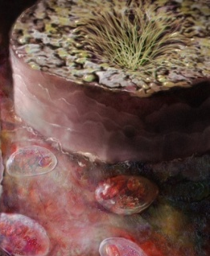
MALE INFERTILITY
Definition
Inability of a male to achieve conception in a fertile woman after one year of unprotected intercourse.
Prevalence
Approximately 15-20% of all couples are infertile
In up to 50% of such cases(7.5-10%),males are responsible
INFERTILITY vs IMPOTENCE – What is the difference?

Slide 4
In male infertility, the semen analysis is abnormal:
Count is low (oligospermia)
Sperms are absent in the ejaculate(azoospermia)
Sperm motility is seriously affected(asthenospermia).
Sperms are totally immobile or dead (necrospermia)

Slide 5
Causes of Male Infertility
1. Ideopathic 25% (causes unknown).
2. Pre- testicular causes(poor hormonal support & poor general
health including:
Hypogonadism;Drugs; alcohol; Tobacco; Strenuous riding(bicycle
& horse riding); Medications(chemotherapy; anabolic steroids).
3. Testicular causes(testes produce semen of low quantity and/or
poor quality):
Age; Malaria; Testicular cancer; etc.
4. Post- testicular causes(conditions that affect male genital
system after testicular sperm production):
Vas deferens obstruction; Infection, e.g. prostatitis, T.B;
Ejaculatory duct obstruction;Impotence.

Slide 6
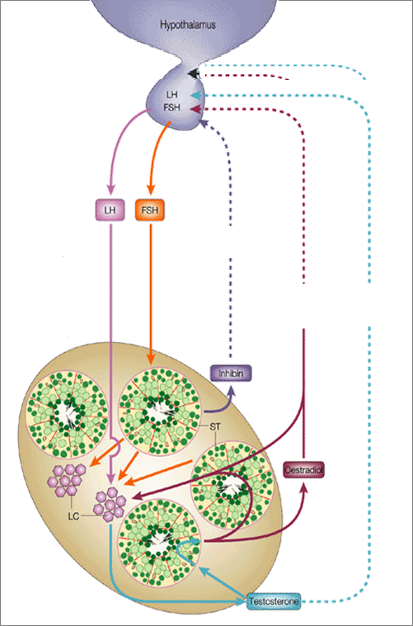
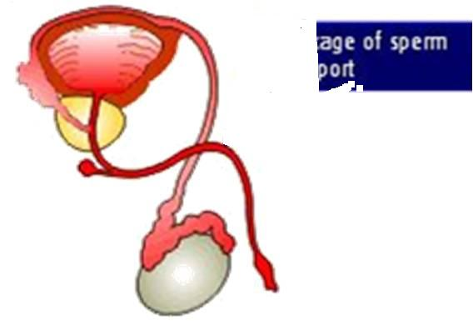
If WRONG INFERTILITY
HYPOTHALAMUS
Pulsatile Secretion
GnRH
3. Problems of Sperm Transport
GnHs
E facilitate –ve of T on GnRH & GnHs
POST-TESTICULAR
LH
FSH
-ve
-ve
Initiation & Maintenance of spermatogenesis
-ve
+ve
PRE-TESTICULAR
Inhibin
4. Problem in Erection & Ejaculation
Estradiol
+ve
1. Problems related to Hormone Production
5DHT
2. Problems related to Sperm Production
TESTOSTERONE
TESTICULAR
LHTestosterone Pulsatile
(chronic LH  makes testis refractory)
MALE INFERTILITY

Slide 7
Needs 3 ms. before semen quality changes
DRUG TREATMENT OF MALE INFERTILITY
HORMONAL THERAPY
NON-HORMONAL THERAPY
SPECIFIC
EMPERICAL
EMPERICAL
SPECIFIC
Hyperprolactinaemia DA₂₋ Agonists
Hypothyroidism Thyroxine
Congenital Adrenal Hyperplasia corticosteroids Glucocorticoids excess  correct levels
Erectile Dysfunction PDE 5 inhibitors,e.g. sildenafil(viagra),vardenafil(levitra),tadalafil(cialis)
Premature Ejaculation SSRIs(e.g.fluoxetine” Prozac”)
Infection of testes,prostate &UTIAntibiotics
Idiopathic Androgens, Antiestrogen, GnH(FSH)
Euogonadotrophic Hypogonadism  (T only) Antiestrogens (SERMs & Aromatase Is)
Hypogonadotrophic hypogonadism  2^{ndry} Hypogonadism ( Hypothalamo-Pituitary )
(T &  FSH / LH )
Pulsatile GnRH, hMG, hCG, Androgens, Clomiphene
Antioxidants; e.g.vit E, vit.c
Zinc Supplements
Folic acid
L-Carnitine
Hypergonadotrophic Hypogonadism (Testicular dysfunction)  1^{ry} Hypogonadism (T &LH ) Assisted Reproduction( no treatment )

Slide 8
Drugs Used in the Treatment of Male infertility
Testesterone and synthetic androgens
Antiestrogens
SERMs-clomifen, tamoxifen
Aromatase inhibitors- Anastrazole
3. GnRH agonists(hypothalamic amenorhea)
4. GnH together with hcG(pituitary failure)
Non- hormonal therapy(antioxidants, zinc,
folic acid, etc.).

Slide 9
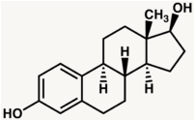
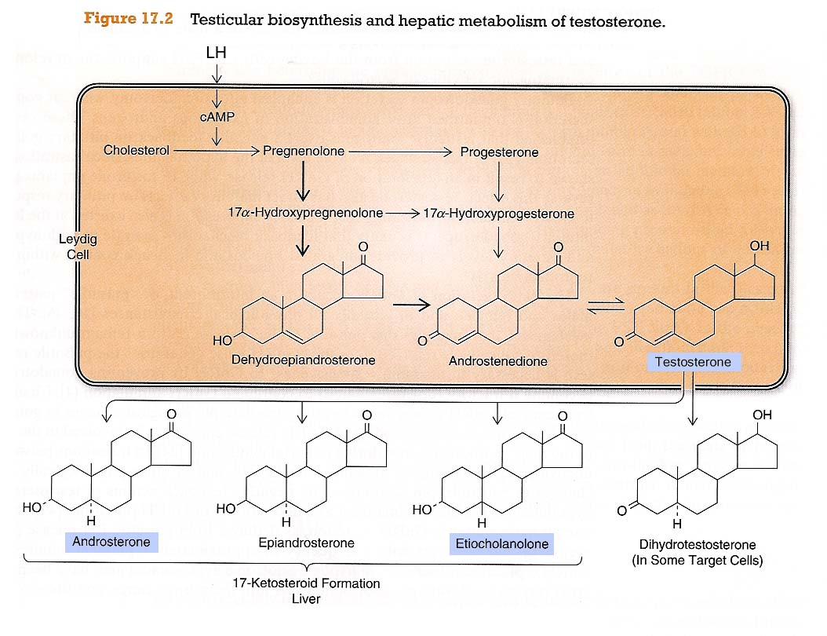
1.Testesterone
> in brain, bone, liver, adipose t.
AROMATASE
Estradiol
> in accessory sex organs
5-α-REDUCTASE
Leydig C
DHT
TESTOSTERONE
Principle male sex hormone produced in testis(> 95%), small amount in adrenals. It follows a circadian patternin early morning & in evening

Slide 10
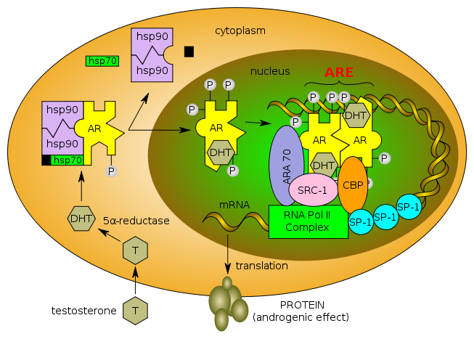
Mechanism of action of testosterone
A.(prostate,seminal vesicles converted by α-reductase to DHT
PROTEIN
TESTOSTERONE

Slide 11
B. Bones and Brain
Testesterone is metabolized by c-p450 aromatase to estradiol .
Bones: estradiol accelerates maturation of cartilage into bone leading to closure of the epiphysis & conclusion of growth.
Brain: estradiol serves as the most important feedback signal to the hypothalamus(esp. affecting LH secretion).

Slide 12
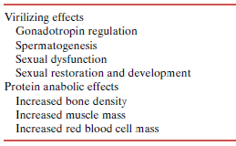
Pharmacological effects of Testesterone
Testesterone has virilizing and anabolic effects
○ Testosterone & Synthetic Androgens
Anabolic Steroids
Un approved use

Slide 13
Kinetics of Testesterone
Ineffective orally(inactivated by 1st pass met.) I.M or S.C.
Skin patch & gels…. are also available
Binds to Sex Hormone Binding Globulin [SHBG]
t1/2 = 10 –20 min
Inactivated in the liver.; 90% of metabolites excreted in urine.
Disadvantages: Rapidly absorbed, rapidly metabolized(Short duration of action).
Synthetic Androgens
Less rapidly metabolized & more lipid soluble ►increasing its duration of action.
Derived from Testosterone
Esters; propionate, cypionate in oil for IM; every 2-3 weeks
Other derivatives as Methyltestosterone, Danazol  given Orally; daily
Derived from DHT; Mesterolone  given Orally; daily

Slide 14
Mesterolone More safely given in  testosterone or in 2ndry hypogonadism.
Why???
1. Not aromatised into estrogens no –ve of GnHs  encourages natural testosterone production spermatogenesis is enhanced.
2. Unlike other oral synthetic androgens it is not hepatotoxic.

Slide 15
1. ANDROGENS
INDICATIONS
As Testesterone Replacement Therapy(TRT)
Therapy for androgen deficiency in adult male infertility.
In delayed puberty with hypogonadism
 give androgen slow & spaced for fear of
premature fusion of epiphyses  short stature.

Slide 16
Adverse effects of Androgens
Excess androgens(if taken > 6 wks) can cause impotence,decreased spermatogenesis &gynecomastia.
Alteration in serum lipid profile: HDL & LDL, hence, risk of premature coronary heart disease.
Polycythemia(increase # of RBC)  risk of clotting.
Salt & water retention leading to edema.
Hepatic dysfunction; aspartate amino transferase levels,alkaline phosphatase,  bilirubin & cholestatic jaundice.
Hepatic carcinoma(long term use)
Behavioral changes; physiologic dependence,↑ aggressiveness.
Premature closing of epiphysis of the long bones.
Reduction of testicular size

Slide 17
Contraindications
Testesterone
Male patients with cancer of breast or prostate
Severe renal & cardiac disease → predispose to edema
Psychiatric disorders
Hypercoagulable states
Polycythemia
Interactions
+ corticosteroids  oedema
+ warfarin  metabolism   bleeding
+ insulin or oral hypoglycemics  hypoglycemia
+ propranolol   propranolol clearance  efficacy

Slide 18
2. Antiestrogens
Because estrogens  –ve feedback on hypothalamus  GnRH pulse & pituitary responsiveness to GnRH , so antiestrogens  Gn RH & improve its pituitary response.
2.a. SERMs
Tamoxifen, Clomiphene
Tamoxifen
Clomiphene
Both drugs can induce libido & bad temper in men
2.b. Aromatase Inhibitors
Anastrozole
Blocks conversion of testosterone to estrogen within the hypothalamus
All are used for inducing spermatogenesis when sperms count is low)

Slide 19
3. GnRH
Used in hypothalamic dysfunction
Given as Pulsatile GnRH therapy using a portable pump.
Exogenous excess of GnRH  down-regulation of pituitary GnRH receptors &  LH responsiveness.
ADRs; Headache, depression, generalized weakness, pain , gynecomastia and osteoporosis.
4. GnHs
Used in 2ndry hypogonadism (FSH or both FSH &LH absent)  spermatogenesis
hMG combined with hCG.
ADRs; Headache, local swelling (injection site), nausea, flushing, depression, gynecomastia, precocious puberty.

Slide 20
5.Non-HORMONAL THERAPY
Sometimes is very promising, to improve sperm quality and quantity.
Antioxidants
Protect sperm from oxidative damage(e.g. vit E,C)
FOLIC ACID
Plays a role in RNA and DNA synthesis during spermatogenesis & has antioxidant properties.
ZINC
Plays an important role in testicular development, sperm production & sperm motility.
L-CARNITINE
Highly concentrated in the epididymis & is important for sperm maturation and motility.

Slide 21
DRUGS USED IN
MALE INFERTILITY
GOOD LUCK

