Slide 1
Reproductive Physiology Lecture 8 Hormones affecting female breast
Dr.Mohammed Alotaibi
Assistant Professor
dEpartment of Physiology
College of Medicine
King Saud University

Slide 2
Objectives
By the end of this lecture, you should be able to:
Know the physiologic anatomy of the breast.
Describe the physiological changes that occur in the breast during mammogenesis, lactogenesis, and galactopoeisis and the hormones involved.
Recognize the phases of lactogenesis.
Describe the endocrine and autocrine control of lactation.
Explain the physiological basis of suckling reflex and its role in lactation.

Slide 3
What is the structure of breast?

Slide 4
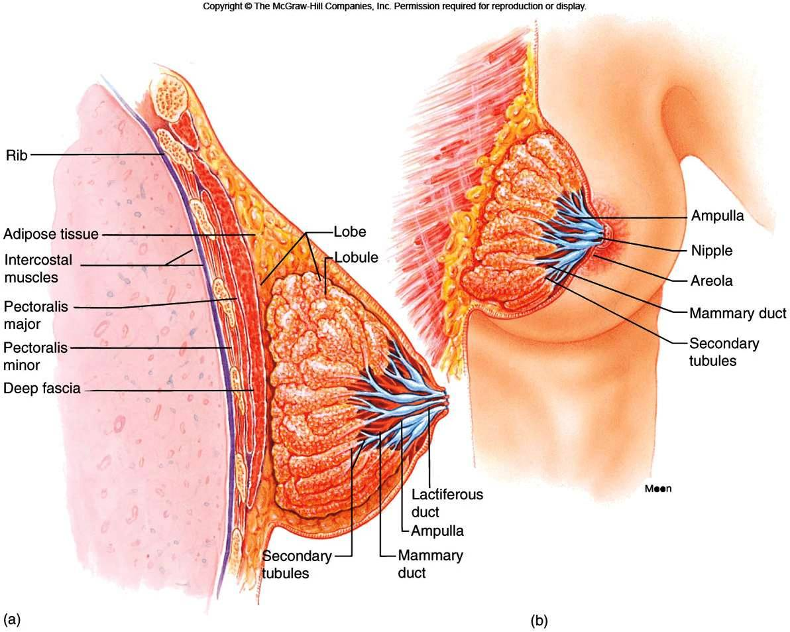
The structure of the breast and mammary glands

Slide 5
Structures of the Mammary Gland
Each breast consists of ~ 23 lobes of secretory tissue
a. Each lobe has one lactiferous duct
b. Lobes (and ducts) are arranged radially
c. Lobes are composed of lobules
d. Lobules are composed of alveoli

Slide 6
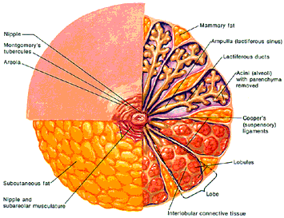
fat
nipple
Lactiferous sinus
Montgomery glands
Lactiferous duct
areola
Alveoli
(alveolar gland)
Suspensory
ligament
(Cooper)
lobules
fat
Lobe
nipple
Interlobular connective tissue

Slide 7
Ductal System
Alveolar tubule
Secondary tubule
Mammary duct
Ampulla (lactiferous sinus)
Lactiferous duct

Slide 8
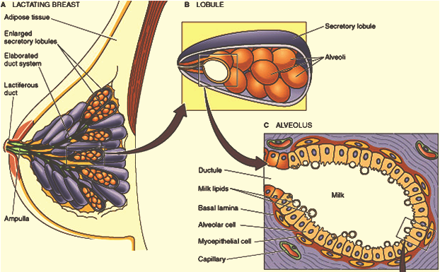
Lobule-Alveolar System
One cell layer
The function of the alveolar epithelial cells is to remove nutrients from the blood and transform these nutrients into the components of milk.

Slide 9
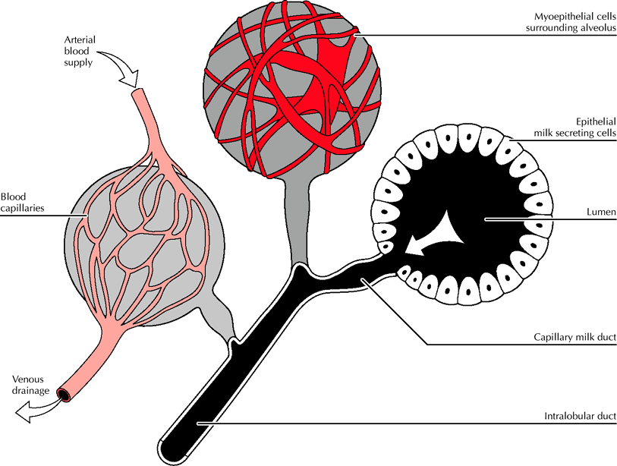
Where does milk come from?
The fundamental secretory unit of the breast is the alveolus

Slide 10
Stages of Mammary Gland Development
1) Mammogenesis (growth and develpoment of mammary gland to a functional state).
2) Lactogenesis (initiation of milk secretion):
Phase 1
Phase 2
3) Galactopoiesis (maintenance of milk secretion in the postpartum period)
4) Involution (cessation of milk production)

Slide 11
Hormones affecting the female breast
Mammogenic hormones (promoting the proliferation of alveolar and duct cells).
Lactogenic hormones (promoting initiation of milk production by alveolar cells).
Galactokinetic hormones (promoting contraction of myoepithelial cells, and thus milk ejection).
Galactopoietic hormones (maintaining milk production after it has been established).

Slide 12
Mammogenic Hormones (Hormones Involved in Mammary Growth)
Estrogens
Progesterone
Growth hormone
Cortisol
Insulin (IGF-1)
hPL also called hCS
Prolactin (PRL)
During puberty (ovarian hormones stimulate mammary growth)
During pregnancy (complete development of mammary glands)

Slide 13
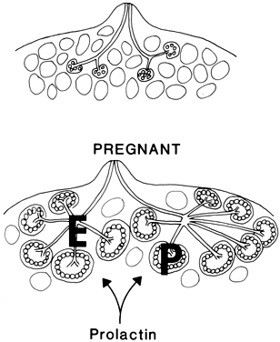
Ovarian Hormones
Estrogen
Growth & branching of ductal system (with GH)
Fat deposition in the stroma.
Progesterone
Growth of lobule-alveolar system (budding of alveoli and secretory changes in epithelial cells).
Although progesterone and estrogen are essential for physical development of the breasts, they inhibit actual secretion of milk during pregnancy.

Slide 14
Lactogenesis
Lactogenesis: Cellular changes by which mammary epithelial cell switches from non-secretory tissue to a secretory tissue (initiation of milk secretion).
Involves 2 Phases:
Lactogenesis 1
Lactogenesis 2

Slide 15
Lactogenesis
Lactogenesis 1: (Histological and enzymatic differentiations of mammary epithelial cells).
Starts in mid-pregnancy and characterized by expression of many genes involved in the synthesis of milk components (increases in uptake transport systems for amino acids, glucose, and calcium required for milk synthesis).
Prolactin stimulates mammary secretory cells to produce milk.
Further differentiation is inhibited by high levels of progesterone from the placenta.

Slide 16
Lactogenesis
Lactogenesis 2: (Copious secretion of all milk components), starts 2-3 days postpartum
At parturition, withdrawal of progesterone + high level of prolactin leads to:
Further increase in expression of milk protein genes
Glands absorb large quantities of metabolic substrates from the blood
Movement of cytoplasmic lipid droplets and casein into alveolar lumen
Transfer of immunoglobulins
Secretion of colostrum followed by milk
Suckling stimulates further increase in expression of genes involved in milk secretion with expansion of alveolar epithelium
Lactation is maintained by removal of milk
Switch from endocrine to autocrine control of milk production.

Slide 17
(Lactogenic Hormones)
Prolactin
hPL (hCS)
Growth hormone
Insulin (IGF-1)
Cortisol
Thyroid hormones
parathyroid hormones
Withdrawal of estrogens and progesterone
All are required to facilitate the mobilization of nutrients and minerals.

Slide 18
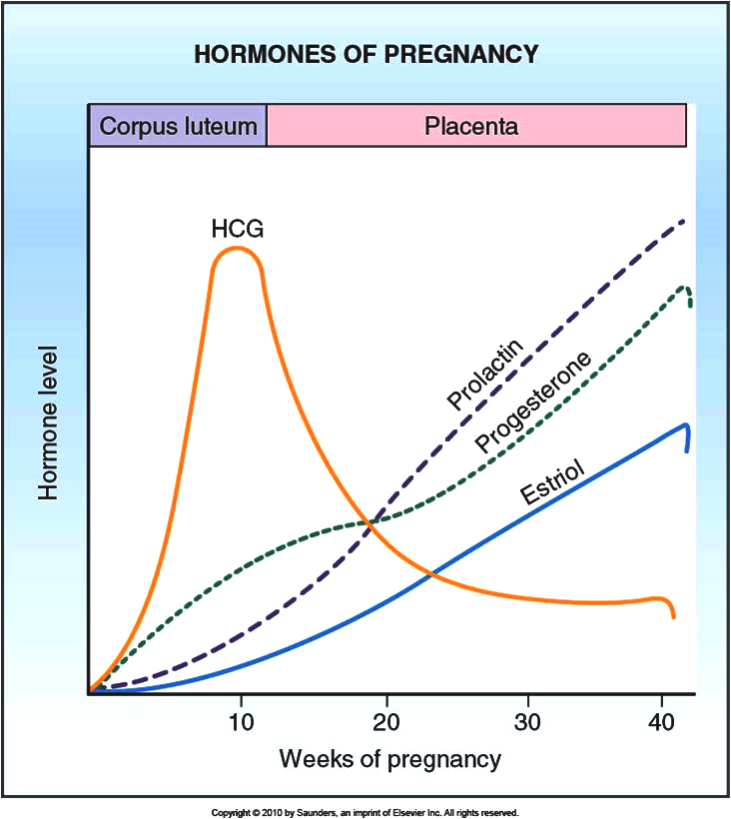
Prolactin (PRL)
Secreted from the anterior pituitary gland.
Its level rises steadily from the 5th week of pregnancy until birth (10-20 times the nonpregnant level) (enhanced by E)
It has mammogenic, lactogenic and galactopoietic effects.
It stimulates expression of genes that encode several milk components (casein/ lactalbumin, lactose and lipids)
Sudden drop in E & P after delivery allows milk production
It is controlled mainly by hypothalamic hormone (Dopamine)

Slide 19
Human placental lactogen (human chorionic somatomammotropin, hCS)
Secreted by the placenta at about the 5th week of pregnancy
Its secretion increases progressively throughout the remainder of pregnancy in direct proportion to the weight of the placenta
Causes at least partial development of the animal’s breasts and in some instances causes lactation [facilitates growth of mammary glands, supports prolactin during pregnancy (lactogenic properties)]
It has weak actions similar to those of growth hormone
It decreases maternal insulin sensitivity, decreases utilization of glucose, and promotes the release of free fatty acids (Metabolic)

Slide 20
The alveolar cell secretes the components of milk through five pathways
IgA

Slide 21
Galactopoeisis
Galactopoeisis is defined as the maintenance of lactation once lactation has been established. starts 9-15 days postpartum
(Galactopoietic Hormones)
PRL (primary)
Cortisol and other metabolic hormones (permissive)

Slide 22
Oxytocin and psychic stimuli initiate milk ejection (“let-down”)
Milk Ejection Reflex:
Oxytocin contracts the myoepithelial cells, forcing milk from the alveoli into the ducts and sinuses where it is removed by the infant (galactokinetic effect).
(Galactokinetic Hormones)
Oxytocin (OT)
Vasopressin

Slide 23
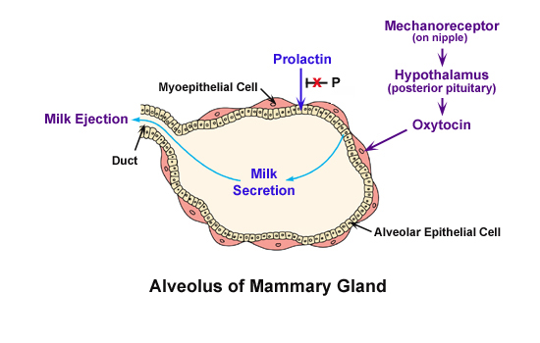

Slide 24
Autocrine Control of Lactation
Influence of Local Factors Acting on the Breasts
It is not just the level of maternal hormones, but the efficiency of milk removal that governs the volume product in each breast
A protein factor called feedback inhibitor of lactation (FIL) is secreted with other milk components into the alveolar lumen
FIL, insensitive to prolactin →  milk production

Slide 25
Autocrine Control of Lactation
FIL
FIL
FIL

Slide 26
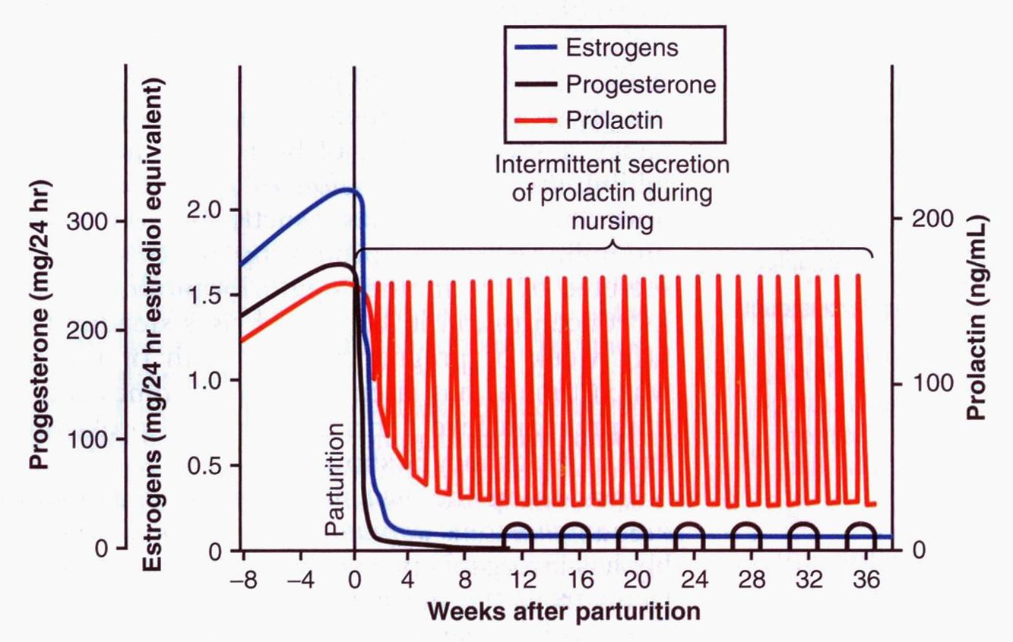
Suckling and Prolactin Secretion
Suckling is the most powerful physiological stimulus for PRL release

Slide 27
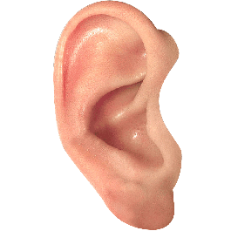
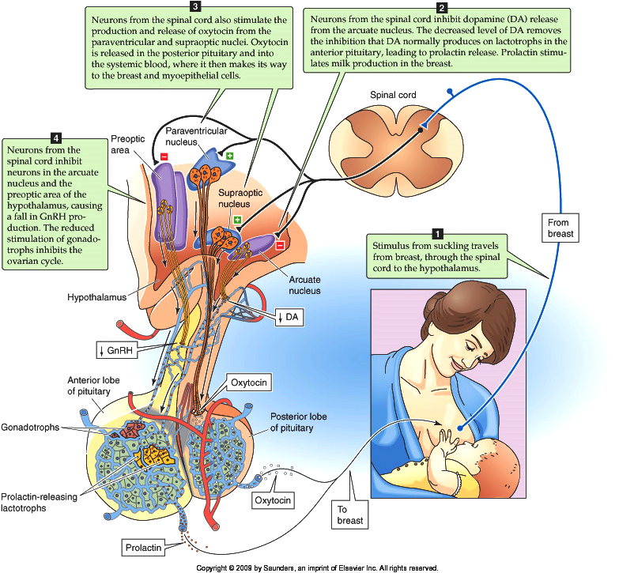
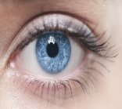
Suckling reflex
psychic stimuli
suckling stimulates
the release of TRH from the hypothalamus

Slide 28
Milk production
Milk production is a "use it or lose it" process. The more often and effectively the baby nurses, more milk will be produced.
Milk production <100 ml/day in day 1 postpartum.
Milk production by day 3 reaches 500 ml/day.
Involution: when the breasts stop producing milk completely after weaning.

Slide 29
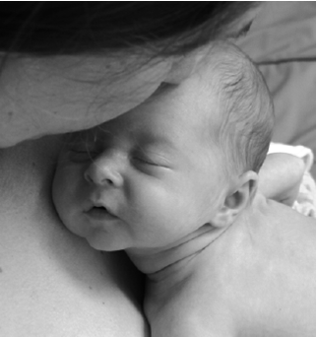
AAP Recommendations
Exclusive breastfeeding for the first six months of life
Continued breastfeeding for at least one year, ‘As long as is desired by mother and child’
يقول تعالى (والوالدات يرضعن أولادهن حولينِ كاملين لمن أراد أن يُتمَّ الرضاعة) [البقرة :233]
American Academy of Pediatrics (2005). "Breastfeeding and the Use of Human Milk." Pediatrics 115(2): 496-506.

Slide 30
The End
Thank You

