Slide 1


Slide 2



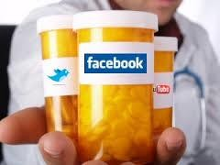




DR. KAMRAN SATTAR
MBBS (PAK) MMed UoD ( UK )
FAcadMEd ( UK )
PGD MedEd UoD ( UK )
Dept: of Medical Education, College of Medicine
King Saud University

Slide 3

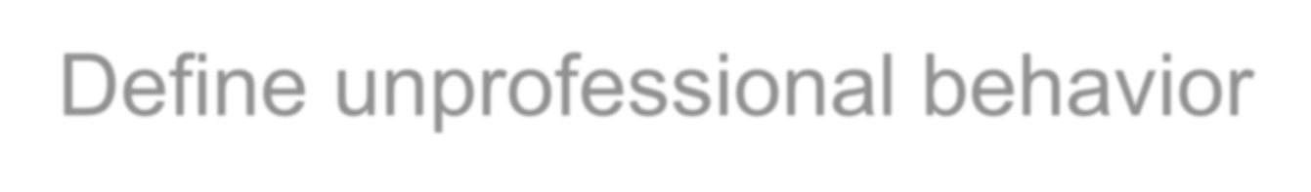








OBJECTIVES
By the end of this lecture You should
be able to;
➢Define unprofessional behavior
➢Identify various elements of human nature that
contribute to unprofessionalism
➢Provide examples of such behaviors from daily life
➢Avoid unprofessional behaviors.

Slide 4












Attributes and behaviors that serve to maintain patient interests above physician self-interest.
It is the unconditional caring of the patient,
putting others before self.
IT IS NOT WHAT WE DO BUT HOW WE DO IT THAT DEFINES MEDCIAL PROFESSIONALISM

Slide 5























Honesty/integrity
Openness
Reliability
Responsibility
Respect
Presence
Compassion/empathy
Competence
Commitment
Self-improvement
Self-awareness / knowledge of
limits
Communication /collaboration
Altruism/advocacy
Morality and ethical conduct
Self regulation
Confidentiality
Autonomy
Teamwork

Slide 6


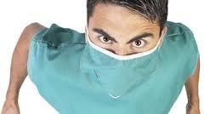
Can you recall a similar experience such as this ?

Slide 7





















A senior doctor, head of a high profile department, is known to bring in research dollars, to be very hard working and adept at specialized medical procedures. S/he is well known for shouting at nurses, throwing instruments back at them, and humiliating junior medical staff. S/he is often absent from department, Complaints are made to hospital administration from staff members; increased numbers of "critical incidents" and staff resignations are noted.

Slide 8













A general practitioner is consistently late or absent for pre-scheduled sessions. S/he gives no explanation, leaving the partners to fill in and make excuses. When confronted, s/he becomes abusive in front of office staff and patients.

Slide 9






















Scenario 3
A final-year medical student has caused disruptions throughout the course by monopolizing time in tutorials, behaving inappropriately with patients and being unwilling to heed advice. Many patients refuse to be interviewed by her/him and have complained to staff. S/he has not failed any exams, but several tutors and nurses have raised concerns about the student's "attitude" and ability to work as an intern.

Slide 10

























Scenario 4
A 54 year old male patient is admitted for the fourth time in two months for complaints of severe ridiculer pain following several attempts at decompressive back surgery.
His pain has been sub-optimally controlled with very
high-dose narcotics and other adjuvant pain-management medications. The nursing staff take his vital signs at the start of every shift but otherwise only appear when his medications are due or he rings the call bell. The pain waxes and wanes but is so severe at times that he cries out. The medication orders for breakthrough pain is ineffective. When he tells one nurse this, she responds, sighing, :you have had your medication and you’ll just have to wait three hours for your next does. I’m going on break, so don’t bother me by ringing the bell”

Slide 11

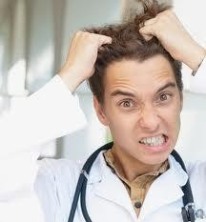
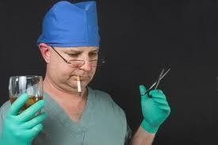
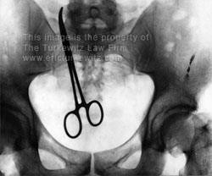

Slide 12


Not pertaining to the characteristic of a
profession.

Slide 13



Do not have to wait until patient dies
to determine that medical care suffered.

Slide 14






Increased workplace difficulties
Decreased morale in other staff
Decline in patient care

Slide 15









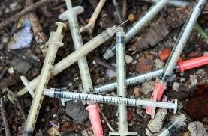



1. Illegal or criminal acts
4. Acts that violate acceptable medical practices
2. Immoral acts
3.Business related acts
5. Plagiarism

Slide 16




A physician may be disciplined and lose his medical license based solely on the fact that he was convicted for a crime or offense.

Slide 17
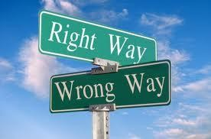







“Immoral” acts generally fall into the
limited category of sexual activity with individuals that may be patients.

Slide 18







These acts are related to the operation of the
business, not the quality of the care
Obtain, maintain, or renew a license to practice medicine by bribery, fraud or misrepresentation

Slide 19








Failure to maintain records of a patient, relating to diagnosis, treatment and care
Altering medical records
Failure to make medical records available for inspection
Medical errors.

Slide 20
Categories of Medical errors
Harmful medical errors.
Near miss medical errors.

Slide 21
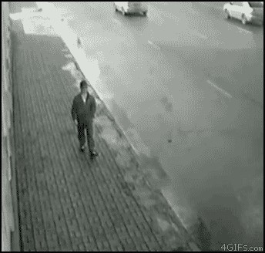
A near miss medical error
An event that under slightly different circumstances could have been an accident, either because the error was detected and corrected in time or because the patient was just lucky.

Slide 22
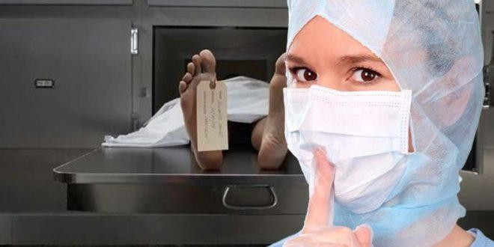
Actions to be taken
Reporting it to the health care system
Disclosing it to the patient involved.

Slide 23

What to report?
Report both types and labelling a near miss medical error as “near miss ME”

Slide 24
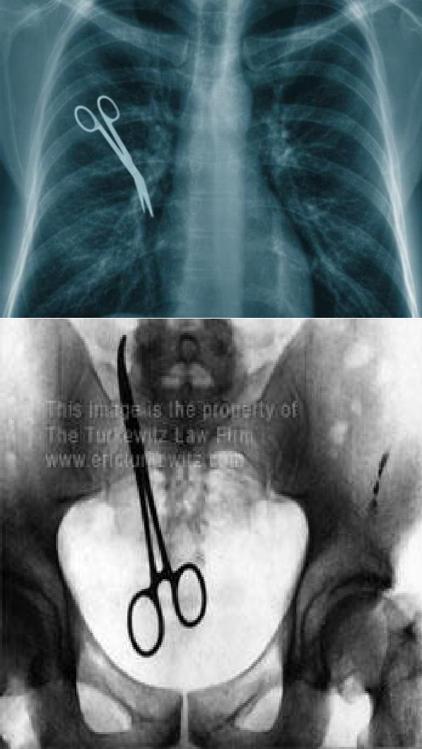
Common types of medical errors
Surgery-related such as:
  Ob/gyn.
  General surgery.
  Orthopedic.
  Cardiac.
  Plastic surgery.

Slide 25

Common types of medical errors
Medication-related such
as:
  Mismanagement and possibly incorrect medication.
  Wrong prescription.
  Wrong dosage.
  Inadequate instructions to patient.

Slide 26
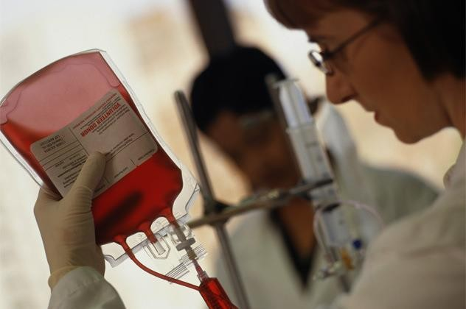
Common types of medical errors
Body-fluid-related
error such as:
  Blood transfusion administered too quickly, which resulted in congestive heart failure and death.
  Transfusion of contaminated blood.

Slide 27
Common types of medical errors
Diagnostic errors such as:
  misdiagnosis leading to an incorrect choice of therapy.
  Failure to order necessary diagnostic test.
  Misinterpretation of test results
  Failure to act on abnormal results.

Slide 28

Common types of medical errors
Equipment failure such
as:
Defibrillators with dead batteries.
Intravenous pumps whose valves are easily dislodged bumped which cause increased doses of medication over too short a period.

Slide 29
Why do we need to disclose
medical errors
Promote public trust.
Prevent further harm to a patient and to other patients.
Respect personal autonomy.
Support principle of justice.
Improve the safety of medical practice.
Be able to trust the physicians and the system.

Slide 30
Non-disclosure of errors
Undermine efforts to improve the safety of medical
practice.
Block efforts to identify the faults and weaknesses
in the health care processes and procedures.

Slide 31
Legal obligations
Having an efficient system for disclosures of our own medical mistakes, and those of higher authorities.
Having written policies and procedures that fully
support patients and their rights.

Slide 32
What do we disclose to patients
Full disclosures of all the errors that result in harm
What has happened and why.
How the problem occurred.
Implications.
How to prevent it happening again.

Slide 33
How to disclose medical errors:
Using the (Practical Disclosure Approach) which is
an approach to the practical prevention of errors.

Slide 34
Practical Disclosure Approach
Disclosure should be at the right time and setting, when the patient
is medically stable enough to absorb the information.
A physician should take the lead in disclosing errors to patients and their families
They should avoid being defensive or evasive, but rather explain
what happened in an objective and narrative way
Avoid reacting to the response that such disclosure might generate.
A proper acknowledgement and empathy accompanied by apology may be appreciated by the patient. Thus it may strengthen, rather than undermine, the physician-patient relationship.
Support should be provided.

Slide 35








Is an unethical, dishonest act whereby an individual uses the work of another, commit literacy theft, or present work as an original idea without crediting the source or stating that it is derived from an existing source.

Slide 36
Types of Plagiarism
Direct copying.
Word switching.
Working with others.
Concealing sources.
Buying assignments.
Self plagiarism.

Slide 37
Direct copying
Copying someone else’s work using the exact words and putting it as your own. This is the most common type of plagiarism.

Slide 38
Word switching
Putting someone else's writing as your own by changing words without showing that you are using someone else's ideas.

Slide 39
Working with others
Copying all or part of another student’s writing is
plagiarism.
Sharing an assignment is plagiarism.
Group work on individual assignment is
plagiarism.
Writing in Arabic and asking some else to translate your work is plagiarism.

Slide 40
What is acceptable when working
with others
Group assignments.
Discussing your work and ideas with other students.
Getting advice on sources of information from other
students, lecturers or professionals.

Slide 41
Concealing sources
Hiding the sources of your work and not revealing
them.
This includes:
Putting someone else’s ideas on your words
without referring to them.
Using a reference more than one time, but only pointing it out once.

Slide 42
Buying assignments
Buying an assignment is the worst kind of plagiarism and may have serious consequences.

Slide 43
Self plagiarism
Re-using all or part of an assignment or a project that you have used before without making it clear is considered as plagiarism.

Slide 44












Impaired
Disruptive behavior
Dishonest
Greedy
Abuses power
Lacks interpersonal skills
Conflict of interest
Self-serving

Slide 45


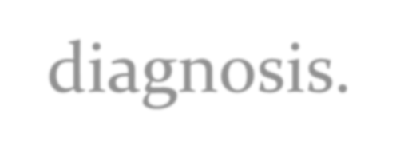







Impairment means more than making incorrect
diagnosis.
Avoidance of patients and their
psychological needs
Dehumanized care
Inappropriate treatment

Slide 46

Include repeated episodes of:
Sexual harassment
Racial or ethnic slurs
Intimidation and abusive language
Persistent lateness in responding
to calls at work

Slide 47










Late or incomplete charting
Delayed or no responses to call or
pagers
Abusive treatment of staff
Unkempt appearance and dress
Inability to accept criticism
Gender or Religious bias bias

Slide 48

















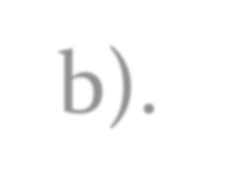



















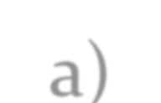
20–25% apparently disappoint their patients
More than 2/3 of physicians never or very rarely generate patient complaints (Hickson et al. 2002, 2007a,2007b).
A total of 6% of doctors, however, received 25
or more complaints over a 6-year period
Nurse surveys suggest that 4–5% of physicians
display such behavior
(Diaz & McMillin 1991; Rosenstein and O’Daniel 2005a)

Slide 49

















The eyes and ears of patients, visitors and healthcare team members are considered to be the most effective surveillance tools for detecting unprofessional behavior.

Slide 50






How should we deal
with such behavior?
Dealing with unprofessional behavior
Surveillance
Registration

Slide 51





Intervention
Norm
Disciplinary
Pattern
persists
Guided by authority
Apparent pattern
Awareness
Single ‘unprofessional’
incident
Informal
Vast majority of doctors: no
professionalism issues
None

Slide 52


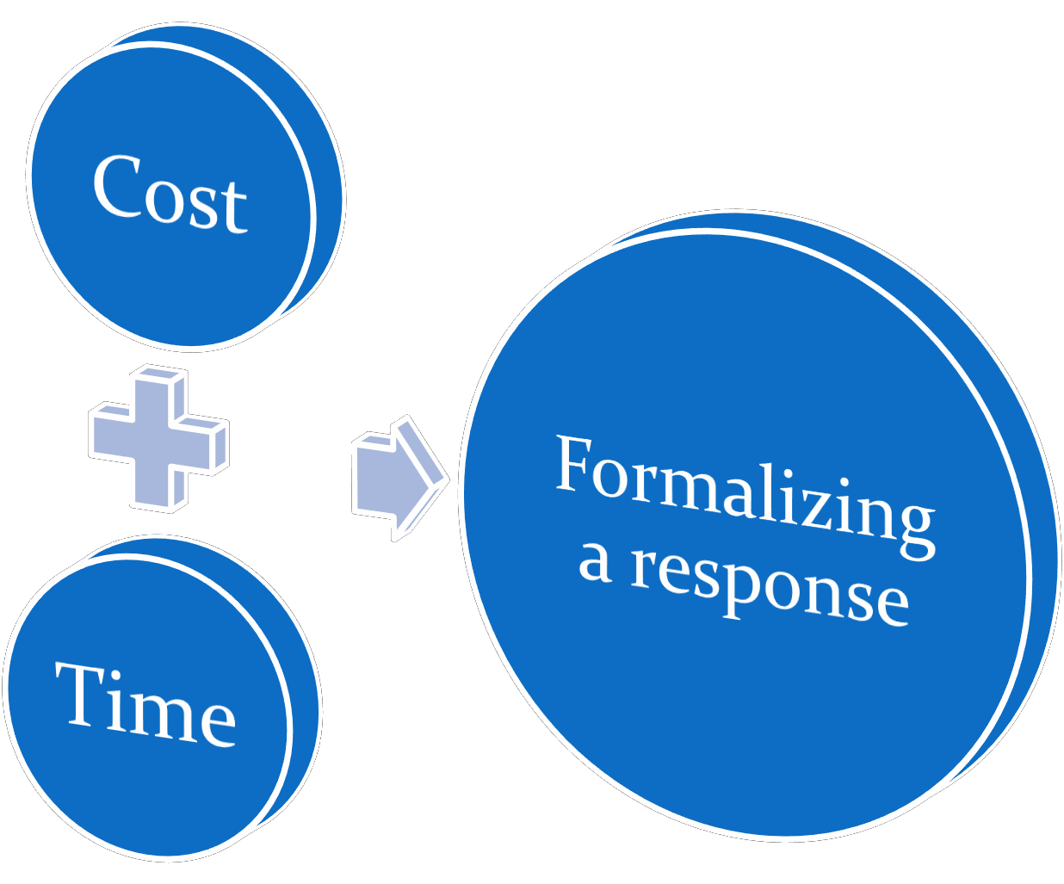
What does formalizing a response need?

Slide 53










هيلع الله ىلص يبنلا نأ ، هنع الله يضر سوأ نب ميمت يبأ نع
؟ الله لوسر اي نمل : انلق ، ةحيصنلا نيدلا ( : لاق ملسو
مهتماعو نيملسملا ةمئلأو ، هلوسرلو ، هباتكلو ، الله( : لاق ملسمو يراخبلاهاور
Abu Tameem ibn Aws may Allah be pleased with him, that the
Prophet peace be upon him said:
(Debt advice, we say: To whom, O Messenger of God? Said: (Allah and His Book, His Messenger, the leaders of the Muslims and their common folk
Ruahalboukhara and Muslim

Slide 54











Not pertaining to the characteristic of a
profession.
Unprofessional behavior fall into five categories:
Illegal or criminal acts
Immoral acts
Business related acts
Acts that violate acceptable medical practices
Plagiarism
Do not have to wait until patient dies to determine that medical care suffered.

Slide 55












Unprofessional Behavior among Medical Students
http://www.nejm.org/doi/full/10.1056/NEJMc060089
Unprofessional physicians
http://www.ncbi.nlm.nih.gov/pmc/articles/PMC1237990/pdf/westjmed00257-0121.pdf
Unprofessional or Disruptive Conduct by Physicians
http://macmedlaw.hubpages.com/hub/Unprofessional-or-Disruptive-Conduct-by-Physicians
The Unprofessional Student Objectives Professionalism
web1.aapa.org/10ACSyllabi/1509UnprofessionalStudent.pdf
Plagiarism
http://www.bradford.ac.uk/library/help/plagiarism/what-is-plagiarism/ http://owll.massey.ac.nz/referencing/referencing-styles.php
Medical Errors:
Hussein GM, Alkabba AF, Kasule OH. Professionalism and Ethics Handbook for Residents (PEHR): A Practical Guide. Ware J, Kattan T (eds). 1st Edition. Riyadh, Saudi Arabia: Saudi Commission for Health Specialties, 2015. MODULE 6 - MEDICAL MALPRACTICE AND MEDICAL ERRORS

Slide 56



Slide 57



& &

