Slide 1




Slide 2




Slide 3










Errors :
Violations:

Slide 4
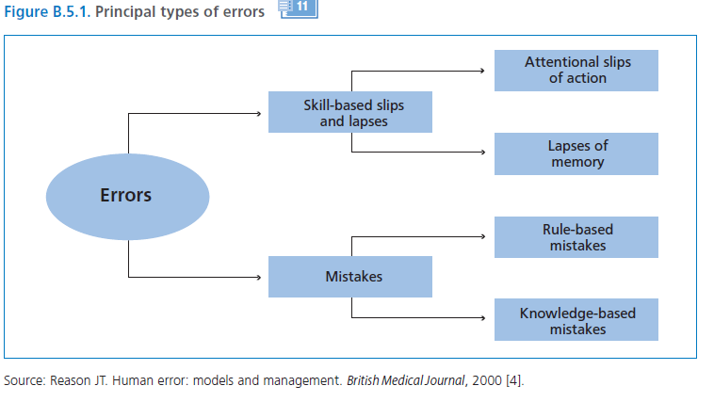

Slide 5













Rule-based,
Knowledge-based

Slide 6








slips
lapse

Slide 7












SOURCE: Leape, Lucian; Lawthers, Ann G.; Brennan, Troyen A., et al. Pr e-venting Medical Injury. Qual Rev Bull. 19(5):144–149, 1993.

Slide 8

A clinical incident:
Near miss:

Slide 9



Situations factors:
Individual factors:
Examples:
  Fatigue
  Stress

Slide 10



Shortage of time:
Inexperience:

Slide 11











Inadequate checking:
Poor procedures:
Inadequate information:

Slide 12

















Limited memory capacity:
Fatigue:
interns
ICU,CCU
more serious mistakes
24 hours or more

Slide 13






Stress, hunger and illness:

Slide 14







Language or cultural factors:
Hazardous attitudes:
perform procedures
supervision
without

Slide 15

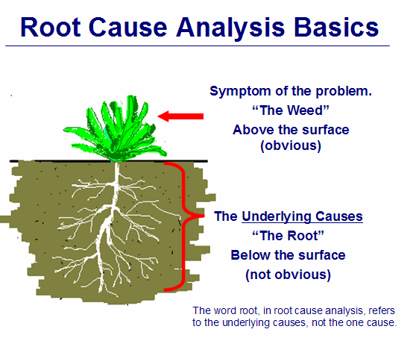











Incident reporting
Root Cause Analysis(RCA):

Slide 16









Slide 17

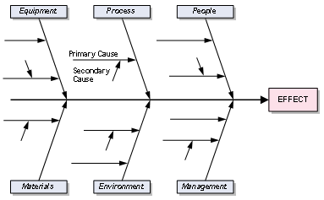






Slide 18

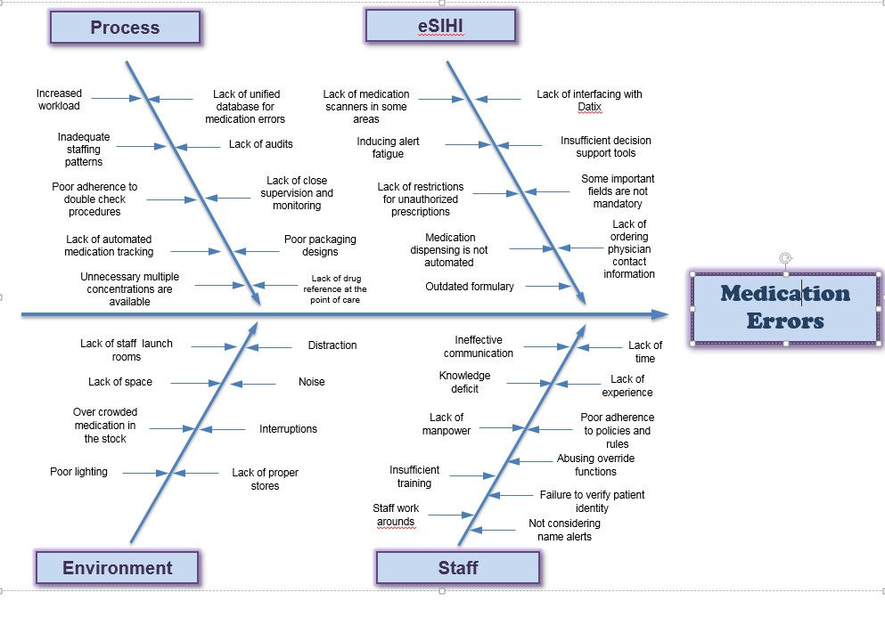

Slide 19



Slide 20



















litigation costs
legal action

Slide 21


Hazard:
potential to cause harm,
Risk:
Risk Management:

Slide 22






Improve organizational and client safety
Identify and minimize the risks and liability losses
Protect the organization resources
Support regulatory, accreditation compliance
reduce
adverse events

Slide 23

















Slide 24


Slide 25

SAC (Severity Assessment Code) Score:

Slide 26
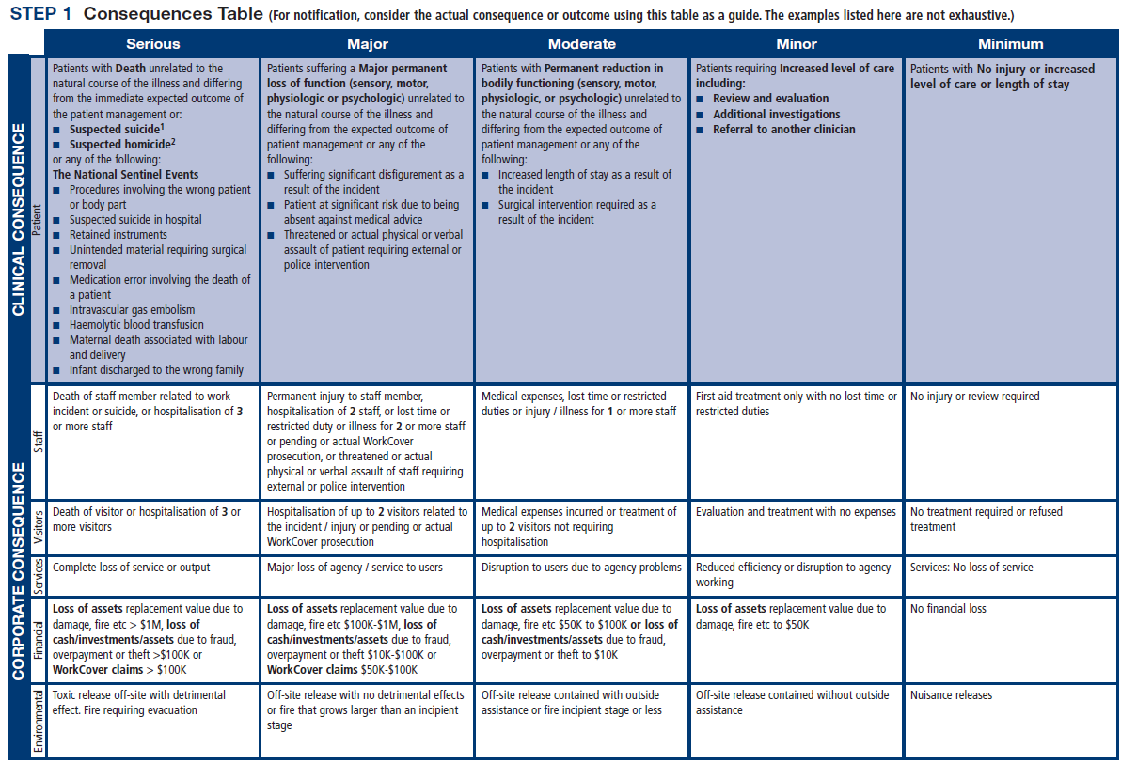

Slide 27
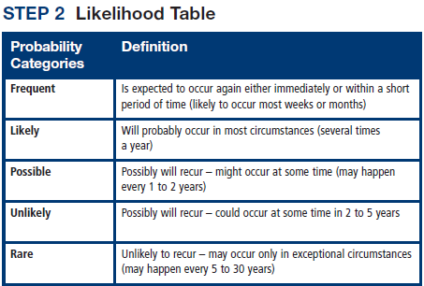

Slide 28
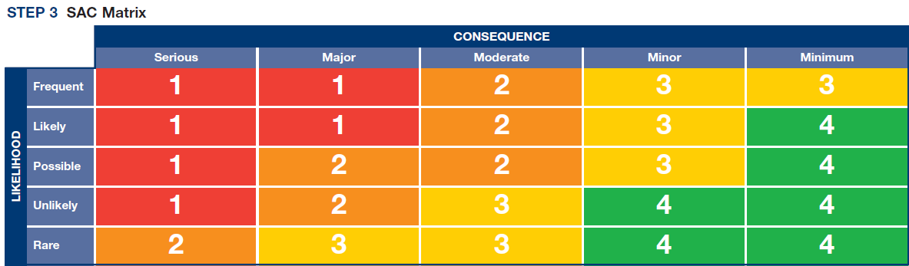

Slide 29
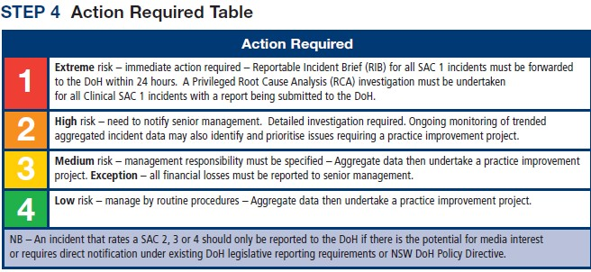

Slide 30












An incident:
Incident monitoring:

Slide 31
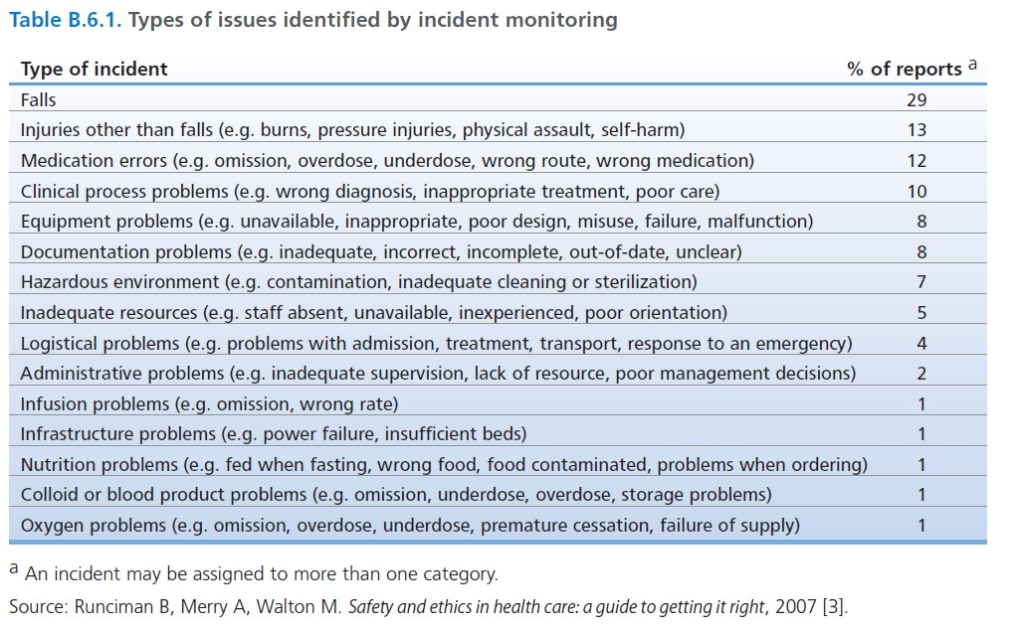

Slide 32













Slide 33








A complaint :

Slide 34





Slide 35










Fitness-to-practice requirements

Slide 36



Slide 37





Slide 38



Slide 39
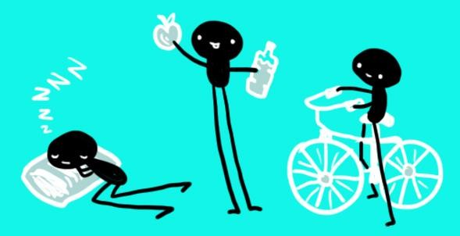







Slide 40







Slide 41




















Slide 42



Slide 43


