Slide 1
Human Factors & Patient Safety
Prepared By :
Mr. Maher titi MRS. Nada Alhabib MR. Alaa abu alrub
Quality Management Department

Slide 2
Objectives
After completing this lecture you should:
Define and describe the Human Factors and its relation to patient safety
Recognize the importance of applying human factors in healthcare
Summarize the impact of Human Factors on people’s health and patient safety
Differentiate between the different types of Medical Errors
Describe several specific Actions to reduce medical errors as related to Humans Factors

Slide 3
Introduction
Delivering healthcare can place individuals, teams and organizations under pressure
In such intense situations, decision making can be compromised, impacting on the quality of care, clinical outcomes, and potentially causing harm to the patient; poor performance also increases costs

Slide 4
What are Human Factors
Human factors refer to environmental, organizational and job factors, and human and individual characteristics which influence behavior at work in a way which can affect health and safety.

Slide 5
What are Human Factors
Human factors can be defined as anything that affects an individual’s performance.

Slide 6
What are Human Factors
A simple way to view human factors is to think about three aspects:
The job
The individual
The organization/environmental
and how they impact on people’s health and safety-related behaviour.’ (HSE, 1999 p2).

Slide 7
Human Factors-The Job
Including :
Nature of the task
Workload
This includes matching the job to the physical and the mental strengths and limitations of people.

Slide 8
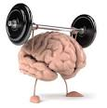
Human Factors-The Individual
Including:
Competency
Skills (changeable)
Personality, attitude(fixed)
Risk perception
Sleep deprivation
Individual characteristics influence behavior in complex ways.

Slide 9
Human Factors-The Organization
Including:
Work patterns
The culture of the workplace, resources Communications
Leadership and so on.

Slide 10
The Benefits of Applying Human Factors in Healthcare
Awareness of human factors can help you to:
To prevent Medical Errors.
Understand why healthcare staff make errors.
Identify ‘systems factors’ threaten patient safety.
To prevent occupational accidents and ill health.

Slide 11
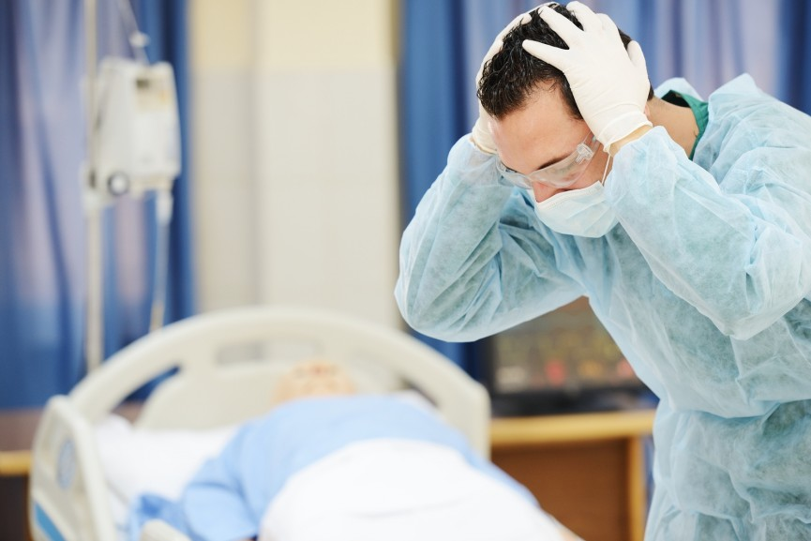
Medical errors
Failure of a planned action to be completed as intended or the use of a wrong plan to achieve an aim, such as :
Retained surgical instruments
Restraint -related injuries

Slide 12
King Saud University Medical City (KSUMC) –Medical Errors
Expired medication dispensed
Un planned hysterectomy
Wrong Sponge counting
Self extubation
Wrong patient ID , went to wrong procedure
Wrong medication delivered
Wrong dose administered

Slide 13
Sources of Error

Slide 14
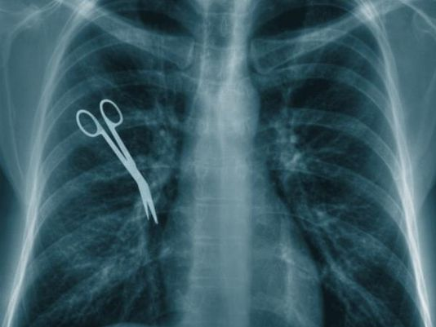
The Most Common Medical Errors
Wrong site surgery (13.4%)
Patient suicide (11.9%)
Operative and post operative complication (10.8% )
Delay in treatment (8.6 %)
Medication error (8.1 %)
Patient fall (6.4 %)
An analysis of sentinel event to the joint commission from 1995 to march 2010

Slide 15
Burden of the Medical Errors
How many of you know or had come cross any Medical Error?

Slide 16
Causes of Medical Errors
Healthcare Complexity
System and Process Design
Environmental factors
Infrastructure failure.
Human Factors and Ergonomics

Slide 17
Causes of Medical Errors
1- Healthcare Complexity
Complicated technologies
Drugs interaction.
Intensive care
Prolonged hospital stay.
Multidisciplinary approach
2- System and Process Design
Inadequate communication,
Unclear lines of authority

Slide 18
Cont:
3- Environmental factors.
Over crowded services
Unsafe care provision areas
Areas poorly designed for safe monitoring
4- Infrastructure failure.
Lack of documentation process
Lack of continuous improvement process

Slide 19
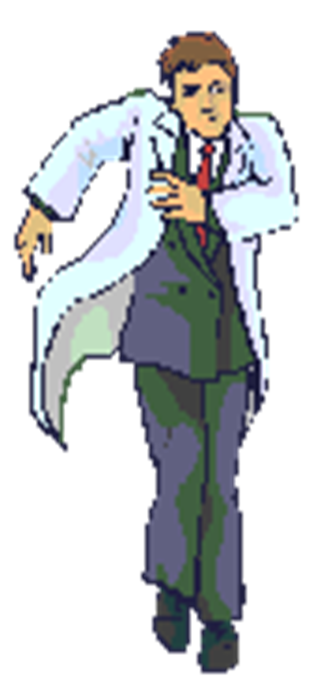
Cont:
5- Human Factors and Ergonomics
Hungry
Angry/ Emotions
Late/ lazy
Tired/fatigue/sleep less
lack of skilled workers.
Lack of training.

Slide 20
Actions to Reduce Medical Errors as Related to Humans Factors
Organizational level organizational Management and Human Factors
individual level
Making your care and work safer

Slide 21
Actions to Reduce Medical Errors as Related to Humans Factors
Part 1: Organizational Management and Human Factors
Developing a positive safety culture
Just culture
Reporting culture (e-OVR Reporting system)
Learning culture(Morbidity and mortality review process)
Human factors training in healthcare
Develop Clinical Practice Guidelines , protocols , algorithms.. etc

Slide 22
Cont:
Part 2: Making your care and work safer (individual level )
Stress
Focus first on the tasks that are high risk or where it is particularly important
Quickly allocate a clear leader
Storage
Look at the products you use and have stored. E.g Look-alike packaging

Slide 23
Physical demands
Physical tiredness :get enough sleeping before your duty
Demands exceeding capability : Most people at some time overestimate their abilities or underestimate their limitations.
Teamwork
Briefing and debriefing can help teams develop a shared mental model of a planned procedure or a patient’s clinical status
SBAR (Situation, Background, Assessment, Recommendation)
The physical environment
Poor lighting: Look at the lighting in the areas where you need to perform detailed or complex tasks

Slide 24
Case Study
A child with a known penicillin allergy was prescribed and administered an intravenous dose of an antibiotic of the penicillin class2
A child was due to have a pacemaker fitted. On pre-admission an allergy to penicillin was recorded. This was noted on both the nursing admission assessment form and the anesthetic record chart. Prior to operation, the allergy was discussed with the specialist pediatric cardiology registrar, the consultant pediatric anesthetist, anesthetic specialist registrar and the cardiology consultant. However, following the procedure the patient’s plan included intravenous and oral penicillin.

Slide 25
Cont.…. Case Study How did this happen?
There was no up-to-date protocol on what other antibiotics should be used if a pediatric cardiac patient has a penicillin allergy
There was no clear record of the allergy in the medical
No system was in place to prevent penicillin prescription when a known allergy was recorded.
A number of appropriate checks were not followed prior to administration of the antibiotics.
During independent checks, neither nurse checked allergy status, and both were under pressure to complete tasks.
The patient’s allergy band was on the same side as their identity band, both of which were covered with a bandage for an intravenous drip.

Slide 26
Cont.…. Case Study
Do you think the outcome could be quite different if human factors had been taken into account?
How we can prevent such error by applying human factors in healthcare?

Slide 27
OVR(Occurrence Variance Reporting) or IR(Incident Reporting)
Occurrence :An Occurrence is defined as any event or circumstance that deviates from established standards of care & safety.
OVR :an internal form/system used to document the details of the occurrence/event and the investigation of an occurrence and the corrective actions taken.

Slide 28
KSUMC Reporting System
http://10.135.196.38/Datix/live/index.php?action=login

