Slide 1
Continuous Professional Development
Dr. Kamran Sattar
Dept. of Medical Education College of Medicine King Saud University

Slide 2
:لاق ملسو هيلع الله ىلص هلا لوسر نأ اهنع الله يضر ةشئاع نع
“هنقتي نأ لامع مكدحأ لمع اذإ بحي الله نإ ”
“Allah loves when one of you to do it well”
يناربطلا هاور

Slide 3
http://www.healthandsafetyatwork.com/hsw/risk-assessment/competence

Slide 4
Objectives
By the end of today’s session the students should be able to;
Understand what is Competence and differentiate its Levels?
Plan for their own Continuous Prof: Devp: (CPD)
Appraise, what is Reflective Learning and how to
utilize it in day to day learning ?
Identify Challenges hindering CPD and learn how to
overcome

Slide 5
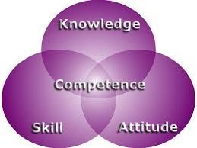
WHAT MEDICAL COLLEGES WANT?
http://teresachinn.co.uk/is-nursing-competence-evident-online/

Slide 6
WHAT MEDICAL COLLEGES WANT?
Competence
Proficiency
Communication skills
Interpersonal skills
Confidence
Cont.:
Critical thinking & problem solving skills
Flexibility
Self motivation
Leadership
Teamwork

Slide 7
Deanship of all Medical Colleges
In Saudi Arabia, a national call to define the competencies of medical graduates has been given a higher priority with the expansion of medical education in the Kingdom (BinAbdulrahman 2008, 2011).

Slide 8
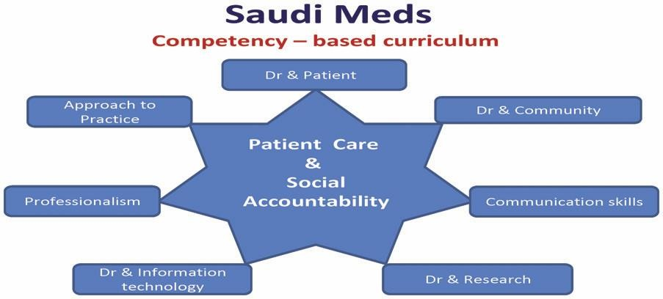
Core competencies
The national competence framework that has been developed by medical schools in
the Kingdom of Saudi Arabia (SAUDI MEDS)
Saudi Meds: A competence specification for Saudi medical graduates
RANIA G. ZAINI, KHALID A. BIN ABDULRAHMAN, ABDULAZIZ A. AL-KHOTANI, ABDOL MONEM A. AL-HAYANI,
IBRAHIM A. AL-ALWAN & SADDIG D. JASTANIAH
Medical Teacher, 2011; 33: 582–584

Slide 10
KSU Medical College Outcomes
Communication and consultation skills
Clinical care
Health promotion and disease prevention
The family and community context of healthcare
Personal professional development
Use of technology and information gathering
Attitudes, ethics and professionalism
Research

Slide 11
Think, Pair & Share
Every five of you.
Why We Are Here?
TO HELP

Slide 12
Levels of competence:
Consultant
Registrar Resident Intern
Medical student

Slide 13
Levels of competence
Medical student
Intern
Resident
Registrar
Consultant
Novice
Advanced beginner
Competent
Proficient
Expert

Slide 14
Think, Pair & Share
Every five of you.
What is your definition of COMPETENCE ?

Slide 15
Definition of competence:
“ The ability to perform a specific
task in a manner that yields desirable outcomes”.

Slide 16
Different Aspects of Competence
Knowledge
Skills
Abilities
Competence develops over time and is nurtured by reflection on experience

Slide 17
Attitudes
Does
Professionalism
Skills
Shows how
Knows how
Knowledge/
Cognition
Knows
Miller’s Pyramid

Slide 18
Bloom’s Taxonomy
Evaluation
Synthesis
Analysis Application Comprehension Knowledge

Slide 19
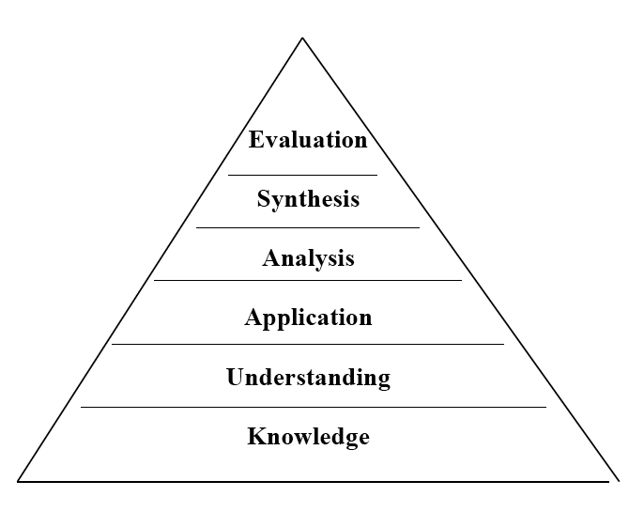
Hierarchy of Knowledge
Bloom’sTaxonomy, 1956
Knowledge - What is the most common cause of...?
Understand - If you see this, what must you consider…?
Application - In this patient, what
is causing…?
Analysis,synthesis,evaluation
- critical thinking?

Slide 20
Think, Pair & Share
Every five of you.
What is your definition of Skills ?

Slide 21
Skills
Skill is the capacity to perform specific actions
A person’s skill is a function of both knowledge and the
particular strategies used to apply knowledge.

Slide 22
Abilities
The power or capacity to do something or act
physically, mentally, legally, morally, etc.

Slide 23
Ability
Skill
is something that can
be learned or acquired through training and can be cognitive, perceptual and motor
is the generic make up
of an individual either perceptual or motor in nature that can be inherited from one's
parents.

Slide 24
Ability
Skill
(Innate)
is performance, or what
you are able to do.
(Acquired )
can be taught and/or
learned

Slide 25
Skill + Ability
What you have learned to do
and
What you can actually do!

Slide 26
How is competence acquired:
It is gained in the healthcare professions through:
▫ pre-service education
▫ in-service training
▫ work experience
Continuous Professional Development
(CPD).
(CPD).

Slide 27
Think Pair & Share
Every five of you
Are you involved in CPD ?

Slide 28
Continuing Professional Development (CPD)

Slide 29
What is CPD?
The conscious updating of
professional knowledge and the improvement of professional competence throughout a person's working life.

Slide 30
What is CPD? Cont:
It is a commitment to being professional, keeping up to date and continuously seeking to improve.
It is the key to optimizing a person's career opportunities, both today and for the future.

Slide 31
Requirement by the governing bodies of the profession
Why CPD?
This is only a ostensible reason

Slide 32
Why CPD?
Cardinal reasons:
Half-life of what we learn is very short.
If we do not update, we will practice obsolete medicine.
There is a high chance that patients will not get optimal care.

Slide 33
Why CPD?
Cardinal reasons: cont:
Because as PROFESSIONALS We are
Students, Teachers, Doctors & Leaders
We all are helping others /dealing with patients

Slide 34
How is CPD different?
CPD is for professionals but not in a formal educational setting
There are no class rooms, prescribed
curricula, prescribed learning events, etc.
Therefore, the learner needs to learn from whatever he/she does in the workplace
Also, there are no formal examinations
Motivation to learning comes from the necessity to improve practice.

Slide 35
How can we achieve
CPD?
.

Slide 36
Lecture programs
Conferences
Workshops
CME courses
Others …..

Slide 37
How can we achieve CPD?
PAST..
Many methods have been tried.
CURRENTLY..
Reflective Practice/Learning is the most favoured

Slide 38
What is the Reflective Learning

Slide 39
What is
Reflective Learning?
Systematic revisiting of a learning
experience with a view to learning from it
Why reflection?
Key to become a lifelong learner – if not most learning opportunities are lost

Slide 40
Reflective log:
a simplified version
What is the learning event?
What did I learn?
What more do I have to learn?
How can I learn it?
Evidence for further learning /
change of practice?

Slide 41
A scenario (3) :
A 55 year old man came to clinic with complaint of low
back pain (LBP).
You have examined his back which was ok. His height was 160 cm, and weight is 100 kg.
You would like to manage this patient’s LBP contributed due to his excess body weight.

Slide 42
Example (LBP)
Learning experience – An obese person who needs to reduce weight.
What did I learn? How the patient’s activities have been affected by obesity.
What do I have to learn more? The advice that should be given to the
patient with a given BMI. Are there guidelines for interpreting BMI?
How do I learn it? Refer a book/article. Talk to the dietician.
Evidence / change of practice – BMI was accurately interpreted. Patient was advised about the dietary/lifestyle changes and referred to an obesity clinic. References of books referred.

Slide 43
Reflective practice
Reflection-in action
Reflection-on action

Slide 44
Reflection - cyclical process
Kolb’s cycle
Concrete experience
Reflective observation
Active experimentation
Abstract
conceptualisation

Slide 45
Reflection
What is the event?
Evidence for learning / change of practice
Concrete experience
Reflective observation
Active experimentation
What did I learn?
How can I learn?
What more do I have to learn?
Abstract conceptualisation

Slide 46
Constraints on Development Development is a continuous process but sometimes
it happens to be a broken continuity
Time
Budgets
Life Cycle Issues
▪Motivation
▪Lack of Trust and Real Leadership

Slide 47
Summary:
Competence
Acquired through
Continuous Professional Development
Acquired through
Reflection & Reflective Practice

Slide 48
FINAL THOUGHT
CPD
Because we all wish to Help others
But
for that we shall first
Help Ourselves
(Competence
CPD Reflective Learning)
to make us able to help

Slide 49
References
Bin Abdulrahman KA. 2011. Saudi Arabia does not need an Abraham
Flexner. Med Teach 33:74–75.
Bin Abdulrahman KA. 2008. The current status of medical education in the Gulf Cooperation Council countries. Ann Saudi Med 28(2):83–88
Saudi Meds: A competence specification for Saudi medical graduates
RANIA G. ZAINI, KHALID A. BIN ABDULRAHMAN, ABDULAZIZ
AL-KHOTANI, ABDOL MONEM A. AL-HAYANI, IBRAHIM A. AL- ALWAN & SADDIG D. JASTANIAH
Medical Teacher, 2011; 33: 582–584

Slide 51
THANK YOU VERY MUCH
& &

