Slide 2
The Concept of Communication Skills in Medicine
DR-MAHA M ALMOHIZEA

Slide 3
OBJECTIVES
At the end of today’s session students should be able to;
Define communication, its theory and types.
Discuss importance of communication in medicine.
Demonstrate effective communication in day to day practice.
Overcome barriers to effective communication.

Slide 4
What is Communication?
The act by which information is shared.
It is the process by which we relate and interact with other people.
It includes listening & understanding with passion & respect as well as expressing views & ideas and passing information to others in a clear manner.

Slide 5
COMMUNICATION THEORY
Communication is a learned skill based on 3 pillars:
Accuracy
Efficiency
Supportiveness
All of the above combine to contribute to effectiveness of communication

Slide 6
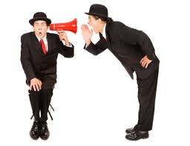
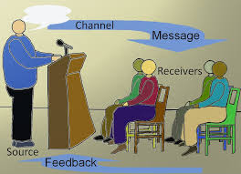
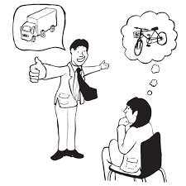
Non-Verbal Verbal

Slide 7
Verbal (mainly focuses on questioning)
Open (broad) – gives control to respondent, allows disclosure.
Open (focused) – gives control to respondent within a given area, encourages disclosure of feelings.
Closed – control is with interviewer, checks information.
Leading – control with interviewer, suggests desired response.

Slide 8
Verbal Communication
Speaking to the person
Look straight in the eye
make eye contact
Show respect
Clear message
Relevant
Use understandable language
Support by illustrations if needed
Good listener
Allow others to understand the message and reply
Listen carefully
Make a dialogue ant not one way instruction

Slide 9
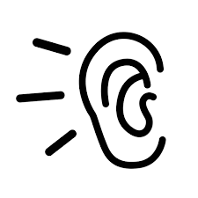
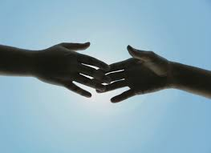
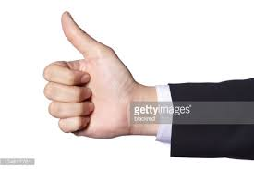
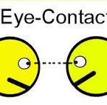
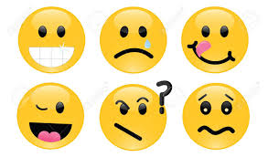
NON VERBAL
Listening (active and passive)
Silence
Touch
Hand gestures
Eye contact
Posture
Facial expression

Slide 10
Communication: Why?
Effective communication is the basis of mutual understanding & trust.
Poor communication causes a lot of misunderstanding & hinders work & productivity.

Slide 11
Communication: Why? Cont.
To develop relationships
To increase our knowledge
To make our feelings and thoughts known
To find out about people
To find out information

Slide 12
Communication & Medicine
Historically the emphasis was on the biomedical model in medical training which places more value on technical proficiency than on communication skills.
Recently learning communication skills & evidence based practice become the corner stones of modern medicine.

Slide 13
Communication in medicine
Increases patient satisfaction and health outcomes (Barlett, Grayson et al., 1984)
Reduces the risk of complaint and litigation (Beckmam 1994)
Higher levels of job satisfaction (Kramer et al., Suchman et al., 1993)

Slide 14
From the doctors What is required Towards the patients
Listen to patients and respond to their concerns and preferences.
Give patients information in way they can understand
Taking patient’s views into consideration when assessing their condition
Respond to patients questions , keep them informed & share information .
.

Slide 15
From the doctors What is required (cont: ) Towards your patients
You must make sure, wherever practical, that arrangements are made to meet patient’s language and communication needs.
You must be considerate to relatives, carers and partners in providing information and support

Slide 16
From the doctors What is required (cont: ) Towards your colleagues
Communicate effectively with colleagues within and outside the team
Make sure your colleagues understand your role and responsibilities in the team and who is responsible for each aspect of patient care
You must treat your colleagues fairly and with respect

Slide 17
Why do the doctors need to practice good communication?
Doctors need to learn essentials of good communication more than other professionals because patients are humans with sensitive needs.
Doctors cannot practice medicine without effective communication skills.
Poor communication causes a lot of medico-legal and ethical problems.

Slide 18
Communication: With whom?
Patients & care-givers
Nurses & auxiliary staff
Colleagues
Administrators
Reporting research findings
Talking to the media
Public & legislature

Slide 19
Where to apply our Communication skills ?
The medical interview is the usual communication encounter between the doctor and the patient
It can be classified according to the purpose of the interview into 4 types:
1. History taking 2. Consultations
3.Obtaining informed 4. Breaking bad news
Consent

Slide 20
Effective communication
Ensures good working relationship
Increases patients satisfaction
Increases patients understanding of illness & management
Improves patients compliance with treatment
Reduce medico-legal problems
Reduce uncertainty

Slide 21
Principles of effective communication
Planning
Interaction rather than a direct transmission
Flexibility in relation to different individuals and contexts.
Ability to handle emotional outbreaks

Slide 22
Communication with peers
Mutual trust & respect
Exchange information
Ask your seniors

Slide 23
Communication & Medical care
Good communication should be established between the patient , the family and the treating multidisciplinary team.
Patient & family should be encouraged to participate and verbalize in the ward round discussion about:
Offered medical care & treatment
Rehabilitation
Follow- up/re-admission plans
Doubts & worries.
Proper information to patient and family regarding services available and how they can utilize them.

Slide 24
Communication skills: Some techniques
PRACTICE- fluent dialogue with patient
USE- silence effectively, allowing patient enough time to express thoughts or feelings
ENCOURAGE- patients with your supportive words
UTILIZE - non-verbal communication

Slide 25
Listening vs Hearing
Hearing - a passive activity; no effort
Listening
Attention
Active involvement,
Full understanding
Takes time and effort

Slide 26
Barriers to effective communication
Personal attitudes
Ignorance
Human failings (tiredness, stress)
Language
Poor time management
Strenuous working environment

Slide 27
Conclusion
Effective communication is the key to success in professional career.
Good communication is essential for proper doctor-patient relationship and help avoids problems of misunderstanding.

Slide 28
Further reading
Faulkner, A (2001) Effective Interact Interaction with Patients, 2nd Ed. Churchill Livingstone, London

Slide 29
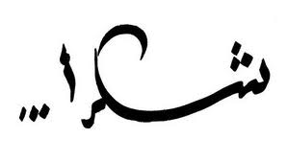
THANK YOU VERY MUCH
& &

