Slide 1
Professionalism
through
Mentoring
DR. KAMRAN SATTAR
MBBS. PGD MedEd UoD ( UK )
FAcadMEd - AoME (UK)
(MMed UoD ( UK )
Co-Chair
Professionalism Block

Slide 2
Objectives Students should be able to understand and describe;
The concept of Mentoring.
The roles of Mentor and Mentee.
What is to be expected from Mentoring?
Professionalism through Mentoring.

Slide 3
What is MENTORING ?
“It is a professional relationship built within an organization that is intended to target and focus the training of individuals”

Slide 4
What is MENTORING ? Cont:
"Mentoring is to support and encourage people to manage their own learning in order that they may maximise their potential, develop their skills, improve their performance and become the person they want to be.”
Eric Parsloe,
The Oxford School of Coaching & Mentoring

Slide 5
What is MENTORING ? Cont:
It is a relationship that involves interaction between two people ( mentor and mentee) normally working in a similar field or sharing similar experiences .[1]
Significant benefits are associated with mentorship. Effective mentorship is crucial to career success in academic medicine[2,3]

Slide 6
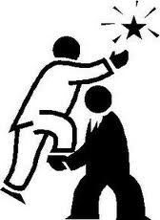
MENTORING A CAREER DEVELOPMENT TOOL
Do you want to build a career ?
Do you want to develop your skills and help others learn, grow, and improve their skills?
Or would you like to have someone help you do these things

Slide 7
An Exercise
Please write a one sentence definition of MENTORING

Slide 8
Good mentoring
One size doesn’t fit all
The nature of a mentoring relationship varies with the level of students and Mentor
Different human relationships
Different learning needs
Different styles of mentoring

Slide 9
Who is involved?
MENTOR
TEACHER
ADVISOR
ROLEMODEL
FRIEND
MENTORING
RELATIONSHIP
MENTEE
STUDENT
LEARNER

Slide 10
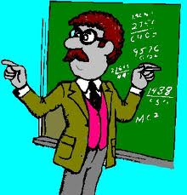
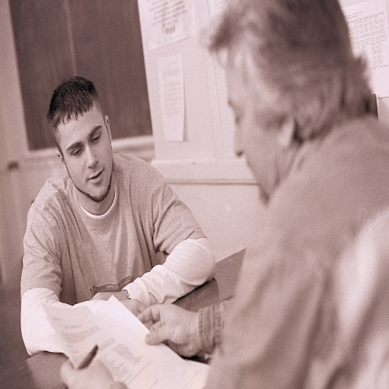
Teacher Advisor Role model Friend
Who is a MENTOR?

Slide 11
Who is a MENTOR ? Cont:

Slide 12
Who is a MENTOR ? Cont:
Although
there is no consistent definition of mentor, most emphasize
teaching, professional and personal guidance,
sponsorship, role modeling, and socialization
into a profession

Slide 13
Good mentoring
WHAT IS COMMON FOR GOOD MENTORS
A good mentor is
AVAILABLE
APPROACHABLE
SOCIABLE

Slide 14
What a MENTOR should do ?
Identify their strengths and weaknesses
Address their
educational needs
Explore options with their mentee
Provide Motivation
Act as a challenger
Encourage Reflection
Working in partnership programme
creating capacity in general practice
NHS

Slide 15
What is achieved by a Mentor?
Satisfaction
Personal development
Experience Contribution

Slide 16
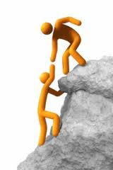
who is MENTEE/PROTÉGÉ
Protégé (male), a protégée (female)
Now a days MENTEE( both male & female )
MENTOR
MENTEE

Slide 17
What a MENTEE should be?
Strategic Tactical
“WHAT
“HOW”
WHY”

Slide 18
What a MENTEE should have?
1. RESPECT:
Mutual respect is the starting and sustaining aspect of a successful mentoring relationship. Professional and personal appreciation of one another is core to enhancing learning.
3 Vital signs by “Triple Creek Associates”

Slide 19
What a MENTEE should have? Cont:
2. RESPONSIVENESS:
Your willingness to learn from your mentor and your mentor’s willingness to respond to your learning needs are important for successful collaboration.

Slide 20
What a MENTEE should have? Cont:
3. ACCOUNTABILITY:
Once you and your mentor establish mutually held goals and expectations, keeping your agreements strengthens trust and helps maintain a positive relationship.

Slide 21
What a MENTEE should consider?
Students are obliged to recognize the multiple demands on a mentor's time.
MOST IMPORTANTLY

Slide 22
Professionalism Through Mentoring
Professional Excellence
INDIVIDUAL
INTERPERSONAL
SOCIETAL
ABIM foundation

Slide 23
What is to be expected from GOOD mentoring?
Mentoring flourishes behavioral, motivational and career outcomes
It is an effective way of helping people to progress in their careers.

Slide 24
Characteristics of GOOD mentoring
1. Establish an open communication system with reciprocal feedback
2. Set standards, goals, and expectations
3. Establish trust
4. Care for and enjoy each other
5. Allow mistakes
(Allen & Poteet, 1999).

Slide 25
What is to be expected from a GOOD mentoring? Cont:
6.Participate willingly
7. Demonstrate flexibility
8. Consider constraints to mentoring
9. Learn from others
10. Work on common tasks
11. Be open and comfortable

Slide 26
SUMMARY
AS A MENTOR YOU SHOUD HAVE
The desire to help – you should be willing to spend time helping someone else, and remain positive throughout.
The ability to challenge the mentee in a non-threatening way. Provide Feedback.
AS A MENTEE YOU SHOULD HAVE
Motivation to continue developing and growing and Listen actively

Slide 27
FOR YOUR READING
The Mentee's Guide:
Making Mentoring Work for You
Lois J. Zachary
http://www.lumhs.edu.pk/jlumhs/Vol09No03/pdfs/v9n3ra01.pdf
Dr. Kamran Sattar

Slide 28
References
Kamran Sattar
http://www.lumhs.edu.pk/jlumhs/Vol09No03/pdfs/v9n3ra01.pdf
Sackett DL. On the determinants of academic
success as a clinician-scientist. Clin Invest Med.
2001;24:94-100.
Larson EB. Academic mentorship: an important
ingredient for our survival. J Gen Intern Med.
1992;7:255.
Triple Creek Associates, Inc. (2007) Mentoring guide for mentees, second edition. Retrieved December 27, 2009, from http://www.3creek.com/resources/booklets/MenteeGuide.pdf
Allen, T. D., & Poteet, M. L. (1999). Developing effective mentoring relationships: Strategies from the mentor’s viewpoint. The Career Development Quarterly, 48, 59-73.
Judi Clements YouTube good coach vs. bad coach

Slide 29
THANK YOU VERY MUCH
& &

