Slide 1
Drugs Used In Management Of Pain
Dr. Aliah Alshanwani
Medical Pharmacology
October 2017

Slide 2
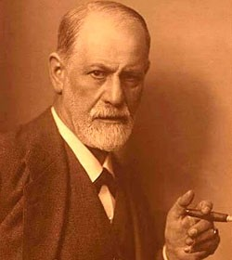
Drugs Used In Management Of Pain
A CASE OF OVERDOSE
Sigmund Freud, the father of psychoanalysis
His cancer of the jaw was causing him increasingly severe PAIN & agony
He begged his friend and doctor, Max Schur to relieve him.
His doctor administered increasing doses of MORPHINE that resulted in Freud's death on 23 September 1939

Slide 3
What effect of morphine caused the death of Sigmund Freud?
Euthenasia

Slide 4
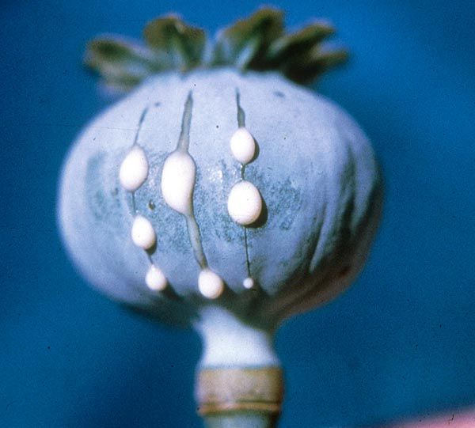
Drugs Used In Management Of Pain
ilos
Categorize the different classes of drugs used to relieve pain
Detail on the mechanism of action, pharmacokinetics & pharmacodynamic effects of morphine & its synthetic derivatives
Hints on the properties & clinical uses of morphine antagonists.

Slide 5
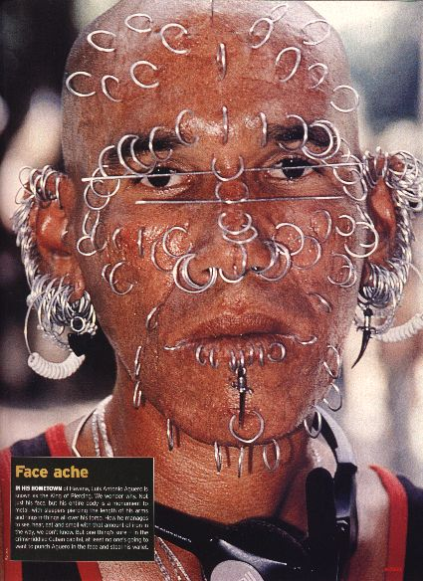
Drugs Used In Management Of Pain
Why should we treat pain?
Pain is a miserable experience
What is pain?
Pain is the most common reason patient seek medical advice
Impairs the patient functional ability & psychological well being
Pain increases sympathetic output
-Increases myocardial oxygen demand
-Increases BP, HR
Pain limits mobility
-Increases risk for DVT/PE

Slide 6
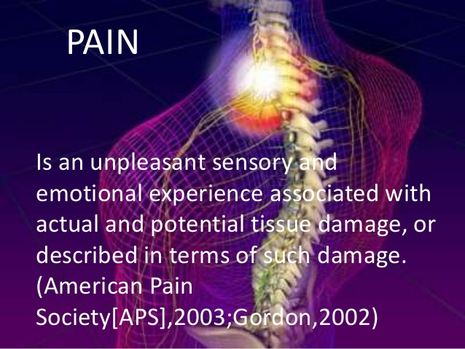
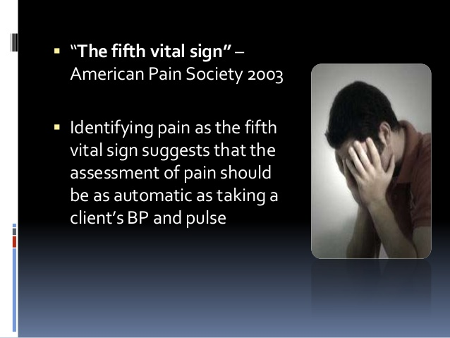

Slide 7
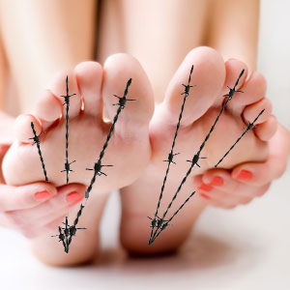
Classes of Drugs Used In Management Of Pain
NSAIDs
Opioids
Adjuvant drugs

Slide 8
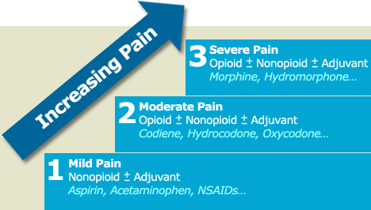
Side-effects
Analgesia
WHO Pain Ladder

Slide 9
NSAIDS
Generally the 1st class of drugs used for controlling pain
Work at site of tissue injury to prevent the formation of the nociceptive mediators
Can decrease opioid use by ~30% therefore decreasing opioid-related side effects
They neither cause tolerance or dependence
Has a ceiling effect to analgesia.

Slide 10
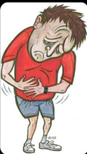
Adjuvant drugs
e.g. Anxiolytics, Neuroleptics,
Antidepressants
Antiepileptics
May modify the perception of pain & remove the concomitants of pain such as anxiety, fear, depression

Slide 11

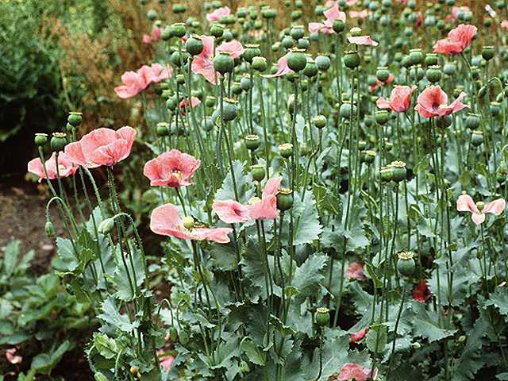
OPioids
Opium is derived from the juice of the opium poppy, Papaver somniferum
The natural products include morphine, codeine, papaverine & thebaine
Opiates are drugs derived from opium & semisynthetic & synthetic derivatives
Endogenous opioid peptides,
e.g. Endorphins, enkephalins & dynorphins.

Slide 12
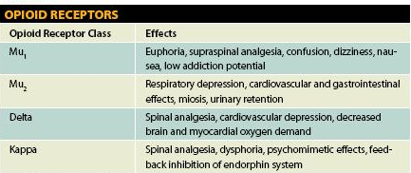
OPIOID RECEPTORS
Anatomical distribution in brain, spinal cord, & the periphery
μ
δ
k
ORL-1 receptor
Nociceptin ligand
All of them are typical G-protein coupled receptors

Slide 13
CLASSIFICATION OF OPOIDs
According to their source
Natural
Morphine, Codeine
Semisynthetic
Heroin
Synthetic
Pethidine, Methadone

Slide 14
CLASSIFICATION OF OPOIDs
According to their source
According to agonistic/antagonistic actions
Natural
Agonists; Morphine, Codeine, Pethidine, Methadone
Mixed agonist /antagonist; Pentazocine
Pure antagonist; Nalaxone, Naltraxone

Slide 15
CLASSIFICATION OF OPOIDs
According to their source
According to agonistic/antagonistic actions
Natural
Agonists; Morphine, Codeine, Pethidine, Methadone
According to their specificity of
action on receptors
Morphine, codeine, heroin → μ-receptor agonists
Pentazocine agonist at k –receptors & antagonist at µ-receptors.

Slide 16
Mechanism of action
Binding to presynaptic opioid receptors coupled to Gi   AC & cAMP   voltage-gated Ca²⁺ channels   excitatory transmitter.
Binding to postsynaptic receptors   opening of K channels   neuronal excitability.

Slide 18
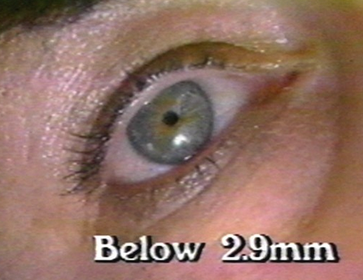
Pharmacodynamic Actions of Morphine
Analgesia [in acute & chronic pain]
Euphoria & sedation
Respiratory depression
Depression of cough reflexes
Nausea & vomiting → ↑CRTZ
Pin point pupil (miosis)
Releases histamine from mast cells
Effects on GIT:-↑in tone ↓ motility → severe constipation.
Constriction of biliary sphincter → ↑pressure in the biliary tract & biliary colic.
Depress renal function & contract gall bladder .

Slide 19
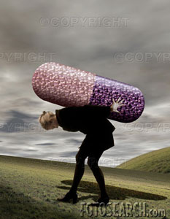
Morphine
TOLERANCE & DEPENDENCE
TOLERANCE
Tolerance occurs rapidly with opioids (with morphine 12–24 hours)
Tolerance develops to respiratory depression, analgesia, euphoria & sedation

Slide 20
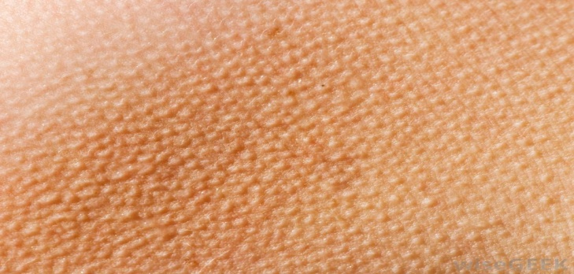
Morphine
TOLERANCE & DEPENDENCE
TOLERANCE
DEPENDENCE
Physical dependence (abstinence)
Withdrawal manifestations develops upon stoppage.
Lasting for a few days (8-10 days) in form of ↑ body ache, insomnia, diarrhea, gooseflesh, lacrimation
Psychological dependence lasting for months / years → craving

Slide 21
Morphine
Pharmacokinetics
t ½ is 2-3h
It is slowly & erratically absorbed orally (bioavailability 20-40%).
-Medically given by SC, IM or IV injection.
Metabolized by conjugation with glucuronic acid
Undergoes enterohepatic recycling,
-crosses BBB
-crosses placenta.

Slide 23
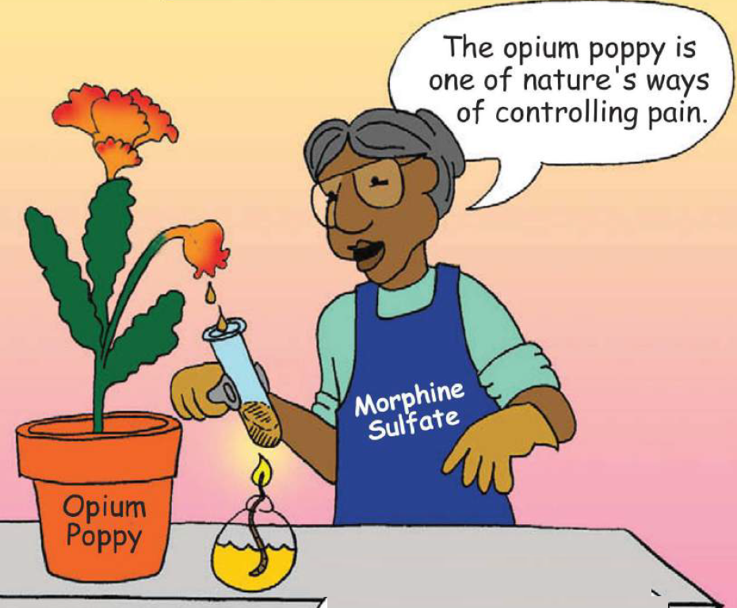
Morphine
Clinical Indications
CONTROL PAIN; cancer pain, severe burns, trauma, Severe visceral pain (not renal/biliary colics, acute pancreatitis)
Acute pulmonary edema
Myocardial ischemia
Non painful conditions e.g. heart failure (to relieve distress)
Pre-anesthetic medication.

Slide 24
Morphine
adrs
constipation
Respiratory depression
itching
C r I n c s
Nauseia, vomiting
Constricted pupil
Sedation.

Slide 25
Morphine
Contraindications
HEAD INJURY
BRONCHIAL ASTHMA or impaired pulmonary function
Biliary colic & pancreatic pain
Elderly are more sensitive; metabolism, lean body mass & renal function
With MAOIs
Not given infants, neonates or during child birth  conjugating capacity  accumulate   respiratory

Slide 26
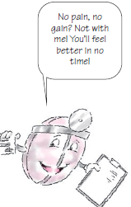
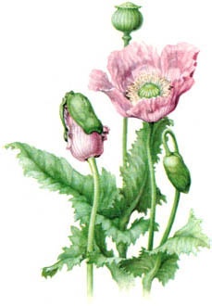
codeine
μ agonist
Dependence < morphine
Used in mild & moderate pain, cough, diarrhea.

Slide 27
TRAMADOL
Synthetic, μ agonist , less potent than morphine
Indications
Inhibits also NE & 5HT reuptake
Can be given orally; more oral bioavailability

Slide 28
TRAMADOL
Indications
-Mild - moderate acute & chronic visceral pain
-During labor
ADRs
-Seizures (not in epileptics), Nausea , Dry mouth, Dizziness , Sedation
-Less adverse effects on respiratory & C.V.S.

Slide 29
Pethidine (mepridine)
Synthetic, more effective κ agonist
actions
LESS analgesic, constipating, depressant on faetal respiration than morphine
No cough suppressant effect
Has atropine –like action (Smooth muscle relaxant)

Slide 30
Pethidine (mepridine)
Synthetic, more effective κ agonist
actions
indications
As in morphine but not in cough & diarrhea
Preanaesthetic medication (better)
Used in obstetric analgesia (No  resp.)

Slide 31
Pethidine (mepridine)
Synthetic, more effective κ agonist
actions
indications
adrs
Tremors, Convulsions, Hyperthermia, Hypotension
Blurred vision, Dry mouth, Urine retention
Tolerance & Addiction
Used in severe visceral pain; renal & biliary colics (sm. relaxant).

Slide 32
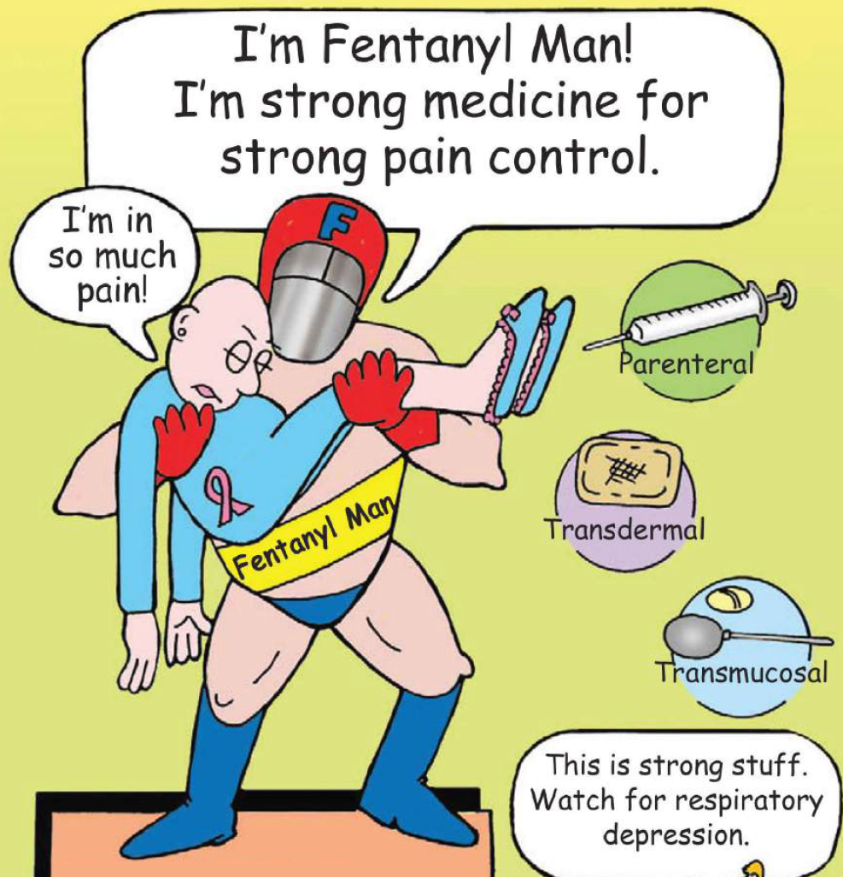

Fentanyl
Synthetic, μ agonist, more potent than pethidine & morphine

Slide 33
Fentanyl
ADRS
Respiratory depression (most serious)
CV effects are less
Bradycardia may still occur.
Clinical uses
Analgesic supplement during anesthesia, (IV or intrathecal)
To induce & maintain anesthesia in poor-risk patients [stabilizing heart]
In combination with droperidol as NEUROLEPTANALGESIA
In cancer pain & severe postoperative pain; (transdermal patch changed every 72 hrs).

Slide 34
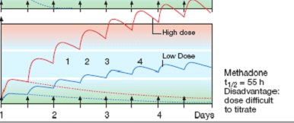
METHADONE
Weaker synthetic μ- agonist
In non addicts, it causes tolerance & dependence but not as severe as that of morphine
t½ 55 h

Slide 35
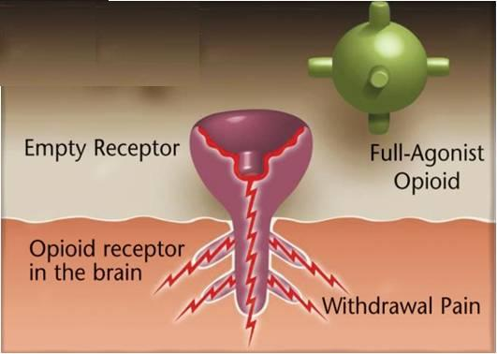
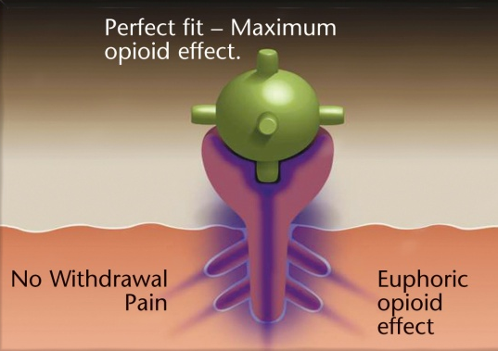
METHADONE
Used to treat opioid withdrawal
An ADDICT

Slide 36
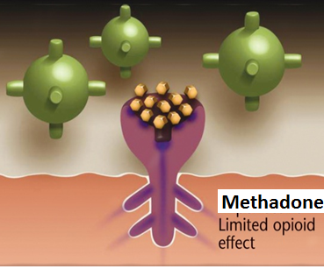
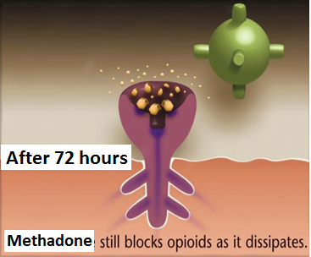
METHADONE
Used to treat opioid withdrawal
An ADDICT

Slide 37
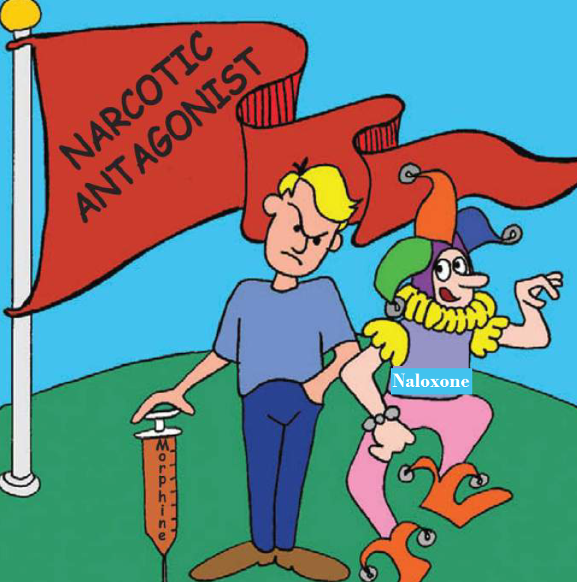
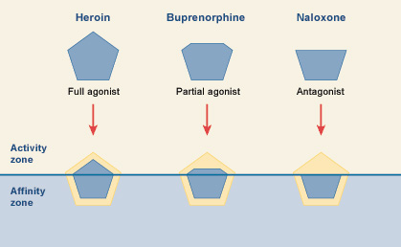
Opioid antagonists
Morphine
Nalorphine
Naloxone

Slide 38
Naloxone
Pure opioid antagonist
Used to treat respiratory depression caused by opioid overdose
To reverse the effect of analgesia on the respiration of the new born baby
Effect lasts only for 2-4 hours
Precipitates withdrawal syndrome in addicts
Naltrexone
Very similar to naloxone but with longer duration of action [t½=10h].

