Slide 1
Vision
1-Physiology of the eye & Refraction
By
Prof/Faten zakareia
College of medicine
King Saud University
Physiology Dept

Slide 2
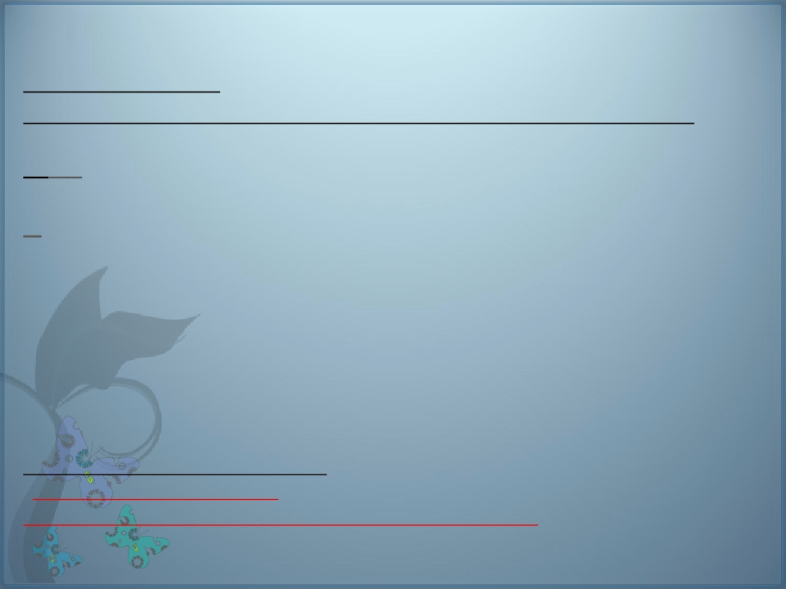
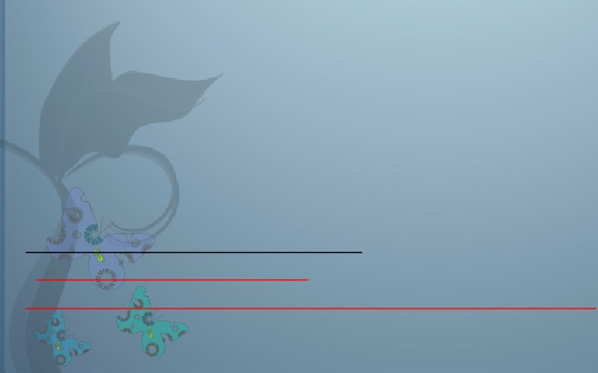
OBJECTIVES:-
At the end of this lecture, the student should be able
: -
to
-Describe different components of the eye and function of
each and -understand the eye protection media
- Describe the refraction of light as it passes through the eye
to the retina, identifying the refractive media of the eye
-Know glocuma and binocular vision
-Know layers of retina, blind spot, and fovea centralis
-explain the different light sensitivities of the fovea,
peripheral retina and optic disk
-Know principles of optics and errors of refraction
- Light pathway in the eye-
-Textbook/Guyton & Hall
Reference book/Ganong review of medical physiology
-

Slide 3
6.3

Slide 4
EYE HAS:-
1-Refracting Media
2- Coats (Sclera, Choroid and Retina)
-Post 2/3 Retina, Ant1/6 Cornea

Slide 5
The eye is a fluid-filled sphere
enclosed by three specialized
tissue layers.
1-the sclera is a tough outer
covering of connective tissue.
2-the middle layer is the
choroid containing blood
vessels.
3-the retina is the innermost
layer which contains light
sensitive cells
5

Slide 6
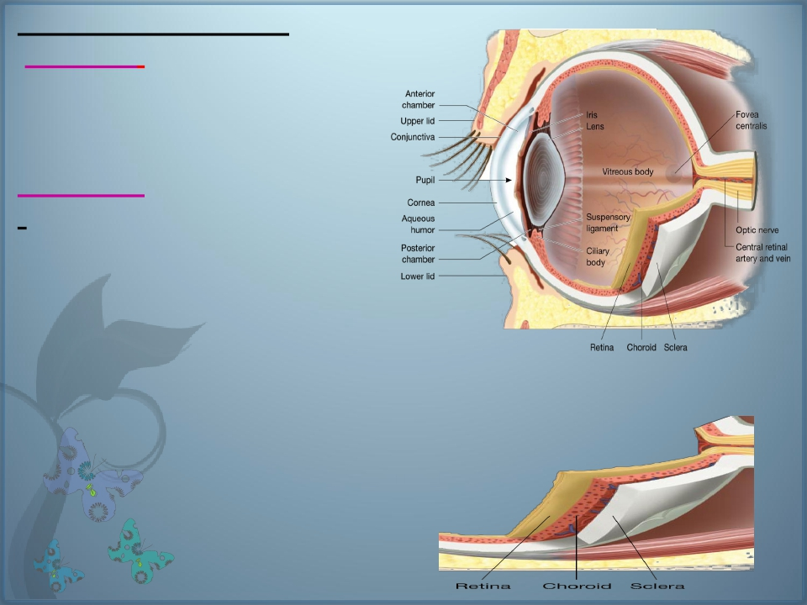
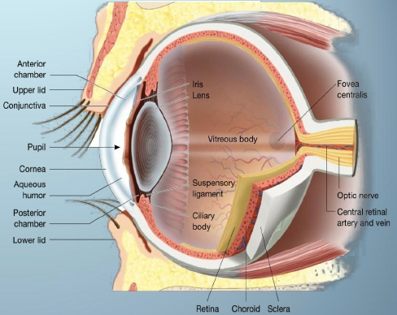
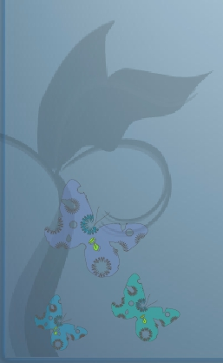
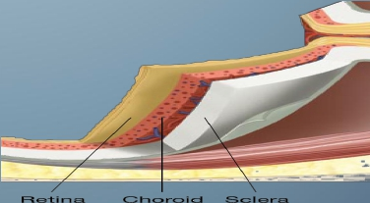
Anatomy of the eye:_
1- Sclera ( thick ,white
fibrous tissue for protection-
spherical appearance)
-Choroids
-inside sclera , highly
vascular
-the capillaries in the choroid
are the primary source of
nourishment for retinal
photoreceptors & oxygen to
rods and cones
- post 2/3 of choroid has
retina (innermost layer
lining)

Slide 7
2- cornea ( modified ant 1/6 of sclera ) to allow
light to enter the eyes, transparent ,
avascular.
Q.From where it gets its nutrition?
-A/ Tears& aquous humor
- Refractive or diopteric power
40-45 D at its anterior surface.

Slide 8
3- conjuctiva
- Transparent membrane cover anterior
surface of eye,reflected on inner surface
of eye lids
- Covered with thin film of tears for
protection,wetness, cleaning

Slide 9
4- pupil /
behind center of cornea, control & allow light to
enter the eye,appears black because, as you
look through the lens, you see the heavily
pigmented back of the eye (choroid and retina)
5- Iris
colored part ( has radial muscle dilates the
pupil as in dimlight (supplied by sympathetic )
+ circular muscles constrict the pupil (by
parasympathetic), as in bright light
-the eyes appear brown to black when the iris
contains a large amount of melanin, and blue
due to low melanin.
.

Slide 10
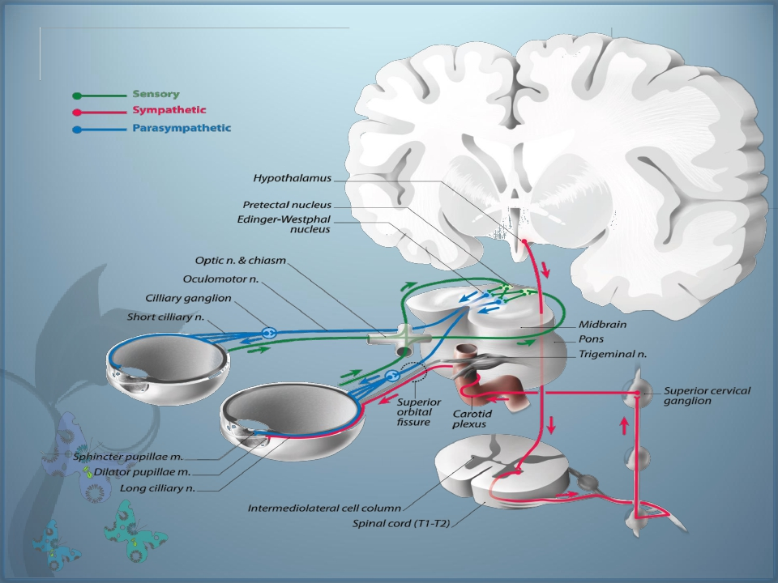
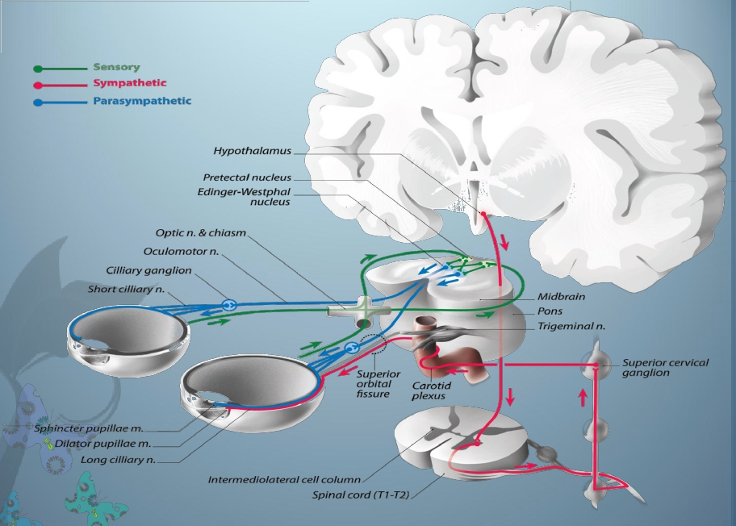
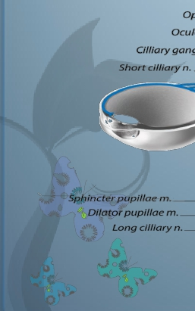

Slide 11
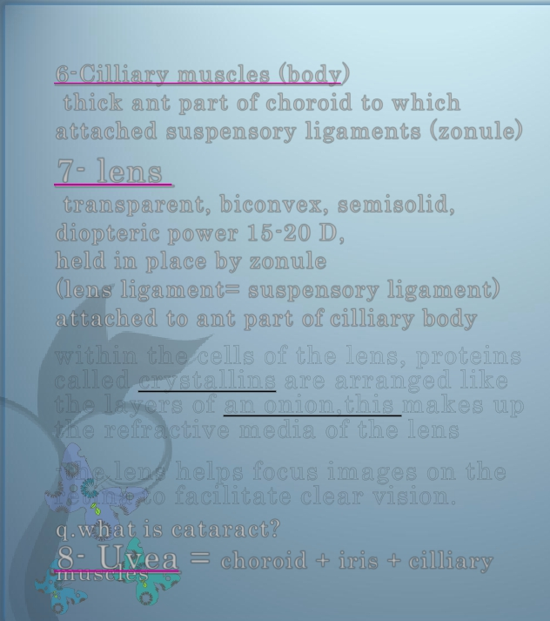
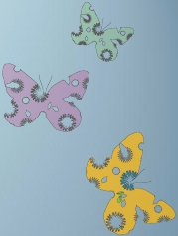
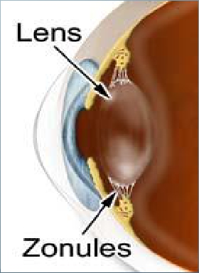
6-Cilliary muscles (body)
thick ant part of choroid to which
attached suspensory ligaments (zonule)
7- lens
transparent, biconvex, semisolid,
diopteric power 15-20 D,
held in place by zonule
(lens ligament= suspensory ligament)
attached to ant part of cilliary body
within the cells of the lens, proteins
called crystallins are arranged like
the layers of an onion,this makes up
the refractive media of the lens
-the lens helps focus images on the
retina to facilitate clear vision.
q.what is cataract?
8 muscles
- Uvea = choroid + iris + cilliary

Slide 12
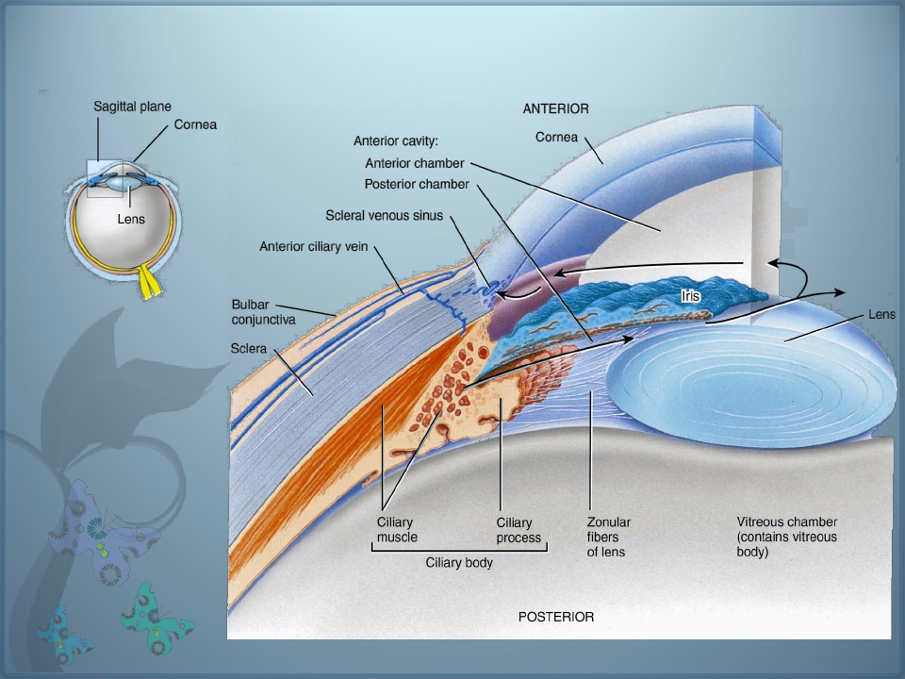
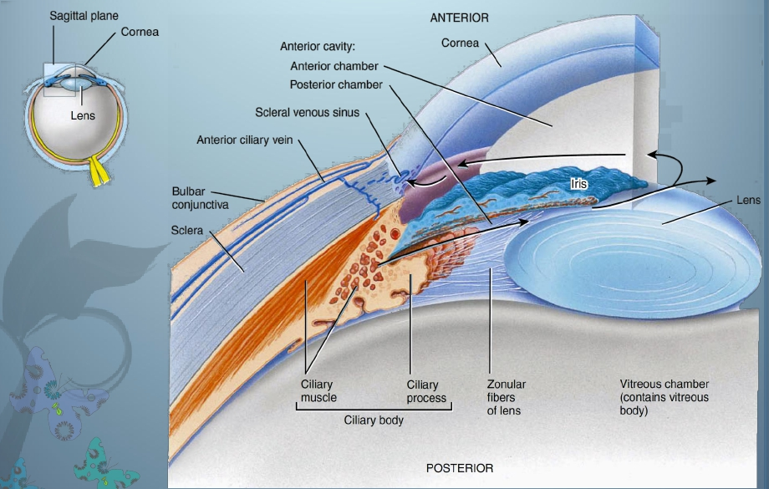
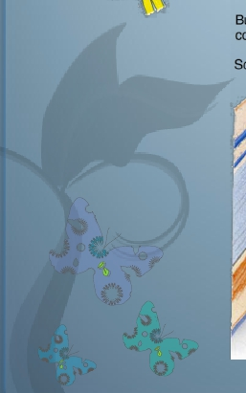

Slide 13
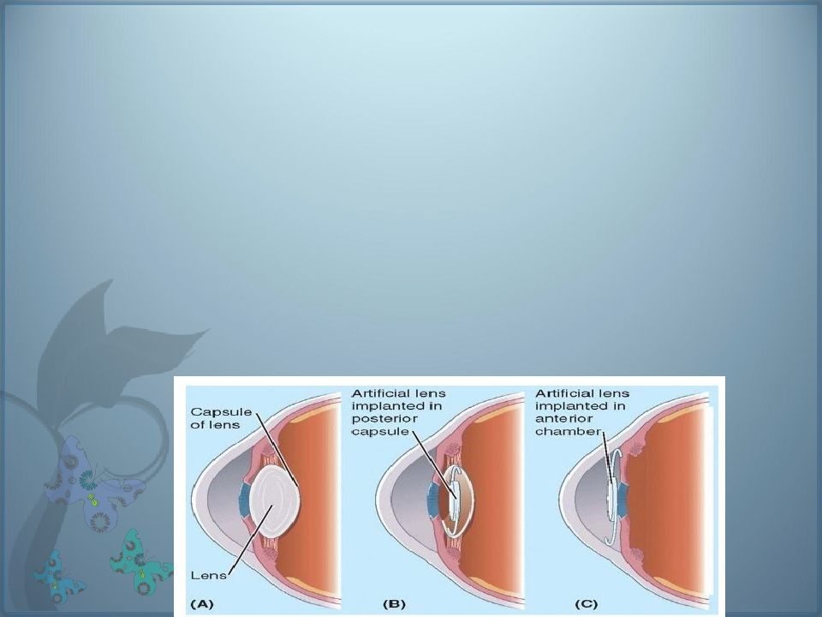
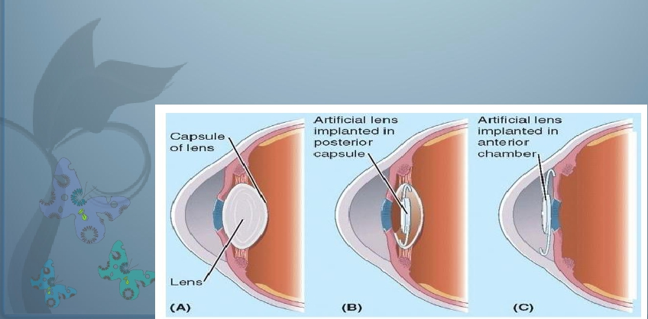
Cataracts” occurs in older people.
is a cloudy or opaque area or areas
in the lens
- the proteins in some lens fibers
become denatured and coagulate to
form opaque areas .
- When a cataract has obscured
light transmission so greatly that it
impairs vision

Slide 14
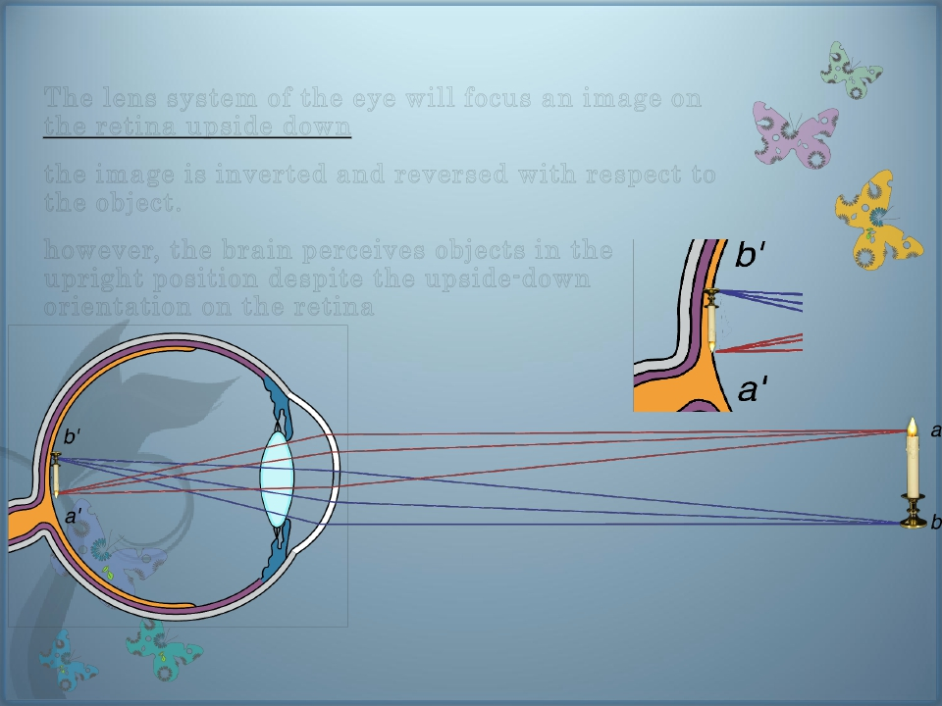
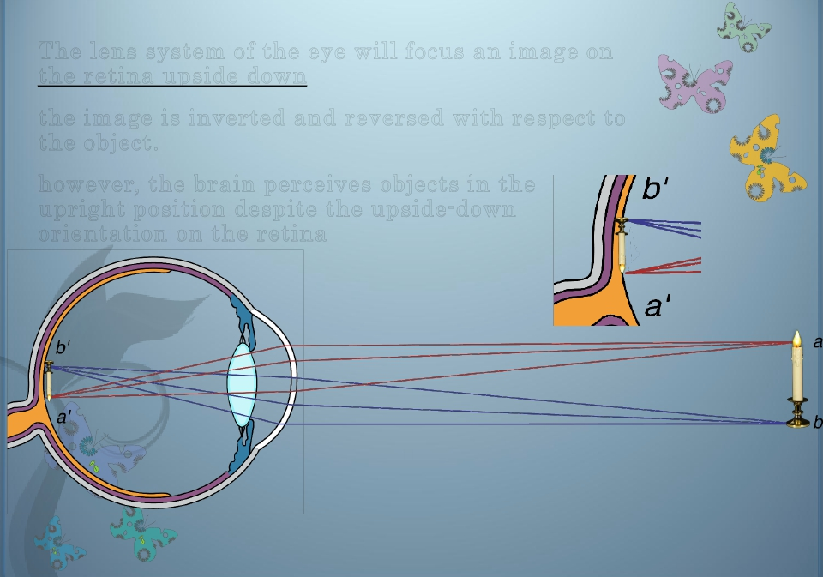
The lens system of the eye will focus an image on
the retina upside down
the image is inverted and reversed with respect to
the object.
however, the brain perceives objects in the
upright position despite the upside-down
orientation on the retina
THE REASON THE WORLD DOES NOT LOOK
INVERTED AND REVERSED IS THAT THE BRAIN
“LEARNS” EARLY IN LIFE TO COORDINATE
VISUAL IMAGES WITH THE ORIENTATIONS OF
OBJECTS.

Slide 16
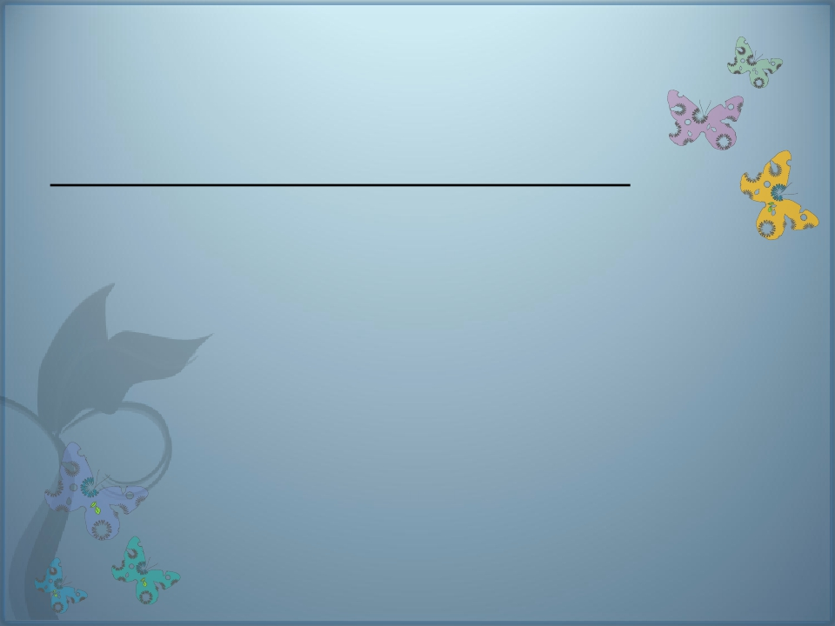
Refractive media of the eye:-
1) the interface between air and the anterior surface of
the cornea,
(2) the interface between the posterior surface of the
cornea and the aqueous humor,
(3) the interface between the aqueous humor and the
anterior surface of the lens of the eye,
(4) the interface between the posterior surface of the
lens and the vitreous humor.
-
A total refractive power of 59 diopters
when the lens is accommodated for distant
vision

Slide 17
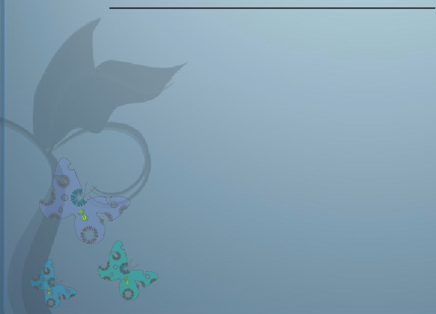
Refractive media of the eye:-
1-Cornea
- Its diopteric power is 40-45 diopter at its anterior surface.
- About two thirds of the 59 diopters of refractive power of the
eye is provided by the anterior surface of the cornea
- The principal reason for this is that the refractive index of
the cornea is markedly different from that of air,
- (whereas the refractive index of the eye lens is not greatly different from the
indices of the aqueous humor and vitreous humor)
-
-
-
-
-
N.B/ The internal index of air is 1
- the cornea, 1.38
-the aqueous humor, 1.33
- the crystalline lens 1.40
-the vitreous humor 1.34.

Slide 18
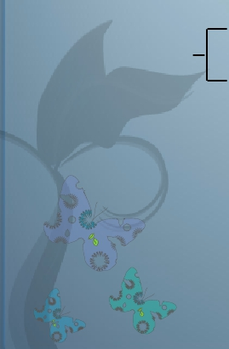
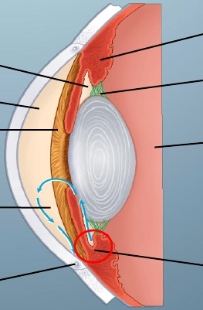
-the
aqueous humour is a transparent, slightly
gelatinous (gel-like) fluid similar to plasma
POSTERIOR
ANTERIOR CHAMBER
CAVITY
CHAMBER
IRIS
FLOW OF
AQUEOUS
HUMOUR
CILIARY
BODY
SUSPENSORY
LIGAMENT
POSTERIOR
CAVITY
CONTAINING
VITREOUS
HUMOR
ANTERIOR
CILIARY BODY INSI
CANAL OF SCHLEMM
CILIARY MUSCLE
18

Slide 19
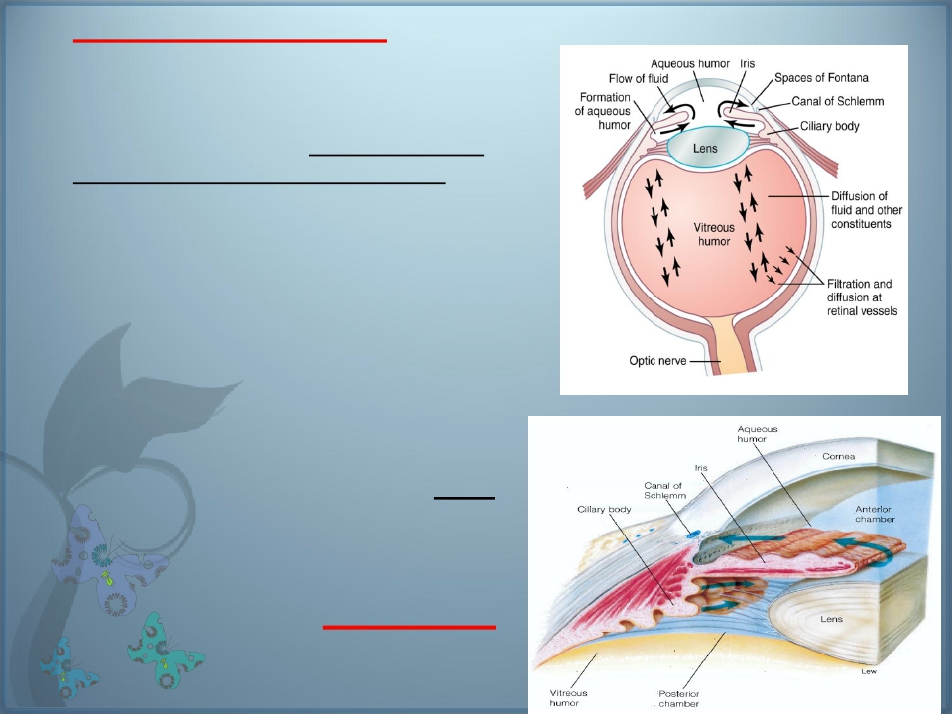
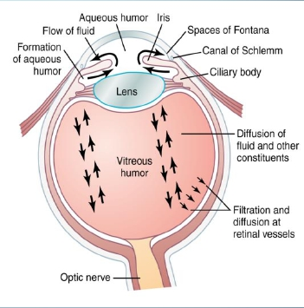
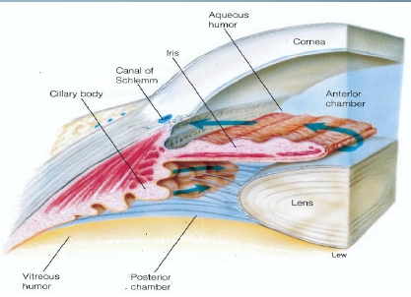
-The aqueous humor
- is continually being formed and
reab- sorbed.
-The balance between its formation and
reabsorption regulates the total volume
and pressure of the intraocular fluid
- nourishes the cornea and iris
- produced in the ciliary body by an
active secretion by ciliary processes..
GO TO ➔ posterior chamber>>> to
pupil >>>> ant chamber >>>>drained
into canal of Schlemm in anterior
chamber angle, which is a venous
channel at the junction between
the iris and the cornea ( anterior
chamber angle ).
-It causes intra-ocular pressure 10-20
mmhg
- Obstruction of this outlet leads to
increased intraocular pressure , a
critical risk factor forglaucoma

Slide 20
What is glucoma
?
(intraocular pressure more than 20mm Hg)
-Why it causes damage of optic nerve?
obstruction of AQ H outlet leads to increased
intraocular pressure.
-excessive aqueous humour pushes the lens
backwards into vitreous, which pushes against
the retina.
this compression causes retinal and optic nerve
damage that can cause blindness if not treated?
the axons of the optic nerve are compressed at
the optic disc. This lack of nutrition of the optic
nerve fibers, which causes death of the
involved fibers& blindness

Slide 21
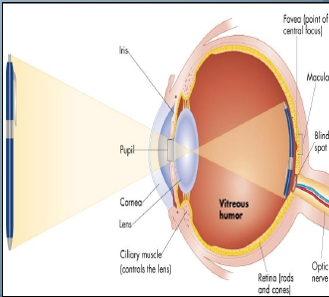
3-lens:-
- Has diopteric power 15-20 D
-(1/3 refractive power of eye) ,
more important than cornea.
why?
-in response to nervous signals from the brain,
its curvature can be increased markedly to
provide “accommodation,
”

Slide 22
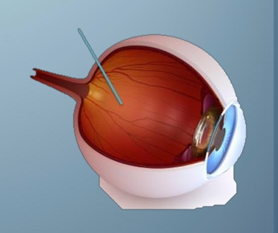
-is the transparent,
colourless, gelatinous mass
.fills the vitreous chamber
between the posterior
surface of lens and the
retina
THE VITREOUS
HUMOUR
(for nourishing retina &
keep spheroid shape of the
eye)
-the vitreous humour is clear
and allows light to pass
through
VITREOUS HUMOUR REMAINS FROM BIRTH
22

Slide 23
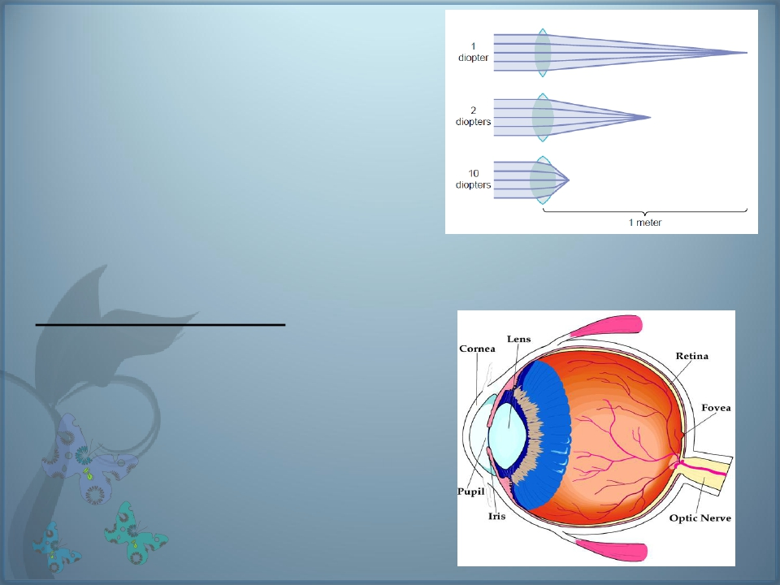
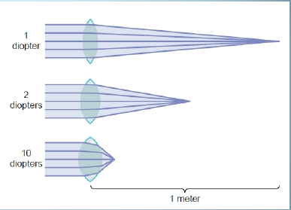
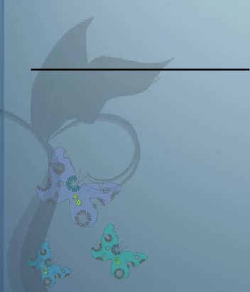
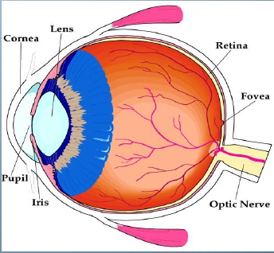
Lens-retina distance =15mm
Dioptre (s) = 1 / Focal length (in meters)
Diopteric power of the eye:
Cornea …………40-45 D (max refraction)
Lens …………… 15-20 D
Accomodation by lens …. +12 D

Slide 24
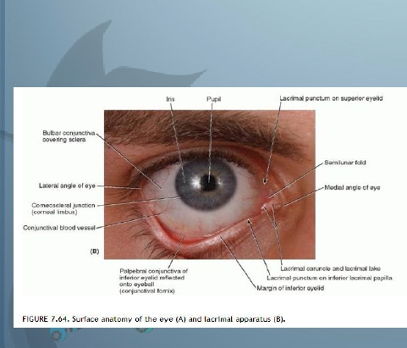
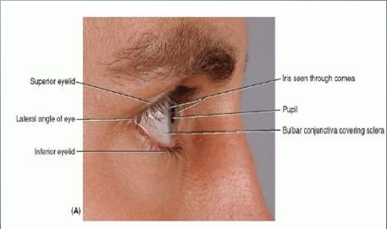
External protection of the eye
1- Bony orbit
2- lids blinking keep cornea moist
3 -Conjuctiva
4-Tears from lacrimal gland has
antibacterial, lubricating effect ,keep cornea
moist & clear & provide nutrition to the cornea
)

Slide 25
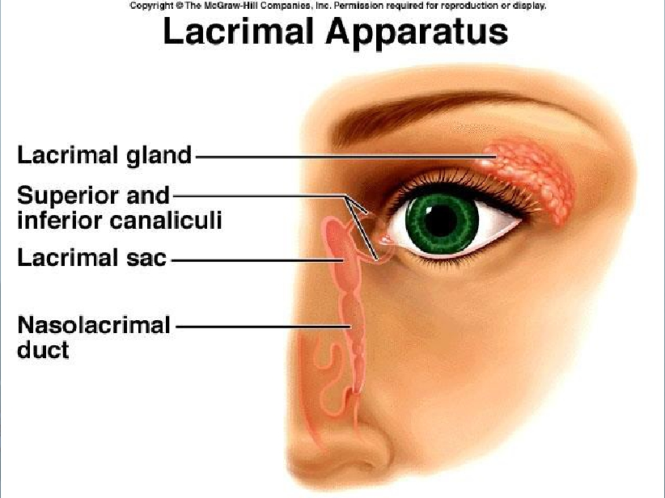

Slide 26
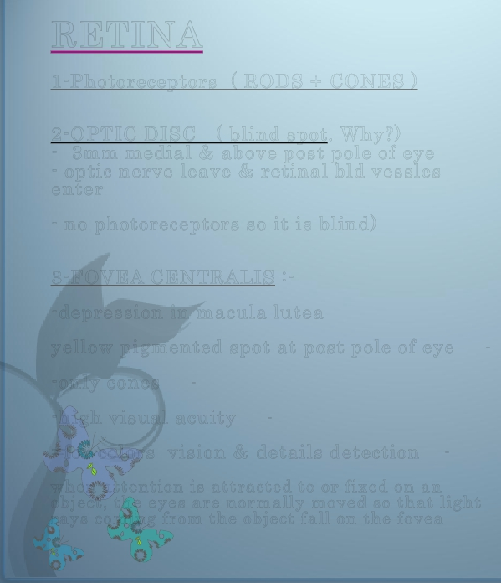
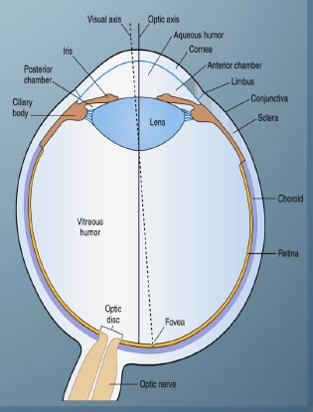
RETINA
1-Photoreceptors ( RODS + CONES )
2-OPTIC DISC ( blind spot. Why?)
- 3mm medial & above post pole of eye
- optic nerve leave & retinal bld vessles
enter
- no photoreceptors so it is blind)
3-FOVEA CENTRALIS :-
-depression in macula lutea
yellow pigmented spot at post pole of eye
-
-only cones
-
-high visual acuity
-
=for colors vision & details detection
-
when attention is attracted to or fixed on an
object, the eyes are normally moved so that light
rays coming from the object fall on the fovea

