Slide 1
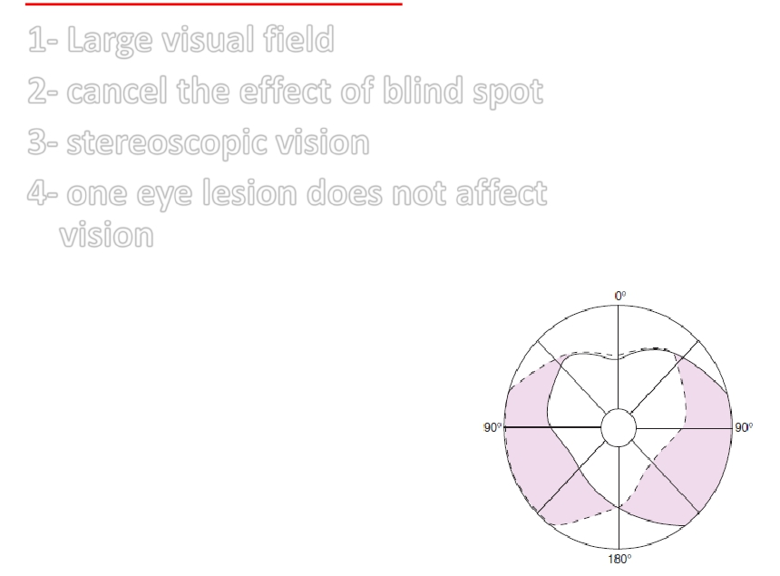
BINOCULAR VISION for :-
1- Large visual field
2- cancel the effect of blind spot
3- stereoscopic vision
4- one eye lesion does not affect
vision
Monocular and binocular visual fields.
-The dashed line encloses the visual field of the
left eye;
-
-
the solid line, that of the right eye. -The
common area (heart-shaped in the center)
is viewed with binocular vision.
- The colored areas are viewed with
monocular vision.

Slide 2
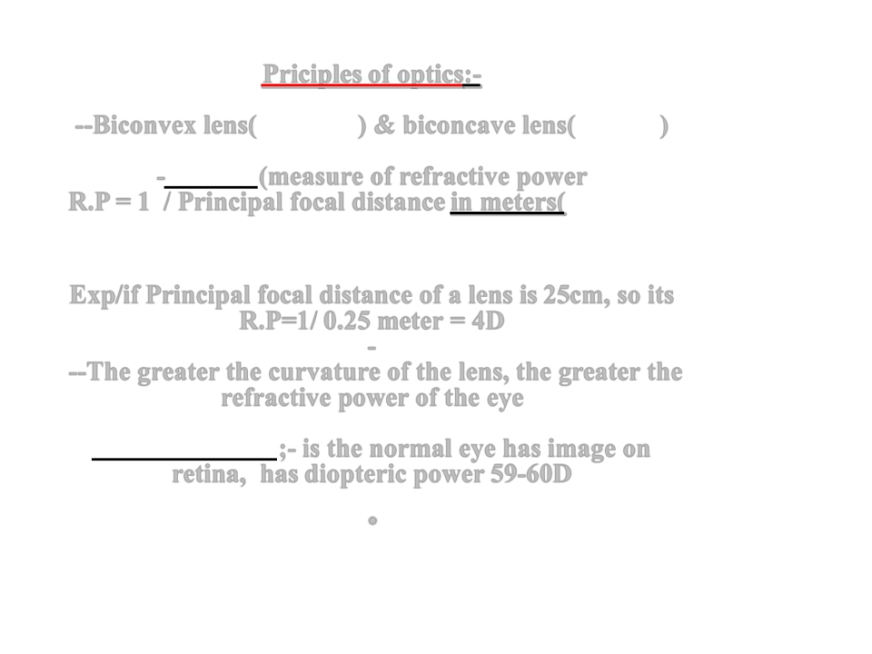
Priciples of optics:-
--Biconvex lens(converge) & biconcave lens(diverge)
-Diopter (measure of refractive power
R.P= 1 / Principal focal distance in meters(The distance
beyond a convex lens at which parallel rays converge to a common
focal point )
Exp/if Principal focal distance of a lens is 25cm, so its
R.P=1/ 0.25 meter = 4D
-
--The greater the curvature of the lens, the greater the
refractive power of the eye
Emmetropic eye;- is the normal eye has image on
retina, has diopteric power 59-60D
.

Slide 3
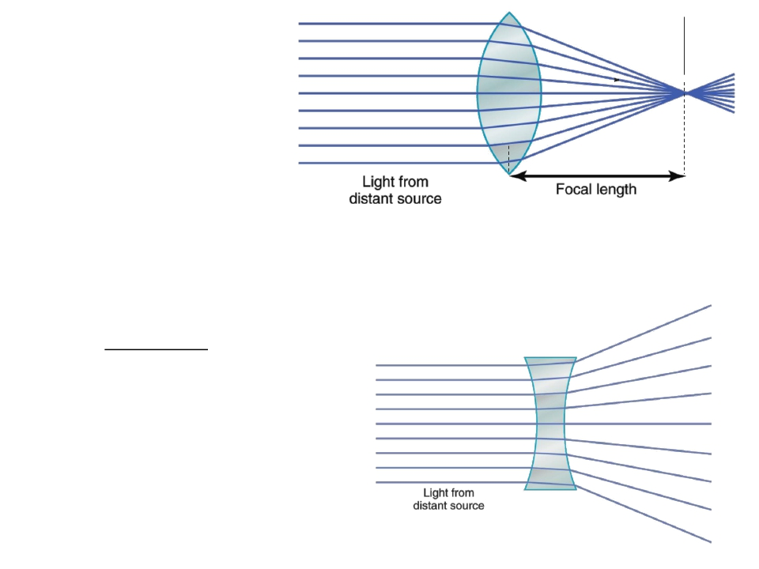
CONVEX SURFACE
FOCAL POINT
CONVERGING
LIGHT RAYS
IF THE LENS HAS EXACTLY THE PROPER
CURVATURE, PARALLEL LIGHT RAYS
PASSING THROUGH EACH PART OF THE
LENS WILL BE BENT EXACTLY ENOUGH
SO THAT ALL THE RAYS WILL PASS
THROUGH A SINGLE POINT, WHICH IS
CALLED THE FOCAL POINT

Slide 4
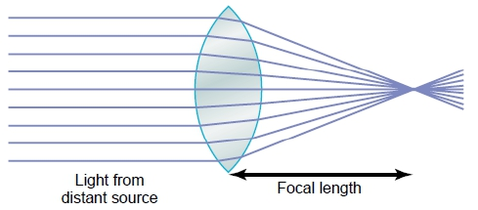
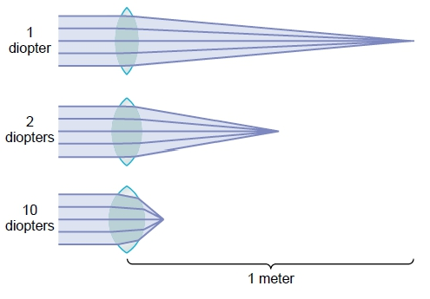
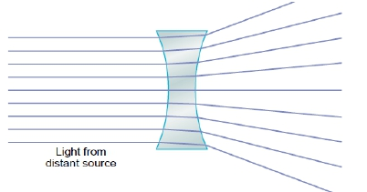
Concave lenses “neutralize” the
refractive power of convex
lenses. Thus, placing a 1-
diopter concave lens
immediately in front of a 1-
diopter convex lens results in a
lens system with zero refractive
power

Slide 5
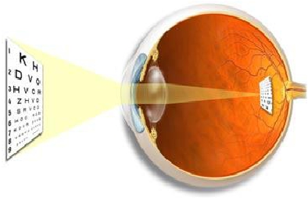
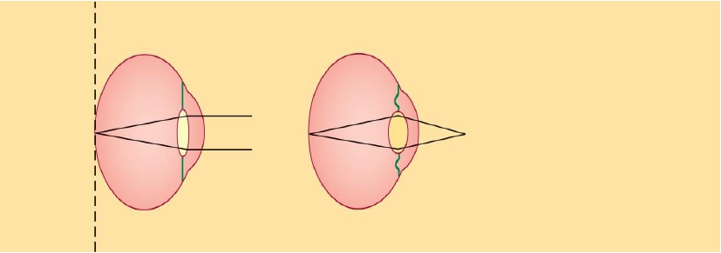
Emmetropic eye
can see all distant objects
clearly with its ciliary
muscle relaxed & see close
objects clearly with ciliary
muscles contracted
Normal eye = Emmetropia
Far
source
Near
source
Far source focused on retina
without accommodation
Near source focused on retina
with accommodation
No
accommodation
Accommodatio
n

Slide 6
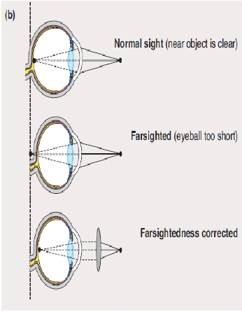
1-Errors of refraction
1/Hyperopia(hypermetropia-farsightedness)
-Small eye ball- weak lens system
-Focus behind retina
-Causes headache & blurred vision
-Continuous accomodation to bring
image on retina causes muscular effort
on cilliary muscle & prolonged
convergence , this leads to headache
& finally squint
- Correction by biconvex lens

Slide 7
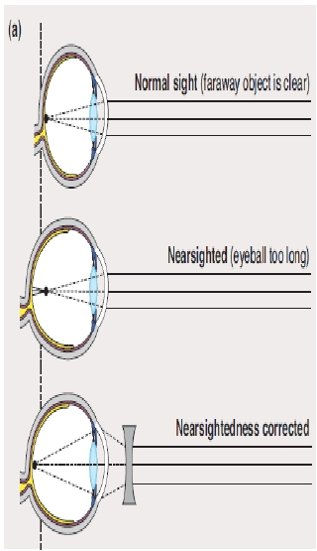
2- MYOPIA(NEAR SIGHTEDNESS)
-Genetic large eye ball or too much refractive power of
lens system or cornea due to its too curved surface-
or due to long antero-posterior diameter of the eye
-extensive close work as in studying
-focus in front the retina
-correction by biconcave lens to
diverge rays before strike the lens

Slide 8
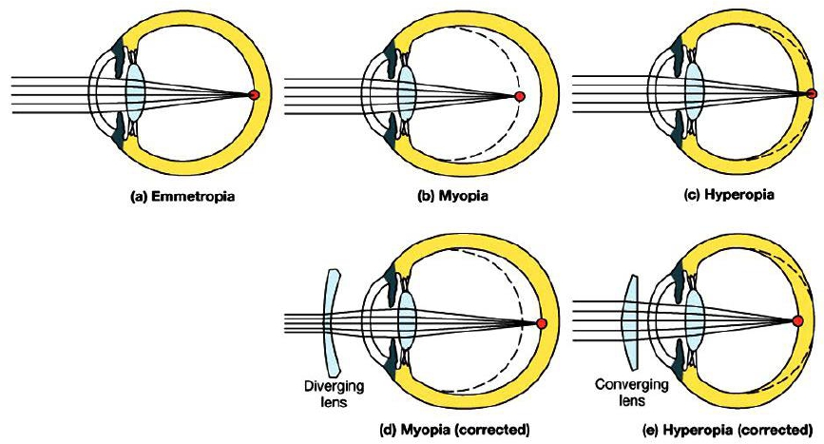

Slide 9
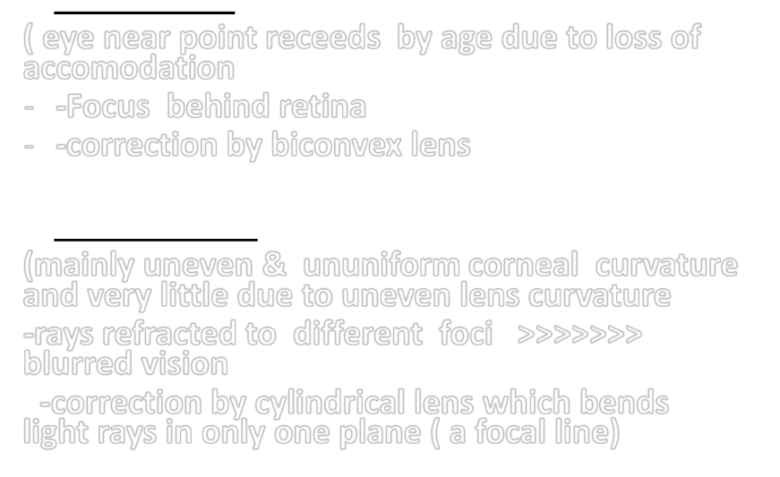
3-Presbyopia
( eye near point receeds by age due to loss of
accomodation
- -Focus behind retina
- -correction by biconvex lens
4-Astigmatism
(mainly uneven & ununiform corneal curvature
and very little due to uneven lens curvature
-rays refracted to different foci >>>>>>>
blurred vision
-correction by cylindrical lens which bends
light rays in only one plane ( a focal line)

Slide 10
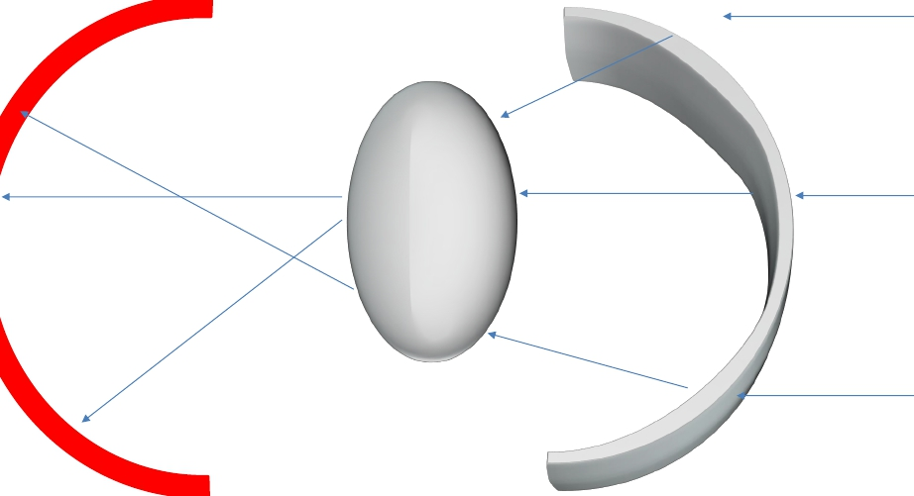
DISTORTED
CORNEA
RETINA

Slide 11
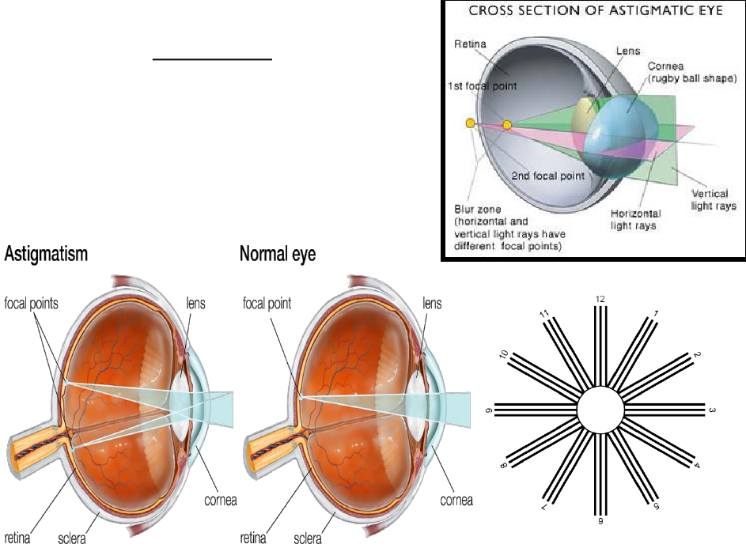
Astigmatism
light rays focus at one focal distance
in more than one focal point

Slide 12
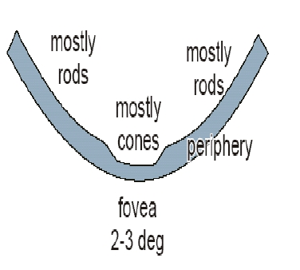
• LAYERS OF RETINA (10 layers), the
most important are :-
1-Pigment cell layer ( vit A ) (
outermost layer) .what is its value?
(absorb light & prevent its reflection
back)
-The pigment layer also stores
large quantities of vitamin A. This
vitamin A is an important precursor
of the photosensitive chemicals of
the rods and cones.
2- rodes & cones
( their outer& inner segments), but
not cell bodies( rodes 90-120 million
& cones 4.5- 6 million ) - describe
their distribution.
photoreceptor cells are responsible for
capturing light and transforming this into
generator potential to be used by the
nervous system
)

Slide 13
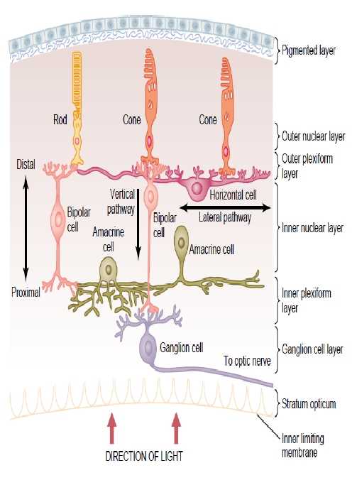
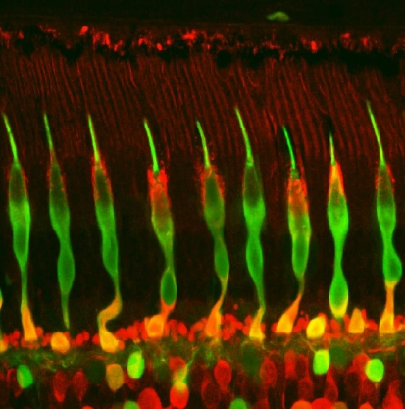

Slide 14
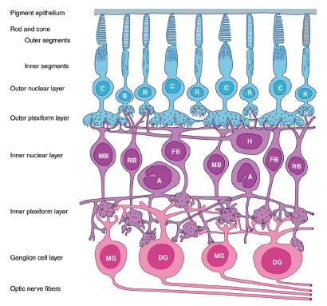
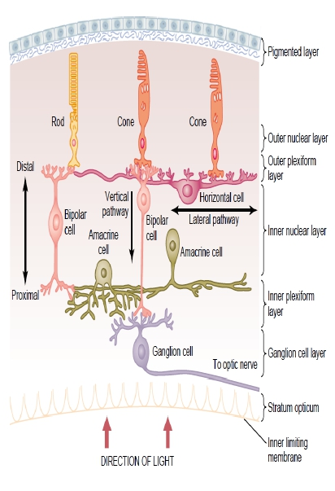
•
THE CELL BODIESAND PROCESSESOF THESE NEURONS ARE STACKEDIN ALTERNATINGLAYERS
• there are five basic classes of neurones in the retina:
–photoreceptors,
–bipolar cells,
–ganglion cells,
–horizontal cells,
–amacrine cells.

Slide 15
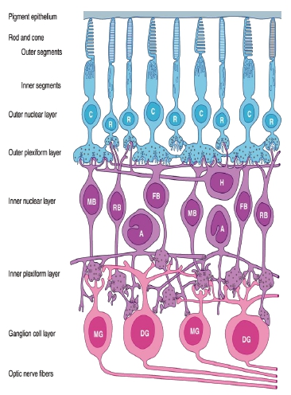
3-Outer nuclear layer( cell bodies of
rodes & cones)
4-Outer plexiform layer
mainly of Horizontal cells.
5-Inner nuclear layer (bipolar cells)
6-Inner plexiform layer.
(amacrine cells) the inner plexiform layer is
interposed between the inner nuclear and
ganglion cell layers.)
7-Ganglion cell layer
8-Optic nerve fibers ( 1.2 million
fibers)
-# Horizontalcells (outer plexiform layer)
(Make synaptic connectionswith receptors
# Amacrine cells (inner plexiform layer)
(make synaptic connections with ganglion cells)

Slide 16
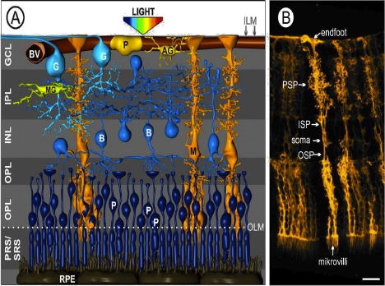
Müller cells are the major glial element of the retina.
-located in the inner nuclear layer
-form architectural support structure
providing metabolic support to retina
-maintaining synaptic levels of neurotransmitters.
-they can be -
differentiate into a neural
progenitor following injury to
the retina,
http://www-huge.uni-regensburg.de/Forschung/AG_Grosche/group_Grosche_projects.shtml
-act as light conductor
which funnels light to the
rods and cone CELLS.

Slide 17
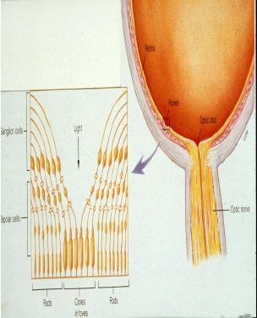
Light pathway in the eye:
_
After light passes through the lens system of the eye
and then through the vitreous humor, it enters the
retina from the inside of the eye
-it passes first through the ganglion cells and then
through the plexiform and nuclear layers before it
finally reaches the layer of rods and cones located all
the way on the outer edge of the retina
--Light absorbed by pigment cell layer that contain melanin pigment
- then impulses pass from rodes & cones to rest of layers finallyto
ganglion cell layer -to optic nerve
.
The visual acuity is decreased by this passage through
such non- homogeneous tissue.
-However, in the central foveal region of the retina,
the inside layers are pulled aside to decrease this loss
of acuity.This allows light to pass unimpeded to the
cones.

Slide 18
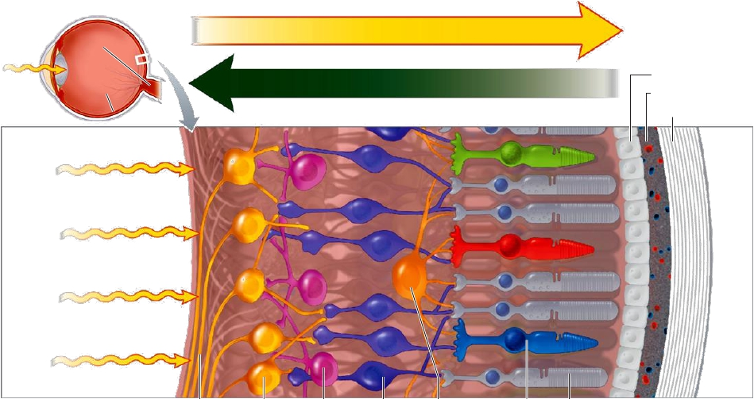
DIRECTIONOF LIGHT
OPTIC NERVE
RETINA
DIRECTION OF RETINAL VISUAL PROCESSING
PIGMENT
CHOROID
LAYER
LAYER
SCLERA
FRONT
OF
RETINA
BACK
OF
RETINA
FIBERS OF
GANGLION
AMACRINE
BIPOLAR
HORIZONTAL
CONE
ROD
THE OPTIC
CELL
CELL
CELL
CELL
PHOTORECEPTOR
NERVE
CELLS
Retina

Slide 19
Thankyoufor
listening

