Slide 1
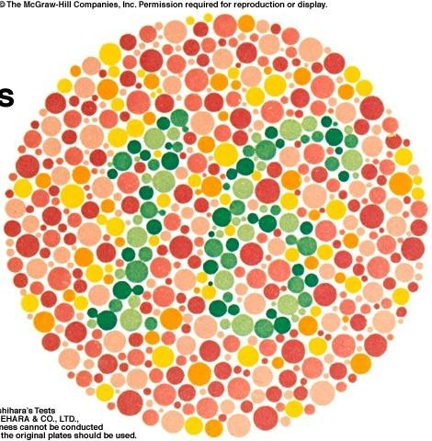
Color Vision by
Prof/Faten zakareia King Saud University Physiology Dept

Slide 2
Objectives:
Define color vision
Identify and describe the mechanism of colour vision and the three types of cones, including the range of spectral sensitivity and color blindness
Identify color vision theory
Describe the items needed for any color perception Compare different types of color blindness

Slide 3
COLOR VISION
- It the ability to discriminate between different colors.
there are 3 primary colors( blue- red- green) sensed by cones in fovea & appreciated within photopic vision.
sensation of extraspectral colors as white, yellow, orange, purple, can be produced by mixing properties of the blue &red & green in different combinations.
black means absence of light ( not darkness because in dark we do not see black only)

Slide 4
Colors have three attributes hue, intensity, and saturation (degree of freedom from dilution with white).
For any color there is a complementary color that, when properly mixed with it, produces a sensation of white
Black is the sensation produced by the absence of light, but it is probably a positive sensation because the blind eye does not “see black;” rather, it “sees nothing.”

Slide 5
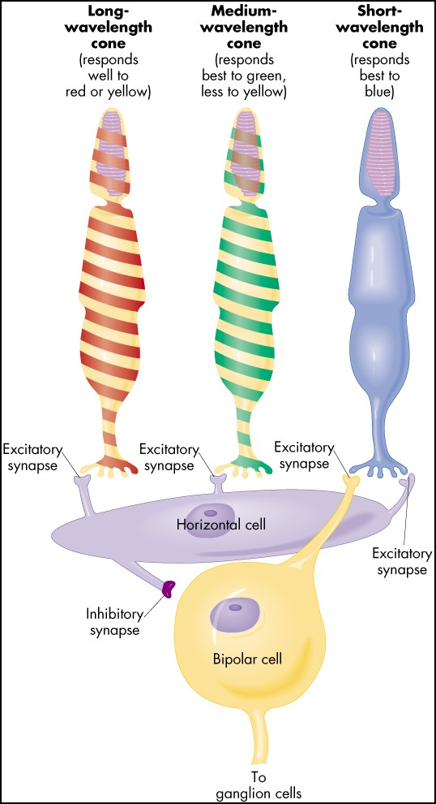

Slide 6
Color vision theory :_( Young- Helmholtz theory )
1- we have 3 kinds of cones each has a specific photopigment (rhodopsin)& is sensitive to one of the 3 primary colors
a- Blue cone system:- has S pigment ( blue sensation pigment) which respond to short wave length ( 440 nm senses the blue color)
b- Green cone system:- has M pigment ( green sensation pigment) which respond to middle wave length ( 535 nm senses the green color & less to yellow) & absorb light at the green portion.

Slide 7
c- Red cone system:- has L pigment ( red sensation pigment) which respond to large wave length at or
> 535 nm so senses the red & yellow color & absorb light at the red portion.

Slide 8
2- sensation of any color determined by:
a- wave length of light
b- amount of light absorbed by each type of cones
c- frequency of impulses from each cone system to ganglion cells which is determined by wave length of light.

Slide 9
3- each cone system respond to its color at a lower threshold than needed to sense other colors ( red cones respond to red or yellow color at a lower threshold than to green color)
5- perception of white is due to equal stimulation of blue & red & green cones.There is no wave length corresponds to white, white is a combination of all wave lengths

Slide 10
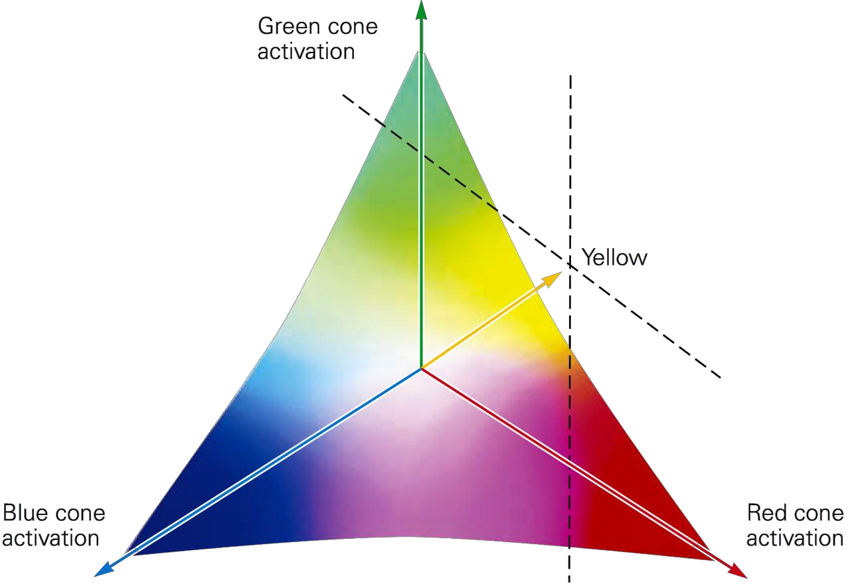

there is no single wavelength of light corresponding to white; instead, white is a combination of all the wavelengths of the spectrum.
as can be seen in this vector diagram – white occupies the middle of the vector

Slide 11
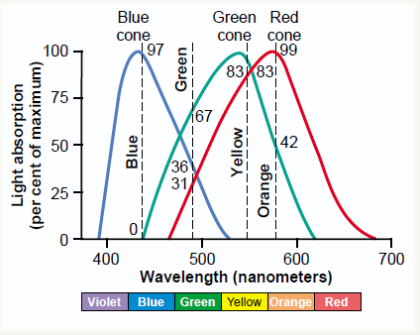
Light absorption by the pigments of three color-receptive cones
of human retina.

Slide 12
#- Color vision is coded by :-
--different responses in ganglion cells that depends upon the wave length of stimulus which determine frequency of impulses in ganglion cells
- the color perception in the brain depends on the amount of activity in each of the 3 cone systems as mentioned above.

Slide 13
6-perception of orange is due to
stimulation of 99% of red cones & 42%
of green cones & 0% of blue cones( so ratio is 99:42: 0)
7--perception of yellow is due to
stimulation of 50% of red cones &
50% of green cones & 0% of blue cones( so ratio is 50:50: 0)
8-perception of blue is due to
stimulation of 0% of red cones & 0%
of green cones & 97% of blue cones( so ratio is 0:0: 97 )

Slide 14

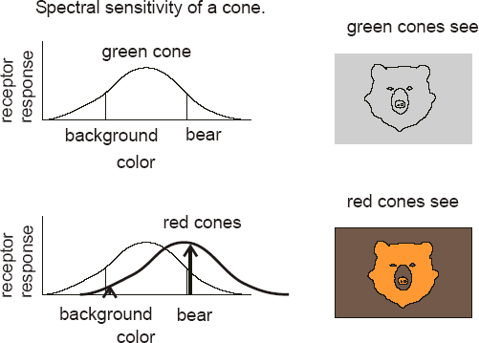

Slide 15

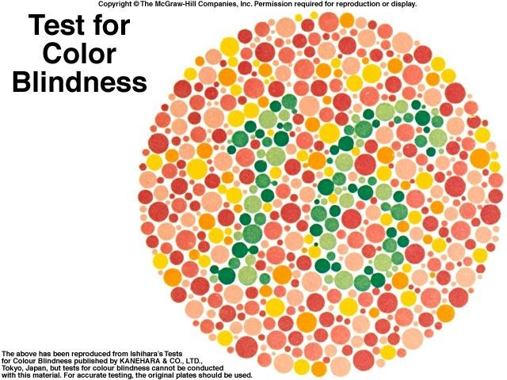

-

Slide 16
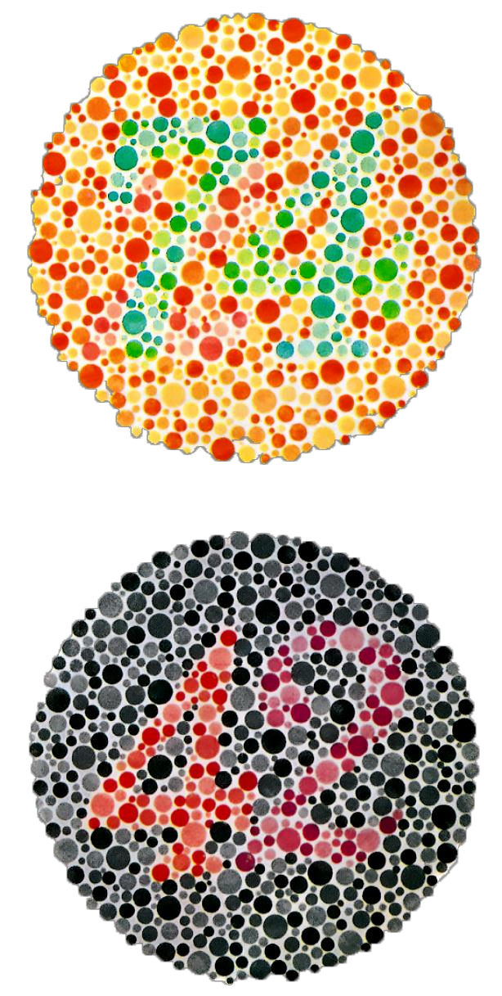
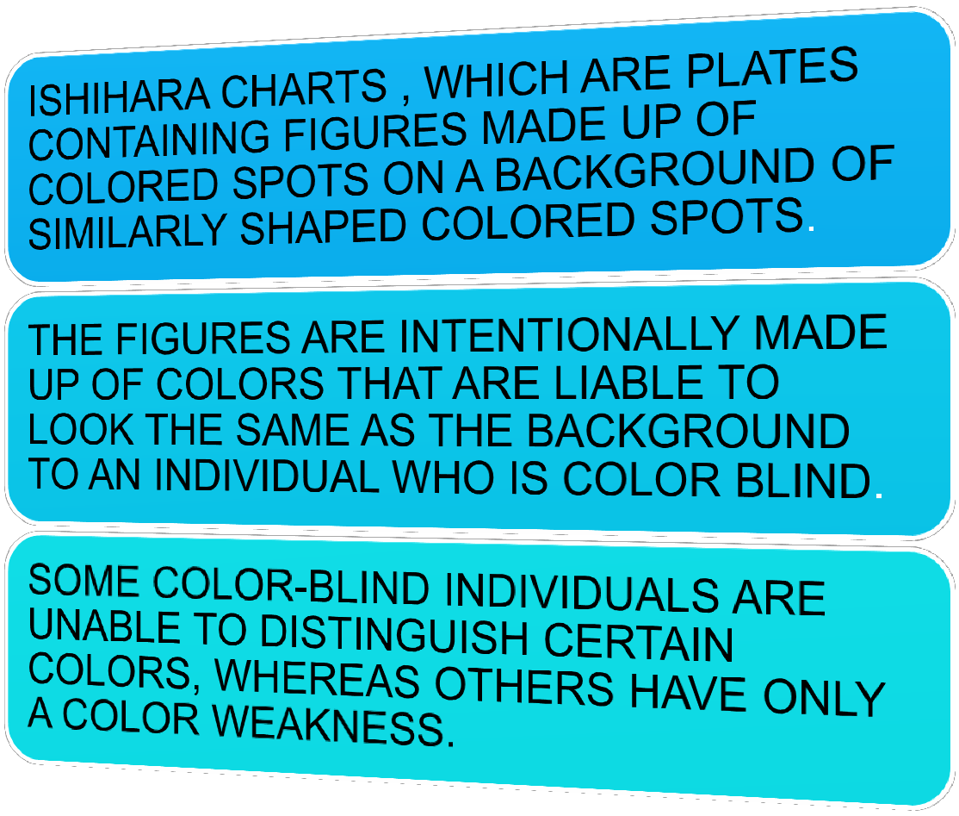

Slide 17
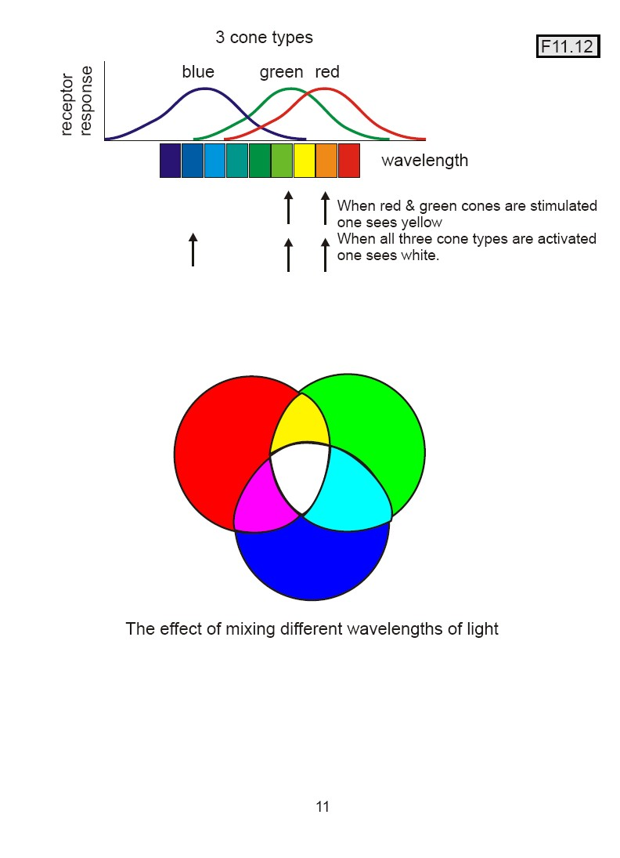

Slide 18
COLOR BLINDNESS:-
- There is gene for rhodopsin on chromosome(3)
- There is gene for blue sensitive S cone pigment on
chromosome(7)
- There is gene for red & green sensitive cone pigment on x chromosome.
- when a single group of color receptive cones is absent ( due to absence of there gene) the person can not see or distinguish some colors from others

Slide 19
- red – green blindness:-
-Green & red cones see different colors between
wave length 525-675 nm & distinguish them.
-If either of these cones are absent, the person can not distinguish 4 colors ( red – green- yellow- orange)& he can not distinguish red from green (primary colors) so called
( red – green blindness).

Slide 20
-It is x- linked disease transmitted from females to their male sons, never occure in females as they have 2 x chromosomes
Males have one x & one y chromosome so if this one x chromosome miss the gene for color vision , he will get red-green color blindness(their gene is on x chromosome).
-Females show the disease only if both x chromosomes lack the gene
Females from color blind fathers are carriers transmit the disease to ½ of their sons.

Slide 21
Trichromats :- have 3 cone pigments( normal or have slight weakness in detecting red or green or blue color
Dichromats:- have only 2 cone pigments systems only so he is completely blind to red or green or blue ( so they may have protanopia, deuteranopia,or tritanopia) they get color by mixing only 2 of the primary colors.

Slide 22
Monochromats :- have only one cone system or loss of all so see only black or grey or have no color perception.

Slide 23
Nopia = blindness, nomaly =weakness
1-Protanopia( red- blindness) :- no red cones system so person has shortened spectrum wave length,
if only weakness in red color vision is called protanomaly.

Slide 24
2-deutranopia ( green - blindness) :- no green cones system
-so person see only long & short wave length)
- if only weakness in green color vision is cal ed deutranomaly.
-
3-tritanopia ( blue - blindness) :- no blue cones system , if only
weakness in blue color vision is cal ed tritanomaly.

Slide 25
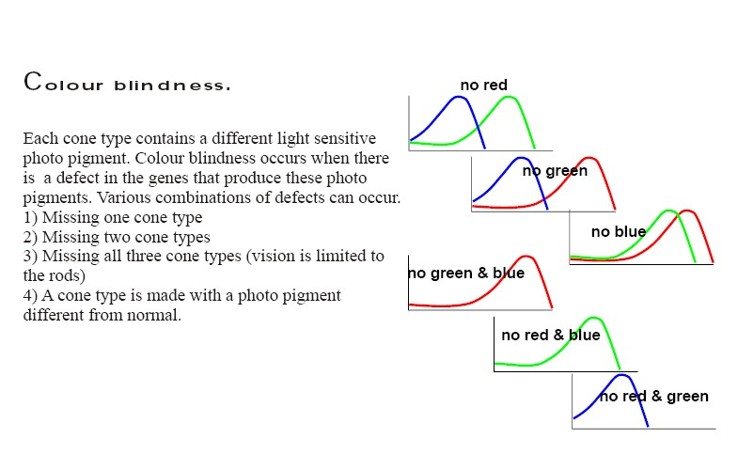

Slide 26
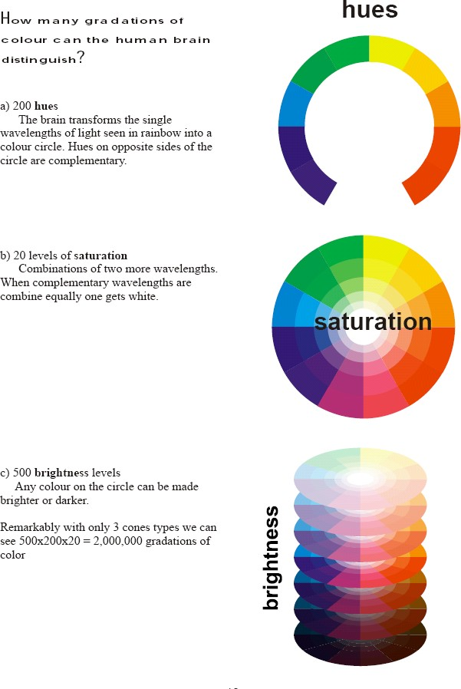

Slide 27






Thank you for listening

