Slide 1
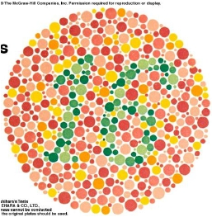
Color Vision
by
Prof/Faten zakareia
King Saud University
Physiology Dept

Slide 2
Objectives:
Definecolor vision
Identifyanddescribethemechanismof colourvisionandthe
threetypesofcones,includingtherangeof spectralsensitivity
andcolorblindness
Identifycolorvisiontheory
Describetheitemsneededfor anycolorperception
Comparedifferenttypesofcolorblindness

Slide 3
COLOR VISION
- It the ability to discriminate between different
colors.
1- there are 3 primary colors( blue- red- green)
sensed by cones in fovea & appreciated within
photopic vision.
2- sensation of extraspectral colors as white,
yellow, orange, purple, can be produced by
mixing properties of the blue &red & green in
different combinations.
3- black means absence of light ( not darkness
because in dark we do not see black only)

Slide 4
Colors have three attributes hue, intensity, and saturation
(degree of freedom from dilution with white).
For any color there is a complementary color that, when properly
mixed with it, produces a sensation of white
Black is the sensation produced by the absence of light, but it is
probably a positive sensation because the blind eye does not “see
black;” rather, it “sees nothing.”

Slide 5
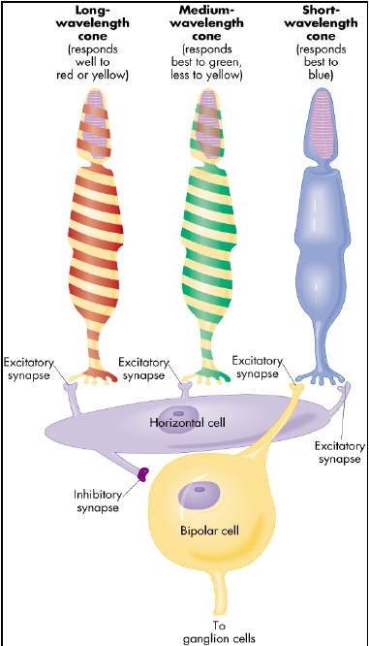

Slide 6
• Color vision theory :_( Young- Helmholtz theory )
• 1- we have 3 kinds of cones each has a specific
photopigment (rhodopsin)& is sensitive to one of the 3
primary colors
• a- Blue cone system:- has S pigment ( blue sensation
pigment) which respond to short wave length ( 440 nm
senses the blue color)
• b- Green cone system:- has M pigment ( green
sensation pigment) which respond to middle wave
length ( 535 nm senses the green color & less to
yellow) & absorb light at the green portion.

Slide 7
c- Red cone system:- has Lpigment ( red
sensation pigment) which respond to large
wave length at or
> 535 nm so senses the red & yellow color
& absorb light at the red portion.

Slide 8
•
•
•
•
2- sensation of any color determined by:
a- wave length of light
b- amount of light absorbed by each type of cones
c- frequency of impulses from each cone system to
ganglion cells which is determined by wave length of
light.

Slide 9
3- each cone system respond to its color at a
lower threshold than needed to sense other
colors ( red cones respond to red or yellow
color at a lower threshold than to green color)
5- perception of white is due to equal
stimulation of blue & red & green
cones.There is no wave length corresponds to
white, white is a combination of all wave
lengths

Slide 10
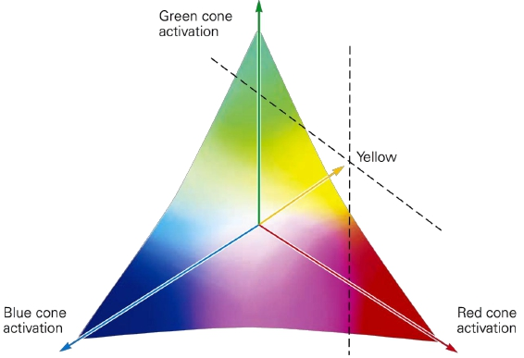
• there is no single wavelength of light
corresponding to white; instead, white is
a combination of all the wavelengths of
the spectrum.
• as can be seen in this vector diagram –
white occupies the middle of the vector

Slide 11
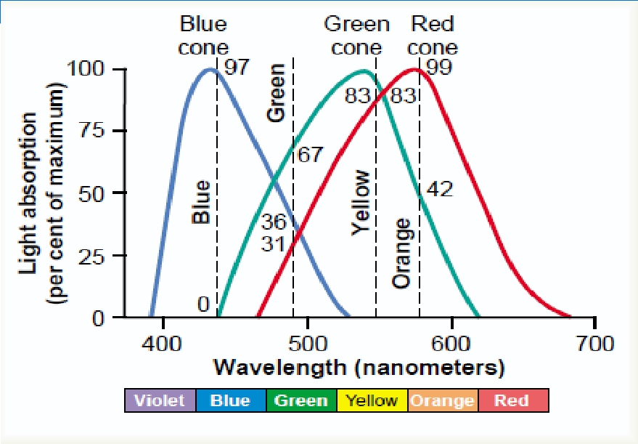
Light absorption by the pigments of three color-receptive cones
of human retina.

Slide 12
• #- Color vision is coded by :-
• --different responses in ganglion cells that depends
upon the wave length of stimulus which determine
frequency of impulses in ganglion cells
• - the color perception in the brain depends on the
amount of activity in each of the 3 cone systems as
mentioned above.

Slide 13
•6-perception of orange is due to
stimulation of 99% of red cones & 42%
of green cones & 0% of blue cones( so
ratio is 99:42: 0)
•7--perception of yellow is due to
stimulation of 50% of red cones &
50% of green cones & 0% of blue
cones( so ratio is 50:50: 0)
•8-perception of blue is due to
stimulation of 0% of red cones & 0%
of green cones & 97% of blue cones(
so ratio is 0:0: 97 )

Slide 14
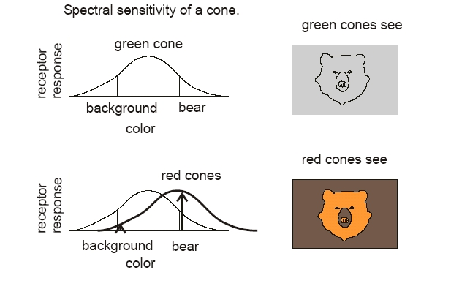

Slide 15
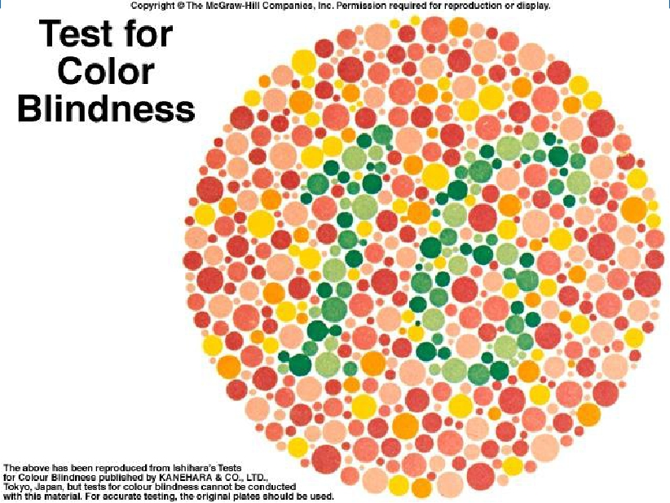
-

Slide 17
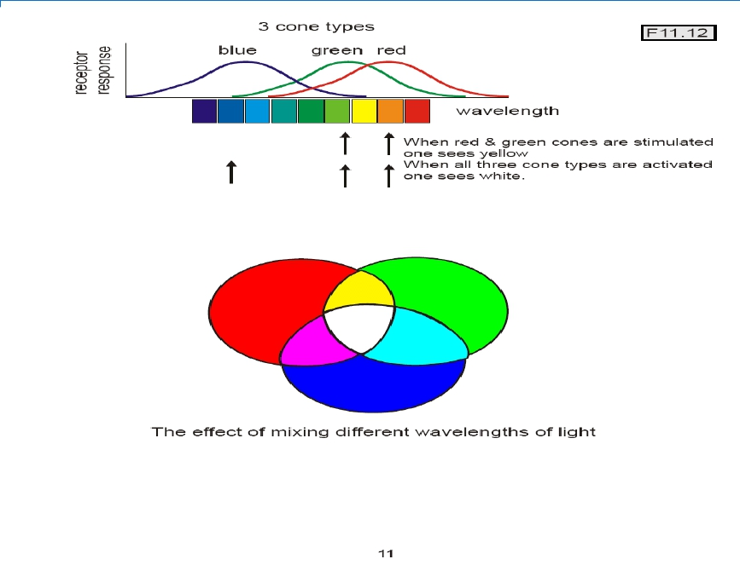

Slide 18
• COLOR BLINDNESS:-
• - There is gene for rhodopsin on chromosome(3)
• - There is gene for blue sensitive S cone pigment on
chromosome(7)
• - There is gene for red & green sensitive cone
pigment on x chromosome.
• - when a single group of color receptive cones is
absent ( due to absence of there gene) the person
can not see or distinguish some colors from others

Slide 19
• - red – green blindness:-
• -Green & red cones see different colors between
wave length 525-675 nm & distinguish them.
• -If either of these cones are absent, the person can
not distinguish 4 colors ( red – green- yellow-
orange)& he can not distinguish red from green
(primary colors) so called
• ( red – green blindness).

Slide 20
-It is x- linked disease transmitted from females
to their male sons, never occure in females as
they have 2 x chromosomes
- Males have one x & one y chromosome so if
this one x chromosome miss the gene for color
vision , he will get red-green color
blindness(their gene is on x chromosome).
-Females show the disease only if both x
chromosomes lack the gene
- Females from color blind fathers are carriers
transmit the disease to ½ of their sons.

Slide 21
• Trichromats :- have 3 cone pigments( normal or
have slight weakness in detecting red or green or
blue color
• Dichromats:- have only 2 cone pigments systems
only so he is completely blind to red or green or
blue ( so they may have protanopia,
deuteranopia,or tritanopia) they get color by
mixing only 2 of the primary colors.

Slide 22
Monochromats :- have only one cone system
or loss of all so see only black or grey or have
no color perception.

Slide 23
• Nopia = blindness,
nomaly =weakness
• 1-Protanopia( red- blindness) :- no red cones
system so person has shortened spectrum wave
length,
• if only weakness in red color vision is called
protanomaly.

Slide 24
2-deutranopia(green-blindness):-nogreenconessystem
-sopersonseeonlylong&shortwavelength)
-ifonlyweaknessingreencolorvisioniscalleddeutranomaly.
-
3-tritanopia(blue -blindness):-noblueconessystem,ifonly
weaknessinbluecolorvisioniscalled tritanomaly.

Slide 26
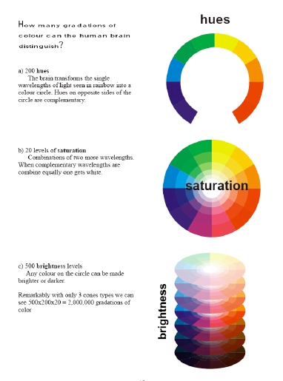

Slide 27
Thankyoufor
listening

