Slide 1
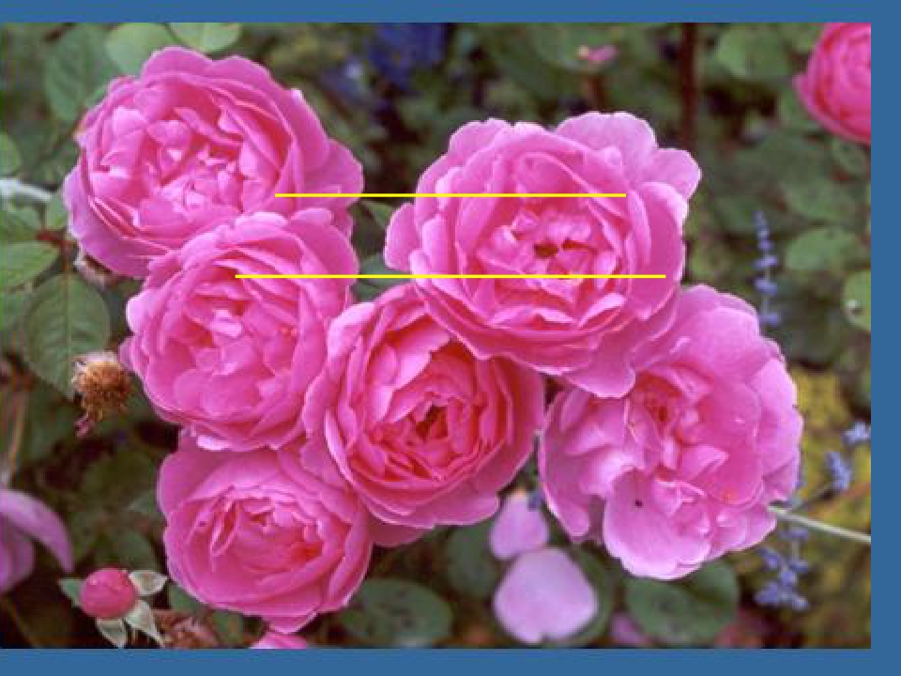
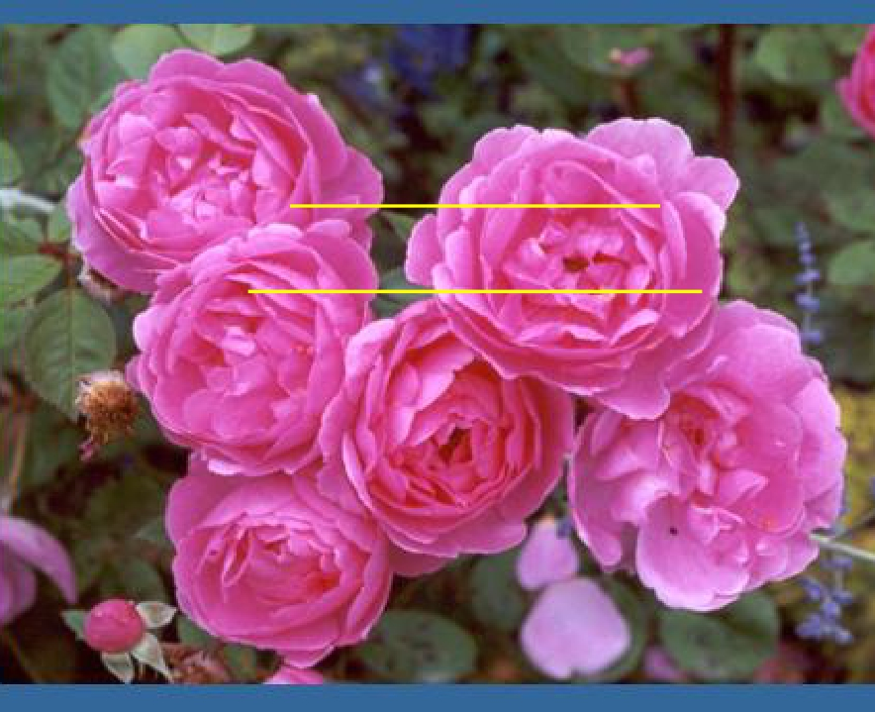
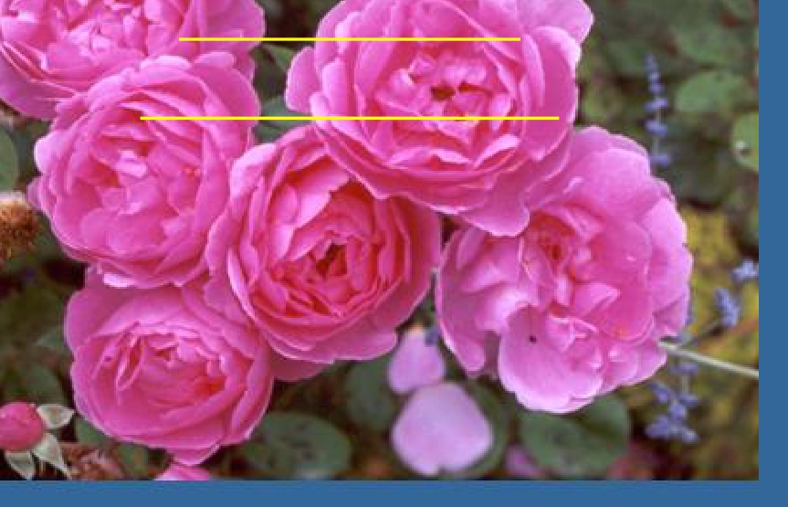
Pathways of
Autonomic
Theproprioception Nervous
System
posterior column&
Spinocerebellar Pathways
Assess Prof. Fawzia Al-Rouq
Department of Physiology
College of Medicine
King Saud University

Slide 2
https://www.youtube.com/watch?v=pMEROPOK6v8

Slide 3
OBJECTIVES
Pathways of proprioception
At the end of this lecture the student should be able
to:-
1-Identify the major sensory pathways
Describe the components, processes and functions of
the sensoty pathways
2-appreciate the dorsal column system in conscious
proprioception (anatomy&functions)
3- describe the pathway of spinocerebellar tract in
unconscious proprioception from
muscles,tendons,and joints
4-differentiate between sensory and motor ataxia

Slide 4
●
Introduction
● Sensory receptors
major
sensory pathways
●
dorsal column system
● spinocerebellar tract
● sensory and motor ataxia

Slide 5
INTRODUCTION

Slide 6
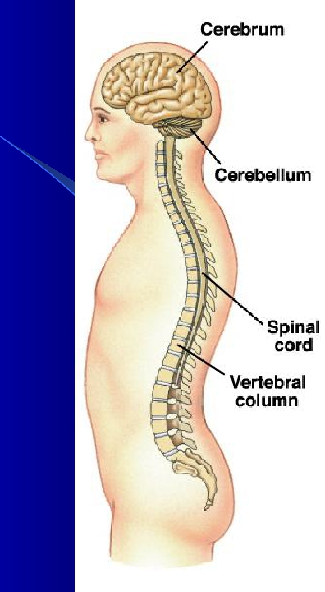
Organization of the
Nervous System
2 big initial divisions:
Central Nervous System
The brain + the spinal cord
The center of integration and control
Peripheral Nervous System
The nervous system outside of the brain and
spinal cord
Consists of:
31 Spinal nerves
Carry info to and from the spinal cord
12 Cranial nerves
Carry info to and from the brain

Slide 7
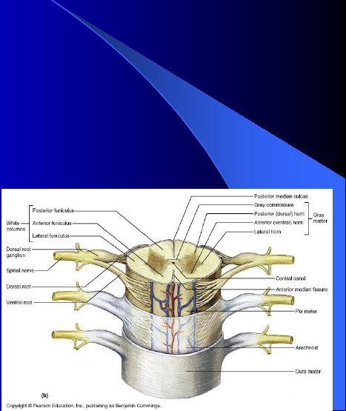
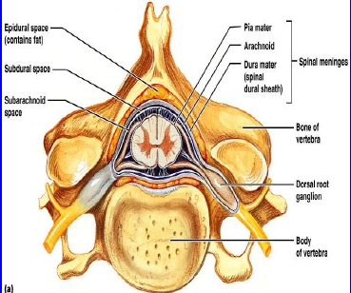
●
●
●
●
Spinal cord
A Cross-section view of spinal cord- wider laterllay than anteroposteriorly.
In the middle on the dorsal side is a shallow groove called the posterior
median sulcus and on the ventral side is the anterior median fissure
(deeper).
center consist of gray matter shaped like a butterfly and there is an opening
at the center
Spinal cord is protected by three layers of meninges. The only difference
from the brain is that the dural matter does not attach to bone. The dural
matter is surrounded externally by a layer of cushioning fat called epidural
space.

Slide 8
Gray Matter: Organization
Dorsal half – sensory roots and ganglia
●
● Ventral half – motor roots
● Dorsal and ventral roots fuse laterally to form
spinal nerves
● Four zones are evident within the gray matter –
somatic sensory (SS), visceral sensory (VS),
visceral motor (VM), and somatic motor (SM)

Slide 9
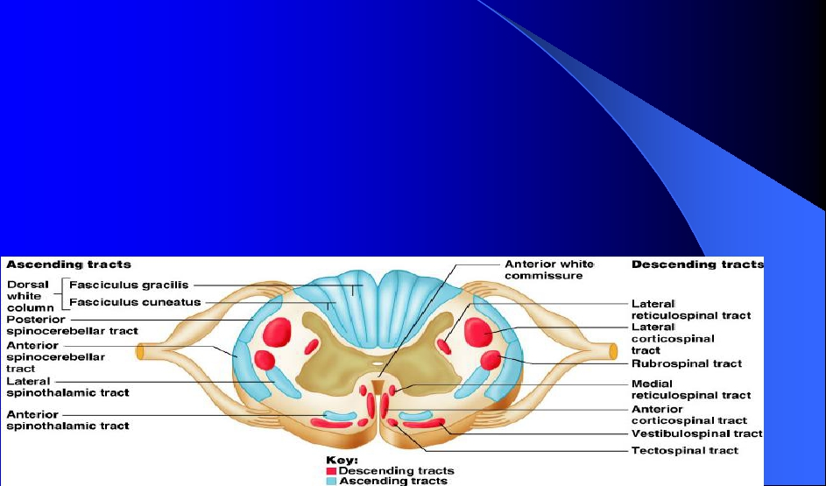
White Matter in the Spinal Cord
Fibers run in three directions – ascending, descending,
●
and transversely
● Divided into three funiculi (columns) – posterior, lateral,
and anterior
● Each funiculus contains several fiber tracks
– Fiber tract names reveal their origin and destination
– Fiber tracts are composed of axons with similar functions

Slide 10
●
Introduction
● Sensory receptors
major
sensory pathways
●
dorsal column system
● spinocerebellar tract
● sensory and motor ataxia

Slide 11
Sensory Receptors

Slide 12
Peripheral Sensory Receptors
●
Sensory receptors classified according to:
– Location
– Type of stimulus detected
– Structure
Copyright © 2005
Pearson Education,
Inc., publishing as

Slide 13
Unencapsulated Nerve
Endings
Copyright © 2005
Pearson Education,
Inc., publishing as

Slide 14
Encapsulated Nerve Endings
●
Consist of one or more end fibers of sensory
neurons
● Enclosed in connective tissue
● Include four main types
Copyright © 2005
Pearson Education,
Inc., publishing as

Slide 15
Encapsulated Nerve Endings
●
Meissner’s corpuscles
● Pacinian corpuscles
● Ruffini’s corpuscles
● Proprioceptors
Copyright © 2005
Pearson Education,
Inc., publishing as

Slide 16
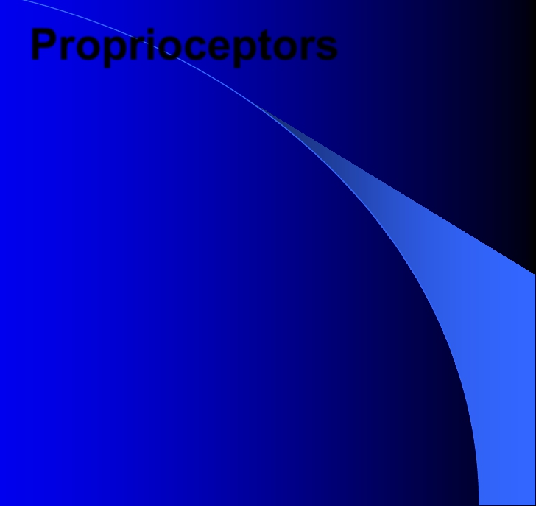
Proprioceptors
– Encapsulated Nerve Endings
– Monitor stretch in locomotory organs
– Three types of proprioceptors

Slide 17
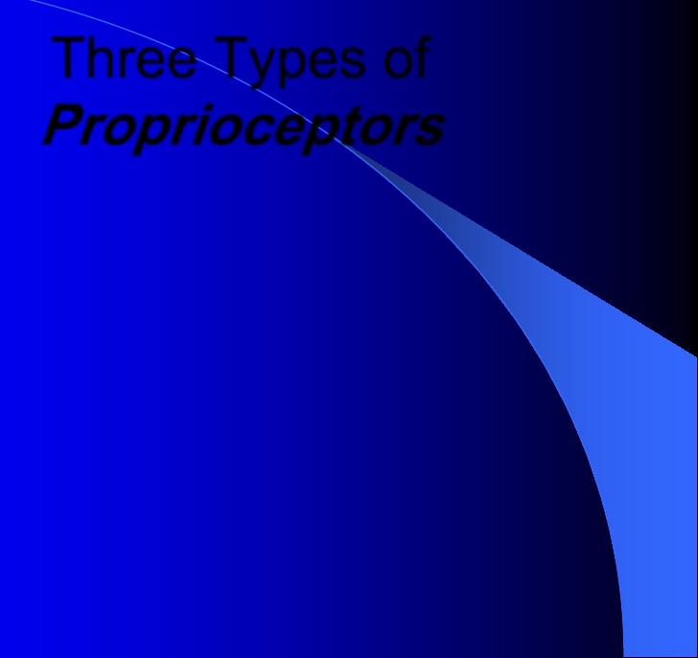
Three Types of
Proprioceptors
Muscle spindles – measure the changing
length of a muscle
– Imbedded in the perimysium between muscle
fascicles
Golgi tendon organs – located near the
muscle-tendon junction
– Monitor tension within tendons
Joint kinesthetic receptors
– Sensory nerve endings within the joint capsules
●
●
●

Slide 18
Proprioceptors
Copyright © 2008 Pearson
Education, Inc., publishing as
Benjamin Cummings

Slide 19
Structure of Proprioceptors
Copyright © 2008 Pearson
Education, Inc., publishing as
Benjamin Cummings

Slide 20
●
Introduction
● Sensory receptors
major
sensory pathways
●
dorsal column system
● spinocerebellar tract
● sensory and motor ataxia

Slide 21
An Overview of Sensory Pathways and the Somatic
Nervous System
Neural pathways
Afferent pathways
– Sensory information coming from the sensory
receptors through peripheral nerves to the spinal cord
and to the brain .
●
Efferent pathways
– Motor commands coming from the brain and spinal
cord, through peripheral nerves to effecter organs .

Slide 22
Sensory pathways

Slide 23
Sensory pathways
Sensory systems allow us to detect, analyze and
respond to our environment
“ascending pathways”
Carry information from sensory receptors to the
brain
Conscious: reach cerebral cortex
Unconscious: do not reach cerebral cortex
Sensations from body reach the opposite side of
the brain
●
●
●
●
●
●

Slide 24
●
●
●
●
●
Spinal tracts- These are known as sensory and motor pathways
consisting of multineuron pathways connecting the CNS to the PNS.
At some point most pathways crossover (decussate),
A. Ascending (sensory) Pathways : -
1. Dorsal column pathway- carries signal of fine touch, pressure,
vibration , stereognosis and concious proprioception, ascends up
dorsal white column in fasciculus gracilis or cutaneatus to medulla
oblongata to the thalamus to primary somatosensory cortex (post
central gyrus).
2 . Posterior and anterior spinocerebellar pathways- carry
subsconcious proprioception. Dorsal gray horn- to lateral column- to
medulla oblongata- to pons – to cerebellum.
3. Spinothalamic pathway- carries signals of pain, temperature, deep
pressure, and course touch. From psterior gray horn decussate into
lateral and anterior funiculi up to the thalamus to primary
somatosensory cortex (postcentral gyrus).

Slide 25
Sensory pathways:
3 neurons
enters spinal cord from periphery
1st:
2nd:
crosses over (decussates), ascends
in spinal cord to thalamus
3rd:
projects to somatosensory cortex

Slide 26
●
Introduction
● Sensory receptors
major
sensory pathways
●
dorsal column system
● spinocerebellar tract
● sensory and motor ataxia

Slide 27
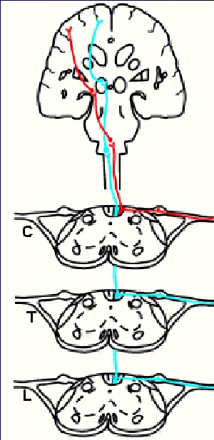
Dorsal column pathway
Carries fine touch, tow point
●
discrimination ,pressure ,vibratio
n ,stereognosis and conscious
proprioception signals
● 1st neuron enters spinal cord
through dorsal root; ascends to
medulla (brain stem)
● 2nd neuron crosses over in
medulla; ascends to thalamus
● 3rd neuron projects to
somatosensory cortex

Slide 28
Two-Point Discrimination

Slide 29
Dorsal column pathway
Primary somatosensory
cortex (S1) in parietal
lobe
Dorsal column
nuclei
Thalamus
Medulla
Medial
lemniscus
Dorsal column
Spinal cord

Slide 30
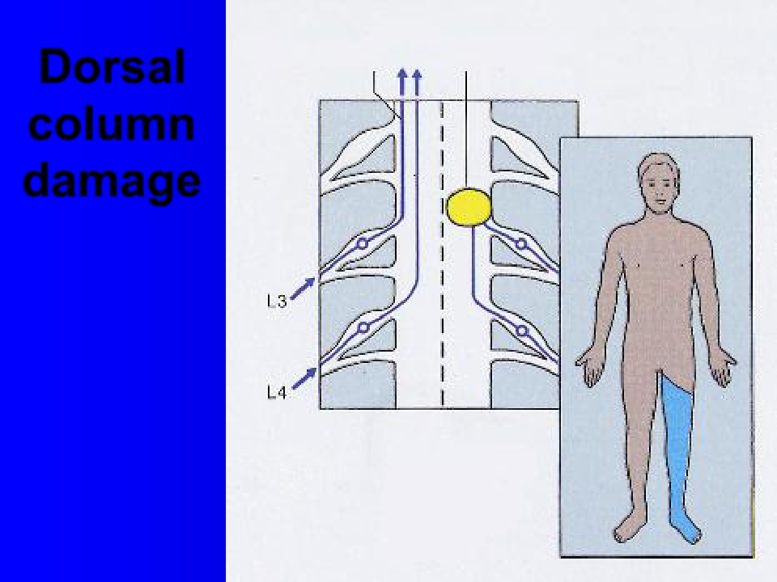
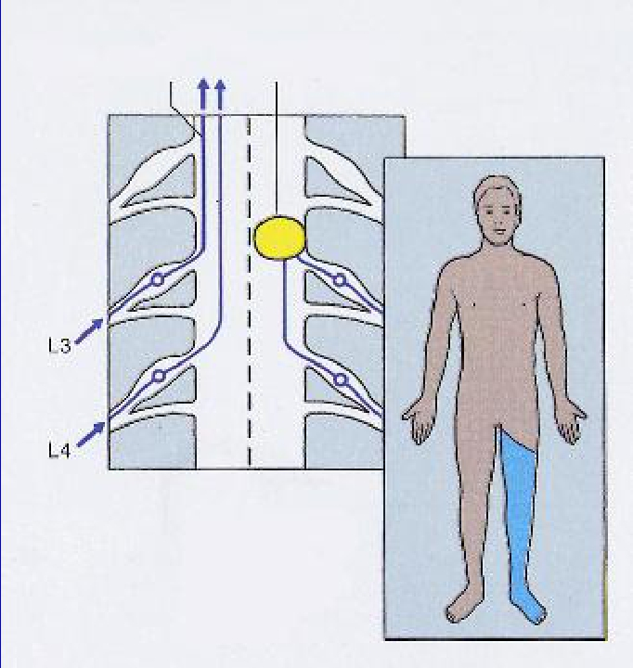
Left
spinal cord injury
dorsal column
pathway
Dorsal
column
damage
Loss of sense of:
•touch
•proprioception
•vibration
in left leg

Slide 31
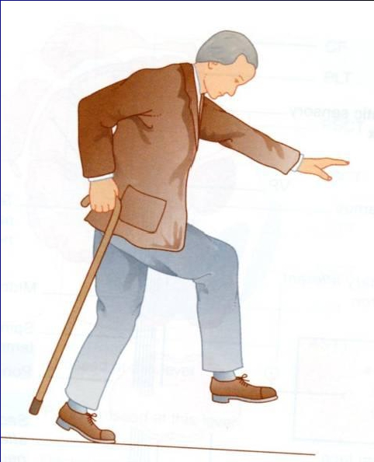
Dorsal column damage
●
●
●
Sensory ataxia
Patient staggers; cannot
perceive position or
movement of legs
Visual clues help movement

Slide 32
●
Introduction
● Sensory receptores
major
sensory pathways
●
dorsal column system
spinocerebellar tract
●
sensory and motor ataxia

Slide 33
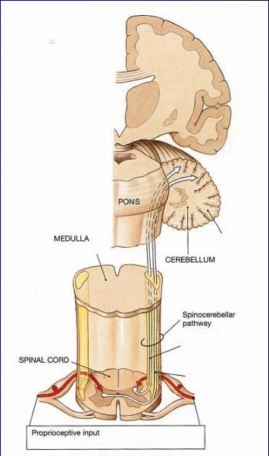
Spinocerebellar pathway
Carries unconscious
proprioception signals
Receptors in muscles &
joints
1st neuron: enters spinal
cord through dorsal root
2nd neuron: ascends to
cerebellum
No 3rd neuron to cortex,
hence unconscious
●
●
●
●
●

Slide 34
Spinocerebellar tract damage
●
Cerebellar ataxia
● Clumsy movements
● Incoordination of the limbs (intention
tremor)
● Wide-based, reeling gait (ataxia)
● Alcoholic intoxication produces similar
effects!

Slide 35
●
Introduction
● Sensory receptores
major
sensory pathways
●
dorsal column system
● spinocerebellar tract
sensory and motor ataxia

Slide 36
Motor
&
Sensory
Ataxia

Slide 37
Ataxia and Gait Disturbances
●
Pathophysiology
– Result from any condition that affects the
central and peripheral nervous systems
– Ataxia: Types
● Motor ataxia
● Sensory ataxia

Slide 38
Ataxia and Gait Disturbances
●
Motor Ataxia
– Caused by cerebellar disorders
● Intact sensory receptors and afferent pathways
● Integration of proprioception is faulty
● Midline cerebellar lesions cause truncal ataxia
● Lateral cerebellar lesions cause limb ataxia
● Thalamic infarcts may cause contra lateral ataxia
with sensory loss
● N.B cerebellar ataxia will discussed later with
cerebellum lecture.

Slide 39
Ataxia and Gait Disturbances
Sensory Ataxia
– Failure of proprioceptive information to the CNS
– May be due to disorders of spinal cord or peripheral
nerves
– Can be compensated for by visual inputs
●

Slide 40
Thank you

Slide 41
Extra informations

Slide 42
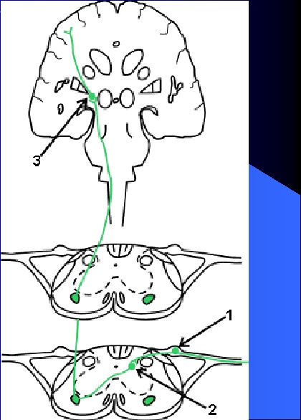
Spinothalamic pathway
Carries pain, temperature,
●
touch and pressure signals
● 1st neuron enters spinal
cord through dorsal root
● 2nd neuron crosses over in
spinal cord; ascends to
thalamus
● 3rd neuron projects from
thalamus to somatosensory
cortex

Slide 43
spinothalamic
pathway

Slide 44
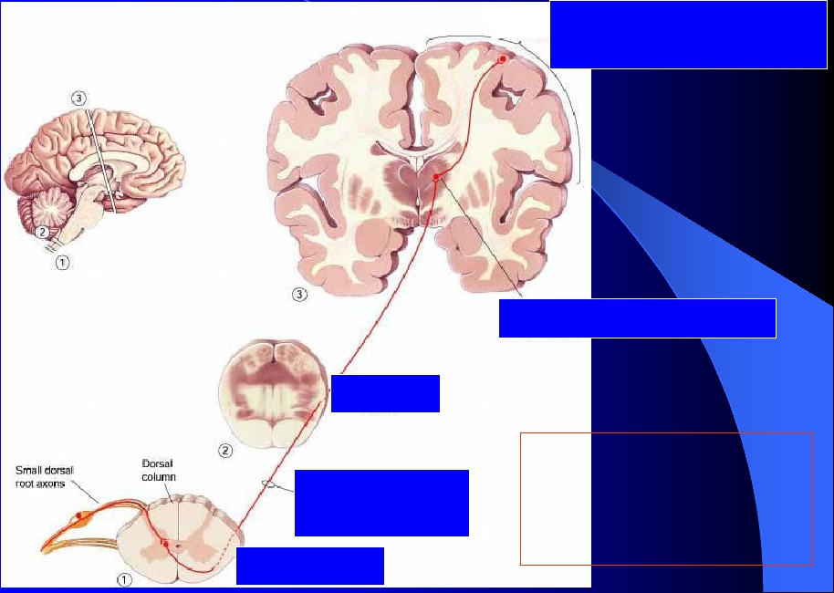
Spinothalamic Pathway
Primary somatosensory
cortex (S1)
Thalamus
Small sensory fibres:
Pain, temperature,
some touch
Medulla
Spinothalamic
tract
Spinal cord

Slide 45
Spinothalamic damage
Left
spinothalamic pathway
spinal cord injury
Loss of sense of:
•Touch
•Pain
•Warmth/cold
in right leg

Slide 46
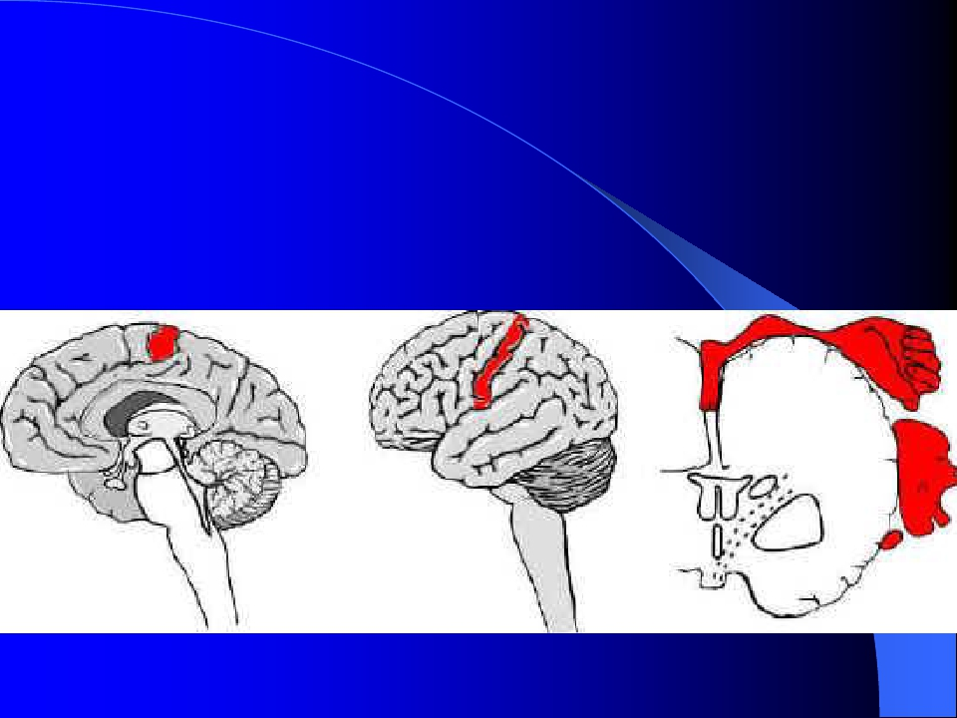
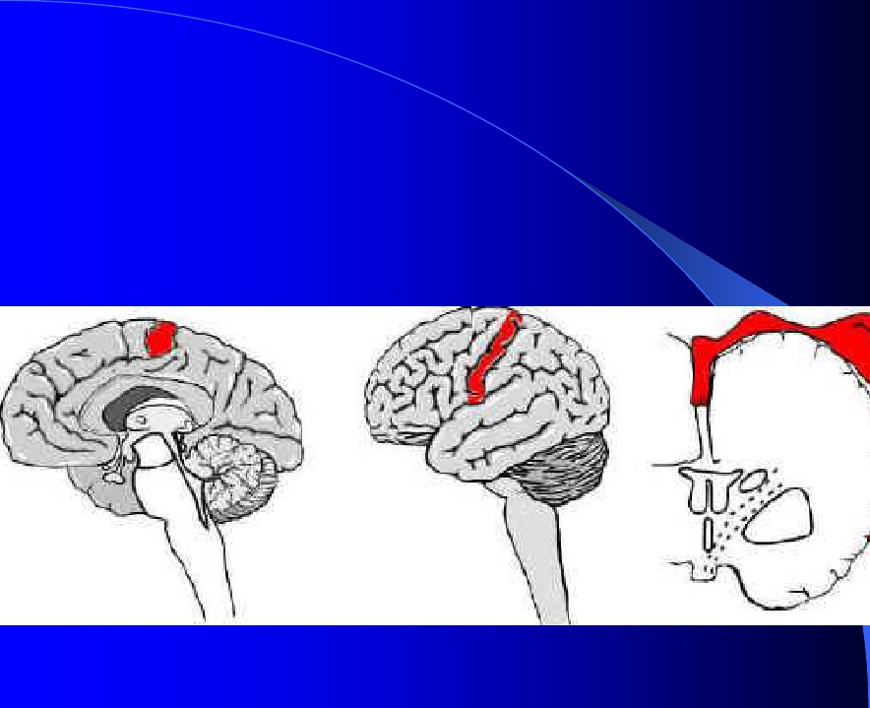
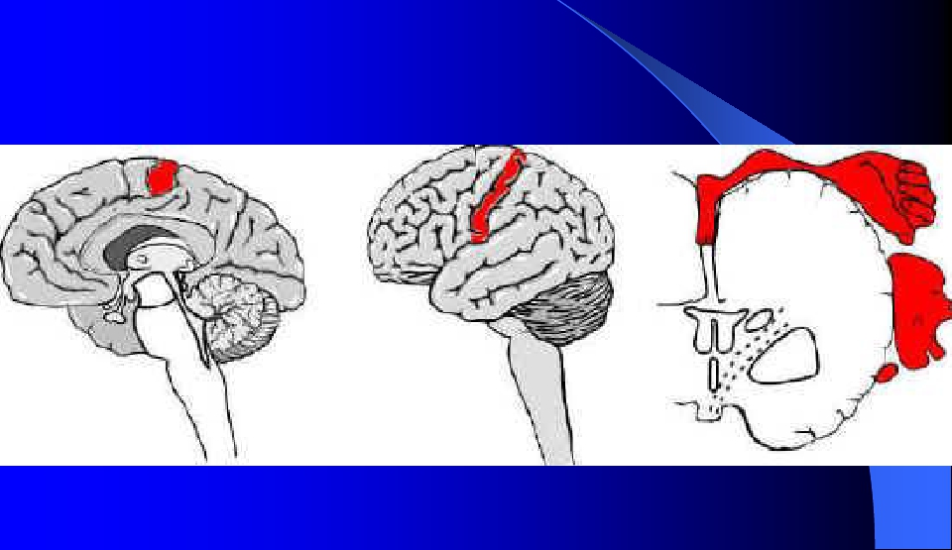
4. Somatosensory cortex
Located in the postcentral gyrus of the
human cerebral cortex.

Slide 47
Spatial orientation of signals.
1) Each side of
the cortex
receives
sensory
information
exclusively
from the
opposite side of
the body
(the exception:
the same side
of the face).

Slide 48
Spatial orientation of signals.
2)The lips, face
and thumb are
represented by
large areas in the
somatic cortex,
whereas the trunk
and lower part of
the body, relatively
small area.
3)The head in the most lateral portion, and the
lower body is presented medially

