Slide 1
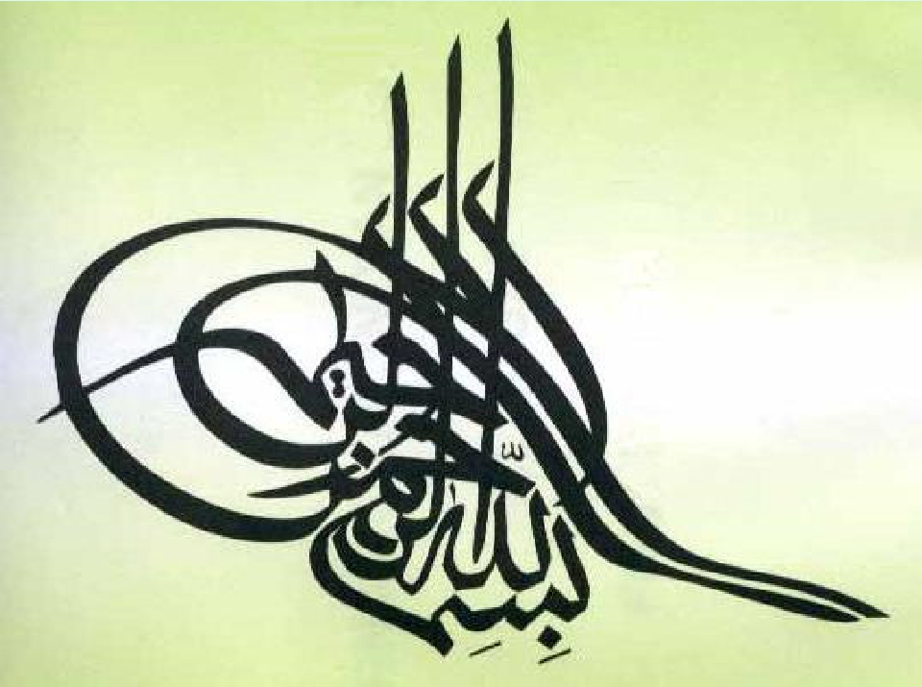

Slide 2
POSTURE & EQUILIBRIUM
Q-What is posture?
It is maintenance of upright position against
gravity (center of body is needed to be between the
legs) it needs antigarvity muscles

Slide 3
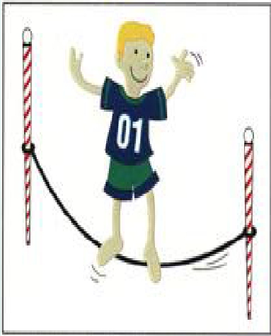
1-Up-right posture need postural reflexes
2- posture depends on muscle tone (
stretch reflex) ( basic postural reflex)
3-The main pathways concerned with
posture are:-
A- medial tracts control proximal limbs &
axial muscles for posture & gross
movements
4- lateral pathways as corticospinal –
rubrospinal) control distal limbs.

Slide 4
postural reflexs depends on the following
receptors:-
• 1- vestibular apparatus receptors as
• Maculae (utricle & saccule) & SCC cristea.
• - Maculae for linear acceleration & orientation of
head in space
• - SCC cristea for angular acceleration
• 2- visual (vision) & auditory(hearing) receptors:-
Vision can compensate for loss of auditory,
vestibular & proprioception
• -(Tabes dorsalis +ve Rombergism)
• -If Pt with sensory ataxia stands with eyes closed ,he
falls down)
3-Proprioceptors of muscles , tendons , ligaments &
joints:-

Slide 5
• a- Neck Proprioceptors:-
• detect head position in relation to trunk
• b- Body Proprioceptors proprioceptors of
anti-gravity muscles
• c- pressure receptors as in sole of feet
initiate positive supporting reaction (
magnet reflex)

Slide 6
•
•
- Stretch reflexes & postural reflexes can be
modified by coordinated activity ;-
▪
▪
▪
▪
▪
Spinal cord
Medulla
Midbrain
Cerebral cortex
cerebellum

Slide 7
Postural reflexes are:-
A-Static reflexes( at rest)
B-Phasic reflexes ( with
motion)

Slide 8
A-Static R:-
(statotonic):- maintain posture at rest:-
A- spinal
B-medullary reflexes
C-Righting reflexes ( midbrain )
A-Spinal reflexes:- ( Center in S.C)
1- local static reflexes:
Positive supporting reaction ( magnet reflex)
(receptors are proprioceptors of flexors(contraction
of both flexors & extensors)
-protective reflex
2 -Stretch reflex

Slide 9
3- Segmental
static reflexes:-
mediated by one segment of the spinal cord as :-
a- Crossed extensor reflex
b- Negative supporting R (which release +ve
supporting reaction -( receptors are proprioceptors of
extensors of the released limb)
N.B spinal R can be studied in spinal animal with cut
at neck b/w the S.C& brain stem so all S.C is intact.

Slide 10
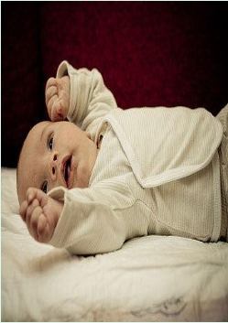
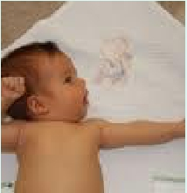
• -
• B-Medullary
static Reflexes
• (Center=medulla oblongata) are:-
• Neck& labyrinthine reflexes
• 1- Neck static reflexes( studied in a
decerebrated animal cut above medulla +
labyrinth destroyed)
• -Stimulus is :-changing head position that
(+) neck proprioceptors

Slide 11
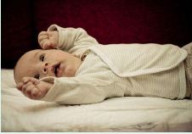
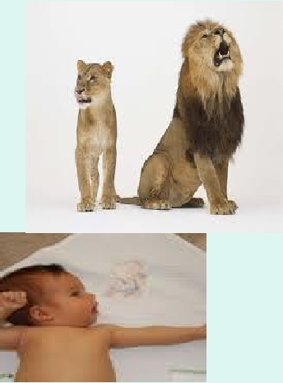
1-- ventroflexion of head
/
arms flexion+ extend hindlimb (
as in decortication).
2-dorsiflexion of head /
arms extended + flex hindlimb.
3-- turning head to one side—
Extention of limbs on that side +
flexion of other side. (as in
decortication)

Slide 12
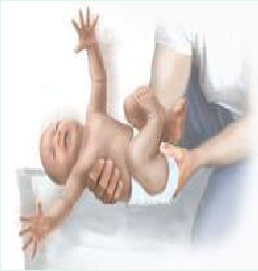
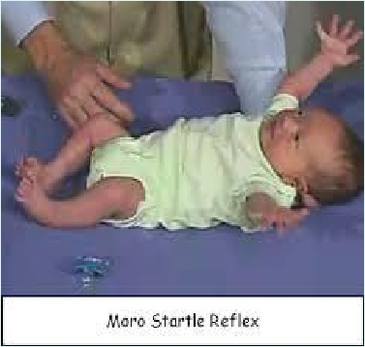
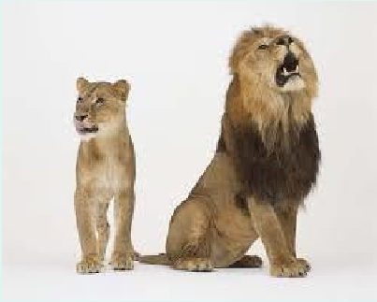

Slide 13
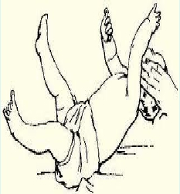
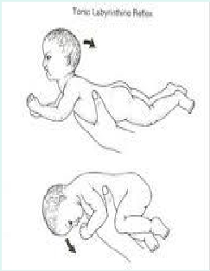
• 2- labyrinthine static reflex:- ( in
decerebrated animal ) + elimination of
neck proprioceptors)( labyrinth intact)
- Receptors are otolith organs (maculae)
• -Stimulus is gravity
1-ventroflexion of head (or prone
position)----- 4 limbs flexion
2- dorsiflexion of head ( or supine
position)-----4 limbs extended( as in
decerebration)

Slide 14
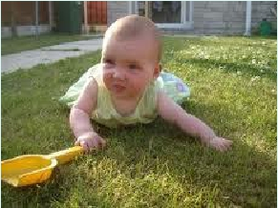
• C- Righting reflexes:-
•
( Center is midbrain except the
visual in C.C):-
when upright posture is disturbed as in falling
down
• - studied in a decerebrated animal ( cut above
midbrain = upper decerebration)
•
a- visual righting reflexes(
cortical):-
- Visual image can correct position of head &
body if position is disturbed
• - center is c.c -
• - stim: visual stim
• - receptors; eye receptors

Slide 15
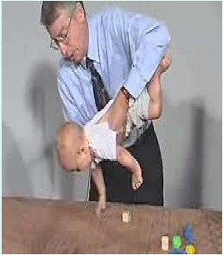
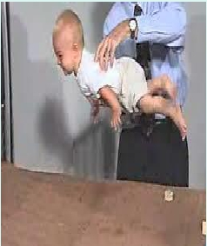
b- labyrinthine righting reflexes
(midbrain):-
(cover eyes) & animal held in air from
pelvis)
- the body is not in the proper position
As in tilting the head (+) otolith organs -
>>>>-(+) neck muscles to correct the head
level, when head is not in proper site.
receptors; otolith organs,
response; righting of head

Slide 16
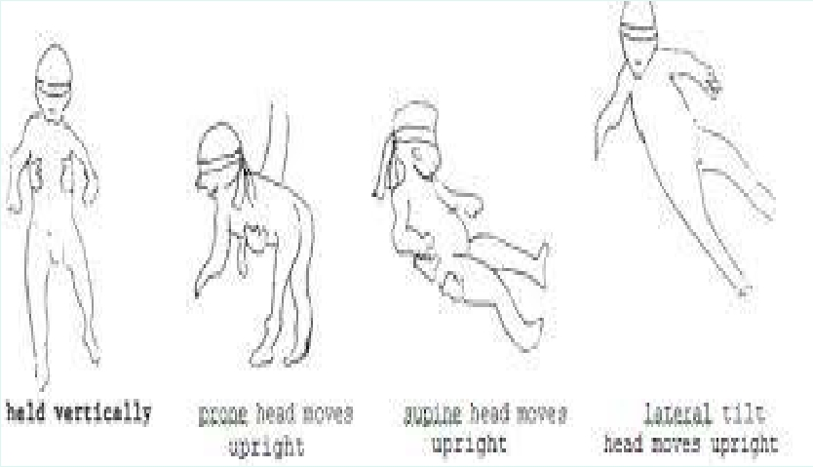

Slide 17
• All static labirynthine reflexes have macula as receptors
•
•
but in statokinetic reflexes during motion SCC receptors.
(macula act in linear & SCC receptors act in angular
acceleration)

Slide 18
c- Body on head righting reflexes (midbrain):- :-
Stim: pressure on side of body& head is free
receptors; trunk proprieoceptors
Response/ reflex correction of head .
d- Body on body (midbrain):-
Pressure on side of the body and head is fixed)
Receptors/ trunk proprieoceptors
response /reflex correction of body

Slide 19
e- Neck righting reflexes (midbrain) :-
stim: stretch of neck muscles
( As if head is corrected & body still tilted
receptors; muscle spindles of neck
muscles
response; -righting of shoulders & then
righting of body.

Slide 20
• B- Phasic reflexes (statokinetic reflexes )(
center in C.C):-
-maintain posture during motion
• a- Hopping reaction:-
•
- when animal is pushed laterally }}}}} reflex hopping to
keep limbs in position to support body.
• The receptors are in muscle spindles.
• b- Placing reaction :-
- blind folded animal suspended in air & moved towards a
supporting surface, the feets will be placed firmly on the
supporting surface ( receptors are touch receptors&
proprioceptors in soles of feet)

Slide 21
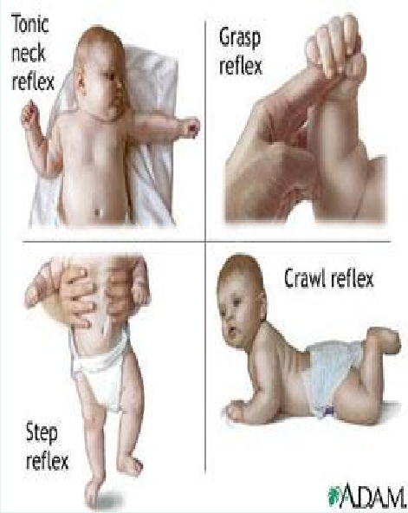

Slide 22
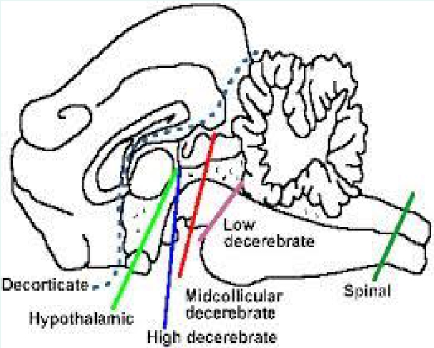
Decerebrate rigidity& Decorticate rigidity

Slide 23
Decerebrate rigidity :-
- In section between superior& inferior colliculi of midbrain
(below the level of the red nucleus (e.g. mid-collicular lesion )>>>>block normal
inhibitory signals from brain & red nucleus in midbrain to tonically active
pontile reticular formation & Vestibular. N causing:
1- Maintained tonic static postural reflexes that support
animal against gravity :-
a-medullary tonic neck
b-medullarylabyrinthine R).
2-Absent midbrain righting R
3-Extension of head & 4 limbs extensors ( as in
labyrinthine static R)
-The jaw may be clenched with the neck hyperextended
due to increased extensor tone from vestibulospinal &
reticulospinal tracts to extensor motor neurons
4- spasticity &rigidity & extension in antigravity muscles
-In human by vascular lesion of brain stem between red N & vestibular nucleus

Slide 24
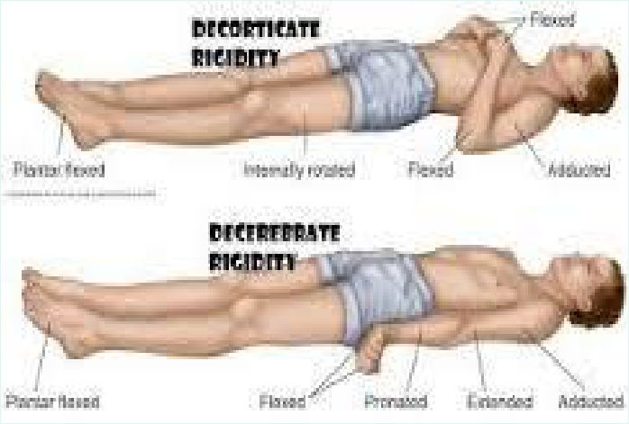

Slide 25
• Decorticate rigidity more common in human than
decerebate rigidity:-
1- lesion in cerebral cortex but brain stem is intact
• as what seen in hemiplegic pts after Hge of
internal capsule
• 2-Medullary tonic neck & tonic labyrinthine
reflexes present
• 3-Righting midbrain reflexes present
• 4-Visual righting, placing & hopping reflexes lost

Slide 26
• 5- it causes extensor rigidity in legs & moderate flexion of
arms if head unturned , as supine position (tonic neck
reflexes)
• - the hands are clenched into fists, and the legs extended and
feet turned inward
• 2- Turning the head to one side initiates tonic neck reflexes
e.g turning head to the left >>>>>>>extension of limbs on
left side & flexion of right side
Cause :-
1-lesions above the red nucleus so rubrospinal are intact together with pontine
reticulospinal and the vestibulospinal leads to the characteristic flexion posturing of the
upper extremities and extensor posturing of the lower extremities.
2-Since the corticospinal tract is interrupted, the pontine reticulospinal and the
vestibulospinal extend L.L
3-normally suppressor area 4 strip in the anterior edge of precentral gyrus inhibit red
nucleus , if this inhibition is lost by decortication ,red nucleus is disinhibited,
disinhibition of the red nucleus facilitate the rubrospinal tract to flex U.L
4- Also/ there is loss of inhibitory cortical signals (from suppressor area 4 strip in the
anterior edge of precentral gyrus) to gamma motor neurons via reticulospinal

Slide 27
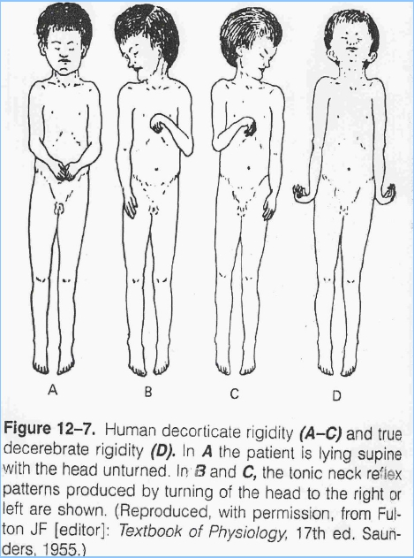

Slide 28
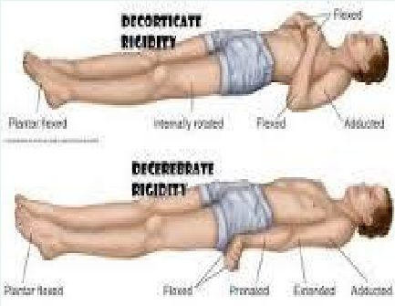
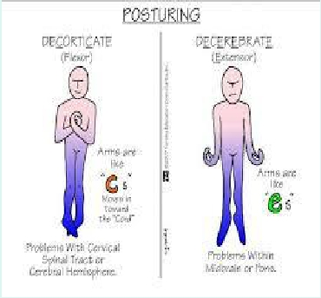

Slide 29
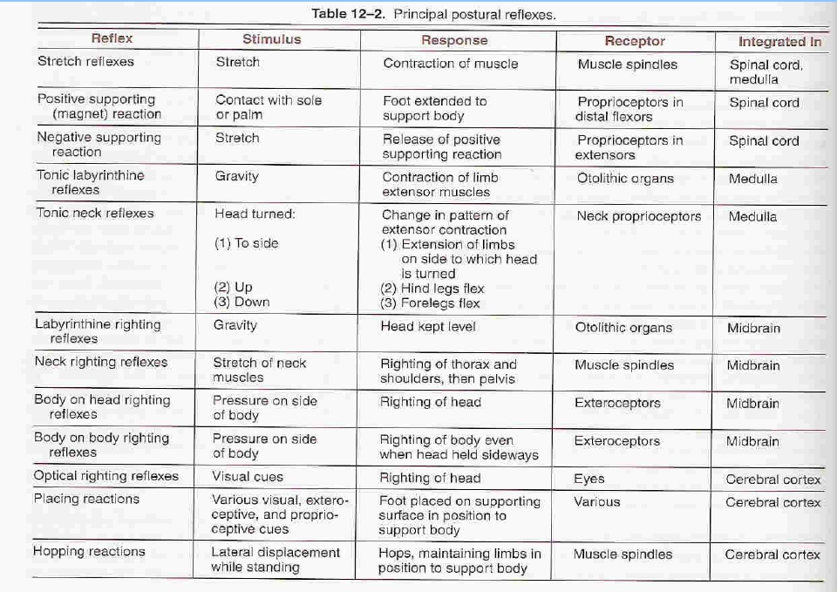

Slide 30
Thank you for
listening

