Slide 1
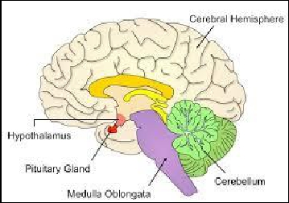
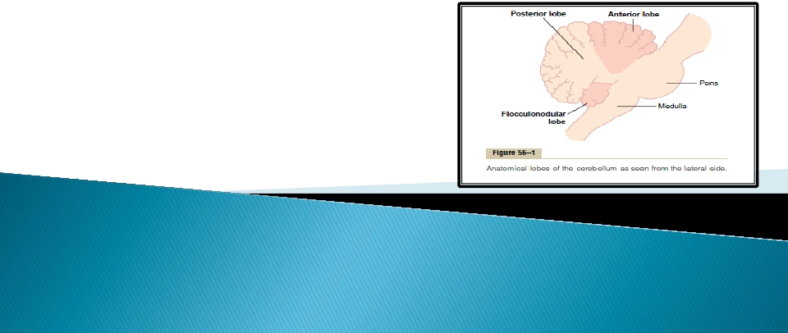
Dr. Aida A. Korish
Assoc. Prof. Physiology
KSU
Dr.Aida A.Korish (
akorish@ksu.edu.sa)
1

Slide 2




At the end of this lecture you will be able to:-
Describe the functional divisions of the
cerebellum; vestibulocerebellum, spinocerebellum
and cerebrocerebellum
Define the physiological roles of the cerebellum
in regulation of movement.
Explain the abnormalities associated with
cerebellar disease: Cerebellar nystagmus,
changes in muscle tone, ataxia, drunken gait,
scanning speech , dysmetria (past-pointing),
intention tremors, rebound phenomenon and
adiadochokinesia.
Dr.Aida A.Korish (
akorish@ksu.edu.sa)
2

Slide 3



Occupies a prominentposition
beside the mainsensory and
motor systems in the brain stem.
It is connected to the brain stem
by three cerebellar peduncles:
superior, middle and inferior.
Various fibers inter and leave the
cerebellum throughthese
peduncles.
Dr.Aida A.Korish (
akorish@ksu.edu.sa)
3

Slide 4
Functions of cerebellum
➢ Maintenance of equilibrium
balance, posture, eye
movement.
➢ Coordination of the half-
automatic movement of walking
and posture maintenance.
➢ Adjustment of muscle tone.
➢Motor Learning – Motor Skills.
❖ Cognitive➢
Dr.Aida A.Korish (
akorish@ksu.edu.sa)
4

Slide 5
Motor learning and motor skill
Pablo Casals
Dr.Aida A.Korish (
akorish@ksu.edu.sa)
5

Slide 6
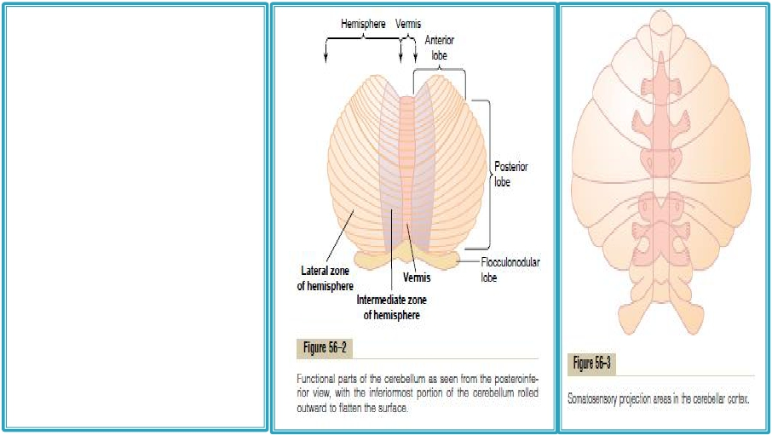
Theanterior&
posteriorlobeson each
side constitute2 large
cerebellarhemispheres,
which are separated by
a narrow band called
the vermis.
Dr.Aida A.Korish (
akorish@ksu.edu.sa)
6

Slide 7
Dr.Aida A.Korish (
akorish@ksu.edu.sa)
7

Slide 8
1. Purkinje cell
2. Granule cell
3. Basket cell
4. Golgi cell
5. Stellate cell
6.Climbing fiber
7. Mossy fiber
8. Parallel fiber
9. Inferior olivary
nucleus
10. Deep cerebellar
nuclei
Dr.Aida A.Korish (
akorish@ksu.edu.sa)
8

Slide 9







The CB has an external layer of gray matter ( cerebellar
cortex), and an inner white matter.
The cortex is deeply infolded, giving a large surface area , and it
contains five different cell types,
Golgi, basket, stellate which are inhibitory interneurons,
The granule cells, which are excitatory
The purkinje cells which are the output cells,. inhibit the deep
nuclear cells (DNCs).
The inhibitory neurons in the CB release GABA ( e.g stellate,
basket, Golgi, PC)
The excitatory neurons release glutamate ( e.g. granule cells,
that also has GABA Areceptors)
Dr.Aida A.Korish (
akorish@ksu.edu.sa)
10

Slide 10



1- Dentate
2- Fastigial
3- Interpositous ( formed of globose and
emboliform nuclei)
 All afferent fibers relay first at the deep
nuclei and the cerebellar cortex, then the latter
discharges to the deep nuclei, from which the
efferent fibers originate and leave the CB.
Dr.Aida A.Korish (
akorish@ksu.edu.sa)
10

Slide 11



The CB receives both
sensory and motor
information through a rich
afferent nerve supply.
This arises from
Other areas of the brain.
Peripheral receptors,
and enters the CB via the 3
cerebellar peduncles.
Dr.Aida A.Korish (
akorish@ksu.edu.sa)
11

Slide 12
1-The climbing fibers:
- From the inferior olivary nucleus.
- It learns the cerebellum to perform new patterns of
movements precisely.
2-The mossy fibers:
- From all other afferent fibers that enter the
cerebellum + some fibers coming from the inferior
olivary nucleus ( so they are greater than the
climbing fibers).
- Help the precise execution of the voluntary
movements (concerning their initiation, duration and
termination), which occurs by controlling the turn on
and turn off output signals from the cerebellum to the
muscles.
Dr.Aida A.Korish (
akorish@ksu.edu.sa)
12

Slide 13
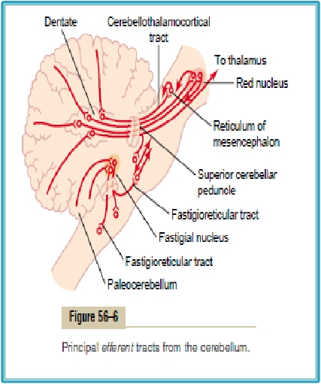
There are 3 main efferent
pathways from the 3 parts
of the CB:-
 Are the axons of the 3 deep
nuclei,
 Leave the CB through the
superior and inferior
peduncles
Dr.Aida A.Korish (
akorish@ksu.edu.sa)
16

Slide 14




The CB is called the silent area, because its
stimulation does not give rise to any sensation and
cause almost no motor movements.
It is important in the precise execution of rapid
muscular movements.
Damage to the CB cause almost total incoordination
of muscular movements, although the muscles are not
paralyzed.
The cerebellum is concerned only with subconscious
control of motor activity, and its functions as well
as the involved part include the following :
Dr.Aida A.Korish (
akorish@ksu.edu.sa)
14

Slide 15
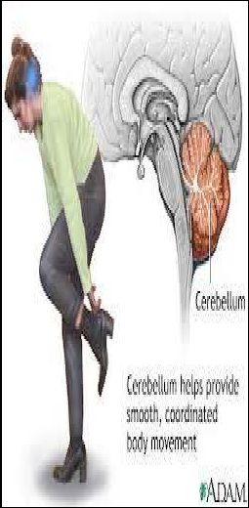
A.

Control of equilibrium & postural
movements:
The function of the vestibulocerebellum.
 It receives information from the vestibular
apparatus
-then through the fastigial nucleus, it
discharges to the brain stem, and through
the vestibulospinal and reticulospinal tracts.
It controls equilibrium & postural
movements by affecting the activity of the
axial muscles (trunk & girdle muscles).
Dr.Aida A.Korish (
akorish@ksu.edu.sa)
15

Slide 16
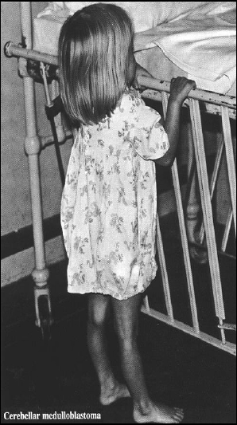
e.g Due to a tumor called
medulloblastoma
 Leads
to trunk ataxia which is
characterized by:
Equilibrium disturbances: the patient
sways on standing, cannot maintain the
erect posture, needs support, and walks by
a staggering or drunken gait and have
nystagmus.
Dr.Aida A.Korish (
akorish@ksu.edu.sa)
16

Slide 17
B) Control of the Stretch Reflex
-The cerebrocerebellum exerts a facilitatory effect on the
stretch reflex & increases the muscle tone, while the
spinocerebellum probably exerts an inhibitory effect.
- However, normally the facilitatory effect predominates
(so cerebellar diseases often result in hypotonia).
Dr.Aida A.Korish (
akorish@ksu.edu.sa)
17

Slide 18
Dr.Aida A.Korish (
akorish@ksu.edu.sa)
18

Slide 19
N.B:
➢ Each cerebellar hemisphere is connected by efferent and afferent
pathways to the contra lateral cerebral cortex (the cortico –
ponto-crebello-dentato- thalamo- cortical circuit).
➢ The cerebellum exerts its effects on the same side of the body:
◦ The vermis controls muscle movements of the axial body,
neck, shoulders and hips.
◦ The intermediate zones controls muscle contractions in the
distal portions of both the upper and lower limbs (especially
the hands, fingers, feet and toes).
◦ The lateral zones help in the planning of sequential
movements.
Dr.Aida A.Korish (
akorish@ksu.edu.sa)
19

Slide 20
The neocerebellar syndrome
This is due to damage of the deep cerebellar nuclei as well as
the cerebellar cortex;
The manifestations occur on the same side of the lesion
(ipsilateral) i.e. a lesion of the left cerebellar hemisphere
produces its effects on the left side of the body.
Bilateral dysfunction of the cerebellum is caused by alcoholic
intoxication, hypothyroidism, inherited cerebellar degeneration
(ataxia), multiple sclerosis or non metastatic disease.



Dr.Aida A.Korish (
akorish@ksu.edu.sa)
20

Slide 21
Video 
https://www.youtube.com/watch?v=R6KBVCkurM0 
https://www.youtube.com/watch?v=knwKmfiaAFk 
Dr.Aida A.Korish ( akorish@ksu.edu.sa)
21

Slide 22


This is incoordination of voluntary movements.
It is either sensory or motor (or mixed).
Motor ataxia: Is due to defect in the coordination of
the voluntary movements. It commonly occur in
lesions of either
a- the cerebellum or spinocerebellar tracts
b- the labyrinth (vestibular apparatus)
c- the cortical motor areas.
Dr.Aida A.Korish (
akorish@ksu.edu.sa)
22

Slide 23



A) Hypotonia: Due to loss of the facillitatory effect of the
CB on the stretch reflex, and it is associated with pendular
knee jerk.
b) Asthenia: (muscle weakness): This is due to difficulty in
initiation and maintenance of muscle contraction secondary
to loss of the potentiating signals by the mossy fiber circuit.
c)Motor ataxia: Incoordination of the voluntary movements,
specially the rapid movements (becoming abnormal in rate,
range, force and direction).
Dr.Aida A.Korish (
akorish@ksu.edu.sa)
23

Slide 24
Posture
Gait – Ataxia
Tremor
Left cerebellar tumor
Ataxic gait and position:
a. Sways to the left in
standing position
b. Steady on the
right leg
c. Unsteady on the
left leg
d. ataxic gait
Dr.Aida A.Korish (
akorish@ksu.edu.sa)
24

Slide 25
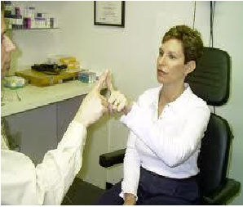
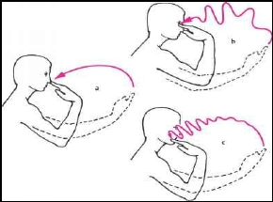
1-Dysmetria:
Inability to control the
distance of the motor act, which may
either overshoot the intended point
(=hypermetria or past pointing) or stop
before it.
2-Kinetic (intension, action or terminal )
tremors:
It appears on performing a voluntary
movement (especially at its end) but is
absent at rest.
Demonstrated by the finger nose test.
It is secondary to dysmetria .
Dr.Aida A.Korish (
akorish@ksu.edu.sa)
25

Slide 26
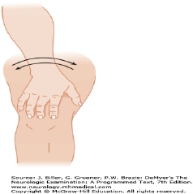
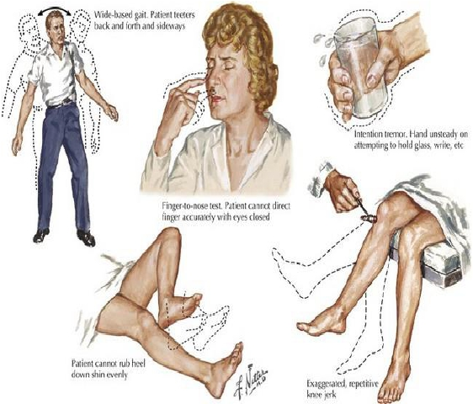
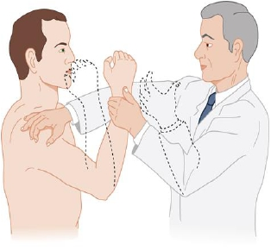
Dr.Aida A.Korish (
akorish@ksu.edu.sa)
26

Slide 27
3-Rebound phenomenon: This is over shooting of a limb when a
resistance to its movement is suddenly removed. (loss of the
braking function of the CB), ( the arm pulling or flexion) test
4- Asynergia: This is loss of the harmony between the three
groups of muscles involved in performance of voluntary
movement the agonists, protagonists, and antagonists).
5-Failure of progression of movements: manifested by:
a- Adidokokinesia (=dysdiadokokinesia)
Inability
to
perform
alternate
(opposite)
movements
successively at a rapid rate e.g pronation and supination of the
forearm or upward and downward movement the hand.
b- Decomposition (fragmentation of movements): Inability to
perform actions involving simultaneous movements at more than
one joint.
Dr.Aida A.Korish (
akorish@ksu.edu.sa)
27

Slide 28
6-Dysartheria: This is difficulty in producing clear speech. It is
due to incoordination of the speech muscles secondary to loss of
the predictive functions of the CB. The syllables may be too long
or too short, loud or weak and speech may be also staccato or
scanning i.e. cut off into separate syllables.
7-Nystagmus: This is tremor of the eyeballs that occurs on looking
to an object placed at one side of the head. (mainly in
vestibulocerebellar damage). Nystagmus is a very common
feature of multiple sclerosis).
8-Staggering (drunken) gait: The patient walks unsteady – on a
wide base (zigzag-like gait) in a drunken (swaying) manner, and
tends to fall on the diseased side. Such gait is more apparent with
archicerebellar damage.
Dr.Aida A.Korish (
akorish@ksu.edu.sa)
28

Slide 29
Dr.Aida A.Korish (
akorish@ksu.edu.sa)
29

