Slide 1
Autonomic Nervous System
The Autonomic Nervous
System
Assess Prof. FawziaAl-Rouq
Department of Physiology
College of Medicine
King Saud University

Slide 2
INTRODUCTION

Slide 3
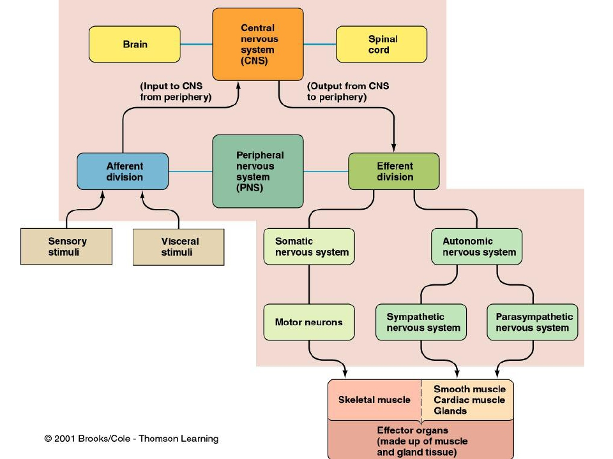
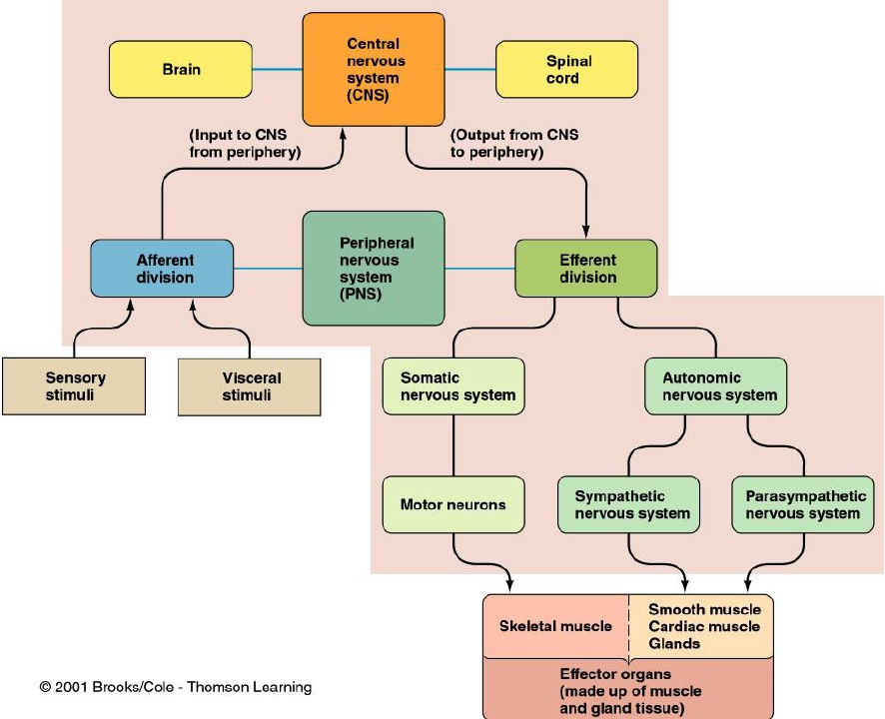
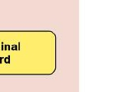
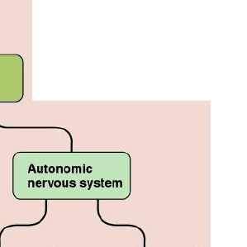
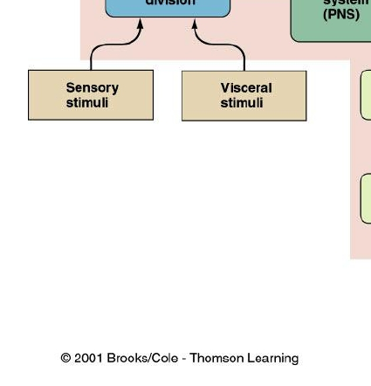

Slide 4
THE NERVOUS SYSTEM
•INTRODUCTION
•The nervous system monitors and controls almost every
organ / system through a series of positive and negative
feedback loops.
•The Central Nervous System (CNS): Includes the brain
and spinal cord.
•The Peripheral Nervous System (PNS): Formed by
neurons & their process present in all the regions of the
body.
•It consists of cranial nerves arises from the brain &
spinal nerves arising from the spinal cord.
•The peripheral NS is divided into
•Somatic Nervous system
•Autonomic nervous system

Slide 5
Functional
Anatomy &
Physiology of
Autonomic NS

Slide 6
OBJECTIVES

Slide 7
Anatomy and physiology of
Autonomic Nervous System
At the end of this lectutre the
student should be able to:-
-appreciate the anatomy of
sympathetic& parasympathetic
nervous system.
-explain physiological functions of
Sympathetic &parasympathetic
nerves in
head&neck,chest,abdomen and
pelvis

Slide 8
FUNCTIONAL
ANATOMY OF THE
AUTONOMIC
NERVOUS SYSTEM

Slide 9
Basic anatomical difference
between the motor pathways of
the voluntary somatic nervous
system (to skeletal muscles) and
those of the autonomic nervous
system

Slide 10
Basic anatomical difference between the motor pathways of
the voluntary somatic nervous system (to skeletal muscles)10 and
those of the autonomic nervous system
Somatic division:
◆
◆
◆
Cell bodies of motor neurons reside in CNS (brain or spinal cord)
Their axons (sheathed in spinal nerves) extend all the way to their
skeletal muscles
◆
Autonomic system: chains of two motor neurons
◆
◆
◆
1st = preganglionic neuron (in brain or cord)
2nd = gangionic neuron (cell body in ganglion outside CNS)
Slower because lightly or unmyelinated

Slide 11
◆
◆
◆
ANS is the subdivision of the peripheral
nervous system that regulates body activities
that are generally not under conscious
control
Visceral motor innervates non-skeletal (non-
somatic) muscles
Composed of a special group of neurons
serving:
◆ Cardiac
muscle (the heart)
◆ Smooth
muscle (walls of viscera and blood
vessels)
◆ Internal
organs
◆ Skin
11

Slide 12
◆
◆
Axon of 1st (preganglionic) neuron leaves12
CNS to synapse with the 2nd (ganglionic)
neuron
Axon of 2nd (ganglionic) neuron extends to
the organ it serves
this dorsal
root ganglion
is sensory

Slide 13
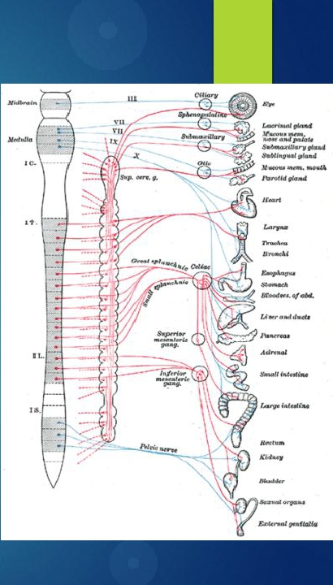
LOCATIONS OFAUTONOMIC GANGLIA
Sympathetic Ganglia
Location
❑ Trunk (chain) ganglia near
vertebral bodies
❑ Prevertebral ganglia near
large blood vessel in gut :celiac
,superior mesenteric &
inferior mesenteric

Slide 14
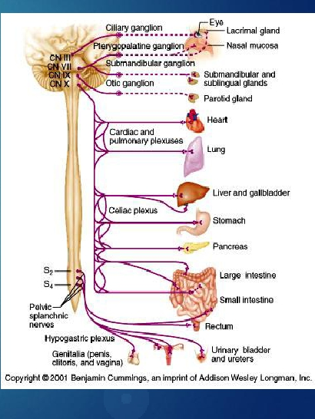
Parasympathetic Ganglia
Location :
Terminal
ganglia
in the wall of organ

Slide 15
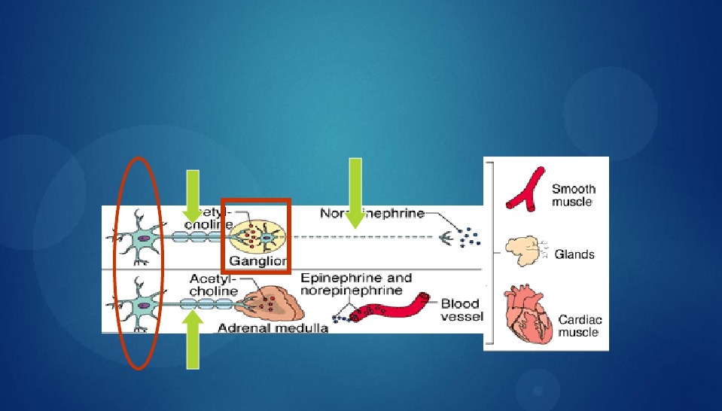
Sympathetic
Innervation of Visceral Targets
• Short, lightly myelinated preganglionic neurons
• Long, unmyelinated postganglionic neurons
◆
Ganglia close to spinal cord
Spina
l

Slide 16
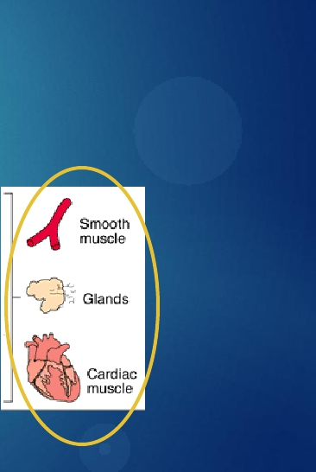
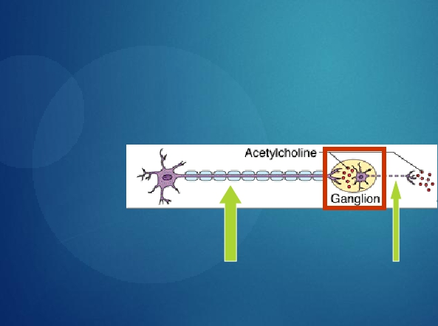
Parasympathetic
Innervation of Visceral Targets
◆
Ganglia close to or on target organs
• Preganglionic neurons - long
• Post ganglionic neurons - short

Slide 17
SYMPATHETIC & PARASYMPATHETIC
NERVOUS SYSTEM ORIGIN
Blue= Para symp; Red symp

Slide 18
Sympathetic - Origin
◆
◆
Thoracolumbar lateral horns of the
spinal segments T1-L2.
Nerve fibers originate between T1 & L2

Slide 19
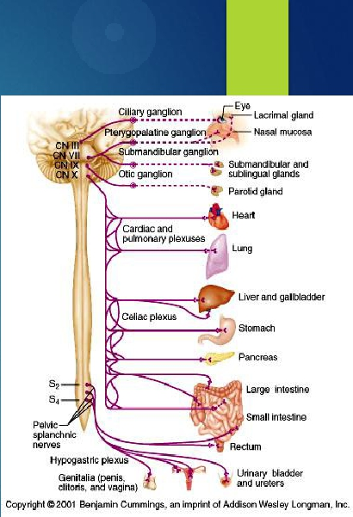
Parasympathetic - Origin
❑ Craniosacral Cell bodies
of the motor nuclei of the
cranial nerves III, VII, IX
and X in the brain stem
❑ Second, third and fourth
[S2-S4] sacral segments of
the spinal cord
◆
◆
Nerve fibers emerge from
brain &
sacrum cranio-sacral
outflow

Slide 20
PARASYMPATHETIC NERVOUS SYSTEM
❑ The cranial nerves III, VII and IX affect the
pupil and salivary gland secretion
❑ Vagus nerve (X) carries fibres to the heart,
lungs, stomach, upper intestine and ureter
❑ The sacral fibres form pelvic plexuses which
innervate the distal colon, rectum, bladder and
reproductive organs.

Slide 21
Autonomic Nervous System
◆
2 divisions:
◆ Sympathetic
◆
◆
“Fight or flight”
“E” division
Exercise,
excitement,
emergency,
and
embarrassment
◆ Parasympathetic
◆
◆
“Rest and digest”
“D” division
Digestion,
defecation,
and diuresis

Slide 22
SYMPATHETIC NERVOUS SYSTEM
FUNCTIONS
FEAR, FLIGHT OR FIGHT
❑ The sympathetic system enables the body to be
prepared for fear, flight or fight
❑ Sympathetic responses include an increase in
heart rate, blood pressure and cardiac output
❑ Diversion of blood flow from the skin and
splanchnic vessels to those supplying skeletal
muscle
❑ Increased pupil size, bronchiolar dilation,
contraction of sphincters and metabolic changes
such as the mobilisation of fat and glycogen.

Slide 23
FUNCTIONS OF SYMPATHETIC NERVOUS
SYSTEM
Bronchioles dilate, which allows for greater
alveolar oxygen exchange.
It increases heart rate and the contractility of
cardiac cells (myocytes), thereby providing a
mechanism for the enhanced blood flow to skeletal
muscles.
Sympathetic nerves dilate the pupil and relax the
lens, allowing more light to enter the eye.

Slide 24
PARASYMPATHETIC
NERVOUS
SYSTEM
FUNCTIONS
❑ The parasympathetic nervous system has "rest and
digest" activity.
❑ In physiological terms, the parasympathetic system
is concerned with conservation and restoration of
energy, as it causes a reduction in heart rate and blood
pressure, and facilitates digestion and absorption of
nutrients, and consequently the excretion of waste
products
❑ The chemical transmitter at both pre and
postganglionic synapses in the parasympathetic system
isAcetylcholine (Ach).

Slide 25
THEAUTONOMIC
NERVOUS SYSTEM
Subdivis Nerves
Location of
Chemical
General
ion
Employed
Ganglia
Messenger
Function
Sympath Thoracolum Alongside
Norepineph Fight or
etic
bar
vertebral
rine
flight
column
Parasym Craniosacral On or near
Acetylcholi Conservati
pathetic
an effector
organ
ne
on of body
energy

Slide 26
PHYSIOLOGICAL FUNCTIONS
OF THE AUTONOMIC
NERVOUS SYSTEM

Slide 27
TheAutonomic Nervous System
Sympathetic Stimulation Parasympathetic Stimulation
Structu
re
Iris (eye
muscle)
Pupil dilation
Pupil constriction
Salivary Saliva production
Glands reduced
Saliva production increased
Oral/Na
sal
Mucosa
Heart
Lung
Mucus production
reduced
Heart rate and force
increased
Bronchial muscle
relaxed
Mucus production increased
Heart rate and force
decreased
Bronchial muscle contracted

Slide 28
TheAutonomic Nervous System
Structure Sympathetic Stimulation
Parasympathetic Stimulation
Stoma
ch
Small
Intes
Large
Intes
Liver
Kidney
Adrenal
medulla
Bladder
Gastric juice secreted; motility
increased
Digestion increased
Secretions and motility increased
Increased urine secretion
Wall contracted
Sphincter relaxed
Peristalsis reduced
Motility reduced
Motility reduced
Increased conversion of
glycogen to glucose
Decreased urine secretion
Norepinephrine and
epinephrine secreted
Wall relaxed
Sphincter closed

Slide 29
MECHANISM OF
ACTIONS
The neurotransmitters
& receptors of
Autonomic NS

Slide 30
OBJECTIVES
describe neurotransmitters
that can release at pre and
post ganglionic of
Autonomic NS.
Describe Autonomic NS
receptors.

Slide 31
Sympathetic
Neurotransmitters
◆
Preganglionic -
Cholinergic
= ( release acetylcholine )
Postganglionic neurons:
release norepinepherine at target
organs
ie. Adrenergic

Slide 32
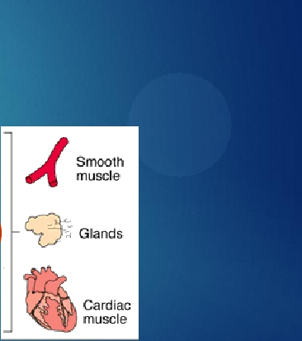
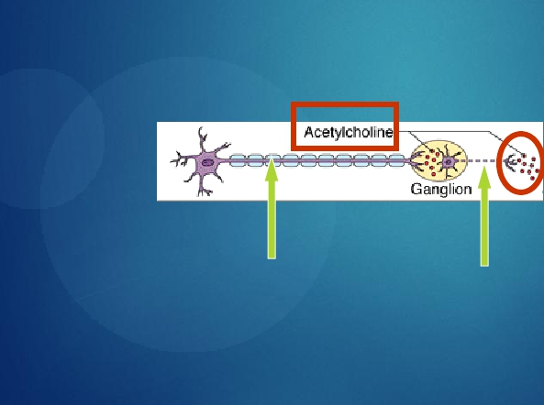
Parasympathetic Neurotransmitters
• Pre & Postganglionic neurons
release acetylcholine = Cholinergic

Slide 33
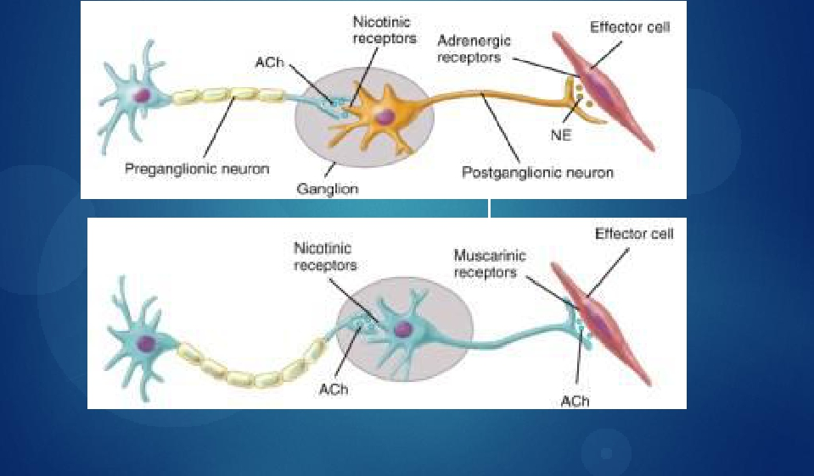
ANS Neurotransmitters: Classified as either
cholinergic or adrenergic neurons based upon the
neurotransmitter released
Adrenergic
Cholinergic

Slide 34
Chemical or neural
transmitter
◆
◆
◆
All preganglionic fibers release
acetylcholin (Ach).
All parasympathetic postganglionic
release Ach.
All sympathetic postganglionic
release noradrenalin except sweat
glands & bl vessels to skeletal
muscles

Slide 35
RECEPTORS
❑ The parasympathetic nervous system uses only
acetylcholine (ACh) as its neurotransmitter.
❑ The ACh acts on two types of receptors, the
muscarinic and nicotonic choloinergic receptors.
❑ Most transmissions occur in two stages: When
stimulated, the preganglionic nerve releases ACh at
the ganglion, which acts on nicotinic receptors of the
postganglionic nerve.
❑ The postganglionic nerve then releases ACh to
stimulate the muscarinic receptors of the target organ.

Slide 36
ANS Receptors : Classified as either parasympathetic or sympathetic
Adrenergic
Cholinergic

Slide 37
The Sympathetic NS Acts on tow types of receptors
: α and β.
What do the receptors do?
Activation of α receptors leads to smooth muscle contraction
Activation of β2 receptors leads to smooth muscle relaxation
Activation of β1 receptors leads to smooth muscle
contraction (especially in heart)

Slide 39
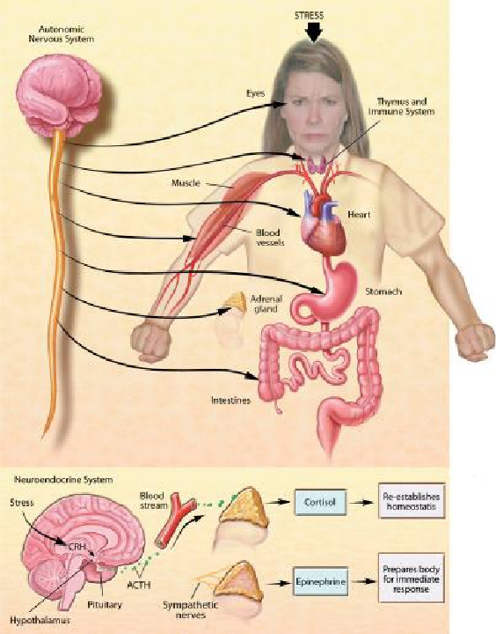
THE STRESS REACTION
When stress occurs, the
sympathetic nervous
system is triggered.
Norepinephrine is released
by nerves, and epinephrine
is secreted by the adrenal
glands. By activating
receptors in blood vessels
and other structures, these
substances ready the heart
and working muscles for
action.
Acetylcholine is released in
the parasympathetic
nervous system, producing
calming effects. The
digestive tract is stimulated
to digest a meal, the heart
rate slows, and the pupils of
the eyes become smaller.
The neuroendocrine system
also maintains the body’s
normal internal functioning.
◆
◆

Slide 40
Chronic stress
◆
◆
When glucocorticoids or adrenaline are
secreted in response to the prolonged
psychological stress commonly encountered
by humans, the results are not ideal. Normally,
bodily systems gear up under stress and
release hormones to improve memory,
increase immune function, enhance muscular
activity, and restore homeostasis. If you are not
fighting or fleeing, but standing frustrated in a
supermarket checkout line or sitting in a traffc
jam, you are not engaging in muscular
exercise.
Yet these systems continue to be stimulated,
and when they are stimulated chronically,
there are different consequences: Memory is
impaired, immune function is suppressed, and
energy is stored as fat.

Slide 41
Response to stress

