Slide 2
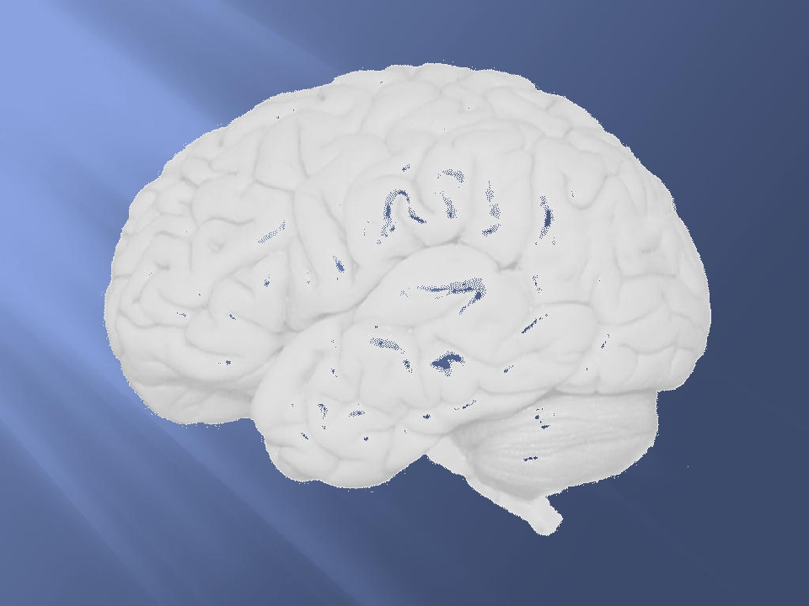
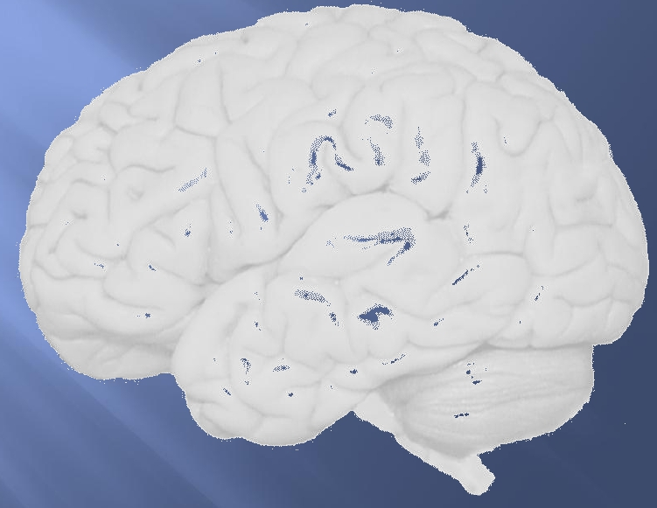
Functions of The Cerebral
Hemisphere
◻
◻
◻
◻
Dr Fawzia AlRouq
Medical college
KSU

Slide 3
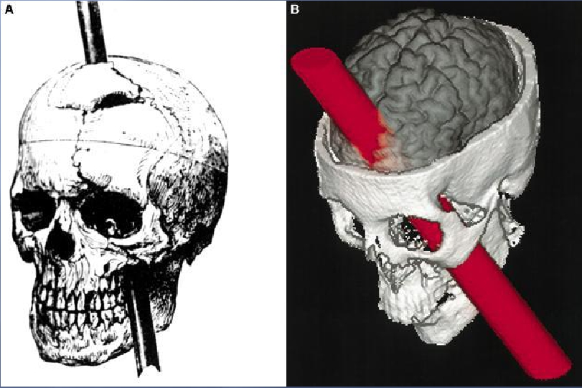

Slide 4
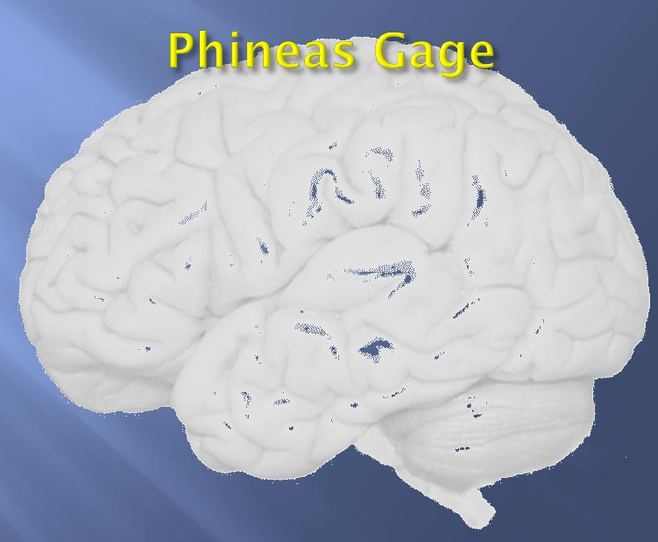
◻
◻
In 1848 in Vermont, had a 3.5-foot-long, 13
lb. metal rod blown into his skull, through
his brain, and out of the top of his head.
Gage survived. In fact, he never even lost
consciousness.
Friends reported a complete change in his
personality after the incident. He lost all
impulse control.

Slide 5
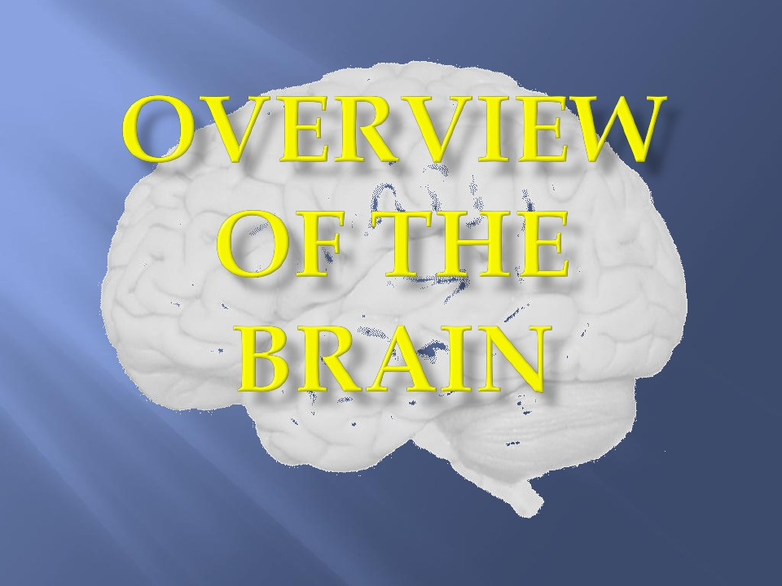
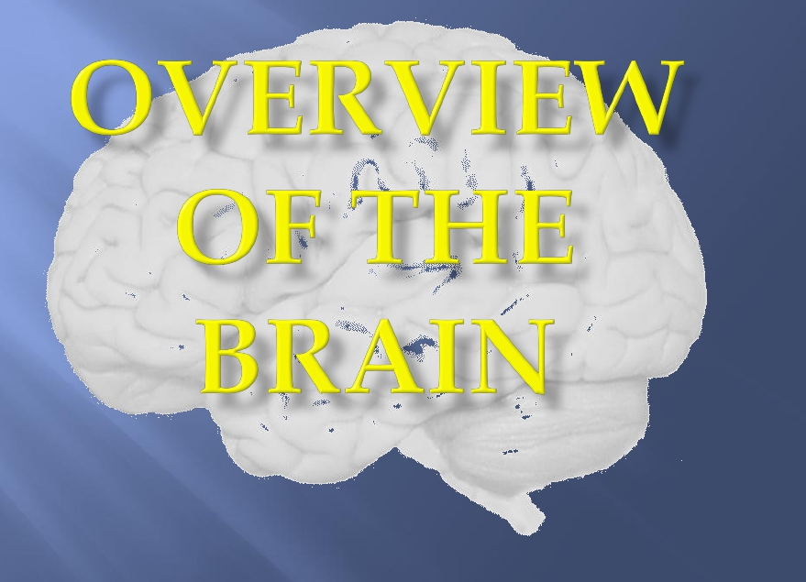
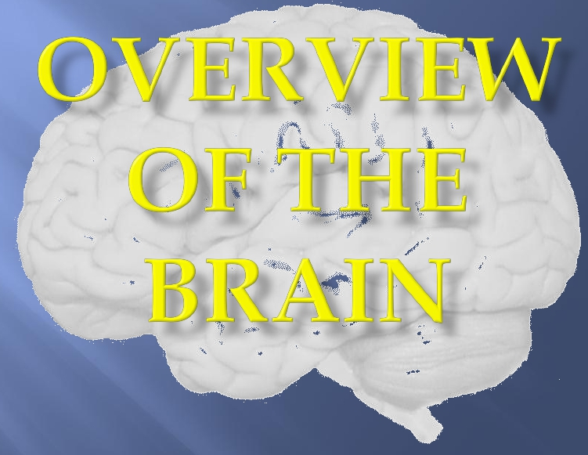
5

Slide 6
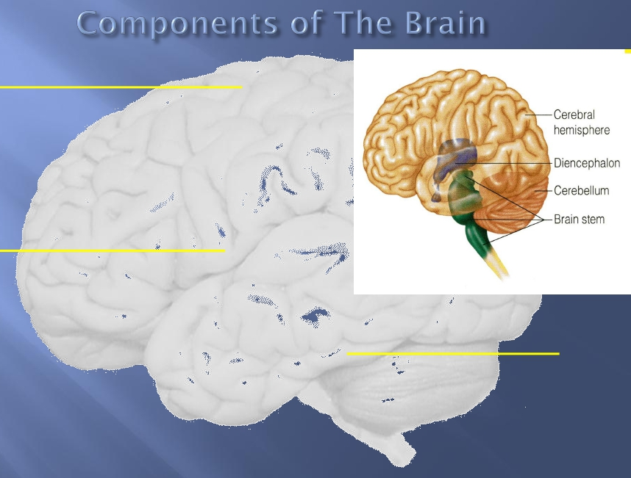
A/ Telencephalon →
◻
(1) Cerebrum and
(2) Basal Ganglia ( collection of
grey matter situated inside
the cerebral hemispheres )
B/ Diencephalon →
Mainly :
◻
◻
(1) Thalamus ( mainly a relay
station for sensory
pathways in their way to the
cerebral cortex )
(2) Hypothalamus ( contains
cesnter for autonomic and
endocrine control )
6
• C/ Brainstem →
(1) Midbrain
(2) Pons
(3) Medulla
• E/ Cerebellum

Slide 7
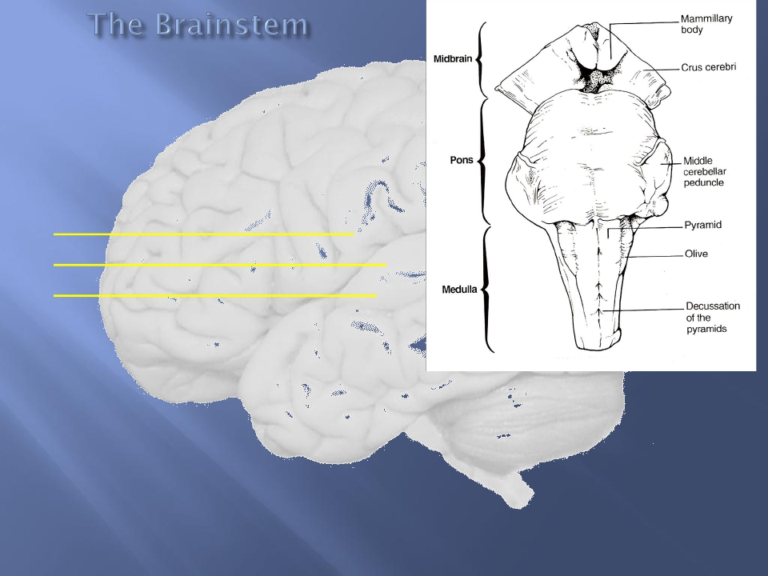
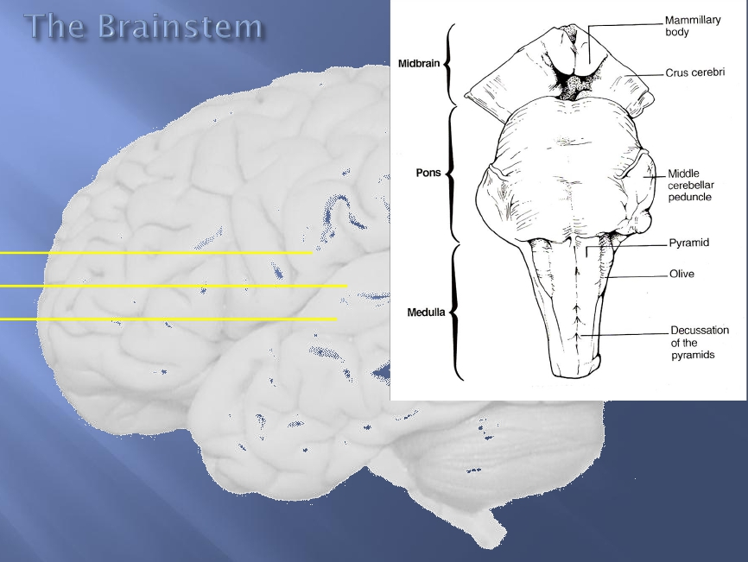
◻
◻
The term “ brainstem ” is
actually an anatomic rather
than physiologic term ,
because it is easier , in
terms of anatomy , to group
“ all CNS structures that
hang between the cerebrum
and spinal cord “ together .
However , in terms of
Physiology , the situation is
more complicated , because
brainstem structures are
involved in many diverse &
different bodily functions .
▪These functions include
▪(1) regulation of Consciousness ,
Wakefulness & Sleep ,
▪(2) Respiratory , Cardiovascular
and Gastrintestinal control ,
▪(3) Balance ( Vestibular nuclei ) .
▪(4) Moreover , it contain several
7
Cranial Nerve nuclei .
,

Slide 8
✓
✓
✓
✓
Most people ( about 90 %) have the left
cerebral hemisphere dominant , and are
therefore right-handed .
The remaining ( around 10 % ) of the
population usually have their right hemisphere
dominant , and are therefore left-handed .
The frontal lobe of the dominant hemisphere
contains Broca’s area (the area for production
of speech ) .
Therefore, if a right-handed person gets a
stroke
involving his left cerebral hemisphere , he is
likely to have right-sided hemiplegia (
paralysis ) and aphasia ( loss of the power of
8
speech).

Slide 9
Lobes, the Cerebral Cortex, and Cortical Regions of the Brain

Slide 10
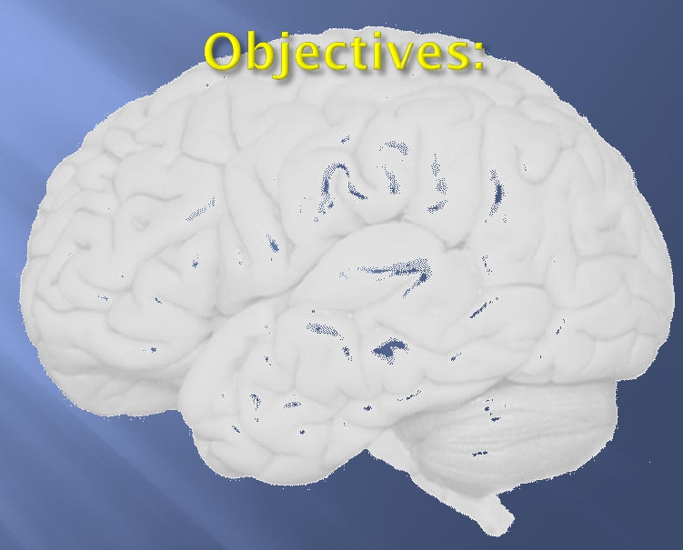
◻
Students will be able to describe the general
structure of the Cerebrum and Cerebral Cortex.
• Students will be able to identify the Cerebrum, the Lobes of
the Brain, the Cerebral Cortex, and its major regions/divisions.
• Students will be able to describe the primary functions of
the Lobes and the Cortical Regions of the Brain.

Slide 11
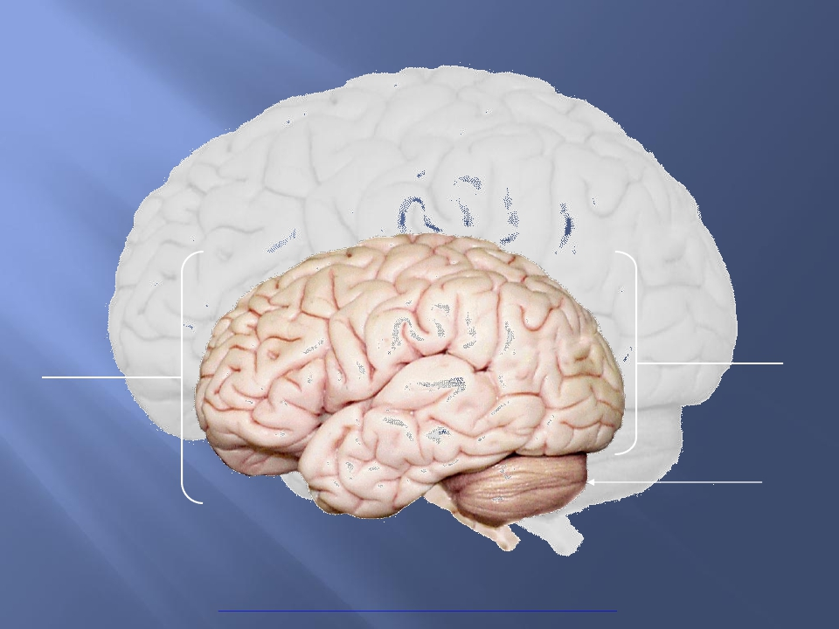
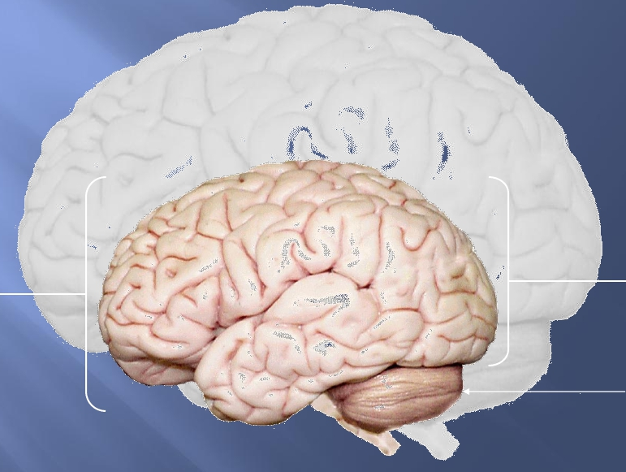
Cerebrum -The largest division of the brain.
divided into two hemispheres, each of which is
divided into four lobes.
It is
Cerebrum
Cerebrum
Cerebellum
http://williamcalvin.com/BrainForAllSeasons/img/bonoboLH-humanLH-viaTWD.gif

Slide 12
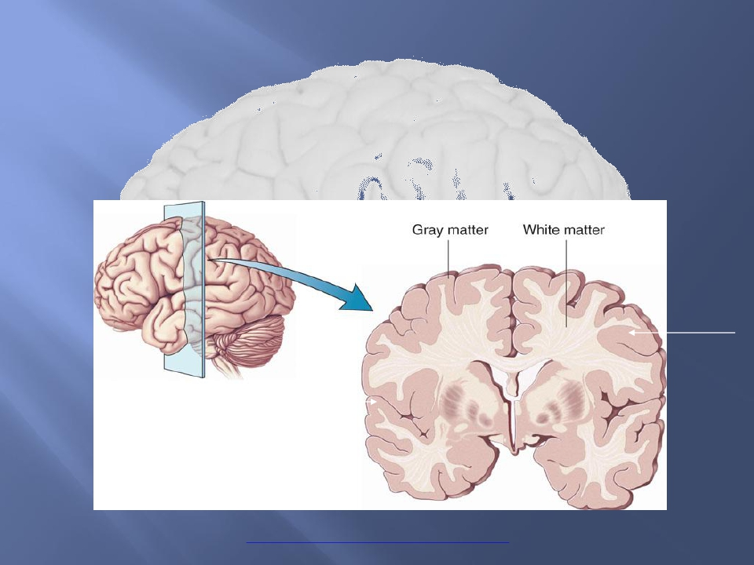
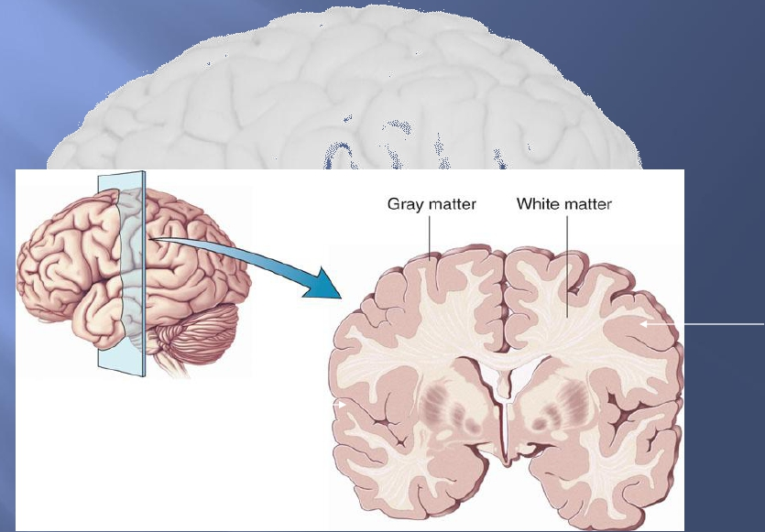
Cerebral Cortex - The outermost layer of
gray matter making up the superficial
aspect of the cerebrum.
Cerebral Cortex
Cerebral
Cortex
http://www.bioon.com/book/biology/whole/image/1/1-6.tif.jpg

Slide 13
Cerebral Features:
• Gyri – Elevated ridges “winding” around the
brain.
• Sulci – Small grooves dividing the gyri
– Central Sulcus – Divides the Frontal Lobe from the Parietal
Lobe
• Fissures – Deep grooves, generally dividing large
regions/lobes of the brain
– Longitudinal Fissure – Divides the two Cerebral Hemispheres
– Transverse Fissure – Separates the Cerebrum from the
Cerebellum
– Sylvian/Lateral Fissure – Divides the Temporal Lobe
from the Frontal and Parietal Lobes

Slide 14
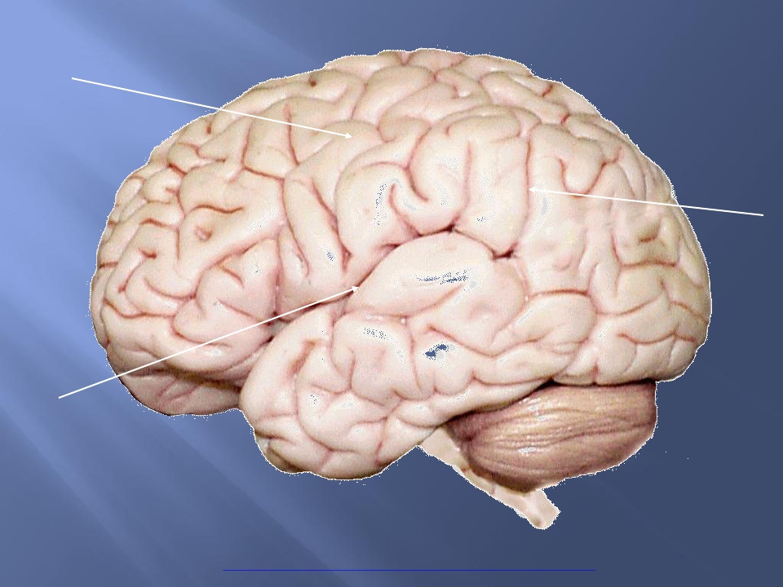
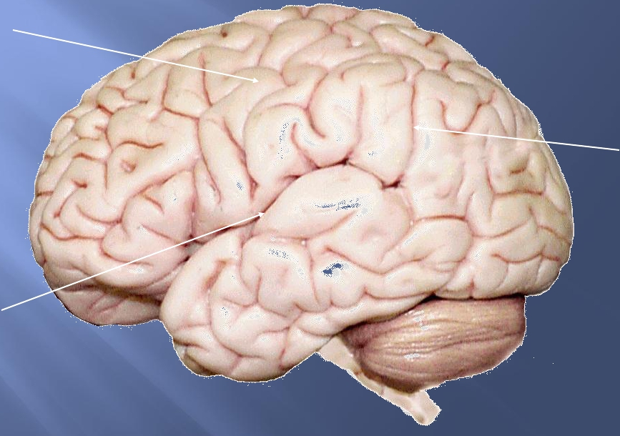
Gyri (ridge)
Sulci
(groove)
Fissure
(deep groove)
http://williamcalvin.com/BrainForAllSeasons/img/bonoboLH-humanLH-viaTWD.gif

Slide 15
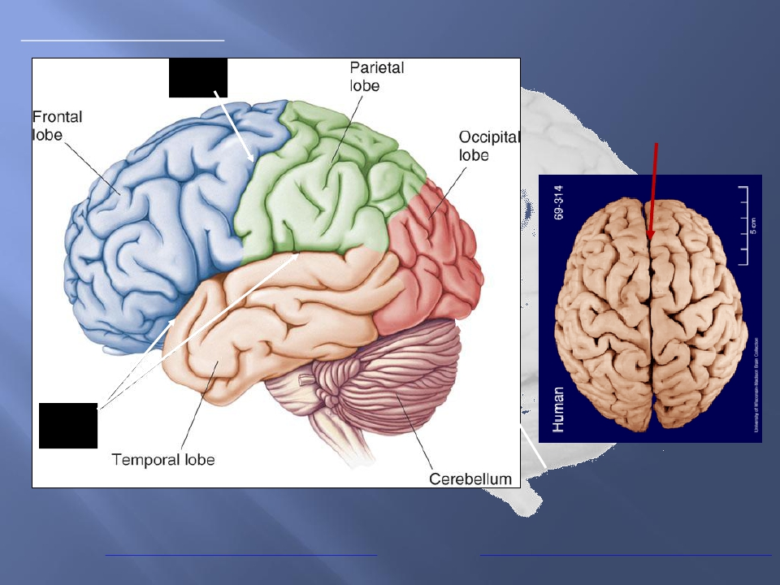
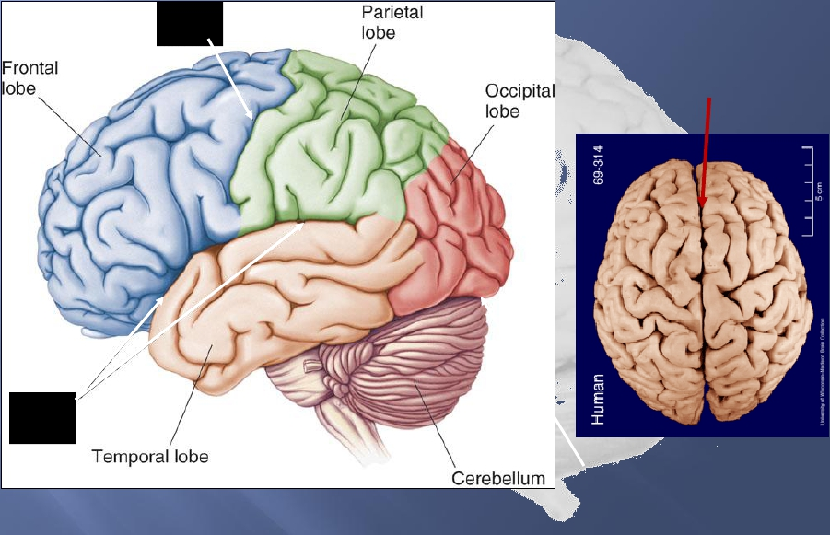
Specific Sulci/Fissures:
Central Sulcus
Longitudinal Fissure
Sylvian/Lateral
Fissure
http://www.bioon.com/book/biology/whole/image/1/1-8.tif.jpg
Transverse Fissure
http://www.dalbsoutss.eq.edu.au/Sheepbrains_Me/human_brain.gif

Slide 16
 Frontal
 Parietal
 Occipital
 Temporal
http://www.bioon.com/book/biology/whole/image/1/1-8.tif.jpg
* Note: Occasionally, the Insula is considered the fifth lobe. It is located deep
to the Temporal Lobe.

Slide 17
The Frontal Lobe of the brain is located deep
to the Frontal Bone of the skull.

• It plays an integral role in the following functions/actions:
- Memory Formation
- Emotions
- Decision Making/Reasoning
- Personality
(Investigation: Phineas Gage)
Modified from: http://www.bioon.com/book/biology/whole/image/1/1-8.tif.jpg

Slide 18
 Responsible for initiation and execution of
voluntary movement .
 Also contains Broca’s area of speech in the
dominnat hemisphere ( i.e., in the left
hemisphere in most people ) .
 Lesion can cause →
(1) paralysis on opposite side of the body ,
(2) aphasia ( loss of ability to speak ) if lesion
involves Broca’s area in the dominant
hemisphere ) .
18

Slide 19
• Primary Motor Cortex (Precentral Gyrus) – Cortical site
involved with controlling movements of the body.
• Broca’sArea – Controls facial neurons, speech, and language
comprehension. Located on Left Frontal Lobe.
– Broca’sAphasia – Results in the ability to comprehend speech, but
the decreased motor ability (or inability) to speak and form words.
Orbitofrontal Cortex – Site of Frontal Lobotomies

* Desired Effects:
- Diminished Rage
- DecreasedAggression
- Poor Emotional
Responses
* Possible Side Effects:
- Epilepsy
- Poor Emotional Responses
- Perseveration (Uncontrolled, repetitive
actions, gestures, or words)
• Olfactory Bulb - Cranial Nerve I, Responsible for sensation of Smell

Slide 20
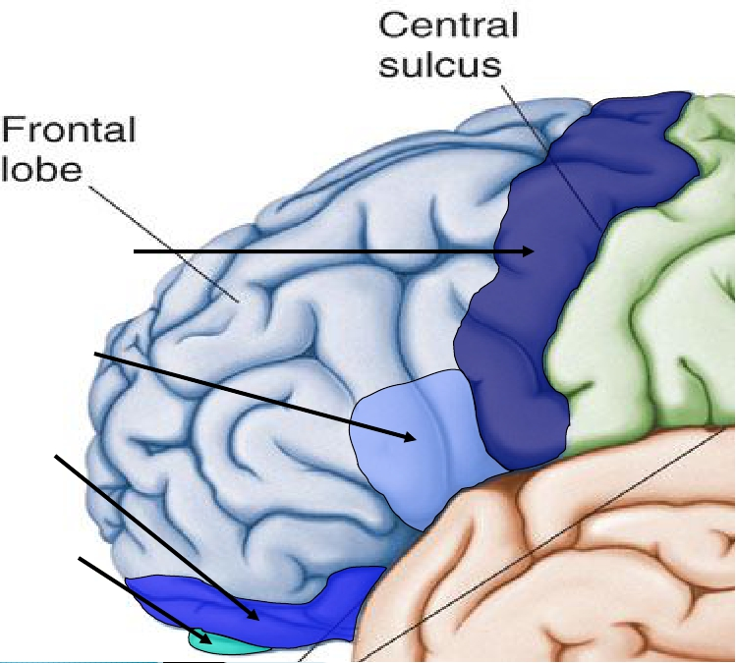
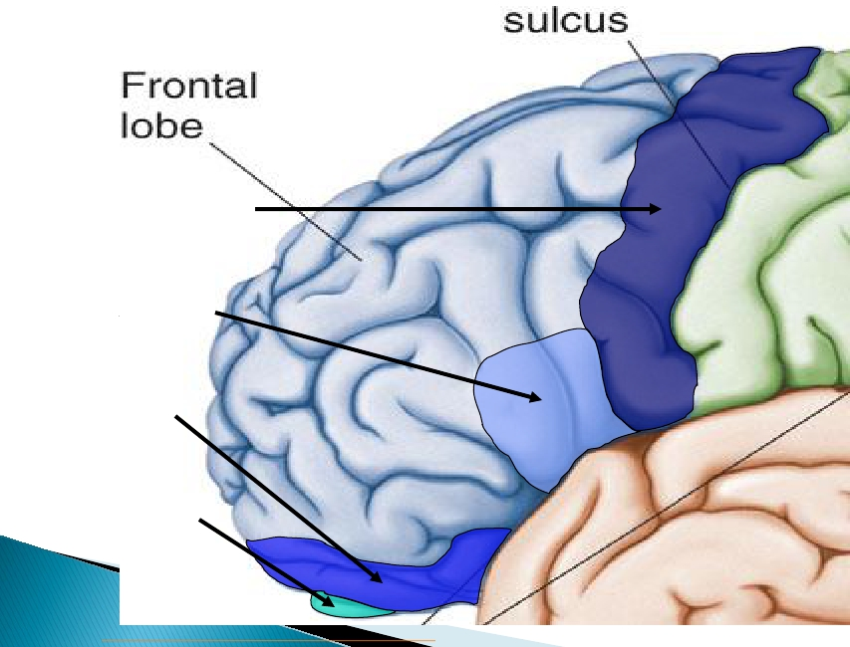
Primary Motor
Cortex/ Precentral
Gyrus
Broca’sArea
Orbitofrontal
Cortex
Olfactory Bulb
Regions
Modified from: http://www.bioon.com/book/biology/whole/image/1/1-8.tif.jpg

Slide 21
The Parietal Lobe of the brain is located
deep to the Parietal Bone of the skull.

• It plays a major role in the following functions/actions:
- Senses and integrates sensation(s)
- Spatial awareness and perception
(Proprioception - Awareness of
body/ body parts in space and
in relation to each other)
Modified from: http://www.bioon.com/book/biology/whole/image/1/1-8.tif.jpg

Slide 22

Primary Somatosensory Cortex (Postcentral
Gyrus) – Site involved with processing of tactile
and proprioceptive information.
• Somatosensory Association Cortex - Assists
with the integration and interpretation of
sensations relative to body position and orientation
in space. May assist with visuo-motor coordination.
• Primary Gustatory Cortex – Primary site
involved with the interpretation of the sensation of
Taste.

Slide 23
Contains →
(1) Primary Somatosensory in the post-central gyrus
→ to receive general sensations from opposite
( contralateral ) half of the body
(2) Sensory Association Cortex
( for integration & association of sensory
information )
Parietal lobe is essential for our feeling of touch,
warmth/heat , cold, pain , body position and
appreciation of shapes of palpated objects .
When damaged , the person loses the ability to
recognize shapes of complex objects by palpation
(palpation = examaination of objects by touch ) .
& develops Sensory Inattention on opposite side
23
✓
✓
✓
✓
✓

Slide 24
Primary
Somatosensory
Cortex/
Postcentral Gyrus
Somatosensory
Association Cortex
Primary
Gustatory Cortex
Modified from: http://www.bioon.com/book/biology/whole/image/1/1-8.tif.jpg
Regions

Slide 25

The Occipital Lobe of the
Brain is located deep to the
Occipital Bone of the Skull.
• Its primary function is the
processing, integration,
interpretation, etc. of VISION and
visual stimuli.
Modified from: http://www.bioon.com/book/biology/whole/image/1/1-8.tif.jpg

Slide 26

Primary Visual Cortex – This is the primary
area of the brain responsible for sight -
recognition of size, color, light, motion,
dimensions, etc.
• VisualAssociationArea – Interprets
information acquired through the primary visual
cortex.

Slide 27
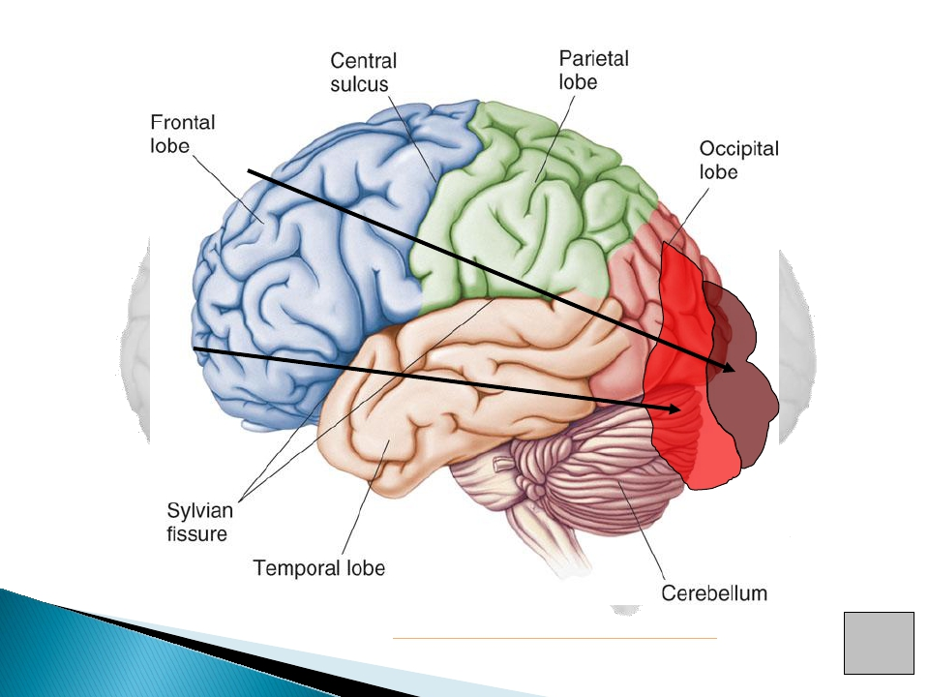
Primary Visual
Cortex
Visual
AssociationArea
Modified from: http://www.bioon.com/book/biology/whole/image/1/1-8.tif.jpg
Regions

Slide 28

The Temporal Lobes are located on the sides
of the brain, deep to the Temporal Bones of
the skull.
•They
play an integral role
in the following functions:
- Hearing
- Organization/Comprehension
of language
- Information Retrieval
(Memory and Memory Formation)
Modified from: http://www.bioon.com/book/biology/whole/image/1/1-8.tif.jpg

Slide 29
Primary Auditory Cortex – Responsible for hearing

• Primary Olfactory Cortex – Interprets the sense of
smell once it reaches the cortex via the olfactory
bulbs. (Not visible on the superficial cortex)
• Wernicke’s Area – Language comprehension.
Located on the Left Temporal Lobe.
- Wernicke’sAphasia – Language comprehension is
inhibited. Words and sentences are not clearly understood,
and sentence formation may be inhibited or non-sensical.

Slide 30
(1) contain centers for hearing and taste ,
(2) contribute to smell perception .
(3) essential for memory function .
(4) lesion → may lead to memory impairment &
can be associated with temporal lobe epilepsy




30

Slide 31
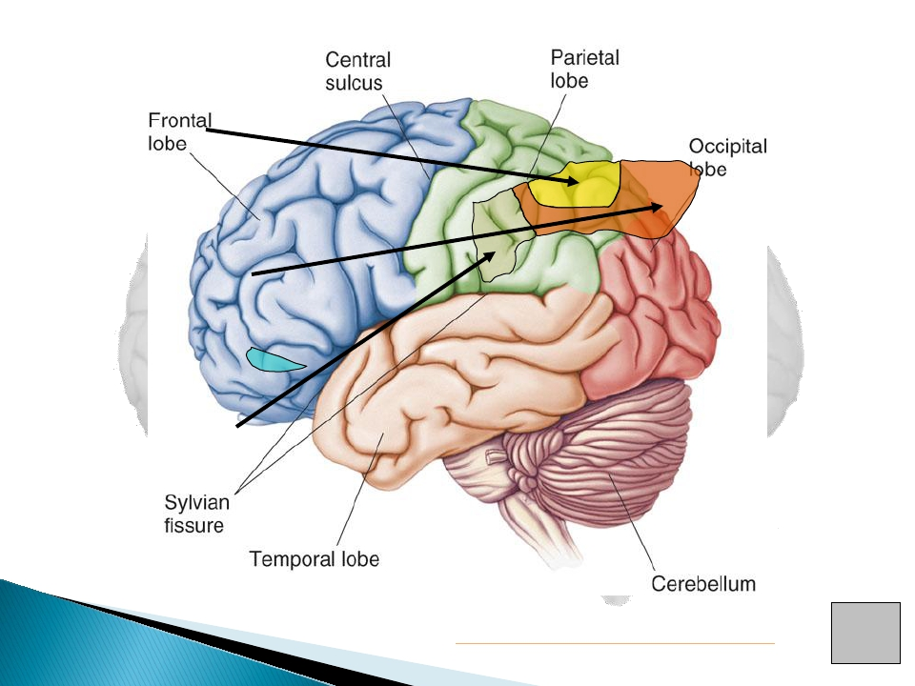
Primary
Auditory Cortex
Wernike’sArea
Primary Olfactory
Cortex (Deep)
Conducted from Olfactory Bulb
Modified from: http://www.bioon.com/book/biology/whole/image/1/1-8.tif.jpg
Regions

Slide 32
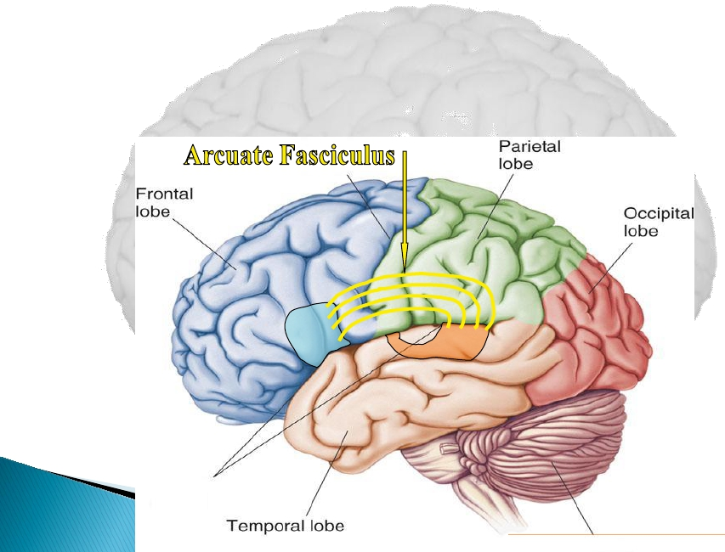
• Arcuate Fasciculus -Awhite matter tract that connects Broca’sArea and
Wernicke’sArea through the Temporal, Parietal and Frontal Lobes. Allows
for coordinated, comprehensible speech. Damage may result in:
- Conduction Aphasia - Where auditory comprehension and speech
articulation are preserved, but people find it difficult to repeat heard
speech.
Modified from: http://www.bioon.com/book/biology/whole/image/1/1-8.tif.jpg

Slide 33
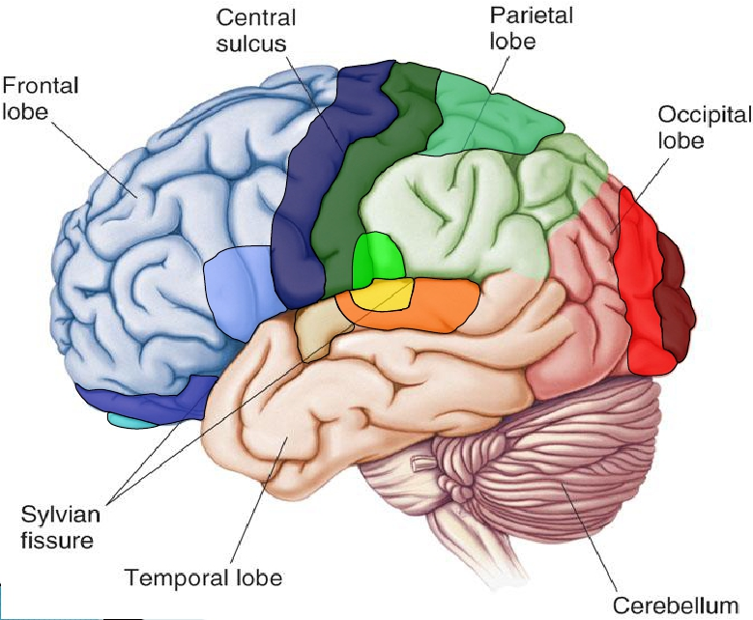
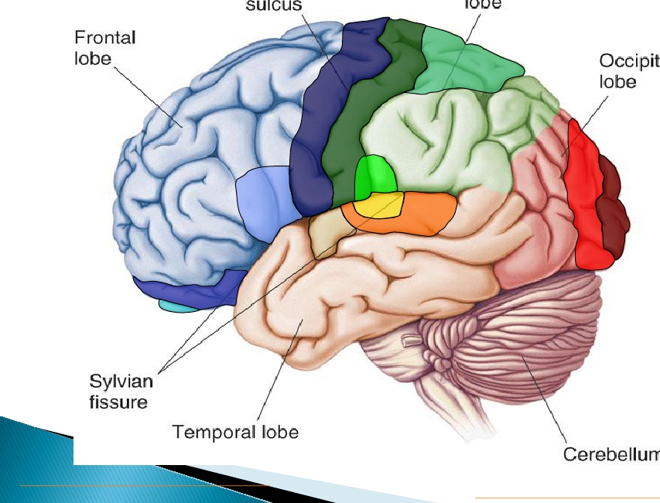
Click the Region to see its Name
Korbinian Broadmann - Learn about the man who divided the Cerebral Cortex into 52 distinct regions:
http://en.wikipedia.org/wiki/Korbinian_Brodmann
Modified from: http://www.bioon.com/book/biology/whole/image/1/1-8.tif.jpg

Slide 34
1.
2.
3.
4.
Each cerebral hemisphere receives sensory
information from, and sends motor
commands to, the opposite side of body
The 2 hemispheres have somewhat
different functions although their
structures are alike
Correspondence between a specific
function and a specific region of cerebral
cortex is not precise
No functional area acts alone; conscious
behavior involves the entire cortex

Slide 35
Most complicated region, coordinates info
from all other association areas
Important in intellect, planning, reasoning,
mood, abstract ideas, judgement, conscience,
and accuratley predicting consequences
Phineas Gage?




Slide 36



Functional differences between left and right
hemispheres
In most people, left hemisphere (dominant
hemisphere) controls:
◦ reading, writing, and math, decision-making, logic,
speech and language (usually)
Right cerebral hemisphere relates to:
◦ recognition (faces, voice inflections), affect,
visual/spatial reasoning, emotion, artistic skills

Slide 37
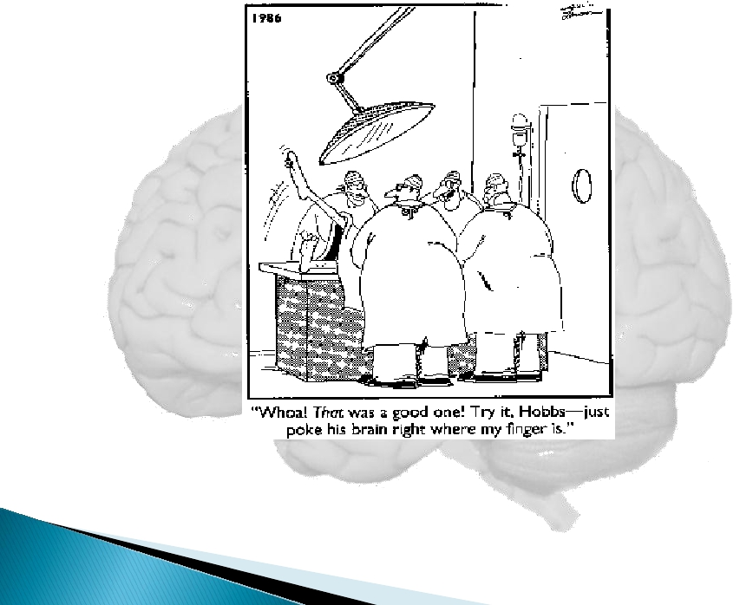
Copyright: Gary Larson
Q:Assuming this comical situation was factually
accurate, what Cortical Region of the brain would
these doctors be stimulating?

