Slide 2
Objectives:
-At the end of this lecture the student would be able to
discuss:_
▪ Cerebral blood flow(normal rate & autoregulation).
▪ - Cerebralblood pressure & Intracranial pressure (ICP)
▪ -Factors affecting cerebral blood flow:
▪ Blood gases & Neural stimuli,
▪ - CSF formation & absorption.
▪
CSF functions.
▪ Blood brain barrier (BBB)

Slide 3
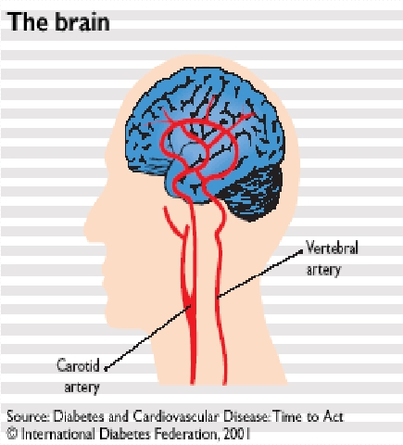
Brain receive its blood supply from
four main arteries:
1- two internal carotid arteries
2- two vertebral arteries.
They form the Circle of Willis: A group
of arteries near the base of the brain

Slide 4
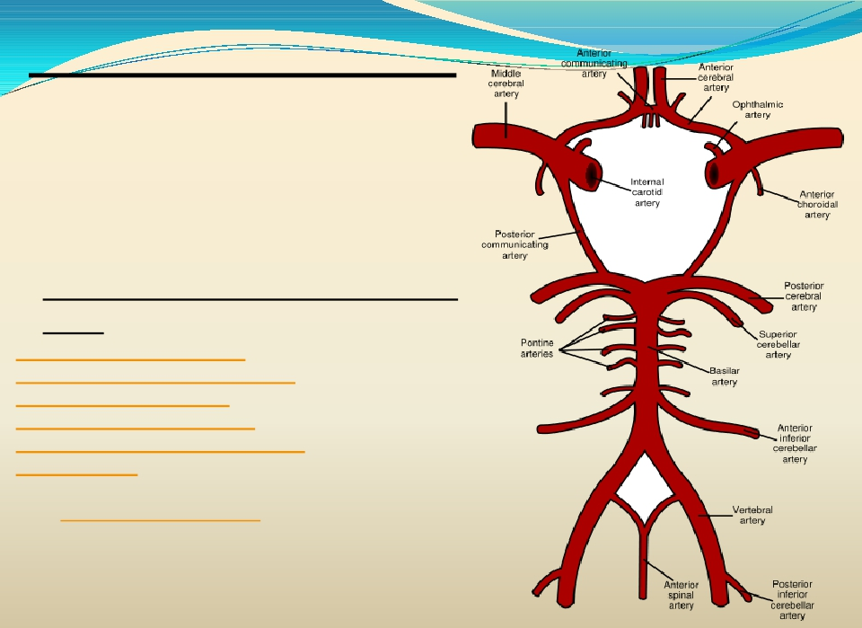
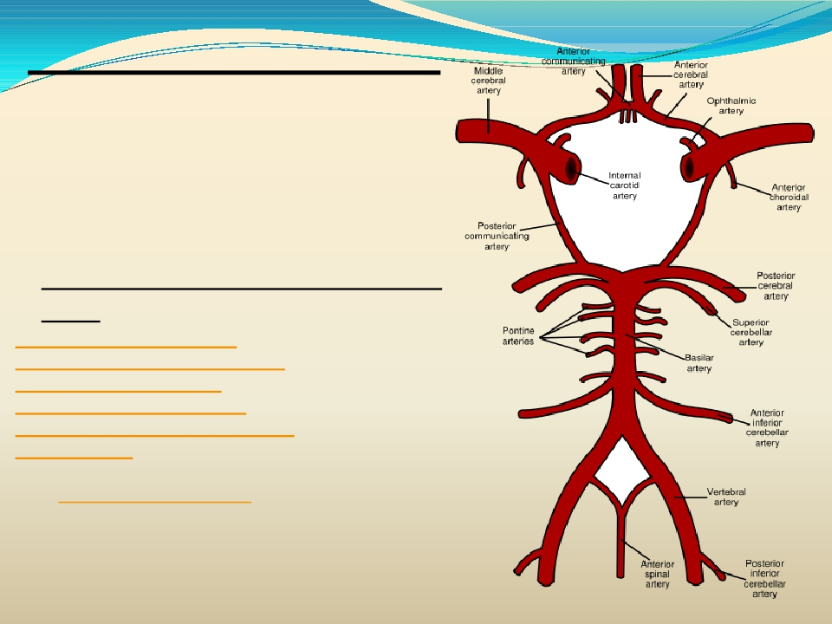
Cerebral Circulation
- The vertebral arteries unite to form Basilar
artery
-The basilar artery and the carotids form the
circle of Willis.
- The circle of Willis consists of six large
vessels
1-Anterior cerebral artery (left and right)
Anterior communicating artery
2-Internal carotid artery (left and right)
3-Posterior cerebral artery (left and right)
Posterior communicating artery (left and right)
Basilar artery
-The middle cerebral arteries, supplying the brain,
are not considered part of the circle.

Slide 5
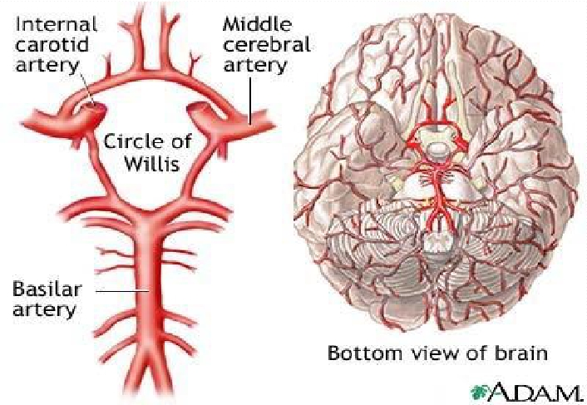
CEREBRAL CIRCULATION

Slide 6
Innervation
Three systemsof nerves innervate thecerebral blood
vessels:
- 1-Sympathetic: Postganglionic sympathetic neurons have
their bodies in the superiorcervical ganglia . During acute
hypertension itattenuates the increase in CBF.
- 2-Parasympathetic: Cholinergic neuron originate in
sphenopalatineganglia end on large arteries.
- 3-Sensory nerves

Slide 7
Cerebral blood flow(CBF)
▪ CBF is tightly regulated to meet the brain's metabolic demands
 -Normal
Rate of Cerebral Blood Flow
 Normal blood flow through the brain of the adult person averages
 50 to 65 ml /100 grams of brain tissue / minute.
 For entire brain: 750 to 900 ml/min, or 15 per cent of the resting
cardiac output.
▪ It is important to maintain CBF within narrow limits because too
much blood can raise intracranial pressure(ICP) which can compress
and damage delicate brain tissue.
▪ Too little blood flow causes ischemia.
▪ - Ischemia results if blood flow to the brain is below 18 to 20 ml / 100 g
/ minute
▪ - Tissue death occurs if flow drops below 8 to 10 ml / 100 g / minute.

Slide 8
Cerebral perfusion pressure(CPP)
 Cerebral perfusion pressure (CPP):-
 The net pressure of blood flow to the brain.
 CPP can bedefined as: CPP = MAP − ICP
 CPP is regulated by two balanced, opposing
forces:
 1-Mean arterial pressure(MAP) is the force that
pushes blood into the brain
 2-ICP force that pushes out.
 - CPP is normally between 70 - 90 mmHg in an
adult human

Slide 9
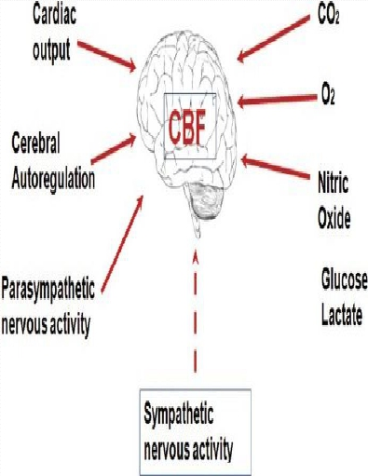
REGULATION OF CEREBRAL
BLOOD FLOW
Regulation of Cerebral Blood Flow
-Three metabolic factors have potent
effects in controlling the cerebral
blood flow :-
(1) Carbon dioxide concentration,
(2) Hydrogen ion concentration,
(3) Oxygen concentration.
- Neural factors
- Other mediators

Slide 10
REGULATION OF CEREBRALBLOOD FLOW
1- Increase Cerebral Blood Flow in Response to Excess Carbon
Dioxide or Excess Hydrogen Ion Concentration.
-70 % increase in arterial PCO2 approximately doubles the cerebral blood flow. –
- Carbon dioxide increase cerebral blood flow by combining first with water in the
body fluids to form carbonic acid, with subsequent dissociation of this acid to form
hydrogen ions.
The hydrogen ions cause vasodilation of the cerebral vessels.
The dilation is directly proportional to the increase in hydrogen ion concentration up
to a blood flow limit of about twice normal.
- Substance that increases the acidity of the brain tissue (Such as lactic acid,
pyruvic acid) & increases hydrogen ion concentration, will increase cerebral blood
flow.

Slide 11
Regulation of CBF, cont.,
▪ Hypoxia & Hypercapnia:
▪ -Excesscarbondioxidecan dilate blood vessels upto 3.5
times their normal size
-Blood vesselsalsodilate in responseto low pH.
▪ - whenactivity inagiven regionof the brain is
heightened, the increase in CO2 and H+ concentrations
causescerebral vasodilatation, and deliver more blood to
thearea to meet the increased demand.
▪ - Hypoxia, orinadequateoxygen, alsodilates blood
vesselsand increases blood flow.
▪ While high levels of oxygen constrict cerebral B.V
-Nitric oxide & adenosine are autoregulation mediators.

Slide 12
▪Neural stimuli:
▪ -Under normal conditions sympathetic has little effect, because the blood flow
auto-regulation mechanism can override the nervous effects.
▪ -During acute hypertension, sympathetic attenuates increase in CBF.
The sympathetic nervous system normally constricts the large- and intermediate-
sized brain arteries enough to prevent the high pressure from reaching the smaller
brain blood vessels. This is important in preventing vascular hemorrhages into the
brain for preventing the occurrence of “cerebral stroke.”

Slide 13
Regulation of CBF, cont.,
Increased hydrogen ion concentration greatly depresses neuronal
activity.
- So an increase in hydrogen ion concentration causes an increase in
blood flow, which in turn carries hydrogen ions, carbon dioxide, Loss of
carbon dioxide removes carbonic acid and other acid forming
substances away from the brain tissues ,this reduces the hydrogen ion
concentration back toward normal to maintain a constant hydrogen ion
concentration in the cerebral fluids and thereby helps to maintain a
normal neuronal activity

Slide 14
Regulation of CBF, cont.,
-
Oxygen Deficiency as a Regulator of Cerebral Blood Flow.
-The rate of utilization of oxygen by the brain tissue is 3.5 (± 0.2) ml of oxygen /
100 grams of brain tissue/minute.
- If blood flow to the brain insufficient , the oxygen deficiency mechanism
causing vasodilation, returning the brain blood flow and transport of oxygen to the
cerebral tissues to normal.
- Decrease in cerebral tissue PO2 below about 30 mm Hg (normal value is 35 to
40 mm Hg) immediately begins to increase cerebral blood flow.
-brain function becomes deranged at lower values of PO2, especially at PO2 levels
below 20 mm Hg.
- Oxygen deficiency is a regulator of cerebral blood flow except during periods of
intense Brain activity ( at this time Co2& H are more important)

Slide 15
Autoregulation
▪ The brain maintains proper CPP through the process of
autoregulation:
▪ -Cerebral blood flow is “autoregulated”
extremely well between arterial pressure limits of
60 and 140 mm Hg.
▪ The response to lower pressure, is arteriolar dilation in
the brain while when blood pressure rises they
constrict.
▪ Thus, changes in the body's overall blood pressure do
not normally alter cerebral perfusion pressure drastically.
▪ At their most constricted condition, blood vessels create
a pressure of 150 mmHg, and at their most dilated the
pressure is about 60 mmHg.

Slide 16
Auto-Regulation of cerebral circulation, continued,….
▪ When pressures are outside the range of 60 to 150 mmHg,
the blood vessels' ability to autoregulate pressure through
dilation and constriction is lost, and cerebral perfusion is
determined by blood pressure alone without
autoregulation.
▪ - Thus, hypotension can result in severe cerebral ischemia
.

Slide 17
Effect of ICP changes on systemic blood
pressure;
Cushing reflex:‘Normally, the ICP
[Intracranial Pressure] ranges from 1 to 15
mm Hg’, (but other sources give ranges like 8 to 18 mm Hg;)
-If ICP > 33 mmHg over a short period of
time, CBF will drop markedly, leading to
hypoxia and hypercapnea of vasomotor area
causing blood pressure rises

Slide 18
Stroke:
Stroke occurs when the blood supply to a part of the brain is blocked resulting in the
death of an area.
- if the middle cerebral artery is blocked on the left side of the brain, the person is
likely to become
- 1- totally demented because of lost function in Wernicke’s speech comprehension
area in the left cerebral hemisphere
- 2-unable to speak words because of loss of Broca’s motor area for word
formation.
- 3-In addition, loss of function of neural motor control areas of the left hemisphere
can create spastic paralysis of most muscles on the opposite side of the body.
-
- Blockage of a posterior cerebral artery will cause infarction of the occipital pole
on the same side, which causes loss of vision as ( hemianopsia).
.

Slide 19
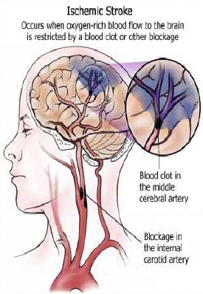
STROKE(con----)
Principal types of stroke:
1-Thrombotic: Stroke due to the blockage of an artery
leading to or in the brain by a blood clot.
2-Haemorrhagic: Stroke due to bleeding from a ruptured
blood vessel, usually a consequence of hypertension.
3-Embolic: Stroke due to the formation of a blood clot in a
vessel away from the brain. The clot is carried in the
bloodstream until it lodges in an artery leading to or in the
brain.
The thrombotic and haemorrhagic forms are common,

Slide 20
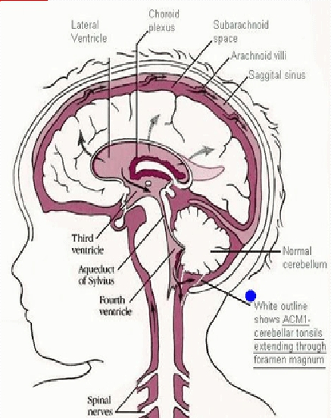
Cerebrospinal fluid
-This fluid is present in the ventricles of
the brain, cisterna around brain and in
the subarachnoid space around both the
brain and the spinal cord.All these
chambers are connected with one
another, and the pressure of the fluid is
maintained at a constant level.

Slide 21
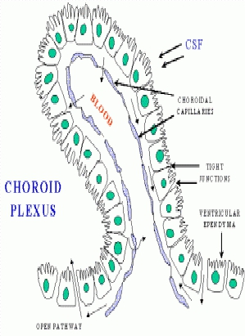
Cerebrospinal Fluid (CSF)
- Volume = 150 ml
- Rate of production = 500 ml/day .
- Lumbar CSF pressure = 70-180 mm hg
- Absorption of CSF is proportionate to
CSF pressure
- At pressure of 112 mm (normal
average): filtration and absorption are
equal.
- Below pressure of 68 mm CSF,
absorption stops.

Slide 22
Composition of the CSF
Substance | CSF | Plasma
Na+ | 147 | 150
K+ | 2.9 | 4.6
HCO3- | 25 | 24.8
PCO2 | 50 | 39.5
pH | 7.33 | 7.4
Osmolality Glucose | 289 64 | 289 100
▪ Thecomposition of CSF is nearly the sameas brain ECF
▪
▪
▪
▪
▪
-osmotic pressure, approximately equaltothatofplasma;-
-sodiumionconcentrationisapproximately equal to that of plasma;
-chloride ion, about 15 percent greater than in plasma;
- potassium ion, approximately 40 percent less
-glucoseabout 30 percent less.

Slide 23
Functions of the CSF
1-Protective function(cushioning):
-In air brain weight =1400 gm, but in its water bath of CSF , brain weight =
50 gm, making it suspended and floated effectively.
2- Facilitation of pulsatile cerebral blood flow
3- Distribution of peptides, hormones, neuroendocrine factors and other
nutrients and essential substances to cells of the body
4- Wash away waste products.

Slide 24
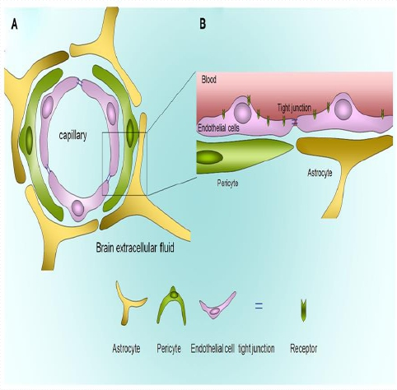
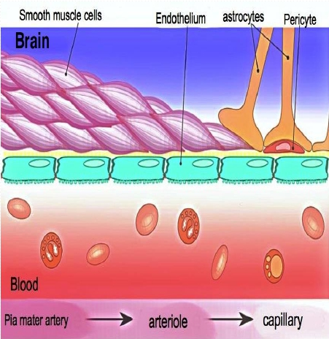
BBB

Slide 25
Blood brain Barrier (BBB)
It is between blood & CSF & brain tissue
- It is formed at :-
- 1-Choroid plexus epithelial cellsand
- 2- At brain tissuecapillary membrane (endothelial
cells )
- -formed by the tight junctions between capillary
endothelial cellsof the brain capillaries and between
epithelial cells in thechoroid plexus.

Slide 26
Penetration of substances into the brain
 Moleculespasseasily:H2O, CO2, O2, lipid-soluble
substances(assteroid hormones).
 Molecules notpass: proteins, antibodies, non- lipid-
soluble large molecules.
 Slight penetration: cl, Na, K
 Glucose : its passive penetration is slow, but is
transported across brain capillaries by GLUT1

Slide 27
Functions of BBB
 1-Maintanins theconstancyof theenvironmentof the
neurons in the CNS.
 2-Protectionof the brain from endogenousand
exogenous toxins.
 3-Preventescape of the neurotransmitters into the
general circulation.

