Slide 1
AGING AND CHANGES IN
THE BRAIN
Dr. Aida Korish
Physiology Department, KSU

Slide 2
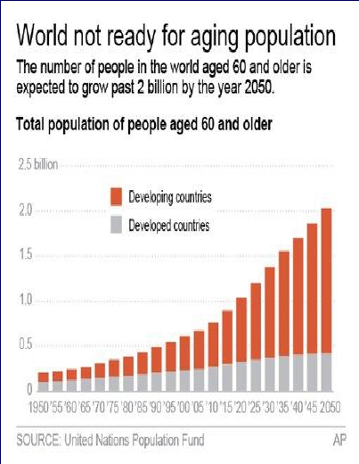

Slide 3
Objectives
Definition of Aging
Theories and terms Used
Body Changes in Aging
Brain Changes in Aging
Memory Changes in Aging
Carotid Hypersensitivity
1.
2.
3.
4.
5.
6.

Slide 4
AGING
Aging is the progressive, universal
decline first in functional reserve and
then
in
function
that
occurs
in
organisms over time
Aging is not a disease; however, the risk of
developing disease is increased, often
dramatically, as a function of age.

Slide 5
AGEING IN THE DEVELOPMENT
AGENDA
“Ageing is a
development issue.
Healthy older persons
are a resource
for their families,
their communities and
the economy.”
WHO Brasilia Declaration onAgeing,
July, 1996

Slide 6
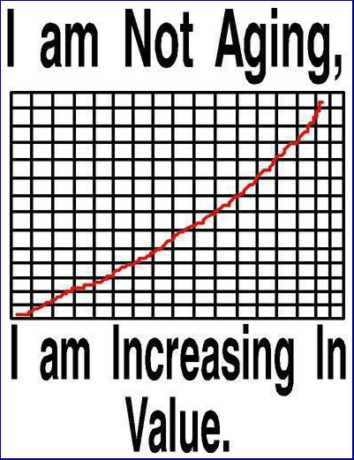

Slide 7
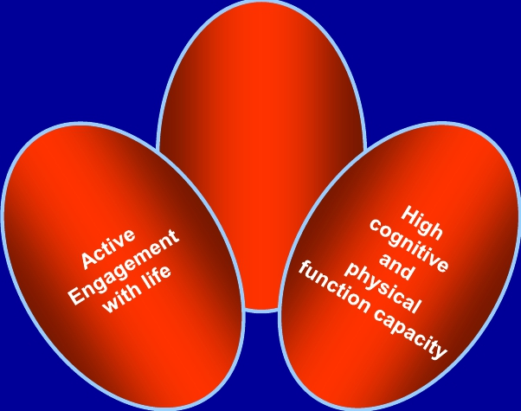
SUCCESSFUL AGEING
Low probability
of
disease
or
disability

Slide 8
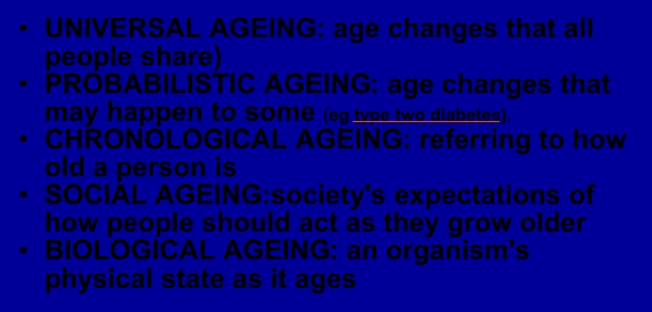
THE TERM AGEING
• UNIVERSAL AGEING: age changes that all
people share)
• PROBABILISTIC AGEING: age changes that
may happen to some (eg type two diabetes).
• CHRONOLOGICAL AGEING: referring to how
old a person is
• SOCIAL AGEING:society's expectations of
how people should act as they grow older
• BIOLOGICAL AGEING: an organism's
physical state as it ages

Slide 9
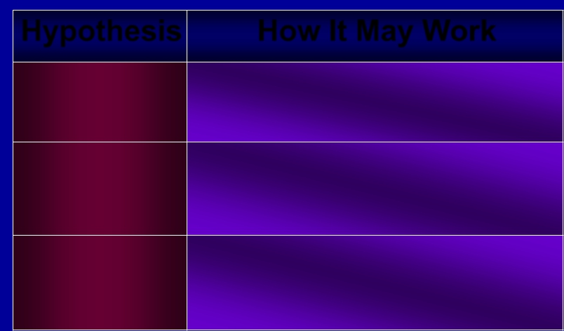
Some Theories ofAging
Hypothesis | HowItMayWork
Genetic | Agingisageneticprogramactivatedinpost- reproductivelifewhenanindividual's evolutionarymissionisaccomplished
Oxidativestress | AccumulationofoxidativedamagetoDNA, proteins,andlipidsinterfereswithnormal functionandproducesadecreaseinstress responses
Mitochondrial dysfunction | AcommondeletioninmitochondrialDNA withagecompromisesfunctionandalters cellmetabolicprocessesandadaptabilityto environmentalchange

Slide 10
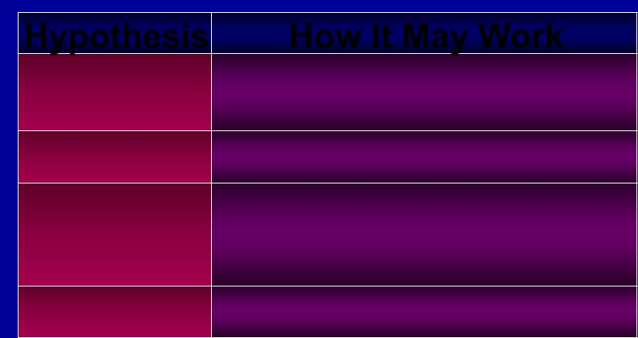
Some Theories ofAging
Hypothesis | HowItMayWork
Hormonalchanges | Thedeclineandlossofcircadianrhythmin secretionofsomehormonesproducesa functionalhormonedeficiencystate
Telomere shortening | Agingisrelatedtoadeclineintheabilityof cellstoreplicate
Defectivehost defenses | Thefailureoftheimmunesystemto respondtoinfectiousagentsandthe overactivityofnaturalimmunitycreate vulnerabilitytoInf..
Accumulationof senescentcells | Renewingtissuesbecomedysfunctional throughlossofabilitytorenew

Slide 11
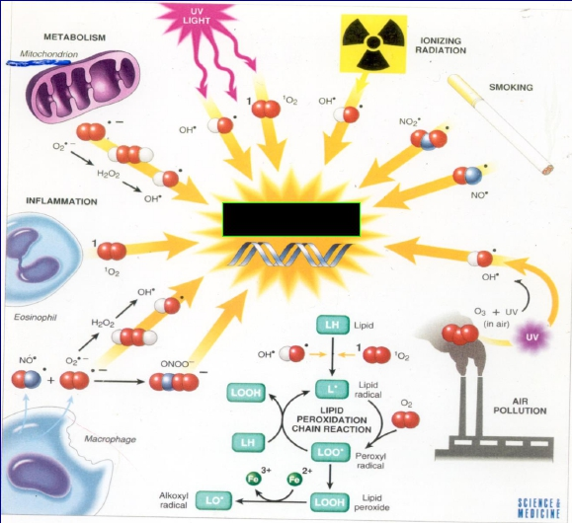
OXYGEN - free radicals (FR) and reactive oxygen species (ROS)
Cell metabolism
environment
Infection
lifestyle
DNA damage
diet
pollution

Slide 12
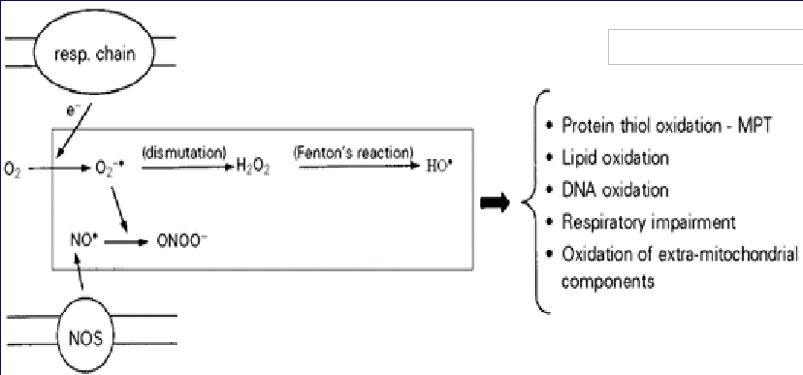
Mitochondria produce ROS:
Molecules damaged
The respiratory chain (resp.chain) produces superoxide radicals (O2-·),which generate
hydrogen peroxide (H2O2) and hydroxyl radicals (HO·).Mitochondrial nitric oxide synthase
(NOS) produces nitric oxide (NO·),which combines with O2-· to generate peroxinitrite
(ONOO-).All these ROS may cause mitochondrial and cellular damage if present in excess.
MPT,Mitochondrial permeability transition.
Kowaltowski 2002

Slide 14
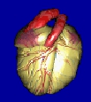
Leading Causes of Death Age 65+
“Medical Diagnoses”
•
•
•
•
•
•
•
Heart Disease
Cancer
Stroke
Chronic respiratory
Flu/Pneumonia
Diabetes
Alzheimer’s
32%
22%
8%
6%
3%
3%
3%
State of Aging and Health CDC/NCHS Health US, 2002

Slide 15
Age Related Changes
• Decreased height,
lean body mass
and body water
• Increased body
fat
• Consequence
Changes in
pharmacokinetics

Slide 16
Cont…Age Related Changes
• A lower metabolic rate
•
Longer reaction times
• Declines in certain memory functions
• Declines in sexual activity and in
women menopause
• A functional decline in audition,
olfaction, and vision
• Declines in kidney, pulmonary, and
immune functions, declines in exercise
performance, and multiple endocrine
changes
(Craik and Salthouse, 1992; Hayflick, 1994, pp. 137-186; Spence, 1995

Slide 17
Aging nervous system
Changes
Consequences
• Drug toxicities
weight
Cerebral blood flow
memory
Alteration in CNS
neurotransmitters
• Decreased vibratory • Increased postural
sense
instability
• Altered gait
• Falls, accidents

Slide 18
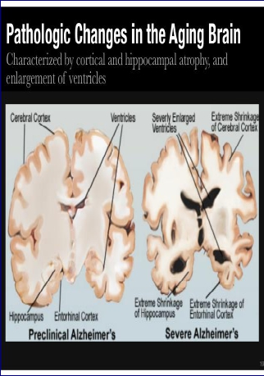
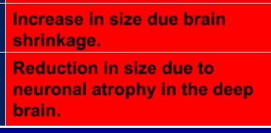
Aging nervous system
Structure | Regionalfunction
Basalganglia | Becomesbrightinappearance duetoironaccumulation
Subarachnoid space | Increaseinsizeduetobrain shrinkage
Hippocampus | Reductioninsizeduetocell lossinthestructure.
Ventricles | Increaseinsizeduebrain shrinkage.
WhiteMatter | Reductioninsizedueto neuronalatrophyinthedeep brain.

Slide 19
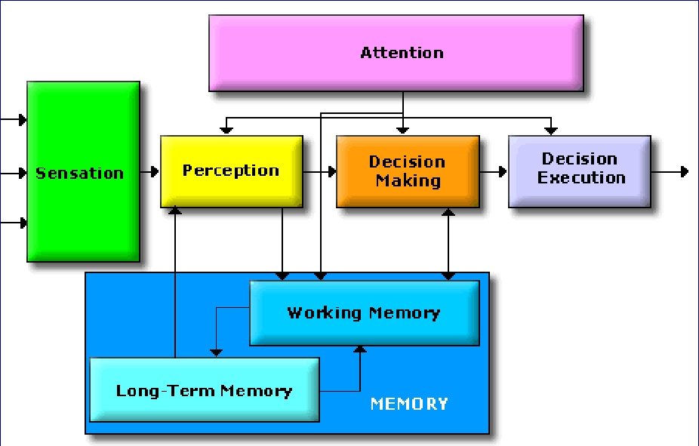
CONGITIVE CHANGES IN AGING: MENTAL
PROCESSING

Slide 20
Nervous System changes
• Aging leads to increased cerebral amyloid
• Average amount of brain protein is reduced with a
marked loss in multiple enzymes (carbonic
anhydrase and the dehydrogenases) but with a
relative increase in abnormal proteins such as
amyloid in tangles and plaques.
• Loss of RNA (messenger and transcription) but
not DNA
• Loss of lipids, and lipid turnover rate, and a
decrease in catabolism and synthesis.

Slide 21
Cont…Nervous System changes
• Neuronal loss is normal in the aging brain but the
ability to learn remains generally unchanged
• There is loss of dendritic arborization
• Recall memory is affected more than cognitive
function in normal aging
• Cerebral atrophy shows up on CTs and MRI
scans
• Reduced Sympathetic nervous system activity
• Reduced Neurotransmitter levels
• Changes in sleep patterns
• Abnormalities in EEG tracings
• Increased risk of stroke

Slide 22
Geriatric Syndromes
•
•
•
•
•
Dementia and Delirium
Falls
Urinary Incontinence
Pressure Ulcers
Functional Decline

Slide 23
Dementia and Delirium
• Dementia is a syndrome of progressive
decline in which multiple intellectual
abilities deteriorate, causing both
cognitive and functional impairment.
• Delirium is an acute state of confusion
Delirium may be the only manifestation of
a life-threatening illness in the older adult.

Slide 24
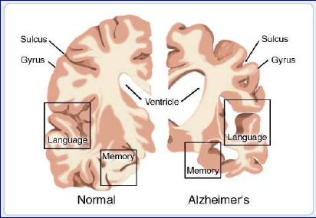
Alzheimer’s
Disease
• Alzheimer’s disease is defined as
premature aging of the brain, usually
beginning in mid-adult life and
progressing rapidly to extreme loss of
mental powers similar to that seen in
very, very old age.

Slide 25
Alzheimer’s Disease
(Features)
(1) an amnesic type of memory impairment
(2) deterioration of language
(3) visuospatial deficits.
Motor and sensory abnormalities, gait
disturbances, and seizures are uncommon
until the late phases of the disease.

Slide 26
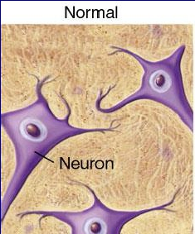
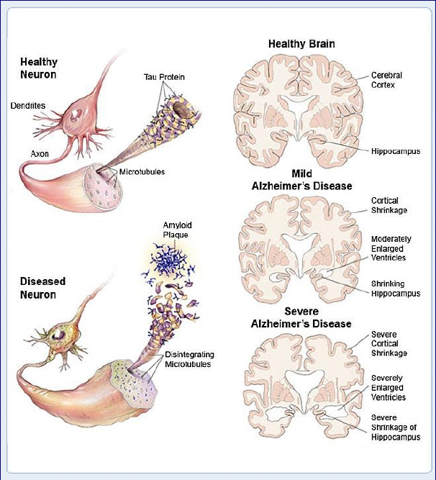
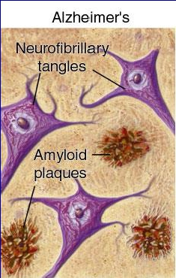

Slide 27
Amyloid Plaques
It is hallmark of Alzheimer's disease .
There is accumulation of amyloid plaques between
nerve cells (neurons) in the brain.
Amyloid is a general term for protein fragments
that the body produces normally. Beta amyloid is a
protein fragment snipped from an amyloid
precursor protein (APP). In a healthy brain, these
protein fragments are broken down and eliminated.
In Alzheimer's disease, the fragments accumulate
to form hard, insoluble plaques.

Slide 28
Neurofibrillary Tangles
• These are insoluble twisted fibers found
inside the brain's cells. Consist primarily of
a protein called tau, which forms part of a
structure called a microtubule. The
microtubule helps transport nutrients and
other important substances from one part
of the nerve cell to another. In Alzheimer's
disease, however, the tau protein is
abnormal and the microtubule structures
collapse.

Slide 30
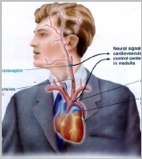
Carotid sinus hypersensitivity
• Carotid sinus syncope occurs when there
is an exaggerated vagal response to
carotid sinus stimulation,
• Provoked by wearing a tight collar, looking
upwards or turning the head
• Carotid sinus syndrome occurs in the
elderly and mainly results in bradycardia.
• Most common etiologies of atrioventricular
block
• Do not massage both carotids
simultaneously.

Slide 31
Vision
• Loss of ability to see items that are close
up begins in the 40’s (Presbyopia)
• Size of pupil grows smaller with age:
focusing becomes less accurate
• Lens of eye yellows making it more
difficult to see red and green colors
• Sensitivity to glare increases
• Night vision not as acute

Slide 32
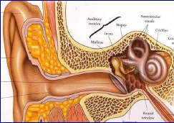
Sensorineural
Hearing Loss
Damage to the hair cells of the organ of Corti may
be caused by intense noise, viral infections,
ototoxic drugs (e.g., salicylates, quinine and its
synthetic analogues, aminoglycoside antibiotics,
loop diuretics such as furosemide and ethacrynic
acid, and cancer chemotherapeutic agents such as
cisplatin), fractures of the temporal bone,
meningitis, cochlear otosclerosis (see above),
Ménière's disease, and aging

Slide 33
Disorders of the
Sense of Taste
Disorders of the sense of taste are caused by
transport loss
sensory loss
neural loss
Sensory gustatory losses are caused by inflammatory
and degenerative diseases in the oral cavity; a vast
number of drugs, particularly those that interfere with
cell turnover such as antithyroid and antineoplastic
agents; radiation therapy to the oral cavity and
pharynx; viral infections; endocrine disorders;
neoplasms; and aging
•
•
•
•
•

Slide 34
Pain and Sense of Touch
With age, skin is not as sensitive as in youth due
to:
1. Loss of elasticity
2. Loss of pigments
3. Reduced fat layer
Safety Implications:
1. Decreased ability to recognize dangerous
levels of heat
2. Decreased ability to maintain temperature
3. Tendency to develop bruises, skin tears.

Slide 35
Sexual Dysfunction
Erectile dysfunction (ED) is not considered a
normal part of the aging process. Nonetheless,
it is associated with certain physiologic and
psychological changes related to age.
In the Massachusetts Male Aging Study
(MMAS), a community-based survey of men
between the ages of 40 and 70, 52% of
responders reported some degree of ED.
Complete ED occurred in 10% of respondents,
moderate ED occurred in 25%, and minimal ED
in 17%

Slide 36
Brief Geriatric Assessment
Instruments
Domain | Instrument | Comments
Cognition
Dementia | MMSE(mini-mentalstate examination) | Widelystudiedand accepted
 | Timeandchange(T&C)test | Sensitiveandquick
Delirium | CAM(confusionassessment method) | Sensitiveandeasyto apply
Affectivedisorders | GDS5-questionform(Geriatric depressionscale) | Rapidscreen
Visualimpairment | Snellenchart | Universallyused
Hearingimpairment | Whisperedvoice | Nospecialequipment needed
 | Puretoneaudiometry | Canbeperformedby trainedofficestaff
Dentalhealth | DENTAL
Nutritionalstatus | Weightlossof>4.5kg(>10lb) in6monthsorweight<45kg (<100lb)
Gaitandbalance | "TimedGetUpandGo"test | Requiresnospecial equipment

Slide 37
THANKS

