Slide 1
Spasticity and Increased Muscle Tone
Prof/Faten zakareia
Physiology Department , College of Medicine , King Saud University , Riyadh, KSU

Slide 2
At the end of this lecture you should be able to
-Define spasticity, regididty& hypertonia
-Know main causes of spasticity&rigidity

Slide 3
Increased Gamma efferent discharge is the main cause of increased muscle tone.
how?

Slide 4
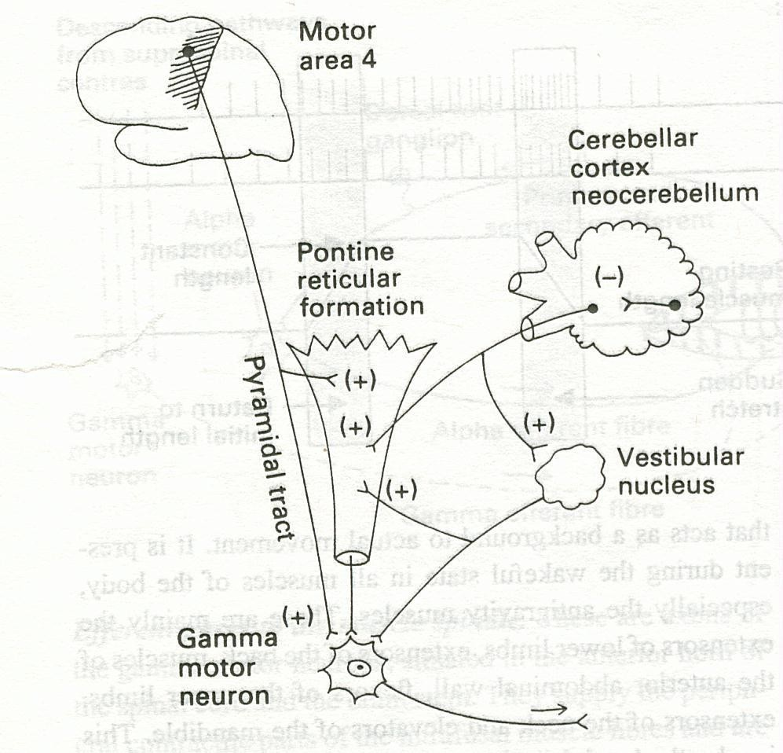
Facilitatory supra spinal centers to gamma motor neurons

Slide 5
Hypertonia refers to increased resistance to passive stretch(passive lengthening) of a muscle . This may mean increased stiffness of the muscle.
Hypertonicity could be due to a neural drive problem such as :-
spasticity or rigidity
1-Spasticity is velocity dependent increased resistance to passive movement of the muscle due to abnormally high muscle tone (hypertonia) which varies with the speed of displacement of a joint.
The faster you stretch the muscle the greater the resistance.
- Spasticity is clearly neural in nature and is a associated with the
UMNL due to Involvement of the corticospinal tract
Spasticity is usually uni- directional
Flexor spasticity in the upper limb & extensor spasticity in the lower limb.

Slide 6
A simple way to assess spasticity is by fast flexion or extension of selected joint, typically the elbow or knee, to elicit a sudden increase in tone.
- This demonstrate the velocity dependent nature of spasticity.
- Clasp-knife spasticity in UMNL, describe a sudden release of tone after an initial hypertonia of selected joint movement
- Spasticity with the increased muscle tone together cause a contraction and deformity of a limb.

Slide 7
2- Rigidity :-
- is an increased resistance to the passive movement of a muscle which is constant throughout the movement and not related to the speed of movement( is not velocity dependent) .
In Rigidity resistance is present in both agonist and antagonist. (is bi-directional)
-Rigidity is usually extra-pyramidal in origin & Rigidity includes other
features of increased muscle tone .
-is often associated with basal ganglia disease such as Parkinson’s disease
-Stiffness is different from rigidity . Stiffness is a principal symptom of the patient ( complain)

Slide 8
-To test for rigidity, passively move the joint in both direction
- a relatively uniform rigidity in both agonist and antagonist muscle
group is known as lead-pipe rigidity;
- if there is tremor superimposed with background increase of tone is cogwheel rigidity. These rigidity is commonly seen in Parkinson’s disease
N.B
-Spasticity is resistance to passive stretch + an involuntary + velocity- dependent + unidirectional - - - leads to----> resistance to movement
-Rigidity is resistance to passive movement + an involuntary + not velocity-
dependent + bidirectional - - - -- leads to- --> resistance to movement

Slide 9
-Spasticity & hypertonia is a feature of altered muscle performance
Usually in Upper Motor Neuron Syndrome (UMNS ).
-Patients complain of stiffness & inability to relax
Muscles become permanently "tight" or spastic.
The condition can interfere with walking, movement, or speech.
-.

Slide 10
When there is a loss of descending inhibition from the brain higher motor-inhibitory centers ( medullary RF & basal ganglia&
suppressor area 4 ) resulting in un-antagonized excitatory input from brain stem excitatory centers
As (pontine RF + Vestibulospinal &
vestibular N) through reticulospinal excitatory
tracts to gamma motoneurones causing hypertonia &pasticity of muscles

Slide 11
- Spasticity is characterised by hyper-excitability of both types of stretch reflex:-
increase in tonic static stretch reflexes (muscle tone) as one component of the upper motor neurone (UMN) syndrome
Exaggerated tendon jerks, resulting from hyper- excitability of the dynamic stretch reflex as one component of the upper motor neurone (UMN) syndrome

Slide 12

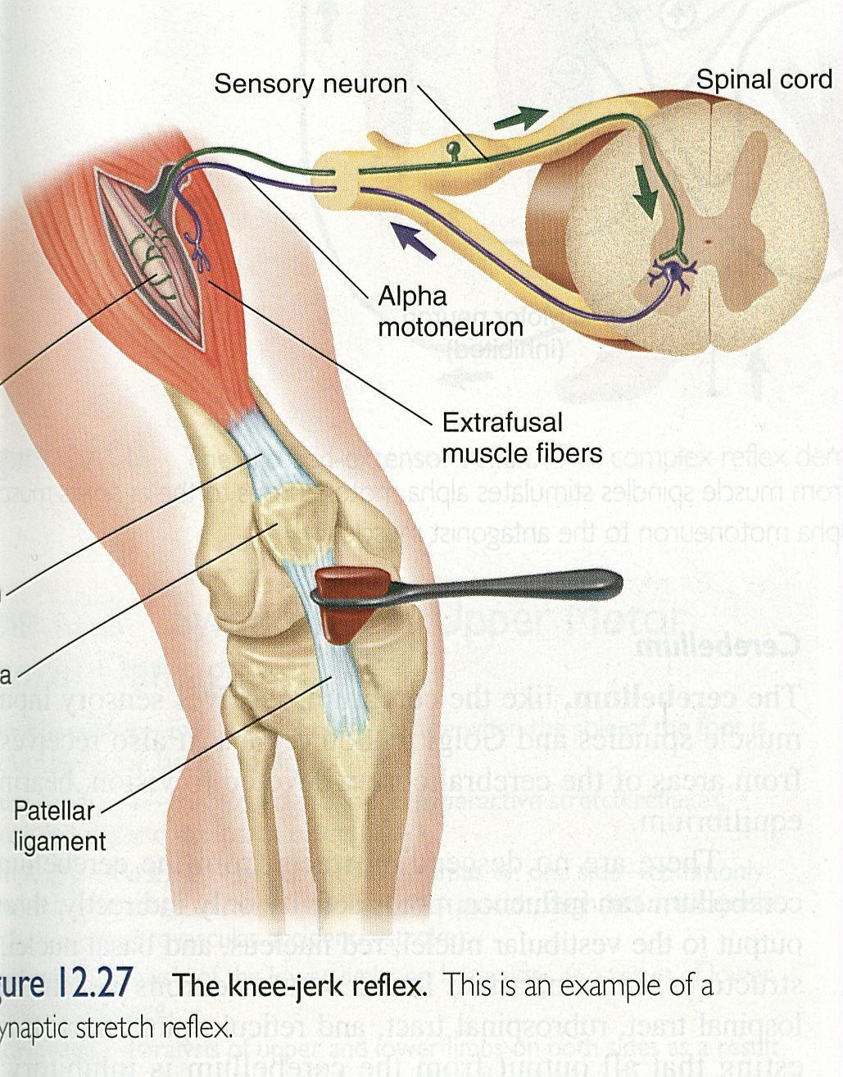

Slide 13
Features of UMN Syndrome
_{n}W_{an}e_{t}a_{a}k_{g}n_{o}e_{n}s_{i}s_{se}a_{d}nd decreased muscle control .
No remarkable muscle wasting , but disuse atrophy
Spasticity & hypertonia , frequently called
“ clasp-knife spasticity ”= increased resistance at the begining of muscle stretch due to increased extensor muscle tone then a sudden collapse in resistance due to inhibition of extensor motor neurons by GTOs (golgi tendon organs)
Clonus Repetitive jerky motions (clonus), especially when limb moved & stretched suddenly
Exaggerated tendon jerks
Extensor plantar reflex = Babinski sign ( dorsiflexion of the big toe and fanning out of the other toes )
Absent abdominal reflexes.

Slide 14
Causes of spasticity:-
A-(UMNS) syndrome include :
(1) Cerebral palsy
(2) Stroke
(3) Spinal cord injury
(4) Multiple Sclerosis
(5) Acquired brain injury ( trauma , etc )
B- Causes of rigidity
-Parkinsonism
- Decerebrate & decorticate rigidity

Slide 15
(1) Cerebral palsy
-Caused by brain damage due to lack of oxygen, as (near drowning or near suffocation ) that cause damage to the motor control centres of the developing brain
- it can occur during pregnancy , during stressed childbirth ( or after birth up to about age three by meningitis)

Slide 16
(2) Multiple Sclerosis
- is an auto-immune demyelinating disease ,
in which the body's own immune system attacks and damages
the myelin sheath of myelinated nerves mainly of brain, SC ,and optic
nerve
Loss of myelin sheath (demyelination) prevents axons
from saltatory conduction of action potentials causing muscle
weakness & wasting.
Disease onset usually occurs in young adults, and it is more common in females .
The disease can attack any part of the CNS , and when it
causes demyelination of descendindg motor tracts in the brainstem &
spinal cord , the subject develops spasticity and other signs of UMNS .
The disease frequently remits and relapses because of remylination
& restore of function
- during acute attacks intravenous corticosteroids can improve symptoms

Slide 17

3-STROKE:-Causes :
a-Haemorrhagic stroke as in cerebral hemorrhage
b- Ischaemic stroke as in thrombosis or embolism in brain bl.v
-Both cause death of brain tissues
Gives the picture of upper motor neuron syndrome UMNL .

Slide 18
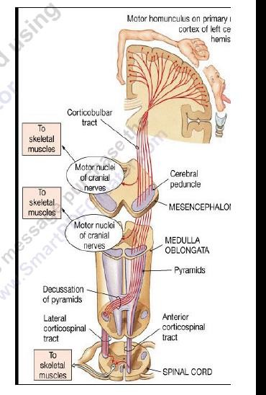

Slide 19
4-Complete transection of spinal cord:-
e.g. following tumor or trauma
The higher the level of the section, the more serious are the consequences.
1- If the transection is in the upper cervical region
immediate death follows, due to paralysis of all respiratory muscles;
2- In the lower cervical region below the 5th cervical segment diaphragmatic respiration is still possible, but the patient suffers complete paralysis of all four limbs (quadriplegia).
3-Transection lower down in the thoracic region allows normal respiration but the patient ends up with paralysis of both lower limbs (paraplegia)--

Slide 20

Stages :-
A/ Spinal shock ( 2-6 weeks ) B/ Recovery of reflex activity C/ Paraplegia in extension
A/ Spinal shock
In the immediate period following transection
there is :
(1) Loss of all sensations (anaesthesia) and voluntary movement
( paralysis) below the level of the lesion , due to interruption of all sensory and motor tracts
(3) Loss of tendon reflexes and superficial reflexes (abdominal , plantar & withdrawal reflexes ) =complete loss of spinal reflex activity below the level of the lesion .
(5) The loss of muscle tone (flaccidity) and absence of any muscle activity (muscle pump ) lead to decreased venous return
causing the lower limbs to become cold and blue in cold weather

Slide 21
The wall of the urinary bladder becomes paralysed and urine is retained until the pressure in the bladder overcomes the resistance offered by the tone of the sphincters and dribbling occurs. This is known as (retention with overflow).
Loss of vasomotor tone occurs, due to interruption of fibres that connect the vasomotor centres in the medulla oblongata with the lateral horn cells of the spinal cord, which project sympathetic vasoconstrictor impulses to blood vessels. vasodilatation causes a fall in blood pressure;
-This stage varies in duration but usually lasts a maximum of 2-6 weeks, after which some reflex activity recovers.

Slide 22
B/ Stage of return of reflex activity
As the spinal shock ends , spinal reflex activity appears again this partial recovery may be due to:-
- increase in degree of excitability of the spinal cord neurons below the level
of the section ,
due to :_
1-disinhibition of motoneurons as a result of absence of inhibitory impulses from higher motor centres
-sprouting of fibres from remaining neurons
-denervation supersensitivity to excitatory neurotransmitters .
Features of the stage of recovery of reflex activity
(1) Gradual rise of arterial blood pressure due to return of spinal vasomotor activity in the lateral horn cells. But, since vasomotor control from the medulla is absent, the blood pressure is not stable
- vasoconstrictor tone in arterioles and venules improve the circulation through the limbs.

Slide 23
2) Return of spinal reflexes:
Flexor tendon reflexes return earlier than extensor ones.
Babiniski sign ( extensor plantar reflex) is one of the
earliest signs of this stage +/- flexion reflex .
Flexor spastic tone causes the lower limbs to take a position of slight
flexion, a state referred to as paraplegia in flexion.
The return of the stretch reflex (muscle tone) ,
-
(2) Recovery of visceral reflexes: return of micturition, defecation &
erection reflexes.
- However voluntary control over micturition and defecation , and the sensation of bladder and rectal fullness are permanently lost
( AUTOMATIC MICTURITION)

Slide 24

(5) Mass reflex appears in this stage
•
A minor painful stimulus to the skin of the lower limbs will not only cause withdrawal of that limb but will evoke many other reflexes through spread of excitation (by irradiation) to many autonomic centres.
So the bladder and rectum will also empty, the skin will sweat, the blood pressure will rise
-Voluntary movements and sensations are permanently lost;
-however , patients who are rehabilitated and properly managed may enter into a more advanced stage of recovery.
-

Slide 25
C/ Stage of extensor paraplegia
(1) During this stage the tone in extensor muscles returns gradually to exceed that in the flexors. The lower limbs become spastically extended.
-Extensor reflexes become exaggerated, as shown by tendon jerks and by the appearance of clonus.
-The positive supportive reaction becomes well developed and the patient can stand on his feet with appropriate support.
(2) The flexor withdrawal reflex which appeared in the earlier stage is associated during this stage with the crossed extensor reflex.

Slide 26
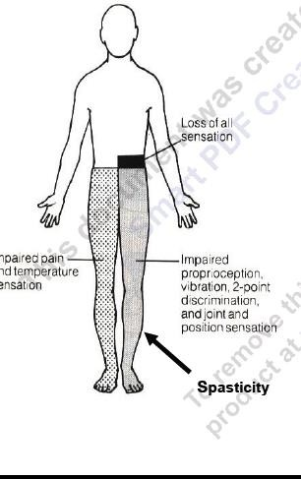
Hemisection of the Spinal Cord ( Brown-Sequard syndrome)

Slide 27
Occurs as a result of unilateral lesion or hemisection of the spinal cord ( e.g. due to stab injury, bullet , caraccident,or tumor ).
The manifestations of the Brown-Sequard syndrome depend on the level of the lesion.( Let us take an example of such injury involving the thoracic spinal cord )
On the same side at the level of lesion
1.Paralysis of the lower motor neuron type, involving only the muscle supplied by the damaged segments.
3. Loss of all sensations in the areas supplied by the afferent fibres that enter the spinal cord in the damaged segments +/- band of hyperesthesia

Slide 28
B/ Ipsilaterally below the level of the lesion :
UMNL/spastic lower limb (spasticity) &CLONUS
Fine touch, two-point discrimination, position and vibration sense are lost. why?
C/ Contralaterally below the level of the lesion : Pain and temperature sensations are lost, Why ?

Slide 29
B-CAUSES OF RIGIDITY
-1-Parkinsonism rigidity is of two types:-
Cog-wheel rigidity
In cogwheel rigidity one feels the resistance in rhythms
( catches)when applying a passive movement. It is thought to be the product of an underlying resting tremor which is masked by the rigidity but can be felt on passive movement .
Lead-pipe rigidity . Lead pipe rigidity describes a constant
resistance when moving a joint
2- Decerebrate rigidity (extension of head & 4 limbs extensors )( brain stem lesions)
3- Decorticate rigidity(extensor rigidity in legs & moderate flexion of arms if head unturned )( descending tract& cerebral lesions)

Slide 30
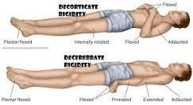

Slide 31


