Slide 1






ميحرلا نمحرلا الله مسب
﴾لايلق لاإ ملعلا نم متيتوأ ام و﴿
ميظعلا الله قدص 58 ةيا ءارسلاا

Slide 2
UPPER & LOWER MOTOR NEURON
lesion By
Dr Fawzia ALROuq
Ph.D
Assistant Professor of physiology Consultant of neurophysiology Department of Physiology
College of Medicine, King Saud UniversityUniversity

Slide 3
Objectives
Appreciate what is meant by upper and lower motor neurons
Explain manifestations of upper and lower motor neurons lesions
Know effects of lesion in pyramidal tracts at various levels
Know effects of lesion in the internal capsule
Explain the manifestations of complete spinal
cord transection and hemisection.

Slide 4
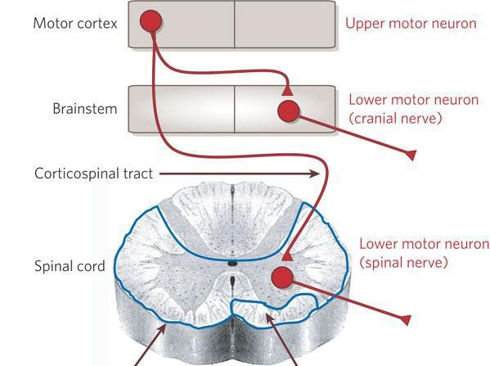
Upper and Lower motor neurones

Slide 5
Causes of UMNL & LMNL
Upper Motor Neuron Lesion,UMNL
5
Can be due to
Cerebral stroke by haemorrhage , thrombosis or embolism
Spinal cord transection or hemisection
(Brown- Sequard syndrome )
Lower Motor Neuron
Lesion,LMNL
Can result from
Anterior horn cell lesions ( e.g.
, poliomyelitis, motor neuron disease )
Spinal root lesions or
peripheral nerve lesion
( e.g. nerve injury by trauma or compressive lesion)
17
October
2017

Slide 6
 | UMNL | LMNL
1-extent of paralysis | widwspread | localized
2-site of paralysis | Opposite side to lesion | Same side of lesion
3-Tone of muscles | Spasticity ( hypertonia ) ” clasp-knife spasticity | Hypotonia ” flaccid paralysis
4- Deep reflexes | Brisk ( exaggerated) tendon jerks | Diminished or absent
5- Superficial reflexes | absent | absent
6-Planter reflex | Extensor plantar reflex , Babinski sign ( dorsiflexion of the big toe and fanning out of the other toes ) , or just an upgoing toe . | Absent .
7-muscle waisting | No marked muscle wasting , but minor wasting may occur due to( disuse atrophy) | Marked muscle wasting (atrophy)
8-Clonus | Clonus present ( rhythmic oscillation on tendon stretch ) | No clonus
9-Fasciculations (seen ) . - Fibrillation potentials by EMG . | No fasciculations No fibrillation potential | Fasciculations may be seen . & Fibrillation by EMG

Slide 7
The effect of a lesion in different parts of the motor system
Lesions of pyramidal tract cause paralysis of the UMNL type below the level of the lesion. However, the side affected and the extent of paralysis vary according to the site
of the lesion:
1- In area 4: 
This leads to restricted paralysis e.g. contralateral monoplegia (paralysis of one 
limb because area 4 is widespread so it is rarely damaged completely.
2- In the corona radiata: 
This leads to contralateral monoplegia or hemiplegia, depending on the extent of 
the lesion.
3- In the internal capsule: 
This often leads to contralateral hemiplegia because almost all fibers are injured 


Slide 8
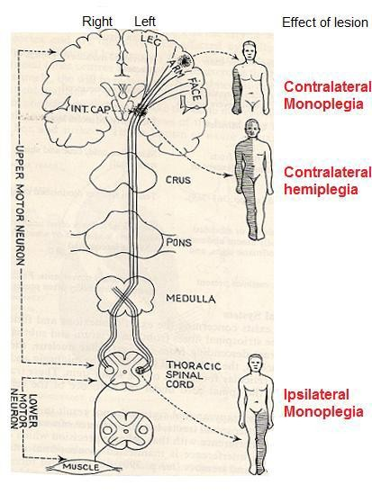
The effect of a lesion in different parts of the motor
system


Slide 9
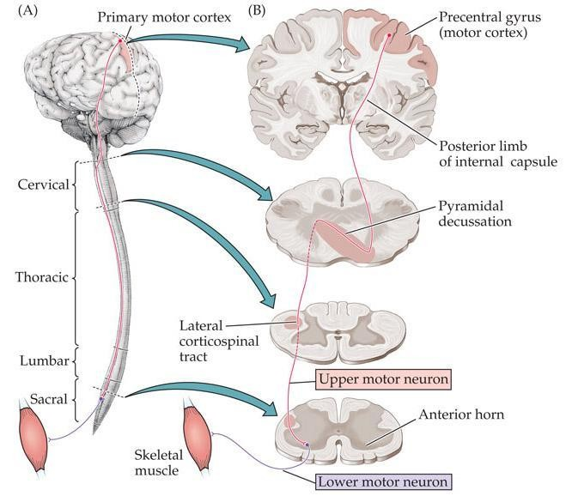

Slide 10
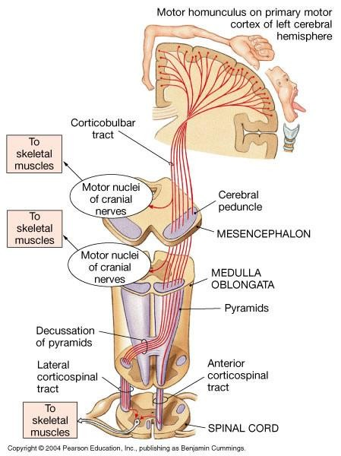

Slide 11



Slide 12







Origin:
From area (6) and area (4) → descends to corpus 
striatum → Globus pallidus→ from the globus pallidus
fibers pass to;
Reticular formation . Vestibular nuclei .
Red nucleus . Tectum of midbrain. .
From these nuclei the extrapyramidal tracts arise 

Slide 13
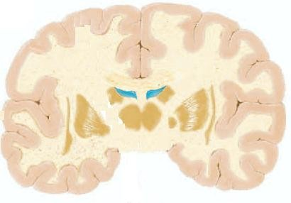
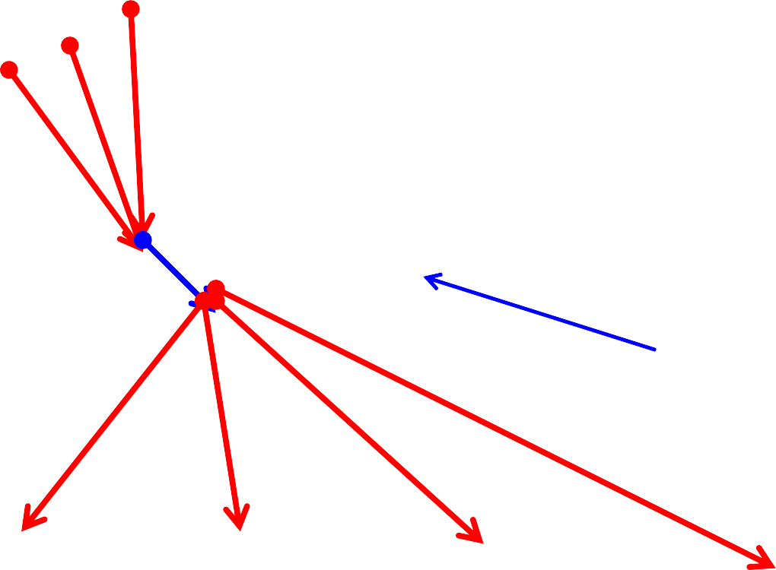
Motor areas 4 and 6
Corpus striatum
Basal Ganglia
Globus pallidus
RF
Vest. Nuclei
Red Nucl.
Tectum
Ret.Spin T.
Vest.Spin.T. Rubrospin. T. Tectospin. T.

Slide 14








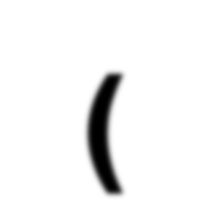





Slide 15
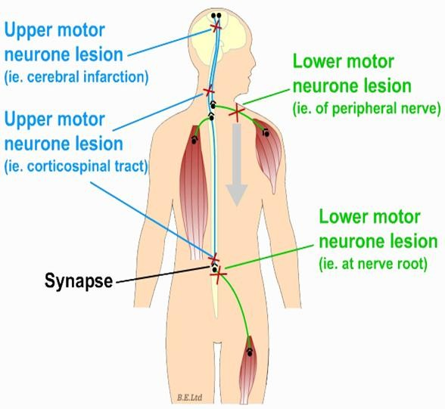

Slide 16








Slide 17

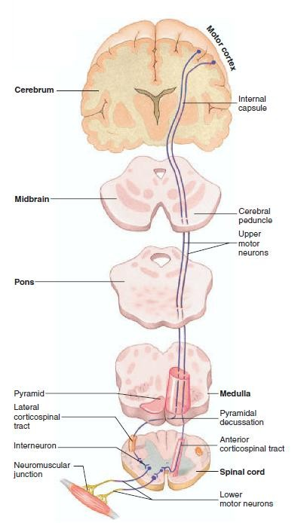
INTERNAL
CAPSULE
MOTOR
CORTEX
BRAIN STEM
SPINAL CORD

Slide 18
Def.,
It is the damage of upper motor neuron in the higher 
center or the descending motor tract.
Causes
Trauma .1
Tumour .2 Vascular disorders as thrombosis or hemorrhage. .3
Sites:
Most common site of UMNL is the internal capsule.

Slide 19


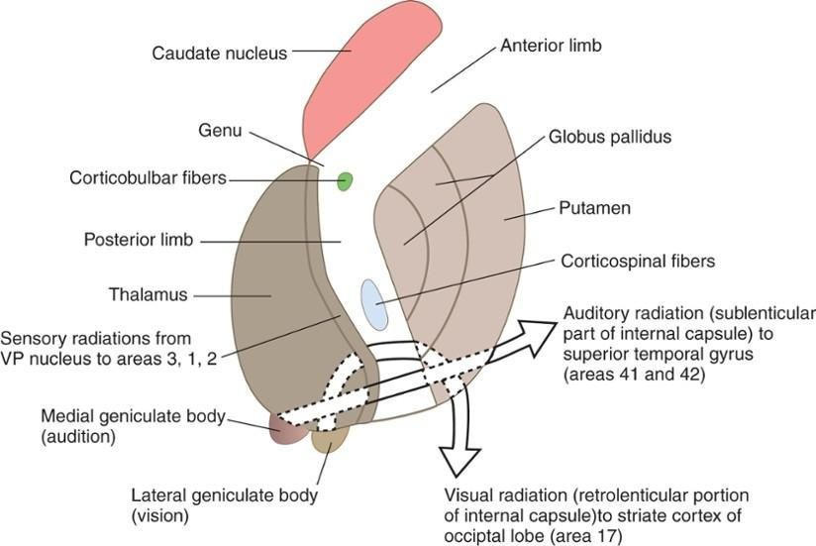

Slide 20
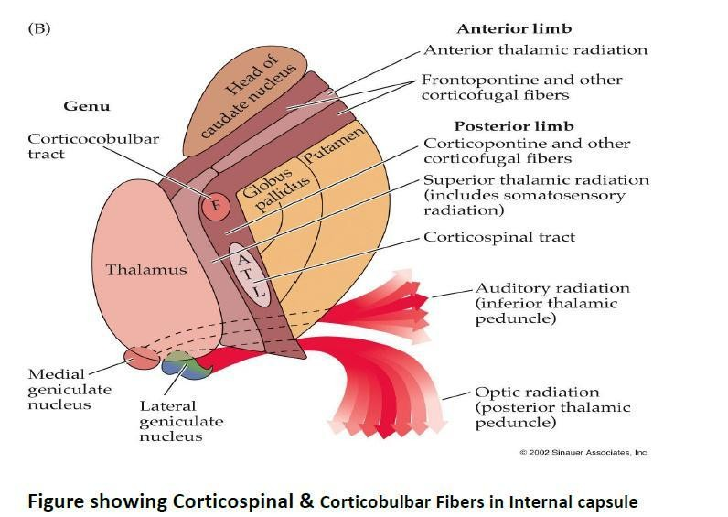

Slide 21

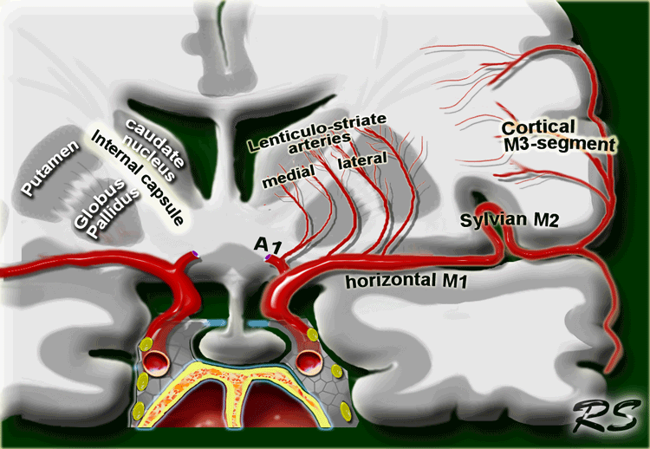

Slide 22




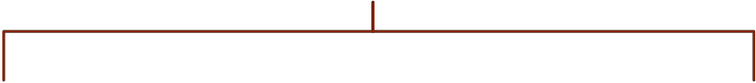






Internal capsule
Motor loss
Sensory loss
Loss of somatic sensations, vision and hearing
Hemiplegia

Slide 23


Contralateral paralysis (loss of only voluntary .1 movements) of the distal ms of the limbs, lower
facial ms and ms of the tongue.
Contralateral paresis (weakness i.e., the ms .2 retains some movements) of the axial ms and
upper facial ms.
Axial ms are supplied by descending motor tracts 
other than CBS whereas ms of the upper face are ipsilaterally innervated by CBS tract.

Slide 24

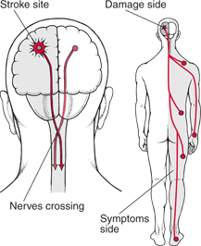

Slide 25
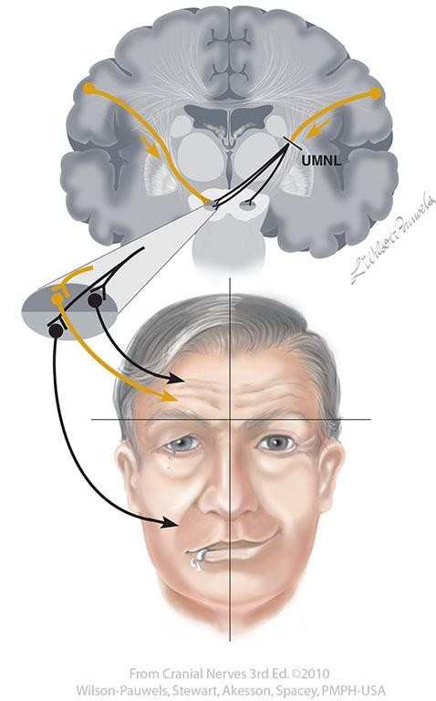

Slide 26
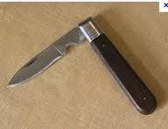
3) Spasticity (increased ms tone) of the skeletal ms due to increased supraspinal facilitation to γ-motor
neurons.
A lesion at the level of internal capsule interrupts the   descending inhibitory cortical fibers which feeds the inhibitory reticulospinal tract leaving the facilitatory
vestibulospinal and reticulospinal to act.
This spasticity is of the clasp-knife type 

Slide 27



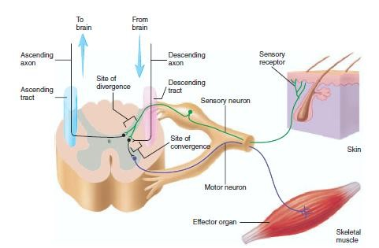
Facilitatory RF and VST
Inhibitory RF

Slide 28
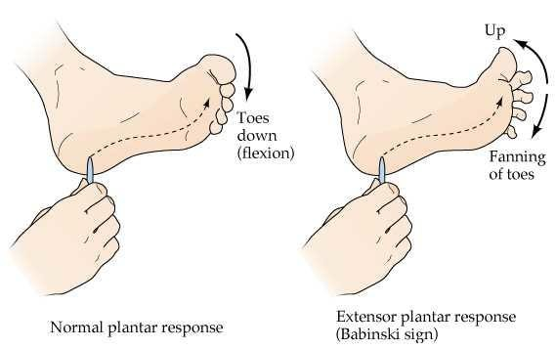
Exaggerated tendon jerk & clonus: due to increased
supraspinal facilitation.
Positive Babinski's sign

Slide 29
The paralyzed ms show no or minimal atrophy as the lower motor neuron is intact and the ms contracts
reflexly.
Normal response of the paralyzed ms to electric
stimulation
Faradic current produces clonic or tetanic contractions
Galvanic current produces contractions that occur only at closing (make) and opening (break) of the circuits.
CCC > ACC > AOC > COC

Slide 30


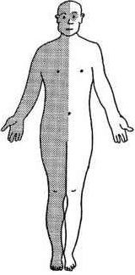
1) Contralateral hemianaesthesia i.e.
loss of all sensations on the opposite side of the body

Slide 31
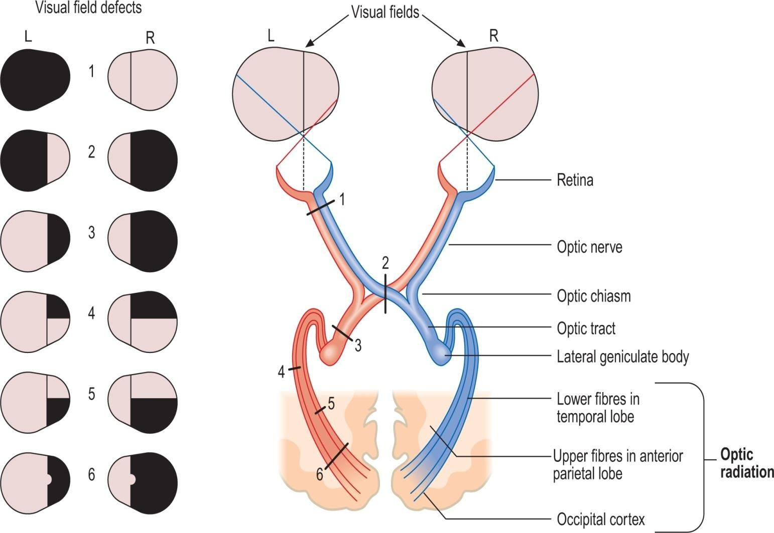
2) Contralateral homonymous hemianopia i.e., loss of vision in the two opposite halves of the field of vision

Slide 32
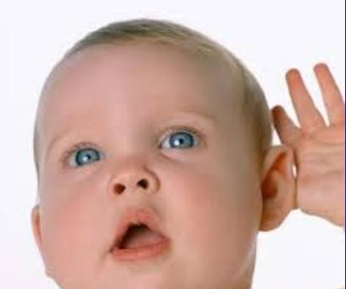
3) Bilateral diminution of hearing acuity.
No complete loss of hearing as both ears are bilaterally represented in both cortices.

Slide 33



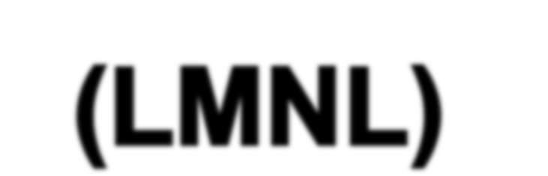


Slide 34
Def.,
 It is damage of the lower motor neurons (the spinal AHCS and the cranial motor nuclei or their axons) resulting in skeletal ms paralysis
Causes
Trauma
Neuropathy

Slide 35


I) Structural changes
In Nerve (degeneration and regeneration
In muscle (atrophy and increase Ach receptors II) Functional changes
Flaccid paralysis
Fasciculation and fibrillation
Dennervation supersensitivity
Reaction of degeneration

Slide 36
A) Flaccid paralysis:
Paralysis of denervated ms with loss of all types of movements; "voluntary, postural and reflex".
All reflexes are lost including stretch reflex resulting in loss of ms tone and tendon jerk (flaccidity).
The extent of paralysis is usually limited to a small group of ms

Slide 37
Appears few days or weeks after denervation
B) Fasiculations and fibrillations:
Disappear when the motor nerve completely degenerates or successful re-innervation of the ms occurs.

Slide 38
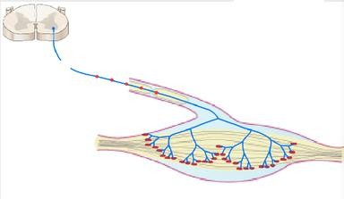
B) Fasiculations :
Synchronous visible contraction of the motor unit (all ms fibers) supplied by the injured axon.
Result from spontaneous generation of action potential (injury potentials) in distal segment of the injured axon

Slide 39
B) Fibrillations:
As degeneration of the injured axon continues, the axon terminals are now separate from the main axon and hence, from each other.
Injury potentials are still generated along the terminals leading to asynchronous contraction of the individual ms fibers attached to terminals.
Invisible to the observer and detected only by electromyogram (EMG).

Slide 40
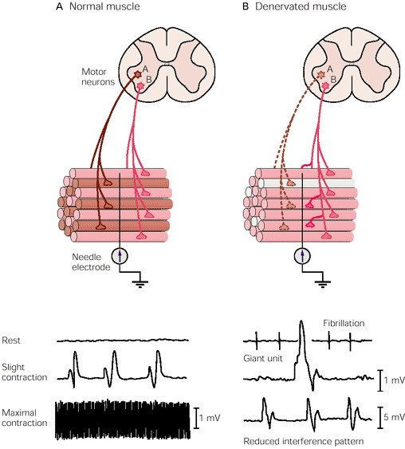
Fibrillations

Slide 41
C) Denervation supersensitivity:
Denervated ms becomes supersensitive to acetylcholine.
This is due to increase in the number of A.Ch. receptors which cover the entire surface of ms cell membrane.

Slide 42

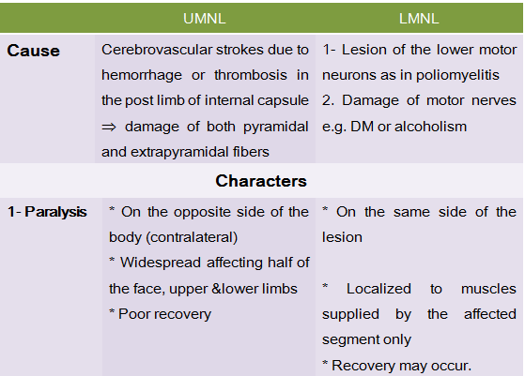

Slide 43
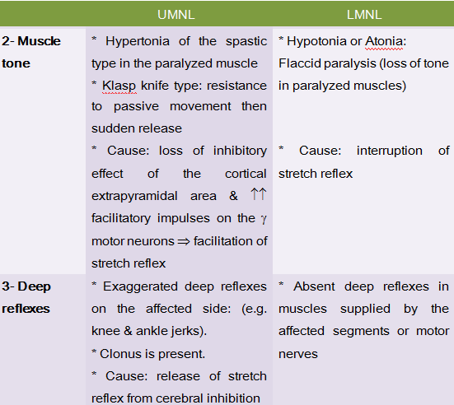

Slide 44
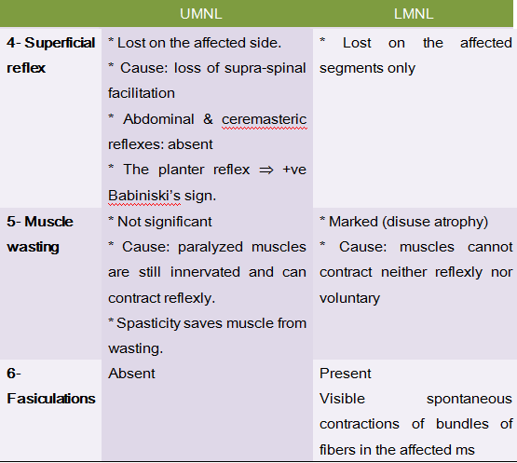

Slide 45


THANKS

