Slide 1



Slide 2





Slide 3
Objectives
➲ Describe the built-in pain suppression analgesic system including:
Spinal modulation (Gate theory of pain
control).
Supra spinal modulation (Special pain control
analgesic system).
➲ Pain modulation by opioid neurotransmitters.
➲ Appreciate that pain can also be facilitated
➲ Know the sites & mechanism of pain relief

Slide 4






It means pain perception variability (the degree to which a person reacts to pain)
i.e. A decrease or an increase in the sensation of pain caused by inhibition or facilitation of pain signals
Inhibition:
  Spinal (segmental) inhibition: Gate control theory
  Supraspinal (descending) inhibition
Facilitation:
  Peripheral sensitization (release of chemicals after
tissue injury)
  Central sensitization (Dis-inhibition)

Slide 5




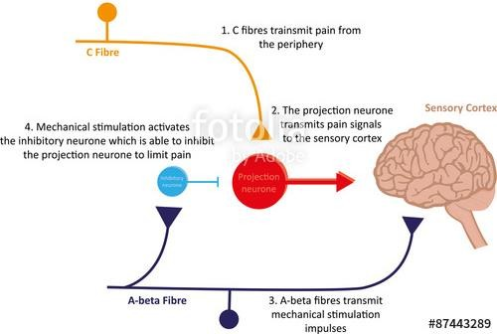
Special neurons in the the dorsal horn of spinal cord (SGR) form the gate through which pain impulses must pass to reach brain.

Slide 6





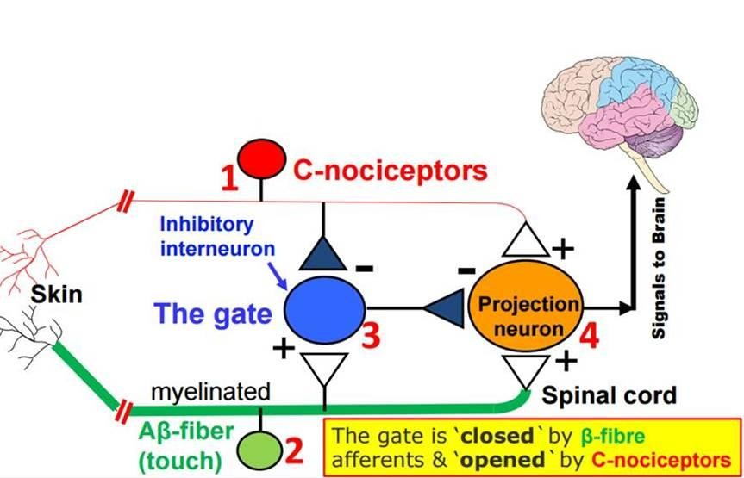
Four variables control this gate:
Type C- fibres (slow pain).
Type A-β fibres (light touch).
Inhibitory interneurons.
Projection neuron

Slide 7
















Gate opened or closed by 3 factors:
Messages
from the
To the brain
brain
Activity in pain
nerves opens the gate
Gate
Transmission
nerve cells
Activity in other sensory nerves closes the gate (e.g. Rubbing the affected area
10/22/2017
7

Slide 8

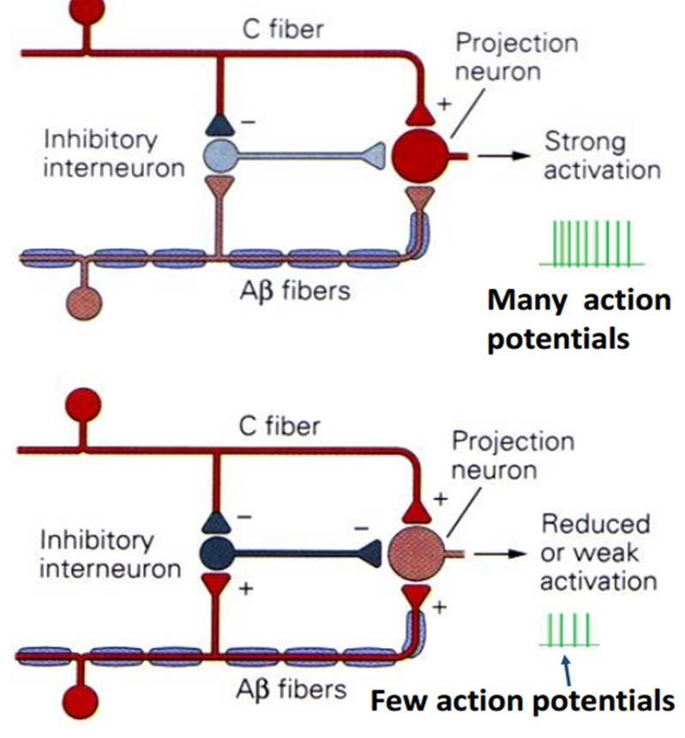
The gate theory of pain control (Cont.)
Projection neuron receives input from both C-fibers and Aβ fibers.
Impulses coming along type C pain fibers cause the release of substance P from these fibers and inhibits the inhibitory interneuron (open the gate).
While impulses coming along Aβ fibers tend to keep the gate closed by activating the inhibitory interneuron.
This theory implies that a non-painful stimulus can reduce transmission of a noxious stimulus.

Slide 9
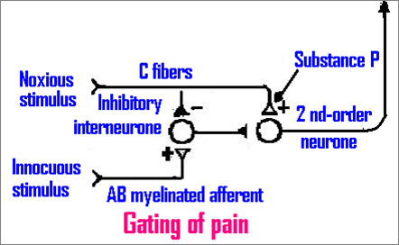


-
+

Slide 10

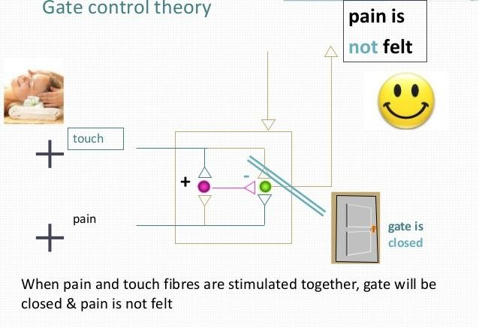

10

Slide 11








Central Nervous System
Close
Aβ fibers
Substantia Gelatinosa
Pain Transmission
Response
C fibers
Open

Slide 12
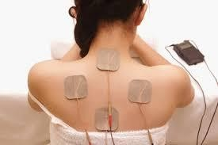



The gate theory explains the pain relief by:
  Skin rubbing
  Shaking the painful part
  Trans Cutaneous Electrical Nerve Stimulation (TENS)
  Acupuncture
All are supposed to stimulate mechanoreceptors that activate neurons of dorsal column, the collaterals relieve pain.

Slide 13






What is the Central Control Trigger
Specialised nerve impulses arise in the brain itself and travel down the spinal cord to influence the gate.
It can send both inhibitory and excitatory messages to the gate sensitising it to either C or A-β fibres.
The inhibitory neurons make a pain blocking
agent called encephalin.
Encephalin is an opiate substance similar to heroin which can block substance P, the neurotransmitter from the C fibers, and this keeps the gate closed.

Slide 14
Supra spinal modulation (Special pain control analgesic system)
This is a specific system that blocks pain
transmission in CNS. Its major constituents are:
1- The periventricular and periaqueductal gray areas of the mesencephalon and upper pons surround portions of the third and fourth ventricles and the aqueduct of Sylvius
2- Raphe magnum nucleus, a thin midline nucleus located in the lower pons and upper medulla.

Slide 15
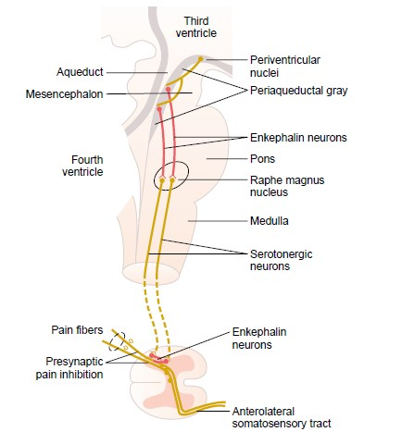

Pain inhibitory complex
Analgesia system of the brain and spinal cord, showing (1) inhibition of incoming
pain signals at the cord level and (2) presence of enkephalin-secreting neurons
15
that suppress pain signals in both the cord and the brain stem.

Slide 16
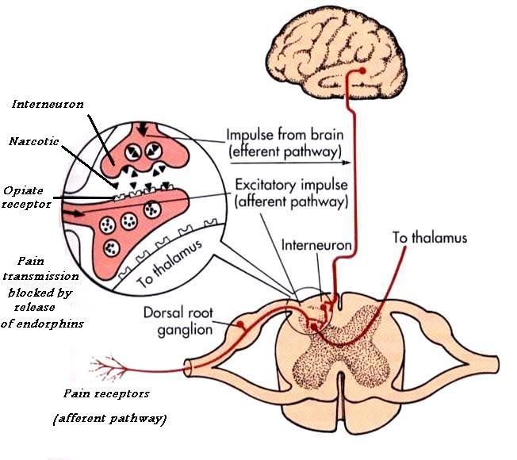
3- Pain inhibitory complex
In dorsal horn of SC. It consists of multiple short encephalinergic neurons that terminate on central endings of pain conducting afferent fibers.
When stimulated, the released encephalin cause pre & postsynaptic inhibition of pain transmission
It prevents the release of substance P from pain nerve endings.

Slide 17
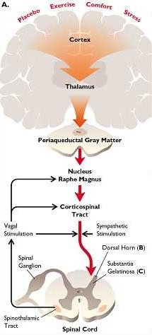
Analgesia occurs as follows:
Periventricular nucleus
projects to PAG.
PAG projects neurons containing aspartate & glutamate that stimulate raphe magnus nucleus (RMN)
RMN projects serotoninergic neurons, this in addition to noradrenergic neurons project from locus coeruleus in medulla to dorsal horn. They block pain signals by activating PIC.

Slide 18




Opioid Peptides and Pain
Modulation
Opioid peptides are morphine-like
substances present in body.
They are natural analgesic substances that act by binding to opiate receptors in analgesic system and dorsal horn of SC on central ending of pain conducting pain fibers.

Slide 19
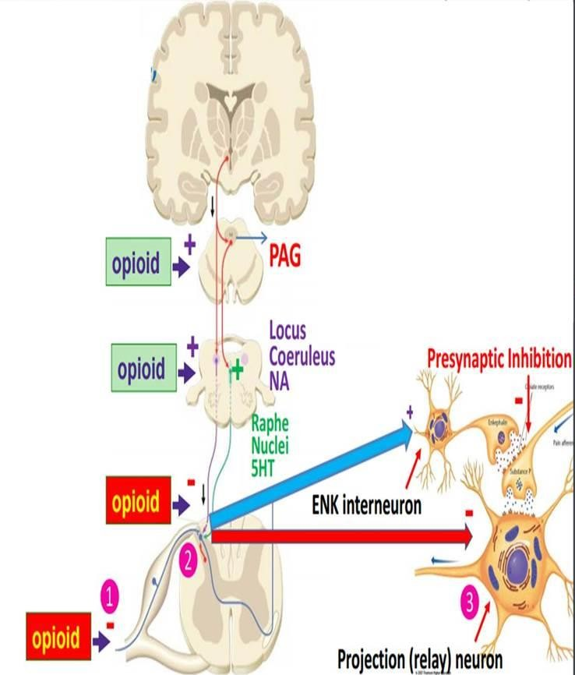
Site of release of opioid peptides:
Endorphin: Are found in PAG where they inhibit GABAnergic interneurons that normally suppress the anti-nociceptor neurons
Encephalin: It is used by interneurons in lamina II responsible for inhibiting the nocioceptor-specific spinothalamic neurons
Dynorphin: In hypothalamus, PAG, reticular formation, and dorsal horn.
Endogenous morphine: In terminals forming synapses with neuron having μ-opioid receptors in pain modulating pathways.
19

Slide 20
Mechanism of actions of Opioid
peptides on pain transmission
They exerts their analgesic effects by acting at various sites in peripheral & CNS
A-Direct effect
Inhibiting discharge of nociceptor neurons.
Inhibiting release of substance P from central terminal of
nociceptor neurons
Cause inhibition of dorsal horn spinothalamic neuron.
B- Indirect effect
Activating the descending inhibitory pathway be exciting
PAG neurons
Activating neurons in the brain stem which suppress pain transmission directly or indirectly via activation of encephalinergic containing inhibitory interneurons

Slide 21


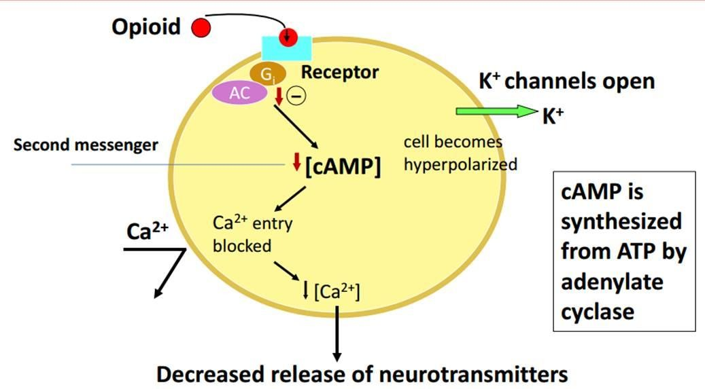

Cellular actions of Opioid peptides
3
1
2
Reduction of cAMP synthesis by inhibiting Adenyl cyclase
Inhibition of transmitter release by inhibiting opening of Ca⁺⁺
channels
Hyperpolarization by facilitating opening of voltage gated K⁺
channels

Slide 22








Opioid Antagonist:
Naloxone
Used to reverse opioid
overdose
Displaces receptor-bound
opioids
Good for overcoming respiratory and CV depression
Naloxone
Morphine
Opioid Receptor

Slide 23
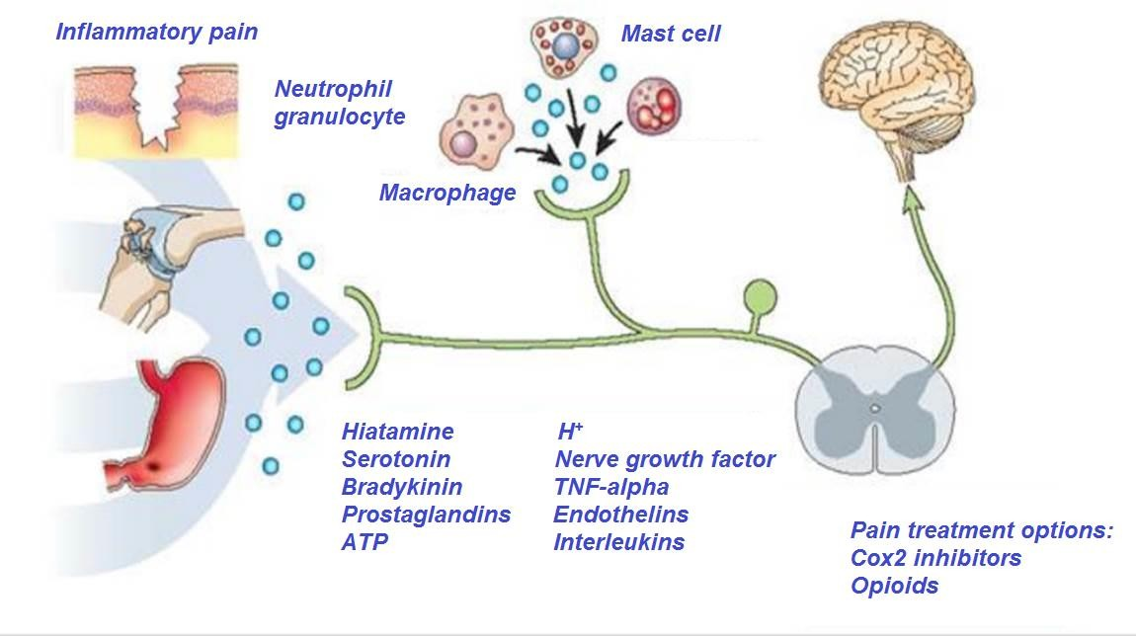
Pain Facilitation: Peripheral Sensitization
Inflammatory mediators can directly activate nociceptors or
cause their sensitization (decrease threshold)

Slide 24


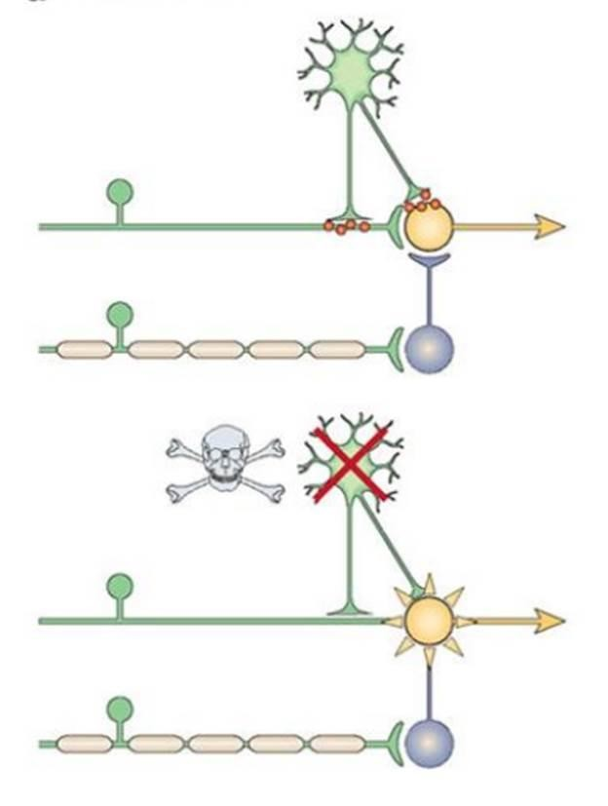
Pain Facilitation: Dis-inhibition
Pain transmission is controlled by inhibitory interneurons
Loss of these inhibitory interneurons after excessive release of glutamate results in increased excitability of projection neurons and thus enhanced pain sensation

Slide 25


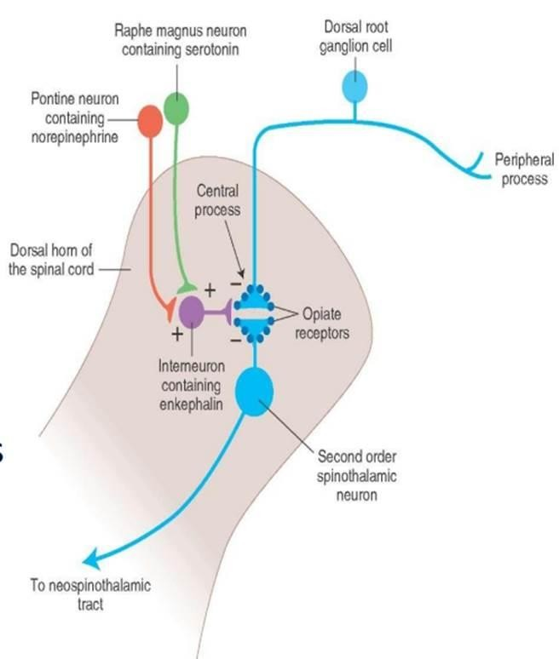
Neurotransmitters for Pain Modulation
▪
▪
▪
Serotonin Noradrenaline Encephalin
The serotonergic and noradrenergic neurons are crucial in the supraspinal modulation
Destroying these neurons with neurotoxins blocks the their analgesic actions

Slide 26
Hyperalgesia
Excessive Pain (e.g due to sun burn)
Allodynia
Pain caused by any other sensation e.g. touch will cause pain.
Muscular Pain
Less blood flow in the muscles (ischemia).
Causalgia
Burning pain.

Slide 27

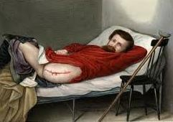
Stress induced analgesia
Pain suppression response that occurs during or following exposure to a stressful or fearful stimulus.
It’s a well known phenomenon seen when the soldier is wounded in battle field but feels no pain until the battle is over.
The cause is not known may be it is
similar to gate control hypothesis.
Phantom pain sensations Perceptions that an individual experiences relating to a limb or an organ that is not physically part of the body.

Slide 28
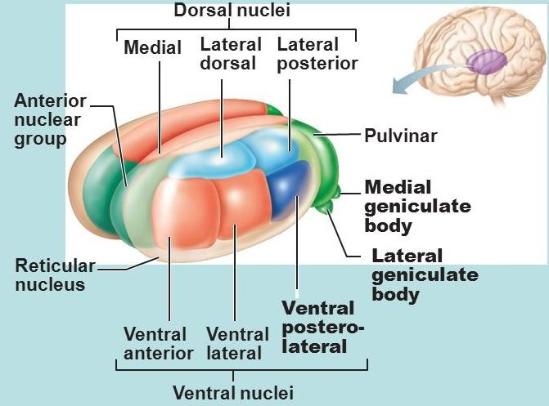
Thalamic Syndrome
It is a neurological condition that results from a brain stroke affecting the thalamus.
Cause: Obstruction of the thalmogeniculate branch
of the posterior cerebral artery.
Affects posterior thalamic nuclei.
Causes prolonged severe pain.

Slide 29

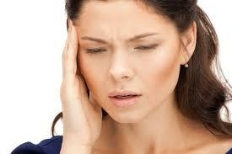
Trigeminal neuralgia
It is excruciating intermittent pain by
stimulation of trigger area in the face.
e.g. Washing of face, combing hair, blast of air
on face.
It results from compression of trigeminal nerve root by blood vessels.

Slide 30





Pain caused by a primary lesion or dysfunction in the nervous system.
Classification:
  Central NP-Damage of CNS
  Peripheral NP- Damage to PNS
Resistant to the current analgesic therapy.
Can persist for years.
Clinical symptoms: Hyperalgesia, allodyni and spontaneous pain
Examples: post herpetic neuralgia, diabetic neuropathy
and after chemotherapy.

Slide 31







Block production of inflammatory mediators .e.g.
Aspirin & nonsteroidal anti-inflammatories.
Exogenously administration of opioid like drugs.
Sympathectomy can be useful.
Electrical stimulation of the dorsal column.
Selective activation of large diameter afferent fibers by transcutaneous electrical nerve stimulation.
Stimulation of brainstem sites or administration of drugs which can modify serotoninergic or adrenergic neurons e.g. antidepressants.

Slide 32






