Slide 1
Pathophysiology of Epilepsy

Slide 2

Definition of seizure and Epilepsy
Seizures are symptoms of a disturbance in brain function , which can be due to epilepsy or other causes
A seizure is a sudden surge in electrical activity in the brain that causes an alteration in sensation, behavior, or consciousness

Slide 3
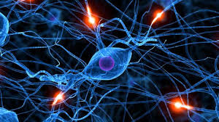
Abnormal , excessive electrical discharge of a group of neurons within the brain.
When a person has recurrent ( 2 or more) , unprovoked seizures → “ epileptic “.
Hence seizures can be a symptom of epilepsy .

Slide 4
Functional Neurophysiological Investigation
Electromyography (EMG) and nerve conduction studies
Electroencephalography (EEG)
Evoked potentials (EP)
Polysomnography (sleep study to diagnose disorders associated with abnormal sleep)
Intraoperative monitoring, Intraoperative neurophysiologic monitoring
Functional MRI

Slide 5
Evoked potential (EP)
Measure the electrical activity of the brain in response to stimulation of specific sensory nerve pathways
Detect the slowing of electrical conduction caused by damage
Auditory EP
Visual EP

Slide 6
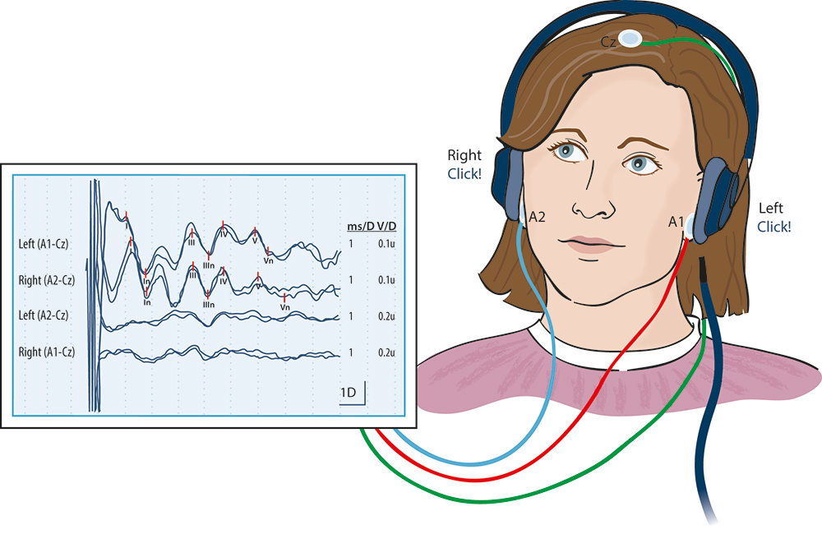
Auditory evoked potential

Slide 7
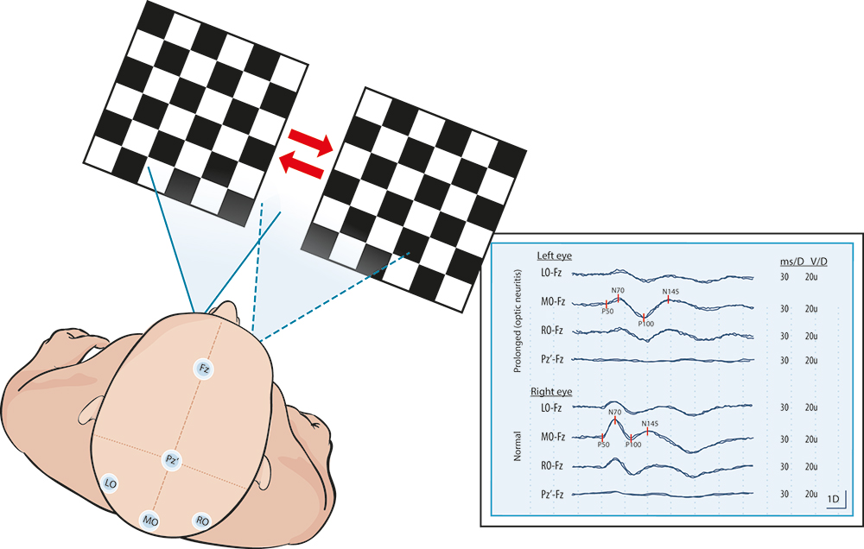
Visual evoked potential

Slide 8
Electroencephalogram ( EEG)
Measuring electrical activity of the brain (without stimulation)
EEG ›››› diagnosis, classifying seizures ›››› therapeutic decisions
spikes or sharp waves (Epileptiform EEG patterns)
Focal epileptiform discharges indicate focal epilepsy
Generalized epileptiform activity indicates a generalized form of epilepsy.

Slide 9
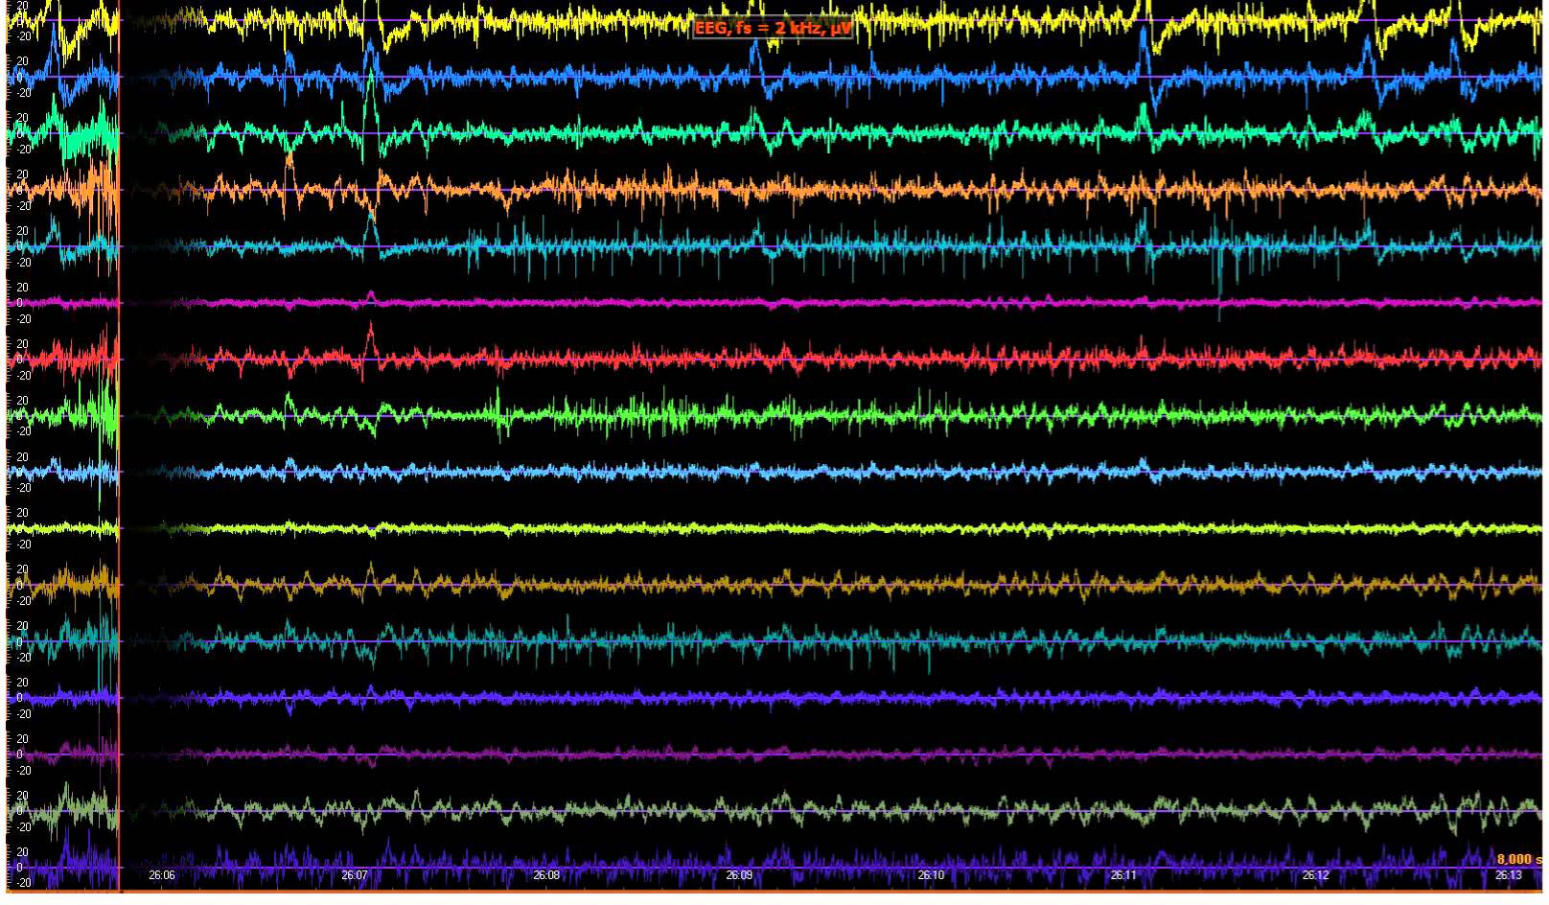
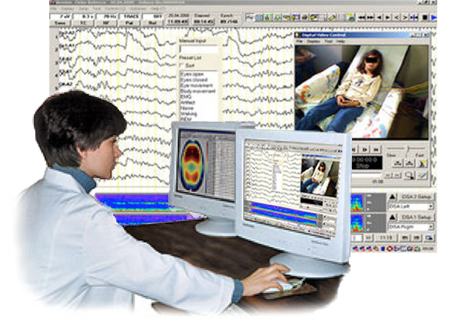

Slide 10
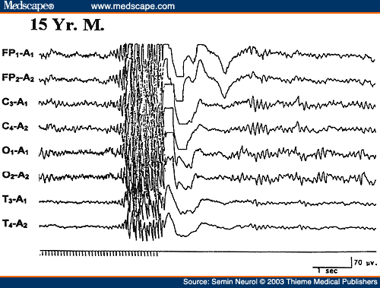

Slide 12
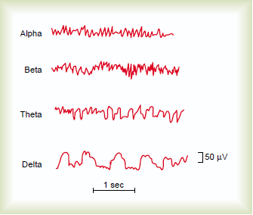
Electroencephalogram

Slide 13
Alpha waves:
Recorded from the parietal &occipital regions
Awake and relaxed+ eyes closed
10 to 12 cycles/second.
Beta waves:
Frontal lobes
Produced by visual stimuli and mental activity, awake
13 to 25 cycles per second.

Slide 14
Theta:
Temporal and occipital
5 to 8 cycles/second
Normal in newborn
Theta waves in awake adults indicates severe emotional stress
Delta:
From the cerebral cortex
1 to 5 cycles/second
Normal in:
Adult during sleep
Awake infant
In an awake adult indicates brain damage

Slide 15
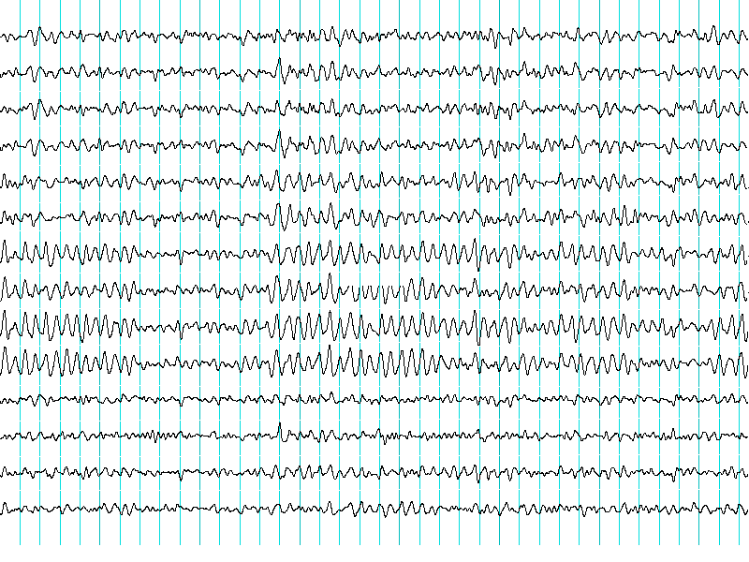
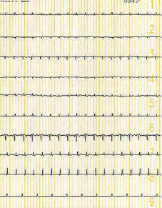
Brain Death Confirmatory Testing with EEG
Normal EEG ( at normal magnification )
Brain Death ( Flat EEG ,at very high magnification )

Slide 16
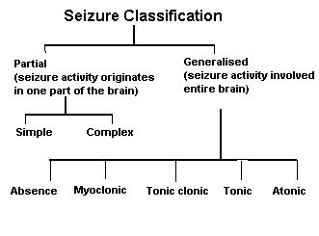
Type of Seizures
Partial
or
Generalized

Slide 18
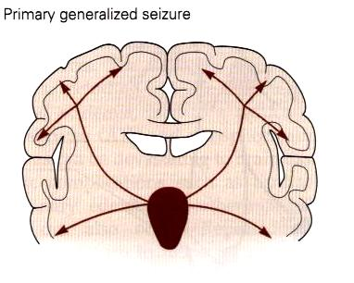
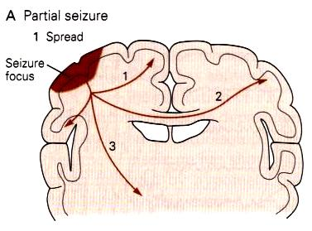
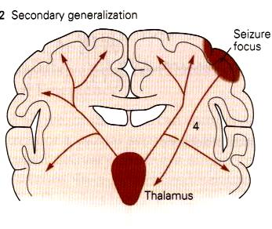

Slide 19
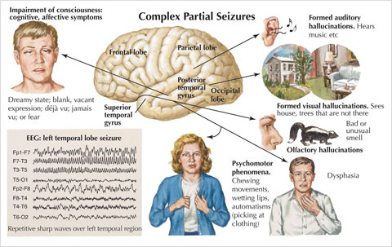

Slide 20
Seizure Classification & Clinical Manifestations
Focal / Partial seizures → their onset ( start) is limited to part of the cerebral hemisphere
Generalized seizures → those that involve the cerebral cortex diffusely ( whole of it ) from the beginning (generalized seizures)

Slide 21

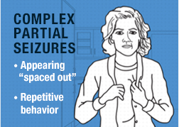
Partial Seizures
a. Simple partial seizures
Motor, somatosensory, and psychomotor symptoms
without impairment of consciousness
b. Complex partial seizures
Impairment of consciousness with or without simple partial symptoms

Slide 22
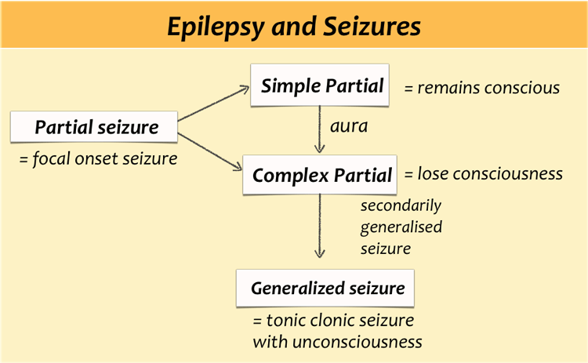

Slide 23
Generalized seizures
Manifest a loss of consciousness:
Generalized seizures include:
1-Myoclonic (are brief shock-like jerks of a muscle or group of muscles)
2- Clonic (rapidly alternating contraction and relaxation of a muscle -- in other words, repeated jerking)
3- Tonic ( the tone is greatly increased and the body, arms, or legs make sudden stiffening movements)
4- Tonic-clonic seizures (Grand Mal epileptic seizure)

Slide 24
Generalized
5- Atonic (Lose of muscles strength)
6- Absence seizures (Or non-convulsive)
(Petit mal epileptic seizures)
a. Loss of contact with environment for 5 to 30 seconds.
b. Appears to be day dreaming or may roll eyes, nod head, move hands, or smack lips.
c. Resumes activity and is not aware of seizure.

Slide 25
The onset of a seizures:
Small group of abnormal neurons undergo
Prolonged depolarizations
Rapid firing of repeated action potentials
Spread to adjacent neurons or neurons with which they are connected into the process.

Slide 26
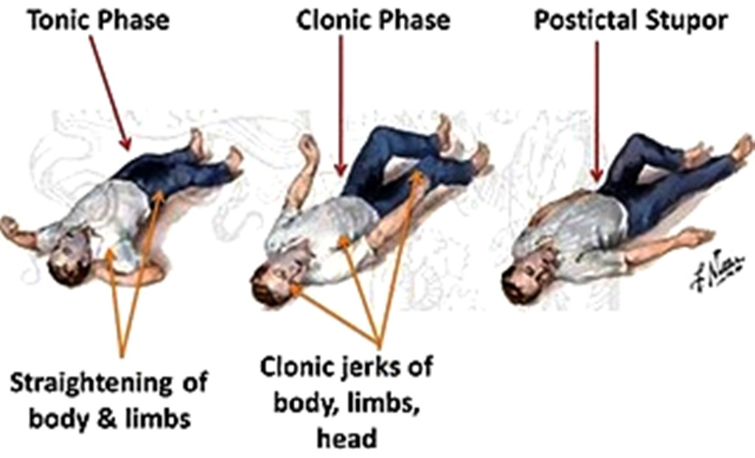
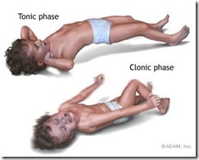
A clinical seizure occurs when the electrical discharges of a large number of cells become abnormally linked together, creating a storm of electrical activity in the brain.
Seizures may then spread to involve adjacent areas of the brain or through established anatomic pathways to other distant areas.

Slide 27
The clinical manifestations of a seizure reflect the area of the brain from which the seizure begins (i.e., seizure focus) and the spread of the electrical discharge.

Slide 28
Clinical manifestations accompanying a seizure are numerous and varied, including →
(1) indescribable bodily sensations,
(2) "pins and needles" sensations,
(3) smells or sounds,
(4) fear or depression,
(5) hallucinations,
(6) momentary jerks or head nods,
(7) staring with loss of awareness, and
(8) Convulsions → i.e., involuntary muscle contractions) lasting seconds to minutes

Slide 29
Pathophysiology of Epilepsy ( at molecular level)
Cortical cell membrane level:
Instability of the nerve cell membrane → Polarization abnormalities (excessive polarization ,hypopolarization , or lapses in repolarization), allowing the cell to be more susceptible to activation → Hypersensitive neurons with lowered thresholds for firing and firing excessively , related to →

Slide 30
(1) Excess of Excaitatory neurotransmitters
(acetylecholine- or Glutamate –related activity)
(2) Decreased inhibitory ( GABA –related activity)
→ leading
-Instability of cell-membrane
- Lowered threshold for excitation
→ excessive polarization, hypopolarization allowing the cell to be more susceptible to activation spontaneously or by any ionic imbalances in the immediate chemical environment of neurons → Seizures

Slide 31
Some types of seizures susceptibility are linked to genes
(run in families)
Genetic abnormalities ›››› increasing a person's susceptibility to seizures that are triggered by an environmental factor
Several types of epilepsy have now been linked to defective genes for ion channels, the "gates" that control the flow of ions in to and out of cells and that regulate neuron signaling.

