Slide 1
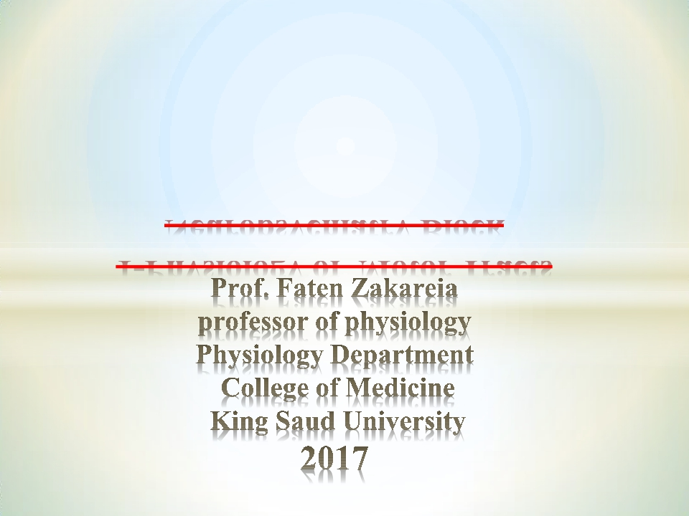
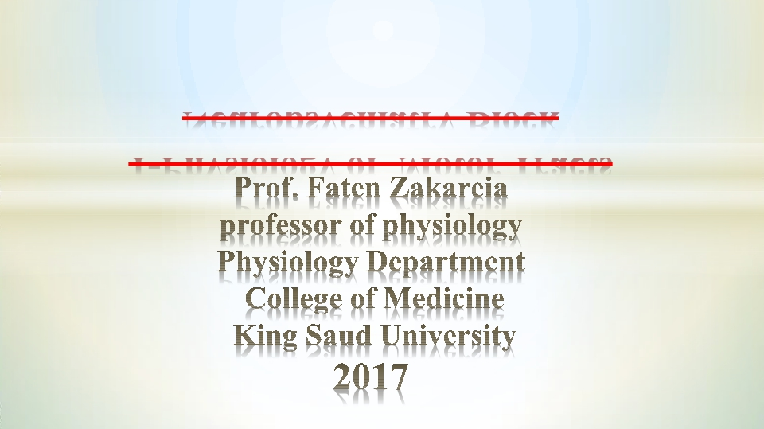
Neuropsychiatry Block
1-Physiology of Motor Tracts

Slide 3
Upper & lower motor neurons
1-Upper motor neurons (UMN):-
There are two UMN Systems :
1- Pyramidal system (corticospinal tracts ).
2- Extrapyramidal system
2- lower motorv neurons(LMN)

Slide 4
Descending Tracts
*

Slide 5
* 1-Corticospinal (Pyramidal tracts )& corticobulbar tracts;-
Origin/
1- 30% motor area 4 ( the primary motor area)
2- 30% from the premotor areas & supplemetary cortex
Premotor area:- (motor association area) lies in front of the primary motor area
& below supplementary motor area. Its stimulation produces complex coordinated
movements, such as setting the body in a certain posture to perform a specific task.
- Supplemetary cortex /located on the lateral side of the brain in front
of area 4 and above the pre-motor area & extends on medial side of the cerebral
hemisphere.
• Concerned with planning and programming motor sequences.•
3- 40% parietal cortex ( somatic sensory area 3,1,2)

Slide 6
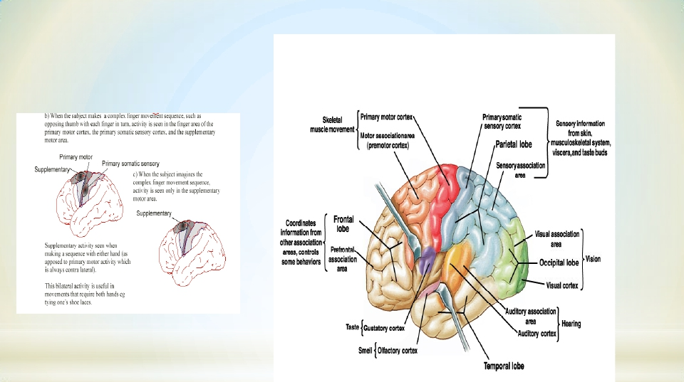
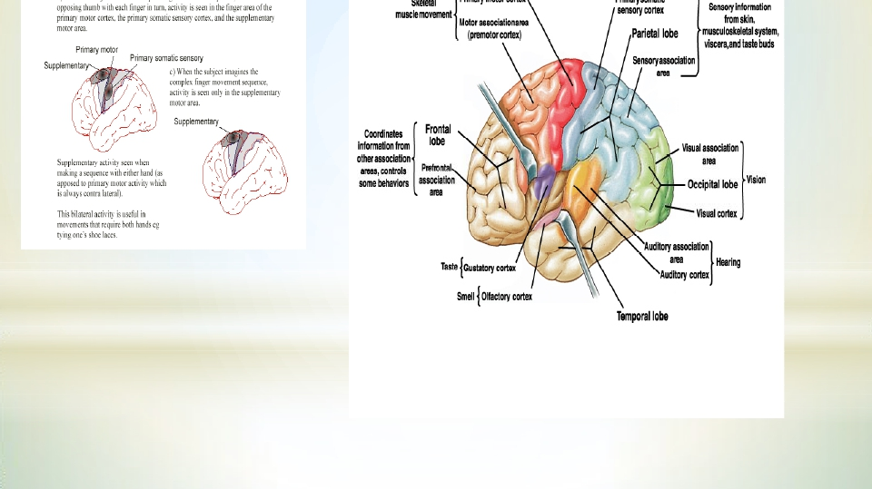

Slide 7
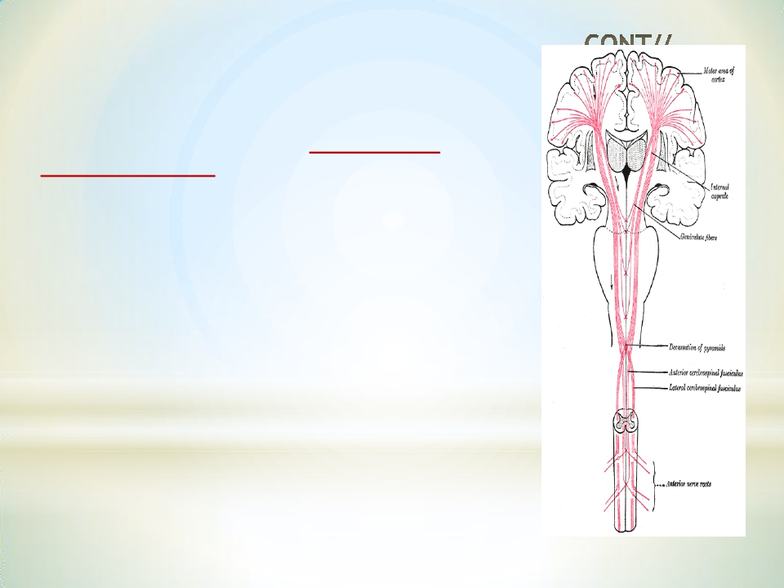
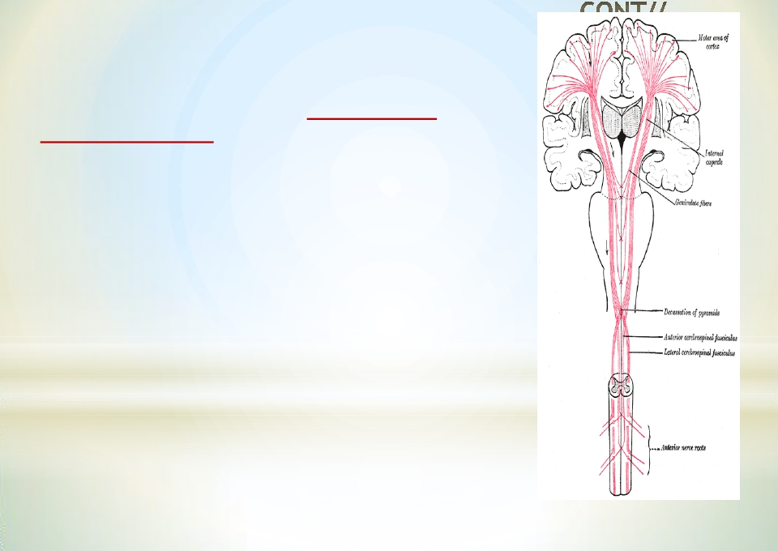
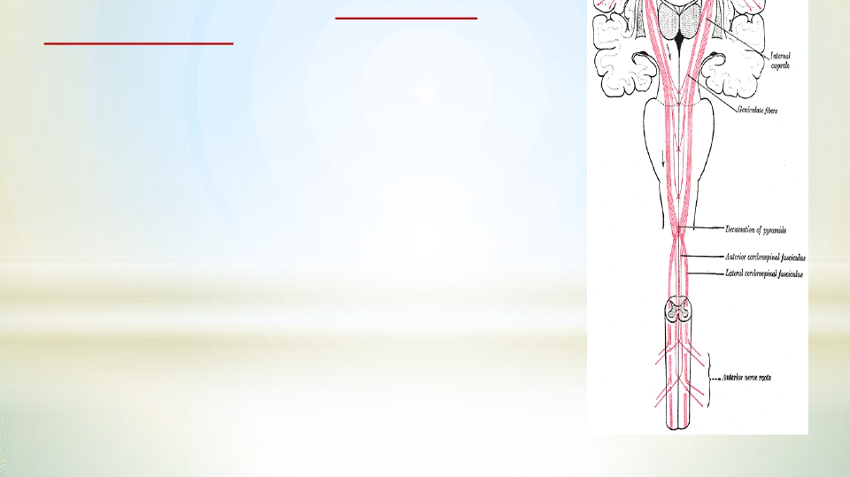
*
• 3% of the pyramidal fibres are large
myelinated, derived from giant, highly excitable
pyramidal Betz cells in motor area 4.
- -The Betz cells fibers transmit nerve impulses to
the spinal cord at a velocity of about 70 m/sec, the
most rapid rate of transmission of signals from
the brain to the cord.
-
Giant Betz cells axons send short collaterals back
to the cortex to inhibit adjacent regions of the
cortex when the Betz cells discharge, thereby
“sharpening” the excitatory signal.
• - Fibers from the cerebral cortex descend in
>>>>CORONARADIATA to >>>>INTERNAL
CAPSULE genu and the anterior two-third of
the posterior limb then to >>>>>>BRAIN
STEM ( midbrain,pons,medulla oblongata)

Slide 8
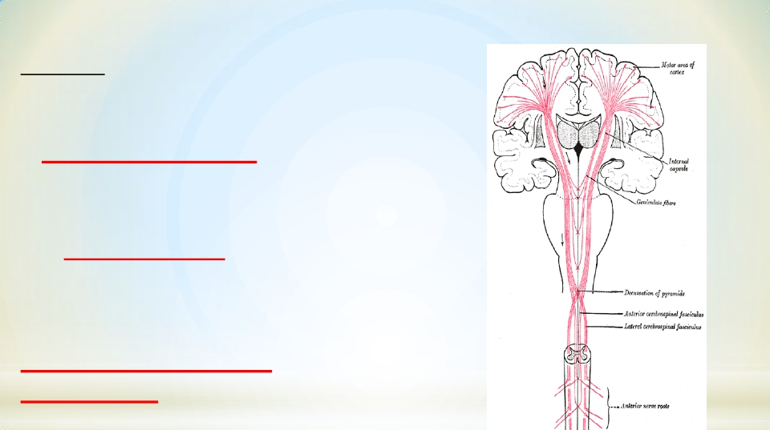
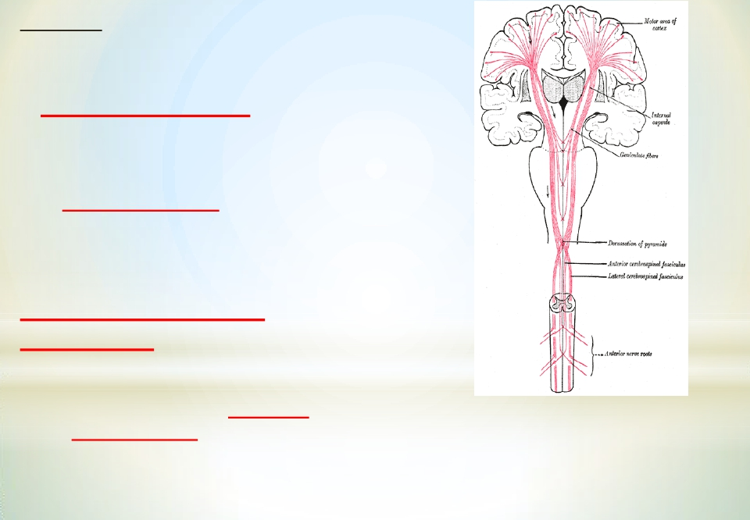
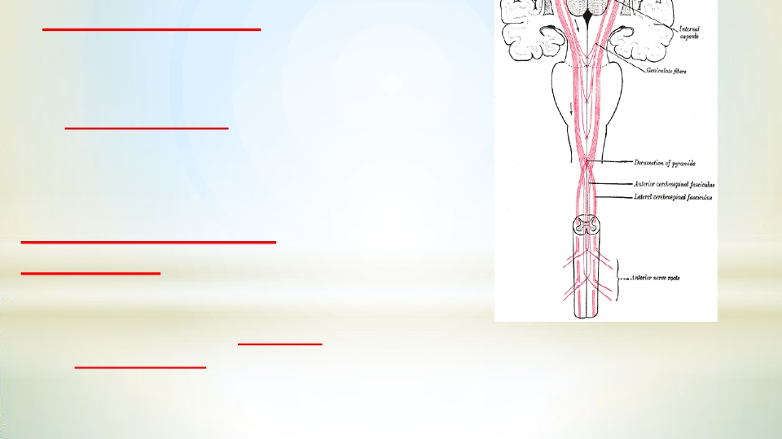
CONT//
-In the brain stem midbrain, pons &
medulla oblongata
1-Corticobulbar tract
terminates on
cranial nerve nuclei of opposite
side ) (decussating just before they reach
their target nuclei .)
-The Corticobulbar tract carries
information to motor neurons of the
cranial nerve nuclei
2- Corticospinal tracts
(pyramidal)
-Descends through the midbrain and pons,
Then in the lower medulla
oblongata the fibers form pyramids so
called pyramidal tract

Slide 9
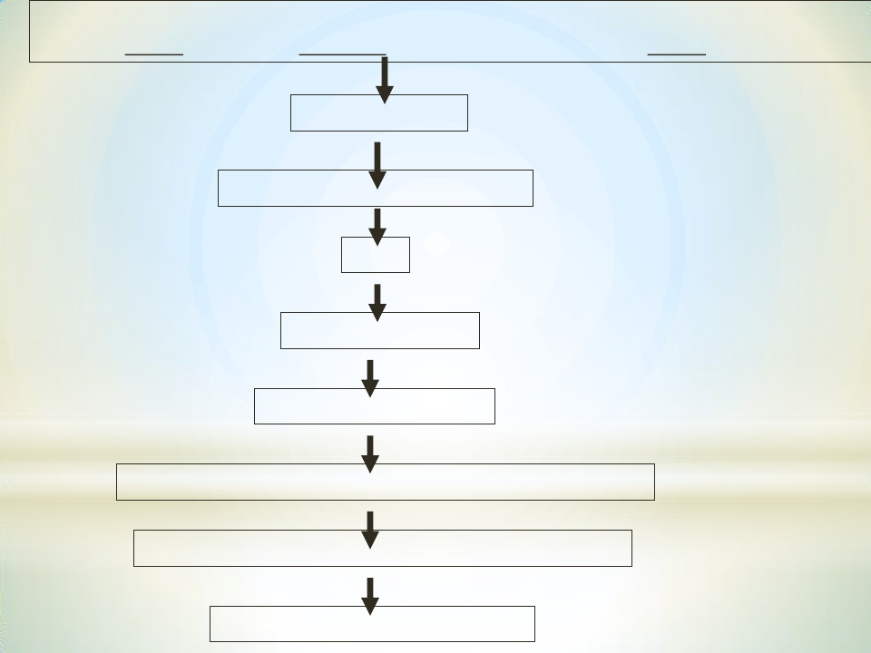
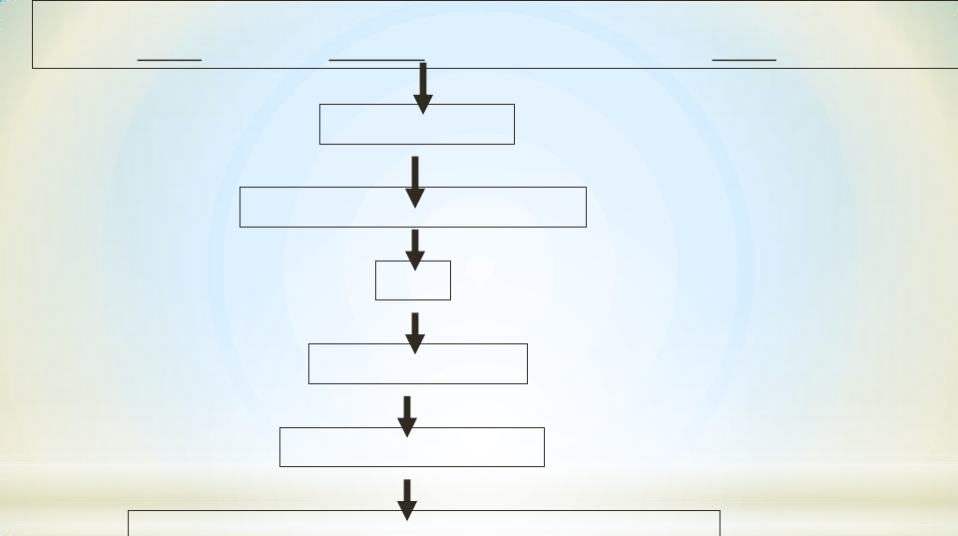
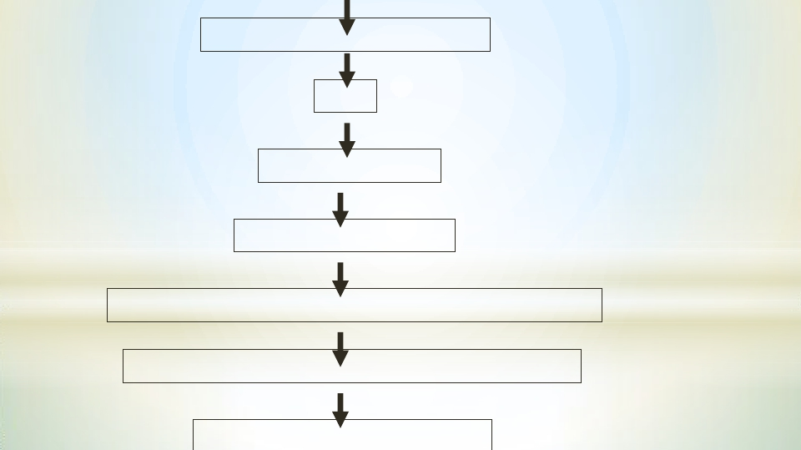
Origin – Sensory cortex, primary Motor Cortex, premotor & supplementary cortex
(40%)
(30%)
(30%)
Internal Capsule
Cerebral Peduncle (midbarain)
Pons
Medullary Pyramid
Pyramidal Decussation
Lat.Cross & Vent. Uncross White matter in spinal cord
Ant. Horn of spinal cord through a interconnection
α motor neuron of opposite side

Slide 10
-Corticospinal tracts ( pyramidal) divides into:_
1- lateral corticospinal tracts :-
- 80% of fibers cross midline in pyramids
- Pass laterally in spinal cord white matter
- Ends directly ( not via interneurons = monosynaptic
connections) on motor neurons (AHCs) of the opposite side
here the lower motor neurons (LMNs) of the corticospinal
cord are located.
-Then peripheral motor nerves carry the motor impulses
from the anterior horn to the voluntary muscles
- The fibers pass laterally in spinal cord white matter, so
they control distal limb muscles
Function//- controls and initiates fine discrete skilled
movements of fingers and toes.

Slide 11
2- Ventral (anterior) corticospinal
tracts :-
- Remaining20% fibers does not cross midline
- Cross at level of theirterminationto synapse
with interneurons , that synapse with motor
neurons (AHCs) of opposite side.
-Pass medially in ventral horn so control axial
& proximal limb muscles
NB/ So corticospinal tract( ANT& LAT) supply skeletal
muscles of the opposite side

Slide 12
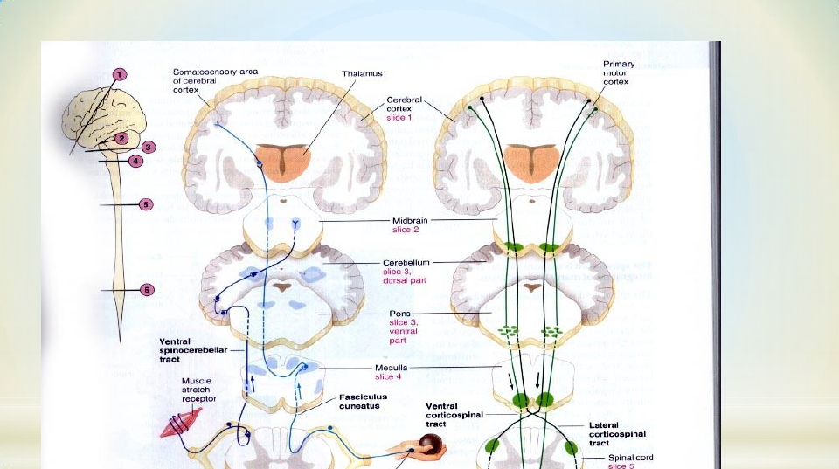
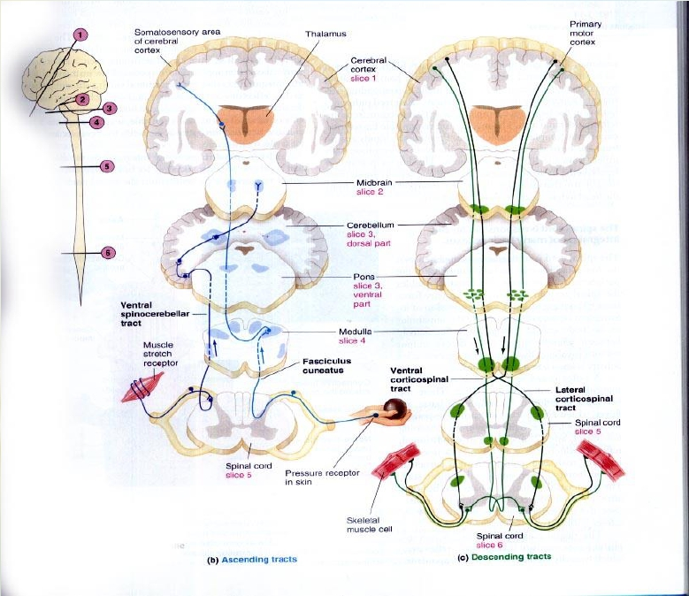
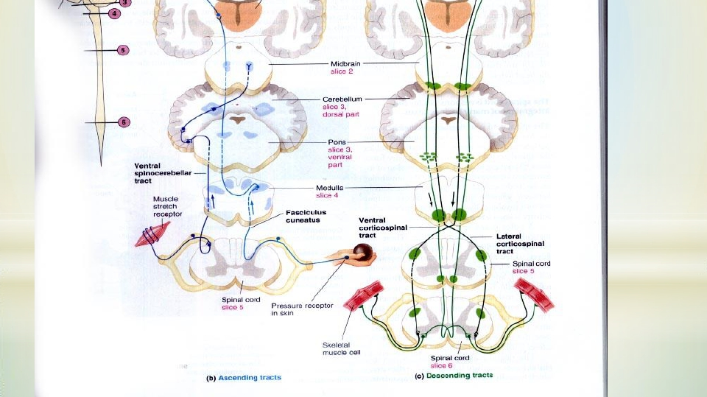
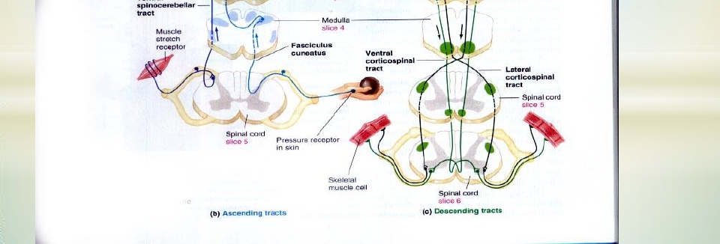

Slide 13
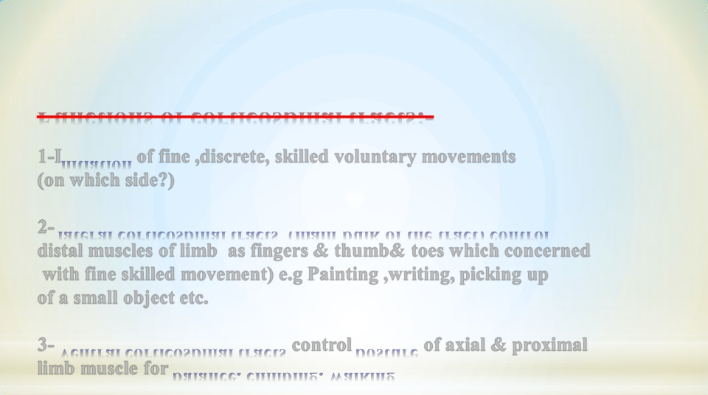
Functions of corticospinal tracts:-
1-Initiation of fine ,discrete, skilled voluntary movements
(on which side?)
2- lateral corticospinal tracts (main bulk of the tract) control
distal muscles of limb as fingers & thumb& toes which concerned
with fine skilled movement) e.g Painting ,writing, picking up
of a small object etc.
3- Ventral corticospinal tracts control posture of axial & proximal
limb muscle for balance, climbing, walking

Slide 14
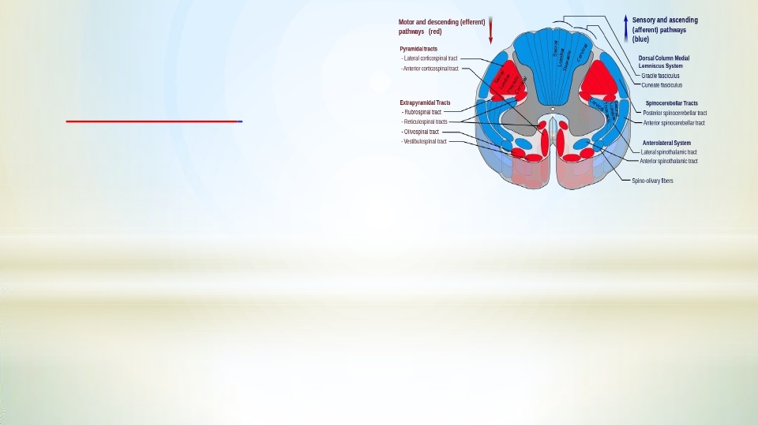
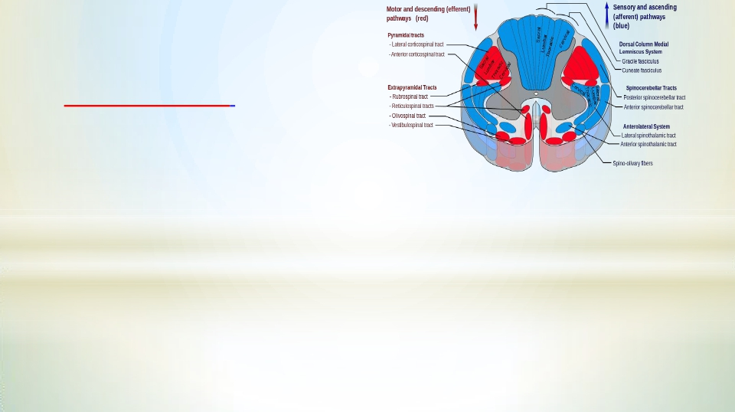
4- Effect on stretch reflex:-
- Faccilitate muscle tone through
gamma motor neurons
5- Fibers originate from parietal lobe are
for sensory-motor coordination
6- Corticobulbar tracts /control face &
neck muscles & faccilitate their tone,
and are involved in facial expression,
mastication& swallowing.

Slide 15
Excitation of the Spinal Cord Motor Control Areas by the Primary
Motor Cortex and Red Nucleus
-Vertical Columnar Arrangement of the Neurons in the Motor Cortex.
-Each column has six distinct layers of cells, The pyramidal cells that
give rise to the corticospinal fibers all lie in the fifth layer of the
cortical surface.
-Function of Each Column of Neurons.
-Each column of cells functions as a unit & as integrative processing
system, using information from multiple inputs to determine the output
response from the column.
- Each column can function as an Amplifying system to stimulate
large numbers of pyramidal fibers to the same muscle or to
synergistic muscles simultaneously.
.

Slide 16
Dynamic and Static Signals Transmitted by the Pyramidal Neurons. .
-Each column of cells excites two types of pyramidal cell neurons
1-The dynamic neurons are excited at a high rate for a short period at the
beginning of a contraction, causing the initial rapid development of contraction.
2- The static neurons fire at a much slower rate, but continue firing at this
slow rate to maintain the force of contraction as long as the contraction
is required.
-The neurons of the red nucleus have similar dynamic and static characteristics, -
Greater percentage of dynamic neurons is in the red nucleus and a greater
percentage of static neurons is in the primary motor cortex.

Slide 17
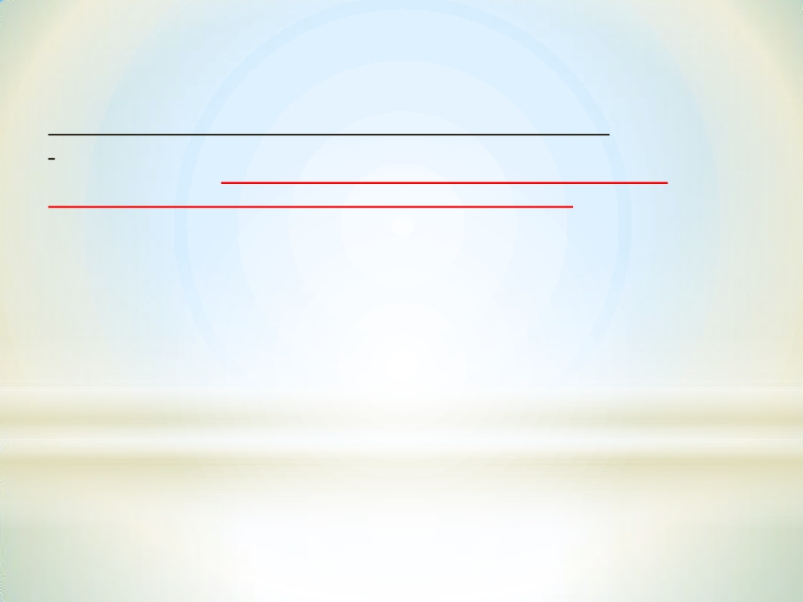
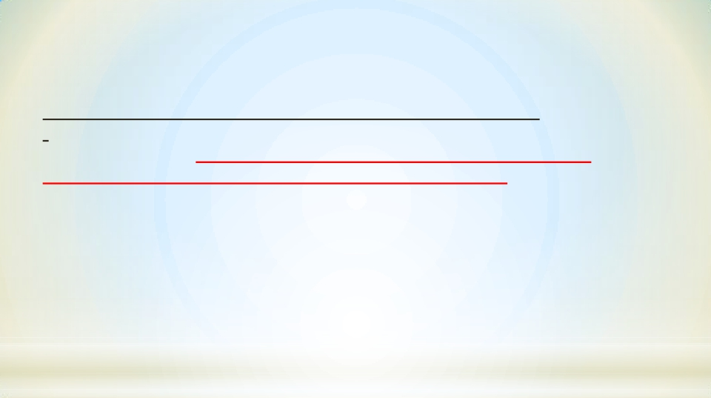
.
Removal of (Area Pyramidalis) of the Primary Motor Cortex
-Removal of a the area that contains the giant Betz pyramidal cells (Area
Pyramidalis) causes loss of voluntary control of discrete movements of the
distal segments of the limbs, especially of the hands and fingers
(This does not mean that the hand and finger muscles themselves cannot contract ( paralysis)
rather, the ability to control the fine movements is gone).
-That is because area pyramidalis is essential for voluntary initiation of finely
controlled movements, especially of the hands and fingers

Slide 18
Extrapyramidal tracts :-
Tracts other than corticospinal tract & are outside pyramids
Origin/ motor area 4, premotor area 6, Suppressor area 4 >>>>CORONA
RADIATA to>>>>INTERNAL CAPSULE to>>>>BASAL GANGLA to
BRAIN STEM
BULBOSPINAL TRACTS descend to spinal cord
as
A- Rubrospinal tract.
B- Vestibulospinal Tract.
C- Reticulospinal Tract
D- Tectspinal Tract.
E- Olivospinal Tract

Slide 19
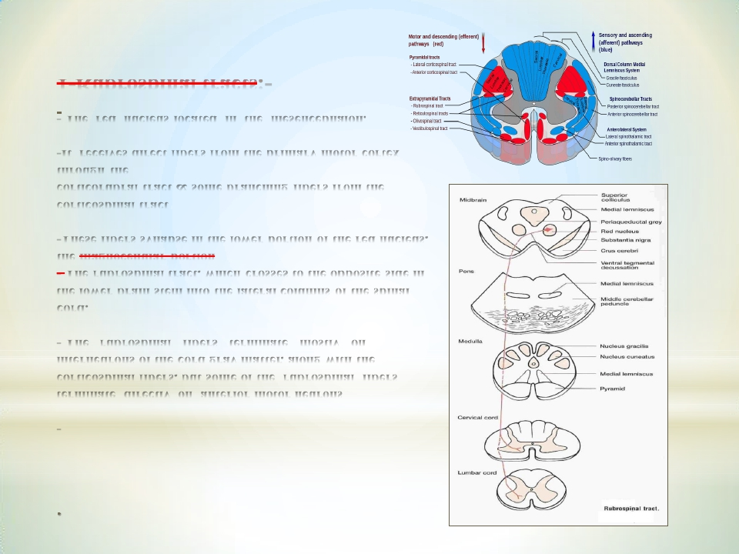
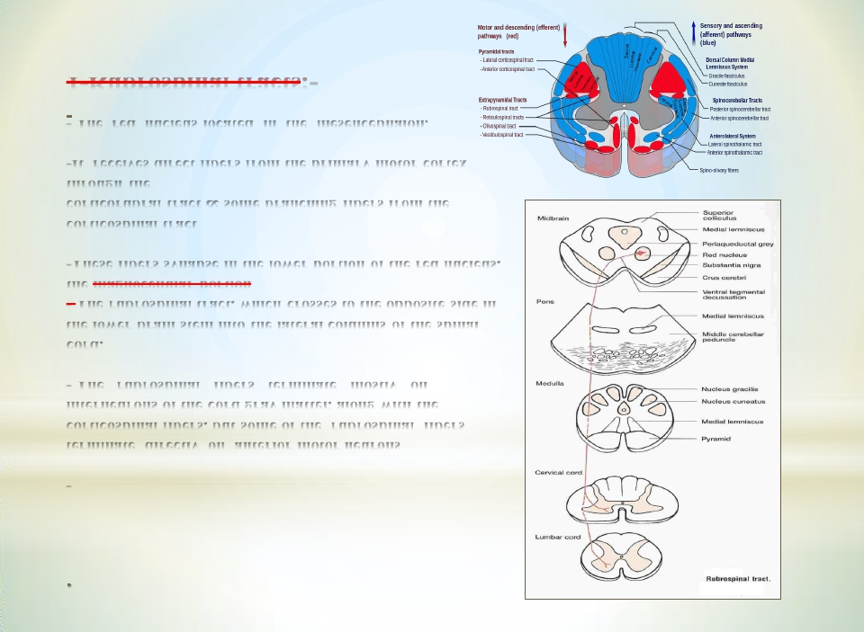
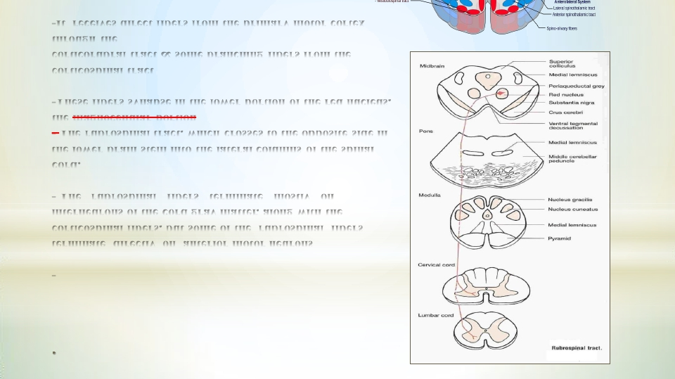
1-Rubrospinal tracts:-
The red nucleus located in the mesencephalon.
-It receives direct fibers from the primary motor cortex
through the
corticorubral tract & some branching fibers from the
corticospinal tract
-These fibers synapse in the lower portion of the red nucleus,
the magnocellular portion
- The rubrospinal tract, which crosses to the opposite side in
the lower brain stem into the lateral columns of the spinal
cord.
- The rubrospinal fibers terminate mostly on
interneurons of the cord gray matter, along with the
corticospinal fibers, but some of the rubrospinal fibers
terminate directly on anterior motor neurons
-

Slide 20
Function of the Corticorubrospinal System.
.
-The corticorubrospinal pathway serves as an accessory route for transmission
of discrete signals from the motor cortex to the spinal cord. When the
corticospinal fibers are destroyed , discrete fine control of the fingers
movements can still occur but impaired..
-Rubrospinal tract lies in the lateral columns of the spinal cord, along with the
corticospinal tract. Therefore, the corticospinal and rubrospinal tracts together are
called the lateral motor system of the cord, in contradistinction to a vestibulo-
reticulospinal system, which lies mainly medially in the cord and is called
the medial motor system of the cord

Slide 21
* 2- Vestibulospinal tracts:-
Fibers originate in vestibular nuclei in pons
(which receive inputs from inner ear
,VestibularApparatus and cerebellum)
-Axons descend in the ipsilateral ventral white
column of spinal cord
- General Functions:-
1- Controls Postural & righting reflexes.
2-Excitatory to ipsilateral spinal motor
neurons-that supply axial & postural muscles
3- Control eye movements

Slide 22
Functions of Vestibulospinal Tracts
The lateral vestibulospinal
excitatory
posture& righting reflexes
B- The medial vestibulospinal tract
cervical segments of the spinal
cord
Medial Longitudinal
Fasciculus fibers in brain stem
forcoordinationof head and eye movements
Role of the Vestibular Nuclei to Excite theAntigravity Muscles
The vestibular nuclei, function in association with the pontine reticular
nuclei to control the antigravity muscles.
- The vestibular nuclei transmit excitatory signals to the antigravity
muscles by way of the lateral and medial vestibulospinal tracts
-Without this support of the vestibular nuclei, the pontine reticular system
would lose much of its excitation of the axial antigravity muscles.

Slide 23
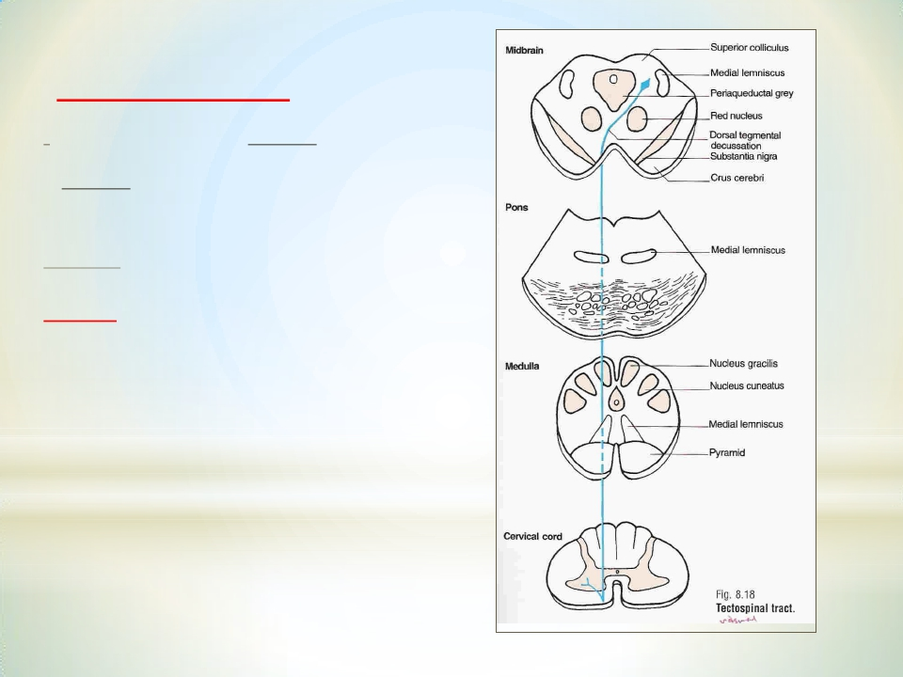
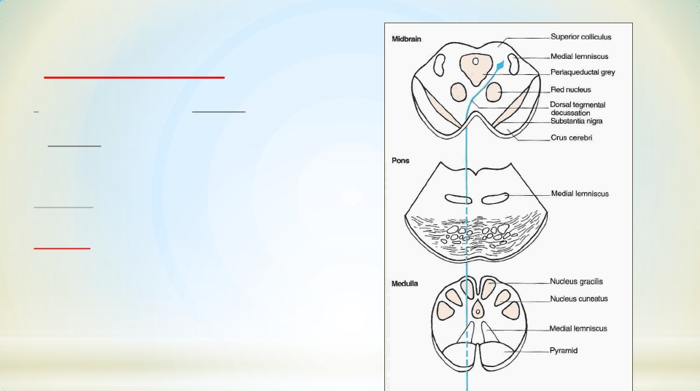
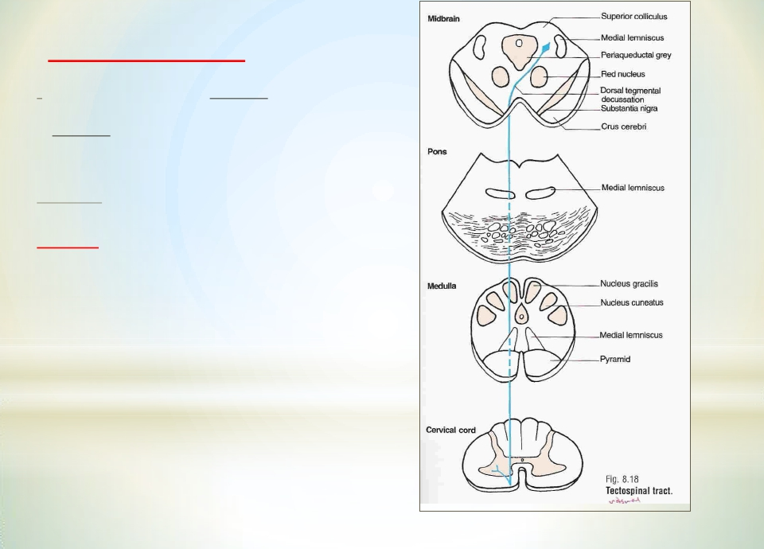
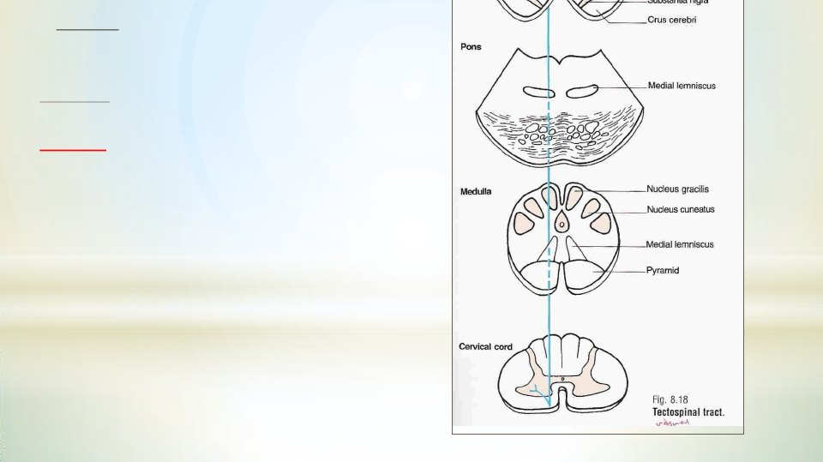
3- Tectospinat tracts:-
-From superiorcolliculi of midbrain
( for VISUAL reflexes) & from inferiorcolliculi of
midbrain
( for AUDITORY reflexes)
- Ends on Contralateralcervicalmotor neurons
Function: Mediate/facilitateturning of the
head in response to visual orAuditory stimuli

Slide 24
*
4- Reticulospinal Tract :-
Pontine and medullary nuclei
Reticulospinal Tract
Types of reticulospinal tracts:-
(1) Pontine (Medial) Reticulospinal Tract:
• Cells of origin: Pontine ReticularFormation which has
high excitability & they receive strong excitatory signals
from the vestibular nuclei .
•Axons descend in anterior(ventral )white column of
spinal cord
• Pontine ReticulospinalTract increases Gamma efferent
activity ( excitatory to axial & antigravity, extensor
muscles of the body&increases muscle tone )
-it causes powerful excitation of antigravity muscles

Slide 25
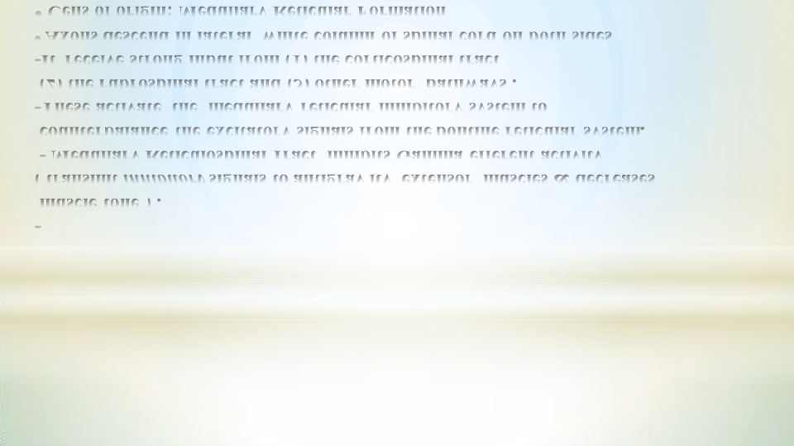
(2) Medullary (Lateral) Reticulospinal Tract:
• Cells of origin: Medullary Reticular Formation
•Axons descend in lateral white column of spinal cord on both sides
-It receive strong input from (1) the corticospinal tract
(2) the rubrospinal tract and (3) other motor pathways .
-These activate the medullary reticular inhibitory system to
counterbalance the excitatory signals from the pontine reticular system,
- Medullary Reticulospinal Tract inhibits Gamma efferent activity
( transmit inhibitory signals to antigrav ity extensor muscles & decreases
muscle tone ) .
-

Slide 26
5-Olivospinal Tract :-
inferiorolivary N
supply neck
muscles)

