Slide 1



Slide 2











Slide 3

What is pain and its significance
Pain reception and perception
Pain receptors (nociceptors)
Mechanism of stimulation of pain receptors
Qualities of pain
Types of pain
•Somatic pain ( superficial & deep pain).
•Visceral pain.
Referred pain
Pathway of pain
  The neospinothalamic pathway
  The paleospinothalamic pathway
Role of thalamus and cerebral cortex in pain perception

Slide 4


Pain & Nociception
What is nociception?
Refers to the transmission of signals evoked by
activation of nociceptors (pain receptors) from
periphery to the CNS.
What is pain?
Is perception of unpleasant sensation that
originates from a specific body region. Is an unpleasant sensory and emotional
experience associated with actual or
potential tissue damage.

Slide 5

Sensory receptors: are specialized peripheral endings of primary afferent neurons.
Nociceptors (pain receptors): primary afferent receptors that respond selectively to noxious stimuli.
Noxious stimulus: any stimulus (mechanical,
chemical or thermal) that produces tissue damage
or threatens to do so (≠ innocuous).
o Polymodal nociceptors: respond to various noxious
stimuli.

Slide 6


It is a protective mechanism meant to make us aware that tissue damage is occurring or is about to occur:-
  Avoid noxious stimuli
  Remove body parts from danger
  Promote healing by preventing further damage
  Storage of painful experiences in memory helps us
to avoid potentially harmful event in the future
The sensation of pain may be accompanied by behavioral responses (withdrawal, defense) as well as emotional responses (crying, anxiety or fear).
Pain is perceived at both the cortical & thalamic levels.

Slide 7


Reception (لابقتسلإا): Response of nerve receptors in the skin and tissues to stimuli resulting from actual or potential tissue damage.
Perception (كاردلإا): The process by which pain is recognized and interpreted by the brain.

Slide 8
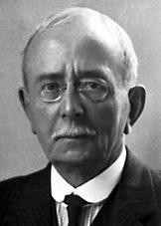
Pain Receptors `Nociceptors`?
‘‘ Are special receptors that respond only to noxious stimuli and generate nerve impulses which the brain interprets as "pain". (Sherrington 1906)
They are the most widely distributed.
Sir Charles Scott
Sherrington
They are specific (have adequate stimulus) in that pain is not produced by overstimulation of other receptors.
They are high threshold receptors i.e. painful stimuli must be
strong & noxious to produce tissue damage.
Do not adapt (or very little) to repetitive stimulation (it allows the pain to keep the person apprised of a tissue-damaging stimulus as long as it persists.)

Slide 9
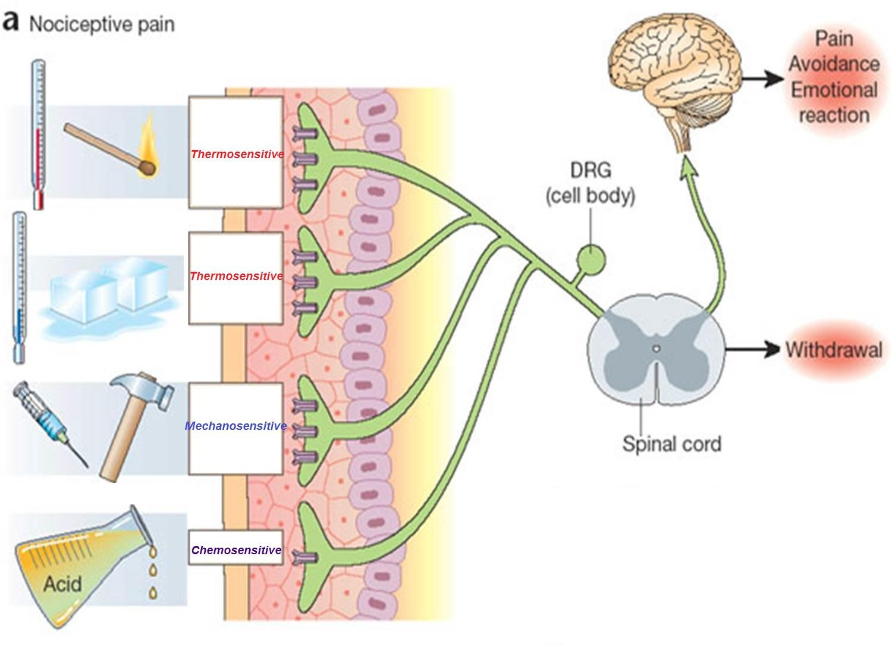
Polymodal nociceptors
Polymodal nociceptors

Slide 10
Distribution of Pain Receptor(Nociceptors)
➢Widespread in
superficial layers of
Nociceptors
skin
➢Fewer in deep tissue
and absent in brain
tissue

Slide 11
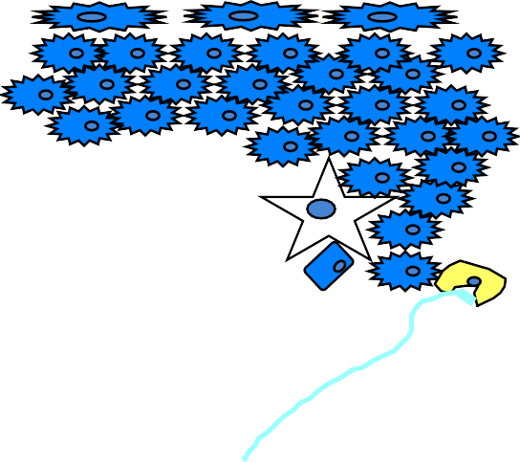
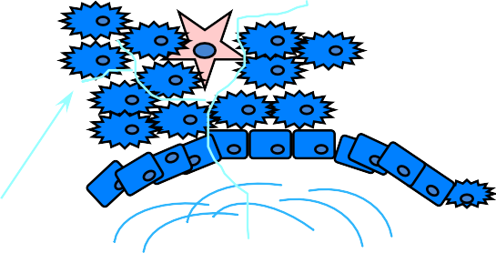

oAll pain receptors are free nerve endings of unmyelinated C fibers & small diameter myelinated Aδ fibers.
Free endings Pain receptors

Slide 12
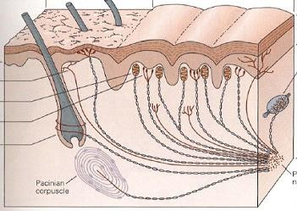
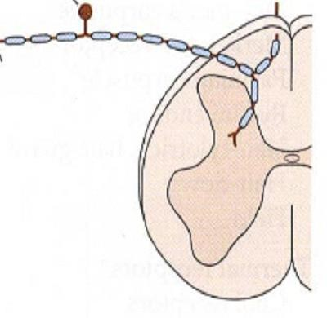
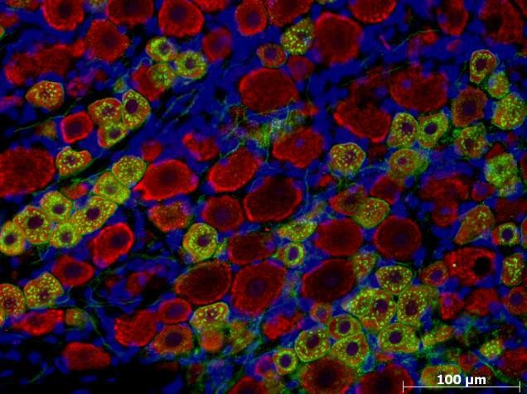
Type-A & Type-C Fibers
A-fibre
C-fibre
Modified: Martin and Jessel (1991) Principles of Neuroscience
Small:<30µm
M
Medium: 31-40µm
Large:>40µm
S
Nociceptors (small/medium)
Non-nociceptors (large)
L

Slide 13
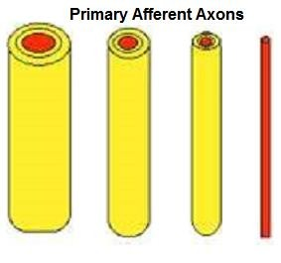
Classification of Nerve fibres
Type
Type Diameter (µm)
I II
Aα Aβ
10-20 5-10
30-70
III
Aδ C
2-5 0.5-2
IV
Conduction Velocity (m/s) 70-120
5-30 0.5-2

Slide 14






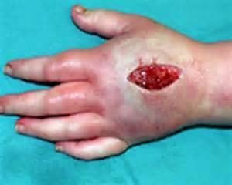
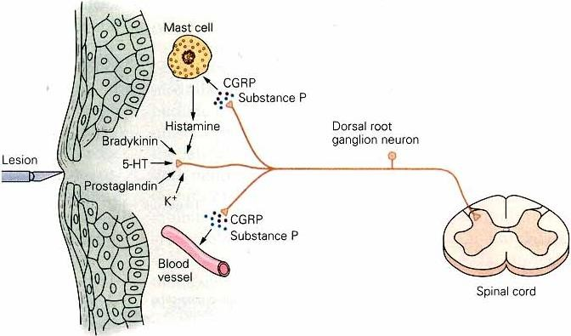
Pain receptors are depolarized either directly or through the production of pain producing substances from damaged tissues as a result of inflammation ( also called inflammatory mediators)
e.g. bradykinin, histamine, substance P, calcitonin gene- related peptide (CGRP), interleukins, prostaglandins, K⁺, Ach, proteolytic enzymes.

Slide 15



Substance | Source
Potassium | Damaged cells
Serotonin | Platelets
Bradykinin | Plasma
Histamine | Mast cells
Prostaglandins | Damaged cells
Leukotrienes | Damaged cells
Substance P | Primary nerve afferents

Slide 16
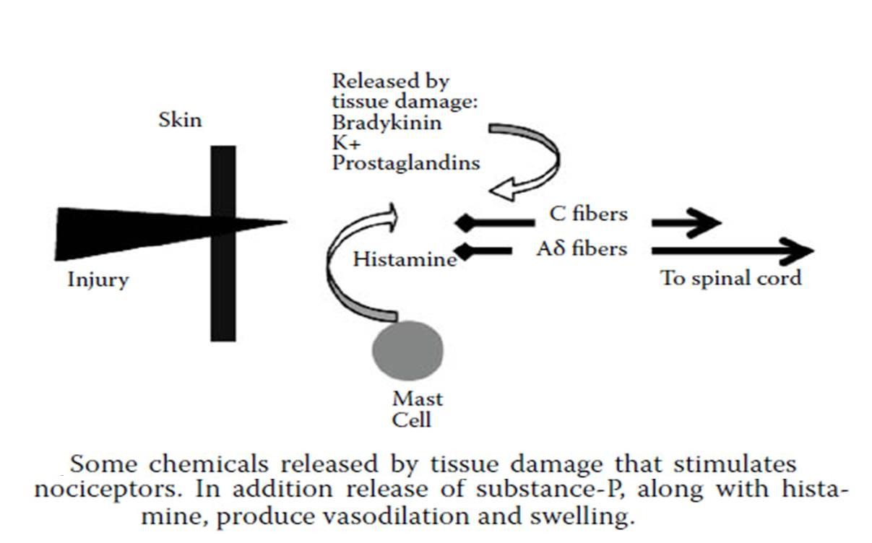

Pain Mechanism

Slide 17









Damage and inflammation
Release chemical mediators activate or sensitize the receptor endings
Cytokines, bradykinin, prostaglandin, Substance p
Results in transduction
Conduction of nerve impulse

Slide 18


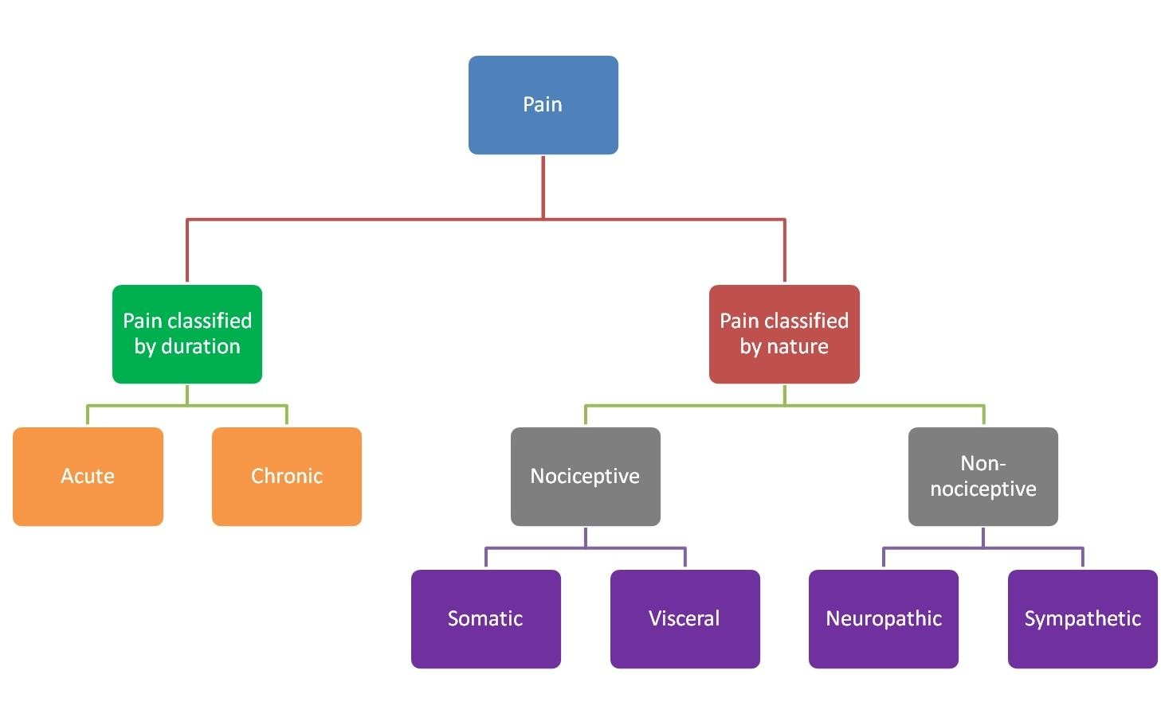

Slide 19

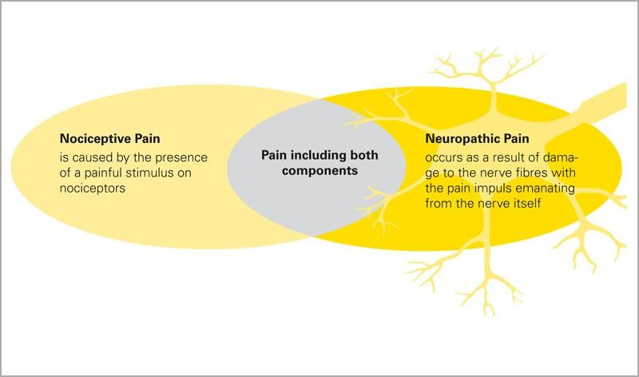

Slide 20





(Phenomenon of double-pain) Fast/Sharp/immediate (1st) pain vs slow/diffuse/delayed (2nd) pain
Fast pain Slow pain (or second)
Sharp, intense, pricking
Burning, aching, throbbing “unbearable” diffuse, dull, or chronic pain
▪Felt after 1 sec or more
Associated with destruction of tissue
Can occur in skin or any internal organ/tissue
Felt within 0.1 sec
Associated with reflex withdrawal
Usually somatic not visceral
Well localized and is mediated by Aδ- ▪ Poorly localized and is mediated by C-fiber
fiber nociceptors
nociceptors: → misery (responsible for emotional aspect of pain)
▪Terminate at II and III laminas
▪Neurotransmitter – Substance- P
▪Terminate at I and V laminas
▪Neurotransmitter – glutamate

Slide 21



Pain can be classified according to the site
of stimulation into:-
Somatic pain (superficial & deep pain).
Visceral pain.

Slide 22


It arises from skin or other superficial
structures.
It occurs in 2 phase of fast pricking followed by
slow burning pain.
It can be well localized.
It may be associated with motor, autonomic,
emotional reactions.

Slide 23


It originates from muscles, joints, periosteum, tendons &
ligaments
It is slow prolonged conducted by type C fibers.
It is diffuse (i.e. poorly localized).
It can initiate reflex contraction of nearby muscles.
It may be referred to other sites.
It is caused by: trauma, bone fracture & inflammation, arthritis, muscle spasm & ischemia.

Slide 24


➢There are few pain receptors in most viscera
➢Some viscera are pain insensitive e.g. liver parenchyma, lung alveoli, brain tissue, visceral layer of peritoneum, pleura and pericardium.

Slide 25

It is slow pain conducted by C fibers (pain arising from parietal peritoneum, pleura and pericardium is sharp, pricking type).
It is diffuse, poorly localized, the patient feels pain
arising from inside but he cannot pinpoint it exactly.
It is often associated with nausea and autonomic
reactions.
It can be associated with rigidity of nearby muscles.
It often referred to other sites.

Slide 26

Distension of a hollow organs
Inflammation of an organ.
Ischemia e.g. pain due to myocardial
ischemia.
N.B: Cutting, crushing are not painful
when applied to viscera.

Slide 27


This is pain that is felt away from its original
site.
It is most frequent with visceral pain & deep somatic pain but cutaneous pain is not referred.
Pain is referred according to dermatomal rule.

Slide 28

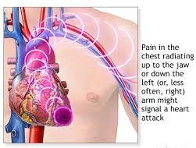
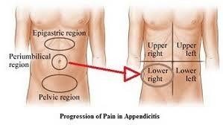
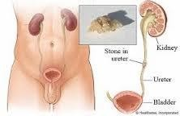
Cardiac pain is referred to the jaw, left shoulder & inner side of left arm.
Pain of appendicitis is referred to
periumbilical region.
Pain from the ureter is referred to
testicular region.

Slide 29
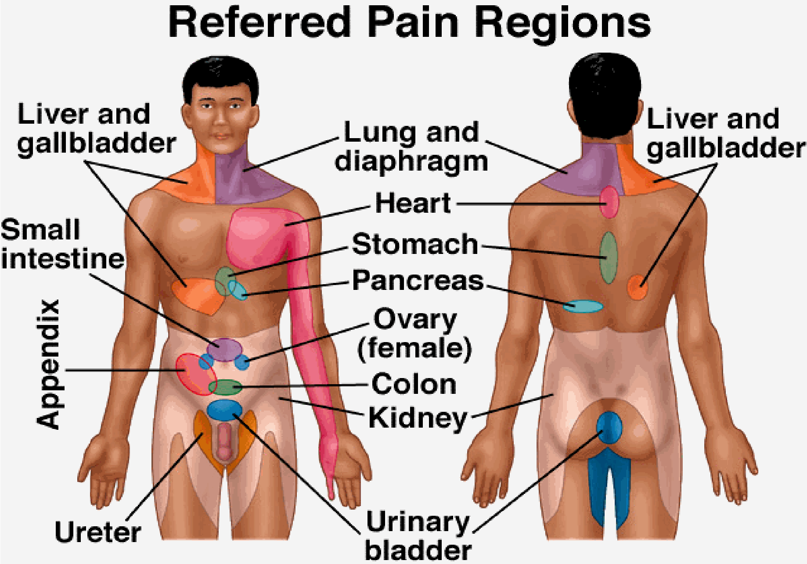

Slide 30

Organ | Site of referred pain
Meninges | Back of head &neck
Heart | Central chest, left arm
Diaphragm | Shoulder tip
Esophagus | Behind sternum
Stomach, duodenum | Epigastrium
Small bowel, pancreas | Around umbilicus
Large bowel, bladder | Lower abdomen
Kidney | Loin
Ureter | Testicles
Trigon of bladder | Tip of penis
Hip | Knee
Appendix | Umbilicus
Uterus | Low back

Slide 31


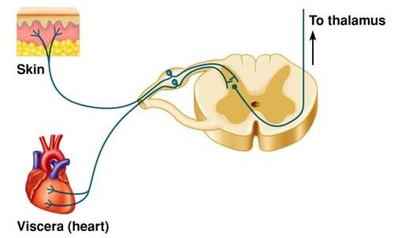
Convergence theory
Afferent pain fibers from skin area & diseased viscera that develop from same embryonic segment converge on same 2nd order neuron and finally stimulate the same cortical neuron.
The brain interprets the information coming from visceral nociceptors as having arisen from cutaneous nociceptors, because this is where nociceptive stimuli originate more frequently

Slide 32
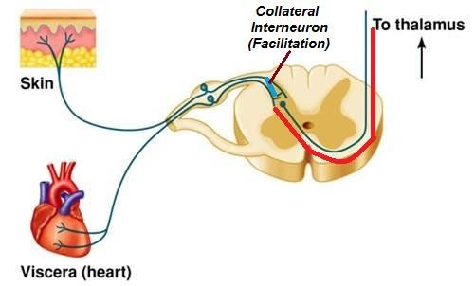
Facilitation theory
Pain fibers from skin are always carrying
impulses, not enough to produce pain.
Impulses from diseased viscus pass through afferents which give collaterals to ST neurons receiving pain fibers from skin.
As a result, ST neurons' excitability is raised (they are facilitated) to reach a threshold level.
The signals reaching the brain are projected to skin area and pain is felt in skin dermatome

Slide 33


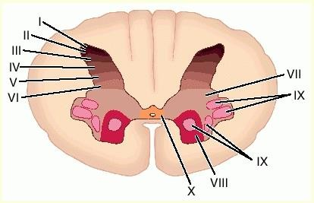
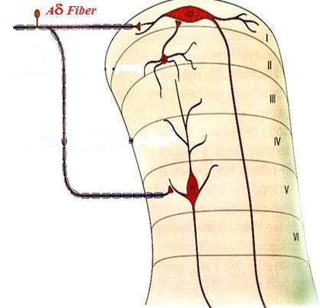
Pain sensation is carried by lateral spinothalamic tracts which includes 2 separate pathways:-
A) The neospinothalamic pathway:
This transmits fast pain.
oFirst order neurons
Are mainly Aδ afferent nerves.
They terminate at lamina I & V of dorsal horn.

Slide 34
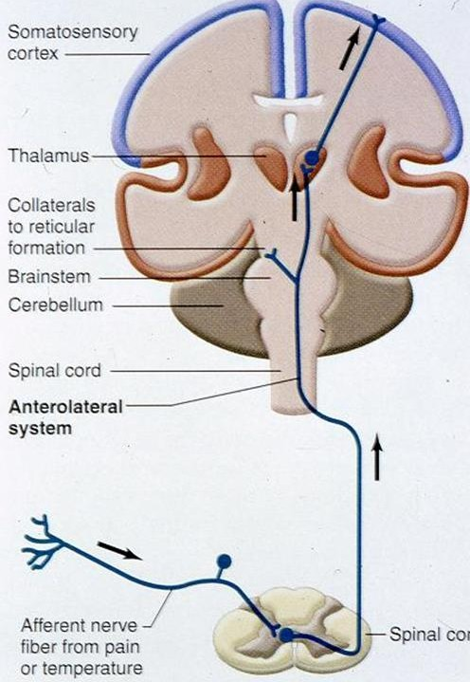
oSecond order neurons These constitute the tract. They start at dorsal horn, cross to opposite side and ascend in lateral column of
₃rd
spinal cord. The fibers ascend in brain stem to terminate in ventrobasal complex of thalamus.
oThird order neurons These start at thalamus & most fibers project to somatosensory cortex.
₁st
₂nd

Slide 35
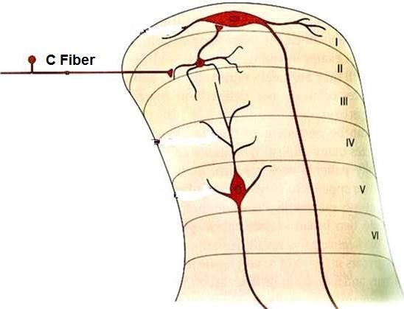

B) The paleospinothalamic pathway:
This transmit slow pain sensation.
oFirst order neurons
They are mainly type C fibers.
They enter spinal cord via dorsal roots, terminate at substantia gelatinosa in laminae II & III of dorsal horn(substantia gelatinosa).

Slide 36
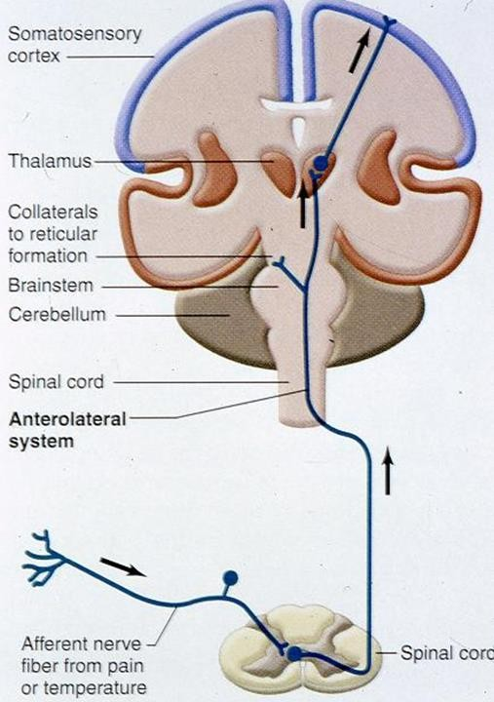
oSecond order neurons
They start at SGR, cross to opposite side in front of central canal, ascend in lateral column of SC & terminate at:-
•Reticular formation of brain stem.
•Intralaminar nuclei of thalamus.
•Hypothalamus & adjacent region of basal
brain.
Impulses arriving these regions have strong arousal effects and can be perceived.
oThird order neurons
These start at thalamus,
Few fibers project to cerebral cortex.
₃rd
₁st
₂nd

Slide 37



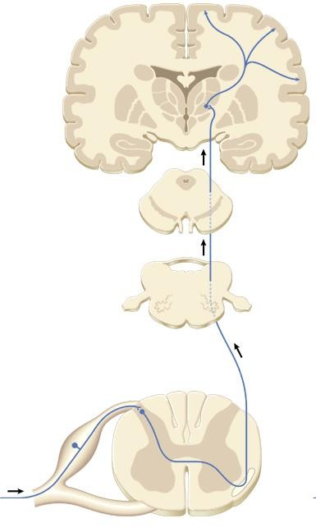

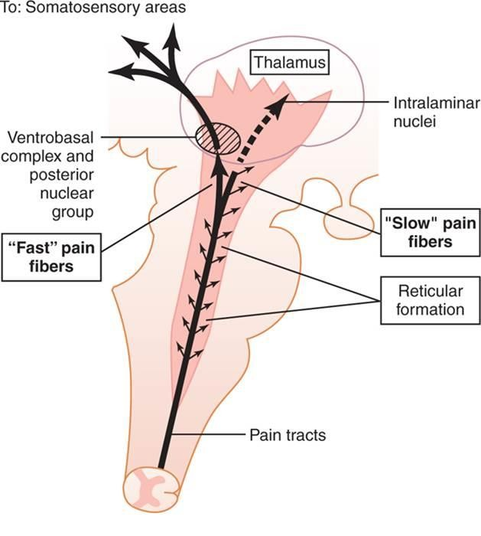
Full perception of pain occurs when signals enter RF of brain stem, thalamus & basal regions.
Somatosensory cortex plays important role in topognosis i.e. localization & interpretation of pain quality.
Fast pain is localized better than slow pain because signals carried in neospinothalamic tract reach somatosensory cortex, while a small propotion of paleospinothalamic pathway reach there.
Spino-thalamic tract
primary afferent
Aδ or C fibers

Slide 38


