Slide 1
NeuroPsychiatry Block
Spinal Cord Functions & Spinal
Reflexes
Prof. Faten Zakareia
Physiology Department
College of Medicine
King Saud University
2017
Email: Faten@ksu.edu.sa
Ext:52736

Slide 2
Objectives:
Uponcompletionofthislecture,studentsshouldbeableto:
-Appreciate thetwo-waytrafficalongthespinalcord.
--Describetheorganizationofthespinalcordformotorfunctions(anteriorhorncells&
interneurons &neuronalpools)
-Describethephysiologicalroleofthespinalcord inspinalreflexes&reflexarc
components
--Classifyreflexesintosuperficialanddeep;monosynaptic&polysynaptic
-Describe withdrawalreflex&crossedextensorreflex
--Recognizethegeneralpropertiesofpropertiesofspinalcordreflexes
-Referencebook/Chapter55(Guyton&Hall)
-Reviewof HumanphysiologybyGanong(lastedition)

Slide 3
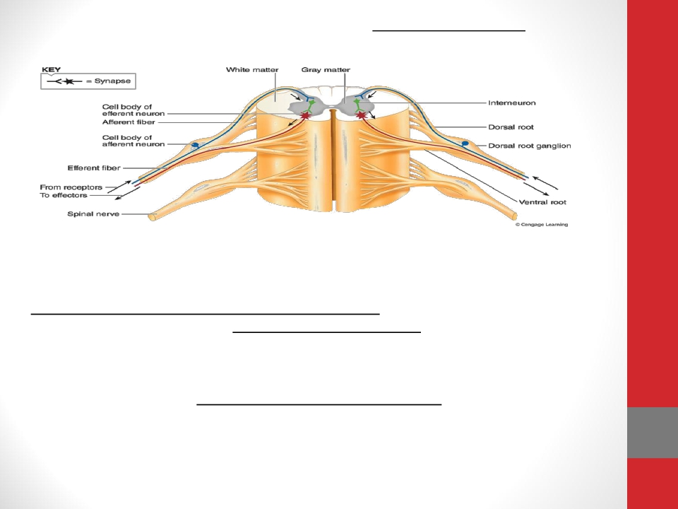
THE SPINAL CORD
Thespinalcordhas31pairsofspinalnerves
Eachspinalnervehas hasventral&dorsalroots:
•Thedorsal(posterior)rootcontains afferent(sensory)nervescomingfrom
receptors.
•Thecellbodyoftheseneuronsislocatedindorsal(posterior)root
ganglion(DRG)
•Theventral(anterior)rootcarriesefferent(motor)fibers
•Thecell-bodyofthesemotorfibresislocatedintheventral(anterior)hornofthe
spinalcord

Slide 4
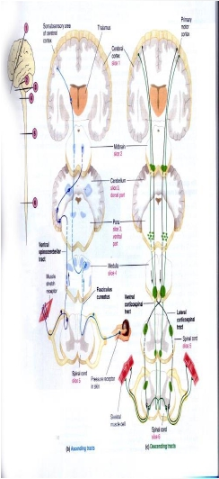
Functions of the Spinal Cord
1- The two-way traffic along the
spinal cord
A-Sensory signals from receptors enter the cord
through the sensory (posterior) roots, then every
sensory signal travels to two separate destinations:
1-One branch of the sensory nerve terminates in
the gray matter of the cord and elicits local
segmental cord reflexes
2-Another branch transmits signals to higher
levels in the cord , or to the brain stem, or even to
the cerebral cortex through:-
A- spinal ascending sensory tracts as:_
-
-
-
Dorsal Column Tracts ( Gracile &Cuneate )
Lateral & Anterior Spinothalamic Tract.
Spinocerebellar Tracts
B- Spinal decending motor tracts:-Motor signals &
brain motor commands pass through descending motor
tracts & then to spinal efferent motor nerves to skeletal
muscles to execute motor functions

Slide 5
2-Initiatespinalreflexes
Aswithdrawal&stretchreflex

Slide 6
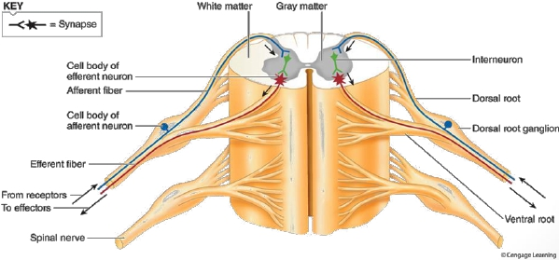
Theorganizationofthespinalcordformotorfunctions
(anteriorhorncells&interneurons&neuronalpools)
Locatedineachsegmentoftheanteriorhornsofthecordgraymatter,severalthousandneuronsthatare50
to100percentlargerthan othersneurons.Theygiverisetothenervefibersthatleave
thecordintheventralrootsanddirectlyinnervatetheskeletalmusclefibers.
• 1-Alpha motor neurons:_
• -They give rise to large type Aalpha motor nerve fibers,
• 2-Gammamotor neurons:-
-smaller gamma motor neurons
-They transmit impulses through much smaller typeAgamma motor nerve fibers

Slide 7
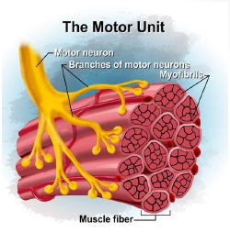
Q-Whatisthemotorunit?

Slide 8
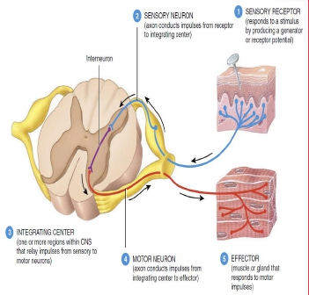
Spinal reflexes
What is a reflex?
-Functional unit of CNS,
rapid, automatic ,
involuntary response to a
stimulus that involve
spinal neurons only
-example/pinprick causes
withdrawal. R

Slide 9
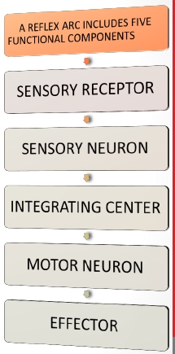
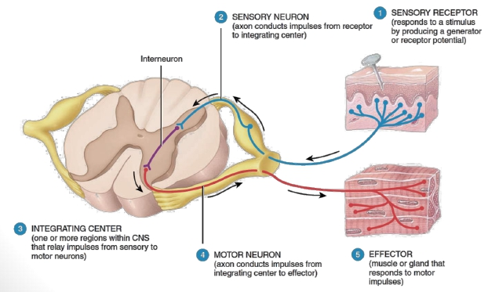
Components ofthereflexarc
REFLEX ARC IS THE PATHWAYFOLLOWED BY
NERVE IMPULSES THAT PRODUCE A REFLEX IS A
REFLEX ARC (REFLEXCIRCUIT)
9

Slide 10
SENSORYRECEPTOR|1|
10

Slide 11
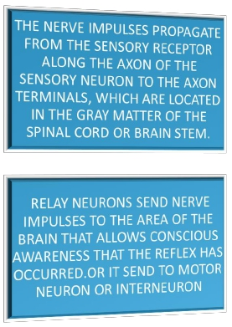
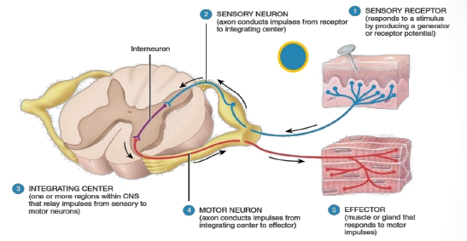
SENSORYNEURON|2|
11

Slide 12
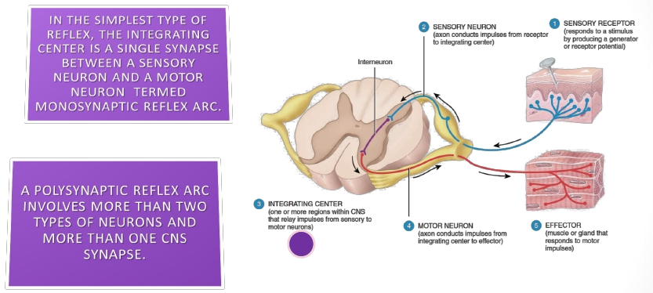
INTEGRATINGCENTRE|3|
12

Slide 13
- Interneurons & interneuron
pool
- Interneurons are present in the gray matter in the dorsal
horns, the anterior horns, and the intermediate areas between
them.
- -30 times as numerous as the anterior motor neurons, small and
highly excitable, often exhibiting spontaneous activity
- Different types of neuronal circuits are found in the interneuron
pool (parallel and reverberating circuits).
- Have diverging, converging, and repetitive-discharge
- They are (excitatory or inhibitory).

Slide 14
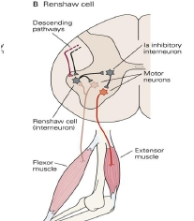
• Renshaw Cells :-
• - As the anterior motor neuron axon leaves the
body of the neuron, sends collateral branches to
adjacent Renshaw cells.
• - These are inhibitory cells that transmit
inhibitory signals to the surrounding motor
neurons BY Lateral inhibition/ So stimulation
of one motor neuron tends to inhibit adjacent
motor neurons .
• -This lateral inhibition helps to focus or sharpen
the signals from each excited motor neuron
• allow transmission of the primary signal in the
desired direction& suppressing the tendency for
signals to spread laterally)

Slide 15
-Efferent neuron
15

Slide 16
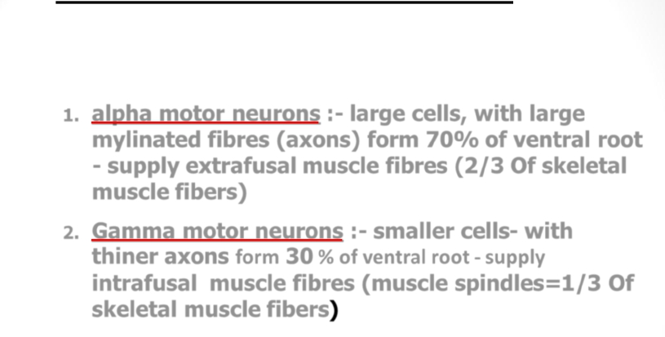
- MOTOR NEURON|4|( Efferent neurons)
- Anterior Horn Cells(Motor neurons)
of spinal cord supplying skeletal muscle:
1.
2.
alpha motor neurons :- large cells, with large
mylinated fibres (axons) form 70% of ventral root
- supply extrafusal muscle fibres (2/3 Of skeletal
muscle fibers)
Gamma motor neurons :- smaller cells- with
thiner axons form 30 % of ventral root - supply
intrafusal muscle fibres (muscle spindles=1/3 Of
skeletal muscle fibers)

Slide 17
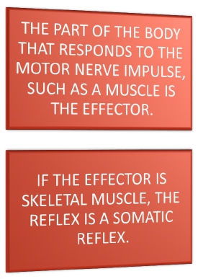
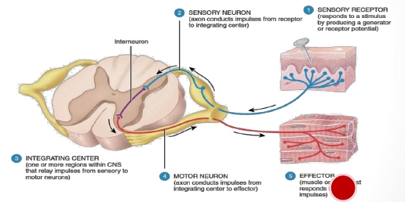
EFFECTOR|5|
17

Slide 18
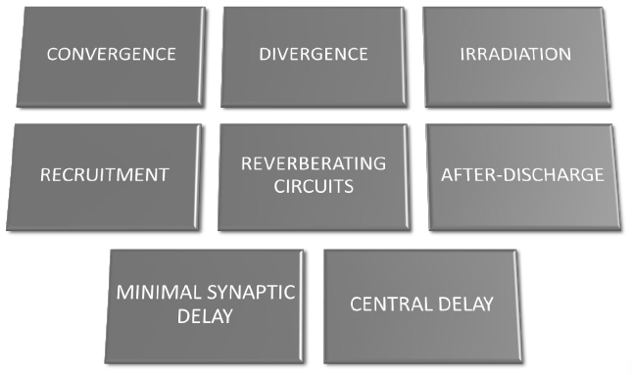
18

Slide 19
- Sensory afferent enter spinal cord via
dorsal(posterior) root, as they enter the neuronal pool
undergo:
1- Divergence help to spread a single stimulus to a
wide area of the spinal cord( amplification of signal)
- it is important for weak signals to excite far
greater numbers of nerve fibers leaving the pool.
2-Convergence :- signals from multiple inputs unit
to excite a single neuron
-multiple action potentials converging on the neuron
provide enough spatial summation to bring the neuron
to the threshold required for discharge.
- (multiple stimuli summate & collect together at the
same time)

Slide 20
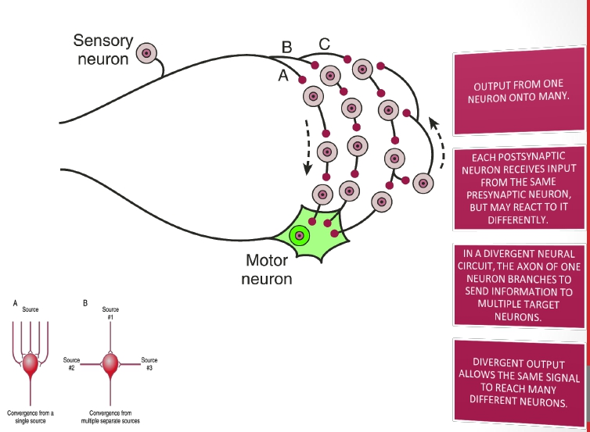
DIVERGENCE
• CONVERGENCE |
20

Slide 21
3-Reciprocalinhibitioncircuits
-Stimulationofflexors muscleaccompaniedbyinhibitionof
extensors throughinhibitoryinterneurons,theneuronal
circuitthatcausesthisreciprocalrelationiscalled
reciprocal innervation_
-Reflexcontractionofanagonistmuscleisaccompaniedby
inhibitionoftheantagonist.
-theinputfibredirectlyexcitestheexcitatoryoutputpathway,butit
stimulatesanintermediateinhibitoryneuron(neuron2),whichsecretesa
differenttypeoftransmittersubstancetoinhibitthesecondoutputpathway
fromthepool.(3)
-Value/preventingoveractivityinmanypartsofthe spinalcord.
21

Slide 22
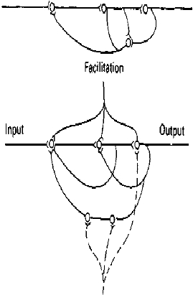
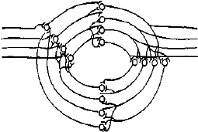
Neuronalpoolcircuits
1-Parallel
2-Reverbrating
1-Parallel circuits //afferent and
efferent are parallel to each other
(input parallel to output)

Slide 23
• 4-Reverberatory (Oscillatory) Circuit
• 1-The simplest reverberatory circuits involves only a single
neuron
• -the output neuron sends a collateral nerve fiber back to its own
dendrites or soma to restimulate the input neuron itself & so the
circuit may discharge repetitively for a long time and causes
signal prolongation (Allow prolonged discharge of the same
motor neurons by a single stimulus
• -Amore complex circuits in which both facilitatory and
inhibitory fibers involved on the reverberating circuit.
• A facilitatory signal enhances the intensity and frequency of
reverberation, whereas an inhibitory signal depresses or stops the
reverberation.
• - Most reverberating pathways are constituted of many parallel
fibers

Slide 24
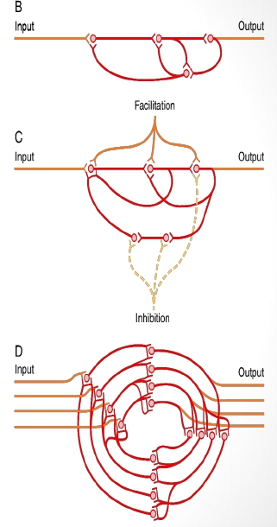

Slide 25
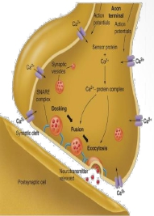
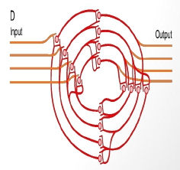
5-After-discharge:-
- A prolonged maintained output discharge ofAHCs
called after -discharge, lasting a few milliseconds or
many minutes after the incoming signal is over.
- After- discharge occurs due to the following:-
- 1-Synaptic After-discharge.
When excitatory synapses discharge on the surfaces of
dendrites or soma of a neuron, a postsynaptic electrical
potential ( PSP)develops in the neuron and lasts for
milliseconds. As long as this potential lasts, it can
continue to excite the neuron to transmit (a series of
continuous repetitive discharges) .
- 2- Reverbrating circuits
- Presence of reverberating circuit restimulate AHCs

Slide 26
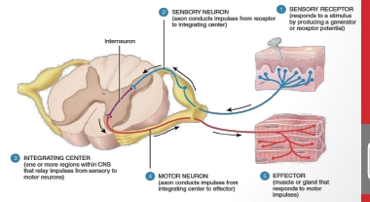
6-SYNAPTICDELAY (centraldelay)
-Is thetimeofreflextopassthroughneuronsofthespinalcord
-
-Theminimalperiodoftimerequiredfortransmissionofaneuronalsignalfrom
apresynapticneurontoapostsynapticneuron, isSYNAPTIC DELAY.
-Equals0.5ms/synapse( itislonginpolysynapticReflex).
- Itis > 2 msinthewithdrawalR (polysynapticReflex)
-Numberofsynapses inareflex =
centraldelay/ 0.5ms
-forkneejerkitequals0.6msc =onesynapse
26

Slide 27
Types of spinal reflexes
-According to number of neurons:-
Monosynaptic
Sensory axon (afferent)synapse directly
with anterior horn cell- (No interneuron )
Ex.Stretch reflex
Polysynaptic
Sensory axon (afferent)synapse
more interneuron
with one or
Ex.Withdarwal,abdominal reflexes,
visceral

Slide 28
Types of reflexes
-According to site of the receptor:-
(A)Deep Reflexes:- by stimulation of receptors deep in
muscle and tendons
(1) Stretch Reflexes (Tendon jerks) ,they are monosynaptic : such
as knee-jerk ( patellar reflex ) and ankle jerk .
The receptor for all these is the muscle spindle ( is located deep within the muscle
itself
(2) Inverse Stretch Reflex ( Golgi Tendon organ reflex ) , polysynaptic :
The receptor is called Golgi Tendon Organpresent deep in the muscle tendon
(B) Superficial Reflexes
Are polysynaptic reflexes . The receptor are superficial in the skin . Examples are
Withdrawal, abdominal reflexes and plantar reflex
©Visceral:-by stimulation of receptors in wall of viscera
As Micturition, defecation

Slide 29
SUPERFICIALANDDEEP
REFLEXES
29

Slide 30
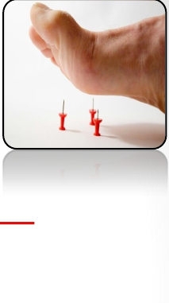
Withdrawalreflex(flexorreflex)
(NociceptiveReflex)
-Asuperficial polysynapticreflex
Stimulation of pain receptors of hand(a pin- prick, heat, or
a wound)>>>>>> impulses to SC inAdelta or C fibres >>>>>>>
interneurons pool >> motor neurons >> stimulate hand flexor
muscles >>move the hand away from the injurious stimulus.
characterised by :_
1- diverging circuits to spread the reflex to the necessary muscles for
withdrawal
(2) reciprocal inhibition circuits
Circuits to inhibit the antagonist muscles
-Stimulation of flexors muscle accompanied by inhibition of extensors
through inhibitory interneurons

Slide 31
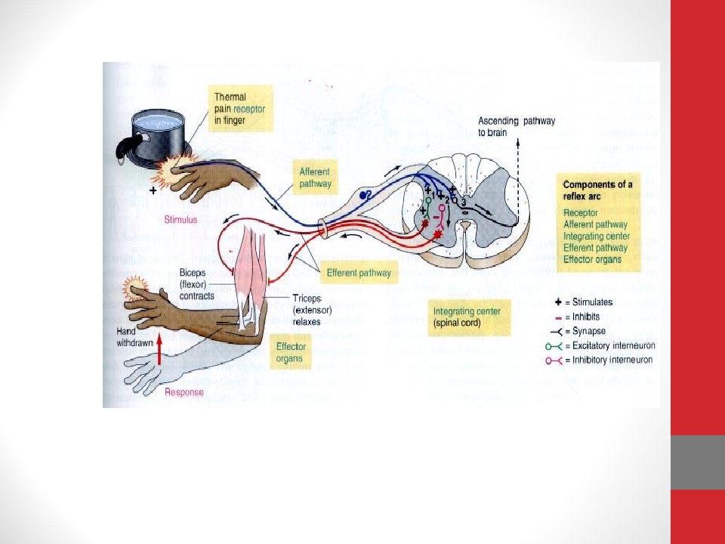
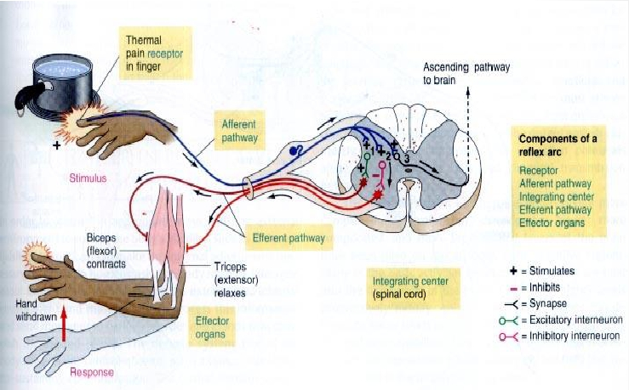

Slide 32
3- RECRUITMENT :
-Gradual activation of more number of motor
neurons (AHCS) on stim of afferent nerve in a reflex
arc by maintained, repetitive stimulus
Cause/ 1-different conduction velocities of afferents some are slowly
&others are rapidly conducting fibres
2-different number of interneurons with short & long pathways to
the motor neurons (AHCs ) (impulses do not reach AHCs at same
time but reach them gradually, so maintained stimulation allow more
neurones to be stimulated)
Motor unit recruitment :
If a repetitive &stronger stimulus is maintained, there
will be gradual increase in the force of the muscle
contraction until the maximum force is reached , due
to gradual recruitment/activation of more and more
motor neurons

Slide 33
4- After-discharge CIRCUITS:-
Circuits to cause afterdischarge lasting many fractions
of a second after the stimulus is over.
-The duration of after-discharge depends on the
intensity of the sensory stimulus that elicited the reflex
Cause/
-Presence of reverberating circuit restimulate AHCs
-Value /prolong the protective response of reflex

Slide 34
5- IRRADIATION :- - spread of impulses up & down to different segments
and motor neurons in the S.C
A strong stim in sensory afferent irradiate to many segments of S.C due to
divergence
****The extent of the response in a reflex depends on the intensity of the
stimulus.
- The more intense the stimulus >>>> greater spread of activity in the spinal
cord >>>involving more & more motor neurons>>>more response
- Weak stim-----irradiates to small number of neurons ,
so it causes weak flexion of limb
- Strong stim---- irradiates to large number of neurons ,
so it causes withdrawal of affected limb &
extension of opposite limb.(as in crossed extensor reflex)

Slide 35
• 6- “local sign” Pattern of Withdrawal.
The pattern of withdrawal that results when the flexor reflex
is elicited depends on which sensory nerve is stimulated.
• - Thus, a pain stimulus on the inward side of the arm
elicits not only contraction of the flexor muscles of the arm
but also contraction of abductor muscles to pull the arm
outward.
• This is called the principle of “local sign”

Slide 36
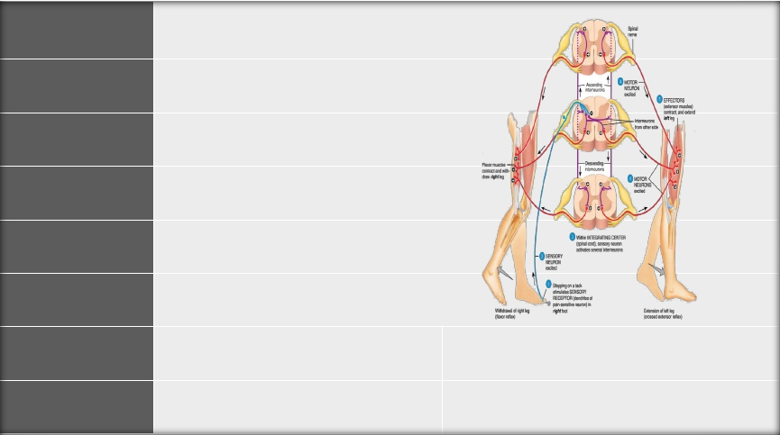
THEWITHDRAWALREFLEX|
REFLEX | FLEXORREFLEXORWITHDRAWALREFLEX
CLINICALTEST| STIMULUS | SHARPPAINFULSTIMULUS(STEPPINGONNAIL)
RESPONSE | LIMBISRAPIDLYWITHDRAWN
SENSORY RECEPTOR | CUTANEOUSSKINANDPAINRECEPTORS
SYNAPSES INVOLVED | POLYSYNAPTIC(VIAINTERNEURON)
EFFECTSON MUSCLE | CONTRACTSFLEXORMUSCLE
OTHEREFFECTS | RELAXES(-)EXTENSORMUSCLEOF SAMELIMB | REVERSEEFFECTONOPPOSITELIMB(CROSS EXTENSORREFLEX)
FUNCTION | PROTECTIVE–WITHDRAWALFROM PAINFULSTIMULUS | CROSSEXTENSORAIDSINMAINTAINING POSTUREWHENOPPOSINGLEGISLIFTED
pdf
https://musom.marshall.edu/anatomy/grosshom/allppt/pdf/Spinalreflexes.
36

Slide 37
Crossed Extensor Reflex:-
Crossed extensor reflex supporting the body weight against gravity While pushing
the body away from the injurious agent by withdrawal R ,the Flexion and withdrawal of the
stimulated limb >> extension of the opposite limb
- Occurs with strong stimulus only. why?
Signals from sensory neurons cross to the opposite side of the cord to excite extensor muscles
motor neurons.
-It does not begin until 200 to 500 milliseconds after onset of the initial pain stimulus, because
many interneurons are involved in the circuit between the incoming sensory neuron and the
motor neurons of the opposite side of the cord
-After the painful stimulus is removed, the crossed extensor reflex has an even longer period of
afterdischarge, results from reverberating circuits among the interneuronal cells.
The prolonged afterdischarge is of benefit in holding the body away from the painful object
- Mostly in the lower limb to support balance.
- It has reciprocal innervations occurs also in crossed extensor reflex. How?
-flexors in the opposite limb are inhibited while extensors are excited supporting the body weight
against gravity during withdrawal .R

Slide 38
Crossed extensor reflex

