Slide 1
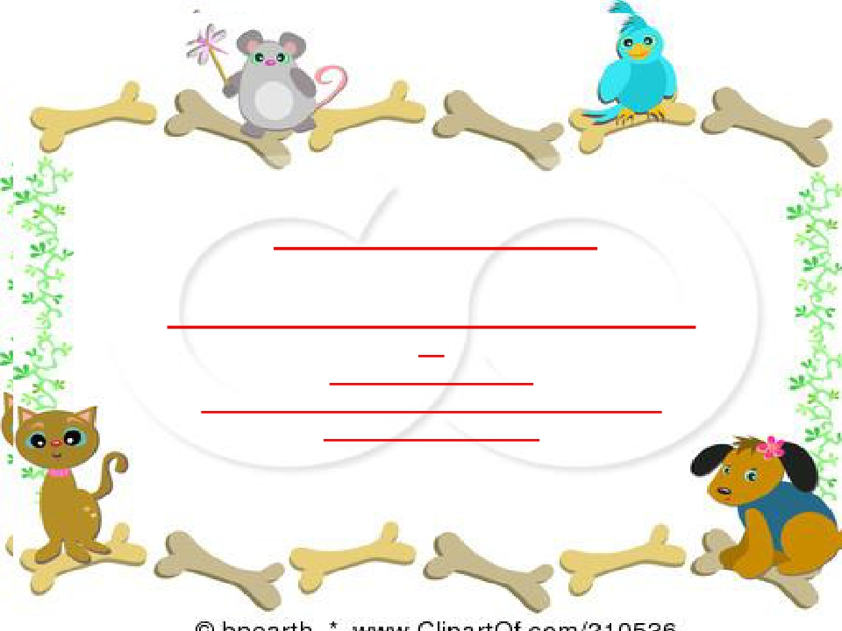
NeuroPsychiatry Block
Stretch reflex and Golgi Tendon Reflex
By
Prof. Faten zakareia
Physiology Department , College of Medicine ,
King Saud University
2017
Email: Faten@ksu.edu.sa
Ext:52736

Slide 2
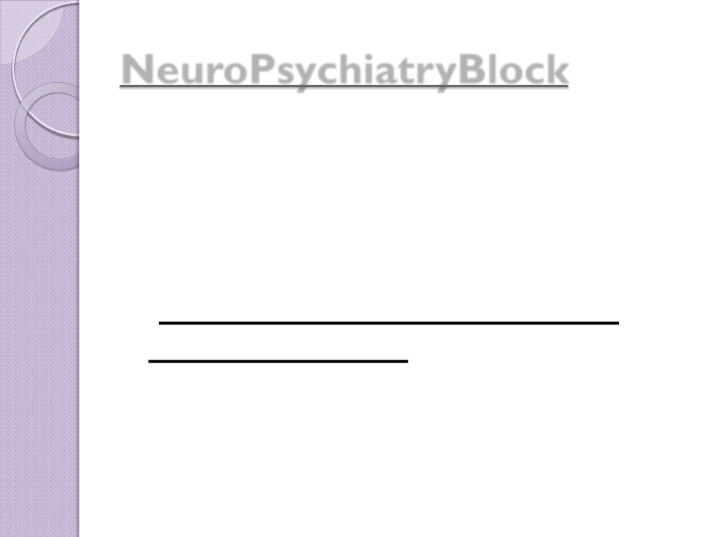
NeuroPsychiatryBlock

Motor Functions of the Spinal Cord,
The cord Reflexes
 Chapter 55 (Guyton & Hall)

-Reference book/Ganong review of
medical physiology

Slide 3
• Objectives:
Upon completion of this lecture, students are expected to :
-
Describe the stretch reflex and ts icomponents
- Describe the structure and function of the muscle spindle
- Differentiate between primary and secondary afferent fibres of
muscle spindle, Intrafusal nuclear bag &nuclear chain fibers
- Differentiate between the Dynamic gamma efferent and Trail
endings discharge and their functional role
- Differentiate between static and dynamic stretch reflex&
damping mechanism
- Describe muscle tone and its abnormalities
- Disscuss spinal and supraspinal regulation of the stretch reflex
- Describe the components of the inverse stretch reflex (golgi
tendon reflex)and its function

Slide 4
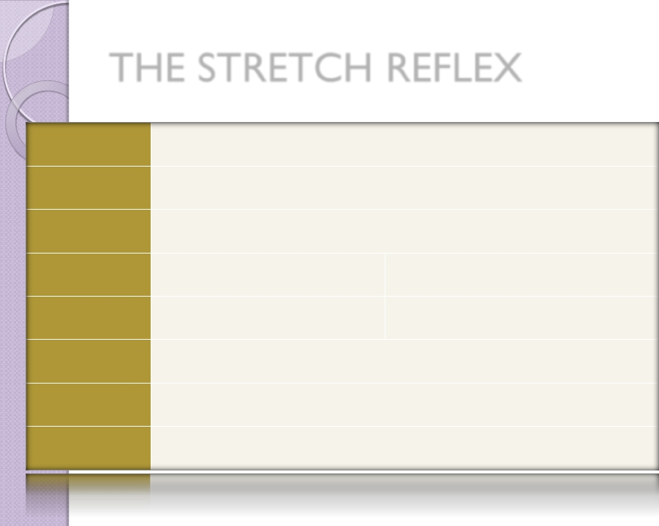
THE STRETCH REFLEX
REFLEX | STRETCH(MYOTACTIC)REFLEX
CLINICALTEST| STIMULUS | RAPIDSTRETCHOFMUSCLE(TAPONMUSCLETENDON)
RESPONSE | STRETCHEDMUSCLECONTRACTRAPIDLY(I.E.KNEEJERK)
SENSORY RECEPTOR | MUSCLESPINDLEPRIMARY
SYNAPSES INVOLVED | MONOSYNAPTIC
EFFECTSON MUSCLE | CONTRACTS(+)SAMEMUSCLEANDSYNERGISTICMUSCLES
OTHEREFFECTS | RELAXES(-)ANTAGONISTICMUSCLE
FUNCTION | AIDSINMAINTAININGPOSTURE,AVOIDMUSCLERUPTURE,COUNTERSSUDDENLOADS
https://musom.marshall.edu/anatomy/grosshom/allppt/pdf/Spinalreflexes.pdf
4

Slide 5
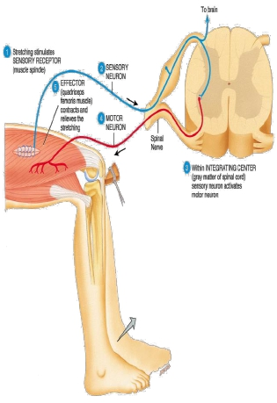
What is the Stretch Reflex or
myotatic Reflex?
• It is reflex contraction of muscle
resulting from stimulation of the
muscle spindle by stretching the
whole muscle
Muscle spindle is the receptor -
that is located inside muscle &
detects changes in muscle length
-Monosynaptic Deep reflex( one
sensory neuron synapse with one
motor neuron)
-Example/tendon jerks as patellar-
or knee jerk

Slide 6
It is:-
-Deep-monosynaptic reflex
-The simplest;it involves only
2neurons & one synapse

Slide 7
Components of the Stretch ReflexArc
Sensory Receptor :
Afferent (group Ia
Integrating center
muscle spindle
&II afferents)
(spinal cord) AHC
-alpha motor neurons
synapse with the afferent sensory
neurones in the spinal cord
Efferent include/
neurons
axons arise from α-and γ-spinal motor
1-
alpha motor efferent from alpha motor neurons to supply
extrafusal muscle fibers
2-
gamma efferent (from gamma motor neurons to supply
intra-fusal muscle fibers
Effector /
Skeletal muscle

Slide 8
1- Stretch reflex receptor (Muscle Spindle): -
-Muscle spindle consists of 3-12 small
muscle fibres ( intrafusal fibres ) within
CT capsule.
- parallel to extrafusal fibres & attached
to it.
-Each intrafusal fibre has:
-Central non-contractile area
(receptor)
-Peripheral contractile area on each
side of central zone,
- it has actin & myosin.

Slide 9
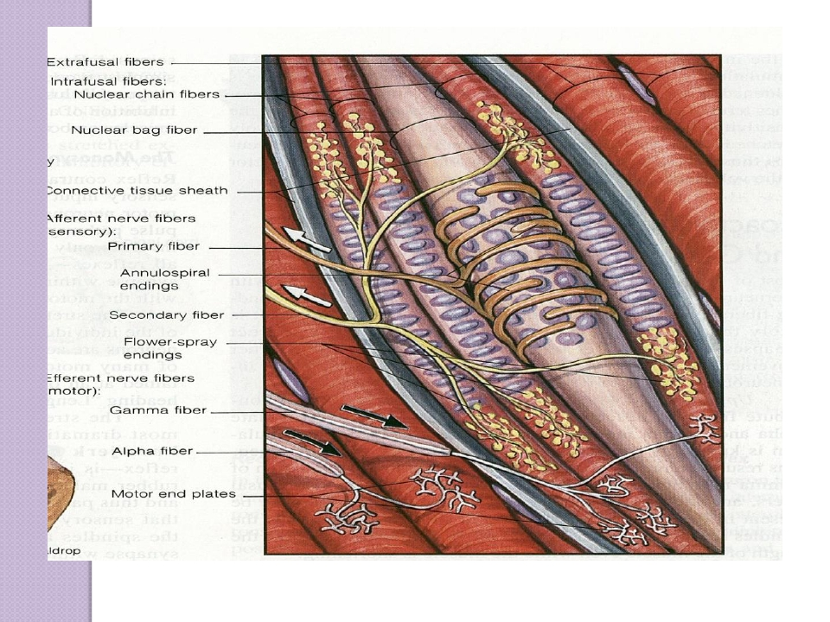
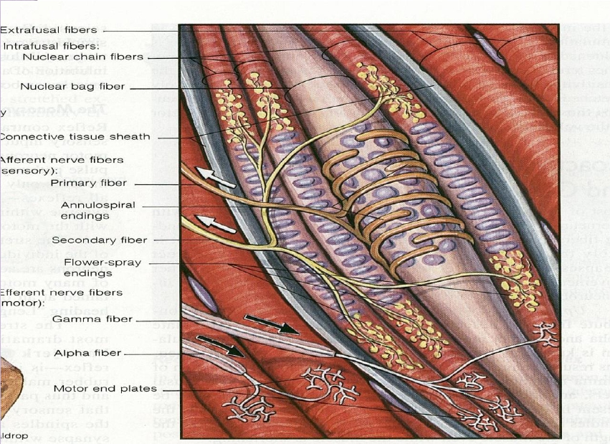

Slide 10
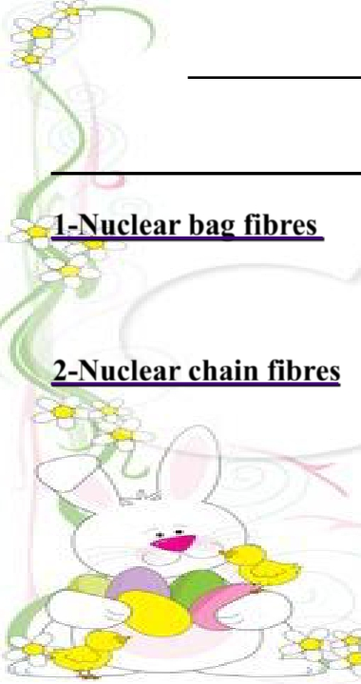
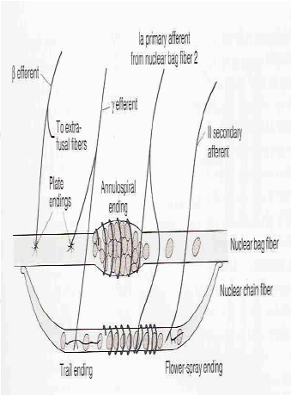
Muscle Spindle(cont)
Has two types of intrafusal fibres:
1-Nuclear bag fibres : (2 / spindle)
- Central area is dilated with group of
( bag) nuclei
2-Nuclear chain fibres: (about 4 or
more /spindle) . Thinner & shorter -
-One line of nuclei in a chain in the -
receptor zone
- bind to nuclear bag on each side

Slide 11
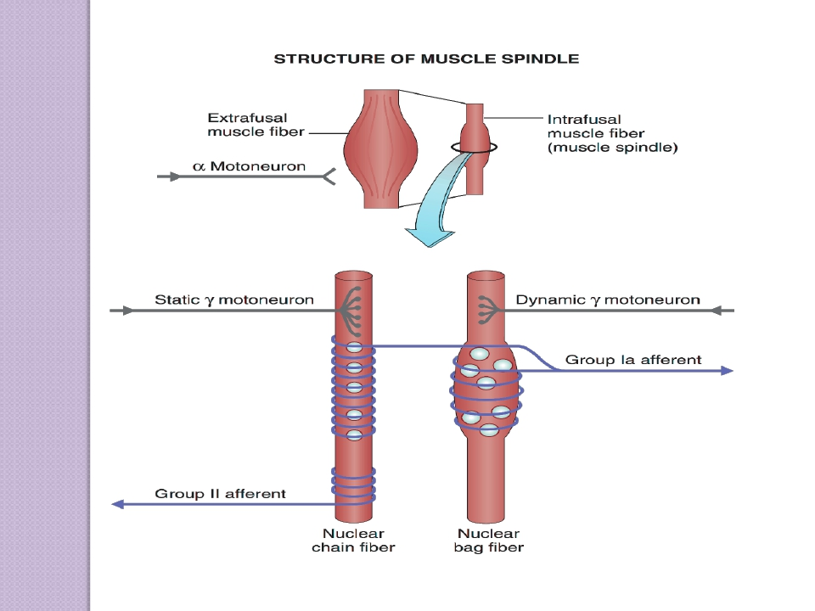
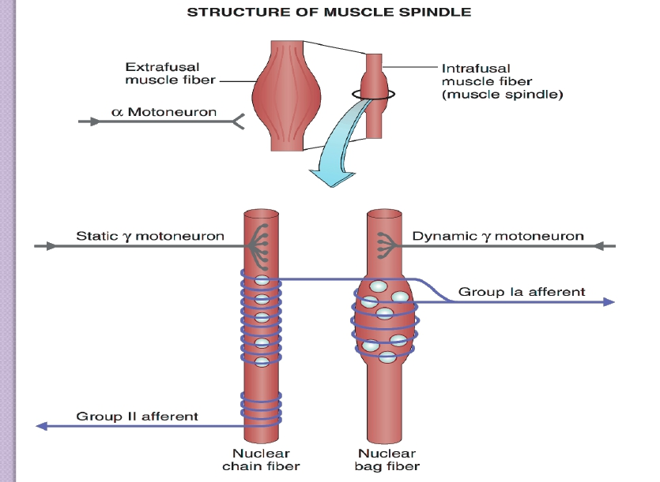

Slide 12
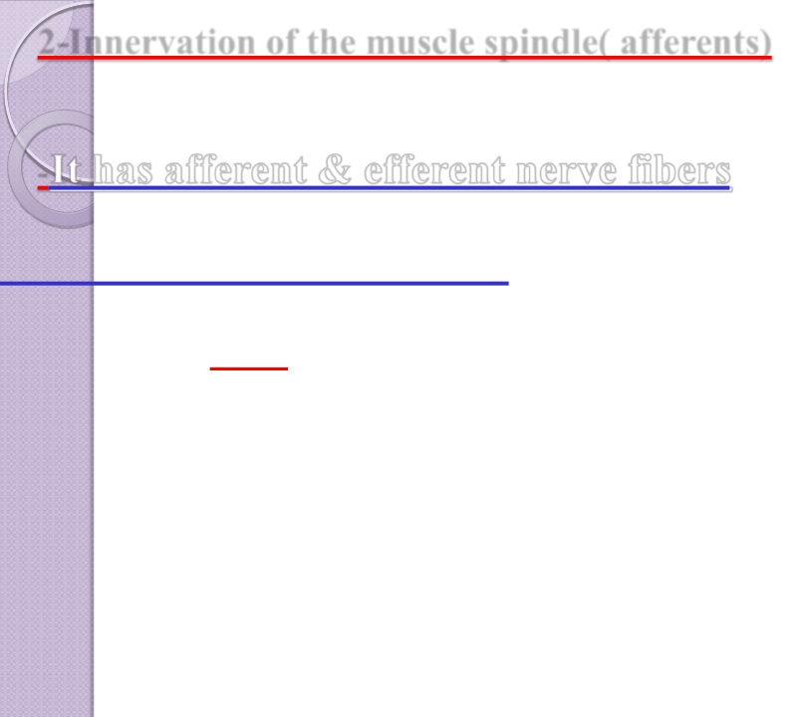
2-Innervation of the muscle spindle( afferents)
-It
has afferent & efferent nerve fibers
1-SensoryAfferent fibres:
-Central receptor area of the intrafusal muscle fibres is
supplied by TWO types of afferent fibres:
-
GROUP
Ia
-
-GROUP II

Slide 13
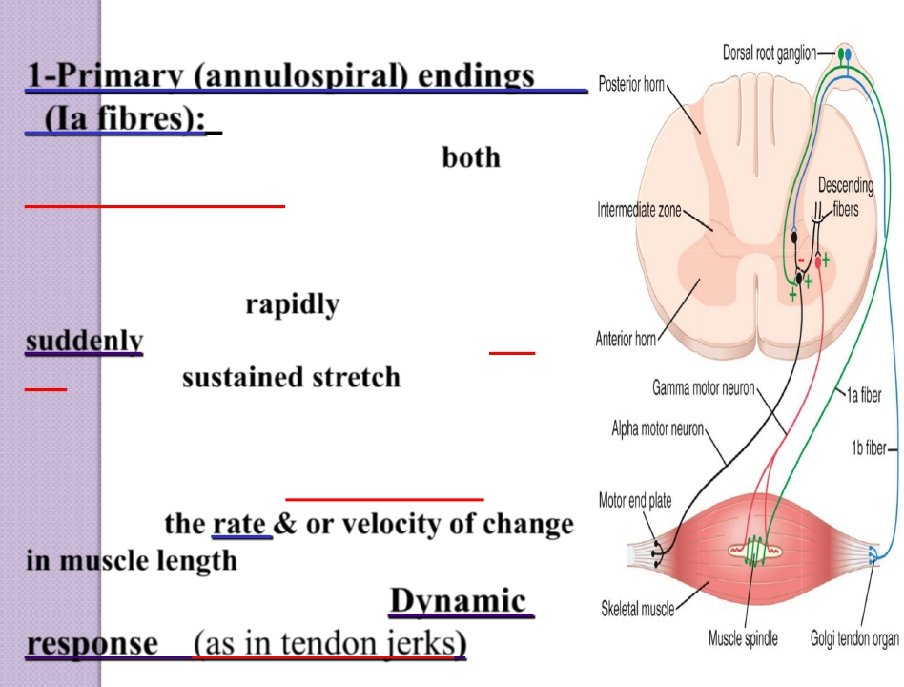
1-Primary (annulospiral) endings
(Ia fibres):
-Fast, encircle receptor areas of both
nuclear bag (mainly ) and nuclear chain
fibres ,synapse directly with the motor
neurons (AHC)
-Discharge most rapidly if the muscle is
suddenly stretched and less rapidly (or
not) during sustained stretch
- Type Ia fiber, 17 micrometers diameter -
- transmits sensory signals to the spinal -
cord at a velocity of 70 to 120 m/sec
-Measure the rate & or velocity of change -
in muscle length of nuclear bag fibres
- This response is called the Dynamic -
response
(as in tendon jerks)

Slide 14
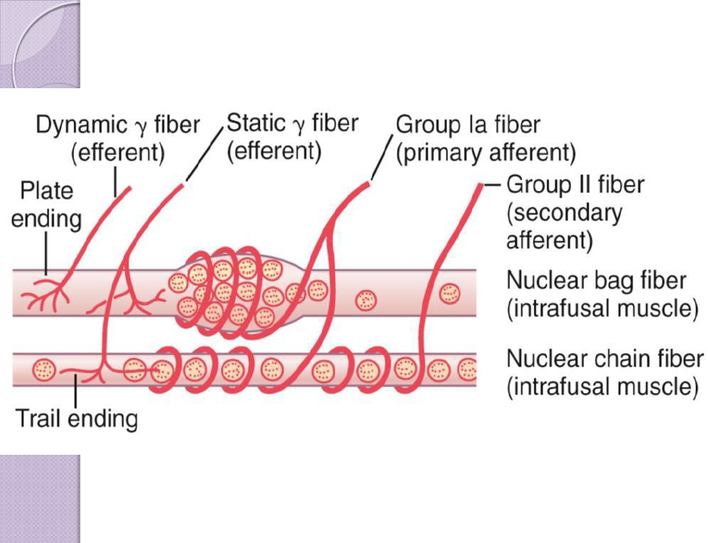
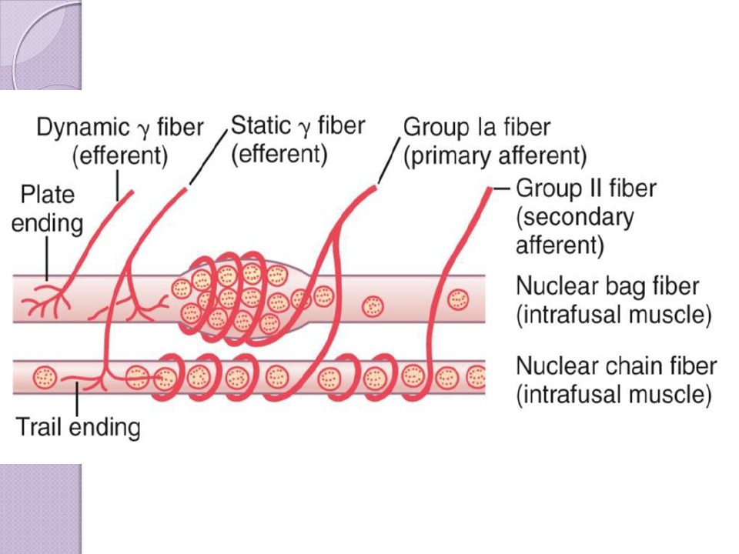

Slide 15
2-Secondary (flower-spray) (Group
II) sensory endings:
-typeIIfibers,diameter of8 micrometers—
innervate the receptor area of the nuclear
chain fibres ONLY on both sides of the
primary ending
-Discharge throughout the period of muscle
stretch, (sustained stretch) (measure mainly
muscle length).
- Responsible for the(Static response)

N.B/
-Nuclear bag fibres are supplied by primary endings only,&
responsible for the dynamic response.
-Nuclear chain fibres are supplied by both primary and secondary
endings & responsible for the static response.

Slide 16
THE ROLE OF MUSCLE SPINDLES

NUCLEAR BAG FIBRES
◦ CAN SENSETHE ONSET OF
STRETCH

NUCLEAR CHAIN FIBRES
◦ CAN SENSEA SUSTAINED
STRETCH
◦ CAN RESPONDTO RAPID
STRETCH
• THESE PREVENT MUSCLE INJURY BY ACTIVATING EXTRAFUSAL FIBRES IN
RESPONSE TO FORCE ACTING ON THE MUSCLE
• IT PRODUCES AN ANTAGONISM OF THAT FORCE
16

Slide 17
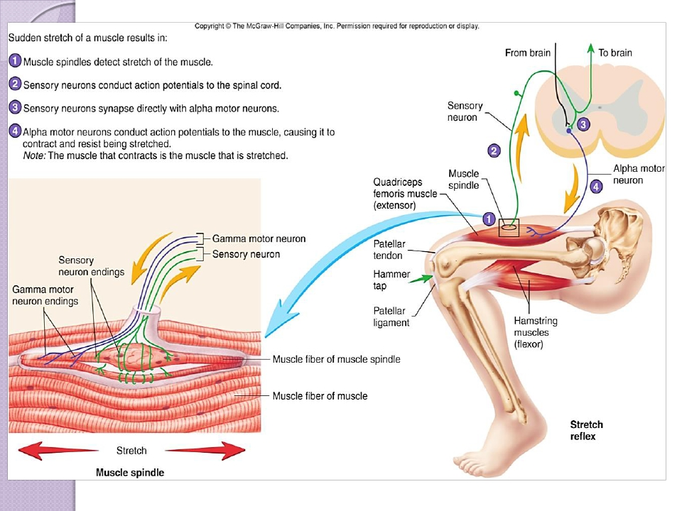
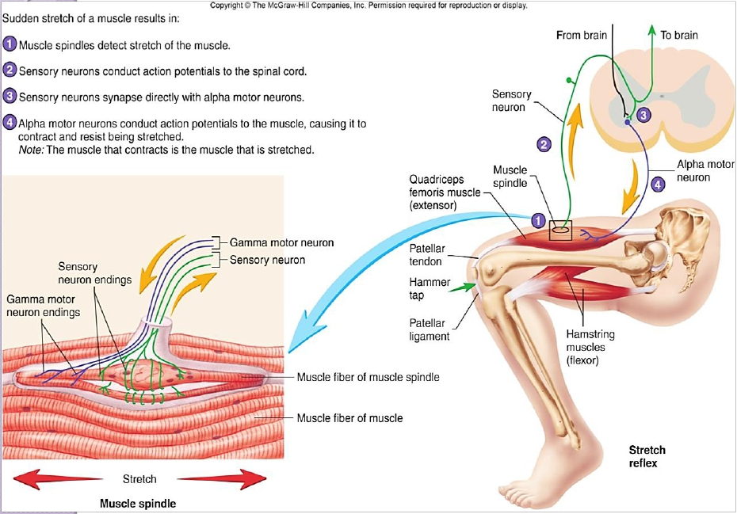
17

Slide 18
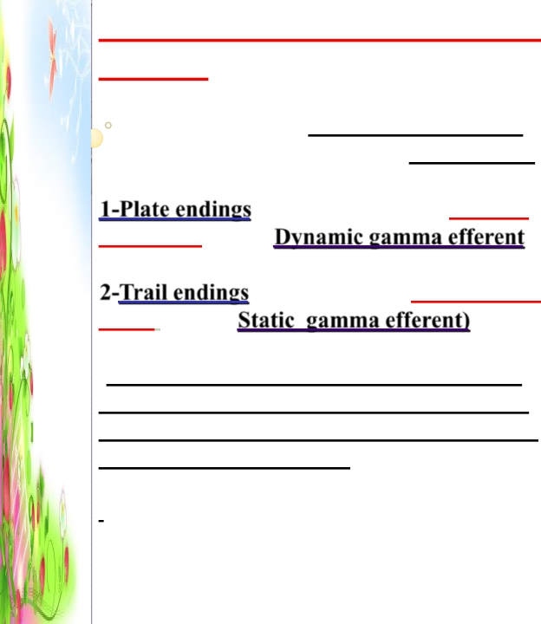
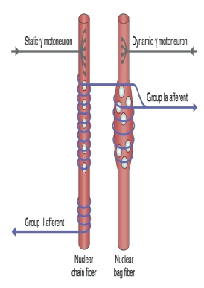
3- ( Motor Efferent fibres to muscle
spindle)
-Gamma motor neurons >>>>gamma
efferent>>>>> to the peripheral contractile parts
of the intrafusal muscle fibres , of two types:
1-Plate endings / end mainly on the nuclear
bag fibres (called Dynamic gamma efferent
2-Trail endings / end mainly on nuclear chain
fibres ( called Static gamma efferent)
-The function of the γ motoneurons (either
static or dynamic) is to regulate& enhances
the sensitivity of the intrafusal muscle fibres
they innervate to stretch
.

Slide 20
Gamma motor neurons function:-
.-When Gamma motor neurons activated, can make
peripheral parts of the muscle spindles to contract
- They increase muscle spindle sensitivity to stretch
-
-When the gamma-d fibers excite the nuclear bag fibers, the
dynamic response of the muscle spindle becomes enhanced
-Conversely, stimulation of the gamma-s fibers, which excite
the nuclear chain fibers, enhances the static response

Slide 21
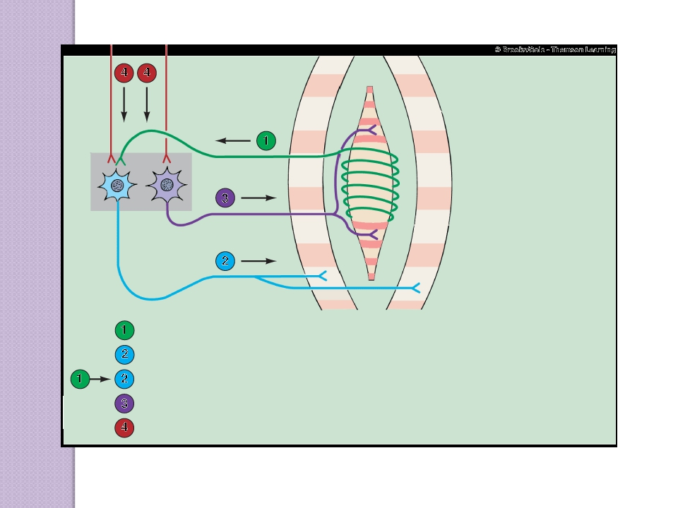
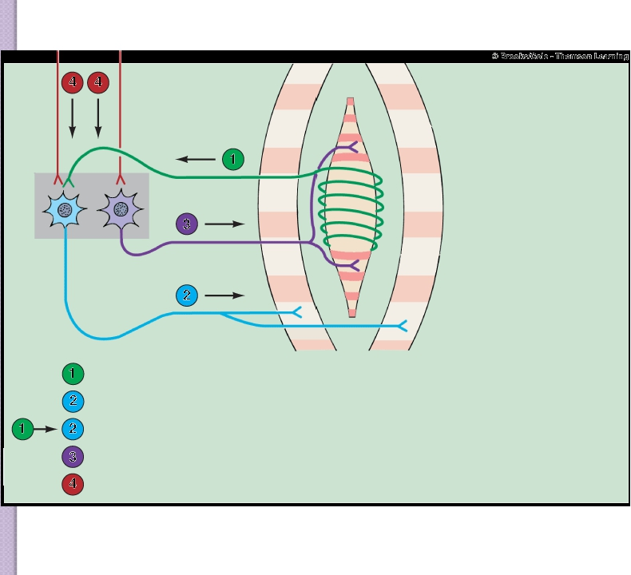
Extrafusal
skeletal
muscle fiber
Afferent input from sensory endings of muscle spindle fiber
Alpha motor neuron output to regular skeletal-muscle fiber
Stretch reflex pathway (Arc)
γ-motorneuron output to the contractile end of spindle fiber
Descending pathways co-activate α- and γ- motor neurons ???!

Slide 22
Stretch reflex.cont
1- Stretching of the muscle>>>>Stretching extrafusal
muscle fibers >> Stretching intrafusal peripheral
contractile fibers>>>>>> + stretch receptor zone
(central) in intrafusal fibre >> +stimulation of
sensory afferent endings encircling receptor area.
Afferent impulses >> spinal cord >> stimulate:
1-alpha motor neurons,(70% of supply) which send
impulses to extrafusal ordinary muscle fibres
>>muscle to contract.
2-gamma motor neurons (30% of supply) which send
impulses to intrafusal peripheral contractile fibers
causing contraction of the peripheral contractile
parts of the intrafusal fibres & stretch central
receptor zone to excite afferent fibers more & more

Slide 23
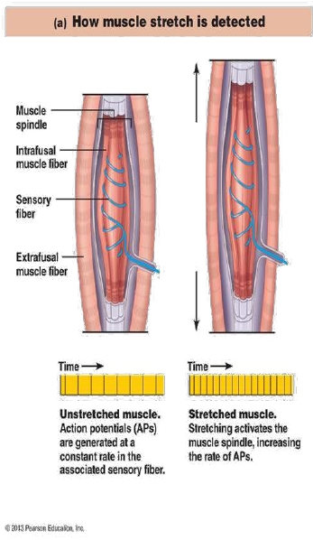
How Muscle Stretch Is detected
 stretching of the
muscle also stretches
the spindle
 this sends impulses to
the spinal cord
 the number of
impulses sent are
proportional to the
stretched length of
the muscle
23

Slide 24
Types of responses
Component of stretch reflex
1-Dynamic stretch reflex (dynamic or
phasic response)
-
-
-
Sudden rapid stretch of a muscle >>
stimulate Nuclear bag fibers which
respond to rate or velocity of
stretch>>>> discharge Synchronous
strong impulses from spindles
>>>>primary ending (annulospiral) send
>>> alpha motor neuron >>>motor
alpha nerve efferent >>>>causing
sudden contraction of muscle extrafusal
fibers synchronously (jerk movement)
-Conversely,when the spindle receptor
shortens, the primary ending sends less signals
to inform it about muscle unstretch
.

Slide 25
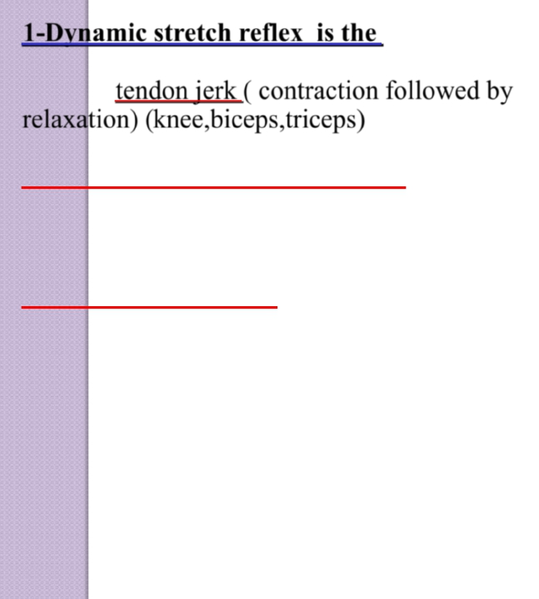
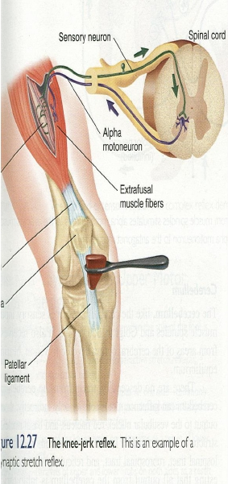
1-Dynamic stretch reflex is the
Basis of tendon jerk ( contraction followed by
relaxation) (knee,biceps,triceps)
-Role of Dynamic gamma efferent
(plate endings)
-When nuclear bag fibres relax during muscle
contraction , its sensitivity to stretch decreases.
Plate gamma endings which end mainly on -
the nuclear bag fibres periphery, send signals to
contract the peripheral contractile part of
nuclear bag fibres, so it stretch the central part.
-It increases sensitivity of muscle spindle to
rate and velocity of change of length & enhances
the dynamic response)
h

Slide 26
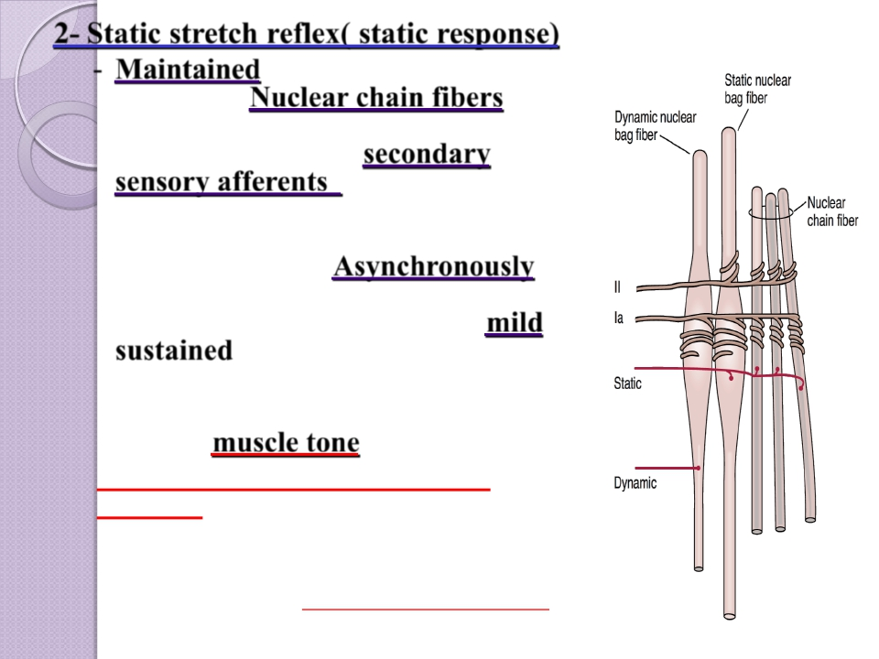
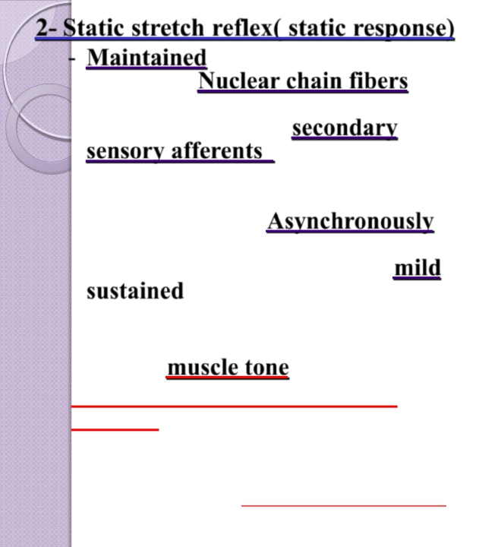
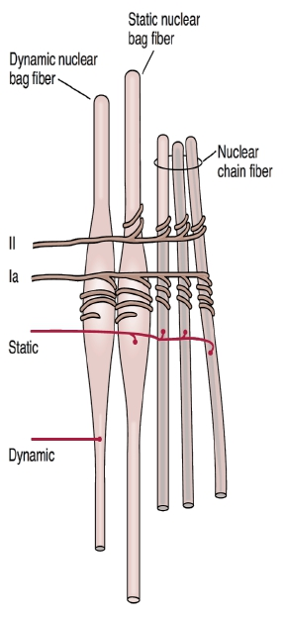
2- Static stretch reflex( static response)
- Maintained stretch of muscle>>>
stimulates Nuclear chain fibers to
discharge with increased rate
>>>Impulses in the secondary
sensory afferents (flower-
spray)>>>>alpha motor neuron >>>
motor effernts>>> contraction of
extrafusal fibersAsynchronously
(motor units not discharge all
together)>>>>>> resulting in mild
sustained contraction of muscle
extrafusal fibers as long as it is
stretched
-Basis of muscle tone
-B-Static gamma efferent (Trail
endings)
Trail endings ( gamma –s) which end mainly on the
nuclear chain fibres periphery , stretching it to
increase sensitivity of muscle spindle to steady
maintained stretch & enhances the static response

Slide 27
Muscle Tone( Static stretch reflex)
Dif/ resistance of muscle to stretch
-Stimulus for muscle tone /Is sustained Stretch of skeletal muscle
between origin and insertion
-Present in antigravity muscle (extensors of LL, back, neck, flexor
of UL, muscle of abdominal wall and elevator of mandible
-if lost by low gamma efferent discharge to muscle
>>>>>hypotonic muscle or flacidity
-if increased by high gamma efferent discharge to muscle
>>>>>>hypertonic muscle , spastic muscle
.

Slide 28


-
Damping” or smoothing function of the Dynamic and
Static Stretch Reflexes
Is the stretch reflex ability to prevent oscillation or jerkiness
of body movements.
- -Signals from the spinal cord transmitted to a muscle in an
unsmooth form, with increasing or decreasing intensity for
few milliseconds, the muscle contraction will be jerky
 -Muscle spindle reflexes make the
contraction
smooth,
because the motor nerve to the muscle is excited at a slow
frequency than the incoming signals from S.C.

Slide 29
Functions of muscle spindle:-
1-keep CNS informed about muscle length &
rate or velocity of change in muscle length & ,
provide information about position, that is
called PROPRIOCEPTION
2-muscle spindle act to oppose stretch&
maintain muscle length against rupture
-

Slide 30
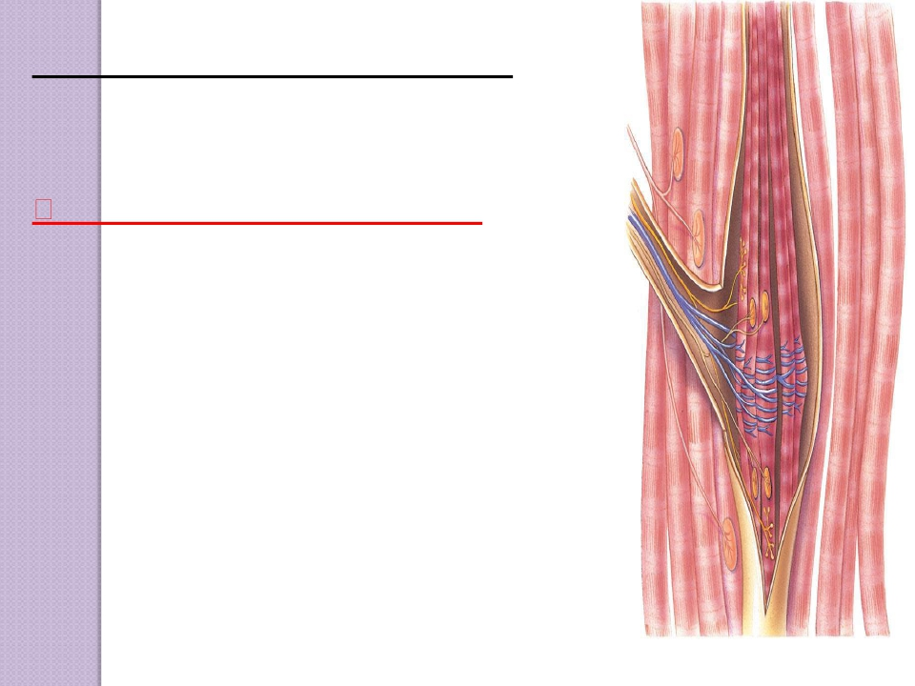
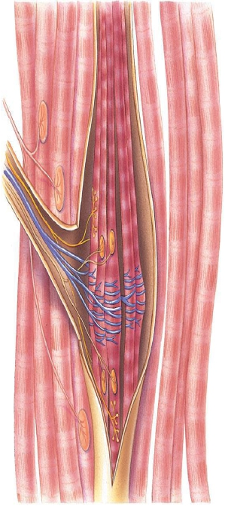
HowAre Muscle SpindlesActivated?
Muscle spindles are stimulated by stretching
of their mid-portion.
They can be excited in two ways:
1. Lengthening of the whole muscle which
stretches the mid-portion of the spindle and,
therefore excites the receptor.
2.Contraction of the peripheral contractile
portions of the spindle's intra-fusal fibers
which stretches the mid-portions of the
spindle & excites the receptor during
γ-efferent discharge

Slide 31
Muscle can contract by:-
1- Stimulation of alpha motor neurons by muscle stretch which
stretchesthe mid-portion of the spindle and,therefore excites the receptor.
2- Stimulation of gamma motor neurons by supraspinal signals
3- Co-activation of α-and γ-Motor Neurons.
Signals from the motor cortex to the alpha motor neurons, mostly
transmitted to the gamma motor neurons simultaneously, an effect
called coactivation.
-The purpose of Coactivation
-First, it keeps the length of the receptor portion of the muscle spindle
constant.

Slide 32
Reciprocal inhibition with stretch reflex
(Reciprocal innervation)
-as IN KNEE JERK
Contraction of EXTENSOR of thigh
cause
>>>>>>>
Relaxation of FLEXORS
-Reflex contraction of an agonistic muscle is
accompanied by inhibition of the antagonist

Slide 33
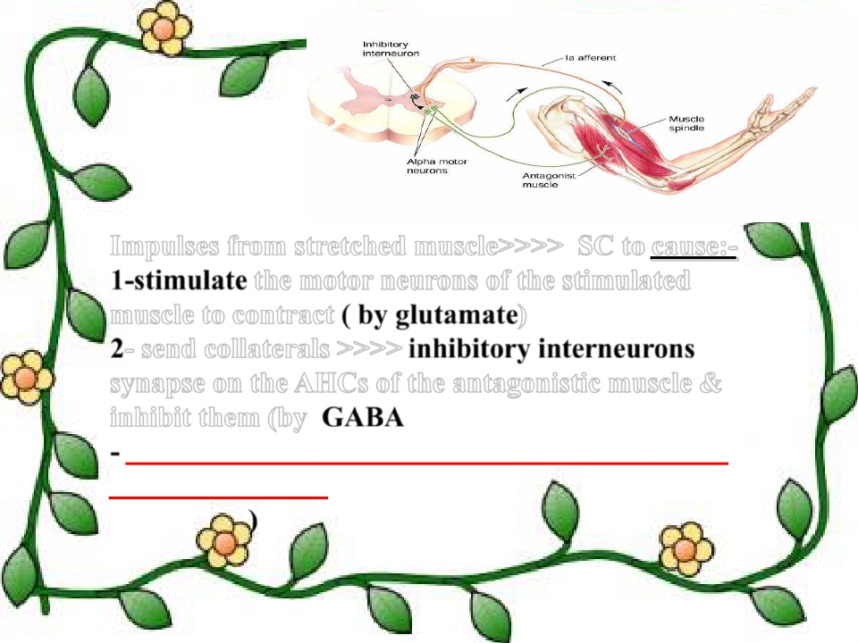
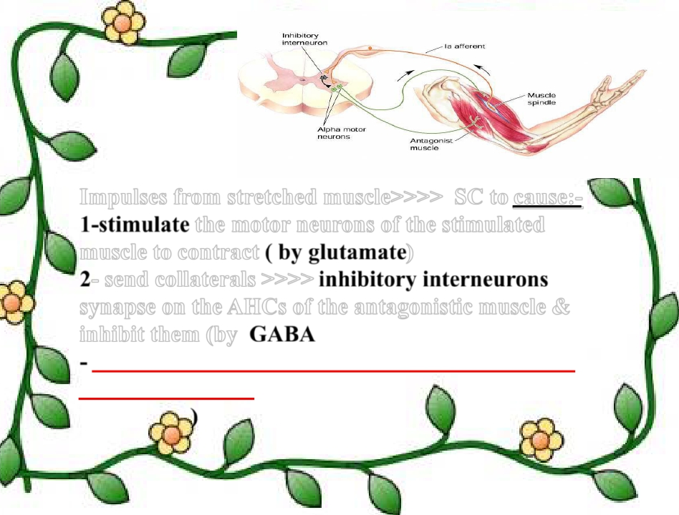
Impulses from stretched muscle>>>> SC to cause: -
1-stimulate the motor neurons of the stimulated
muscle to contract ( by glutamate)
2- send collaterals >>>> inhibitory interneurons
synapse on theAHCs of the antagonistic muscle &
inhibit them (by GABA
- Reciprocal innervation prevents conflict between
opposing muscles and is vital in coordinating body
movements)

Slide 34
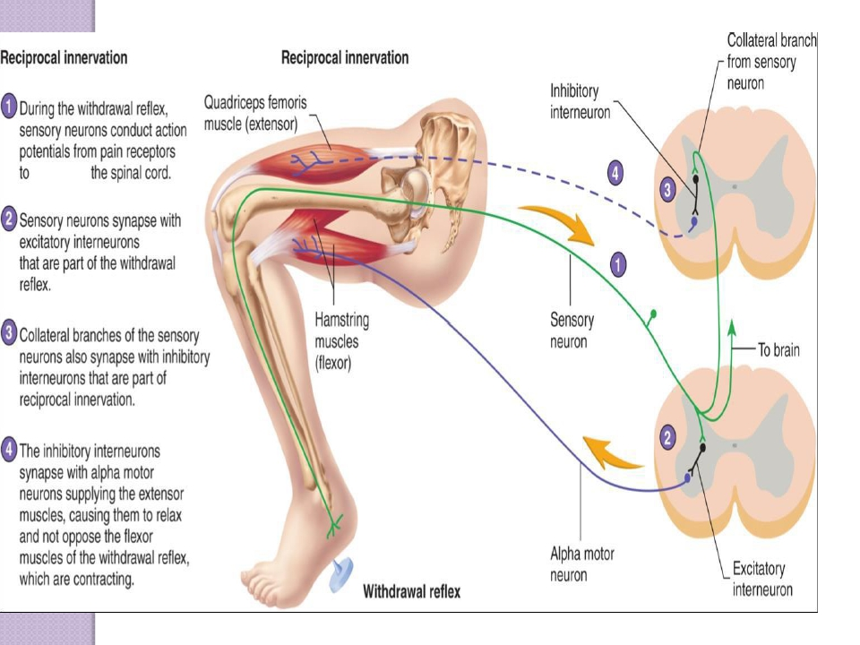
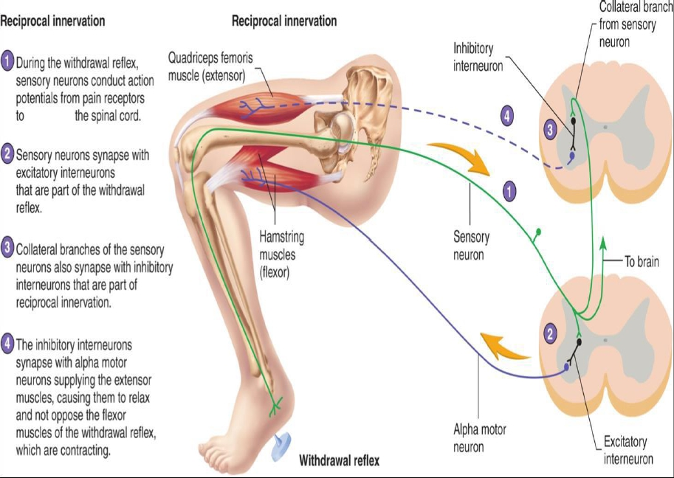

Slide 35
What is the Clinical Significance of
Tendon Reflexes ?
They are carried out clinically to test the integrity of
reflex arc.
A-reflexia or hypo-reflexia (hypo-tonia) indicates that the
reflex arc is interrupted at one of its components by:
Lesions of lower motor neuron e.g.poliomyelitis
Peripheral nerve lesions e.g.peripheral neuropathy
Neuromuscular junction disorder e.g.myasthenia gravis
Primary muscle disorder e.g.myopathy
Hyper-reflexia (hyper-tonia):exaggerated deep reflexes.
Upper motor neuron lesion.
Anxiety

Slide 36
CONSCIOUSAWARENESS


Axon collaterals of the
muscle spindle sensory
neuron also relay nerve
impulses to the brain
over specific ascending
pathways,to allow
conscious awareness
that the reflex has
occurred.
In this way,the brain
receives input about
the state of stretch or
contraction of skeletal
muscles to coordinate
them.
36

Slide 37
SUPRASPINAL REGULATION OFTHE
STRETCH REFLEX
Stretch reflexes are subject to strong regulation by
supraspinal centres,especially certain motor centres
in the brainstem and cerebral cortex. These
supraspinal centres send to gamma motor neurons
through descending fibres

http://humanphysiology.tuars.com/program/section8/8ch3/s8ch3_20.htm
37

Slide 38
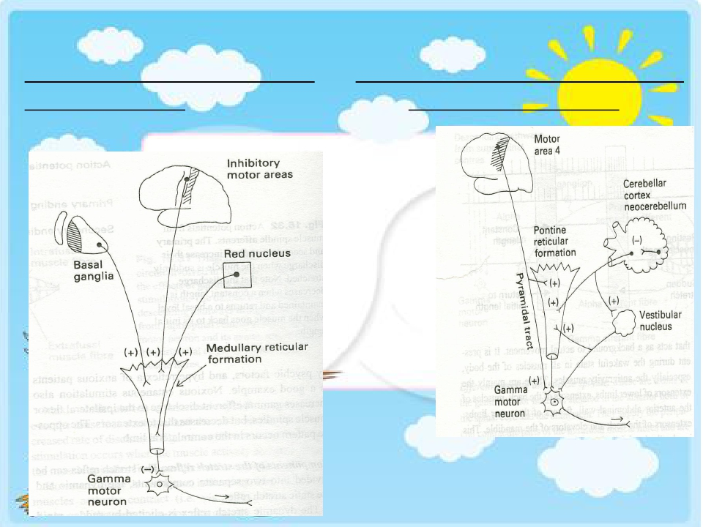
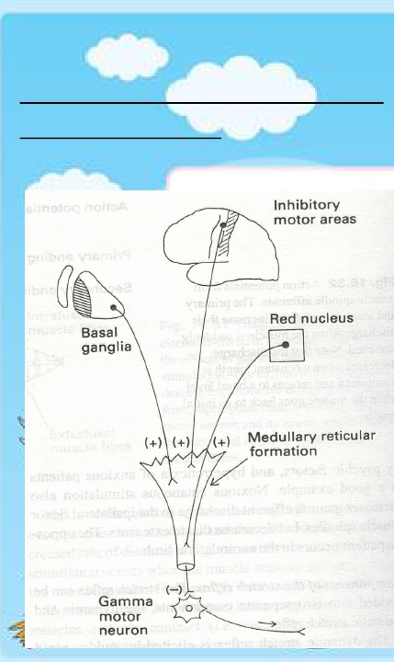
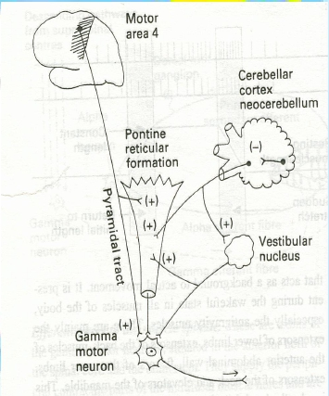
Inhibitory supra spinal centers
to gamma motor
Facilitatory supra spinal centers to
gamma motor neurons

Slide 39
Factors influence stretch reflex
( all act on gamma motor neurons)
Enhances
1-Suprspinal
-Primary motor
area4
-Vestibular N
-Pontine RF-
-Neocerebellum
2-Anxiety
3-Noxious painful
stimuli
4-Jendrassik-
manuver
Inhibits
1-Supraspinal
-Cortical (suppressor
area4&Area 6)
-Basal ganglia
-Medullary RF
-Red nucleus
-paleocerebellum
2-Excessive stretch
of muscle(golgi
tendon reflex)

Slide 40
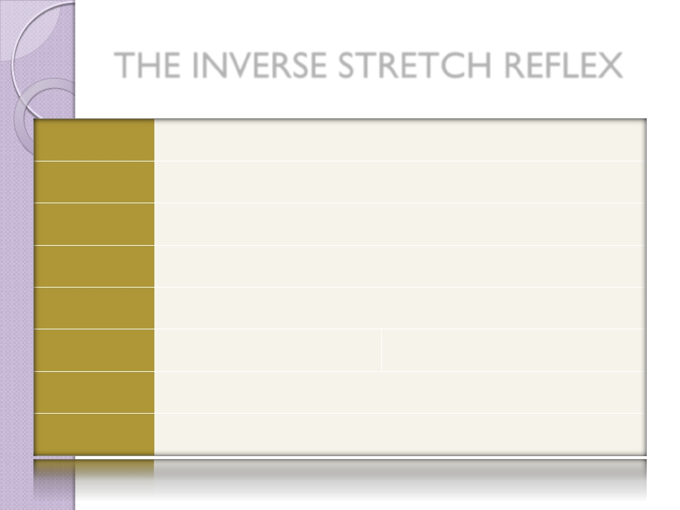
THE INVERSE STRETCH REFLEX
REFLEX | GOLGITENDONORINVERSESTRETCHREFLEX(AUTOGENICINHIBITION)
CLINICALTEST| STIMULUS | IncreasedtensionbyLARGEFORCEONTENDON(PULLONMUSCLEWHENRESTED)
RESPONSE | MUSCLETENDONDECREASES(CLASPEDKNIFEREFLEX)
SENSORY RECEPTOR | GOLGITENDONORGAN
SYNAPSES INVOLVED | POLYSYNAPTIC(VIAINTERNEURON)
EFFECTSON MUSCLE | RELAXESSAMEMUSCLE | RELAXESSYNERGISTICMUSCLES
OTHEREFFECTS | CONTRACTION(+)OFANTAGONISTICMUSCLE
FUNCTION | PROTECTIVE|PREVENTSDAMAGETOTENDON
https://musom.marshall.edu/anatomy/grosshom/allppt/pdf/Spinalreflexes.pdf
40

Slide 41
(Inverse Stretch Reflex)-
The Golgi tendon reflex
- It is Deep & polysynaptic
-
reflex
- -(opposite response to stretch
reflex = Inverse Stretch
Reflex).
Mechanism/
Excessive tension in the muscle
( by passive over-stretch of
tendon or severe active muscle
contraction) >>> cause muscle
relaxation

Slide 42
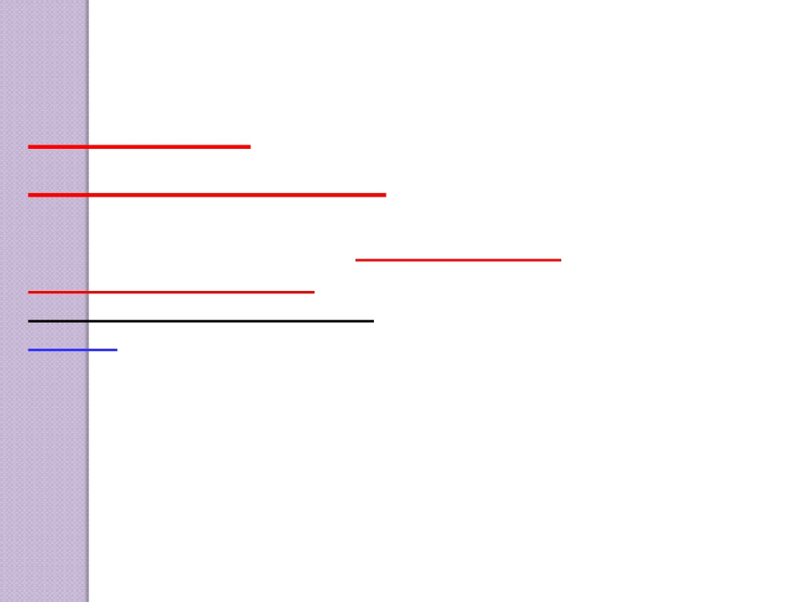
RECEPTOR
Golgi tendon organs
-
Transmit information about tendon tension or
rate of change of tension.
Golgi tendon organs (3-25) present in
tendons , encapsulated sensory receptor
,through which muscle tendon fibers pass.
-About 10 to 15 muscle fibers are usually
-
-
connected to each Golgi tendon organ
-The organ is stimulated when this small -
bundle of muscle fibers is “tensed” by sever
contracting

Slide 43
Inhibitory Nature of the Tendon Reflex and Its
Importance
-Stimulated golgi tendon organ by an increase in muscle
tension>>> impulses via fast Ib nerve fibers , large,
rapidly conducting fibers that average 16
micrometers in diameter >>>> SC >>> The local cord
signal excites inhibitory interneuron ( secrete Glycine
)>> inhibit alpha motor neuron >>> negative feedback
mechanism>>>>>muscle relaxation (lengthening
reaction )
-Also stim excitatory interneuron to antagonist.
(reciprocal innervation)
-Value/Protect muscle from rupture& tendon from
avulsion& tear

Slide 44
5 EFFECTOR
(muscle attached
to same tendon)
relaxes and
relieves excess
4
MOTOR NEURON
inhibited
+
2 SENSORY
NEURON
excited
+
–
tension
1 Increased tension
stimulates SENSORY
RECEPTOR (tendon
organ)
+
Spinal
nerve
3 Within INTEGRATING
CENTER (spinal cord),
Excitatory
interneuron
+
sensory neuron
activates inhibitory
interneuron
Antagonistic
muscles
contract
Motor neuron to
antagonistic
muscles is excited
44

Slide 45
The Golgi tendon reflex (inverse
stretch reflex)

Slide 46
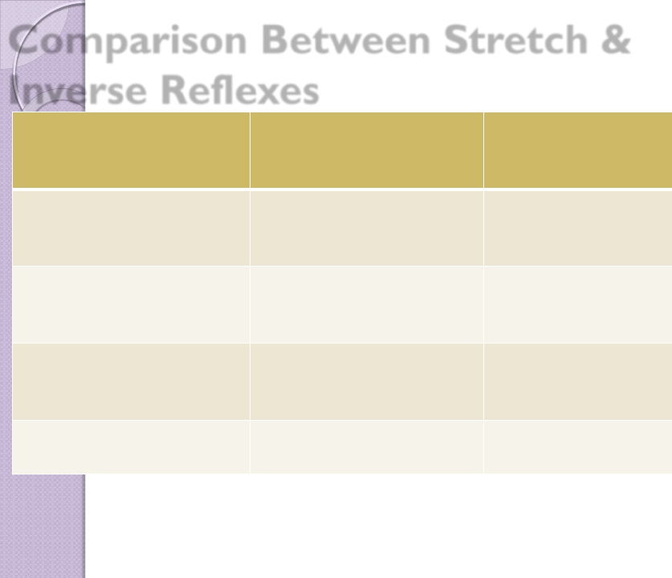
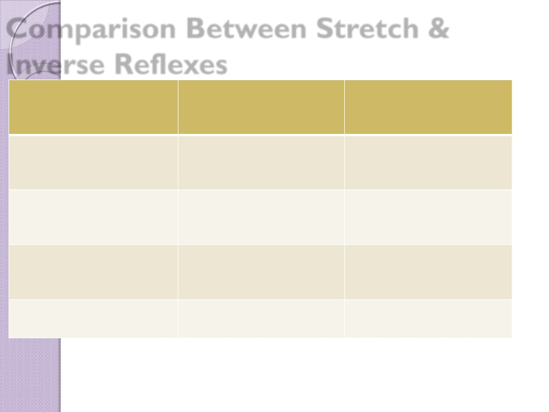
Comparison Between Stretch &
Inverse Reflexes
 | Stretchreflex | Inversestretchreflex
STIMULUS | Increasedmusclelength | Increasedmuscletension
RESPONSE | Musclecontraction | Musclerelaxation
Receptor | Musclespindles | Golgitendonorgans
AFFERENTS | TypeIa&IIfibers | TypeIbfibers

Slide 47
SYNAPSES | Monosynaptic | Polysynaptic
RECEPROCAL INNERVATION Regulation | Inhibitantagoniststhrough inhibitoryinterneurons | Excitesantagonisticmuscles throughexcitatory interneurons
PHYSIOLOGICAL SIGNIFICANCE | Regulatemusclelength | Regulatemuscletensionto preventexcessivetension increase
CLINICAL ASSESSMENT | Suddentapofmusclecauses briskcontractionmuscle jerk | Overstretchofmuscle- suddenmusclerelaxation (lengtheningreaction)

