Slide 1


Slide 2

PHYSIOLOHY OF
BRAIN STEM

Slide 3

Components of Brain Stem
Important structures in Brain Stem
Functions of the Brain Stem
Signs & Symptoms of Brain Stem Lesion
Brain Stem Function Tests

Slide 4

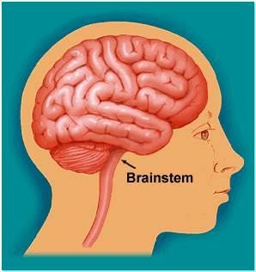
The brain stem is the
lower part of the brain.
It is adjoining and structurally continuous with the spinal cord.

Slide 5

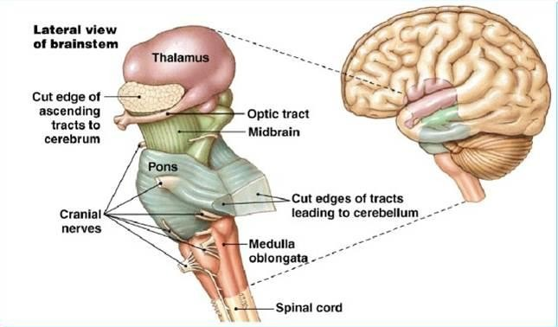
Mid Brain
Pons
Medulla
Oblongata

Slide 6
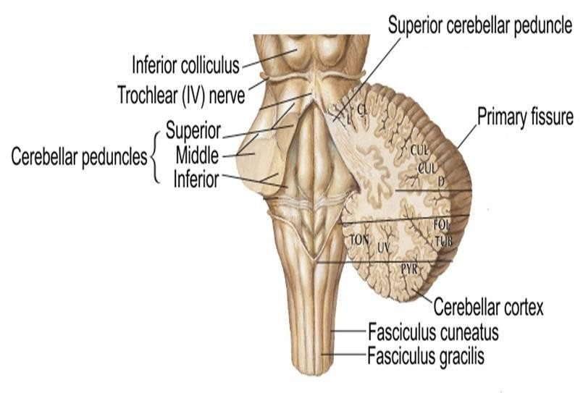
The midbrain, pons and medulla connect to the cerebellum via the superior, middle and inferior peduncles respectively.

Slide 7

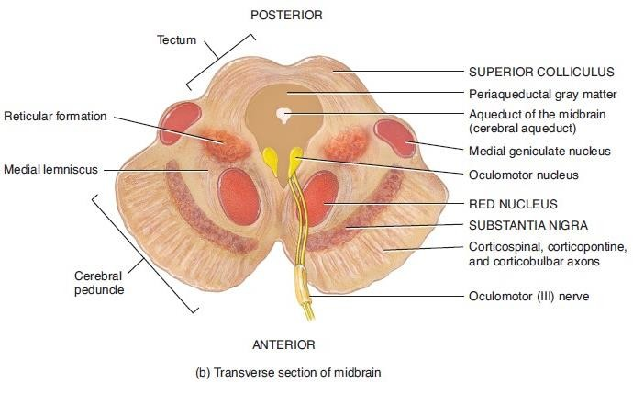
The midbrain is divided
into three parts:
The Tectum
The Tegmentum
Cerebral Peduncles

Slide 8







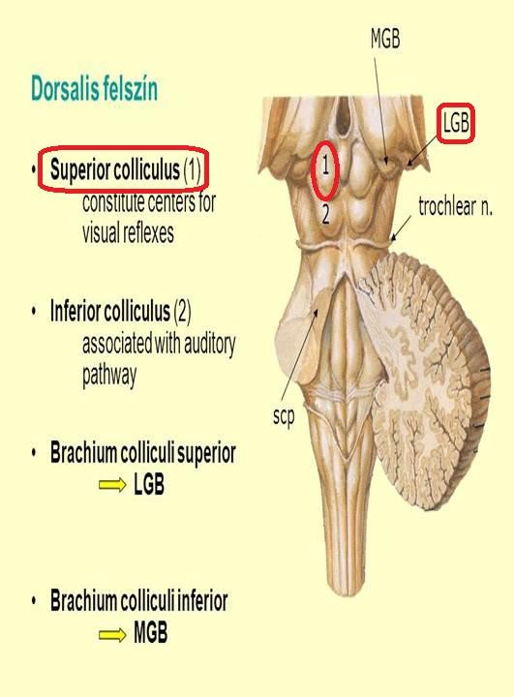
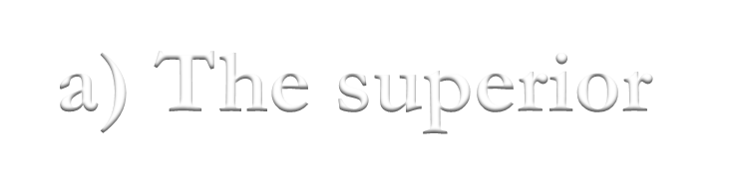


1- The Tectum ("roof" in latin) includes:
a) The superior colliculus
▪It constitutes center for
visual reflexes
▪It sends its superior brachium to the lateral geniculate body of the thalamus.

Slide 9
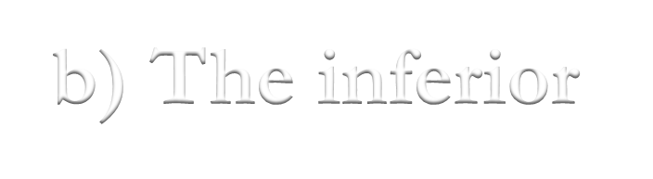

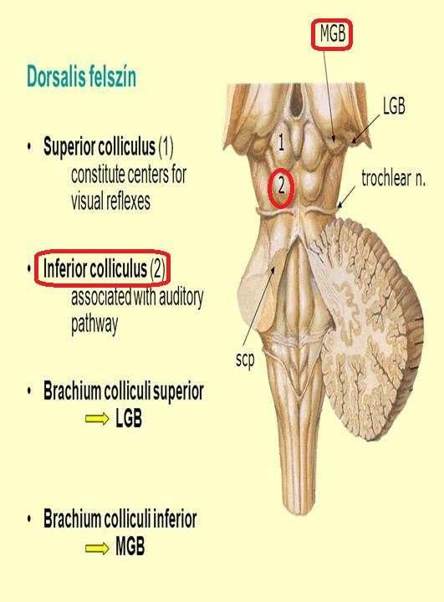
The inferior colliculus
  It is associated with auditory
pathway
  It sends its inferior brachium to the medial geniculate body of the thalamus.
  The cerebral aqueduct runs through the midbrain, beneath the colloculi.

Slide 10





Ventral to the cerebral aqueduct.
Several nuclei, tracts and the reticular formation is contained here.
The ventral side is
comprised of paired
These transmit axons
of UMN.

Slide 11
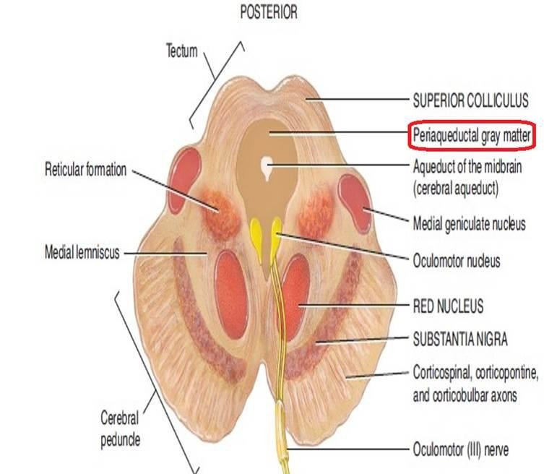
 Periaqueductal Gray: Around the cerebral aqueduct, contains neurons involved in the pain desensitization pathway
.

Slide 12
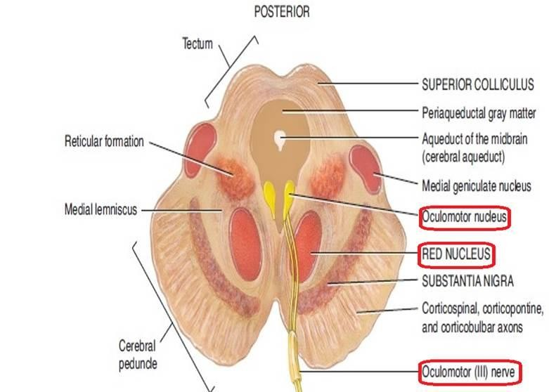
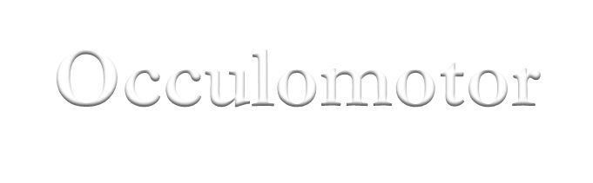

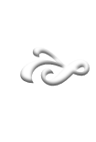



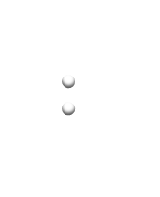
Occulomotor Nerve (CN III) nucleus.
Trochlear Nerve (CN IV) nucleus.
Red Nucleus This is a motor nucleus that sends a descending tract to the lower motor neurons.

Slide 13


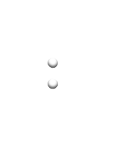
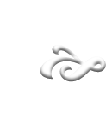
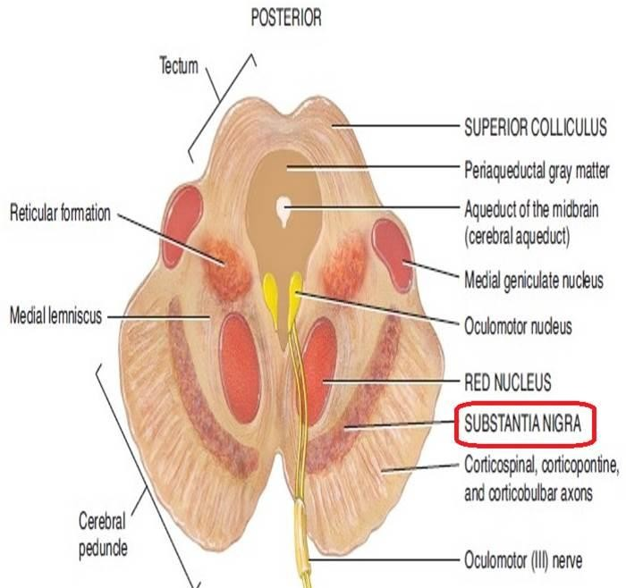
 Substantia Nigra:
A concentration of neurons in the ventral
portion of midbrain
It is involved in motor function.

Slide 14




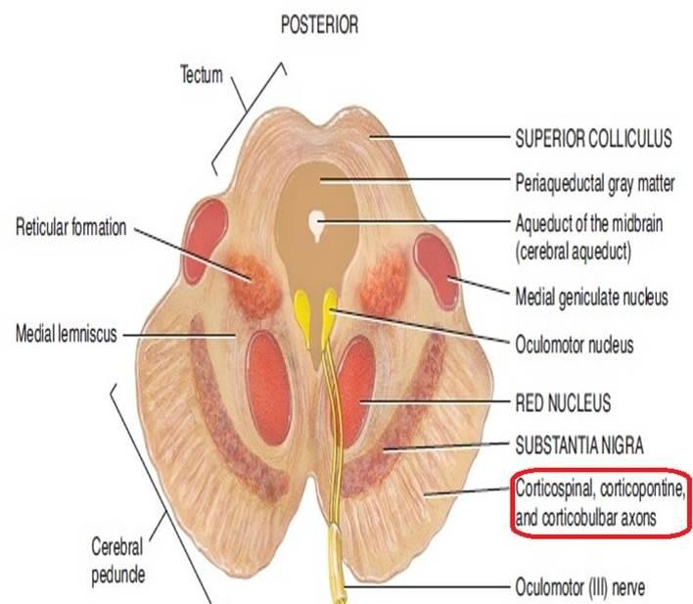
 Central Tegmental Tract:
Directly anterior to the floor of the 4th
ventricle.
It is a pathway by which many tracts project up
to the cortex and down to the spinal cord.

Slide 15
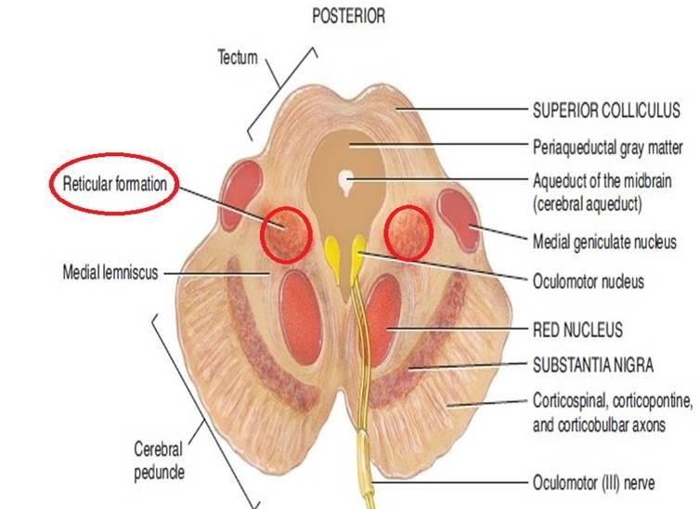


 Reticular Formation: A large area that is involved in
various important functions of the midbrain:
It contains LMN
It is involved in the pain desensitization pathway
It is involved in the arousal and consciousness systems
It contains the locus ceruleus, which is involved in intensive alertness modulation and in autonomic reflexes.

Slide 16

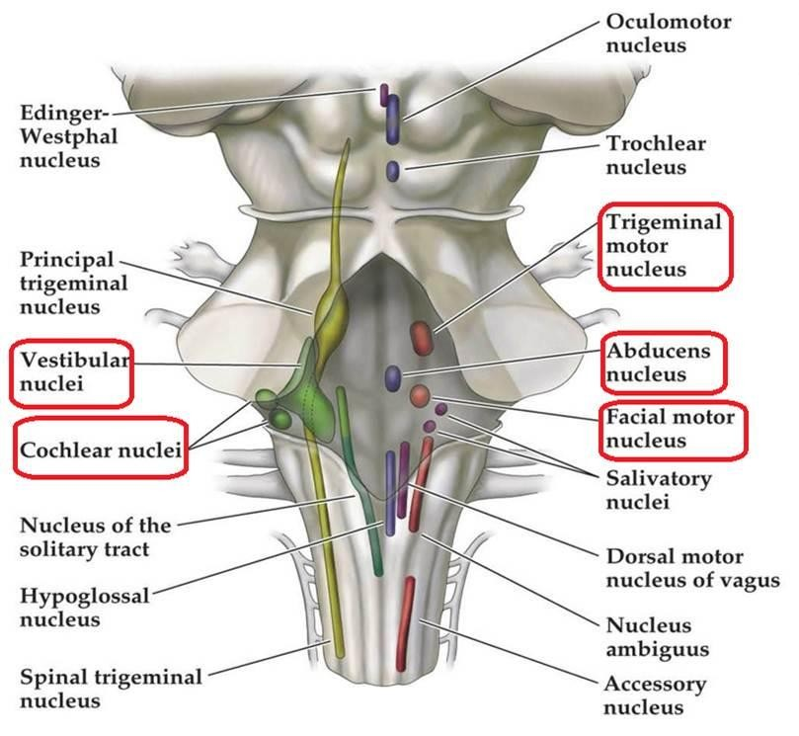
At the level of the midpons, trigeminal nerve (CN V) emerges.
Between the basal pons, cranial nerve 6 (abducens), 7 (facial) & 8 (vestibulo- cochlear) emerge (medial to lateral).

Slide 17



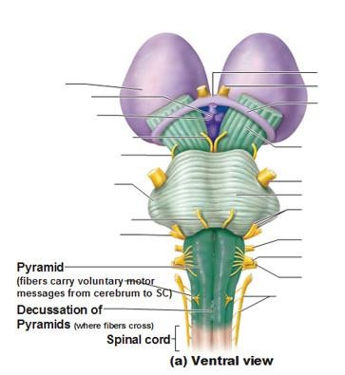

e
The most medial part of the medulla is the anterior median fissure.
Moving laterally on each side ar the pyramids. They contain the fibers of the corticospinal (pyramidal) tract as they head inferiorly to synapse on lower motor neuronal cell bodies within the ventral horn of the spinal cord.

Slide 18

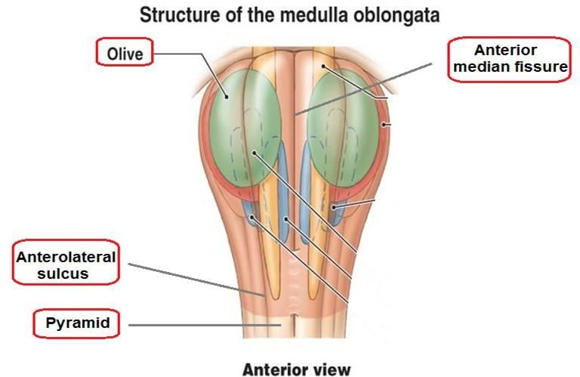
The anterolateral sulcus is
lateral to the pyramids.
Emerging from the anterolateral sulci are the hypoglossal nerve (CN
XII) rootlets.
Lateral to the anterolateral sulci are the olives containing underlying inferior olivary nuclei and afferent fibers).
Lateral (and dorsal) to the olives are the rootlets for glossopharyngeal (IX) & vagus (X) cranial nerves.

Slide 19
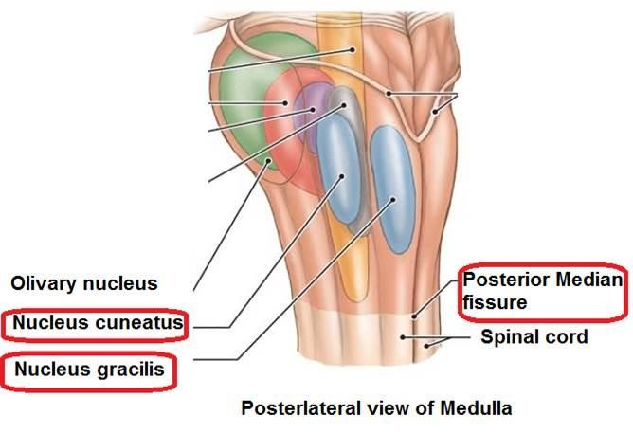

The most medial part of the medulla is the posterior median fissure.
Moving laterally on each side is the fasciculus gracilis.
Lateral to that is the
fasciculus cuneatus.
Superior to each of these, are the gracile and cuneate tubercles, respectively.
Underlying these are their
respective nuclei.

Slide 20
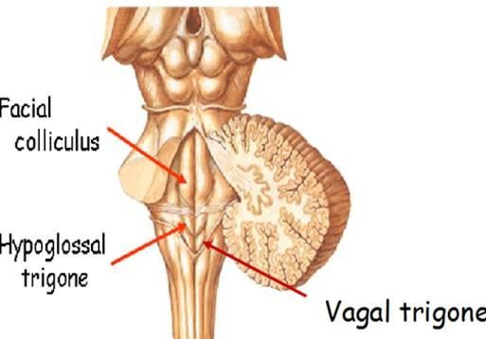
In the midline is the vagal trigone and superior to that is the hypoglossal trigone. Underlying each of these are motor nuclei for the respective cranial nerves.

Slide 21

Though small, brain stem is an extremely important part of the brain:
Conduct functions.
Provides the origin of the cranial nerves (CN
III-XII).
Conjugate eye movement.
Integrative functions.

Slide 22


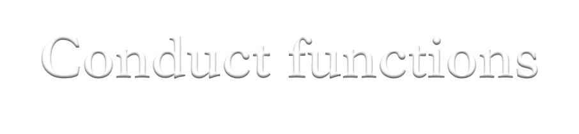
1. Conduct functions
All information related from the body to the cerebrum and cerebellum and vice versa, must traverse the brain stem.

Slide 23
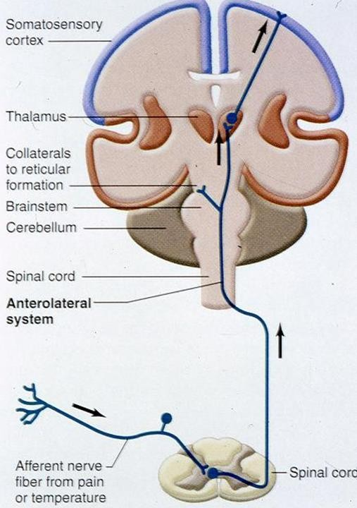

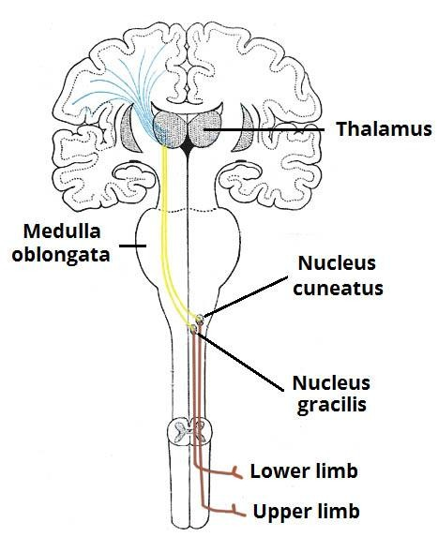

The ascending sensory pathways coming from the body to the brain includes:
  The spinothalamin tract for pain and temperature sensation.
  The dorsal column, fasciculus gracilis, and cuneatus for touch, proprioceptive and pressure sensation.

Slide 24
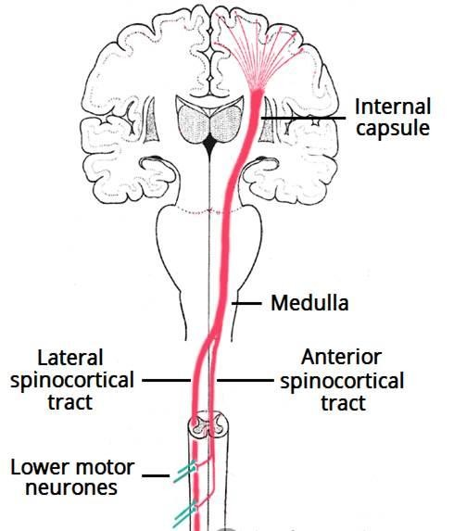
b) Descending tracts
Corticospinal tract (UMN): runs through crus cerebri (the anterior portion of the cerebral peduncle), basal part of pons and medullary pyramids; 70-90 % of fibers cross in pyramidal decussation to form the lateral corticospinal tract, synapse on LMN in ventral horn of spinal cord.
Upper motor neurons that originate in brain stem's vestibular, red, and reticular nuclei, which also descend and synapse in the spinal cord.

Slide 25
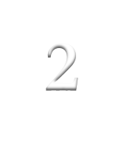



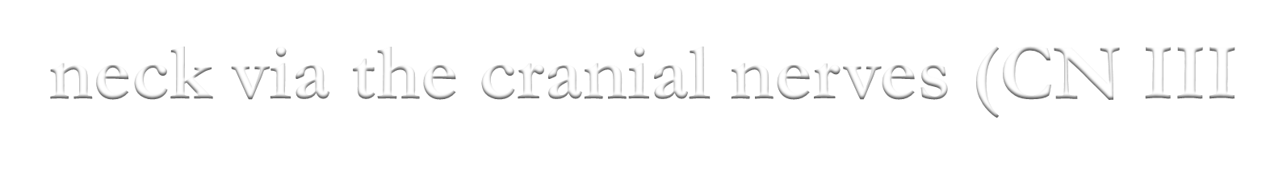

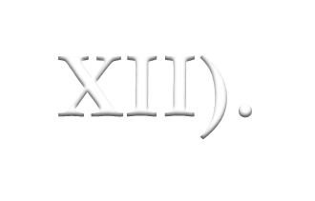
2. The brain stem provides the main motor and sensory innervation to the face and neck via the cranial nerves (CN III-XII).
The fibers of cranial nerve nuclei except for olfactory & optic nerve either originating from, or terminating in the cranial nerve nuclei in brain stem.

Slide 26



CN III (oculomotor)
CN IV (trochlear)
Both moves eyes; CN III constricts the
pupils, accommodates.

Slide 27


CN V (trigeminal): Chews and feels front
of the head.
CN VI (abducens): Moves eyes.
CN VII (facial): Moves the face, tastes,
salivates, cries.
CN VIII (acoustic): Hears, regulates
balance.

Slide 28


CN IX (glossopharyngeal): Tastes, salivates,
swallows, monitors carotid body and sinus.
CN X (vagus): Tastes, swallows, lifts palate, talks, communication to and from thoraco- abdominal viscera.
CN XI (accessory): Turns head, lifts
shoulder.
CN XII (hypoglossal): Moves tongue.

Slide 29
Sensory
CN I, CN II, CN VIII
Motor
CN III, CN IV, CN VI, CN XI, CN XII
Mixed
CN V, CN VII, CN IX, CN X

Slide 30
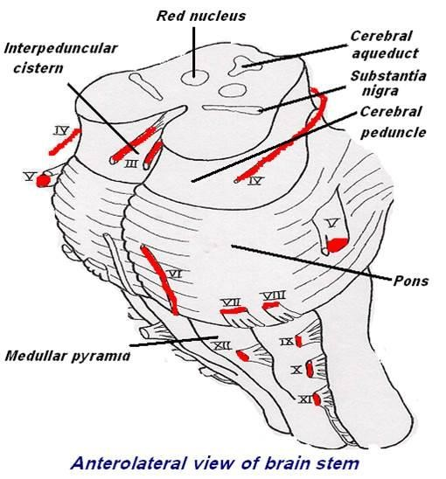

Slide 31
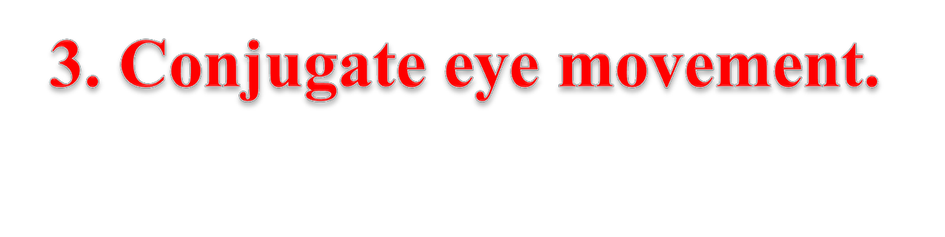
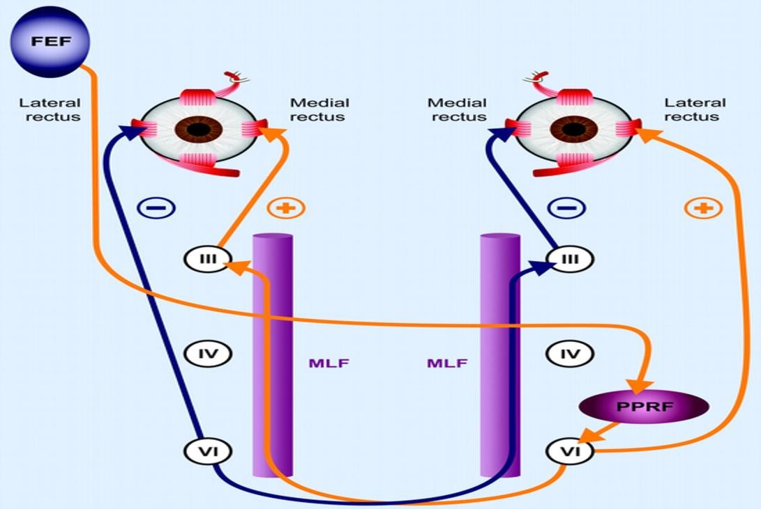
It refers to motor coordination of the eyes that allows for bilateral fixation on a single object
The frontal eye field (FEF) projects to the opposite side at the midbrain-pontine junction, and
then innervates the paramedian pontine reticular formation (PPRF).
From there, projections directly innervate the lateral rectus (contralateral to FEF) and the
medial rectus muscle (ipsilateral to FEF).
The left FEF command to trigger conjugate eye movements to the right.

Slide 32
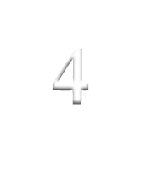
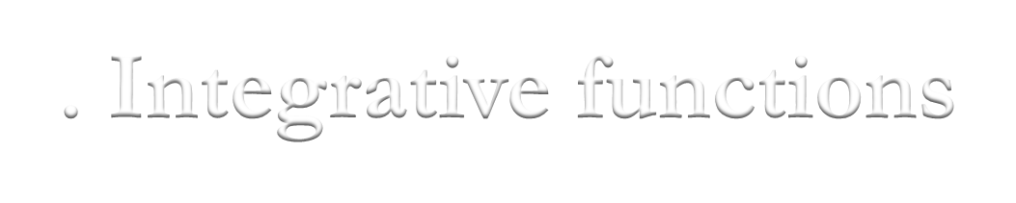
Integrative functions
  It controls consciousness & sleep cycle (alertness and arousal) through reticular formation.
  It has got center for cardiovascular,
respiratory & autonomic nervous system.
  It has centers for cough, gag, swallow, and
vomit.
  Sense of body balance (Vestibular
functions)

Slide 33
oSubstantia which is a part of the basal ganglia is present in midbrain and is involved in control of movement.
oMidbrain also contain red nucleus which regulate the motor activity through cerebellum.

Slide 34
Inferior and superior colliculi are situated on the dorsal surface of the midbrain and is involved in auditory & visual processing required for head movements.
Pain sensitivity control: Periaqueductal grey matter of mesencephalon is an area which is rich in endogenous opioid and is important in modulation of painful stimuli.

Slide 35
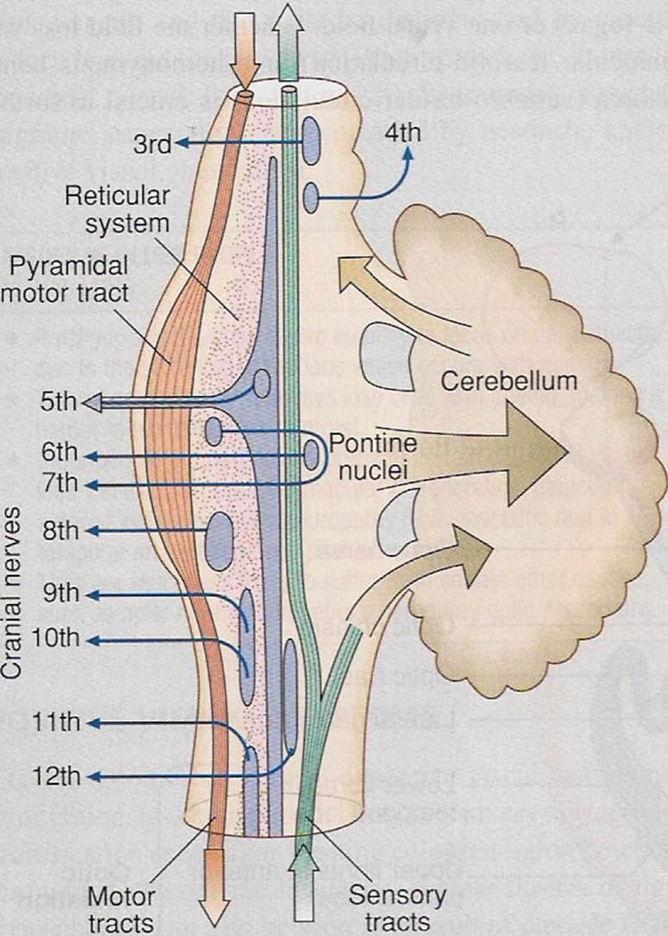


oVentral layer of
brainstem is motor
in function.
oMiddle layer is sensory in function & contains medial lemniscus which conveys sensory information from dorsal column.

Slide 36
Function of Midbrain
Nerve pathway to cerebral hemispheres.
Auditory and Visual reflex centers.
Cranial Nerves:
CN III - Oculomotor [motor]. (Related to eye
movement).
CN IV - Trochlear [motor]. (Superior oblique muscle of the eye which rotates the eye down and out).

Slide 37
Signs & Symptoms of midbrain lesion
Cranial Nerve (CN) deficits: Ipsilateral CN III,
CN IV palsy and ptosis (drooping).
Pupils:
Size: Midposition to dilated. Reactivity: Sluggish to fixed.
Movement: Abnormal extensor.
Respiratory: Hyperventilating.
Loss of consciousness (LOC): Varies

Slide 38
Functions of pons
Respiratory Center.
Cranial Nerves:
  CN V - Trigeminal [motor and sensory]. (Skin of face, tongue, teeth; muscle of mastication).
  CN VI - Abducens [motor]. (Lateral rectus muscle of eye which rotates eye outward).
  CN VII - Facial [motor and sensory]. (Muscles
of facial expression).
  CN VIII - Acoustic [sensory]. (Hearing)

Slide 39
Symptoms and signs of lesion in pons
Pupils size: Pinpoint
LOC: Semi-coma
Movement: Abnormal extensor.
Respiratory:
-Apneustic (Abnormal respiration marked by
sustained inhalation).
-Hyperventilation.
CN Deficits: CN V, CN VI, CN VII, CN
VIII.

Slide 40
Functions of medulla oblongata
Crossing of motor tracts.
Cardiac Center.
Respiratory Center.
Vasomotor Center (nerves having muscular
control of the blood vessel walls)
Centers for cough, gag, swallow, and vomit.
Cranial Nerves:

Slide 41
CN IX - Glossopharyneal [mixed]. (Muscles & mucous membranes of pharynx, the constricted openings from the mouth & the oral pharynx and the posterior third of tongue).
CN X - Vagus [mixed]. (Pharynx, larynx, heart,
lungs, stomach).
CN XI - Accessory [motor]. (Rotation of the
head and shoulder).
CN XII - Hypoglossal [motor]. (Intrinsic
muscles of the tongue).

Slide 42
Signs and symptoms of lesion in medulla
Movement: Ipsilateral paralysis.
Pupils:
Size: Dilated. Reactivity: Fixed.
Respiratory: Abnormal breathing patterns
CN Palsies: Inability to control movement. Absent cough, gag.
LOC: Comatose.

Slide 43



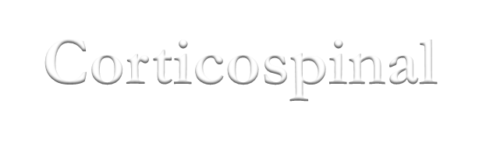


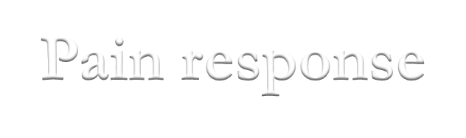

To test reticular formation
Alertness, Consciousness & Sleep.
Corticospinal tract
Motor power, reflexes
Pain response
Facial grimacing on firm pressure over the supra
orbital ridge.
To test respiratory center
look for the normal pattern of respiration

Slide 44



To test cardiovascular center
Look for normal circulatory function
To test brainstem reflexes:
Pupilary and corneal reflexes.
Vestibulo-ocular reflex: Injection of iced water into the ear will produce eyes movement.
Oculo-cephalic reflex: Eyes will be fixed when
head is moved in one or another directions.
Gag reflex.
Cough reflex

Slide 45










Slide 46


