Slide 1
BASALGANGLIA
Physiology of basal ganglia and
The Autonomic Nervous
regulatory mechanisms
System
Dr FawziaAl-Rouq
Department of Physiology
College of Medicine
King Saud University

Slide 2
OBJECTIVES
At the end of this lecture the
students should be able to:-
•Appreciate different nuclei of basal ganglia
• Know different neurotransmitters that have
a role in basal ganglia functions
•Appreciate general functions of basal
ganglia
• Diagnose basal ganglia disorders

Slide 3
OVERVIEW OF MOTOR
ACTIVITY CONTROL

Slide 4
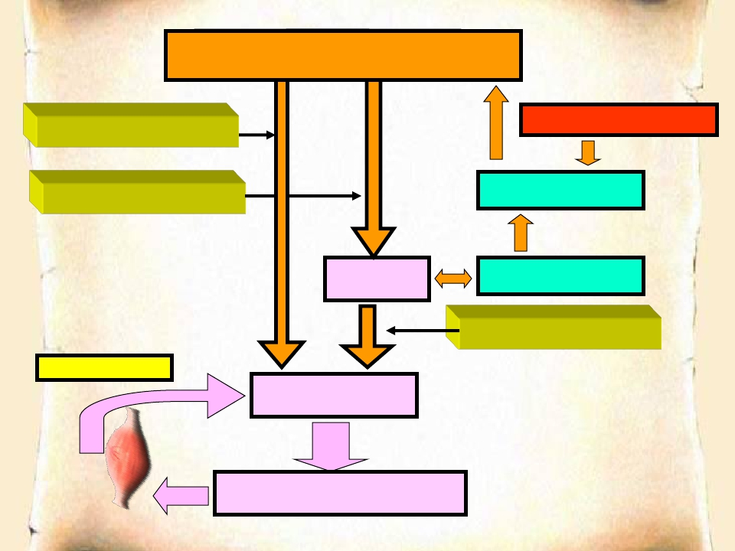
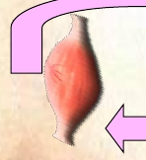
Cortex Cortex Cerebral Cerebral
CEREBRAL CORTEX
Corticospinal tracts
Corticobulbar tracts
BASAL GANGLIA
THALAMIUS
BRAIN STEM
CEREBELLUM
Bulbospinal tracts
SENSORY INPUT
SPINAL CORD
FINAL COMMON PATH

Slide 5
BASAL GANGLIA
COMPONENTS
FUNCTIONAL ANATOMY

Slide 6
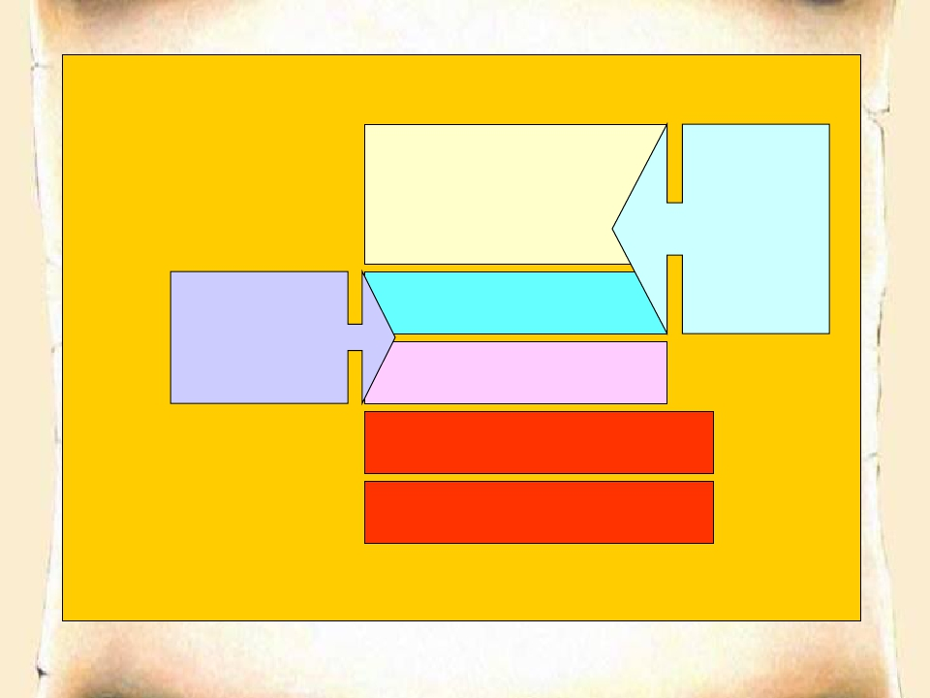
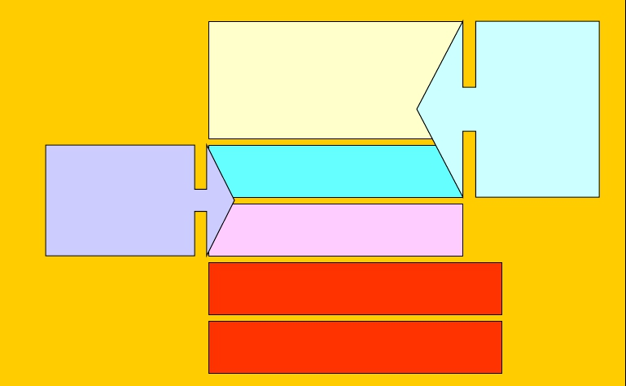
Basal
Nuclei
Caudate
Nucleus
Corpus
Striatum
Lenticular
Nucleus
Putamen
Globus Pallidus
Subthalamic Nucleus
Substantia Nigra

Slide 7
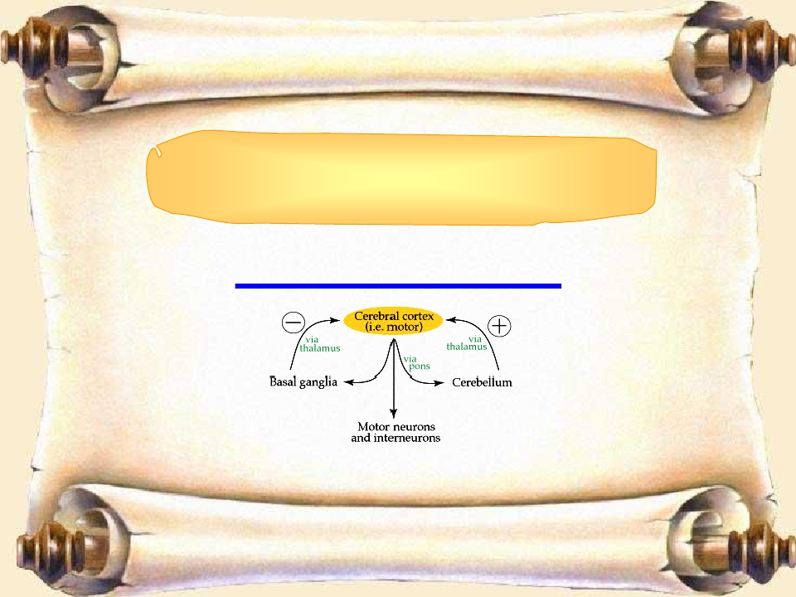
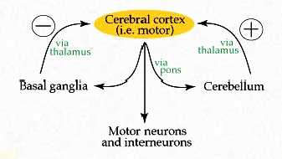
BASAL GANGLIA
CONNECTIONS

Slide 8
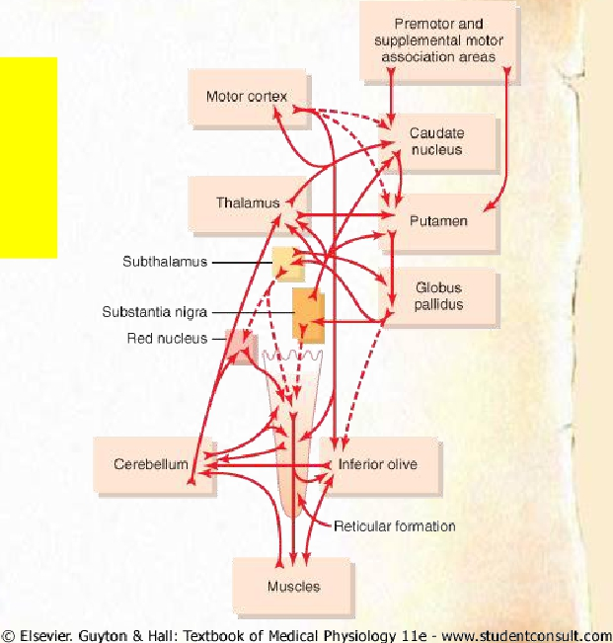
Connections
for Motor
Control

Slide 9
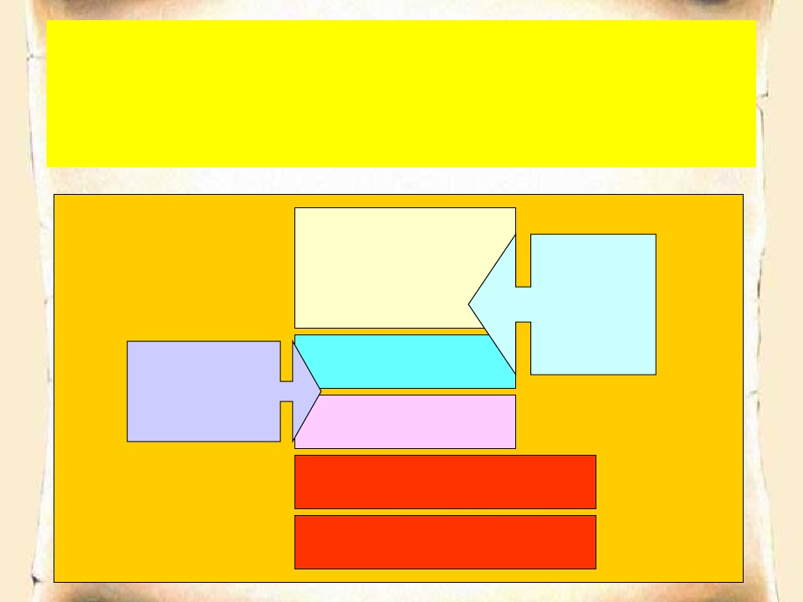
3 Connections to remember
1. Main input to the basal ganglia
2. Main output from the basal ganglia
3. Connections between parts of basal ganglia
Basal
Nuclei
Lentiform
Caudate
Nucleus
Putamen
Corpus
Striatum
Globus Pallidus
Subthalamic Nucleus
Substantia Nigra

Slide 10
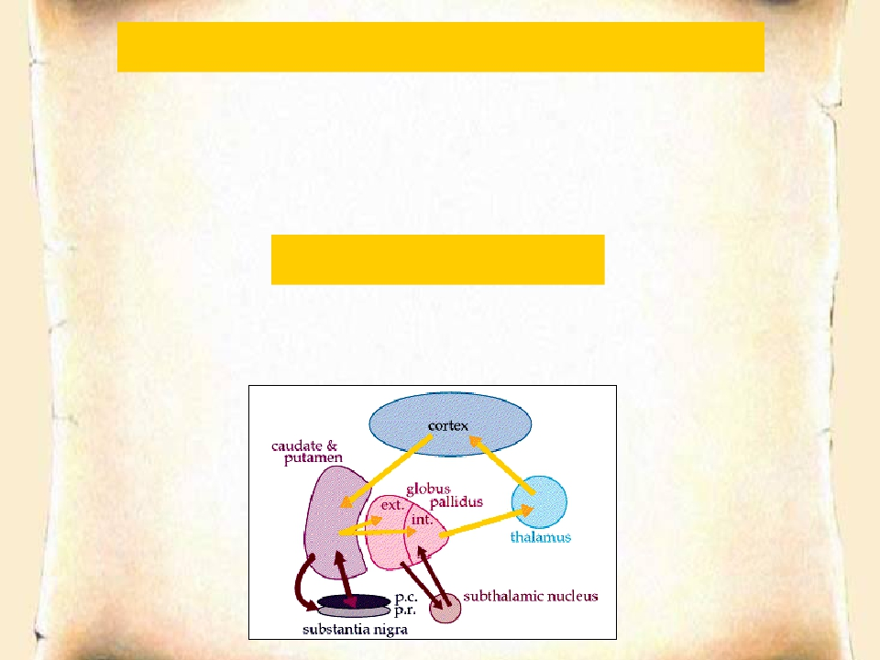
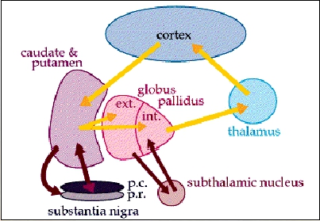
MAIN INPUT TO THE BASAL GANGLIA
The comes from the cerebral cortex (motor area) and
projects to the NEOSTRIATUM
(a term for the caudate nucleus and putamen)
THE MAIN OUTPUT
Is via the thalamus to the cerebral cortex
(motor area)

Slide 11
BASIC CIRCUITS OF BASAL GANGLIA
1. Motor loop (putamen circuit) concerned with
learned movment.
2. Cognitive loop (Caudate circuit) concerned
with cognitive control of sequences of motor
pattern. Basically it is concerned with motor
intentions.
(Note: cognition means thinking process using sensory input
with information already stored in memory.)
3. Limbic loop involved in giving motor expression to
emotions like, smiling, aggressive or submissive
posture.
4. Occulomotor loop concerned with voluntary eye
movement [ saccadic movement]
11

Slide 12
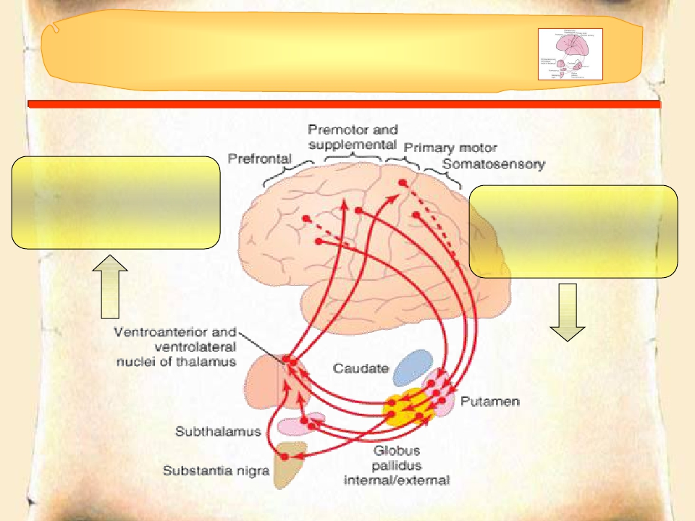
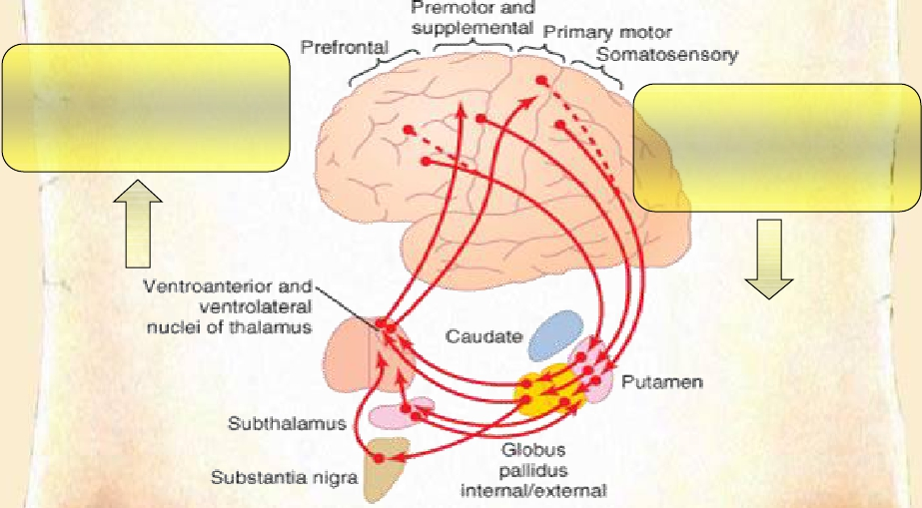
The Putamen Circuit
•Prim Motor Cortex
•Premotor
•Suppl Motor Areas
•Premotor
•Suppl Motor
•Somatosensory Cortex

Slide 13
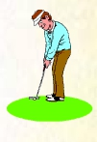
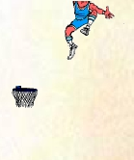
The Putamen Circuit
Executes Learned Patterns of Motor Activity
• Basal ganglia function in association with the corticospinal
system to control complex patterns of motor activity.
• Examples are:
– writing of letters of the alphabet.
– cutting paper with scissors,
– hammering nails,
– shooting a basketball through a hoop,
– passing a football,
– throwing a baseball,
– the movements of shoveling dirt,
– most aspects of vocalization,
– controlled movements of the eyes
– virtually any other of our skilled movements, most of
them performed subconsciously.

Slide 14
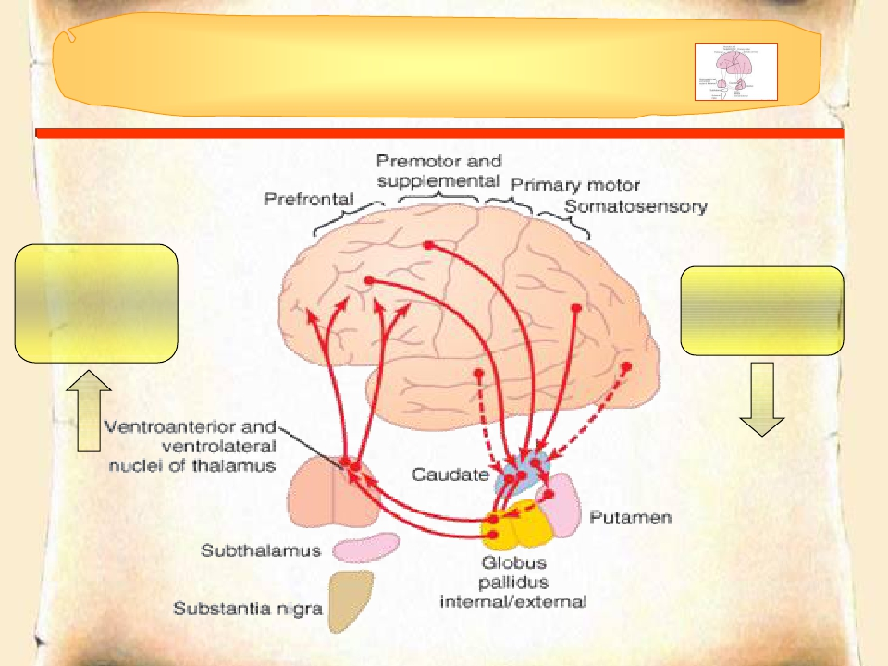
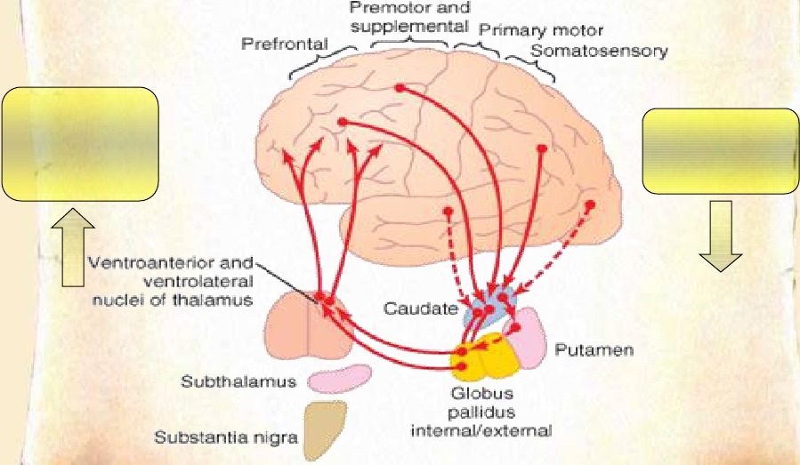
The Caudate Circuit
•Prefrontal
•Premotor
•Suppl Motor
Association
Areas

Slide 15
The Caudate Circuit
Cognitive Control of Sequences of Motor Patterns
• Cognition means the thinking processes of the brain,
using both sensory input to the brain plus information
already stored in memory. Thoughts are generated in
the mind by a process called cognitive control of
motor activity.
• Example:A person seeing a lion approach and then
responding instantaneously and automatically by (1)
turning away from the lion, (2) beginning to run, and
(3) even attempting to climb a tree.
• Thus, cognitive control of motor activity determines
subconsciously, and within seconds, which patterns
of movement will be used together to achieve a
complex goal

Slide 16
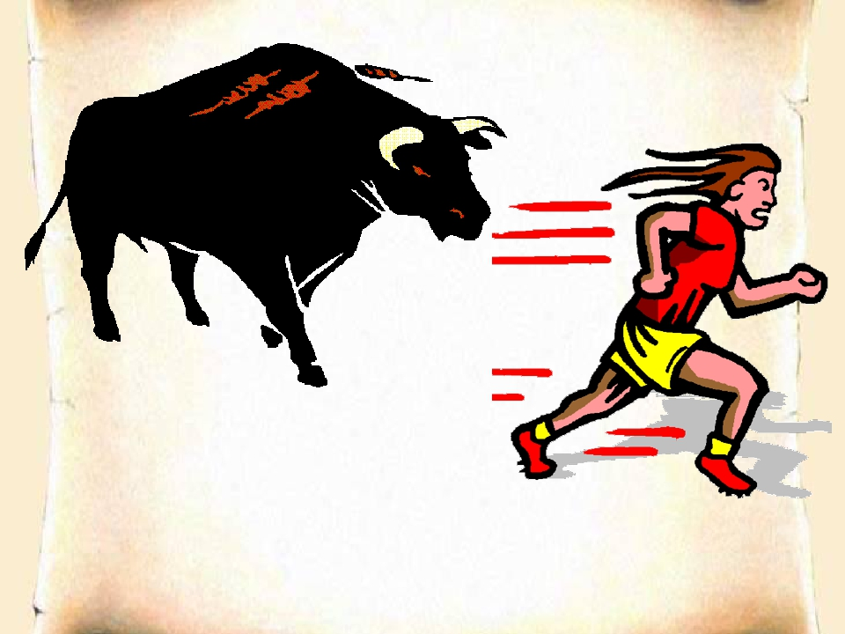
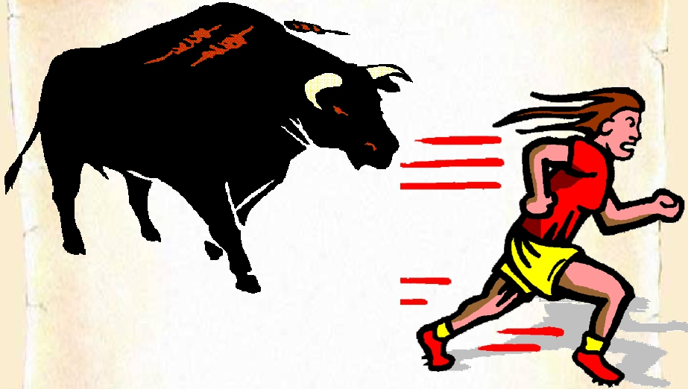

Slide 17
The Caudate Circuit
Change the Timing and to Scale the Intensity of Movements
• Two important capabilities of the brain in
controlling movement are
– (1) to determine how rapidly the movement is
to be performed and
– (2) to control how large the movement will be.
• For instance, a person may write the letter "a"
slowly or rapidly. Also, he or she may write a
small "a" on a piece of paper or a large "a" on a
chalkboard. Regardless of the choice, the
proportional characteristics of the letter remain
nearly the same

Slide 18
Basal Ganglial Pathways
Direct and Indirect

Slide 19
Direct Basal Ganglial
Pathway
↑ MOTOR ACTIVITY
GLU
+
GLU
+
GPe
GPi -
↑ GABA
+
↓GABA
Thalamus
-
DA1+
St
-
DA2 -
Thalamocortical Neurons
are disinhibited
SThN
SNPC

Slide 20
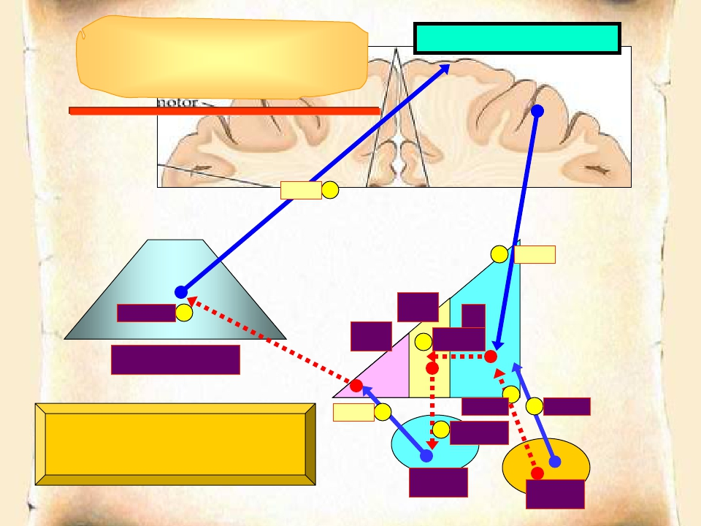
↓ MOTOR ACTIVITY
Indirect Basal Ganglial
Pathway
GLU
+
+
GLU
↑GABA -
Thalamus
GPe
↑ GABA
St
GPi
-
-
GLU
+
DA2 -
- ↓GABA
+
DA1+
Subthalamic Neurons
are disinhibited
SThN
SNPC

Slide 21
Direct and indirect pathways together
facilitate action selection
• Activation of direct pathway facilitates movement
• Activation of indirect pathway suppresses movement
• Direct output makes focal inhibitory contact on GPi/SNr
• Indirect output makes diffuse, widespread excitatory contact on
GPi/SNr
• Co-activation of these pathways facilitates action selection through
center-surround mechanism

Slide 22
Dopamine effects on direct and
indirect pathways
• Dopamine signaling through D2 receptors
in the indirect pathway suppresses striatal
activity
• Dopamine signaling through D1 receptors
in the direct pathway:
– Facilitates strong, phasic inputs
– Suppresses weak inputs

Slide 23
Metabolic characteristics
• High Oxygen consumption .
• High Copper content in Wilson’s disease
(Copper intoxication):
• Autosomal Recessive
• Copper binding protein Ceruloplasmin is
low
• Lenticular degeneration occurs

Slide 24
BASAL GANGLIA
FUNCTIONS
• Control of movements
• Planning and programming of
movements
• Cognition

Slide 25
BASAL GANGLIA
DISORDERS
MOVEMENTS (ATAXIA Rate, Range, Force, Direction)
SPEECH
POSTURE
GAIT
MENTAL ACTIVITY
OTHERS

Slide 26
Movement Disorders
Hyperkinetic
•Hemiballismus
•Huntington’s
Disease
•Athetosis
Hypokinetic
•Parkinson’s Disease
•Drug Induced (Neuroleptics, MPTP)

Slide 27
Movement Disorder | Features | Lesion
Chorea | Multiolequick,random movements,usuallymost prominentinthe appendicularmuscles | Atrophyofthestriatum. HuntingtonChorea
Athetosis | Slowwrithing movements,whichare usuallymoresevereinthe appendicularmuscles | Diffusehypermyelination ofcorpusstriatumand thalamus
Hemiballismus | Wildflingingmovementsof halfofthebody | Hemorrhagicdestruction ofcontralateral subthalamicn. Hypertensivepatients
Parkinsonism | Pillrollingtremorofthe fingersatrest,leadpipe rigidityandakinesia | DegenrationofSubstantia Nigra

Slide 29
Parkinson’s Disease
• Described by James Parkinson
• Degeneration of dopaminergic nigrostriatal
neurons (60-80 %).
• Phenthiazines (tranquilizers drugs) .
• Methyl-Phenyl-Tetrahydro-Pyridine (MPTP). The
oxidant MPP+ is toxic to SN.
• Five cardinal features
– Tremor
– Rigidity
– Akinesia & Bradykinesia
– Postural Changes
– Speech Changes

