Slide 1
schizophrenia
Noor Al-Modihesh
Consultant child & adolescent psychiatrist

Slide 2
Psychotic Disorders are mental illnesses characterized by gross impairment in reality testing and personal functioning
Its symptoms include dysfunctions in nearly every capacity of which the human brain is capable—perception, inferential thinking, language, memory, and executive functions.
It is not split personality
The illness is called “schizo” (fragmented or split apart) “phrenia” (mind)
In DSM-V : psychotic spectrum

Slide 3
schizophrenia is defined by a group of characteristic symptoms,
such as hallucinations, delusions, or negative symptoms (i.e., affective
flattening, alogia, avolition); deterioration in social, occupational,
or interpersonal relationships; and continuous signs of the disturbance
for at least 6 months.

Slide 4
TABLE 5–1. DSM-5 schizophrenia spectrum and other psychotic disorders:
Schizotypal personality disorder
Delusional disorder
Brief psychotic disorder
Schizophreniform disorder
Schizophrenia
Schizoaffective disorder
Substance/medication-induced psychotic disorder
Psychotic disorder due to another medical condition
Catatonia associated with another mental disorder (catatonia specifier)
Catatonic disorder due to another medical condition
Unspecified catatonia
Other specified schizophrenia spectrum and other psychotic disorder
Unspecified schizophrenia spectrum and other psychotic disorder

Slide 5
Epidemiology :
worldwide prevalence of schizophrenia is about 0.5%–1%.
age at first psychotic episode is typically 18–25 years for men and 21–30 years for women
About one-third attempt suicide
Annual incidence of 0.5 – 5.0 per 10,000

Slide 6
Clinical features :
Psychotic symptoms : delusion & hallucinations
Negative dimension :
the absence of something that should be present, such as volition [lack of motivation]).
Diminished emotional expression (affective flattening or blunting)
Alogia is characterized by a diminution in the amount of spontaneous speech
Anhedonia is the inability to experience pleasure
Social withdrawal
The disorganized dimension :
includes disorganized speech and behavior and inappropriate affect.

Slide 7
Cognitive deficits :
Attention , memory , verbal fluency
Mood symptoms :
Depression , anxiety , suicidal behavior, hostility , aggression

Slide 8
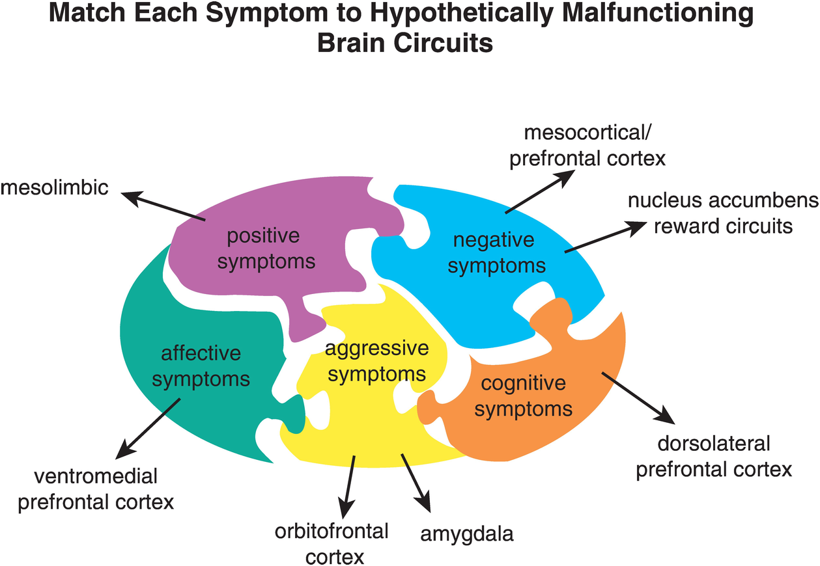

Slide 9
Other Symptoms
lack insight; they do not believe they are ill and reject the idea that they need treatment.
Non localizing neurological soft signs such as abnormalities in stereognosis, balance
In active sex drive
Substance abuse is common and includes alcohol and other drugs It is thought that many schizophrenic patients abuse substances in an attempt to lift their mood, boost their level of motivation, or reduce their medication side effects

Slide 10
Etiology :
The exact etiology is UN KNOWON
1. Genetics : A wide range of genetic studies strongly suggest a genetic component to the inheritance of schizophrenia that outweights the environmental influence.
These include: family studies, twin studies and chromosomal studies.

Slide 11
siblings of schizophrenic patients have about a 10% chance of developing schizophrenia.
children who have one parent with schizophrenia have a 5%–6% chance.
17% for persons with one sibling and one parent with schizophrenia
46% for the children of two schizophrenic parents
monozygotic twins—an average of 46%, compared with 14% concordance in dizygotic twins

Slide 12
2. Neuroimaging and Neuropathology
Cerebral ventricular enlargement
Sulcal enlargement and cerebellar atrophy
decreased thalamus size
abnormalities have been reported in the brain particularly in the limbic system, basal ganglia and cerebellum. Either in structures or connections
3. Neurobiology
Certain areas of the brain are involved in the pathophysiology of schizophrenia: the limbic system, the frontal cortex, cerebellum, and the basal ganglia.
a- Dopamine Hypothesis;
Too much dopaminergic activity ( whether it is ↑ release of dopamine, ↑ dopamine receptors, hypersensitivity of dopamine receptors to dopamine, or combinations is not known ).
b- Other Neurotransmitters;
Serotonin, Norepinephrine, GABA, Glutamate(hypofunction in NMDA receptors) & Neuropeptides

Slide 13
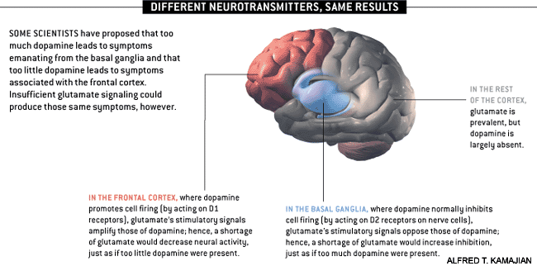

Slide 14
c. Psychoneuroimmunology;
↓ T-cell interlukeukin-2 & lymphocytes, abnormal cellular and humoral reactivity to neurons and presence of antibrain antibodies.
These changes are due to neurotoxic virus ? or endogenous autoimmune disorder ?
d. Psychoneuroendocrinology;
Abnormal dexamethasone-suppression test
↓ LH/FSH
A blunted release of prolactin and growth hormone on stimulation.

Slide 15
4- Psychosocial Factors:
In family dynamics studies, no well-controlled evidence indicates specific family pattern plays a causative role in the development of schizophrenia.
High Expressed Emotion family : increase risk of relapse.
5- Stress-Diathesis Model:
Integrates biological, psychosocial and environmental factors in the etiology of schizophrenia.
Symptoms of schizophrenia develop when a person has a specific vulnerability that is acted on by a stressful influence.

Slide 16
Diagnosis :
DSM-5 Diagnostic Criteria for Schizophrenia:
A- ≥ two characteristic symptoms for one month, at least one of them is (1),(2) or (3)
1- Delusions
2- Hallucinations
3- Disorganized speech (frequent derailment or incoherence)
4- Grossly disorganized or catatonic behavior
5- Negative symptoms ( diminished emotional expression or lack of drive (avolition))

Slide 17
B- Social, Occupation or self-care dysfunction
C- Duration of at least 6 months of disturbance (include at least one month of active symptoms that meet Criterion A; in addition of periods of prodromal and residual symptoms).
D- Schizoaffective & mood disorder exclusion
E- The disturbance is not due to Substance or another medical condition.
F- If there is history of autism spectrum disorder or a communication disorder of childhood onset, schizophrenia diagnosis is made only if delusion or hallucinations plus other criteria are present.

Slide 18
Mental Status Examination (MSE) :
- Appearance & behavior ( variable presentations)
- Mood, feelings & affect ( reduced emotional responsiveness, inappropriate emotion)
- Perceptual disturbances ( hallucinations, illusions )
- Thought: Thought content ( delusions)
Form of thought ( looseness of association)
Thought process ( thought blocking, poverty of thought content, poor abstraction, perseveration )
- Impulsiveness, violence, suicide & homicide
- Cognitive functioning
- Poor insight and judgment

Slide 19
clinical course :
Acute exacerbation with increased residual impairment
Full recovery: very rare
Longitudinal course: downhill

Slide 21
Differential diagnosis :
Primary Psychiatric disorders:
Schizophreniform disorder
Brief psychotic disorder
Delusional disorder
Schizoaffective disorder
Mood disorders
Personality disorders ( schizoid, schizotypal & borderline personality)
Factitious disorder
Malingering
Secondary psychiatric disorders:
-Substance-induced disorders
-Psychotic disorders due to another medical disorder :
Epilepsy ( complex partial)
CNS diseases
Trauma
Others

Slide 22
Other psychotic disorders :
Psychotic Disorders due to another medical condition
Substance-induced psychotic disorder
Schizophreniform disorder ;
1-6 month of disturbance
Brief psychotic disorder:
<1month of disturbance
Delusional disorder(delusion only >1m)
Schizoaffective disorder: An uninterrupted period of illness during which there is a major mood episode (major depressive or manic) concurrent with Criterion A of schizophrenia. There is Delusions or hallucinations for 2 or more weeks in the absence of a major mood episode during the illness course.

Slide 23
Treatment :
Reasons to hospitalize patients with schizophrenia
1. When the illness is new, to rule out alternative diagnoses and to stabilize the dosage of antipsychotic medication
2. For special medical procedures such as electroconvulsive therapy
3. When aggressive or assaultive behavior presents a danger to the patient or others
4. When the patient becomes suicidal
5. When the patient is unable to properly care for himself or herself (e.g.,refuses to eat or take fluids)
6. When medication side effects become disabling or potentially life
threatening (e.g, neuroleptic malignant syndrome)

Slide 24
Biological Therapy :
Antipsychotic medications are the mainstay of the treatment of schizophrenia.
Generally, they are remarkably safe.
Two major classes:
-Conventional, (1st generation) e.g. haloperidol, chlorpromazine.
-Atypical, 2nd generation (Serotonin-dopamine receptor antagonists) e.g. Risperidone, clozapine, olanzapine ).
Depot forms of antipsychotics eg. Risperidone Consta is indicated for poorly compliant patients.
Electroconvulsive therapy (ECT) for catatonic or poorly responding patients to medications

Slide 25
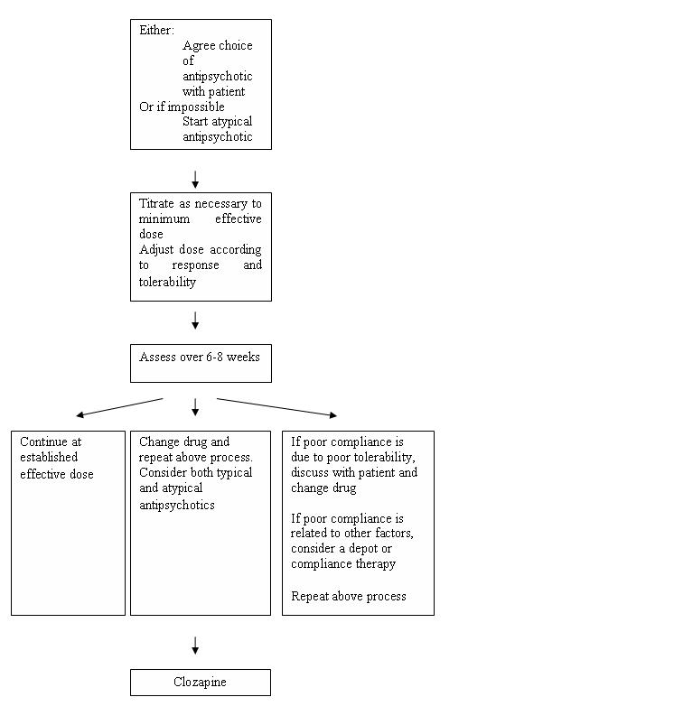

Slide 26
Psychosocial Interventions
Assertive community treatment (ACT) programs : careful monitoring of patients through mobile mental health teams
Family therapy,
Cognitive rehabilitation involves the remediation of abnormal thought processes known to occur in schizophrenia, using methods pioneered in the treatment of brain-injured persons.
Social skills training (SST) aims to help patients develop more appropriate behavior
Psychosocial rehabilitation serves to integrate the patient back into his or her community rather than segregating the patient in separate facilities
Vocational rehabilitation may help a patient obtain supported employment, competitive work in integrated settings, and more formal job training programs

