Slide 1
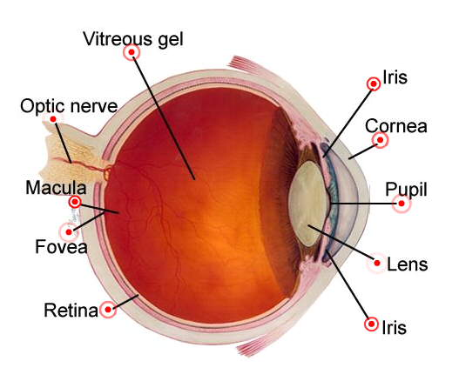
Ocular pharmacology
Challenges to drug delivery to the eye
Blood- retinal, blood- aqueous, blood- vitreous barriers prevent high concentration of drugs passage from the blood stream
Most agents injected into the vitreous are cleared rapidly and therefore are ineffective
Subconjunctival and intravitreal injections carry a risk of infection

Slide 2
Ocular pharmacology
ILOS
Outline common routes of administration of drugs to the eye
Discuss the pharmacokinetics of drugs applied topically to the eye
Classify drugs used for treatment of disorders of the eye
Elaborate on autonomic, anti-inflammatory drugs & drugs used for glaucoma
Hint on ocular toxicity of some drugs

Slide 3
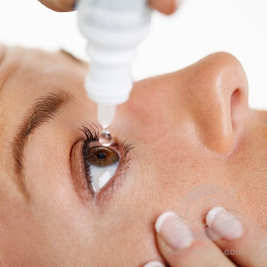
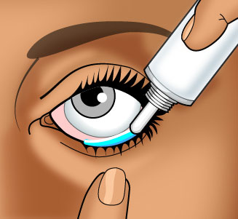
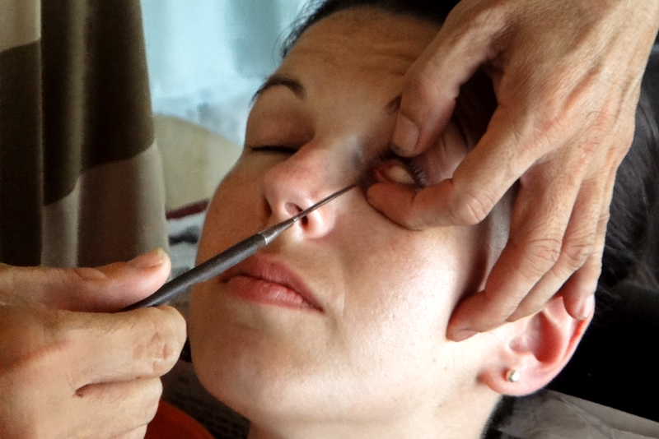
Routes of administration
1- Topical
Eye drops
Ointments
Injections
2- Systemic
Oral, IV

Slide 4
Topical applications
Advantages
Convenient
Economic
Relatively safe
Disadvantages
Compliance
Corneal & conjunctival toxicity

Slide 5
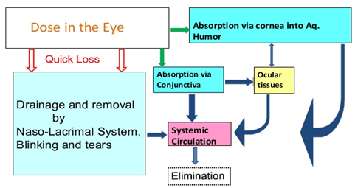
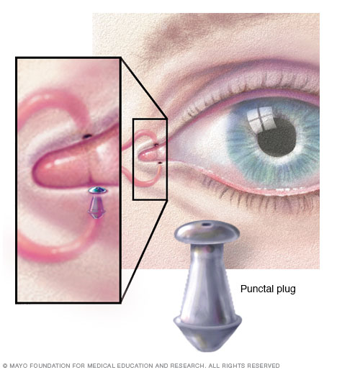
Pharmacokinetics of topical applications
Absorption: After topical application, rate of absorption is determined by the time drug remains in cul-de-sac, tear, elimination by nasolacrimal drainage, binding to tear protein, metabolism, diffusion across cornea & conjunctiva.
Drug residence time can be prolonged by plugging tear ducts or change of formulation

Slide 6
pharmacokinetics
Distribution: After corneal absorption, the drug accumulates in the aqueous humor , intraocular structures or systemically distributed.
Melanin binding prolongs the effect of α -agonists in patients with dark pigmented iris.
Chloroquine binds to retinal pigment →↓ visual acuity.
Metabolism: Significant biotransformation takes place in the eye.
Esterases activate pro drugs e.g. dipivefrin → (adrenaline), latanoprost →( PGF2α)

Slide 7
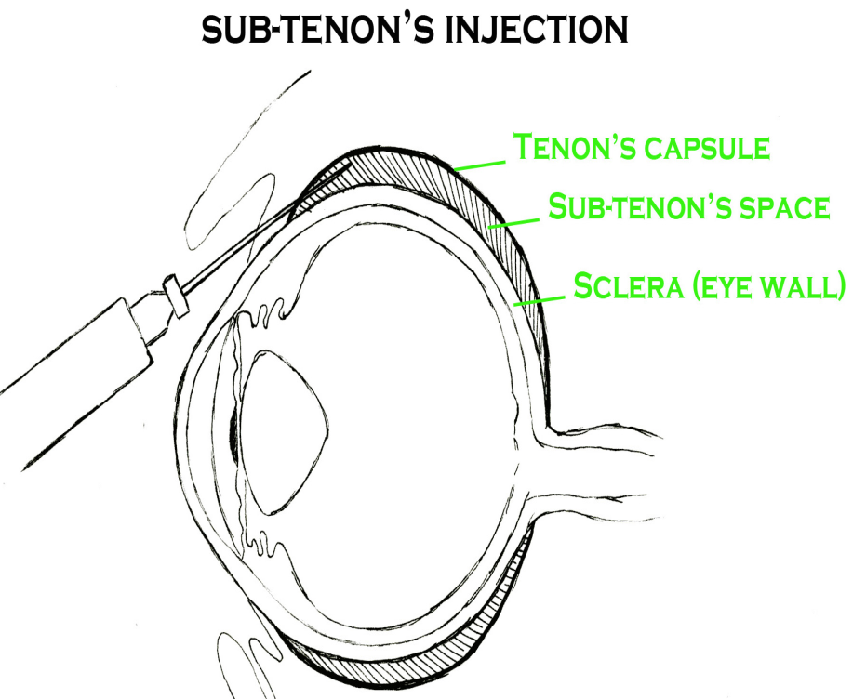
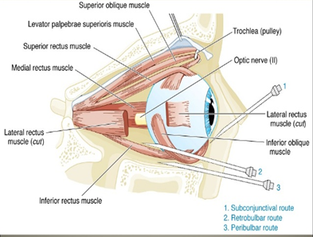
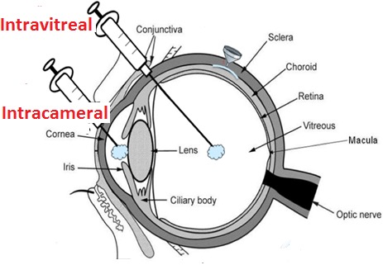
Local injections
i- Periocular
Subconjunctival, peribulbar, retrobulbar, or subtenon
ii- Intraocular
Intracameral or intravitreal

Slide 8
Peri-ocular injections
Subconjunctival, subtenon, peribulbar, or retrobulbar
For infection of anterior segment and inflammation of uvea
bypass the conjunctival and corneal epithelium which is good for drugs with low lipid solubility (e.g. penicillins)
steroid and local anesthetics
Local toxicity, tissue injury, globe perforation, optic nerve damage

Slide 9
Intraocular injections
For anterior segment surgery, infections & retinitis
Intracameral acetylcholine during cataract surgery
Intravitreal antibiotics in cases of endophthalmitis
Intravitreal steroid in macular edema
ADRS: Retinal, intraocular , corneal toxicity

Slide 10
Systemic drugs
Factor influencing systemic drug penetration into ocular tissue
lipid solubility of the drug: more penetration with high lipid solubility
Protein binding: more effect with low protein binding
Eye inflammation: more penetration with ocular inflammation

Slide 11
Ocular drugs
Autonomic drugs
Miotics
Mydriatics
Cycloplegics
Antiglaucoma Drugs
Anti-inflammatory drugs
Steroids & NSAIDs
Chemotherapeutics
Antibacterial, antifungal, antiviral, antimitotic
Local anesthetics
Ocular lubricants

Slide 12
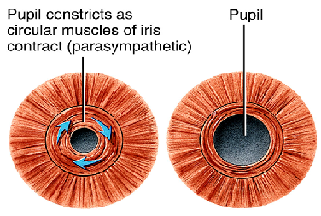
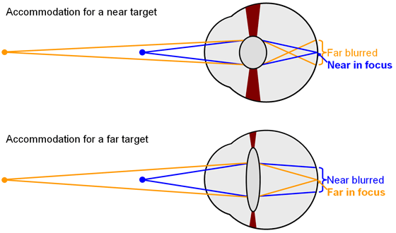
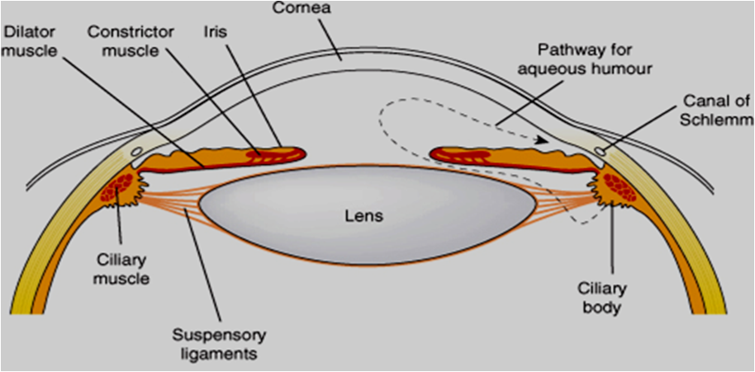
Autonomic drugs
Parasympathetic Drugs
Constriction of the pupillary sphincter muscle (miosis)
Contraction of the ciliary muscle (accommodation for near vision).
Increase aqueous outflow through the trabecular meshwork into canal of Schlemm by ciliary muscle contraction
Decrease intraocular pressure
Increase lacrimation
Conjunctival vasodilatation

Slide 13
Parasympathetic Drugs
Clinical uses
Glaucoma (open and close angle)
Ocular uses | Drugs
Induction of miosis in surgery Glaucoma | Acetycholine Carbachol Methacholine
In open angle glaucoma | Pilocarpine
Glaucoma, accommodative esotropia | Physostigmine
Glaucoma, accommodative esotropia | Ecothiophate
Counteract action of mydriatics
To break adhesions
In accommodative esotropia (ecothiophate)
In lice infestation of lashes (physostigmine)
Ocular ADRS
Diminished vision (myopia), headache

Slide 14
Cholinergic antagonists
Mydriasis due to relaxation of circular muscles
Cycloplegia (loss of near accommodation) due to relaxation of ciliary muscles
Loss of light reflex
Increased I.O.P
↓ Lacrimal secretion → sandy eye

Slide 15
Cholinergic antagonists
Clinical uses
To prevent adhesion in uveitis & iritis
Funduscopic examination of the eye
Measurement of refractive error

Slide 16
Adrenergic agonists
Non-selective agonists
Mechanism: ↑ uveoscleral outflow of aqueous humor
Uses: open angle glaucoma
α₁ agonists e.g. phenylepherine
Mydriasis (without cycloplegia)
Funduscopic examination of the eye
Decongestant in minor allergic hyperemia of eye
To prevent adhesion in uveitis & iritis

Slide 17
Adrenergic agonists
α₂ agonists e.g. apraclonidine
Mechanism: ↓ production of aqueous humor
Uses: glaucoma treatment,
Prophylaxis against IOP spiking after
glaucoma laser procedures

Slide 18
β- blockers
non-selective: timolol, carteolol
selective: betaxolol (beta 1 “cardioselective”)
Mechanism: Act on ciliary body to ↓ production of aqueous humor
Uses: open angle glaucoma
Advantages can be used in patients with hypertension/ischemic heart disease
Ocular ADRS:- irritation

Slide 19
Treatment of open angle glaucoma (chronic)
Goal is to decrease IOP
Decreasing production of aqueous humor
Β- blockers
α₂ agonists
Carbonic anhydrase inhibitors
Increasing outflow of aqueous humor
Prostaglandins
Adrenergic agonists (non-specific)
Parasympathomimetics

Slide 20
Carbonic anhydrase inhibitors
Acetazolamide (oral), Dorzolamide (topical)
Mechanism:-↓ production of aqueous humor
Side Effects:
myopia, malaise, anorexia, GI upset, headache
metabolic acidosis, renal stone,
Contraindications:
sulpha allergy, digitalis users, pregnancy

Slide 21
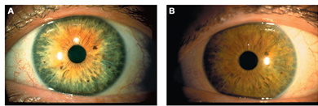
prostaglandins
Latanoprost
Mechanism: ↑Uveoscleral outflow
Uses: open angle glaucoma
Administration: Topical drops
Side Effects: Iris color change

Slide 22
Drug Therapy of acute angle closure glaucoma (narrow angle)
Acute, painful increases of pressure
Is associated with occlusion of the outflow drainage pathway
Emergency situation that require treatment before surgery (Iridectomy)
Oral Acetazolamide
Topical cholinomimetics e.g.: pilocarpine
Dehydrating agents: IV infusion Of hypertonic solution ( Mannitol, Glycerol)
Analgesics: pethidine or morphine (for pain)

Slide 23
Osmotic agents
Glycerol 50% syrup (cause nausea, hyperglycemia)
Mannitol 20% IV (cause fluid overload and not used in heart failure)
Dehydrate vitreous body which reduce IOP prior to anterior surgical procedures
Used for short term management of acute rise in IOP

Slide 24
Corticosteroids
Mechanism:- Inhibition of arachidonic acid release by inhibiting phospholipase A2
Topical:-prednisolone, dexamethasone, hydrocortisone
Uses: postoperatively, anterior uveitis, severe allergic conjunctivitis, scleritis, prevention and suppression of corneal graft rejection
Systemic:- prednisolone, cortisone
Uses: posterior uveitis, optic neuritis
Ocular ADRS:-Glaucoma, cataract, skin atrophy, secondary infection, delayed wound healing.

Slide 25
NSAIDs
e.g. ketorolac, diclofenac, flurbiprofen
Mechanism: inhibition of cyclo-oxygenase
Uses: Flurbiprofen preoperatively to prevent miosis following cataract surgery
Diclofenac for postoperative inflammation
Ketorolac for cystoid macular edema occurring after cataract surgery
Side effects: stinging , sterile corneal melt& perforation

Slide 26
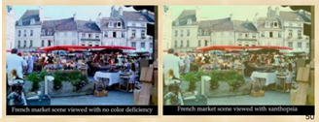
toxicology
Digitalis causes chromotopsia with overdose
Chloroquine causes retinopathy
Amiodarone causes optic neuropathy & pigmented deposits of the cornea
Phenothizines cause brown pigmentary deposits in the cornea, conjunctiva & eyelid

Slide 27
Sildenafil
Inhibits PDE5 in the corpus cavernosum to achieve penile erection
It also mildly inhibits PDE6 which controls the level of cyclic GMP in the retina→ seeing a bluish haze & causing light sensitivity
Steroids → cataract formation, elevated IOP & glaucoma
Ethambutol → optic neuropathy characterized by gradually progressive central scotomas & vision loss

