Slide 1

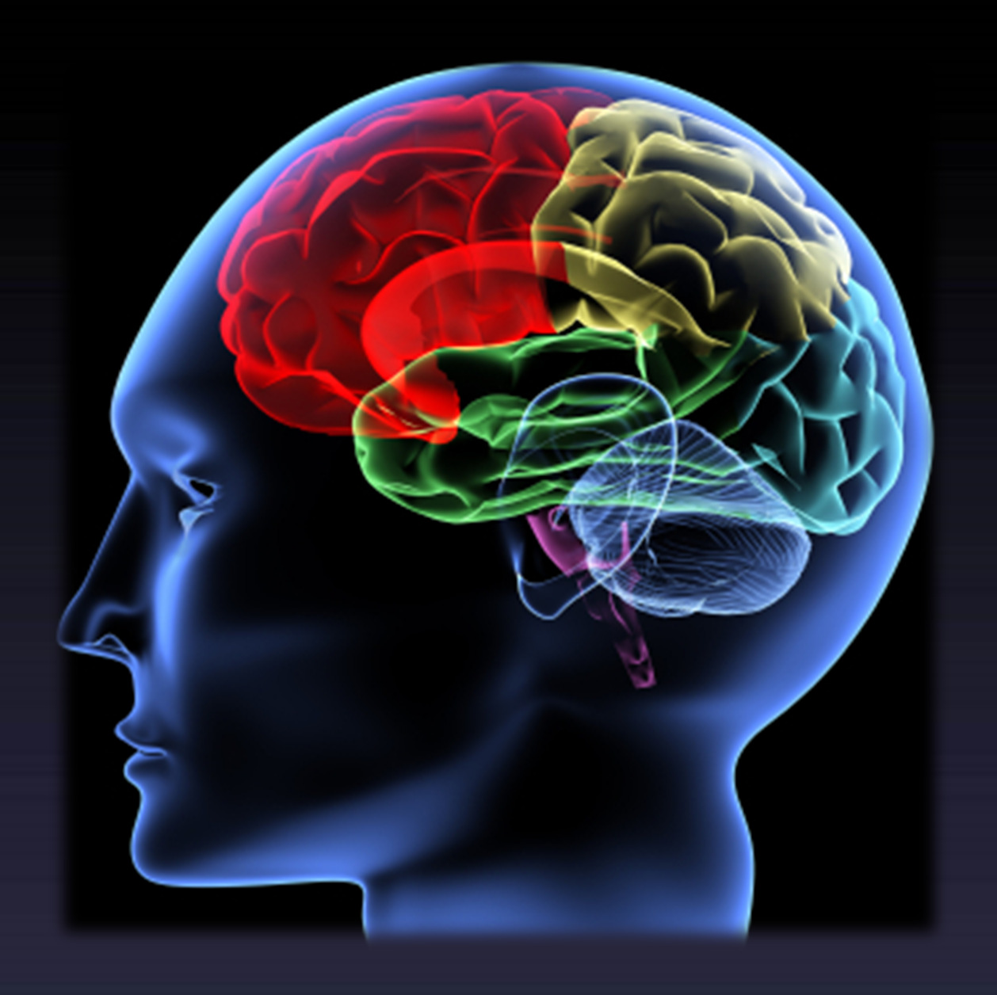

Stretch reflex and tendon jerks
Dr Syed Shahid Habib
MBBS DSDM PGDCR FCPS
Professor & Consultant Clinical Neurophysiology Dept. of Physiology
College of Medicine & KKUH King Saud University

Slide 2
OBJECTIVES
At the end of this lecture the student should be able to :
be able to describe a stretch reflex .
be able to explain what is muscle tone
describe the structure , innervations and function of the muscle spindle .
explain what is meant by static and dynamic stretch reflex .
describe the spinal and supraspinal regulation of the stretch reflex .
describe the inverse stretch reflex and its function

Slide 3
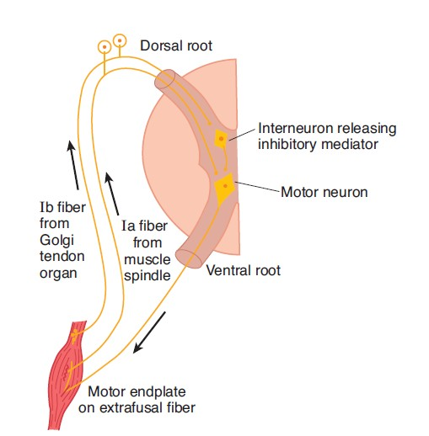


WHAT IS STRETCH REFLEX?
When a skeletal muscle with an intact nerve supply is stretched, it contracts. This response is called the stretch reflex or myotatic reflex.
Stretch stimulates the muscle spindle, which activates Ia fibers that excite the motor
Stretch also stimulates the Golgi tendon organ, which activates Ib fibers that excite an interneuron that releases the inhibitory mediator glycine

Slide 4



MUSCLE SPINDLES AND GOLGI TENDON ORGANS
MUSCLE SENSORY RECEPTORS
Proper control of muscle function requires not only excitation of the muscle by spinal cord anterior motor neurons but also continuous feedback of sensory information from each muscle to the spinal cord, indicating the functional status of each muscle at each instant
what is the length of the muscle?
what is its instantaneous tension?
how rapidly is its length or tension changing?
Entirely for the purpose of intrinsic muscle control and operate almost completely at a subconscious level
Continuous Discharge of the Muscle Spindles Under Normal Conditions to maintain tone

Slide 5
Stretch Reflex
Inverse Stretch Reflex
Stimulus
Muscle Stretch
Over Stretch
Receptor
Muscle Spindle
Golgi Tendon Organ
Afferent 1b
Afferent
Afferent 1a
Spinal Cord (Center)
Center
Spinal Cord (Center)
Inhibitory Interneuron
Efferent
Efferent αMotor
Efferent αMotor
Effector
Extrafusal Fibers
Extrafusal Fibers
Effect
Ms Contration
Ms Relaxation
(lengthening reaction)
Reciprocal Inhibition of antagonist
Reciprocal Excitation of antagonist

Slide 6
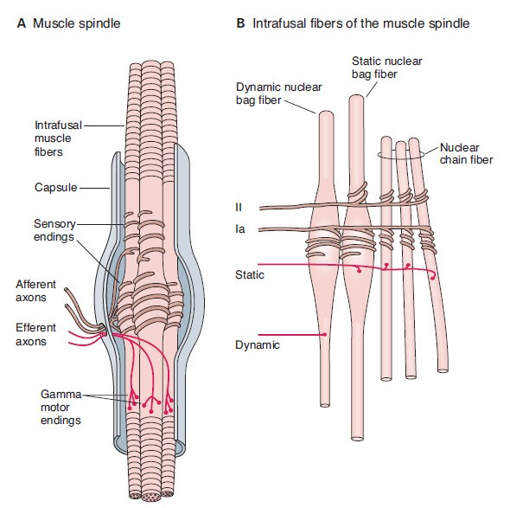
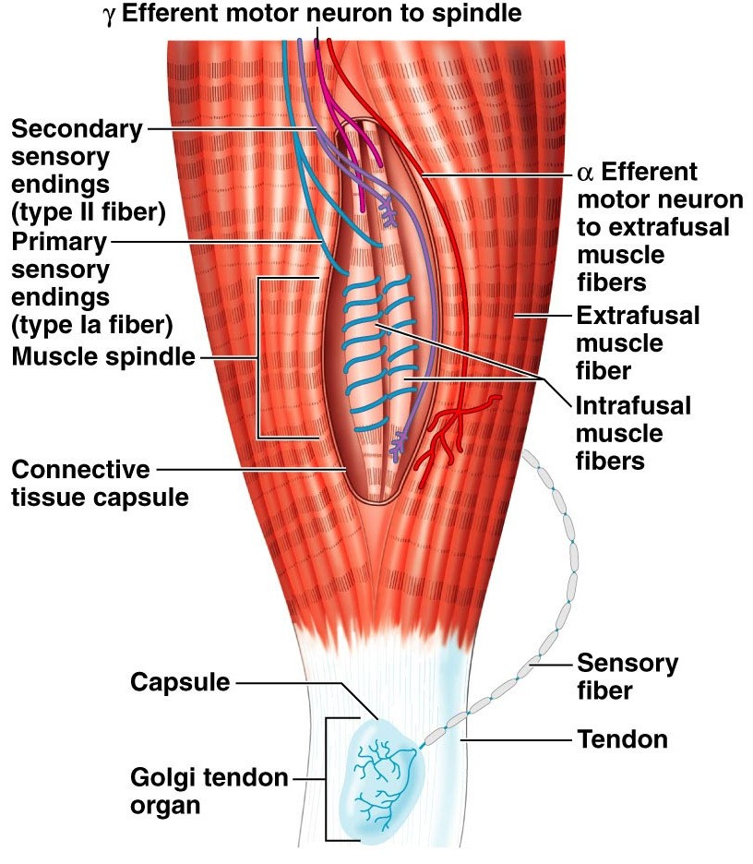
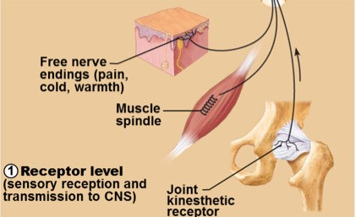
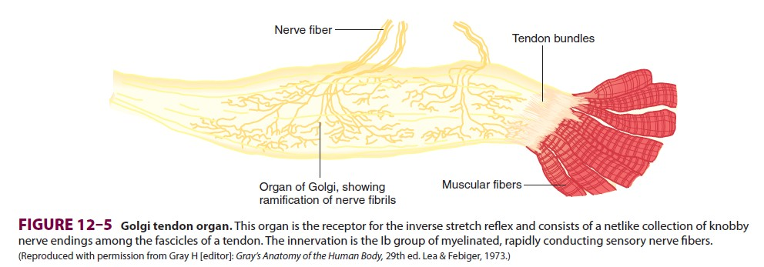
Structure of Proprioceptors

Slide 7
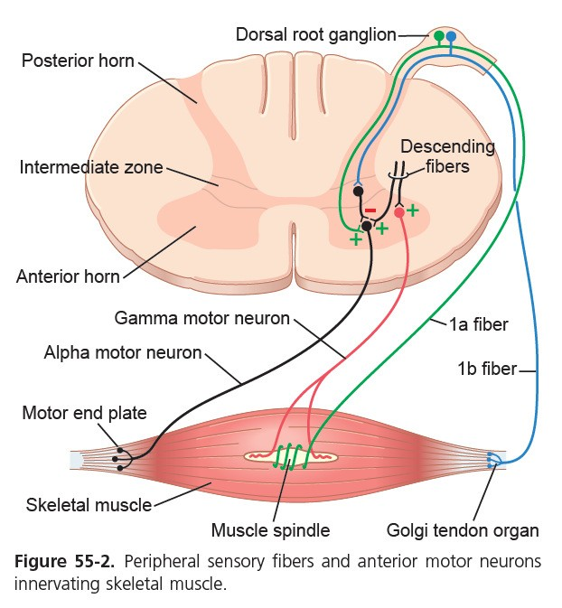
Stretch reflex
Muscle Stretch
Muscle Spindle Afferent 1a
Spinal Cord (Glutamate) Efferent αMotor Extrafusal Fibers
Ms Contration
Reciprocal Inhibition of antagonist

Slide 8
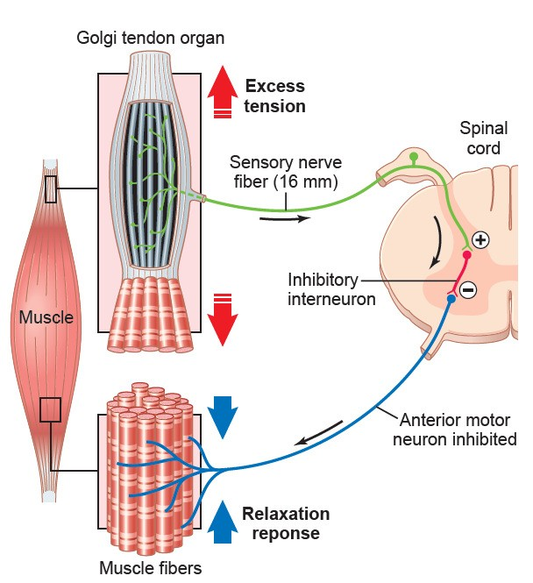

inverse stretch reflex
Over Stretch
Golgi Tendon Organ Afferent 1b
Spinal Cord (Center)
Inhibitory Interneuron (Glycine)
Efferent αMotor
Extrafusal Fibers Ms Relaxation
(lengthening reaction)
Reciprocal Excitation of antagonist
Prevent tearing of the muscle or avulsion of the tendon

Slide 9
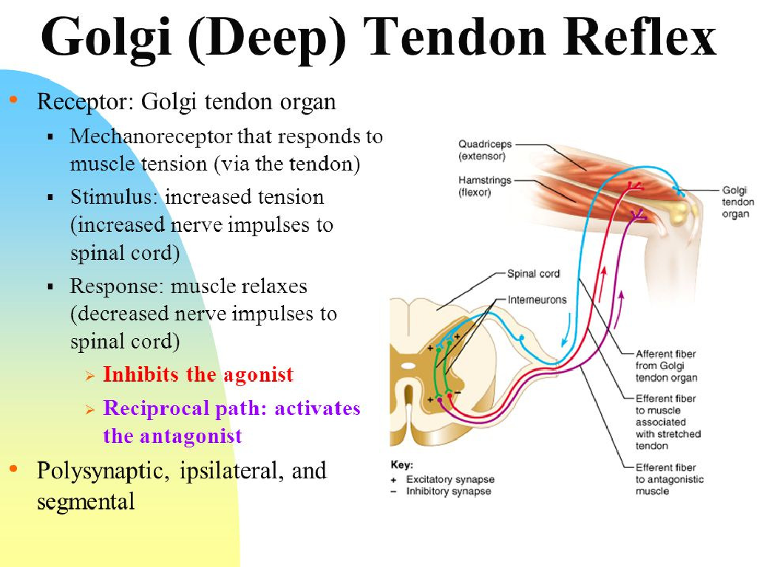
Inverse stretch reflex

Slide 10
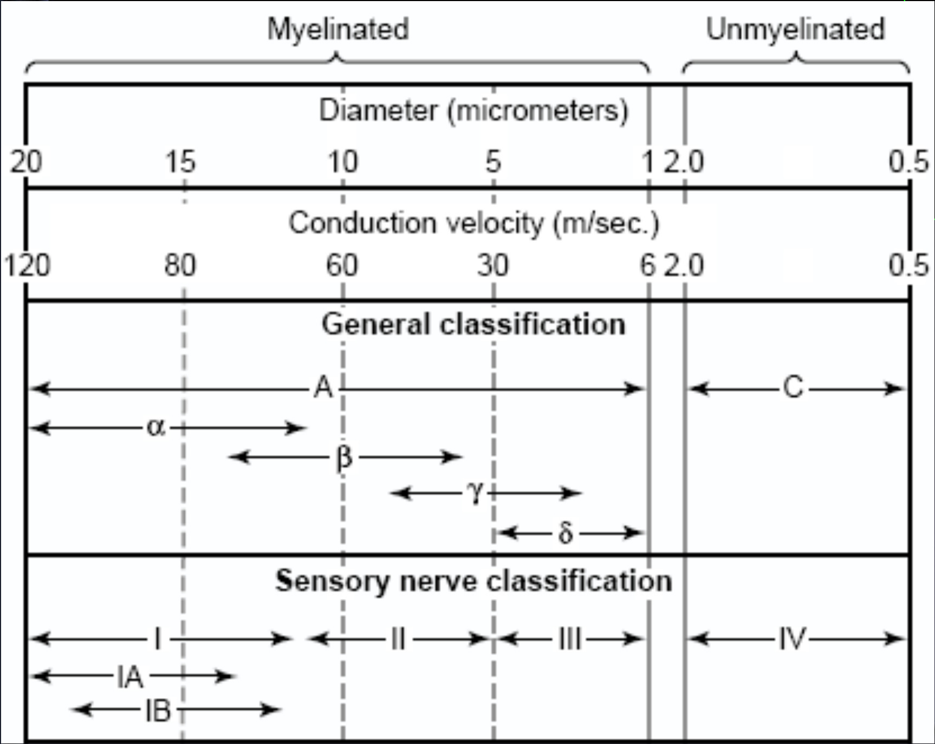
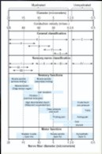
NERVE FIBERS CLASSIFICATION
Type A
  Alpha
  Beta
  Gamma
  Delta
Type C
•

Slide 11
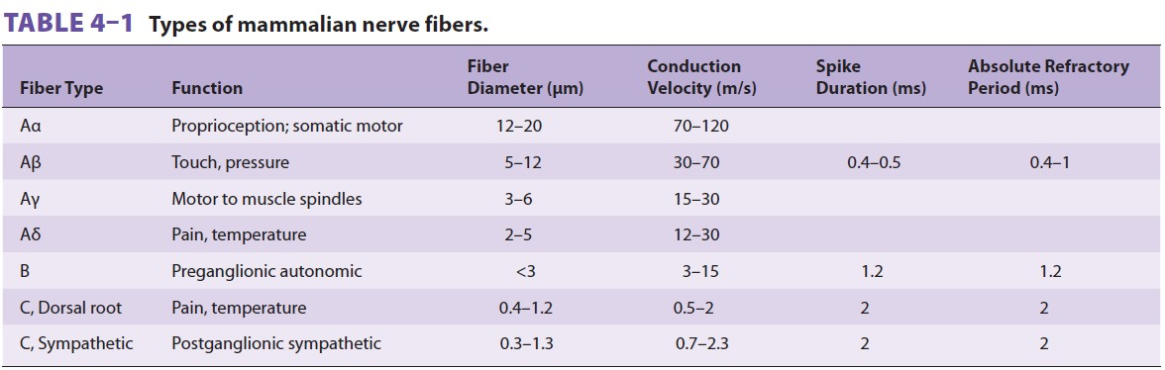

Slide 12
PROPRIOCEPTION
Perception about the relative positions of different body parts and strength of effort being employed in movements.
Three Types of Proprioceptors
Muscle spindles – measure the changing length of a muscle
  Imbedded in the perimysium between muscle fascicles
Golgi tendon organs – located near the muscle- tendon junction
  Monitor tension within tendons
Joint kinesthetic receptors
  Sensory nerve endings within the joint capsules

Slide 13
Three Types of Proprioceptors
Muscle spindles – measure the changing length of a muscle
  Imbedded in the perimysium between muscle fascicles
Golgi tendon organs – located near the muscle-tendon junction
  Monitor tension within tendons
Joint kinesthetic receptors
  Sensory nerve endings within the joint capsules

Slide 14
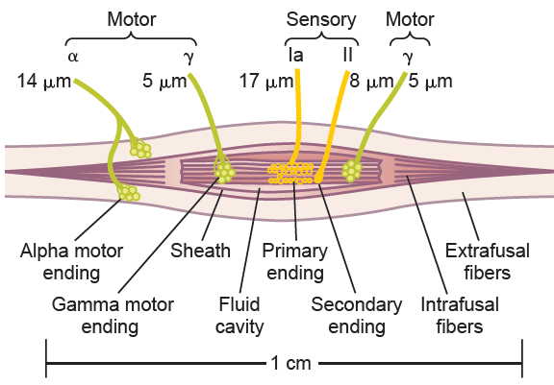
Alpha motor neurons innervate the large skeletal muscle fibers. (Extrafusal Fibers)
Gamma motor neurons supply intrafusal fibers in middle of the muscle spindle, which helps control basic muscle “tone”
3 to 10 mm
3 to 12 tiny intrafusal fibers pointed at their ends and attached to the glycocalyx of the surrounding large extrafusal skeletal
muscle fibers.
Intrafusal fibers Receptors for stretch reflex
Central non-contractile area
Peripheral contractile area

Slide 15

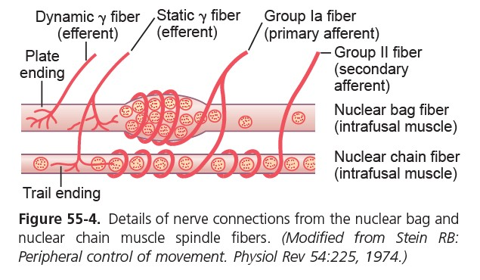
INTRAFUSAL FIBERS
Nuclear Bag and Nuclear Chain Fibers
70 to 120 m/sec
The secondary afferent is usually excited only by nuclear chain fibers

Slide 16
Response of Both the Primary and the Secondary Endings to the Length of the Receptor
“Static” Response.
steady-state length of the muscle
When the receptor portion of the muscle spindle is stretched slowly, both the primary and the secondary endings are stimulated and transmit impulses for several minutes
Response of the Primary Ending (but Not the Secondary Ending) to Rate of Change of Receptor Length
“Dynamic” Response.
When spindle is stretched suddenly, the primary ending (but not the secondary ending) is stimulated powerfully called the dynamic response

Slide 17
EFFECTS OF αMOTOR NEURON DISCHARGE
Stimulation of α-motor neurons results in detectable contraction of the muscles directly
EFFECTS OF γMOTOR NEURON DISCHARGE
Stimulation of γ-motor neurons does not lead directly to detectable contraction of the muscles because the intrafusal fibers are not strong enough or plentiful enough to cause shortening.
Initiating impulses in the Ia Fibers can lead to reflex contraction of the muscle indirectly.
γ-Static Efferent (trail ending)
€Nuclear Chain intrafusal fibers
γ-Dynamic Efferent (plate ending)
€Nuclear Bag intrafusal fibers
DESCENDING EXCITATORY INPUT TO SPINAL MOTOR CIRCUITS CAUSE COACTIVATION
intrafusal and extrafusal fibers shorten together, and spindle afferent activity can occur throughout the period of muscle contraction.

Slide 18
Factors influencing stretch reflex
( all act on gamma motor neurons)
Enhances
Suprspinal
-Primary motor area4
-Vestibular N
-Pontine RF( bulboreticular)
-Neocerebellum
Anxiety
Noxious painful stimuli 4-Jendrassik-manuver
Inhibits
Supraspinal
-Cortical (suppressor area4&Area 6)
-Basal ganglia
-Medullary RF
-Red nucleus
-paleocerebellum
Excessive stretch of muscle(golgi tendon reflex)

Slide 19
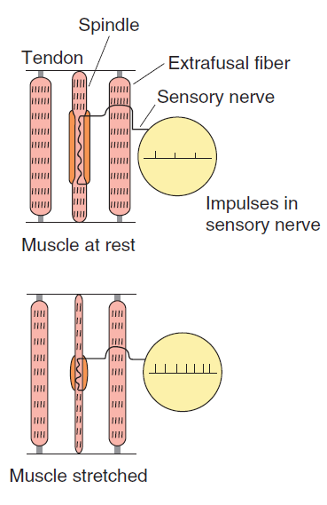
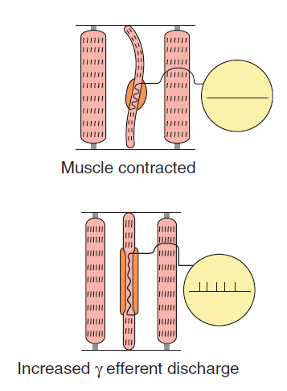

“unloading the spindle”
“loading the spindle”
 γ-motor discharge

Slide 20
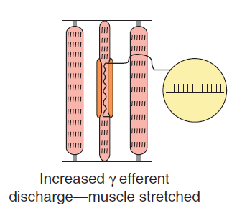

If the whole muscle is stretched during stimulation
of the γ-motor neurons, the rate of discharge in sensory fibers is further increased.

Slide 21
ROLE OF THE MUSCLE SPINDLE IN VOLUNTARY MOTOR ACTIVITY
With alpha motor neurons, in most instances the gamma motor neurons (31%) are stimulated simultaneously, an effect called
COACTIVATION
It keeps the length of the receptor portion of the muscle spindle constant. Therefore, coactivation keeps the muscle spindle reflex from opposing the muscle contraction.
Second, it maintains the proper damping function of the muscle spindle, regardless of any change in muscle length.
Otherwise receptor portion of the spindle would sometimes be flail and sometimes be overstretched, causing unsmooth muscle contractions

Slide 22
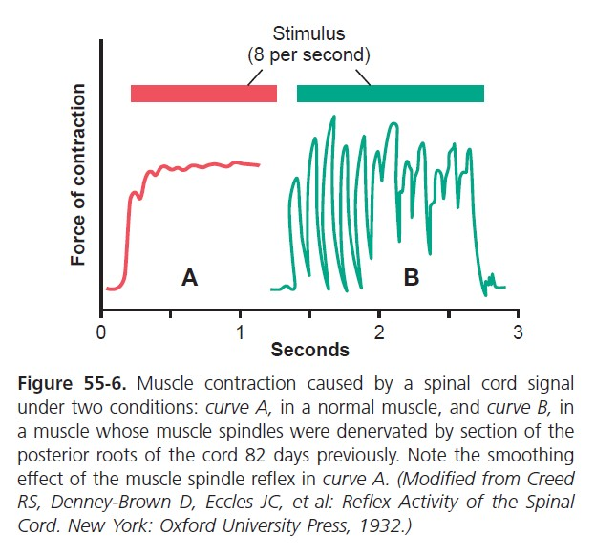
Signal averaging function of the muscle spindle reflex.

