Slide 1
Spinal Cord

Slide 2
Imaging Methods to Evaluate Spinal cord

Slide 3
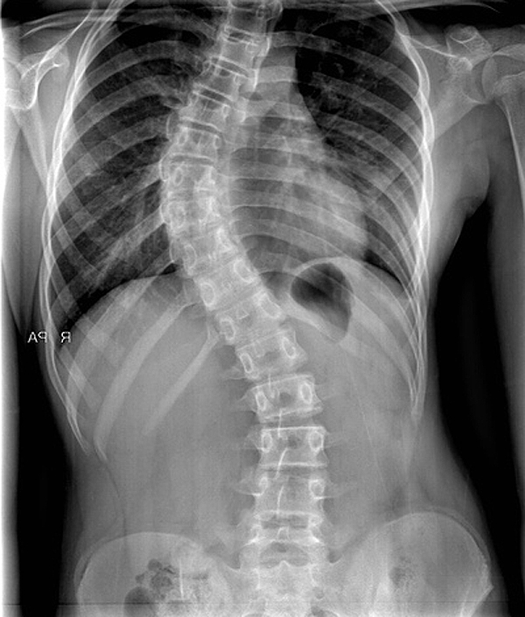
X-RAYS (RADIOGRAPHS)
Often the first diagnostic imaging test
Small dose of radiation to visualize the bony parts
Can detect
Spinal alignment and curvature
Spinal instability – with flexion and extension views
Congenital (birth) defects of spinal column
Fractures caused by trauma
Moderate osteoporosis (loss of calcium from the bone)
Infections
Tumors

Slide 4
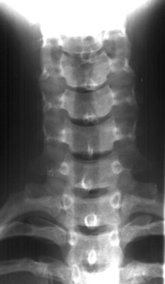
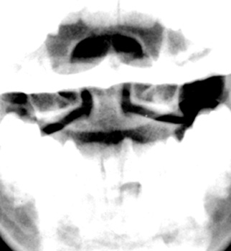

Slide 5
Is this film an adequate lateral film?

Slide 6
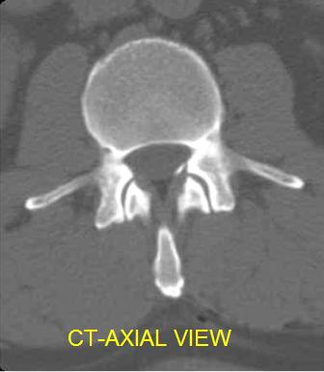
COMPUTERIZED TOMOGRAPHY (CT SCAN)
Uses radiation
Entire spine can be imaged within a few seconds
Detailed information regarding bony structures
Limited information about spinal cord & soft tissues
Obtain 2-D images → can be processed to 3-D images

Slide 7
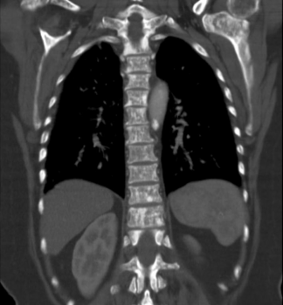
COMPUTERIZED TOMOGRAPHY (CT SCAN)
Uses radiation
Entire spine can be imaged within a few seconds
Detailed information regarding bony structures
Limited information about spinal cord & soft tissues
Obtain 2-D images → can be processed to 3-D images

Slide 9
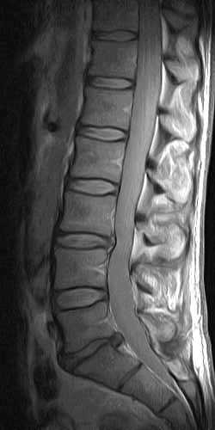

Slide 10
Magnetic Resonance Imaging (MRI)
Gold standard of imaging for spinal cord disorders
No radiation
Can identify abnormalities of bone, soft tissues and spinal cord
Limitations: Claustrophobic patients, uncooperative and children may need sedation or general anesthesia
Contraindications include implanted devices e.g. cardiac pacemakers and electromagnetic devices

Slide 12
 | Indications | Advantages | Disadvantages
X-Ray | Trauma Intra-operative localization | Inexpensive Widely available Quick Portable | Radiation exposure Difficulty in interpretation High rate of false-positive findings
CT | Trauma | Visualization of bony structures Widely available Quick | Less useful at showing soft tissue structures Radiation exposure Cost
MRI | Patients with "red flags" Radiculopathy Tumor Myelopathy | Visualization of soft tissue structures (e.g. relationship of disc to nerve) No radiation exposure | Contraindications: presence of ferromagnetic implants, cardiac pacemakers, intracranial clips, Claustrophobia Availability Cost$$$

Slide 13
Abnormalities Of Spinal Cord
Trauma
.
Demyelination
.
Congenital
.
Tumors
.

Slide 14
Trauma
Plain films are usually the first imaging method used in minor trauma.
If fractures, or other bony defects, are suspected, CT images can provide very detailed information.
When soft tissue / spinal cord injury is suspected, MRI is the imaging method of choice.

Slide 15
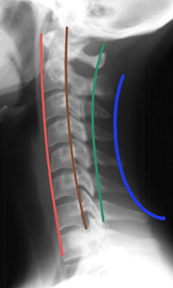
Assess four parallel lines.
1. Anterior vertebral line
2. Posterior vertebral line
3. Spinolaminar line
4. Posterior spinous line

Slide 16
Mechanism Of Injury

Slide 17
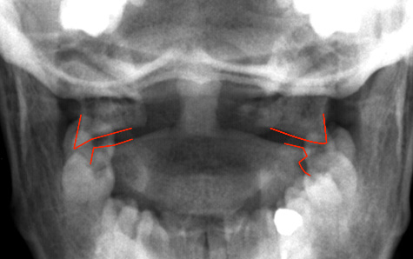
Compression Fracture

Slide 18
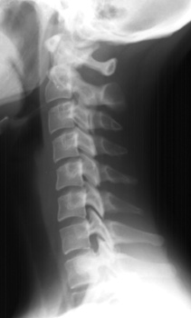
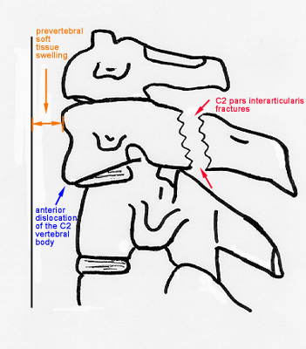
Hangman's Fracture

Slide 19
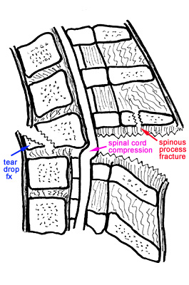
Hyperflexion

Slide 20
Congenital ANOMALIES

Slide 21
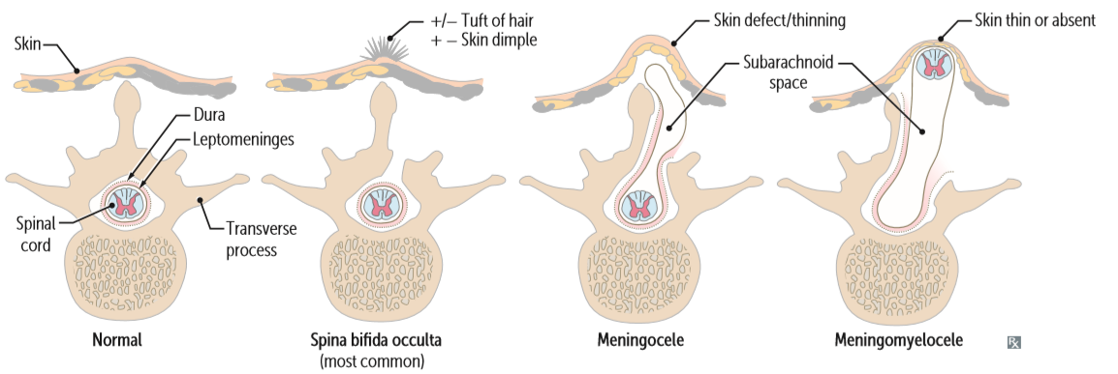
Spina bifida

Slide 22
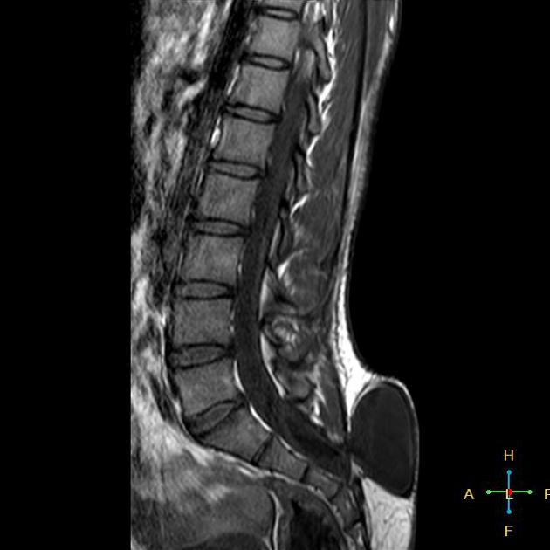

Slide 23
Syringomyelia

Slide 24
Demyelination

Slide 25
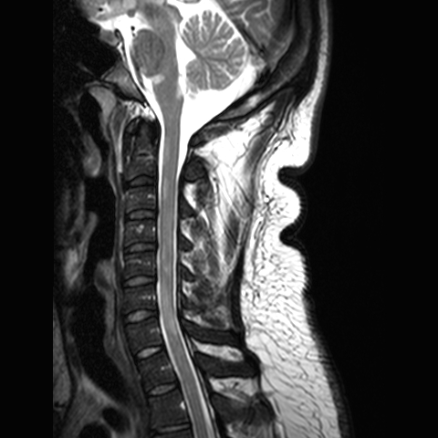
Multiple Sclerosis
Multiple sclerosis (MS) is a relatively common acquired chronic relapsing demyelinating disease involving CNS.
Characteristically disseminated lesions with resolution – recurrence pattern

Slide 26
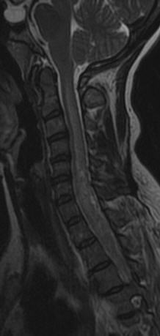
Transverse Myelitis
Inflamed cord of uncertain cause
Viral infections
Immune reactions
Idiopathic

Slide 27
TM VS MS
MS lesions in spinal cord are
more likely multiple
don’t cover the entire section on axial images
often < 2 vertebral body heights in sagittal plane
Transverse myelitis lesions
Often one big lesion
>3 vertebral body heights in sagittal plane
Covers entire spinal cord in axial plane
No brain lesions
Monophasic

Slide 28
Tumors

Slide 29
Classification
Intramedullary lesions
its location is determined within the cord.
extramedullary lesions
May be related to nerve roots and may extend into the neural foramen (e.g. schwannomas and neurofibromas)
or they may have a broad dural attachment (e.g. meningiomas).

Slide 30
Astrocytoma

Slide 31
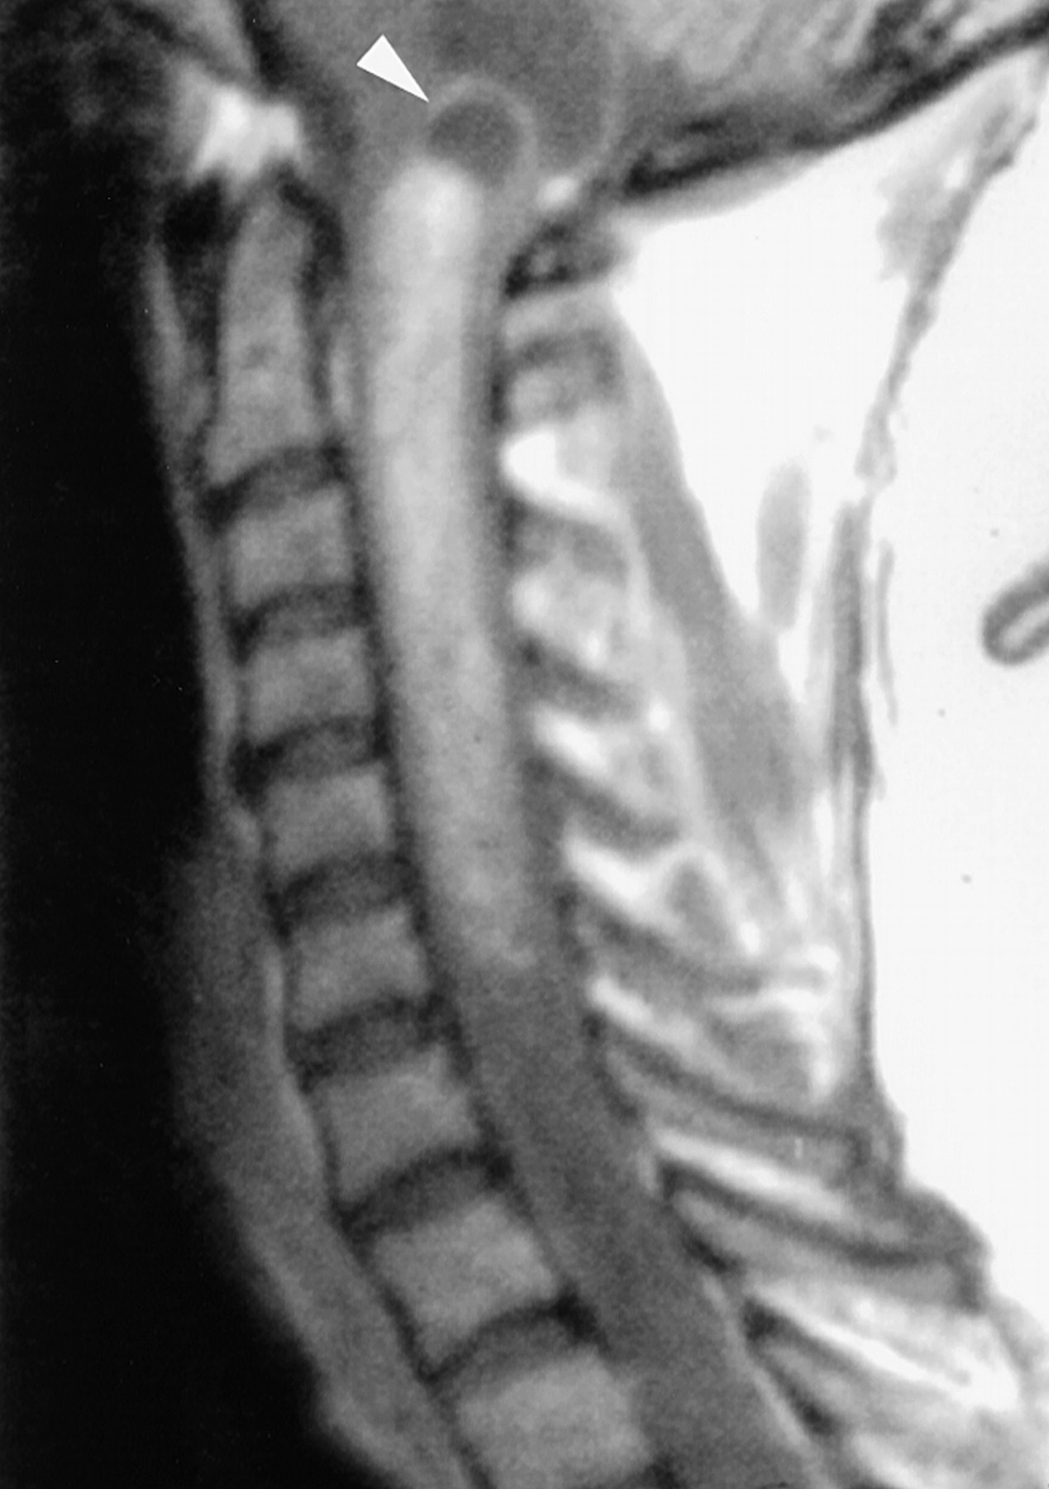
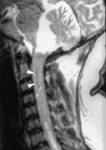
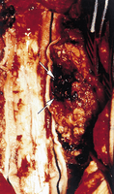
Ependymoma

Slide 32
Thank you

