Slide 1
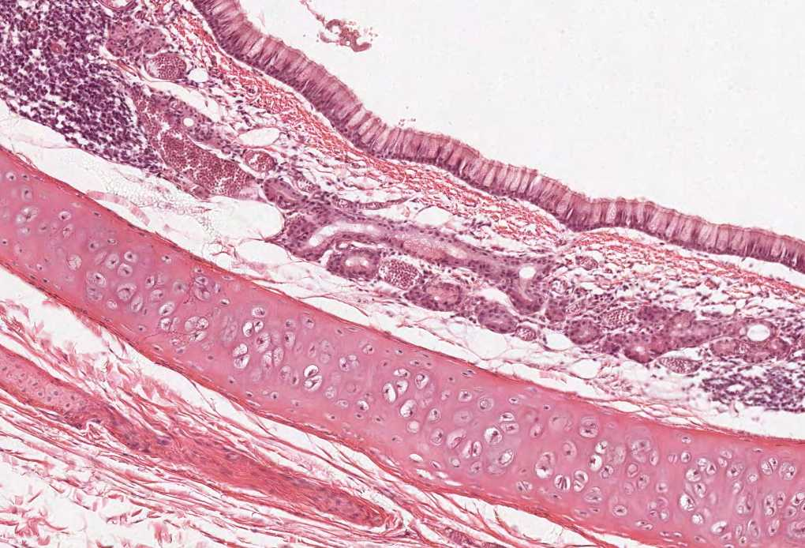
Practical Histology
Neuropsychiatry Block
Contents:
Cervical, thoracic, & lumbar spinal cord.
Ascending & descending tracts.
Unipolar, bipolar, pseudo-unipolar neurons.

Slide 2
Things you need to know before the exam :
The pictures in the exam will be the same as the ones included in the slides.
Don’t try to take short cuts during the exam so avoid using abbreviations so you don’t lose marks.
Please keep in mind that this work is done by students , so if there are any mistakes please inform us.
This work is not by any means a reference.
Please study hard and don’t worry the exam will be easy!!

Slide 3
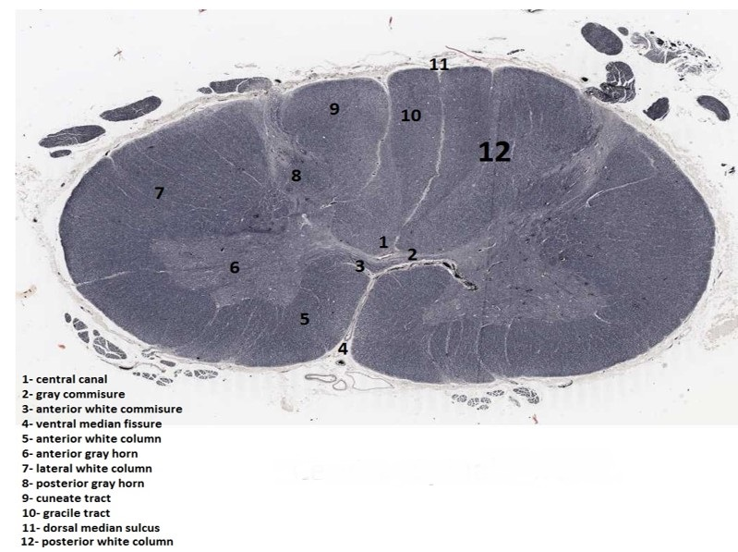
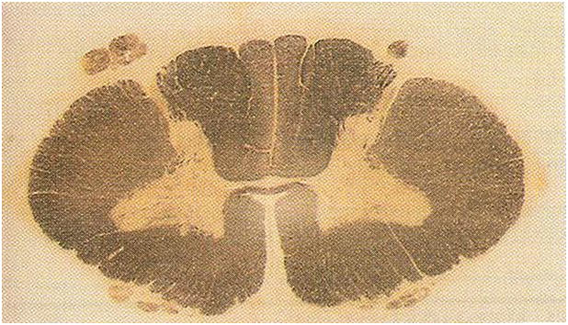
Cervical Spinal cord
Posterolateral
sulcus
Posterior
intermediate sulcus
separates gracile tract from cuneate tract
Features:
Oval in shape
Wide ventral horn ‘’ Because of brachial plexus ‘’
Thin dorsal horn
NO lateral horn
You have to memorize them all along with the features ☺

Slide 4
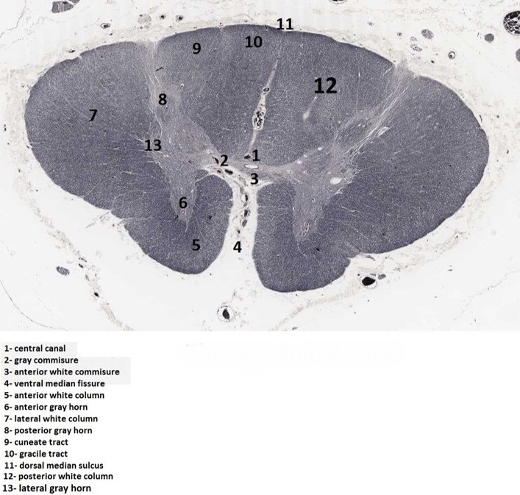
Thoracic Spinal cord
Features:
Ventral and dorsal horn are thin
It contains a lateral horn
You have to memorize them all along with the features ☺

Slide 5
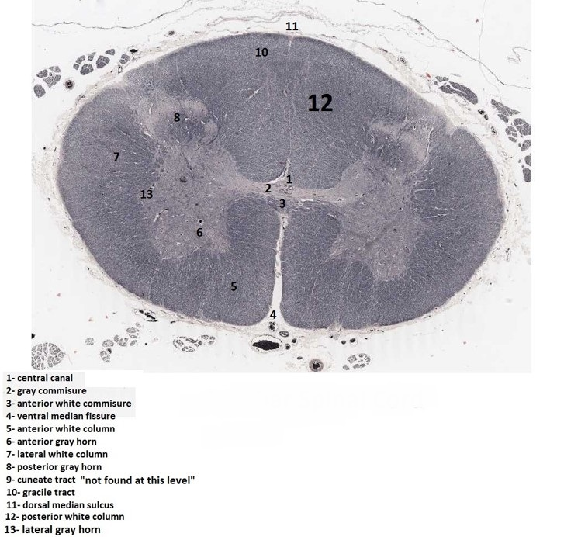
Lumbar Spinal cord
Note: don’t worry about the 13 structures, they’re the same in all the spinal cord segments except when there’s no lateral horn, or no cuneate!
Features:
Ventral and dorsal horn are wide
It doesn’t contain cuneate tract
You have to memorize them all along with the features ☺
Remember: gracilis and cuneate ascending (sensory) tracts of the dorsal column.

Slide 6
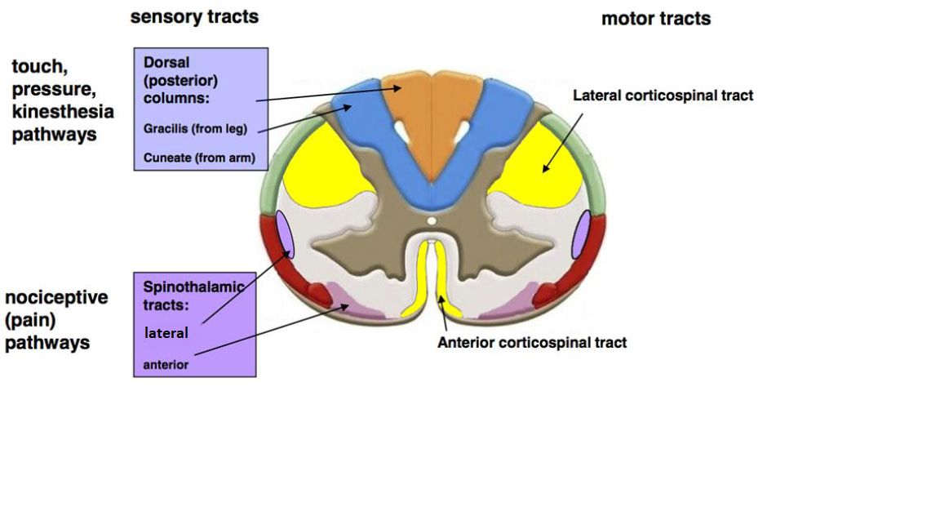
Ascending & Descending Tracts
Identify the labelled structures
Identify the function of each tract

Slide 7
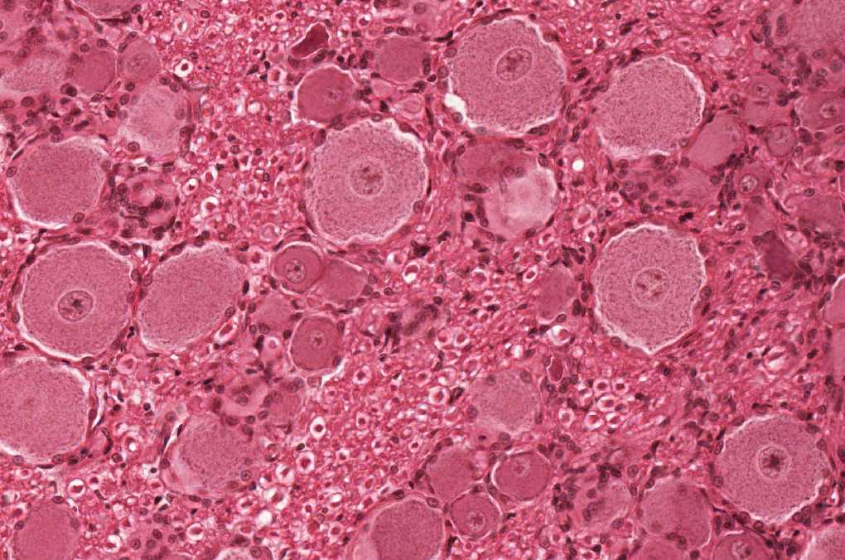
Pseudo-unipolar/Unipolar Neuron
Contains:
Cell body
Nucleus and Nucleolus
Nissl bodies
Mitochondria
These features are NOT specific for this type only!
They are found in every neuron!
Location:
Dorsal root ganglion
Mesencephalic nucleus of the trigeminal nerve

Slide 8
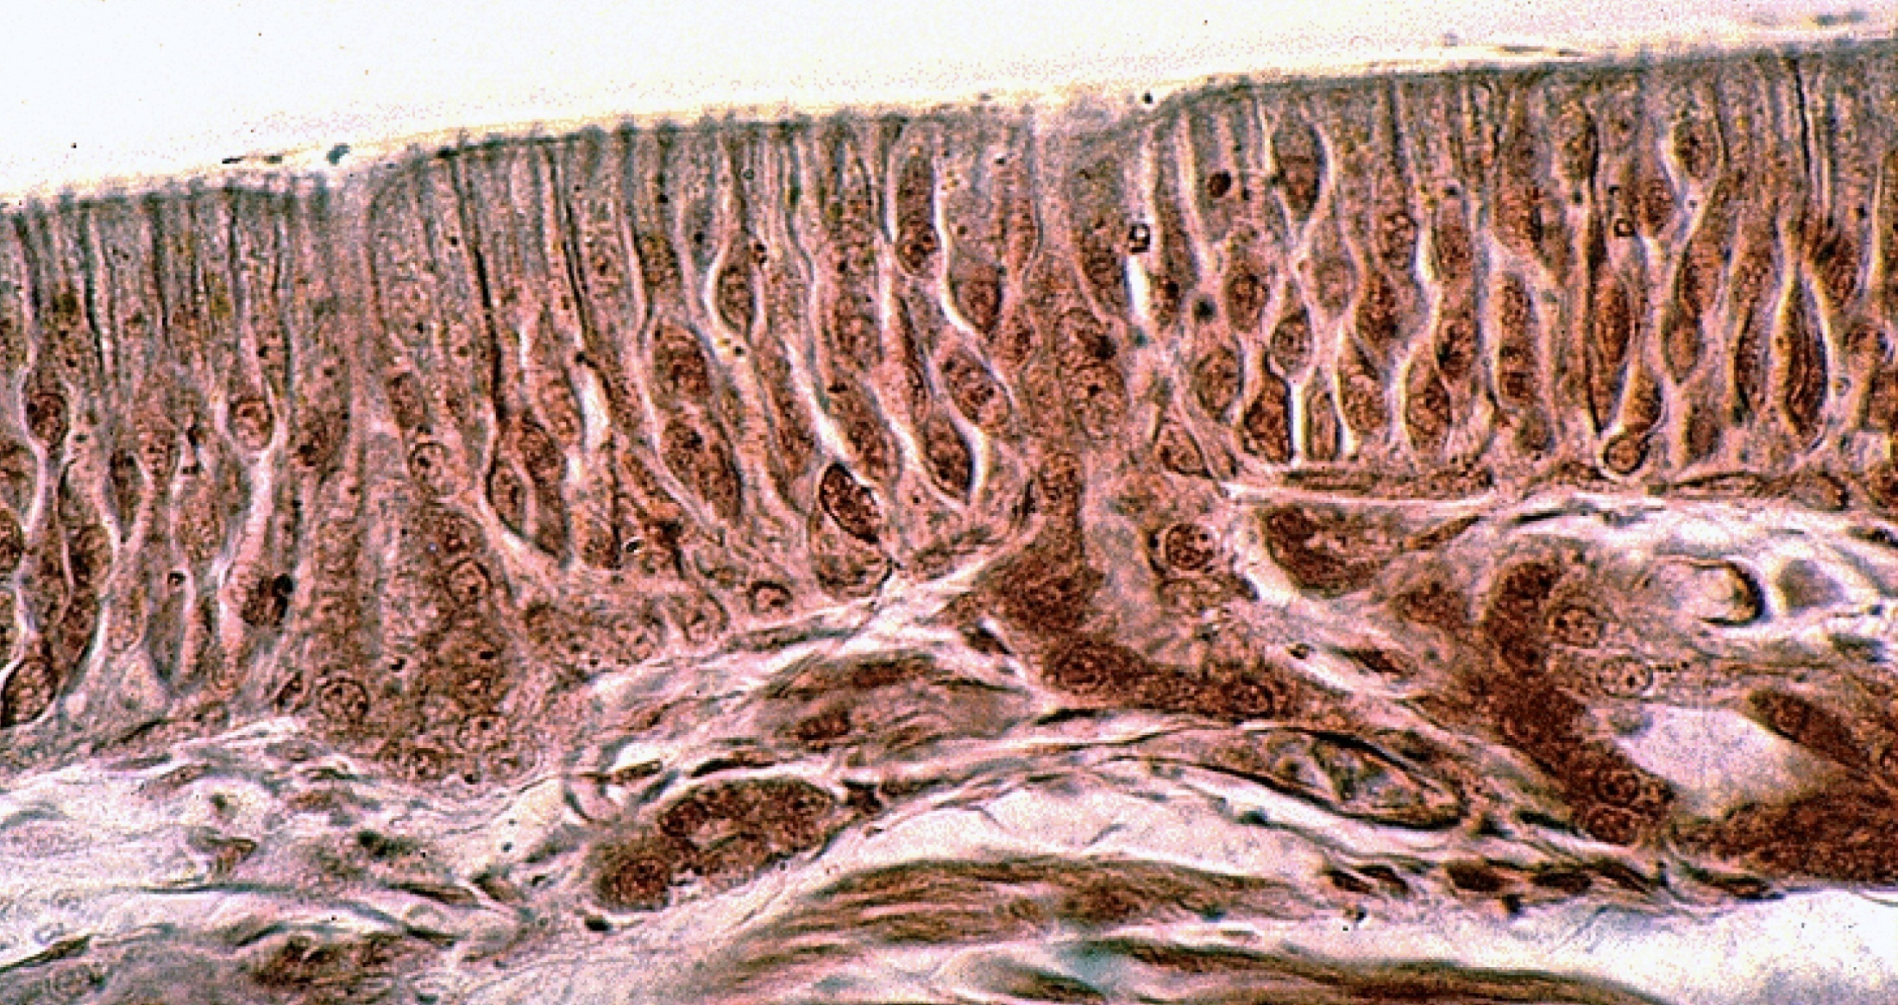
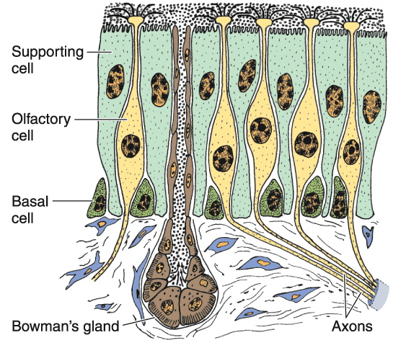
Bipolar Neuron
Contains:
Cell body
Nucleus and Nucleolus
Nissl bodies
Mitochondria
These features are NOT specific for this type only!
They are found in every neuron!
Location:
Olfactory Epithelium
Retina

Slide 9
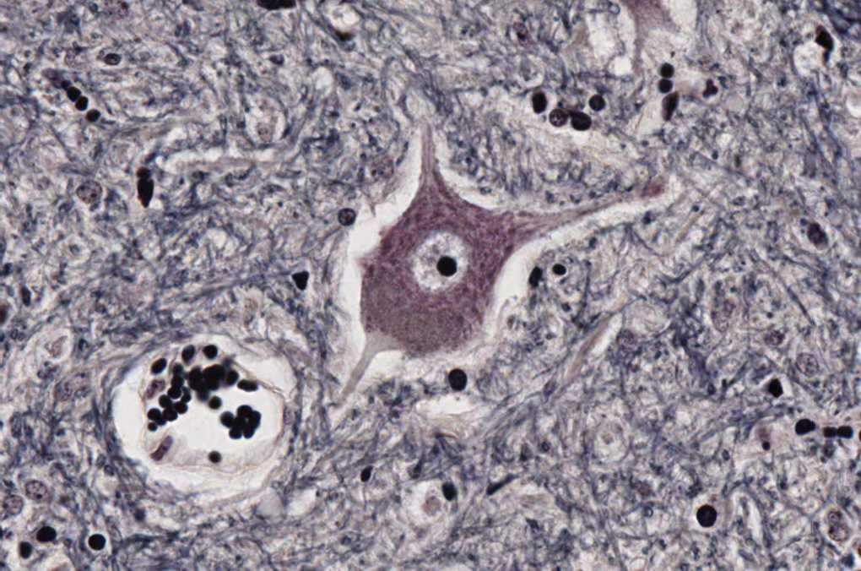
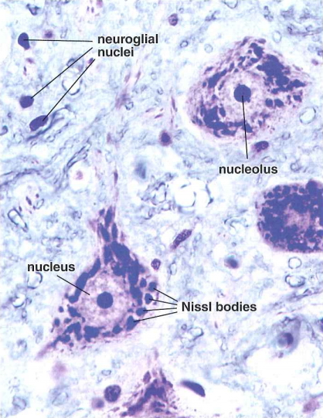
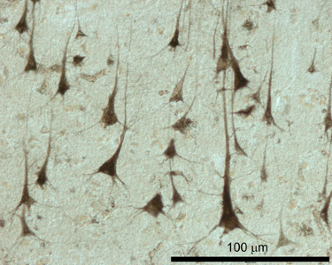
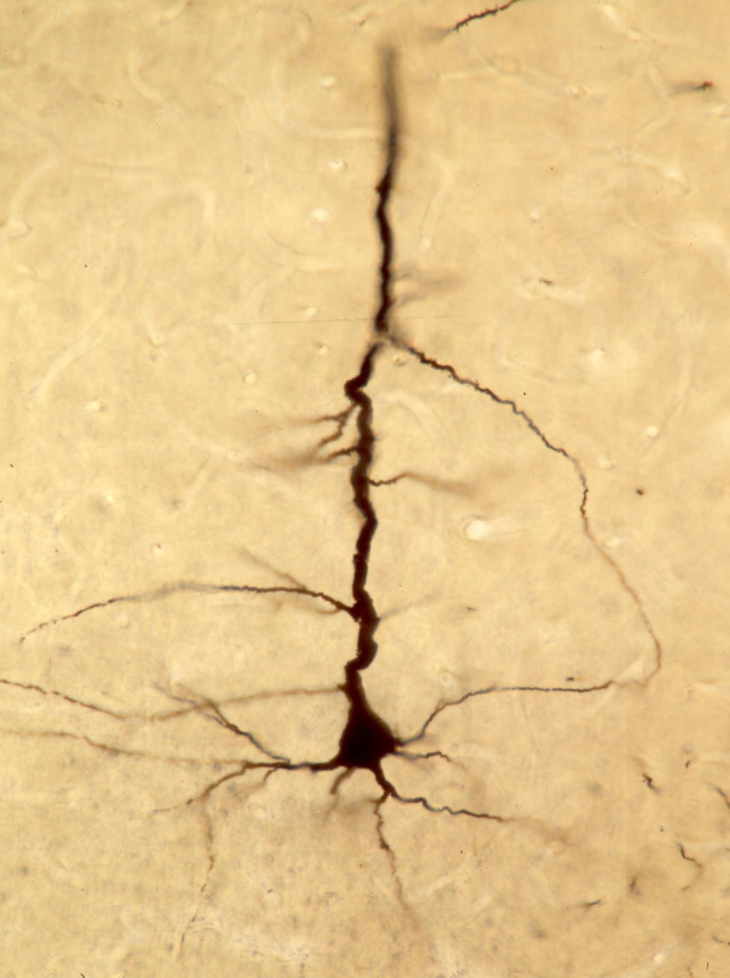
Multipolar Neuron
1- Stellate neuron:
*Location:
Anterior horn cells of the spinal cord
*Contains:
Nucleus
Nucleolus
Nissl bodies
Mitochondria
These features are NOT specific for this type only!
They’ are found in every neuron!
2- Pyramidal neuron:
*Location:
Cerebrum (motor area 4)

Slide 10
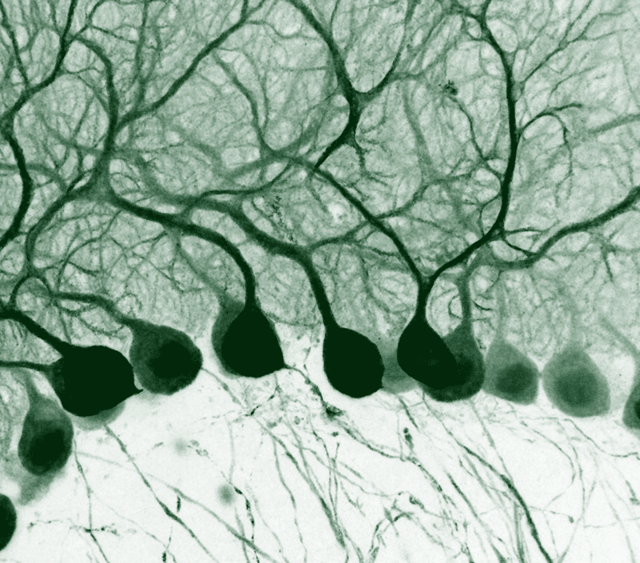
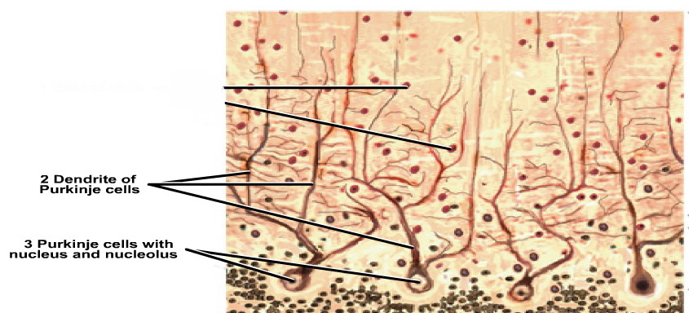
Multipolar Neuron
3- Pyriform neuron:
*Location:
Purkinje cells of cerebellum
*Contains:
Purkinje cells with nucleus and nucleolus
Dendrites of Purkinje cells
Nissl bodies
Mitochondria
These features are NOT specific for this type only! , it’s found in every neuron

Slide 11
Summary of neurons
Unipolar neuron (Pseudounipolar) (rounded neuron) Not directly connected to the cell body | Location: 1- Mesencephalic nucleus of trigeminal nerve. 2- Dorsal root (spinal) ganglion. Contains: Cell body Nucleus and Nucleolus
Bipolar Neuron (spindle-shaped neuron) like having 2 necks | Location: 1- Retina 2- olfactory epithelium.
Multipolar neuron: Has one axon and multiple dendrites. | Stellate Neurons (star shape) | Pyramidal Neurons (wide base) | Pyriform Neurons
 |  | Location: Cerebrum (motor area 4)
Location:
Anterior horn cells of the spinal cord
*Contains:
Nucleus
Nucleolus
Nissl bodies
Mitochondria
Location:
Purkinje cells of cerebellum
*Contains:
Purkinje cells with nucleus and nucleolus
Dendrites of Purkinje cells
Nissl bodies
Mitochondria

Slide 12
Thank you & good luck
- Histology team
Team leaders:
Rana Barasain
Faisal Alrabaii

