Slide 1
Practical Microbiology
Neuropsychiatry Block
Doctor’s notess
Extra explanation
Answers
"لا حول ولا قوة إلا بالله العلي العظيم" وتقال هذه الجملة إذا داهم الإنسان أمر عظيم لا يستطيعه ، أو يصعب عليه القيام به .
Done by: Samar Al-Qahtani & Hamad Al-Khudairy

Slide 2
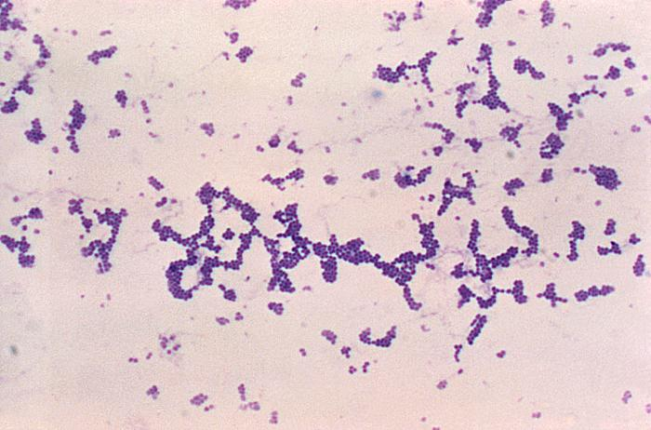
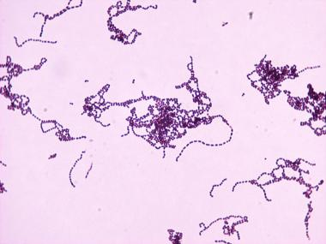
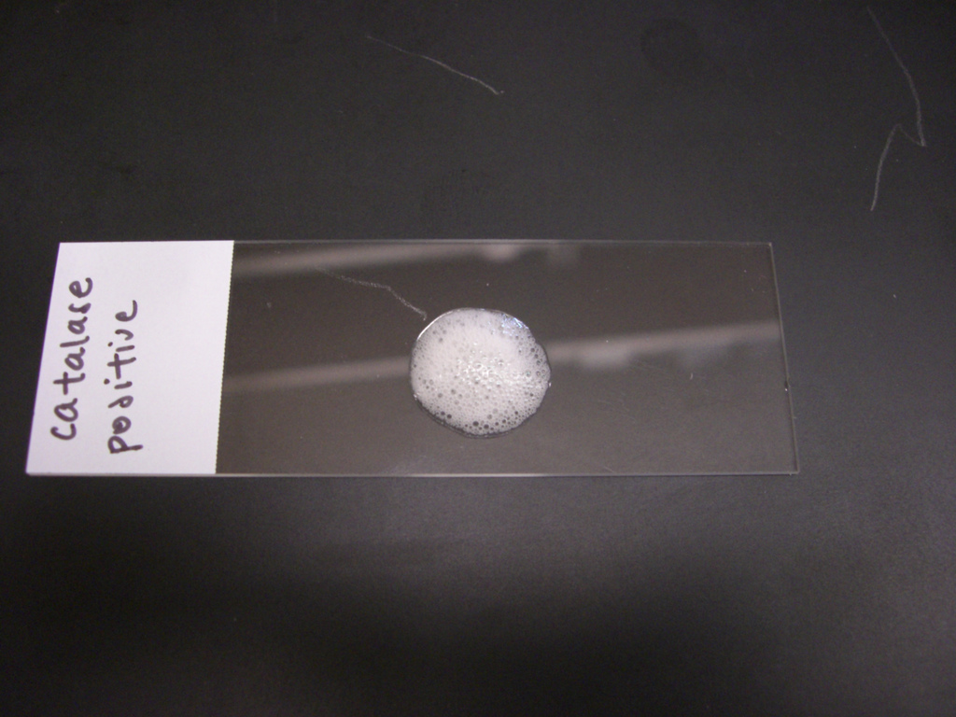
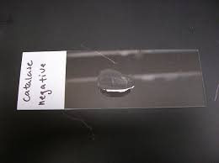
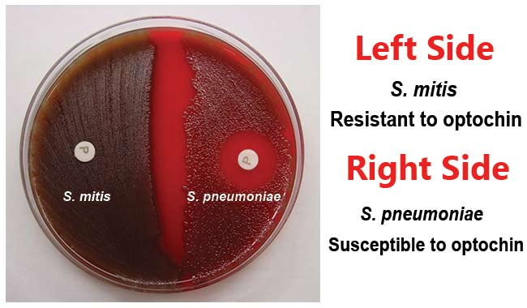
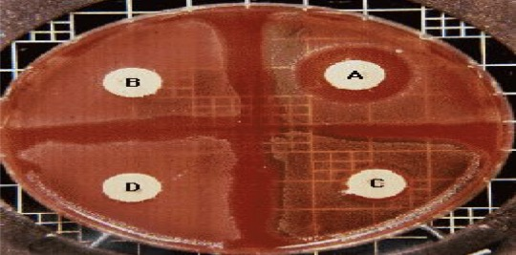
EXTRA
this slide is just review the basics of microbiology
If you are already familiar with these terms just skip it.
How can I know if the bacteria is Gram positive or Gram negative? GRAM STAIN IS THE ONLY WAY
+ve |  | -ve
Purple / Blue |  | Red / Pink
Coccus | Bacillus | Coccus | Bacillus
Gram +ve Cocci
Staphylococcus (in clusters) | Streptococcus (in chains or pairs)
We differentiate between the two by using the “Catalase test”
Bubbles → Catalase Positive | No reaction → Catalase Negative
Streptococcus
Alpha Hemolytic (α)
Species | Further test | Result
Streptococcus pneumoniae Streptococcus viridans | We differentiate between them using “Optochin Test” | Pneumoniae = Sensitive Viridans = Resistant
Beta Hemolytic (β)
Species | Further test | Result
Group A (​Pyogen) Group B (Agalactiae​) Group C | We differentiate between them using “Bacitracin Test” | Group A = Sensitive Group B and C = Resistant

Slide 3
EXTRA
Key words to help you answer cases’ questions.
Key information
Acute Pyogenic Meningitis
Acute onset (sudden)+ pus cells+ fever, headache, stiff neck, other meningitis symptoms + Turbid CSF + High protein + Low glucose + Polymorphs.
Viral (Aseptic/Lymphocytic) Meningitis
Acute onset (sudden)+ Symptoms of meningitis +Clear CSF + Unchanged/high protein + Unchanged/low glucose + Lymphocytes.
Chronic Meningitis
Chronic onset + chronic headache,facial weakness, double vision, other meningitis symptoms + Turbid CSF + High protein + Low glucose + Lymphocytes.
causes of Acute Pyogenic Meningitis it differs based on the age group and all are capsulated
Neisseria meningitidis | Streptococcus pneumoniae | Haemophilus influenzae | Escherichia coli
Adults&Infants / Children. Gram -ve diplococci.(kidney shaped) Glucose & maltose fermenter . Its capsule: 1-Produce endotoxin (LPS). Causes skin rash and septic shock. 2-Resists phagocytosis. | Adults&Infants / Children. Gram +ve diplococci. Optochin sensitive. The most invasive pathogen, high mortality rate>30% Its capsule: produce pnemolysin → immunogenic and induce immuneresponse. | Infants / Children. Gram -ve coccobacilli / pleomorphic. Need blood for optimal growth, Hematin (factor X) & NAD (factor V). Type B is invasive and capsulated. The capsule is used as a conjugate vaccine | Newborns. Gram -ve bacilli / Lactose fermenter. K1 sialic acid capsule → invasion of brain microvascular endothelial cells.
Management
Treatment (10-14 days): ● Children & Adults: Ceftriaxone + Vancomycin ● Neonates: Ampicillin + Cefotaxime
Causes of Chronic Meningitis
Tuberculosis “Mycobacterium tuberculosis” | Brucellosism “Br.melitensis”
Microscopically: Ziehl–Neelsen stain → acid fast bacilli. Tests: Mantoux test, Tuberculin skin test (TST) Treatment: Start with 4 drugs “for 2 months” Rifampicin + Isonized (INH) + Ethambutol + Pyrazinamide. Then: Rifam Rifampicin + Isonized (INH) “for 4-6 months” | Affect people who are in contact with domestic animals “Sheep” or those who consume raw milk and milk products. Can rarely be transmitted sexually & by inhalation.(lab. Acquired) Treatment: Rifampicin + Cotrimoxazole .

Slide 4
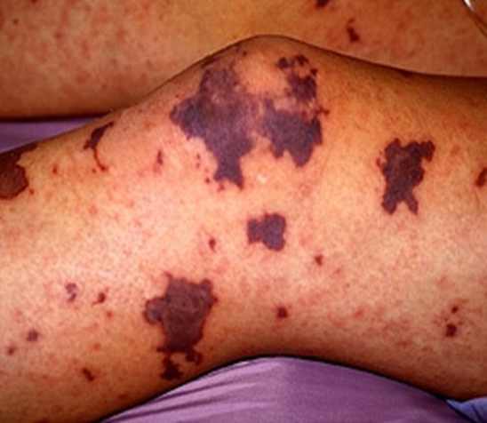
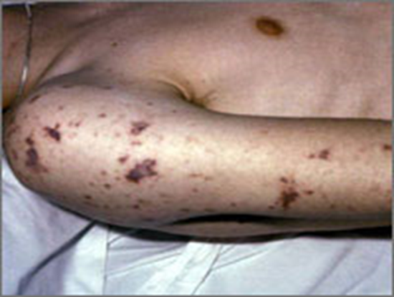
CASE 1
Acute Pyogenic Meningitis
Scenario: A 15-year-old healthy male visited the ER presenting with fever, headache, vomiting and drowsiness for the past week. Physical examination showed decreased level of consciousness, neck stiffness and high temperature of 38℃. Cerebrospinal fluid (CSF) examination revealed opening pressure of 20 cmH2O. Microscopy of the cerebrospinal fluid showed gram –ve diplococci. The patient showed complete recovery after administration of ceftriaxone for 10 days. (purpura is classic sign for neisseria) The results of the lumber puncture are shown below: |  |  | Clinical Presentation
CSF | Patient’s results | Normal range
Appearance | Turbid (cloudy) | Clear
WBCs (cells/mm³) | 8,320 Mainly polymorphonuclear leucocytes (84%) | Few (<5)
Protein (g/L) | 5.0 | 0.1-0.4
Glucose (mmol/L) | 1.3 | 3.0-4.5
Chloride(mmol/L) | 110 | 115-130

Slide 5
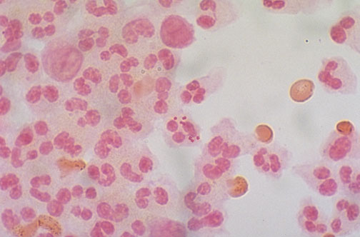
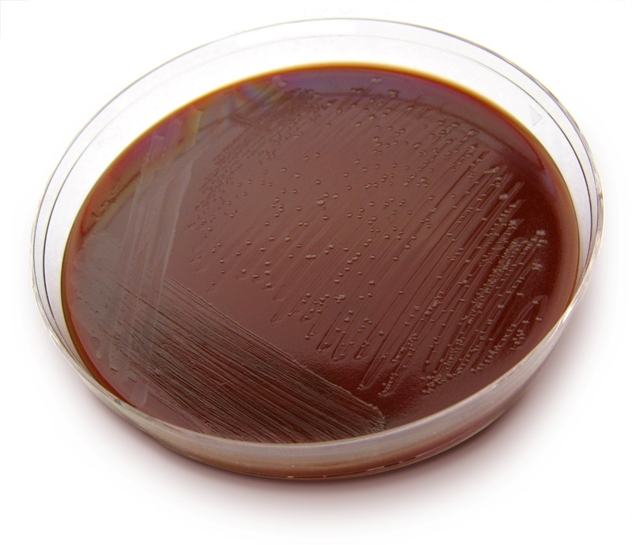
Acute Pyogenic Meningitis 1- Neisseria meningitidis
Microscopic Appearance | Culture on Thayer-Martin agar Specific for neisseria
Protect against meningitis caused by Neisseria meningitides, by Meningococcal conjugate vaccine for people going to Hajj.
Q1: What is your diagnosis?
Acute Pyogenic Meningitis.
Q2: What is the most likely infection responsible?
Bacterial infection. More serious than viral infections.
Q3: What is your justification for your answer to question two?
↑ WBCs + ↑ Protein + ↓ Glucose + there is Polymorphs.
Q4: Describe the microorganism’s appearance under microscope?
Gram negative intracellular bean-shaped diplococci + many pus cells.
Oxidase and catalase tests are ( positive )
Q5: Name the media used for growing such organism?
Thayer-Martin agar or Chocolate agar.
Q6: What further investigation would you like to do at this stage?
CSF culture and smear, Blood culture, CBC (complete blood count) , Protein and glucose levels, PCR (polymerase chain reaction) (DNA detection), Serology (Antigen detection). antigen = capsule )
Q7: Mention two recommended empirical antibiotics that can be used in such a case?
Ceftriaxone with Vancomycin. Because they’re bactericidal.
Extra Q: if the patient received the required vaccination before his travel to Hajj, how would you explain his infection despite vaccination?
A: he might take the vaccination for 2 serotypes (A&C) and he may be infected by W135.
B: he should take the vaccination before traveling by tow weeks at least.

Slide 6
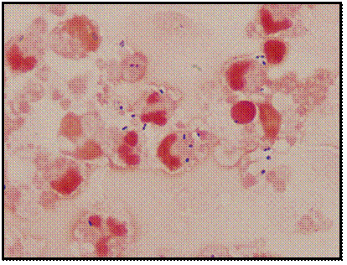
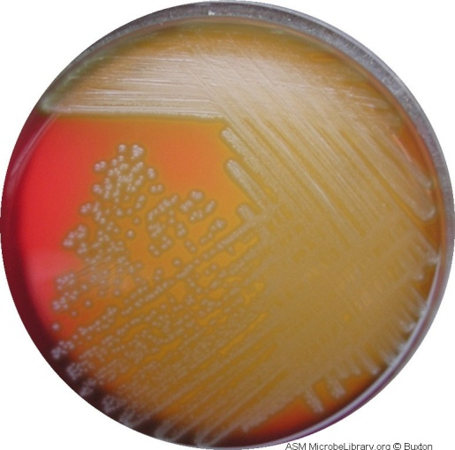
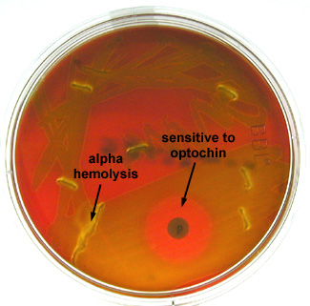
CASE
Scenario: A 59 year-old male farmer with sudden onset of fever, headache, neck stiffness and confusion The results of the lumber puncture are shown below:
CSF | Patient’s results | Normal range
Appearance | Turbid | Clear
WBCs (cells/mm³) | 3520 Neutrophils(100%) | Few (<5)
Protein (g/L) | 3.68 | 0.1-0.4
Glucose (mmol/L) | 0.5 | 3.0-4.5
2-Streptococcus Pneumoniae
Microscopic Appearance | blood agar | Optochin Test
Q1: What is your diagnosis?
Acute Pyogenic Meningitis
Q2: What is the most likely infection responsible?
Pneumococcal bacterial infection.
Q3: Describe the microorganism’s appearance under microscope?
gram-positive diplococcic with lanceolate shape and polymorphneoclear leucocyte
Q4:Name the media used for growing such organism?
Blood agar.
Q5: Describe the microorganism’s morphology?
Gray white, Alpha hemolytic streptococci.
Q6: Describe the microorganism’s reactivity towards the Optochin test?
Optochin sensitive.
Q7: What further investigation would you like to do at this stage?
CSF culture and smear, Blood culture, CBC, Protein and glucose levels, PCR
Q8: Mention two of the recommended antibiotics that can be used as empiric treatment in such a case?
Vancomycin + ceftriaxone

Slide 7
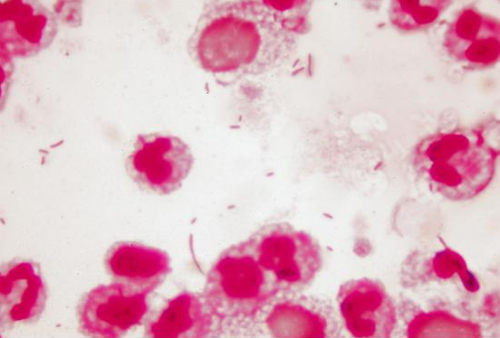
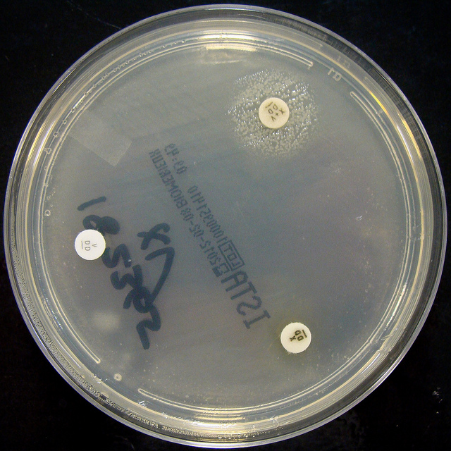
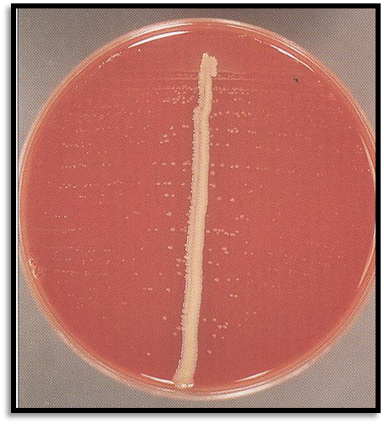
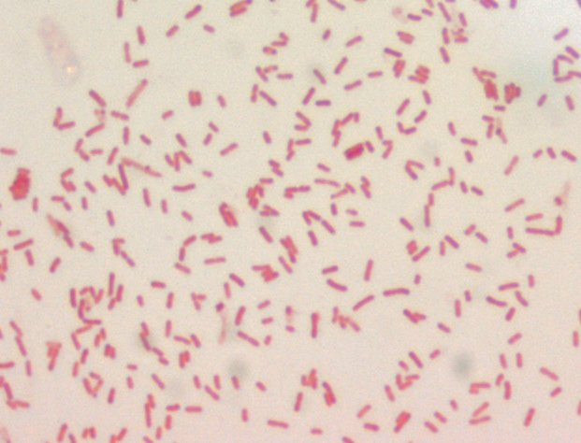
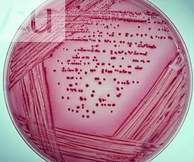
3- Haemophilus Influenzae
Microscopic Appearance | Nutrient agar | chocolate agar | Blood agar
Q1: What is your diagnosis?
Acute Pyogenic Meningitis.
Q2: What is the most likely infection responsible?
Bacterial infection.
Q3: What is the most probable Pathogen isolated?
Haemophilus Influenzae.
Q4: Describe the microorganism’s appearance under microscope?
Gram-Negative pleomorphic coccobacilli with many polymorphneuclear leucocyte. Q5: Name the media used for growing such organism?
Chocolate agar , Blood agar and Nutrient agar.
Q6: Describe the microorganism’s morphology on Chocolate Agar?
Grey mucoid colonies of Haemophilus Influenzae due to the presence of X and V factors.
Q7:Describe the microorganism’s morphology on Nutrient Agar?
H. influenzae :Growth around XV factors( requires both factors XV)
no growth around X or V alone the optimum growth temperature is (35°C - 37°C in 5% CO2). In this culture haemophilus has only grown around the paper disc that has been impregnated with X and V factors. There is no bacterial growth around the discs that only contain either X or V factor.
Q8:Describe the microorganism’s morphology on Blood Agar?
Growth on blood agar showing satellitisim adjacent to a streak of S.aureus.
S.ureus producing surplus factor increasing growth of adjacent H.influenzae.
satellitism is the pattern of arrangement of heamophillus influenzae on blood agar strearked with staphylococcus aureus in the centre.
Q9: What further investigation would you like to do at this stage?
CSF culture and smear, Blood culture, CBC, Protein and glucose levels, PCR.
Q10: Mention two recommended empirical antibiotics that can be used in such a case?
Ceftriaxone with Vancomycin.
4. Escherichia Coli
Microscopic Appearance | MacConkey agar
Q1: What is your diagnosis?
Acute Pyogenic Meningitis.
Q2: What is the most likely infection responsible?
Bacterial infection.
Q3: What is the most probable Pathogen isolated?
Escherichia Coli.
Q4: Describe the microorganism’s appearance under microscope?
Gram negative bacilli (rods).
Q5: Name the media used for growing such organism?
MacConkey’s agar.
Q6: Describe the microorganism’s morphology on MacConkey Agar?
Lactose fermenter (pink colonies).
Q7: What further investigation would you like to do at this stage?
CSF culture and smear, Blood culture, CBC, Protein and glucose levels, PCR.
Q8: Mention two recommended empirical antibiotics that can be used in such a case?
Child: ​Ceftriaxone with Vancomycin.
Neonate:​ Ampicillin with Gentamicin.

Slide 8
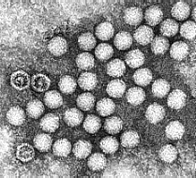
CASE 2
Viral (Aseptic/Lymphocytic) Meningitis |  |  | Electron Micrograph of Enterovirus
Scenario: A 10-year-old boy is brought to the emergency department at KKUH accompanied by his mother. He has fever, headache, and vomiting for the last 2 days. Clinical examination confirmed that he has meningeal irritation. The results of the lumber puncture are shown below:
CSF | Patient’s results | Normal range
Appearance | Clear | Clear
WBCs (cells/mm³) | 1200 Mainly lymphocytes (80%) | Few (<5)
Protein (g/L) | 0.5 | 0.1-0.4
Glucose (mmol/L) | 2.7 | 3.0-4.5
Chloride (mmol/L) | 100 | 115-130
CSF Molecular testing is positive
Q1: What is your diagnosis?
Aseptic (Lymphocytic) Meningitis.
Q2: What is the most likely infection responsible?
Viral Infection.
Q3: What is your justification for your answer to question two?
↑ WBCs + moderate ↑ Protein + normal Glucose + present of Lymphocytes.
Q4: What further investigation would you like to do at this stage?
CSF culture and smear, Blood culture, CBC, Protein and glucose levels, PCR.

Slide 9
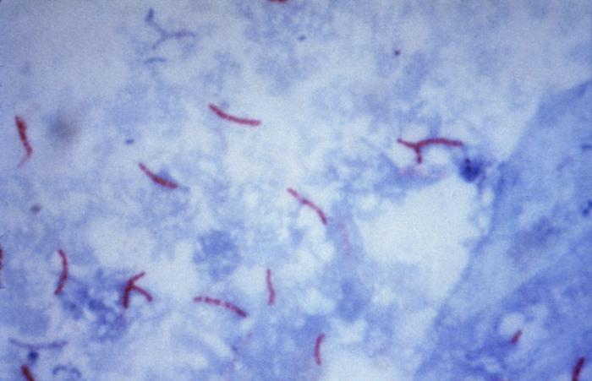
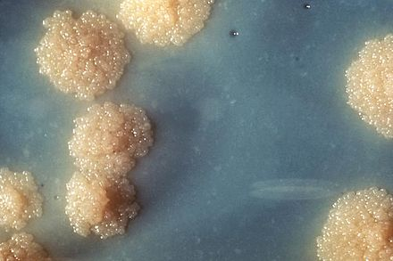
CASE 3
Chronic Meningitis
Scenario: A 65-year-old is referred from a general practitioner because of headache, fever, excessive sweating at night, and weight loss over the last 4-5 months. He has lost his appetite for food. On examination, there is neck rigidity. Laboratory tests including blood count, serum and electrolytes, blood urea, creatinine and blood culture are all normal. The results of the lumber puncture are shown below:
CSF | Patient’s results | Normal range
Appearance | Turbid | Clear
WBCs (cells/mm³) | 300 Mainly lymphocytes (80%) | Few (<5)
Protein (g/L) | 0.8 | 0.1-0.4
Glucose (mmol/L) | 2.0 | 3.0-4.5
Chloride (mmol/L) | 115 | 115-130
Chronic Meningitis Mycobacterium Tuberculosis
Microscopic Appearance | Lowenstein-Jensen Medium
Q1: What is your diagnosis?
Chronic Bacterial Meningitis.
Q2: What is the most likely infection responsible?
Mycobacterial infection.
Q3: What is your justification for your answer to question two?
↑ WBCs + ↑ Protein + ↓ Glucose + present of Lymphocytes.
Q4: What is the most probable Pathogen isolated?
Mycobacterium Tuberculosis.
Q5: What is the stain used to identify such organism?
Ziehl-Neelsen (ZN) stain for Acid Fast Bacilli (AFB).
Q6: Describe the microorganism’s appearance under microscope?
Acid Fast Bacilli (AFB) with a blue background.
Q7: Name the media used for growing such organism?
Lowenstein-Jensen (LJ) media.
Q8: describe the culture on Lowenstein-Jensen?
Colonies or growth is rough, tough and buff.
Q9: what further investigation would like to do at this stage?
CSF culture, blood culture, PCR, CBC, Tuberculin skin test, chest X-ray.
Q10: Name the drug used to treat such infections?
For the first 2 months:​ Rifampicin + Isoniazid (INH) + Ethambutol + Pyrazinamide. Then, for 4-6 months:​ Rifampicin + Isoniazid (INH).

