Slide 1



Text.
Important
Numbers
Doctor notes
Extra notes and explanation
Practical File
“والله إن المسألة تُغلق في وجهي، فأستغفر الله ألف مرة فتُفتح لي “
ابن تيمية

Slide 2
Please Read This Notes!
This file contain the 3 lectures.
This work is not by any means a reference.
Please keep in mind that this work is done by students , so if there are any mistakes please inform us .
Some slides have notes and extra explanation that will help you understand the content, please see it.
We put all the content of male / female slides to make sure that the file includes everything
We put this sign according to female’s doctor revision, but please read it incase it come in the exam.
Please study hard and don’t worry the exam will be easy!
Be sure to practice the correct SPELLING and write the FULL name in the exam.
Just read it ☺
تفسير الملاحظة اعلاه :
هذا الملف يشمل جميع سلايدات البنات والأولاد، النوتز والHand out، تم وضع (Just read it) عند المواضيع التي قد لا تكون بتلك الأهمية ولكن مروا عليه احتياطاً.
هذا الملف مُراجع من قبل الدكتورة والدكتور.

Slide 3
1. Nerve Conduction Studies & EMG
At This File, We Are Going To Discuss The Following :
Motor Nerve Conduction Velocity (MNCV)
Motor Unit Potential (MUP)
Electromyogram (EMG)

Slide 4
Just read it ☺
Introduction
Nerve conduction studies
Motor Nerve Conduction Velocity (MNCV)
Electromyography (EMG)
What is motor unit?
  It consists of a motor neuron and all the muscle fibers it innervates.
  When an action potential occurs in a motor neuron, all the muscle fibers in its MU are stimulated to contract.

Slide 5
Cont.
Just read it ☺
Motor Nerve Conduction Velocity (MNCV):
  Standard nerve conduction studies typically include motor nerve conduction, sensory nerve conduction.
  Sensory and motor nerve conduction studies involve analysis of specific parameters, including latency, conduction velocity, and amplitude. (The amplitude depends on the number of axons).
Abnormalities:
    Axonal degeneration / segmental demyelination.
    Focal / multifocal / generalized.
    Purely / predominantly sensory or motor.
    The severity.
Site of pathology:
    Nerve (cell body, nerve root, peripheral nerves).
    Muscle.
    Neuromuscular junction NMJ.
Electromyograph (EMG):
    Electro-diagnostic technique for recording the electrical activity (AP) of skeletal muscle.

Slide 6
Motor Nerve Conduction Velocity (MNCV) Study
Just read it ☺
What is MNCV:
    MNCV is a test to evaluate the function, especially the ability of electrical conduction, of a nerve; or the speed of propagation of an action potential along a nerve.
    The motor nerve conduction is abnormal in both preganglionic and postganglionic injuries.
Procedure:
  Stimulation of median nerve at two points until visible muscle contraction is seen and a reproducible Compound Muscle Action Potential (CMAP) is recorded.
  Recording electrode over the thinner eminence.
  CMAP: summated potentials from all Motor Units in a muscle.
Abnormalities:
Comparing results:
  Compare nerves same limb (hand median vs ulnar or radial).
  Compare left and right limb.
  Compare upper and lower limbs.
  Compare to previous results in same subject.
  Compare to normal reference values.
Abnormalities
Axonal degeneration neuropathy features | Demyelinating neuropathy features
Low amplitudes | Normal amplitudes
Normal / slight delay in latency | Significant delay in latency
Normal / slightly low conduction velocity | Significantly low conduction velocity

Slide 7
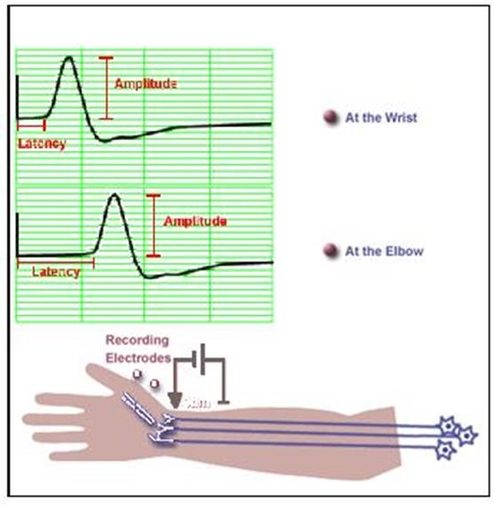
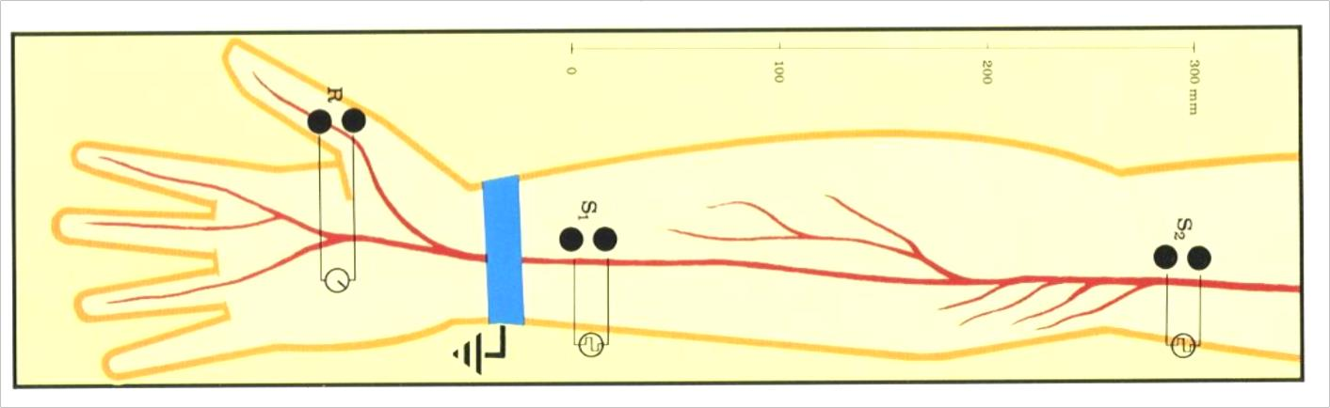
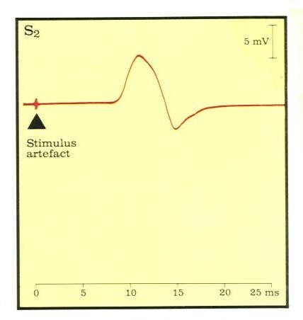
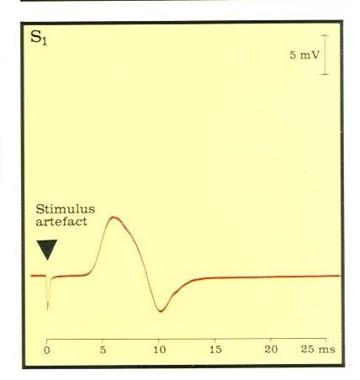
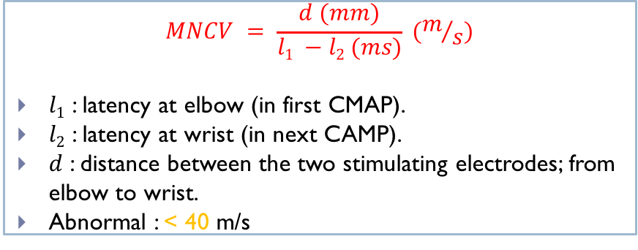
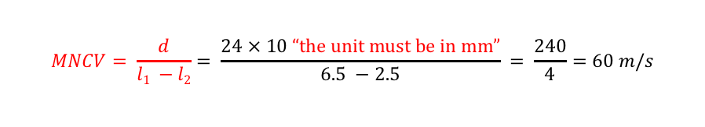
Cont.
The latency is the interval between the onset of the stimulus and the onset of the
initial deflection from baseline of the resultant CMAP (in ms).
$$MNCV = \frac{d (mm)}{l1 −l2 (ms)} (m/s)$$
$l1$ : latency at elbow (in first CMAP).
$l2$ : latency at wrist (in next CAMP).
$d$ : distance between the two stimulating electrodes; from elbow to wrist.
Abnormal : < 40 m/s
VERY IMPORTANT
Distance: 24 cm
Latency at elbow: 6.5 ms
Latency at wrist: 2.5 ms
$$MNCV= \frac{d}{l1 −l2}= \frac{24 × 10 “the unit must be in mm”}{6.5 −2.5} = \frac{240}{4}=60 m/s$$
Normal values for MNCV
Conduction is faster in myelinated fibers.
Conduction is dramatically slowed (20-30 m/s) in demyelinating peripheral neuropathies (diabetes, Gillain Barré) and in some nerve compression/entrapment (carpal tunnel syndrome).
In arm | 50 – 70 m/s
In leg | 40 – 60 m/s

Slide 8
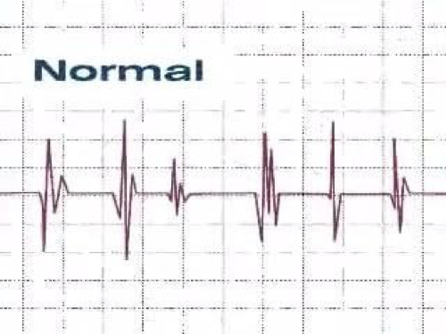
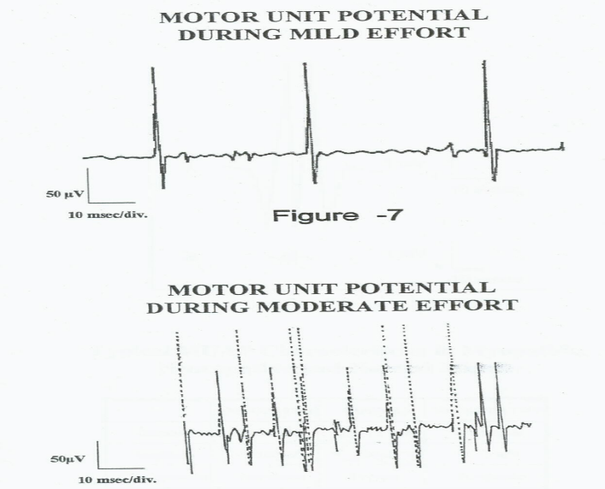
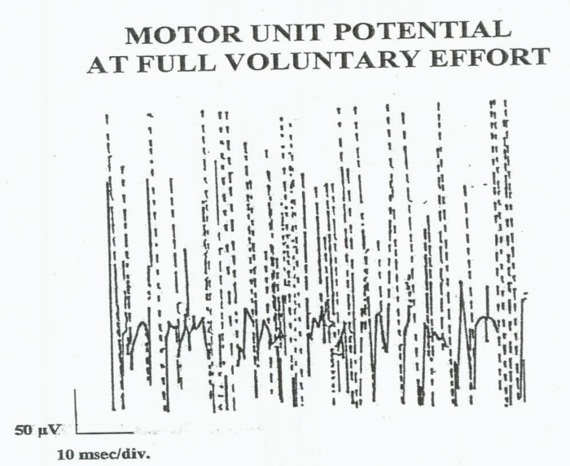
Motor Unit Potential (MUP)
You have to know the MUP before moving to the 2nd type of nerve conduction study (The EMG)
Motor unit potential:
Represents the summation of the potentials generated by muscle fibers belonging to the MU.
Voluntary Muscle contraction:
The potentials recorded on voluntary effort are derived from motor units of the muscle,
hence known as motor unit potentials (MUPs).
Mild to moderate contraction
Full contraction
With increasing strength of contraction → recruitment of MUs → ↑ number & size of motor unit action potential.
At full contraction separate motor unit AP will be indistinguishable resulting in a complete recruitment = interference pattern.

Slide 9
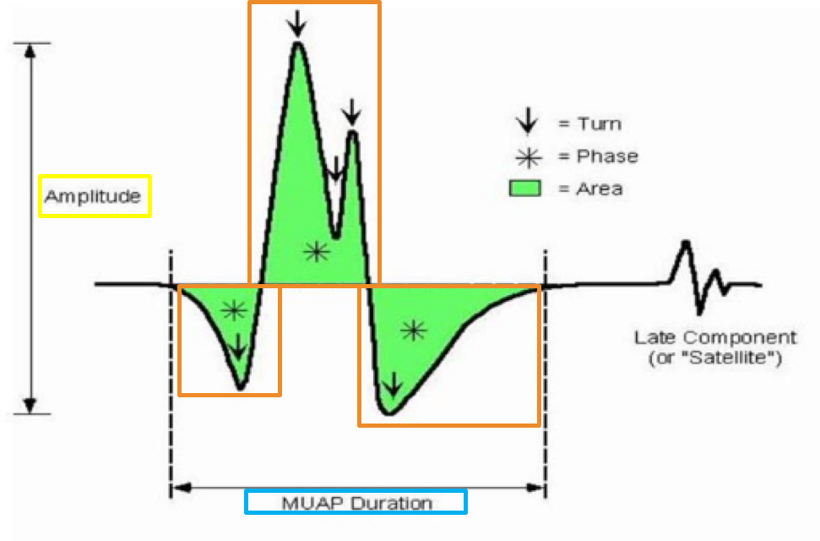
Cont.
Normal Motor Unit Potential (MUP):
  Amplitude: 300μV – 5 mV
  Bi – Triphasic (phase: portion of the wave from a baseline to the other)
  Duration: 3 – 16 msec

Slide 10

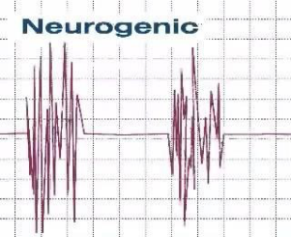
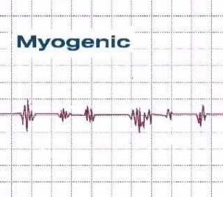
Analysis of Motor Unit Potential (MUP)
Patients often have difficulty completely relaxing a muscle (during the test).
Motor units when first recruited or de-recruited fire regularly at 6 –10 spikes per second (Hz) .
MUP | Duration (msec) | Amplitude | Phases | Insertional activity | Resting activity | Recrutiment Interference pattern | picture
Normal | 3 – 16 msec Reflects the degree of synchrony of firing of the muscle fibers within the motor unit | 300 – 5000µV Reflection of the total number of activated muscle fibers near the needle | Biphasic/ triphasic | These are discharge potentials provoked by the disruption of the cell membrane itself | Absent | Full Normally number of MUAPs activated and their frequency rises with increased exertion until it become full with maximal voluntary contractions.
Neurogenic | Long duration >16 msec | High voltage >5 mV | Polyphasic (+3 phases) | increased | Present | Partial
Myopathic | Short duration < 3 msec | Reduced voltage < 300 µV | May be polyphasic | decreased | Present | Full (Rapid recruitment; low amplitude)

Slide 11
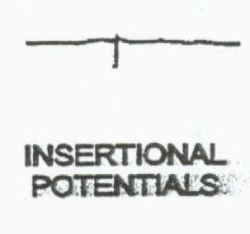
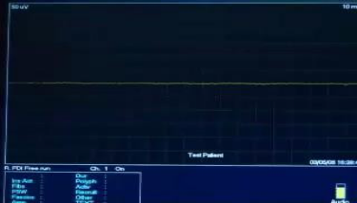
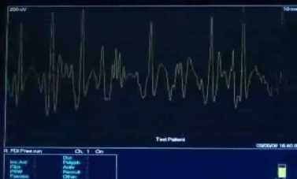
Electromyography (EMG)
Electromyography (EMG)
Definition
Procedure
component
Uses
Is the recording of electrical activity of a muscle at rest & during contraction, (to evaluate the electrophysiology of a MU)
Activity is amplified and displayed on an oscilloscope.
- A concentric needle electrode is inserted into the belly of the muscle.
- Needle EMG does not introduce any electrical stimulation instead it records the intrinsic electrical activity of skeletal muscle fibers.
Normally a muscle is silent after insertion activity has ceased.
(any electrical activity seen in this stage is considered abnormal e.g. fibrillation and/or fasciculation )
- Then the patient is asked to contract the muscle smoothly.
- With muscle contraction, MUs are activated and MUAPs appear on the screen.
Instrument
To evaluate :
Insertional activity
Morphology
resting activity
Size of motor units
voluntary recruitment
Motor unit recruitment
Electromyograph
Record
Electromyogram

Slide 12
Analysis of EMG
Where do we use EMG in?
    To investigate both neuropathic and myopathic disorders (weakness, numbness, pain) How?
    The size, duration & frequency of the electrical signals generated by muscle cells help determine if there is damage to the muscle or to the nerve leading to that muscle.
Disorder | Definition | Example/s
Myopathy Spontaneous activity exists | Progressive degeneration of skeletal muscle fibers. | Duchenne muscular dystrophy.
Neuropathy | Damage to the distal part of the nerve. Peripheral neuropathy mainly affects feet & leg. | Most common: Guillain barré syndrome. Diabetes mellitus. Alcohol abuse.
Lower motor neuron (LMN) lesion | Interrupt the spinal reflex arc (α motor neuron) → partial or complete loss of voluntary contraction, muscle wasting, ↓reflexes, fasciculation. | Polyomyelitis.

Slide 13
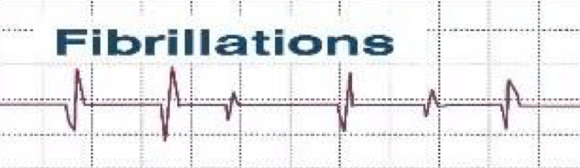
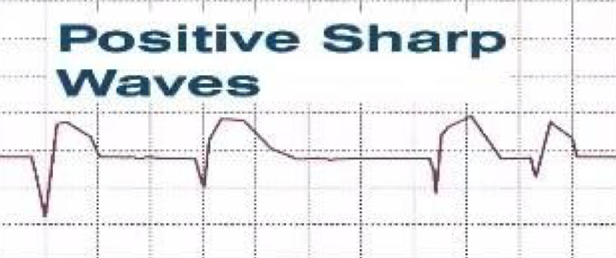
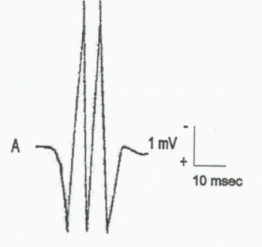
Abnormal EMG Potentials
In neurogenic lesion or in active myositis, the following spontaneous activity is noted:
Low amplitude, short duration, biphasic potentials, correspond to the spontaneous discharge of a denervated single muscle fiber due to denervation hypersensitivity to acetylcholine or axonal loss not balanced by re-innervation.
Fine invisible (not visible through the skin), irregular contractions of individual muscle fibers. without the consciousness of the patient
An electrical sign not a clinical sign.
Fibrillations
“not visible by the eye”
Small fibrillation aps (50 to 100 µv, and duration of 5 to 10 msec) whose propagation is blocked at the level of the recording electrode (arise when the needle tip damages fibers and spontaneous action potentials propagate up to the needle tip and then are extinguished)
Have fast downtroke and slower return to baseline.
Have the same origin & significance as fibrillations.
Positive sharp waves
Giant motor unit potentials or fasciculations
“visible by the eye”
Spontaneous discharge of a MU at rest, can be seen and felt by the patient.
Partial re-innervation of denervated muscle, by sprouting of the remaining nerve terminals, produces abnormally high voltage, polyphasic, long duration potentials (Giant Potentials).
Isolated discharges that recur at irregular intervals, usually in the order of several seconds.
May be benign and they occur in motor neuron disease, radiculopathy and neuropathy.

Slide 14
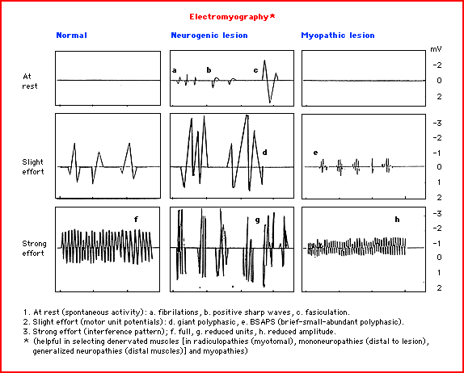
Cont.
Important definitions mentioned by the male’s doctor:
  Radiculopathy: damage in the nerve roots.
  Plexopathy: damage in nerve plexuses.
if the degeneration happens in the dendrites of the sensory nerve the sensory nerve conduction test will be abnormal and the motor nerve conduction test will be abnormal because the damage is in the dendrites so everything after it will be negative.
if the degeneration happens in the axons, the sensory NCV will be normal but the motor NCV will be abnormal because the sensory before the degeneration is still intact so there will be impulses but after that the impulses will stop and the motor will be negative.

Slide 15
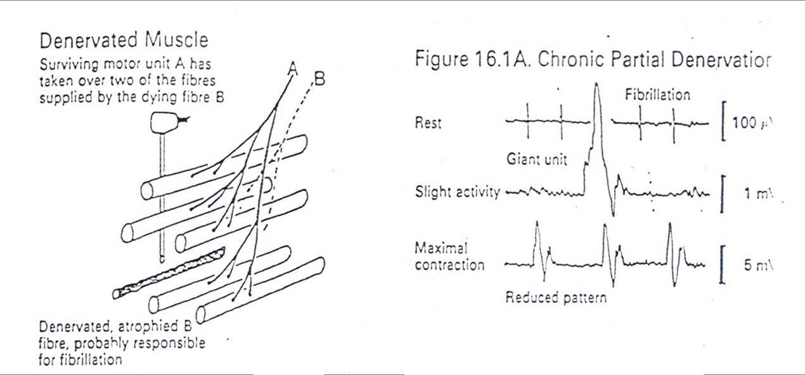
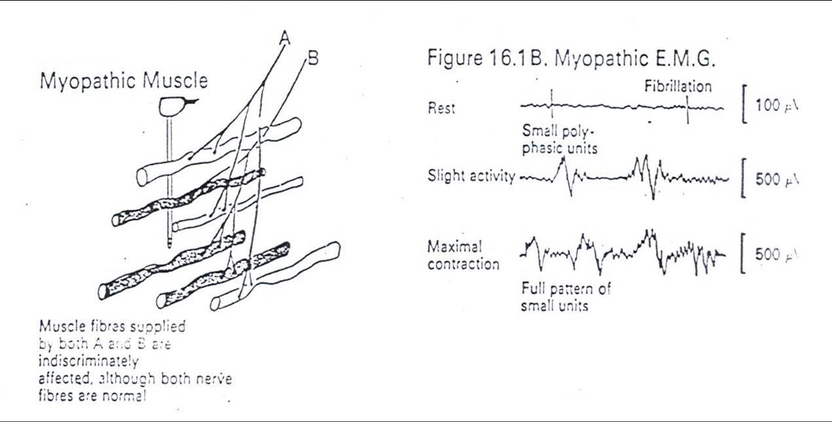
Extra Images
Neuropathic EMG changes:
Myopathic EMG changes:

Slide 16
Extra Explanation
The experiment in the lab was divided into two parts:
Initially, 3 electrodes are placed on the arm.
1- Calibration
we do this first because the machine needs to know the maximum effort a muscle can achieve before testing it out.
Calibration starts, wait for 2 seconds, then clench hard for 2 seconds.
2- Recording
Perform 4 clenches, starting weakly, and the 4th should be the strongest one.
The harder the clench, the more tension in the muscle, the more motor unit recruitment, the bigger the wave form (motor unit potential) on the EMG.
Since this was done on a student, the size, duration & frequency of the electrical signals were all normal.

Slide 17
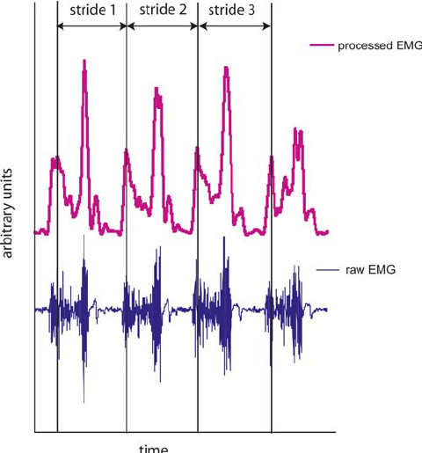
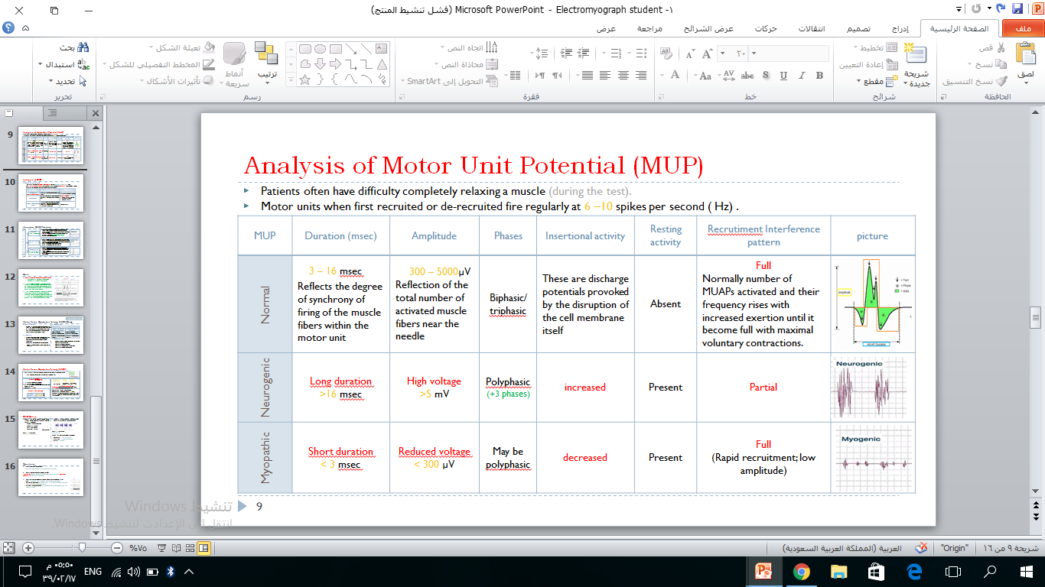
EMG Cases ‘’ Examine Yourself !!‘’
Case1: A 29 year old woman is referred for EMG studies because of difficulty in walking. Her EMG reveals the following:
  MUAP amplitude reduced
  Polyphasia present
  Early ( Rapid ) recruitment
  Fibrillations absent
What is the diagnosis?
Myopathy (Muscle disease)
Case 2: A 50 year old man is referred for EMG because of difficulty in walking. Her EMG is:
What is the diagnosis?
Neuropathy
Explain features of each one of the following:
  Amplitude: > 5 mV (high voltage)
  Duration: > 16 msec (long duration)
  Phases: Polyphasic
هذا المثال مو موجود بالسلايدات بس الدكتورة عطتنا اياه ... قالت اللي يفهمه كويس و اللي ما يفهمه عادي مو لازم.
Remember:

Slide 18
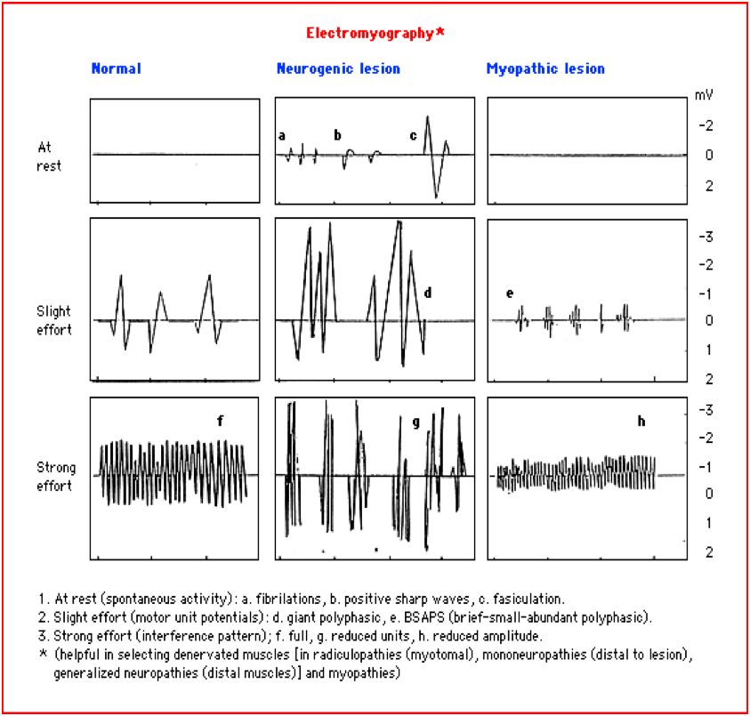
Questions
1. What is meant by “the motor unit”?
It consists of a motor neuron and all the muscle fibers it innervates.
2. What is meant by motor unit potential (MUP’s)?
Summated potentials recorded on voluntary effort that are derived from muscle fibers belonging to motor units of the muscle.
  3. What will a normal recording of a muscle show in each of the following states;
  Rest: No resting activity (electrically silent); no positive sharp waves.
  Mild muscle contraction: Normal MUPs, not filling all the screen of the oscilloscope.
  Maximal muscle contraction: Full interference pattern (screen completely filled with
  normal MUPs).

Slide 19
2. Pure Tone Audiometry
At This lecture, We Are Going To Discuss The Following :
The usual primary purpose of pure-tone tests is to determine the type, degree, and configuration of hearing loss.
To plot the frequency intensity recording and construct the audiograms.
To interpret the audiograms.
In this practical we will do:
1- Tunning fork tests.
2- Audiometry.

Slide 20
Introduction ‘’ Terminology ‘’
Air conduction | This test assess the sensitivity of the entire hearing mechanism including the sensory neural mechanism of cochlea and auditory nerve. when the sound is given to the external ear, then transmitted to middle, inner ear and then through the brain to the cortex. Testing may be performed using headphones or insert earphones. The sound is amplified 22 times when transmitted via air conduction; 17 time by tympanic membrane and 1.3 time by ossicles (17 X 1.3 = 22) → that’s why air conduction is always better in a normal person.
Bone conduction | when the sound is transmitted through the bone of the skull (by oscillating the skull) , the cochlea which is embedded in the skull is stimulated, bypassing the outer and middle ear. This technique measures the sensitivity of the sensorineural mechanism.
Masking Level | Masking presents a constant noise to the non-test ear to prevent crossover from the test ear. The purpose of masking is to prevent the non-test ear from detecting the signal (line busy), so only the test ear can respond. (creating a static sound on non-test ear to make sure that you hear from only the test ear )
هنا يتكلم عن خطوة من تجربة الaudiometry .

Slide 21
Cont.
Types of Hearing Loss | Sensory Neural Hearing Loss | Occurs when there is damage to the inner ear (cochlea) or to the nerve pathways from the inner ear to the brain. Cannot hear better by either conduction route.
 | Conductive hearing loss | Impaired sound transmission to the inner ear. The ability to hear air-conducted sound is decreased or lost. It doesn’t affect the ability to hear bone conducted sounds that do not pass through the outer or middle ear.
 | Mixed Hearing Loss | Conductive & sensorineural.
Electronic Vibrator |  | For testing bone conduction from the mastoid process to the cochlea.
Calibration (during Audiometry test) |  | Zero intensity (0 db) level of sound at each frequency is the loudness that can be barely heard by the normal person.
Pure Tone |  | is a single frequency tone with no harmonic content (no overtones). This corresponds to a sine wave.
Only in Males’ slides

Slide 22
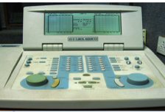
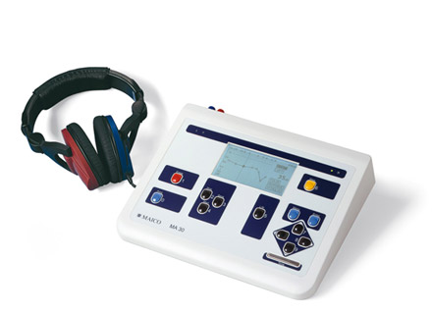
Pure Tone Audiometry
Pure Tone Audiometry
Definition
Measures
Threshold
Requirements
Components of audiometer
Is the instrument used by audiologists to measure hearing thresholds.
Your ability to hear sounds that reach the inner ear through the ear canal (AC) or through bone (BC).
AC = Air conduction
BC = Bone conduction
The minimum level at which a signal can be detected.
Sound proof room.
Pure tone audiometer.
Audiogram paper.
Frequency selector dial: selection of different pure-tone frequencies. Range: 125 to 8000Hz.
Hearing level dial: Controls the intensity of the signal 100dB range in 5dB steps.
Presentation button: presents tone to the listener.
Electronic Vibrator for BC.
Output selector: AC /BC.

Slide 23
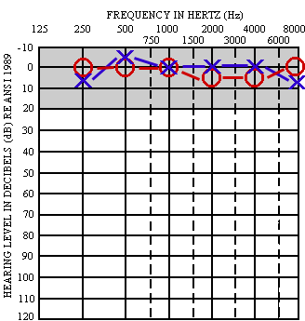
Audiogram Paper
The graph is designed so that:
  X axis: represents frequency (is the pitch of the sound in Hertz Hz) with 125 Hz near left and 8000 Hz near right.
  Y axis: represents intensity (is the volume/ loudness of sound measured in decibels dB) with 0 dB near the top and 110 dB near the bottom.
The horizontal line at 0 dB hearing level (HL) represents normal (Nl) hearing sensitivity for the average young adult.
The decibel is the unit used to express magnitude of hearing loss.
The amount of hearing loss: on the vertical axis. (explained in the next slide)
The normal thresholds should be in the area above 25 dB (from -10dB to 25 dB), on
the top of the graph.
Frequency(Hz): number of sound waves/ second
Intensity(Db): volume of sound

Slide 24
Extra Explanation
The numbers on the vertical or Y axis determine the loudness (volume/ intensity). Also, it detects the hearing level (HL) of the delivered tone; and at the same time they indicate the amount of hearing loss (HL) (deafness/degree of hearing impairment). (HL stands for both; hearing loss and hearing level.)
For example: if the hearing threshold (the least sound a patient can hear at a particular frequency) is 50dB, (this is the intensity of the sound ); it means that he has a hearing loss of 50 dB for that tone. Because, a normal thresholds should be in the area above 25 dB (from -10dB to 25 dB), on the top of the graph.

Slide 25
Procedure
Just read it ☺
Patient comfortably seated in a sound proof room, earphones on:
Red → right ear
Blue→ left ear
Select the test ear (start by the better ear).
Deliver masking noise to the other ear.
Pure tones are delivered: start with a frequency of 125 Hz & 0 db.
Gradually increase the db. Till person hears the sound & responds: ask him to raise a finger as soon as the very least sound is heard.
Mark the threshold intensity on the chart.
O→right
X →left
Repeat the procedure for frequencies 250 Hz to 8000 Hz.
Join the threshold points from 125 Hz to 8000 Hz (AC audiogram).
Switch to the opposite ear and repeat the procedure.
Placement of the bone vibrator:
  Place the vibrator over the mastoid process.
  Switch from AC to BC.
  Follow the same procedure as for AC.
  Use different colors or signs for BC audiogram.
R ear [ L ear ]

Slide 26
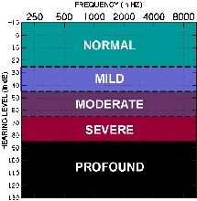
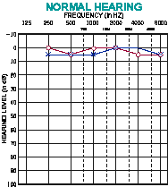
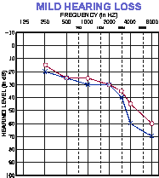
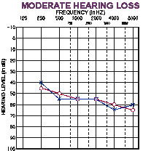
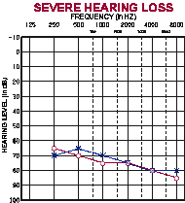
Audiogram Interpretation
It will help us to know the degree of hearing impairment in each ear.
Deafness: Hearing loss of any degree from a slight loss to a total inability to hear a sound.
If hearing thresholds is better than a hearing level of 25 dB , HL are considered normal (Nl).
If the threshold (the minimum sound a patient can hear) is plotted on the top of the graph:
from -10 dB to 25 dB (the green colored band), it means that he has no Hearing Loss (HL) for that tone.
Increased hearing threshold = decreased sensitivity = decrease in conduction

Slide 27
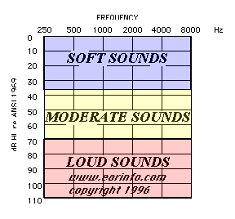
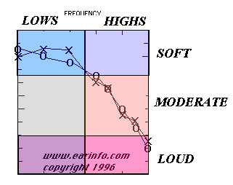
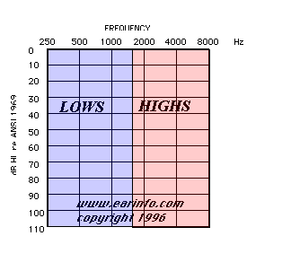
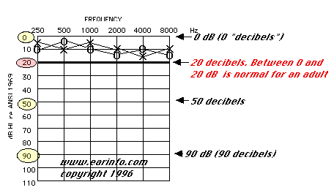
Extra Images
1
3
2
4

Slide 28
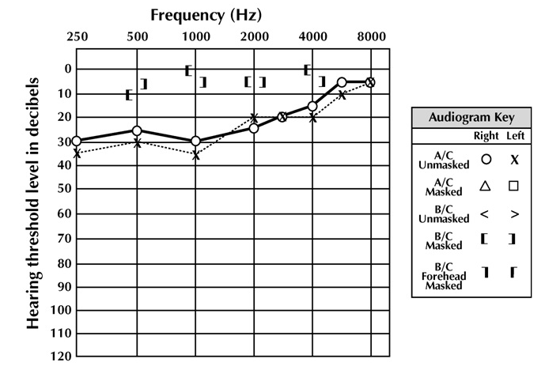
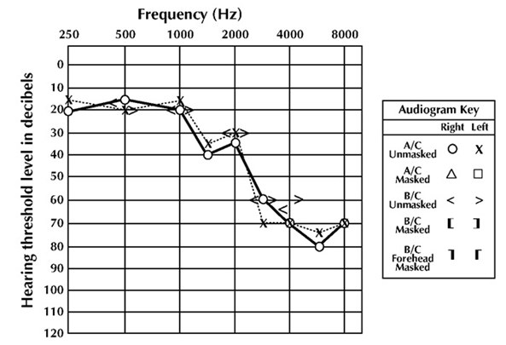
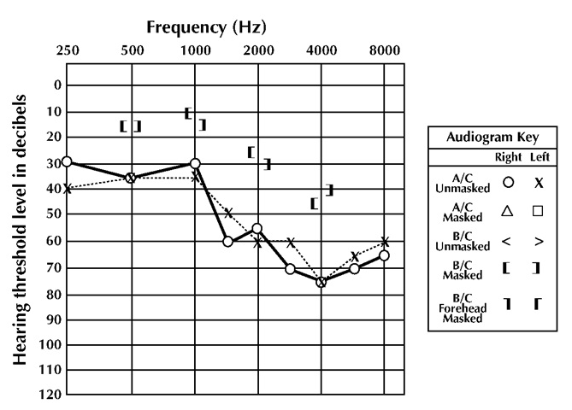
Types of Impairment
Remember :
hearing threshold = sensitivity = in conduction
Conductive hearing loss | Sensorineural hearing loss | Mixed hearing loss
AC: Decrease in hearing sensitivity. BC: Nl sensitivity. Or if Air-bone gap ≥10dB ( in the graph ) | AC and BC thresholds are both decreased in sensivity & are approximately the same (±10dB) at all frequencies. | Both AC thresholds and BC thresholds are reduced in sensitivity, but BC yields better results than AC.
Causes: Obstruction or blockage of the outer or middle ear. E.g: Otitis media Congenital atresia Cerumen Perforation of tympanic membrane Otosclerosis | Causes: Damage to cochlea, auditory nerve, auditory cortex. E.g: | The patient’s HL is partially conductive, partially sensorineural. Pure-tone air-conduction thresholds are poorer than bone-conduction thresholds by more than 10 dB, and bone-conduction thresholds are less than 25 dB.
Congenital | Acquired
Heredity Complication of maternal infection Birth trauma | Noise: Low frequency sounds Aging: For high frequency sounds (sloping audiogram): presbyacousis Ototoxic drugs: For all frequencies Inflammatory disease: measles, mumps.
Explanation: In the graph, BC within normal range, but AC is not .
Explanation: In the graph, BC & AC are not within the normal range.
Explanation: In the graph, BC & AC are not within the normal range. BC is better.

Slide 29
  Cont.
Remember :
hearing threshold = sensitivity = in conduction
Summary:
Examine Yourself !!
What is the diagnosis ? And why ?
Conductive HL | BC (Nl) | AC ↓
Sensorineural HL | BC ↓ | AC ↓ but no AB gap
Mixed HL | BC↓ | AC↓ but BC > AC
The answer :
Conductive hearing loss.
Because BC is normal while AC is decreased.
Remember : NI = Normal

Slide 30
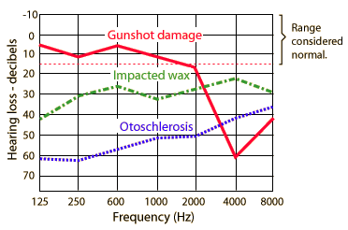
Degrees of hearing loss
Just read it ☺
Common auditory disorders
Presbyacusis:
A progressive, bilateral symmetrical, age-related sensorineural hearing loss. The hearing loss is marked at higher frequencies.
Otitis media:
Inflammation of the middle ear, usually caused by bacteria that causes fluid build up behind the ear drum.
Noise-induced hearing loss:
due to excessive exposure to loud sounds, it can result from a one-time exposure to a very loud sound. It causes conductive deafness when only ear drum is ruptured; it may be sensorineural if the cochlea is damaged. May lead to mixed hearing loss if both are damaged.
Otosclerosis:
The condition is caused by stapedial (3rd ossicle) fixation on the oval window, stiffening the middle ear system. Causes conductive deafness.
Ménière disease:
Inner ear disorder that affects balance and hearing due to increased endolymph pressure.
Normal hearing: 0-25 dB
Mild hearing loss: 26-40 dB
Moderate hearing loss: 41-55 dB
Moderate-severe hearing loss: 56-70 dB
Severe hearing loss: 71-90 dB
Profound hearing loss: >90 dB

Slide 31
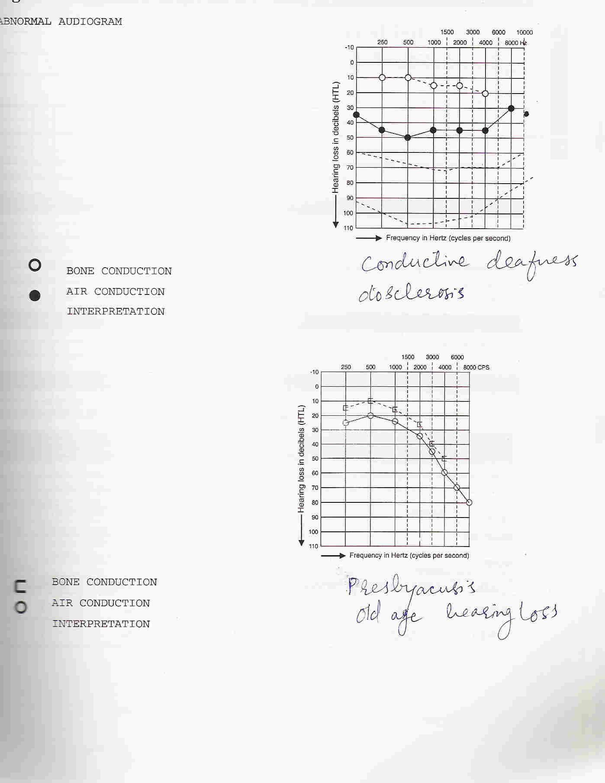
Cont.
Conductive Deafness caused by otosclerosis:
Sensorineural Deafness at higher frequencies (Presbyacusis):
For the graph:
Air conduction = •
Bone conduction = ◦

Slide 32
Tests
Tests | Weber Test | Rinne Test
Function | Distinguishes between conductive and sensorineural hearing. Checks for lateralization in unilateral hearing loss. | Compares air and bone conduction hearing for the same ear.
Procedure | Strike a 512 Hz tuning fork softly Place the vibrating fork on the middle of the client's head Ask client if the sound is heard better in one ear or the same in both ears | Strike a 512 Hz tuning fork softly. Place the vibrating tuning fork on the base of the mastoid bone. Ask client to tell you when the sound is no longer heard. Note the time interval and immediately move the tuning fork to the auditory meatus. Ask the client to tell you when the sound is no longer heard.
Results | If hearing is normal, the sound is heard symmetrical in both ear with no lateralization. Sound localizes toward the poor ear with a conductive loss Sound localizes toward the good ear with a sensorineural hearing loss. | Normal hearing: clients will note air conduction twice as long as bone conduction (AC > BC) ”positive Rinne test“ Conductive hearing loss: bone conduction sound is heard longer than or equally as long as air conduction (BC > AC) "negative test“ Sensorineural hearing loss: air conduction is heard longer than bone conduction in affected ear, but less than 2:1 ratio (AC > BC) ”positive Rinne test“ (just like the normal result)
Remember :
Normally , Air Conduction is better than Bone Conduction.
توضيح : في حالة ال sensorineural loss راح نسمع الإهتزازات من العظم , لما يوقف راح نسمعها من الهواء بس راح توقف بسرعة ...وهذا اللي يفرق بينها و بين الناس الطبيعيين.

Slide 33
3. Visual experiments
Visual Acuity for near and far objects.
Astigmatism.
Accommodation.
Color vision and color blindness.
Blind Spot.

Slide 34
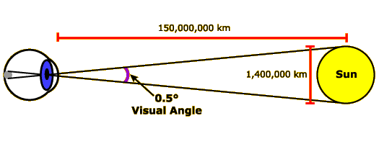
Visual acuity
It is the power to discriminate details or the shortest distance by which 2 lines can be separated and still perceived as 2 lines.
Depends on:
The refractive ability of the refractive media.
The density of the photoreceptors.
The visual angle.
Visual angle:
  It is the angle subtended at the nodal point by the light rays converging on the nodal point of the eye.
  The average person can resolve 2 points & recognise their separation when the angle they subtend is 1 minute (1/60 of a degree). The space on the retina is 4.5 μm or there is at least one unstimulated receptor between the 2 lines.

Slide 35
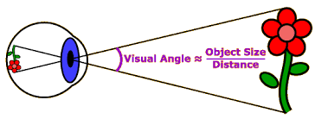
Visual Acuity
It is the power to discriminate details or the shortest distance by which 2 lines can be separated and still perceived as 2 lines.
Depends on:
  The refractive ability of the refractive media (Cornea&lens) .
  The density of the photoreceptors.
  The visual angle.
The fovea centralis is the place of greatest visual acuity during the daylight. While the mid-peripheral portion of the retina is the place of greatest visual acuity in the dim light.
Visual angle:
  It is the angle subtended at the nodal point by the light rays converging on the nodal point of the eye.
  The average person can resolve 2 points & recognize their separation when the angle they subtend is 1 minute (1/60 degree). The space on the retina is 4.5μm or there is at least one unstimulated receptor between the 2 lines.
Extra Explanation:
    Refractive ability refers to the ability of the eyes to bend parallel rays of light coming from infinity to focus on the retina.
    Visual angle is the angle formed by 2 imaginary lines; formed by the light rays and they are projecting to the eye.
    It is calculated by the unit minute of arc which is equal to 1/60 degree and that is the space which a person can distinguish between 2 point .

Slide 36
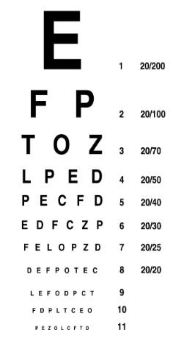
Test For Visual Acuity (VA)
The units in exam may be in Meter or Feet … so you can apply the same concept on both units
VA = Visual Acuity
Test For Visual Acuity
Visual acuity test: is indicative of the function of the fovea which is used for central vision.
Types | Procedure |  | Recording results | Example
Distant Vision Using Snellen Chart Test | Snellen chart is placed at a distance d= 20 feet (6m). Cover one eye. Ask her/him to read aloud the letters of each row (begin at top). Find out the smallest letter she/he could see. Note the distance D of this line. Repeat the test covering the other eye. Perform the test without glasses. | Snellen chart: Snellen Alphabet Chart Snellen E chart | Visual acuity = d / D d = distance between patient & chart. D = distance from where a normal subject can read. Snellen chart detects myopia Myopia is a refractive error in which close objects are seen clearly, but the far objects appear blurred, that is why this condition is also called nearsightedness. | A VA of 6/9 m : the patient can recognize at 6 meter a symbol that can be recognized by a person with normal VA at 9 meter. VA of 20/20 in feet or 6/6 in meter is a reference standard. The larger the bottom number (denominator) the poorer the vision. (Eg: 6/24). The less the bottom number the better the acuity. (Eg: 6/4). Extra Explanation: first patient can read line 3 maximally at 2 m distance. Second patient reads the line 3 maximally at 3 m distance so, he has better acuity.
Myopia Explanation : light entering the eye from a distant object isn’t focused exactly on the retina but focuses in front of it.

Slide 37
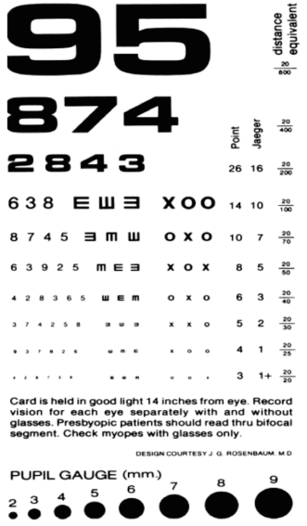
Cont.
Test For Visual Acuity
Types | Procedure |  | Recording results
Near Vision Using Jaeger's Card Test | Ask the subject to hold the jaeger card at a distance of 30 cm. Select the test eye & cover the other. Ask him to read the smallest line or recognize the smallest picture. Repeat the test with the other eye. Jaeger chart detects hypermetropia / hyeropia A hyperopia is a refractive error in which close objects appear blurred, but the far objects are seen clearly , this condition is also called farsightedness. | Jaeger's Card: | The Jaeger scale ranges from J1+ to J16 , J1+ being the smallest type. J1+ is considered the equivalent of 20/20 feet, (6/6 meter) distance in visual acuity. Person with normal near vision should be able to read up to this line ( J1+ ) Suppose that the subject can read the picture up to the line marked J3, it means that he can read at 30 cm distance from his eye which can be read or recognized by a normal subject at 60 cm.
Hyperopia Explanation: The image from a near object is focused behind the retina.

Slide 38
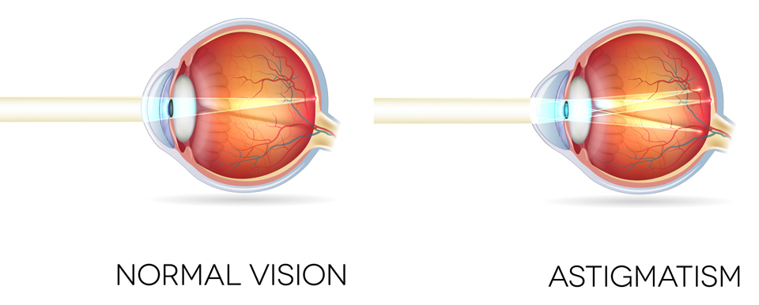
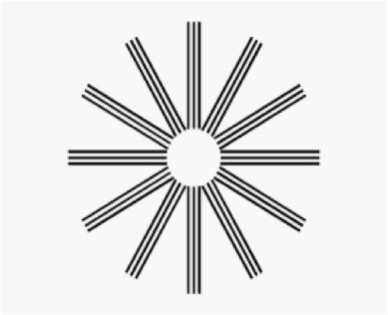
Test For Astigmatism
Astigmatism: irregular curvature of one or more surfaces of the cornea or lens; so there is no distinct point of focus inside the eye, but rather smeared or spread out focus.
Objects at any distance appear blurry & distorted.
It may happen with Myopia or Hypermetropia.
Procedure:
Subject stands at 6m (20 ft) from an astigmatism chart.
Covers one eye.
This chart consists of a number of dark lines radiating from a central point.
If astigmatism is present, some of the spokes appear sharp & dark, others appear blurred & lighter.
Repeat the same procedure for the other eye.

Slide 39
Test for Accommodation
Accommodation: Is the process by which the refractive power of the lens is increased by increasing the curvature of the anterior surface of the lens for viewing near objects.
Types | Notes
Determination of near point | Definition: The nearest point to the eye at which an object can be brought into clear focus by accommodation. The N.P (near point) of vision increases with age due to loss of elasticity of lens & weakening of ciliary muscles which control lens focusing (presbyopia). At age 10, NP = 8 cm At age 70, NP = 100 cm
 | Procedure
 | Place one hand over one eye. Focus on a pin held at arm length. Gradually bring the pin closer focusing continually until the pin begins to blur. Measure the distance from the eye to the pen at the point of blurring; this is the near point of vision. Repeat with the other eye.
Sanson-purkinje images | The subject looks at a distant object in a dark room. Place a candle light in front of and a little to the side of the subject's eye. Look into the subject's eye from the side opposite to the candle. Before accommodation, when the eye is in relaxed state observe how many clear images of the candle light are reflected in his pupillary area. Take note of the relative size and position of the images. Now ask him to focus on an object nearby. Observe the changes that are produced in the size and position and brightness of the three images.
As the age increase…NP will be increased
Explained on the next slide

Slide 40
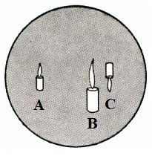
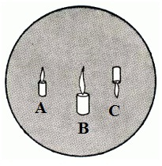
Cont.
Images | Before Accommodation | After Accommodation
First | Bright, small and upright from cornea. | image does not change (corneal curvature unchanged).
Second | Dim, large and upright from anterior surface of lens. | image becomes smaller, closer to the upright image (↑curvature of anterior surface of lens).
Third | Small and inverted from posterior surface of lens. | changes very little (the curvature of the posterior lens surface changes very little).
Conclusion:
The increased convexity occurs mainly in the anterior surface of the lens.
Visual Disorders:
Myopia: corrected by concave lenses.
Hypermetropia: corrected by convex lenses.
Astigmatism: corrected by cylindrical lenses.
Presbyopia: corrected by bifocal lenses.
Before Accommodation
A = First image from Cornea.
B = Second image from anterior surface of lens.
C = Third image from posterior surface of lens.
After Accommodation

Slide 41
Test for color vision
Q) Mention how color blindness is diagnosed ?
Answer: By using Ishihara’s colored plates.
Ishihara's colored plates are made up of colored numbers or spots on a background of identical shaped colored spots.
The figures or numbers are intentionally made up of colors that are likely to look the same as the background to an individual who is color blind.
Procedure:
  Select the eye to be tested; close the other eye.
  Chart held at 30 inch in a good reading light.
  Ask the subject to read the number in several plates or to trace the zigzag pathway with his index finger.
  Note if he has difficulty or fails to read the number or trace the path in the plates.
Remember : Color vision is the function of the cones. There are three types of cones in our eyes; red, green and blue. Relative lack or deficiency of one, two or all of them will lead to a defect in color vision. The gene that causes defect in color vision is carried on the X chromosome, making the handicap more common among men (who have just one X chromosome) than among women (who have two, so must inherit the gene from both parents to have the defect).

Slide 42
Type of color blindness
Just read it ☺
Type of color blindness | Definition & pathology
Protanopia (Red blindness) | A form of colorblindness characterized by defective perception of red and confusion of red with green or bluish green due to the complete absence of red cones.
Deuteranopia (green blindness) | A form of colorblindness characterized by insensitivity to green, moderately affecting red–green hue discrimination due to the complete absence of green cones.
Tritanopia (Blue blindness) | A very rare visual defect characterized by the inability to differentiate between blue and yellow due to the complete absence of blue cones.
Protanomaly | A type of anomalous trichromatic vision with defective perception of red due to less sensitivity of red cones.
Deuteranomaly | A type of anomalous trichromatic vision in which the green cones have decreased sensitivity, mildly affecting red–green hue discrimination.
Tritanomaly | A rare type of anomalous trichromatic vision in which the blue cones have decreased sensitivity, affecting blue–yellow hue discrimination.

Slide 43
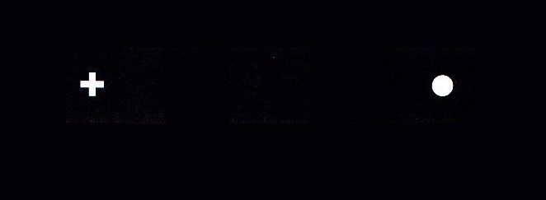
Demonstration of Blind Spot
What is Blind Spot ?
  The place in the visual field where an object cannot be seen keeping one eye closed. This is due to the light rays from that part of the visual field focus on the optic disc of the retina which lacks the light-detecting photoreceptor cells.
  When both eyes are open, normally there will be no Blind Spot, because one eye will cover the other one.
Procedure:
  Hold the card 20 inch from your face.
  Cover the R eye; focus the L eye on the +.
  Slowly bring the card closer until the dot disappears.
  Continue to move the image closer until the dot reappears .
  Cover the L eye; focus on the dot with the R eye.
  Move the image slowly closer to you and the plus should disappear.
Blind Spot Card
آخر محاضرة فيسيولوجي عملي في سنوات العلوم الأساسية ☺
اللهم إني استودعك ما قرأت وما حفظت وما تعلمت فرده عند حاجتي إنك على كل شيء قدير

Slide 44





Thank you!
اعمل لترسم بسمة، اعمل لتمسح دمعة، اعمل و أنت تعلم أن الله لا يضيع أجر من أحسن عملا.
Done by:
Lama AlTamimi
Allulu Alsulayhim
Rana Barasain
Reema Alshayea
Wejdan Alzaid
Laila Mathkour
Hassan Alshammari
Mohammad Nusser
Talal Alenezi
Contact us:
References:
Females’ and Males’ slides.
Doctors’ notes and handouts.

