Slide 1
Cranial Nerve VIII (The Vestibulo-Cochlear Nerve)
Color Code
Important
Doctors Notes
Notes/Extra explanation
Please view our Editing File before studying this lecture to check for any changes.

Slide 2
Objectives
At the end of the lecture, the students should be able to:
List the nuclei related to vestibular and cochlear nerves in the brain stem.
Describe the type and site of each nucleus.
Describe the vestibular pathways and its main connections.
Describe the auditory pathway and its main connections.
Due to the difference of arrangement of the lecture between the girls and boys slides we will stick to the girls slides then summarize the pathway according to the boys slides.

Slide 3
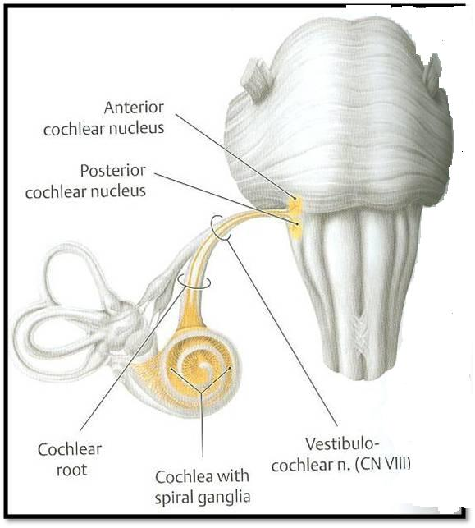
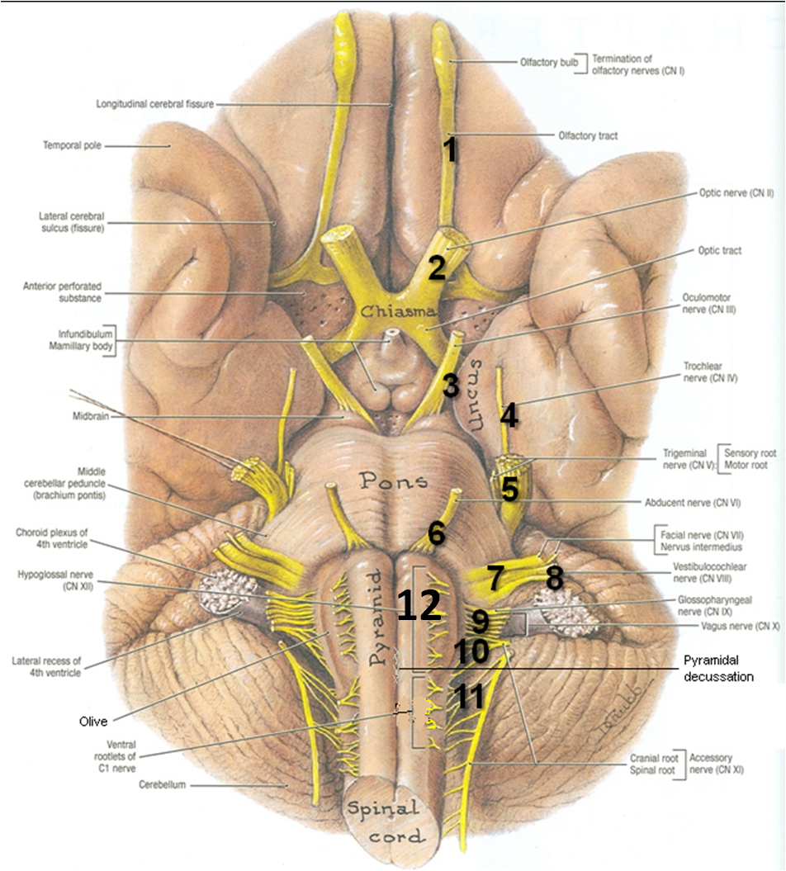
Ponto-medullary
Sulcus (cerebello-pontine angle)
Recall: both cranial nerves 8 and 7 emerge from the ventral surface of the brainstem at the ponto-medullary sulcus (cerebello-pontine angle)
Brain – Ventral Surface

Slide 4
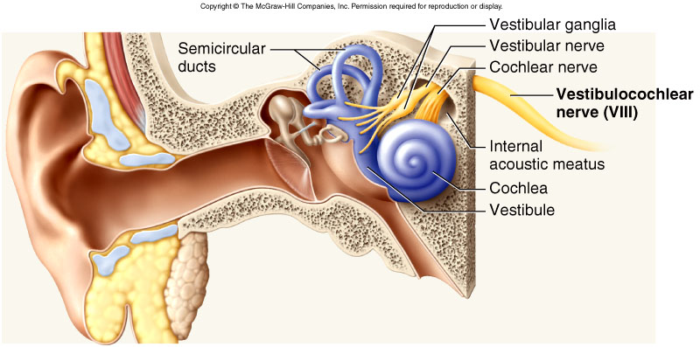
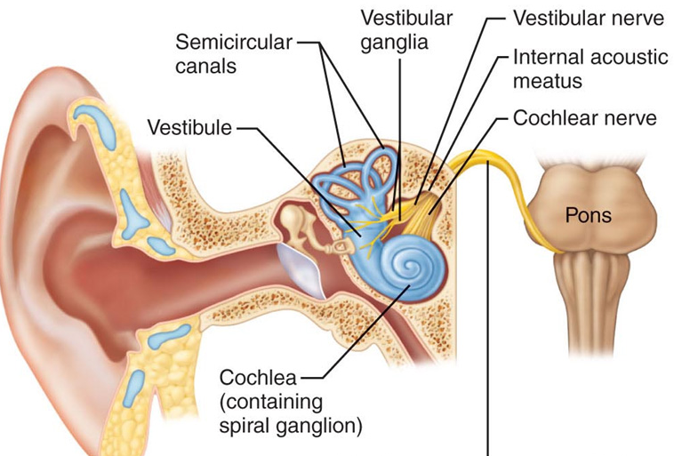
Vestibulo-Cochlear (VIII) 8th Cranial Nerve
Type: Special sensory (SSA)
Conveys impulses from inner ear to nervous system.
Components:
Vestibular part: conveys impulses associated with body posture ,balance and coordination of head & eye movements.
Cochlear part: conveys impulses associated with hearing.
Vestibular & cochlear parts leave the ventral surface* of brain stem through the pontomedullary sulcus ‘at cerebellopontine angle*’ (lateral to facial nerve), run laterally in posterior cranial fossa and enter the internal acoustic meatus along with 7th (facial) nerve.
*see the previous slide

Slide 5
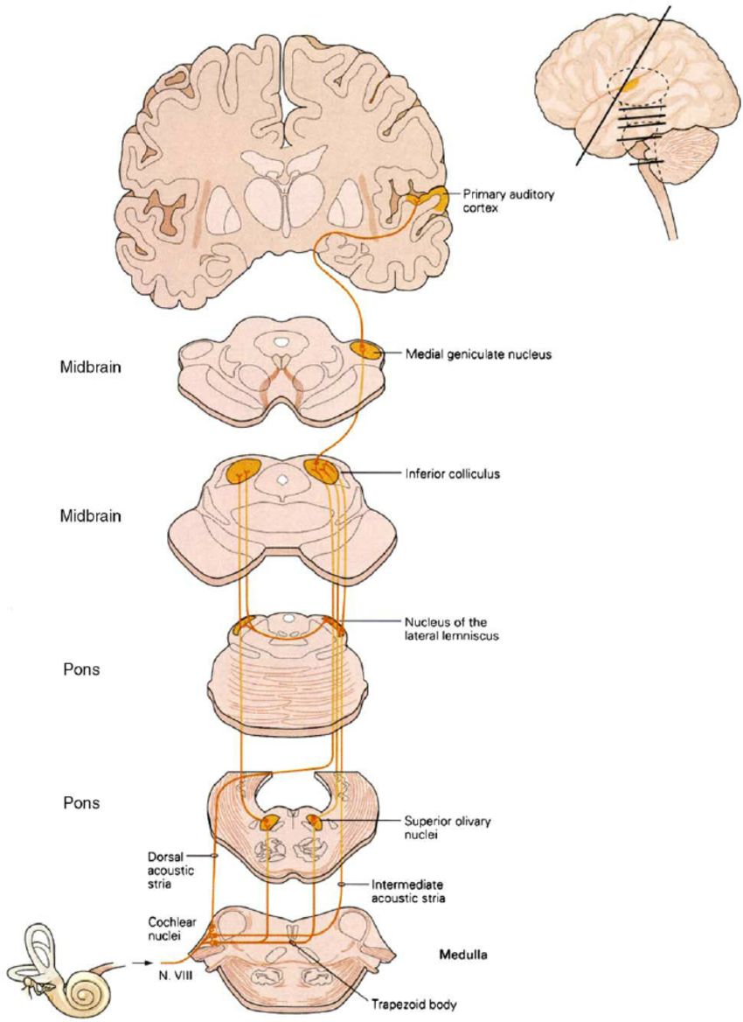
Auditory Pathway
Only on the girls’ slides
04:14
Characteristics:
It is a multisynaptic pathway
There are several locations between medulla and the thalamus where axons may synapse and not all the fibers behave in the same manner.
Representation of cochlea is bilateral at all levels above cochlear nuclei.
Its important to know the characteristics to know what is affected when there is a lesion.
Extra
The auditory pathway involves the cochlear part of the vestibulocochlear nerve

Slide 6
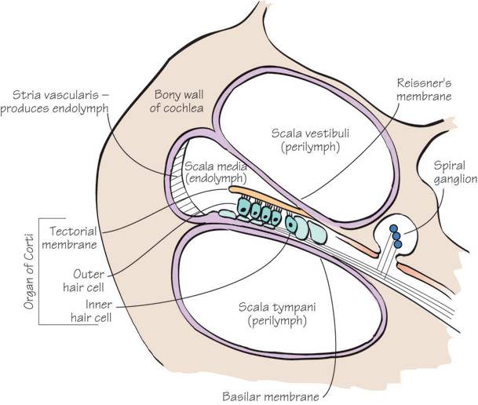
Auditory Pathway
Cochlear (Auditory) Nerve
The Peripheral processes make dendritic contact with hair cells of the organ of Corti within the cochlear duct of the inner ear.
The cell bodies (1st order neurons) are located in the spiral ganglion within the cochlea (organ of Corti in inner ear) axons form cochlear nerve.
ICP
ICP
The central processes (cochlear nerve fibers) terminate in the dorsal and ventral cochlear nuclei (2nd order neurons), which lie close to the inferior cerebellar peduncle (ICP) in open rostral medulla.
Cochlear nuclei belong to special somatic afferent column in brain stem.

Slide 7
Auditory Pathway
From the (dorsal and ventral cochlear nuclei, 2nd order neurons, fibres ascend into the pons, where:
Most fibers cross the midline in trapezoid body(1) and terminate in:
Some fibers run ipsilaterally and terminate in the superior olivary nucleus (2).
4
4
the nucleus of trapezoid body
in the contralateral superior olivary nucleus (2)
3
5
5
3
From the superior olivary nuclei, ascending fibers comprise the lateral lemniscus (3) contaning both crossed (mainly) and direct (few) cochlear fibres,
Some axons within lateral lemniscus terminate in small nucleus of the lateral lemniscus (5)
2
2
which runs through tegmentum of pons and terminate in the inferior colliculus* (4) of the midbrain (3rd order neurones).
1
*Both colliculi are inter-connected by commissural fibers
Notes:
I add: Both colliculi are inter-connected by commissural fibers

Slide 8
Auditory Pathway
7
Auditory radiation
7
6
6
The inferior colliculi project to medial geniculate nuclei (4th order neurones) of thalamus (6)
4
4
The axons originating from the medial geniculate nucleus (auditory radiation) pass through sublenticular part of the internal capsule to:
3
5
5
3
the primary auditory cortex (Brodmann’s areas 41, 42) located in the dorsal surface of the superior temporal gyrus (Heschl’s gyrus) (7)
2
2
← heschl كأنك تقول (auditory)هش
1
Notes:
The highlighted text is found only in Female slides.

Slide 9
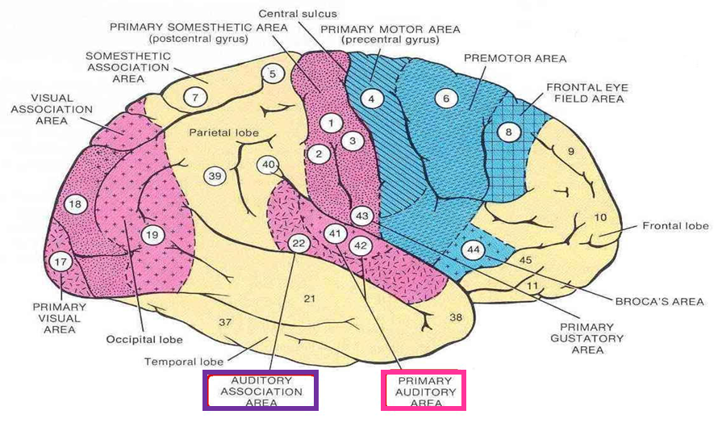
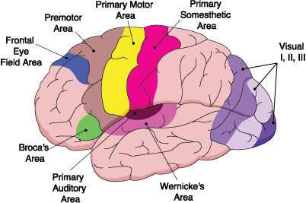
Auditory Pathway
Auditory radiation ends in primary auditory cortex (superior temporal gyrus) which is connected to auditory association cortex.
The region surrounding the primary auditory cortex is known as the auditory association cortex or Wernick’s area (Brodmann’s areas 22)
Wernick’s area is related to recognition and processing of language by the brain.
N.B.: Representation of cochlea is bilateral at all levels above cochlear nuclei.
Wernick → ear
Extra
Notes:
-The text highlighted with yellow is found only in Female slides.
- The text highlighted with orange is repeated in slide No.5 .

Slide 10
Auditory Pathway
Other Functions of some nuclei :
Superior olivary nucleus & the nucleus of the lateral lemniscus sends olivocochlear fibers to end in organ of Corti through the vestibulocochlear nerve. These fibers are inhibitory in function and serve to modulate transmission of sound to the cochlear nerve.
Superior olivary nucleus & the nucleus of the lateral lemniscus establish reflex connections with motor neurons of trigeminal and facial motor nuclei mediating contraction of tensor tympani and stapedius muscles as They reduce the amount of sound that gets into the inner ear in response to loud noise
Inferior colliculi establish reflex connections with motor neurons in the cervical spinal segments (tectospinal tract) for the movement of head and neck in response to auditory stimulation.
Notes:
1- النص المضلل بالأصفر: في سلايد الدكتور ما فرق بينهم, أتمنى ترجعون للمرجع ولو كان خطأ على الدكتور نصحح له.
2- النص المضلل بالرتقالي: غير موجود في سلايد الدكتور

Slide 11
Auditory Pathway (summary arranged according to boys slides)
First order neurons:
Cells of spiral ganglion in the cochlea.
Axons form cochlear nerve.
Second order neurons:
Cells of dorsal and ventral cochlear nuclei in pons.
Third order neurons:
Cells of inferior colliculus (midbrain).
Both colliculi are inter-connected by commissural fibers
On ascending most axons decussate in the trapezoid body and form lateral lemniscus.
Cochlear nerve makes dendritic contact with hair cells of organ of corti in cochlear duct.
Fourth order neurons:
Cells of medial geniculate nucleus (thalamus).
Some fibers end in superior olivary nucleus & nucleus of lateral lemniscus which modulate transmission of auditory information to cochlear nerve by:
Both cochlear & vestibular nerves meet and emerge through internal auditory meatus to cranial cavity.
Axons form auditory radiation that pass through retrolenticular part of internal capsule
1. Sending inhibitory fibers through vestibulocochlear nerve ending in organ of corti
2. Establishing connection with motor neurons suppling tensor tympani & stapedius muscle
Auditory radiation ends in primary auditory cortex (superior temporal gyrus) which is connected to auditory association center.
Both cochlear & vestibular nerves enter pons through pontocerebellar angle. (lateral to facial nerve)

Slide 12
Auditory Association Cortex
Auditory Association Cortex
Only on the boys’ slides
Primary Auditory Cortex
Primary Auditory Cortex
Auditory Radiation
Retrolenticular Part of IC
Medial Geniculate Nucleus
Medial Geniculate Nucleus
Inferior Colliculus
Inferior Colliculus
Commissural fibers
Nucleus of
Lateral
Leminiscus
Lateral Leminiscus
Superior Olivary
Nucleus
Trapezoid Body
Dorsal & Ventral Cochlear Nuclei
Dorsal & Ventral Cochlear Nuclei
Cochlear nerve
Cochlear nerve
Cells of Spiral Ganglion (in cochlea)
Cells of Spiral Ganglion
In the PowerPoint presentation this slide is animated.

Slide 13
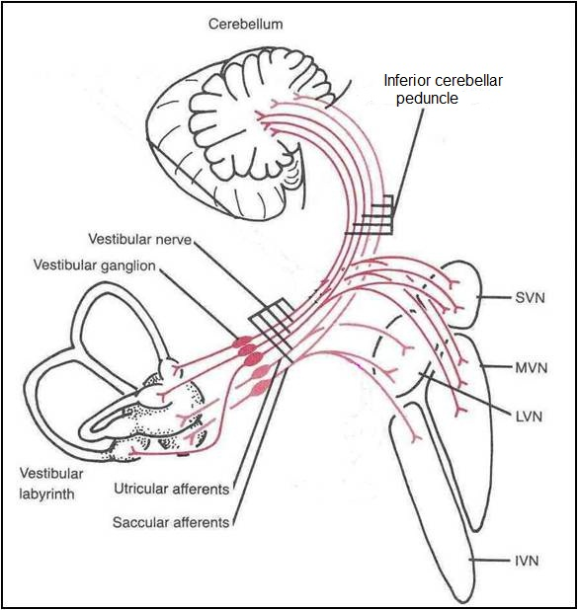
Vestibular Pathway
Note: pay attention to form (يكون) and from (من عند)
1st order neurons
The cell bodies are located in the vestibular ganglion within the internal auditory meatus.
2
The Peripheral processes/axons (vestibular nerve fibers) make dendritic contact with hair cells in vestibule & semicircular canals of the membranous labyrinth (inner ear).
The central processes form the vestibular nerve and go to :
2nd order neurons
Mostly end up in the lateral, medial, inferior and superior vestibular nuclei of the rostral medulla, (located beneath the lateral part of the floor of 4th ventricle) and pons
Some fibers go to the cerebellum through the inferior cerebellar peduncle
1
Vestibular nuclei belong to special somatic afferent column in brain stem.

Slide 14
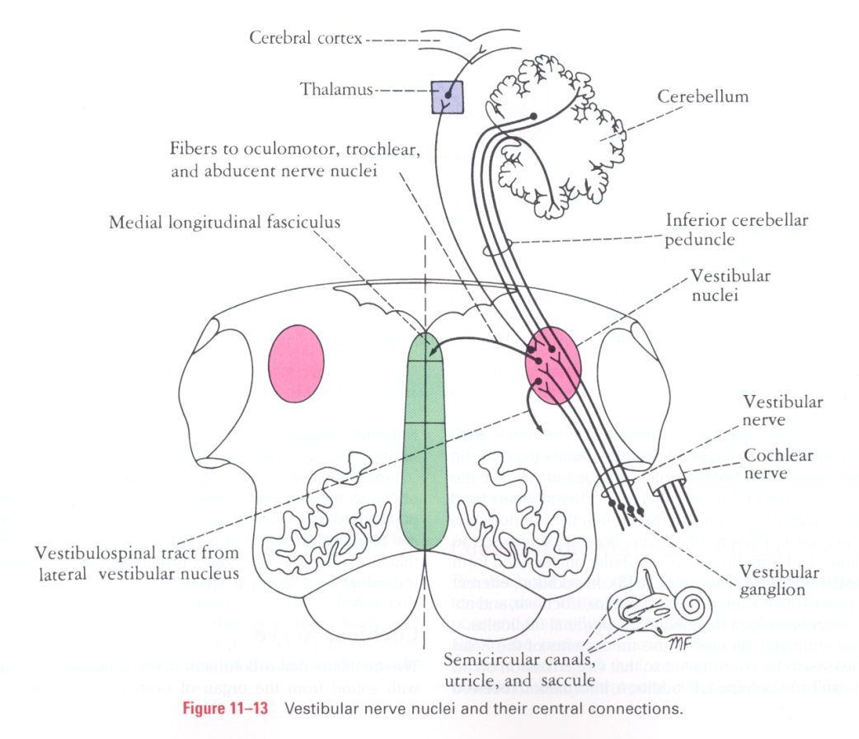
Vestibular Pathway
Axons(Efferents) from the vestibular nuclei project to number of other regions:
1 | To ipsilateral flocculonodular lobe of cerebellum (vestibulo-cerebellar tract) | through inferior cerebellar peduncle | for maintenance of equilibrium
2 | Bilaterally (cross midline and ascend) to ventral posterior nucleus of thalamus | which in turn project to the vestibular area in cerebral cortex | for conscious awareness of vestibular stimulation.
3 | Bilaterally to motor nuclei of cranial nerves (vestibulo-ocular tract) | through medial longitudinal fasciculus | for co-ordination of head & eye movements and the
4 | To motor neurons (anterior horn cells) of the spinal cord: directly as lateral (ipsilateral), and join MLF (medial longitudinal fasciculus) and descend as medial vestibulospinal (bilateral) tracts through for control the posture. |  | for control of posture
2
1
3
4

Slide 15
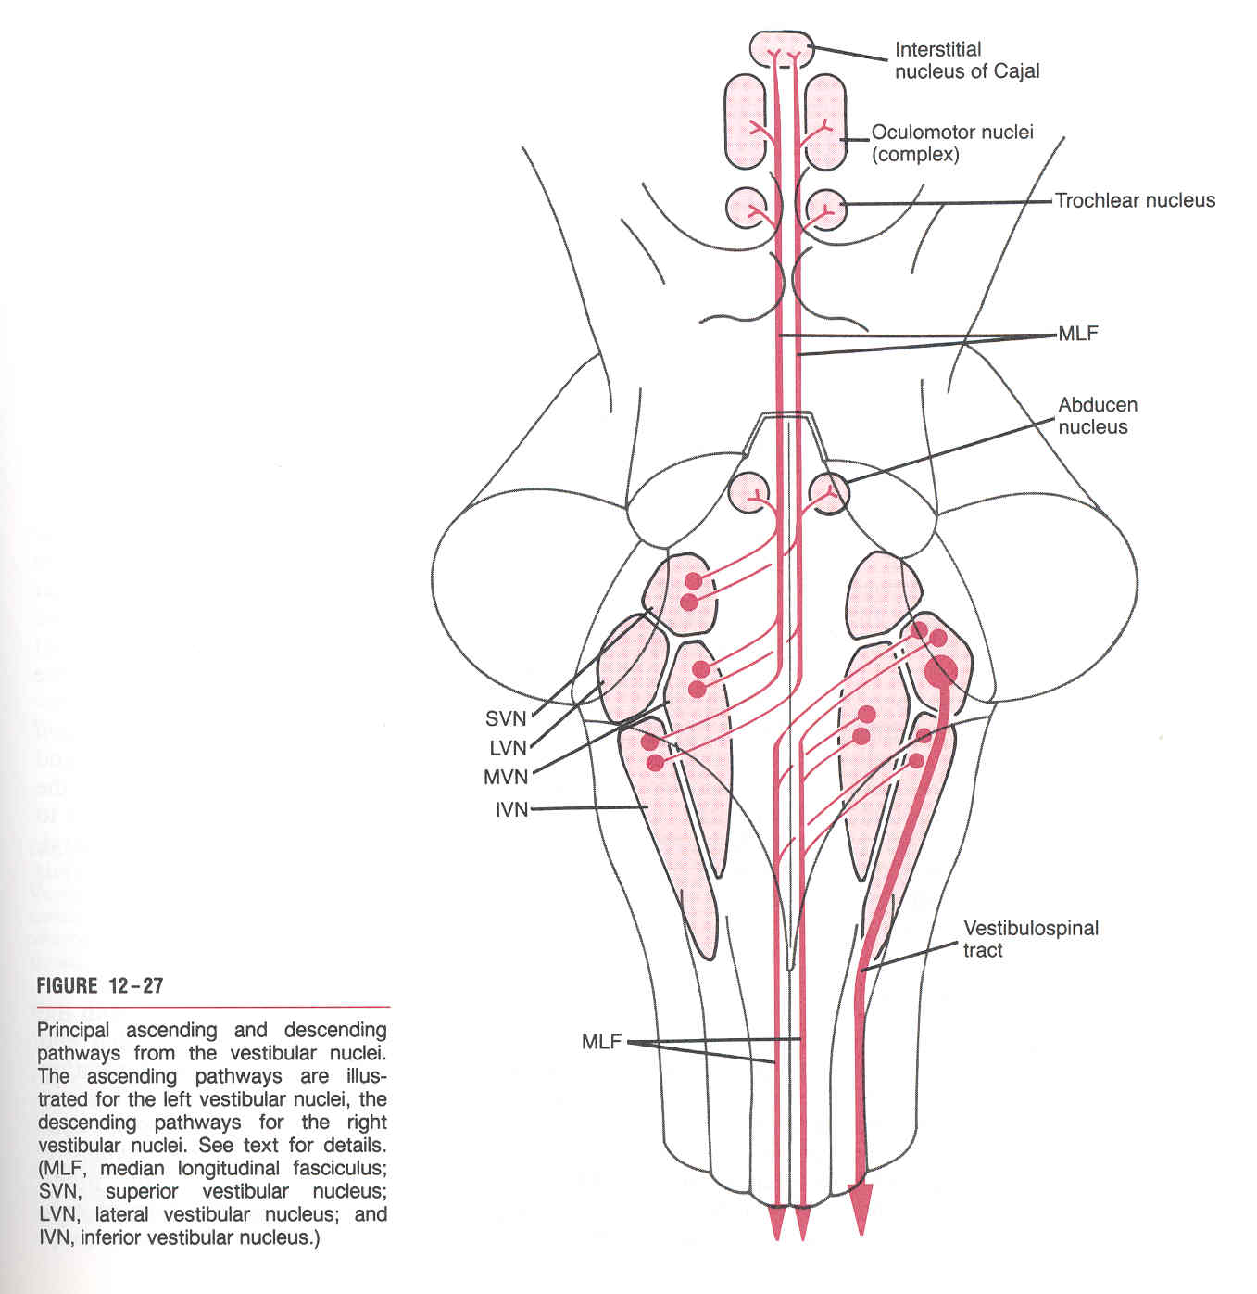
Vestibular Pathway
Medial Longitudinal Fasciculus
Also called medial longitudinal bundle
Extends through out the brain stem and formed of both descending & ascending fibers
Projects bilaterally
Has two components:
The ascending component (vestibulo-ocular) (number 3 in previous slide) | The descending component (number 4B in previous slide)
establishes connections with the nuclei of the Occulomotor, Trochlear & Abducent nerves (motor nuclei for extraoccular muscles) | extends into anterior horn cells of the spinal cord as the medial vestibulospinal tract
for coordination of head & eye movements | for control the body posture and balance

Slide 16
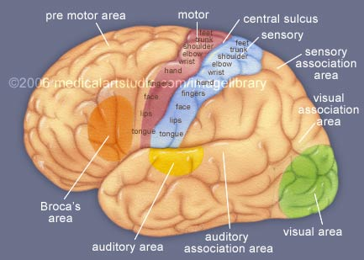
Vestibular Pathway
Vestibulospinal Tracts
Vestibulospinal fibers influence the activity of spinal motor neurons concerned with the control of body posture and balance.
Two tracts: lateral & medial
Lateral arises from lateral vestibular (Deiter’s) nucleus, descends ipsilaterally (efferent number 4A mentioned previously)
Medial is the descending part of the medial longitudinal fasciculus, projects bilaterally. (efferent number 4A mentioned previously)
Only on the girls’ slides
Vestibular Cortex/Area
Located in the lower part of postcentral gyrus (head area).
Responsible for conscious awareness of vestibular sensation.

Slide 17
Vestibular Pathway (summary arranged according to boys slides)
First order neurons:
Cells of vestibular ganglion located in internal auditory meatus.
Second order neurons:
Cells of superior, lateral, medial and inferior vestibular nuclei in medulla and pons.
Axons of vestibular nuclei may:
Axons make dendritic contacts with hair cells in vestibule & semicircular canals.
1. Descend as lateral vestibulospinal tract to anterior horn cells of spinal cord
Both cochlear & vestibular nerves meet and emerge through internal auditory meatus to cranial cavity.
2. Join medial longitudinal fasciculus & descend as medial vestibulospinal tract to anterior horn cells of spinal cord.
3. Pass through inferior cerebellar peduncle to flocculonodular lobe of cerebellum
Both cochlear & vestibular nerves enter pons through pontocerebellar angle. (lateral to facial nerve)
4. Cross midline & descend to ventral posterior nucleus of thalamus then to vestibular area in cerebral cortex.

Slide 18
Vestibular Pathway
Only on the boys’ slides
Vestibular Area
A + B = Medial Longitudinal fasciculus
Median Plane
NVP
(Thalamus)
Occulomotor Nucleus
Trochlear Nucleus
Abducent Nucleus
A
Flocculonodular
Lobe
(Cerebellum)
ICP
S
M
Vestibular Nuclei
L
I
Medial
Vestibulospinal
tract
Vestibular nerve
Late ral
Vestibulospinal
tract
Vestibular
Ganglion
Hair Cells
in Vestibule
& Semicircular
Canals
B
Cochlear nerve
AHCs
AHCs
In the PowerPoint presentation this slide is animated.

Slide 19
Clinical Notes
Only on the girls’ slides
Lesion of vestibulocochlear nerve produces:
deafness (disturbance of cochlear nerve functions),
tinnitus, vertigo, dizziness, nausea, nystagmus, loss of balance and ataxia (disturbance of vestibular nerve functions).
Acoustic neuroma: a benign tumor of 8th nerve leads to compression of the nerve leading to attacks of dizziness, and profound deafness and ataxia
Rostral to the cochlear nuclei the representation of cochlea is essentially bilateral at all levels. (important!)
So, Lesions anywhere along the pathway usually have no obvious effect on hearing, producing weakness of hearing in both ears but mostly in the opposite ear.
Complete Deafness of the affected ear is essentially only caused by damage to the middle ear, cochlea, or auditory nerve.

Slide 20
Summary
Ganglia related to vestibulocochlear nerve are located in the inner ear.
Vestibular & cochlear nerves pass through internal auditory meatus to cranial cavity, then enter pons at pontocerebellar angle, lateral to facial nerve.
Cochlear & vestibular nuclei are of the special somatic afferent type (receiving special afferent sensation, hearing and equilibrium), and are located in pons & medulla.
Inferior colliculi, medial geniculate nucleus and finally auditory cortex are stations in cochlear pathway.
Hearing is bilaterally represented.
Vestibular nuclei are connected to: spinal cord (directly or through medial longitudinal fasciculus), flocculonodular lobe of cerebellum and to vestibular area of cerebral cortex.

Slide 21
MCQs
1. The third order neurons of the auditory pathway are found in:
A- midbrain
B- thalamus
C- pons
D- cerebral cortex
Answer: A
2. Regarding the vestibular pathway:
A- the vestibular ganglion is located in the middle ear
B- the vestibular nuclei are located in the midbrain
C- the vestibular nuclei are connected to the cerebellum
D- the vestibulospinal tracts are located in the lateral white column of the spinal cord
Answer: C
3. The vestibular nuclei are connected to the oculomotor neuron though:
A- lateral lemniscus
B- lateral vestibulospinal tract
C- medial longitudinal fasciculus
D- vestibular nerve
Answer: C
4. Vestibular nuclei belong to ___ column in brain stem :
A- special somatic afferent
B- special somatic efferent
C- special visceral afferent
D- special visceral efferent
Answer: A
5. The vestibular cortex is located in:
A- precentral gyrus
B- postcentral gyrus
C- post-temporal gyrus
D- pretemporal gyrus
Answer: B
6. The primary auditory cortex is located in:
A- superior temporal gyrus
B- inferior temporal gyrus
C- superior frontal gyrus
D- inferior frontal gyrus
Answer: A
7. The fourth order neurons of the auditory pathway are:
A- cells of spiral ganglion in the cochlea
B- cells of dorsal and ventral cochlear nuclei
C- cells of inferior colliculus
D- medial geniculate nuclei
Answer: D
8. Both cochlear & vestibular nerves enter pons through:
A- inferior cerebral peduncle
B- pontocerebellar angle
C- anterolateral olivary sulcus
D- basilar sulcus
Answer: B

Slide 22
Leaders:
Nawaf AlKhudairy
Jawaher Abanumy
Members:
Talal alhuqayl
Abdullah alhashim
Feedback
anatomyteam436@gmail.com
References:
1- Girls’ & Boys’ Slides
2- Greys Anatomy for Students
3- TeachMeAnatomy.com
@anatomy436
Anatomy Team

