Slide 1
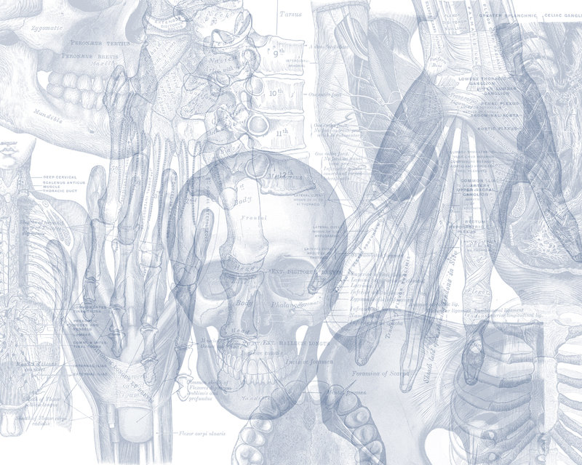
Cranial Nerves II, III, IV & VI (Optic, Oculomotor, Trochlear, & Abducens)
Color Code
Important
Doctors Notes
Notes/Extra explanation
Please view our Editing File before studying this lecture to check for any changes.

Slide 2
Objectives
By the end of the lecture, you should be able to:
List the cranial nuclei related to occulomotor, trochlear, and abducent nerves in the brain stem.
Describe the type and site of each nucleus.
Describe the site of emergence and course of these 3 nerves.
Describe the important relations of occulomotor, trochlear, and abducent nerves in the orbit (only on the girls slides).
List the orbital muscles supplied by each of these 3 nerves.
Describe the effect of lesion of each of these 3 nerves.
Describe the optic nerve and visual pathway.

Slide 3
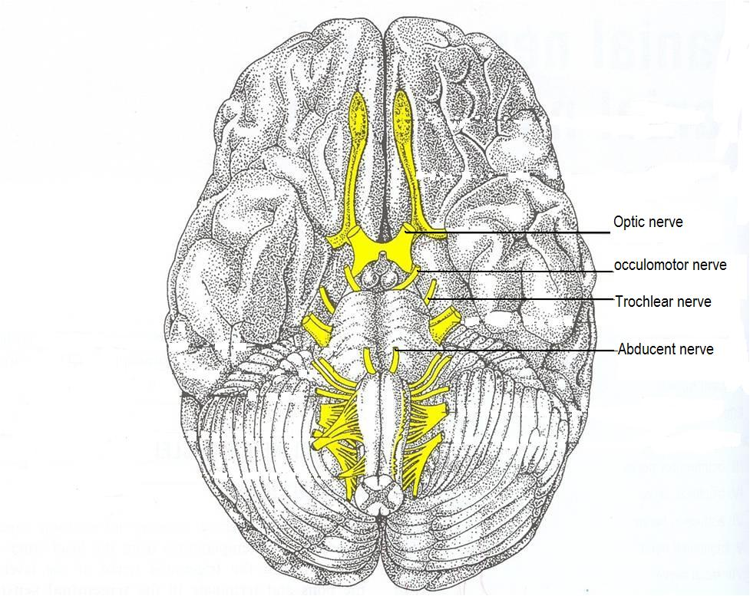
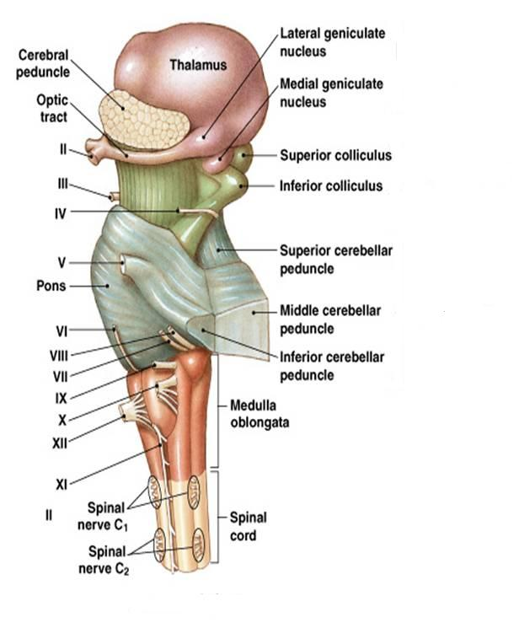
Recall the how these nerves exit from the brain stem:
Optic (does not exit from brain stem)
Occulomotor: ventral midbrain (medial aspect of crus cerebri)
Trochlear: dorsal midbrain (caudal to inferior colliculus)
Abducent: ventral Pons (junction b/w pons & pyramid)
Brain (Ventral view) Brain stem (Lateral view)

Slide 4
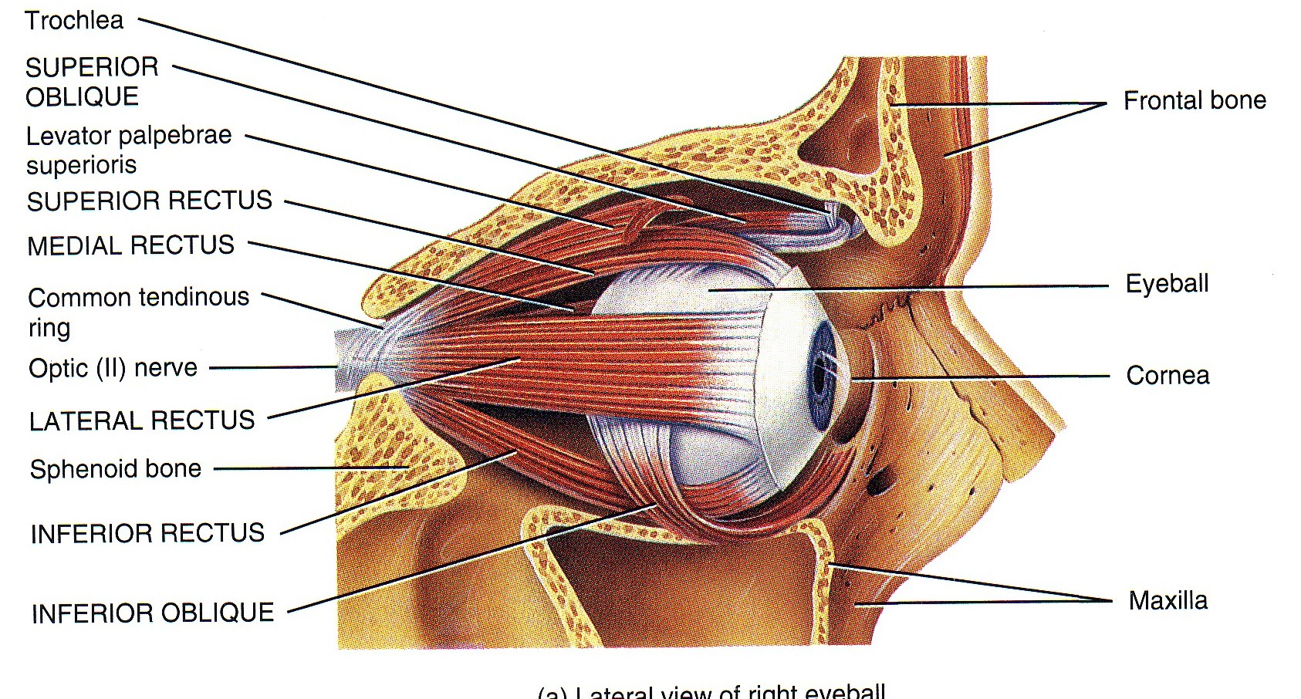
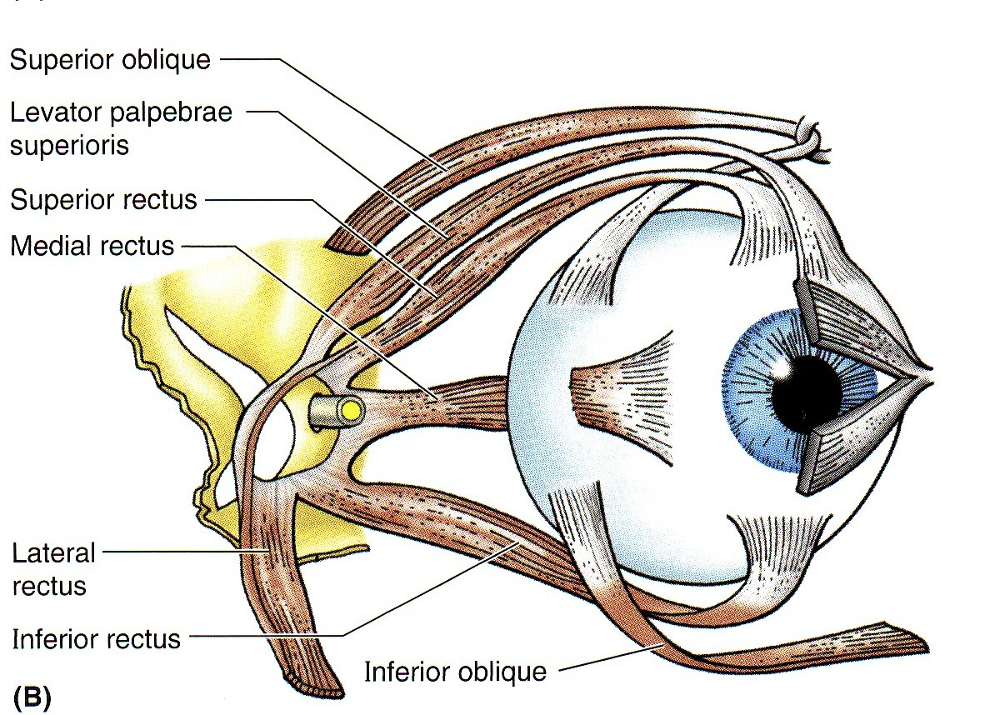
Extra-Ocular Muscles
7 muscles:
1. Levator palpebrae superioris.
(4) Recti muscles:
Superior rectus,
Inferior rectus,
Medial rectus,
Lateral rectus,
(2) Oblique muscles:
Superior oblique,
Inferior oblique.
NB. All muscles of the eye are supplied by the oculomotor nerve , EXCEPT SO4 superior oblique (by trochlear) and LR6 lateral rectus (by abducens)
((ترفع جفن العين
Rectus:
ماشي على الصراد المستقيم
(medial)
فحركته نفس اسمه
Oblique:
منحرف يمشي عكس كلامه
(Upward and medially )
(Downward and medially)
(medial)
(lateral)
How to remember the 2 muscles not supplied by CN3?
1- Superior oblique goes up (superior) and turns around (oblique) a notch or pulley and its supply is trochlear which in latin means pulley (بكرة)
2- Lateral rectus function: abduction and is supplied by abducens
* *اسمها عكس وظيفتها
(Downward and laterally)
(upward and laterally)

Slide 5
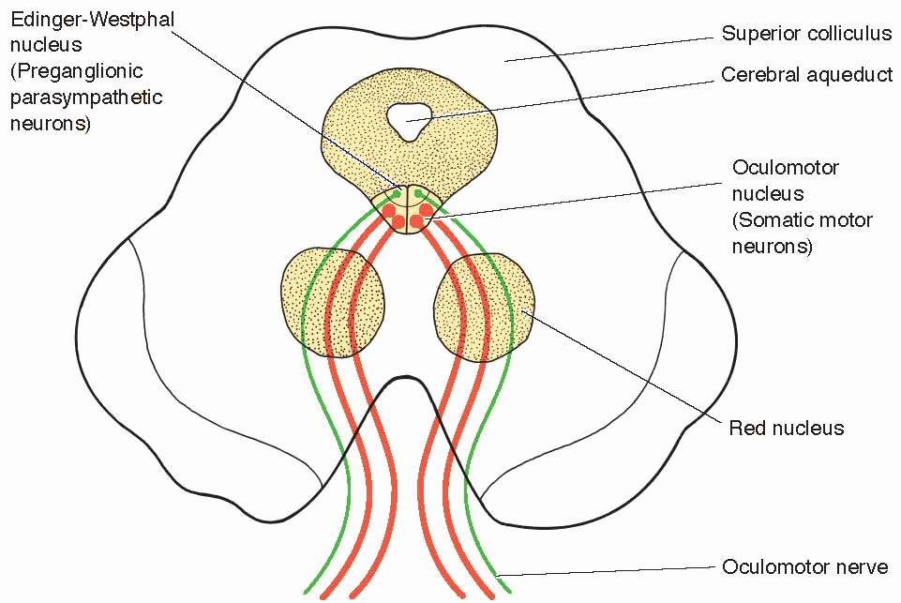
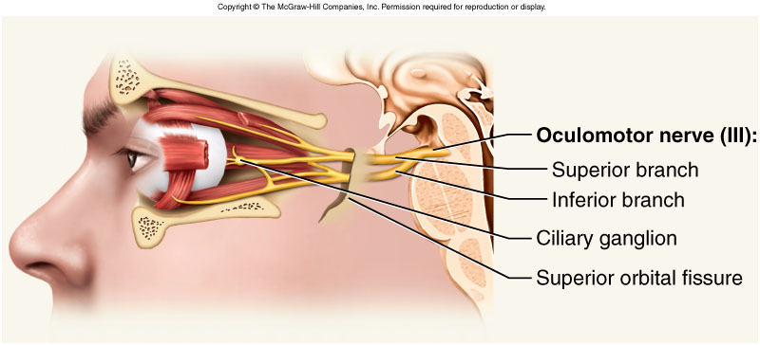
Occulomotor (III) 3rd Cranial Nerve
Motor for most of extraocular muscles.
Also carries preganglionic parasympathetic fibers to the pupillary constrictor and ciliary muscles.
Has two nuclei:
1- Main occulomotor nucleus;
Lies in the mid brain, at the level of superior colliculus, located in the periaqueductal grey matter.
2- Accessory nucleus (Edinger-Westphal nucleus);
Lies dorsal to the main motor nucleus,
Its cells are preganglionic parasympathetic neurons.
It receives; Corticonuclear fibers for (1) accommodation reflex, and from the pretectal nucleus for the direct and consensual (2) pupillary reflexes.

Slide 6
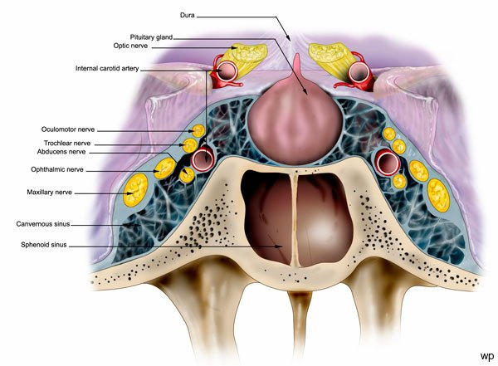
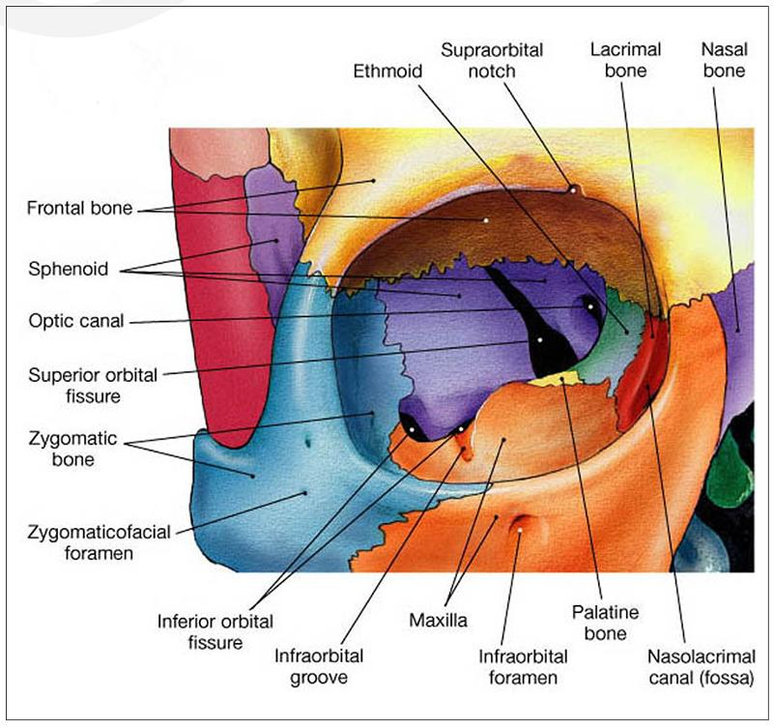
Occulomotor (III) 3rd Cranial Nerve
Axons from the oculomotor nucleus curve ventrally through the tegmentum* and the red nucleus in the midbrain.
The nerve emerges on the anterior surface of the midbrain in the interpeduncular fossa medial to crus cerebri/cerebral peduncle.
Then it passes forward between posterior cerebral and superior cerebellar arteries.
In the middle cranial fossa it runs in the lateral wall of the cavernous sinus, then it divides into superior and inferior divisions which pass to the orbit through the superior orbital fissure.
Extra
*Recall: the midbrain is divided into a dorsal part (Tectum) and
a ventral part (Tegmentum)
Cavernous sinus: trochlear and occulomotor run in the lateral wall and abducent runs in the floor

Slide 7
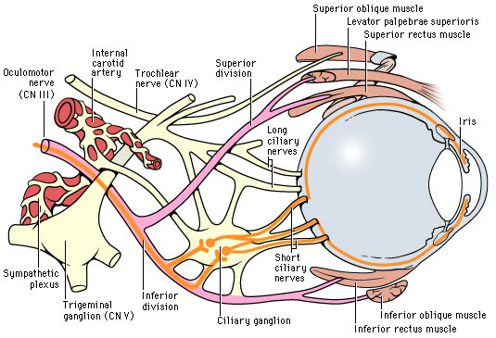
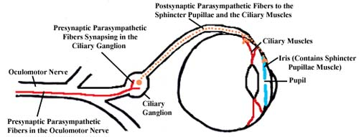
Occulomotor (III) 3rd Cranial Nerve
Axons from the Edinger-Westphal nucleus accompany the oculomotor nerve fibers to the orbit, where they terminate in the ciliary ganglion.
Postganglionic fibers pass through the short ciliary nerves to the eyeball, where they supply:
Constrictor pupillae muscle of the iris and
Ciliary muscle.
Extra

Slide 8
Occulomotor (III) 3rd Cranial Nerve
Occulomotor nerve supplies:
Motor to:
Levator palpebrae superioris
Superior rectus muscle
Medial rectus muscle
Inferior rectus muscle &
Inferior oblique muscle.
Parasympathetic fibers to:
1- Constrictor pupillae and
2- Ciliary muscles.
It is responsible for;
Elevation of upper eyelid (open the eye) (by levator palpebrae superioris).
Turning the eyeball upward, downwards and medially,
Constriction of the pupil (papillary reflex).
Accommodating reflex of the eyes.

Slide 9
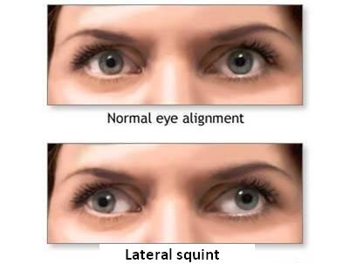
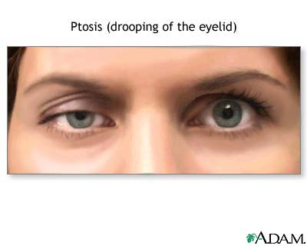
Occulomotor (III) 3rd Cranial Nerve
Lesion results in:
Lateral squint. (since medial is affected and only lateral is working)
Ptosis (drooping of the eyelid).
Diplopia (double vision). Diplopia always accompanies squint
Pupillary dilatation.
Loss of accommodation.
The eyeball is fully abducted and depressed (down and out) because of the unopposed activity of lateral rectus and superior oblique.
The preganglionic parasympathetic fibers run superficially in the nerve and are therefore the first axons to suffer when a nerve is affected by external pressure. Consequently, the first sign of compression of the occulomotor nerve is ipsilateral slowness of the pupillary response to light.

Slide 10
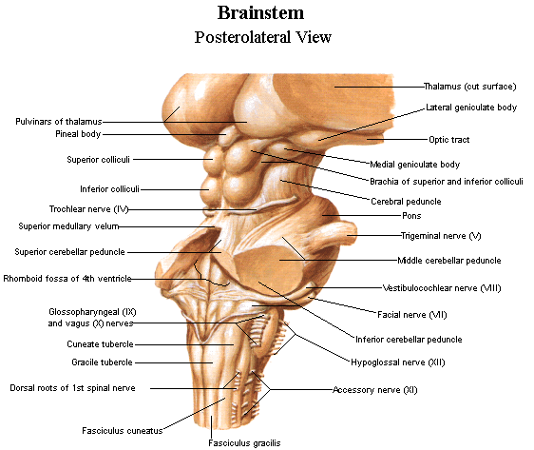
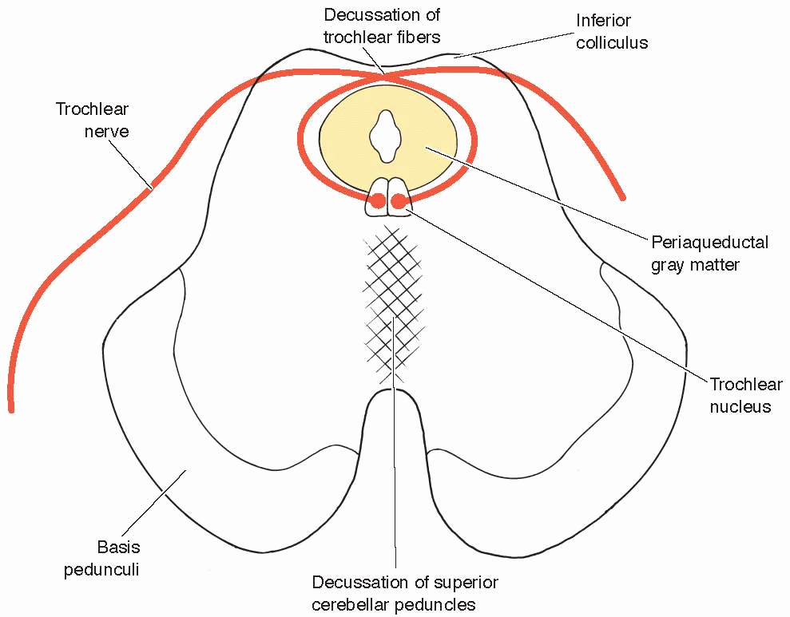
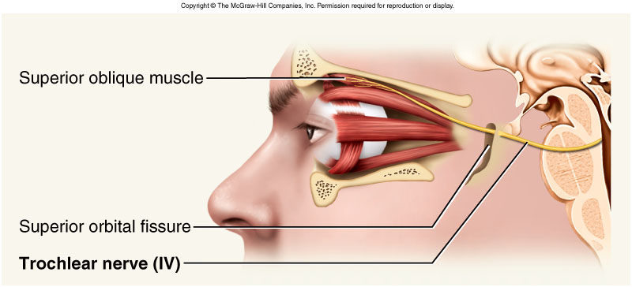
Trochlear (IV) 4th Cranial Nerve
Type: motor
Small motor nucleus located in the periaqueductal grey matter at the level of inferior colliculus of the midbrain.
Fibers curve backwards and decussate.
The nerve emerges immediately caudal to the inferior colliculus, on the dorsal surface of brain stem. (recall it is the only cranial nerve to emerge from the dorsal surface).
It passes forward through middle cranial fossa in the lateral wall of the cavernous sinus*.
The nerve then enters the orbit through the superior orbital fissure (with oculomotor).
Extra
*Cavernous sinus: trochlear and occulomotor run in the lateral wall and abducent runs in the floor

Slide 11
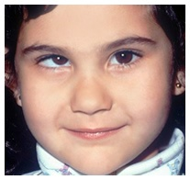
Trochlear (IV) 4th Cranial Nerve
It supplies;
Superior oblique muscle, (only one muscle).
Its function;
Rotates the eye ball downwards and laterally.
Lesion of trochlear nerve results in
diplopia (double vision) &
Inability to rotate the eyeball infero-laterally.
So, the eye deviates; upward and slightly inward (medially).
This person has difficulty in walking downstairs

Slide 12
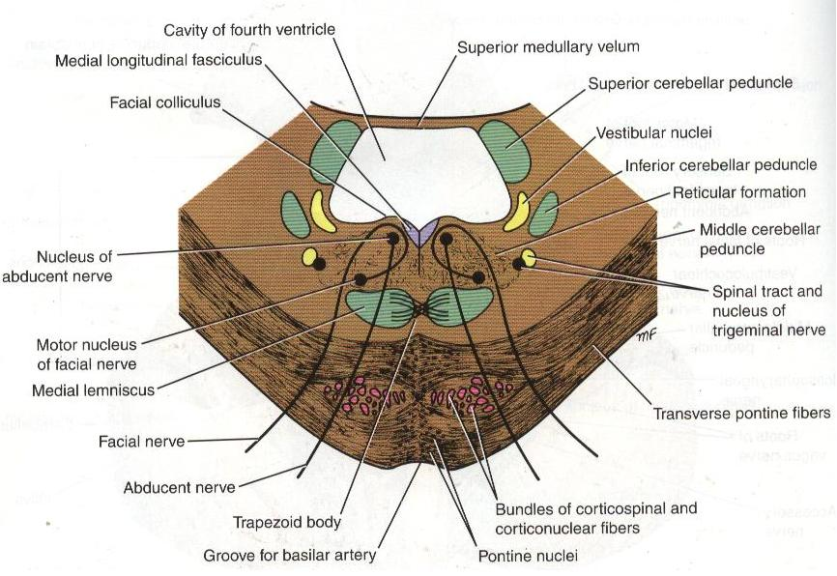
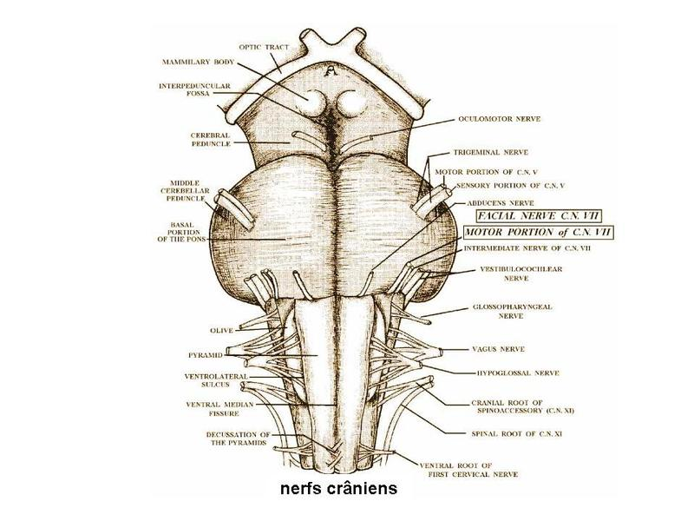
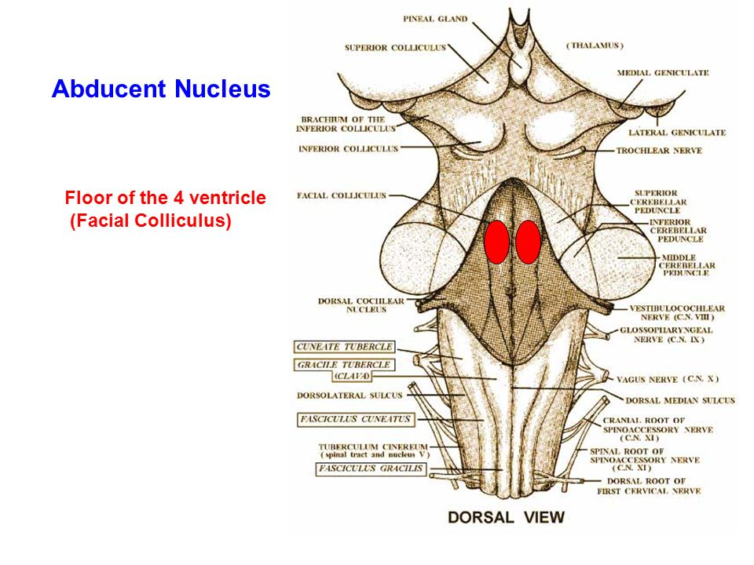
Abducent (VI) 6th Cranial Nerve
Only one motor nucleus.
Lies in caudal pons in the floor of the 4th ventricle.
Lies close to the middle line, in a line with 3rd, 4th & 12th nerves.
Fibers of facial nerve looping around the abducent nucleus forms the facial colliculus. (recall from anatomy of brainstem: The abducent nucleus lies medially, and below it is the fiber of the facial nerve which goes above and around it and forms the facial colliculus)
It emerges from the ventral aspect, at the junction of the pons and the pyramid of the medulla oblongata.
Extra

Slide 13
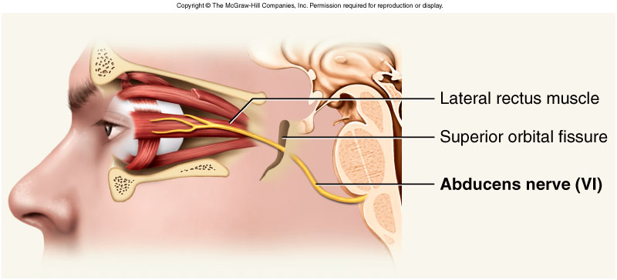
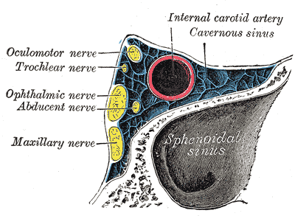
راح يتاثر هذا النيرفAneurysm ** لو حصل
***لانه يمشي مسافة طويلة فهو اكثر نيرف معرض ان يحصل له مشكلة
Abducent (VI) 6th Cranial Nerve
It passes through the floor of cavernous sinus, lying below and lateral to the internal carotid artery**
Then it enters the orbit through the superior orbital fissure.
It supplies;
the lateral rectus muscle which rotates the eye ball laterally ; (abduction).
Lesion results in:
Inability to direct the affected eye laterally, so it result in (medial squint*).
A nuclear lesion may also involve the nearby nucleus or axons of the facial nerve, causing paralysis of all facial muscles in the ipsilateral side.
*Occulomotor → lateral squint
Abducent → medial squint

Slide 14
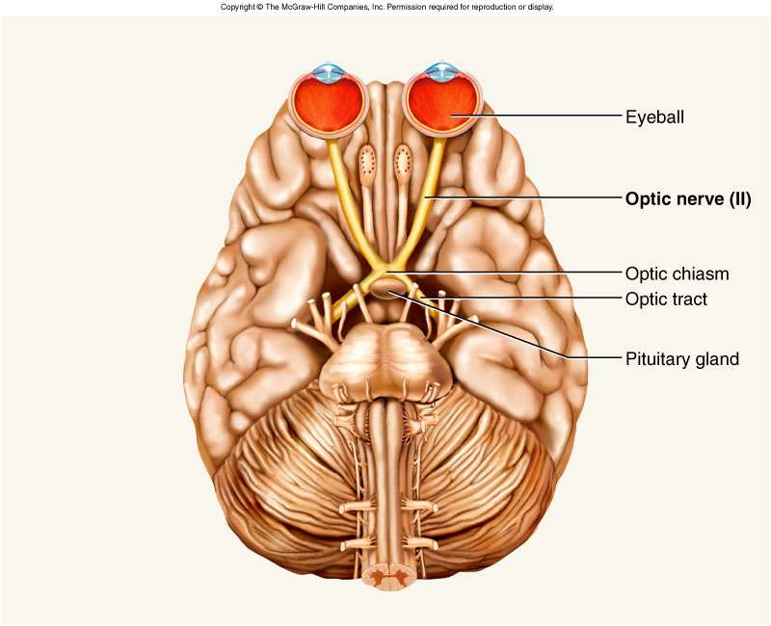
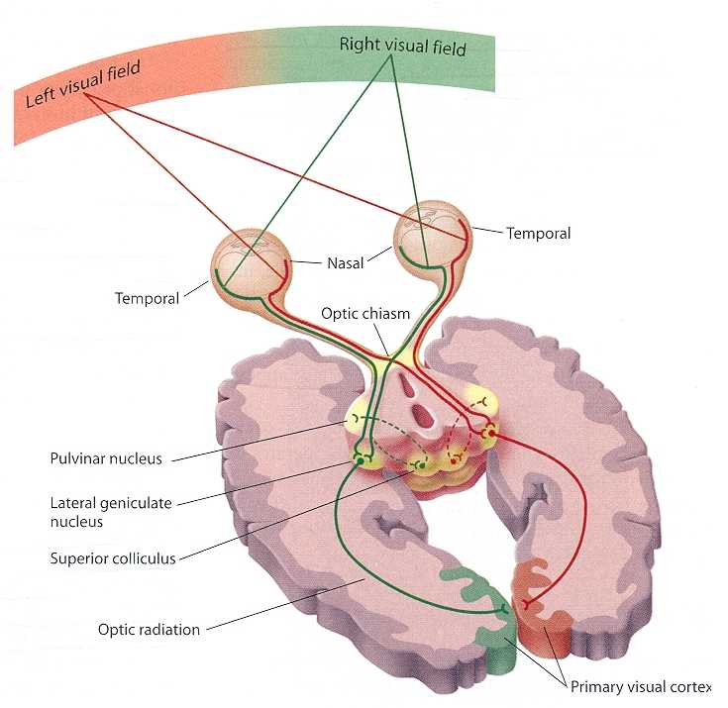
Optic (II) 2nd Cranial Nerve
Type: Special sensory N.
Function: Vision
Lesion results in: visual field defects and loss of visual acuity, a defect of vision is called anopsia.
Visual Pathway
Optic nerve.
Optic chiasm.
Optic tract.
Lateral geniculate body (nucleus).
Optic radiation.
Visual cortex.

Slide 15
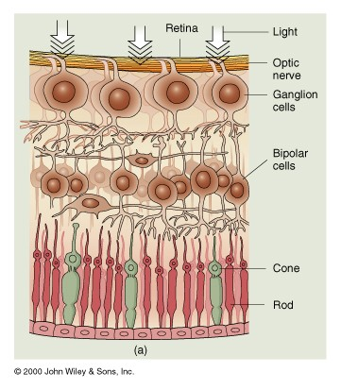
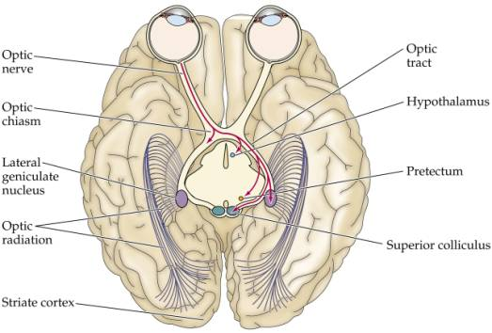
Visual Pathway
Photoreceptors:
Rods & Cones of the retina
Three neurons pathway
1st order neurons:
Bipolar cells of retina
2nd order neurons:
Ganglion cells of retina.
Their axons form the optic nerve
3rd order neurons:
Neurons in the lateral geniculate body.
Their axons terminate in primary visual cortex.
Extra

Slide 16
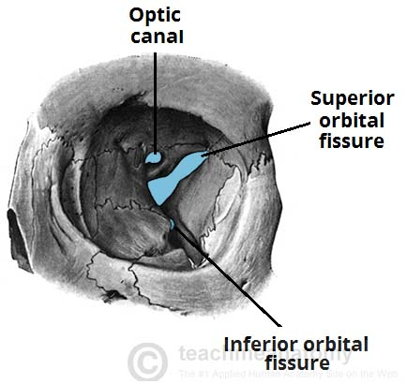
Visual Pathway
Optic Nerve
Axons of retinal ganglion cells converge at the optic disc and pass as the optic nerve.
Then the nerve passes posteromedially in the orbit.
Then exits through the optic canal to enter the middle cranial fossa to form the optic chiasma.
Extra

Slide 17
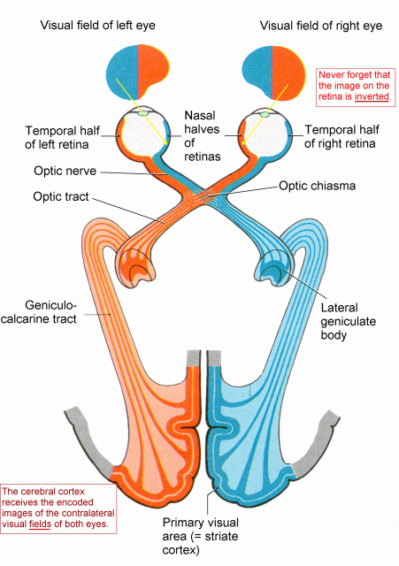
Visual Pathway
Optic Chiasma
Fibers from the nasal (medial) half of retina decussate in the chiasm and join uncrossed fibers from the temporal (lateral) half of the retina to form the optic tract.
The decussation of nerve fibers in the chiasm results in the right optic tract conveying impulses from the left visual field and vice versa.
The partial crossing of optic nerve fibers in the optic chiasma is a requirement for binocular vision.
Which retinal fibres are present in the left optic tract?
Fibers from left temporal and right nasal.

Slide 18
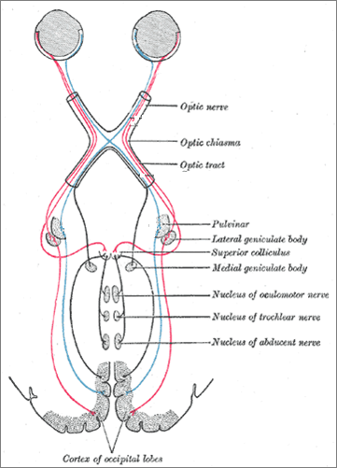
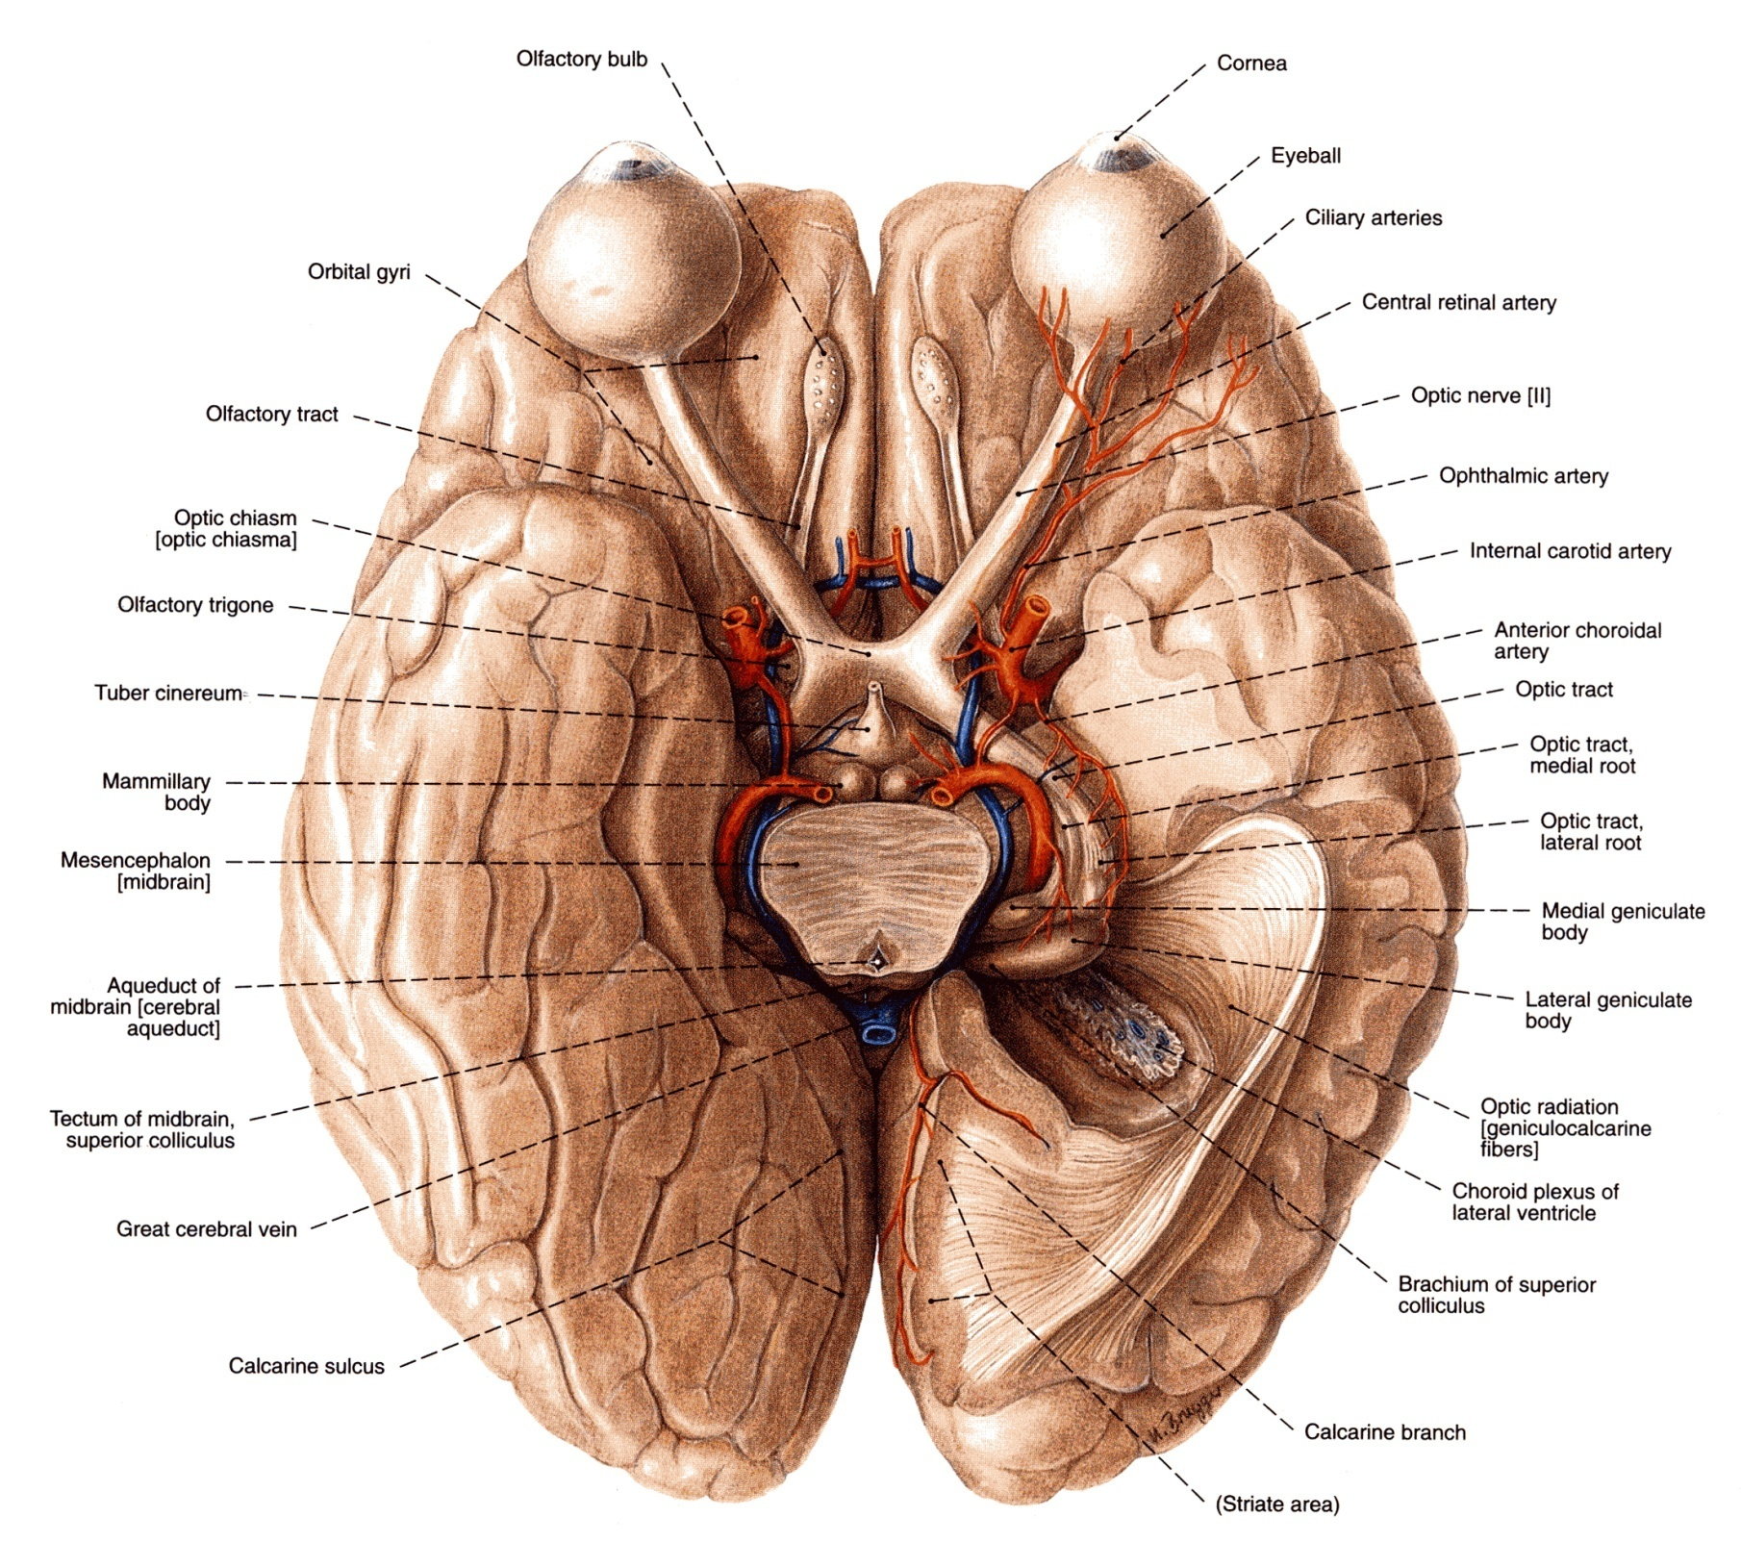
Visual Pathway
Optic Tract
Fibers in the optic tracts:
A few fibers terminate in pretectal area and superior colliculus.
These fibers are related to light reflexes.
Mainly terminate in the (LGB), lateral geniculate body of the thalamus (3rd order neuron).
From the lateral geniculate nucleus (third-order neuron), thalamocortical fibres project through the retrolenticular part of the posterior limb of the internal capsule as the optic radiation,
which terminates in the primary visual cortex of the occipital lobe.
The primary visual cortex is located predominantly on the medial surface of the hemisphere in the region above and below the calcarine sulcus.

Slide 19
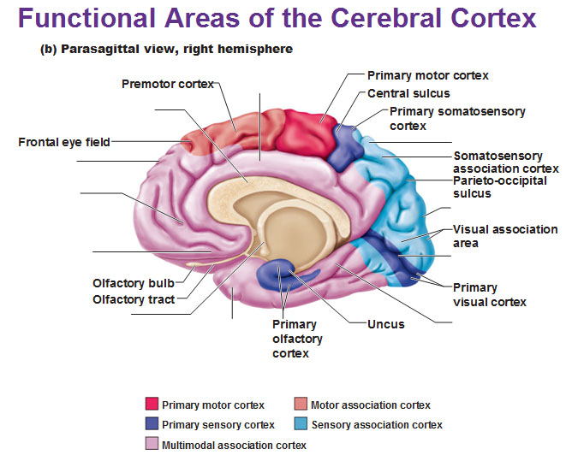
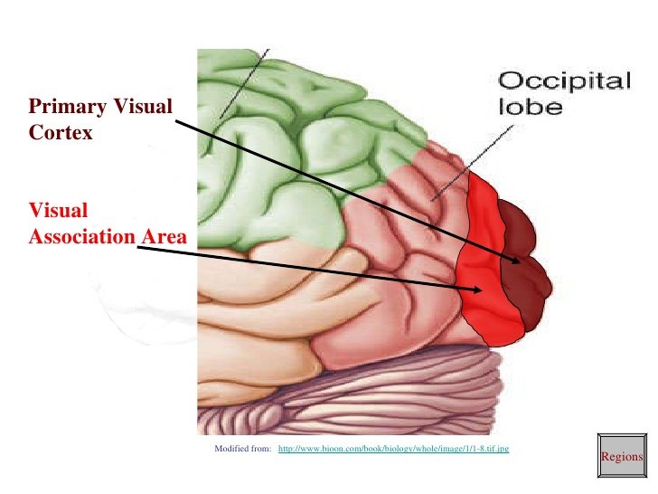
Visual Pathway
Visual Cortex
The primary visual cortex (area 17* of Brodmann's) occupies the upper and lower lips of the calcarine sulcus on the medial surface of the cerebral hemisphere.
The visual association cortex is extensive, including the whole of the occipital lobe, the adjacent posterior part of the parietal lobe. This cortex is involved in interpretation and recognition of objects and perception of color, depth, motion, and other aspects of vision.
The primary cortex: I saw something (recognition)
Association: what did I see (interpretation)
Note: each primary cortex has an association cortex
* ١٧ بالعربي تشبه
VI → visual

Slide 20
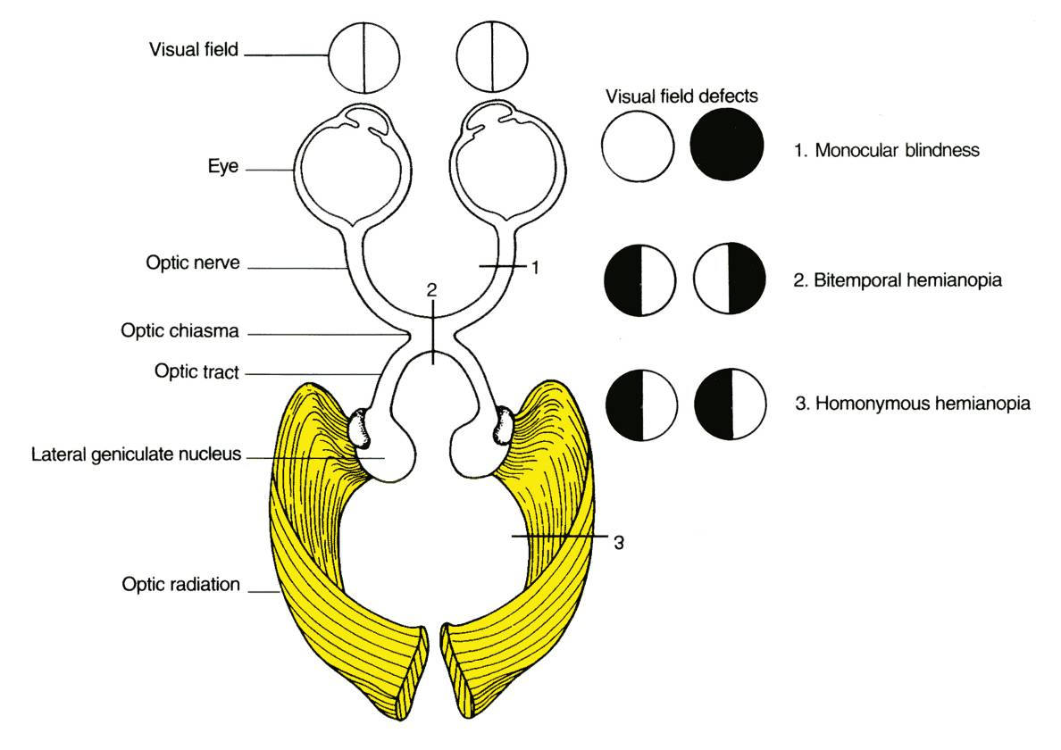
Visual Defects
Disease of the eyeball (cataract, intraocular haemorrhage, retinal detachment) and disease of the optic nerve (multiple sclerosis and optic nerve tumors) lead to : loss of vision in the affected eye (monocular blindness).
Compression of the optic chiasm by an adjacent pituitary tumour leads to: bitemporal hemianopia.
Vascular and neoplastic lesions of the optic tract, optic radiation or occipital cortex produce: contralateral homonymous hemianopia.
For you: Visual field deficits
A person may not be able to see objects on their right or left sides (homonymous hemianopsia) if the optic tract or radiation or visual cortex is affected.
Or may have difficulty seeing objects on their outer visual fields (bitemporal hemianopsia) if the optic chiasm is involved.
The pretectal area, or pretectum, is a midbrain structure composed of seven nuclei and comprises part of the subcortical visual system. Pretectal nuclei are bilateral group of highly interconnected nuclei located near the junction of the midbrain and forebrain.

Slide 21
Retinitis Pigmentosa
Retinitis pigmentosa is an inherited metabolic disorder of the photoreceptor and retinal pigment epithelial cells.
It is due to mutation of a key protein in the retinal photoreceptors.
Which protein?
Rhodopsin.
There is:
Progressive night blindness
Peripheral visual field constriction
Pigmentation of the retina visible on ophthalmoscopy.
Which type of photoreceptor is affected?
Rods.
Notes:
What else is known about this disease?
http://www.emedicine.com/oph/topic704.htm

Slide 22
OPTIC
*Special sensory N. *Function: Vision. *Lesion results in: visual field defects and loss of visual acuity, anopsia. *Visual Pathway 1. Optic nerve. 2. Optic chiasm. 3. Optic tract. 4. Lateral geniculate body (nucleus). 5. Optic radiation. 6. Visual cortex
OCCULOMOTOR
*Motor to: 1. Levator palpebrae superioris 2. Superior rectus muscle 3. Medial rectus muscle 4. Inferior rectus muscle 5. Inferior oblique muscle. *Parasympathetic fibers to: 1- Constrictor pupillae and 2- Ciliary muscles. *Lesions: 1. Lateral squint. 2. Ptosis. 3.Diplopia. 4. Pupillary dilatation. 5. Loss of accommodation. 6. The eyeball is fully abducted and depressed.
TROCHLEAR
*Motor to Superior oblique muscle. *Its function; Rotates the eye ball downwards and laterally. *Lesion of trochlear nerve results in • diplopia (double vision) • Inability to rotate the eyeball inferolaterally. So, the eye deviates; upward and slightly inward (medially). This person has difficulty in walking downstairs
ABDUCENT
*Only one motor nucleus. *It forms the facial colliculus. *It supplies; the lateral rectus muscle which rotates the eye ball laterally ; (abduction). *Lesion: -Inability to direct the affected eye laterally, so it result in (medial squint*). -A nuclear lesion may also involve the nearby nucleus or axons of the facial nerve, causing paralysis of all facial muscles in the ipsilateral side.
Occulomotor : lateral squint --Abducent :medial squint

Slide 23
MCQs
1. The occulomotor nerve has:
Motor fibers
Sensory fibers
Sympathetic fibers
Parasympathtic fibers
Answer: A&D
2. The edinger-westphal nucleus receives fibers from corticonuclear fibers for:
Stretch reflex
Pupillary reflex
Accommodation reflex
Answer: C
3. Lesion of trochlear nerve results in:
Lateral squint
Loss of accommodation
Inability to rotate the eyeball infero-laterally
Answer: C
4. First order neurons of optic nerve are:
Bipolar cells of retina
Ganglion cells of retina
lateral geniculate body
Answer: A
5. Abducent nerve together with facial nerve forms:
Inferior colliculus
Superior colliculus
Facial collicullus
Answer: C
6. Abducent nerves supplies:
Inferior oblique muscle
Inferior oblique muscle
Lateral rectus muscle
Answer: C
7. Compression of the optic chiasm leads to :
monocular blindness
bitemporal hemianopia
contralateral homonymous hemianopia
Answer: B
8. Which of the following nerves runs in the floor of the cavernous sinus:
III
IV
VI
Answer: C

Slide 24
SAQs
Name all muscles supplies by the nerves below and what movement is lost due the their injury.
Occulomotor:
Muscles:
Lesion:
Trochlear:
Muscle:
Lesion:
Abducent:
Muscle:
Lesion:
Answers:
A:
A.
Levator palpebrae superioris
Superior rectus muscle
Medial rectus muscle
Inferior rectus muscle &
Inferior oblique muscle.
B.
Lateral squint.
Ptosis
Diplopia
Pupillary dilatation.
Loss of accommodation.
The eyeball is fully abducted and depressed (down and out) because of the unopposed activity of lateral rectus and superior oblique.
B:
A. Superior oblique muscle,
B. Diplopia & Inability to rotate the eyeball infero-laterally.
C:
A. lateral rectus muscle
B. Inability to direct the affected eye laterally, so it result in (medial squint).

Slide 25
Leaders:
Nawaf AlKhudairy
Jawaher Abanumy
Members:
Ashwaq Almajed
Rawan AlWadee
Reema Alotaibi
Safa Al-Osaimi
Feedback
anatomyteam436@gmail.com
References:
1- Girls’ & Boys’ Slides
2- Greys Anatomy for Students
3- TeachMeAnatomy.com
@anatomy436
Anatomy Team

