Slide 1
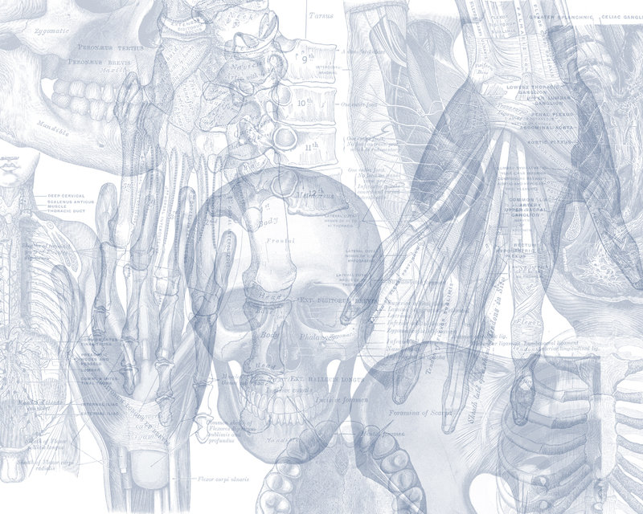
Anatomy of Cerebellum and Relevant Connections
Color Code
Important
Doctors Notes
Notes/Extra explanation
Please view our Editing File before studying this lecture to check for any changes.

Slide 2
Objectives
At the end of the lecture, students should:
Describe the External features of the cerebellum (lobes, fissures).
Describe briefly the Internal structure of the cerebellum.
List the name of Cerebellar Nuclei.
Relate the Anatomical to the Functional Subdivisions of the cerebellum.
Describe the Important connections of each subdivision.
Describe briefly the Main Effects in case of lesion of the cerebellum.

Slide 3
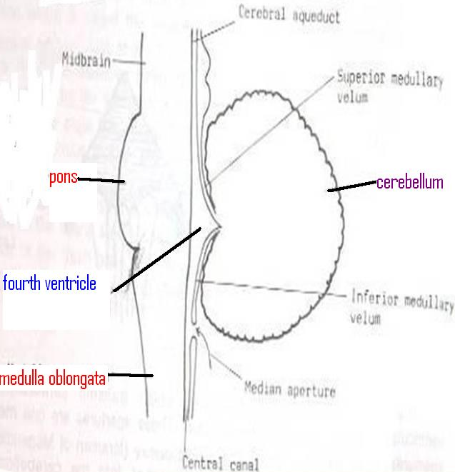
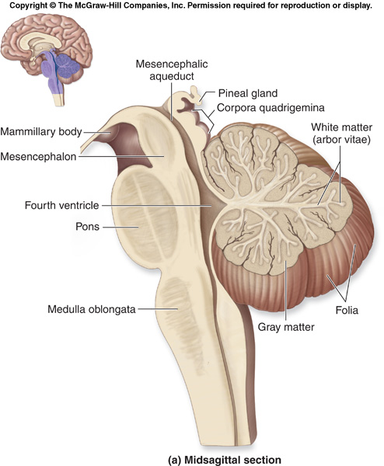
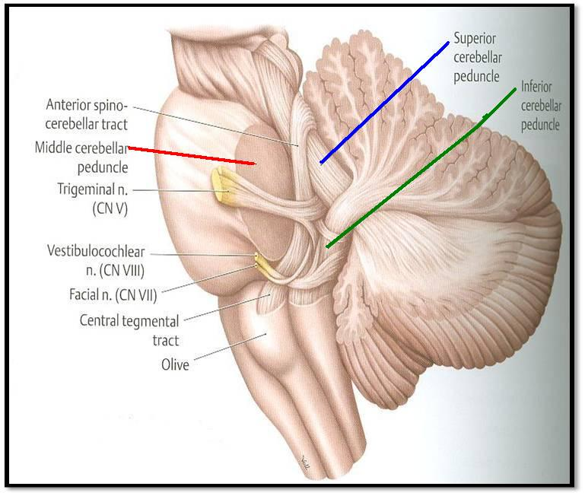
Cerebellum
Playlist
Origin: from Hindbrain.
Position: lies behind Pons & Medulla Separated from them by Fourth ventricle.
Connections: to the brainstem by Inferior, Middle & Superior Cerebellar Peduncles.
(medulla)
(pons)
(midbrain)
Extra

Slide 4
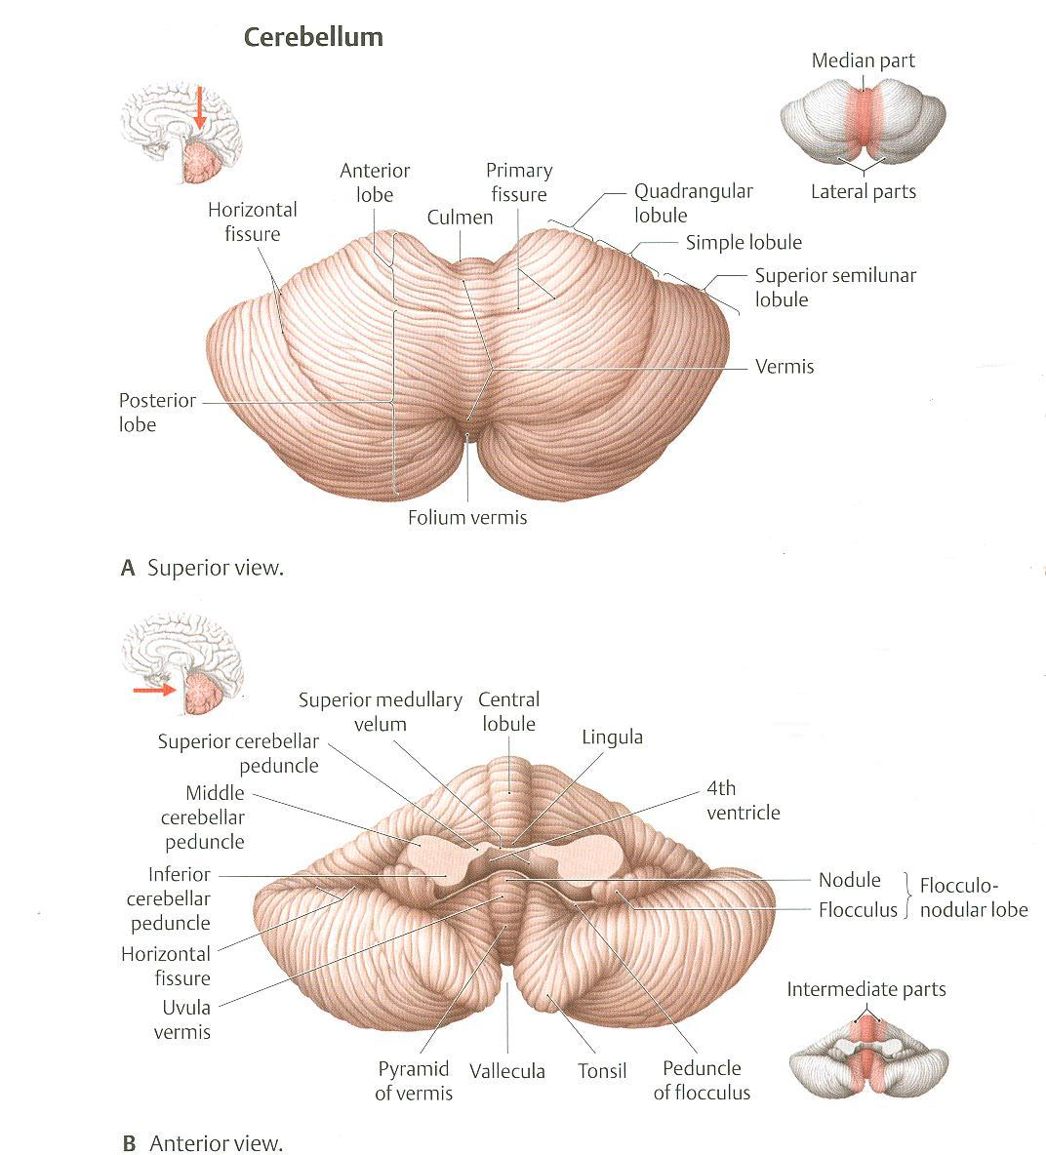
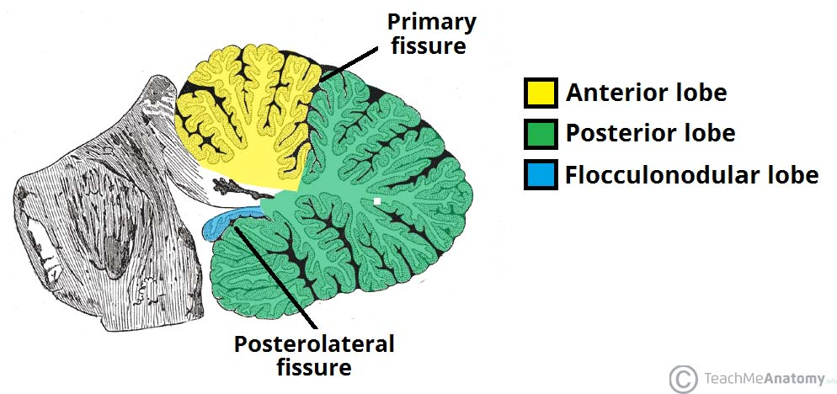
Cerebellum External Features
It consists of two Cerebellar Hemispheres joined in midline by the Vermis.
Its surface is highly convoluted forming Folia (like gyri), separated by Fissures (like sulci).
Anatomical Subdivision
Anterior lobe: in front of primary fissure, on the superior surface.
Posterior (middle) lobe: behind primary fissure (Between Primary & Secondary/posterolateral fissures).
Flocculonodular lobe: in front of secondary (Posterolateral) fissure, on the inferior surface .
Extra

Slide 5
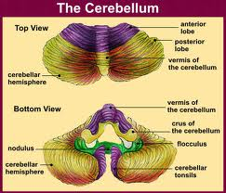
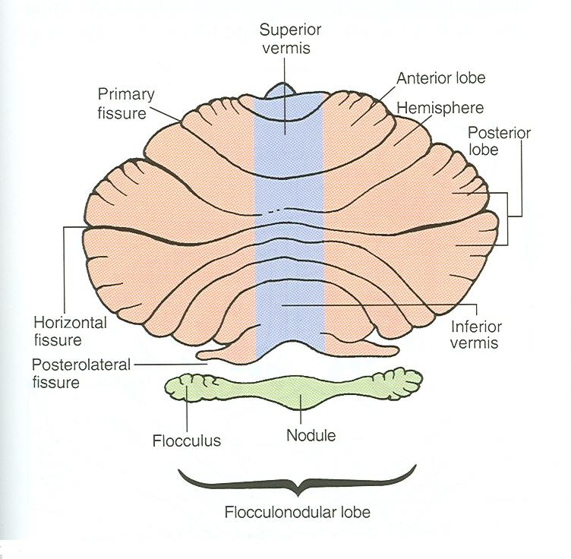
Cerebellum Anatomical Subdivision
Primary Fissure
Superior Surface
Posterolateral = Secondary Fissure
Anterroinferior Surface

Slide 6
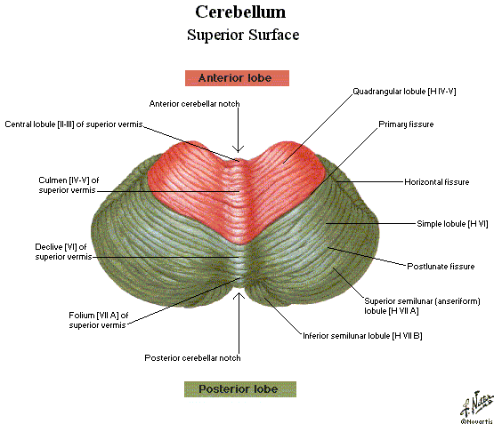
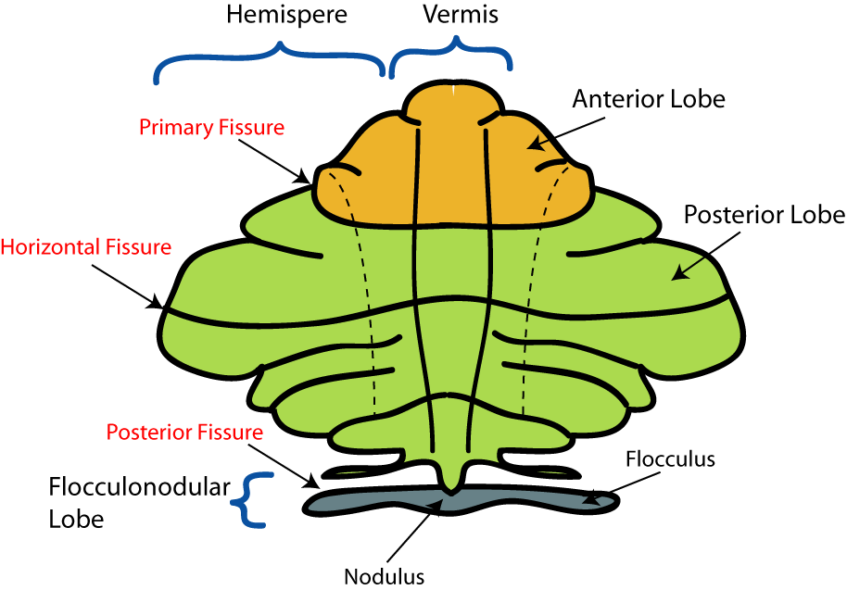
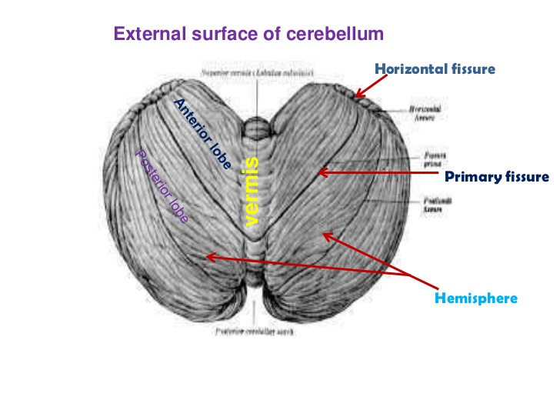
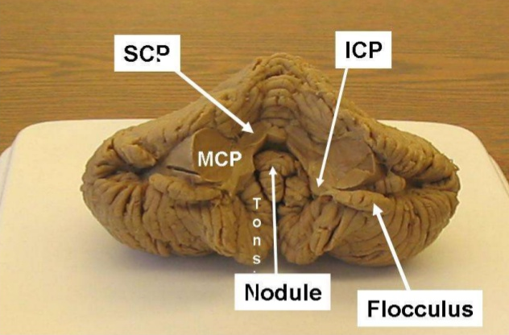

Slide 7
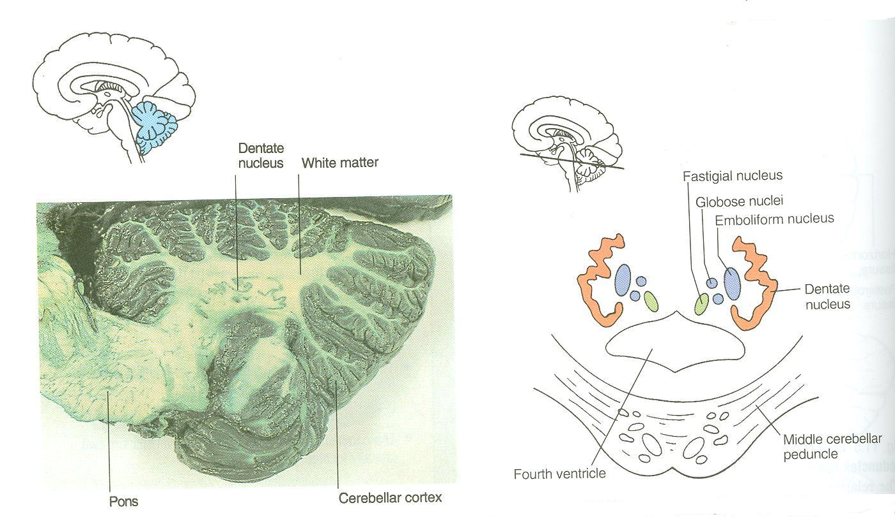
Cerebellum Constituents (Internal Structure and Nuclei of Cerebellum)
Outer grey matter: cerebellar cortex
Inner white matter: cerebellar medulla
Deeply seated nuclei in white matter: from medial to lateral:
Fastigial nucleus: smallest one
Globose nucleus.
Emboliform nucleus.
Dentate nucleus: largest one.
Extra

Slide 8
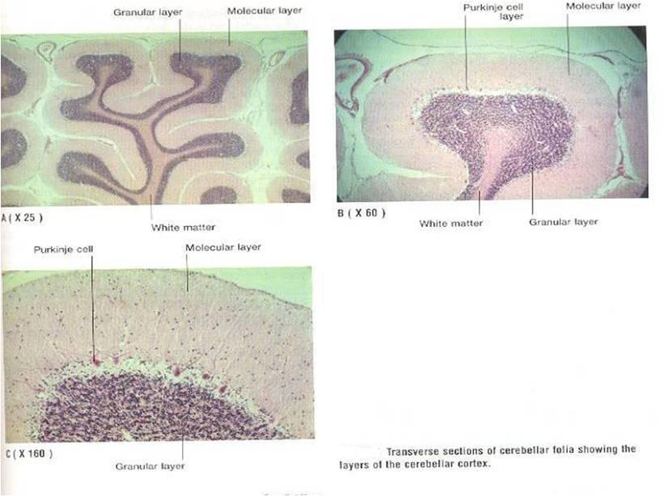
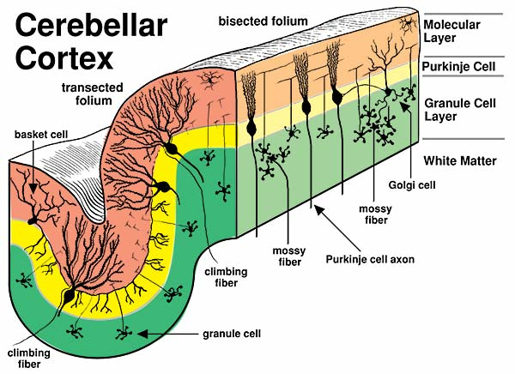
Cerebellum Cerebellar Cortex
The cerebellar cortex is divided into 3 layers:
Outer molecular layer
Intermediate Purkinje cell layer
Inner granular layer
Extra

Slide 9
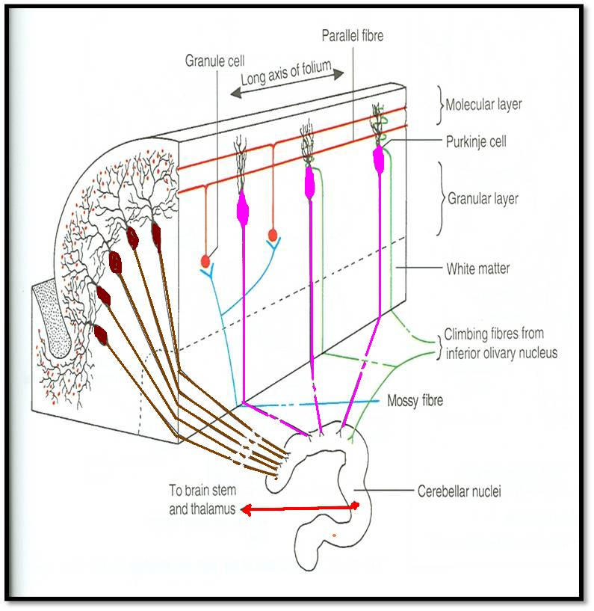
Cerebellum Cerebellar Medulla
Climbing fibres:
from inferior olivary nucleus, relay to purkinje cells
Afferent fibers:
Fibers coming into the cerebellum They are of two types:
mossy and climbing
Extra
Mossy fibres: rest of fibres:
From vestibular nuclei
From spinal cord
From pons
They relay to granule cells which in turn relay to purkinje cells.
Finally all afferent fibers passing through the medulla relay to purkinje cells in the cortex.

Slide 10
Cerebellum Cerebellar Medulla
Axons of Purkinje Cells are the only axons to leave the cortex to medulla:
The great majority of axons do not leave cerebellum & end in deep cerebellar nuclei, specially Dentate nucleus.
Some of axons leave cerebellum as efferent fibres.
Dendato-rubro-thalamic
Efferent Fibres:
Most of efferent fibres are axons of deep cerebellar nuclei.
Main Efferents go to:
Vestibular nuclei (cerebello-vestibular tract).
Red nucleus (Dendato-rubro-thalamic tract).
Ventral lateral nucleus of thalamus (Dendato-thalamic).
Extra

Slide 11
Cerebellum Functional Subdivisions
Cerebellum is divided according to function into 3 parts:
Archicerebellum
Paleocerebellum
Neocerebellum
Vestibular Part of cerebellum: Flocculonodular lobe.
Spinal Part of cerebellum:
Vermis & Paravermis
Cerebral Part of cerebellum:
Rest of Cerebellum.

Slide 12
Cerebellum Functional Subdivisions
SCP = superior cerebellar peduncle
MCP = middle cerebellar peduncle
ICP = inferior cerebellar peduncle
 | Archicerebellum | Paleocerebellum | Neocerebellum
Nuclei Related | Fastigial | Globose & Emboliform | Dentate
Afferents | from Vestibular nuclei (Vestibulocerebellar fibres), (through ICP) | from spinal cord (dorsal spinocerebellar tracts through ICP & ventral spinocerebellar tract through SCP) | from Pons (Pontocerebellar fibres) (through MCP)
Efferents | cortical (purkinje cell) Fibres project : to Fastigial nucleus, which projects to vestibular nuclei (through ICP) + to Reticular formation | to globose & embliform nuclei which project to red nucleus (through SCP) | to Red nucleus but mostly to Ventral Lateral Nucleus of Thalamus (through SCP) then to motor cortex
Function | 1. controls body Balance (via vestibulospinal & reticulospinal tracts). 2. Control of eye movement (via VO vestibulo-ocular reflex) | controls posture & muscle tone (via Rubrospinal tract). | coordination of voluntary movements (via descending corticospinal & corticobulbar tracts or rubrospinal tract).

Slide 13
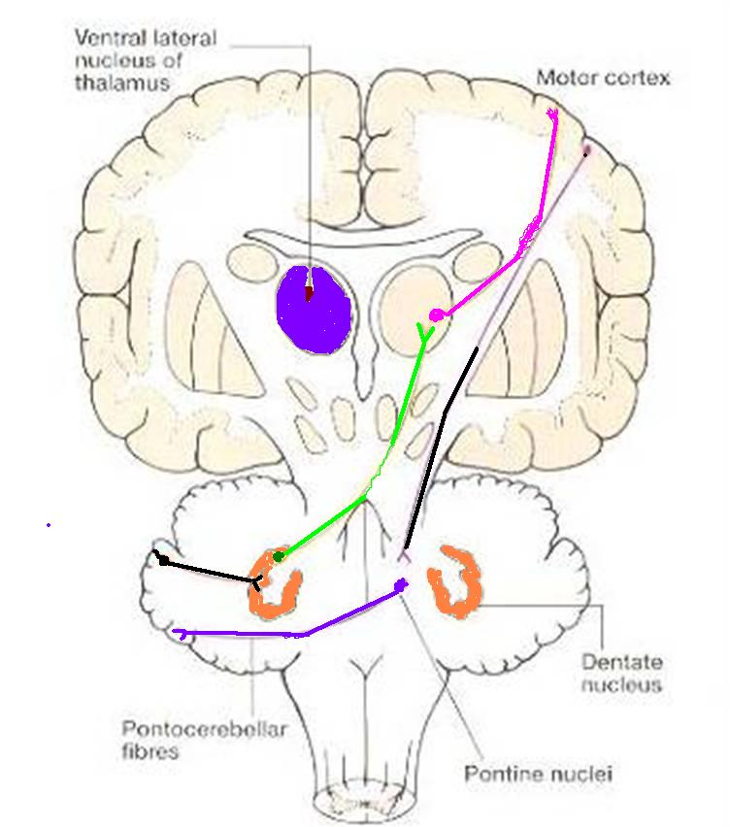
Only on the girls’ slides

Slide 14
In the PowerPoint presentation this slide is animated.
Only on the boys’ slides
Archicerebellum
Paleocerebellum
Neocerebellum
Purkinge cells of vermis & paravermis
Purkinge cells of rest of cerebellum
Purkinge cells of flocculonodular lobe
Dentate nucleus
ICP
Globose & emboliform
nuclei
Fastigeal nucleus
Red nucleus &
Ventral lateral nucleus
of thalamus
ICP
MCP
SCP
ICP
SCP
Spinal cord
Red nucleus
Pons
Motor cortex
Vestibular nuclei
POSTURE
& MUSCLE TONE
COORDINATION
OF VOLUNTARY MOVEMENTS
BALANCE

Slide 15
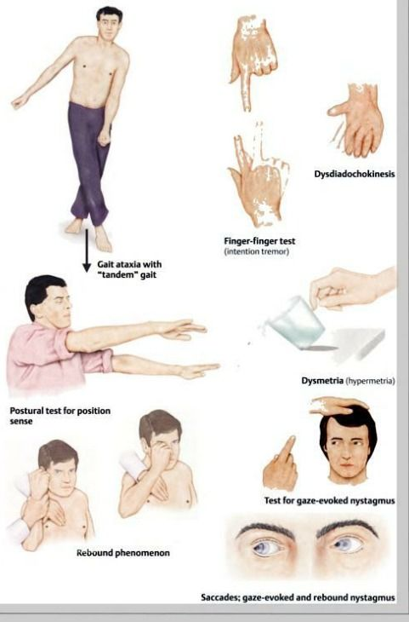
Cerebellum Cerebellar Lesions
MIDLINE LESION: Loss of postural control.
UNILATERAL LESION: “Cerebellar ataxia” causes ipsilateral:
Incoordination of arm: intention tremors (on performing voluntary movements)
Incoordination of leg: unsteady gait
Incoordination of eye movements: nystagmus
Slowness of speech: dysarthria (difficulty of speech)
Extra

Slide 16
Summary
Anatomically, the cerebellum is divided into:
anterior, posterior & flocculonodular lobes.
Developmentally & functionally, it is divided into:
archi- paleo- & neocerebellum.
Archicerebellum (flocculonodular lobe) is the oldest part of cerebellum, related to fastigial nucleus, connected to vestibular nuclei & concerning for control of body balance.
Paleocerebellum (vermis & paravermis) is related to globose & emboliform nuclei, connected to spinal cord & red nucleus & concerned with regulation of posture & muscle tone.
Neocerebellum (most of human cerebellum) is related to dentate nucleus, connected to pons, thalamus. Its final destination is to motor cortex. It is concerned with coordination of voluntary movements.
Cerebellar lesions lead to ipsilateral incoordination (ataxia).

Slide 17
Characteristics | Cerebellum
Origin | From hindbrain
Position | Lies behind the pons and medulla, separated from them by 4th ventricle
External structures | Consists of two cerebellar hemispheres joined in the midline by vermis | Its surface is highly convoluted forming folia, separated by fissures
Internal structures | Outer grey matter: cerebellar cortex Inner white matter: cerebellar medulla | Deep seated nuclei in white matter: (from medial to lateral) Fastigial nnucles Globose nucleus Emboliform nucleus Dentate nucleus
Anatomical subdivisions | Anterior lobe: In front of primary fissure | Posterior (middle) lobe: Between primary and secondary (postero-lateral) fissures | Flocculonodular lobe: In front of secondary fissure

Slide 18
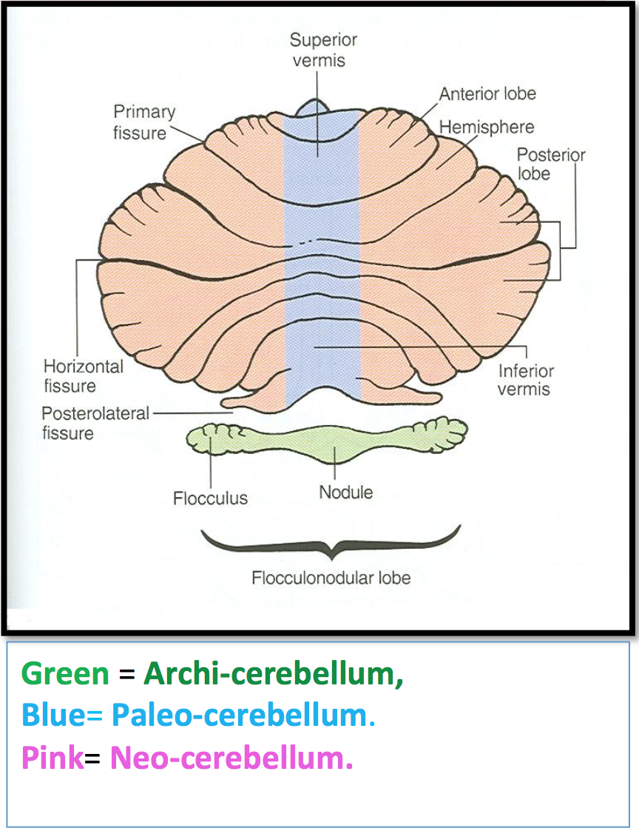
Characteristics | Cerebellum
Functional subdivisions | Archicerebellum: Fastigial nucleus relation Afferent: from vestibular nuclei (vesttibulocerebellar fibers) through ICP Efferent: cortical (purkinje cell) fibers project to fastigial which project to vestibular nuclei + reticular formation Function: Control body balance and eye movement | Paleocerebellum: Globose and emboliform nuclei relation Afferent: from spinal cord (ventral and dorsal spinocerebellar tracts through ICP and SCP respectively) Efferent: to globose and emboliform nuclei which projects to red nucleus (through SCP) Function: Control posture and muscle tone | Neocerebellum: Dentate nucleus relation Afferent: from pons (pontocerebellar tract) through MCP Efferent: to red nucleus but mostly to ventral lateral nucleus of thalamus through SCP then to motor cortex Function: Coordination of voluntary movements
Cerebellar lesions
MIDLINE LESION: Loss of postural control. UNILATERAL LESION: “Cerebellar ataxia” causes ipsilateral : Incoordination of arm: intention tremors (on performing voluntary movements) Incoordination of leg: unsteady gait Incoordination of eye movements: nystagmus Slowness of speech: dysarthria (difficulty of speech).

Slide 19
______ Climbing and mossy fibers relay to: ______
Afferent, Inner granular layer
Efferent, Inner granular layer
Afferent, purkinje cells
Efferent, purkinje cells
Answer: C
To which of the following do main efferents go to:
Red nucleus
Ventral posterior nucleus of thalamus
Globose nucleus
Emboliform nucleus
Answer: A
The nuclei related to paleocerebellum are:
Globose & Dentate
Emboliform & Fastigial
Dentate & Fastigial
Globose & Emboliform
Answer: D
The cerebellum originates from the dorsal aspect of the
brain stem and overlies the ______ ventricle.
Lateral ventricle
Midline ventricle
Third ventricle
Fourth ventricle
Answer: D
5. Neocerebellum coordinate voluntary movements via:
Vestibulospinal & reticulospinaltracts
Descending corticospinal & corticobulbar tracts
Descending corticospinal & reticulospinaltracts
Vestibulospinal & corticobulbar tracts
Answer: B
6. Archicerebellum controls:
Body Balance
Posture
Memory and speech
All of the above
Answer: A
7. Damage to the cerebellum does not cause disorders of:
Movement
Equilibrium
Motor learning
Posture
Answer: C
8. List the effects of unilateral cerebellar lesion:
Answer: intention tremors, unsteady gait, nystagmus, dysarthria.
9. Name the three layers of the Cerebellum's cortex:
Answer: Molecular, Purkinje, and Granular
10. Damage to the cerebellum results in effects on which side of the body?
Answer: ipsilateral
Questions

Slide 20
Leaders:
Nawaf AlKhudairy
Jawaher Abanumy
Members:
Allulu Alsulayhim
Deena AlNowiser
Lama AlTamimi
Reema Alshayie
Feedback
anatomyteam436@gmail.com
References:
1- Girls’ & Boys’ Slides
2- Greys Anatomy for Students
3- TeachMeAnatomy.com
@anatomy436
Anatomy Team

