Slide 1
Cerebral Blood Circulation
Color Code
Important
Doctors Notes
Notes/Extra explanation
Please view our Editing File before studying this lecture to check for any changes.

Slide 2
Objectives
List the cerebral arteries.
Describe the cerebral arterial supply regarding the origin, distribution and branches.
Describe the arterial Circle of Willis .
Describe the cerebral venous drainage and its termination.
Describe arterial & venous vascular disorders and their clinical manifestations.
You can skip the first 3 slides; it’s just revision.

Slide 3
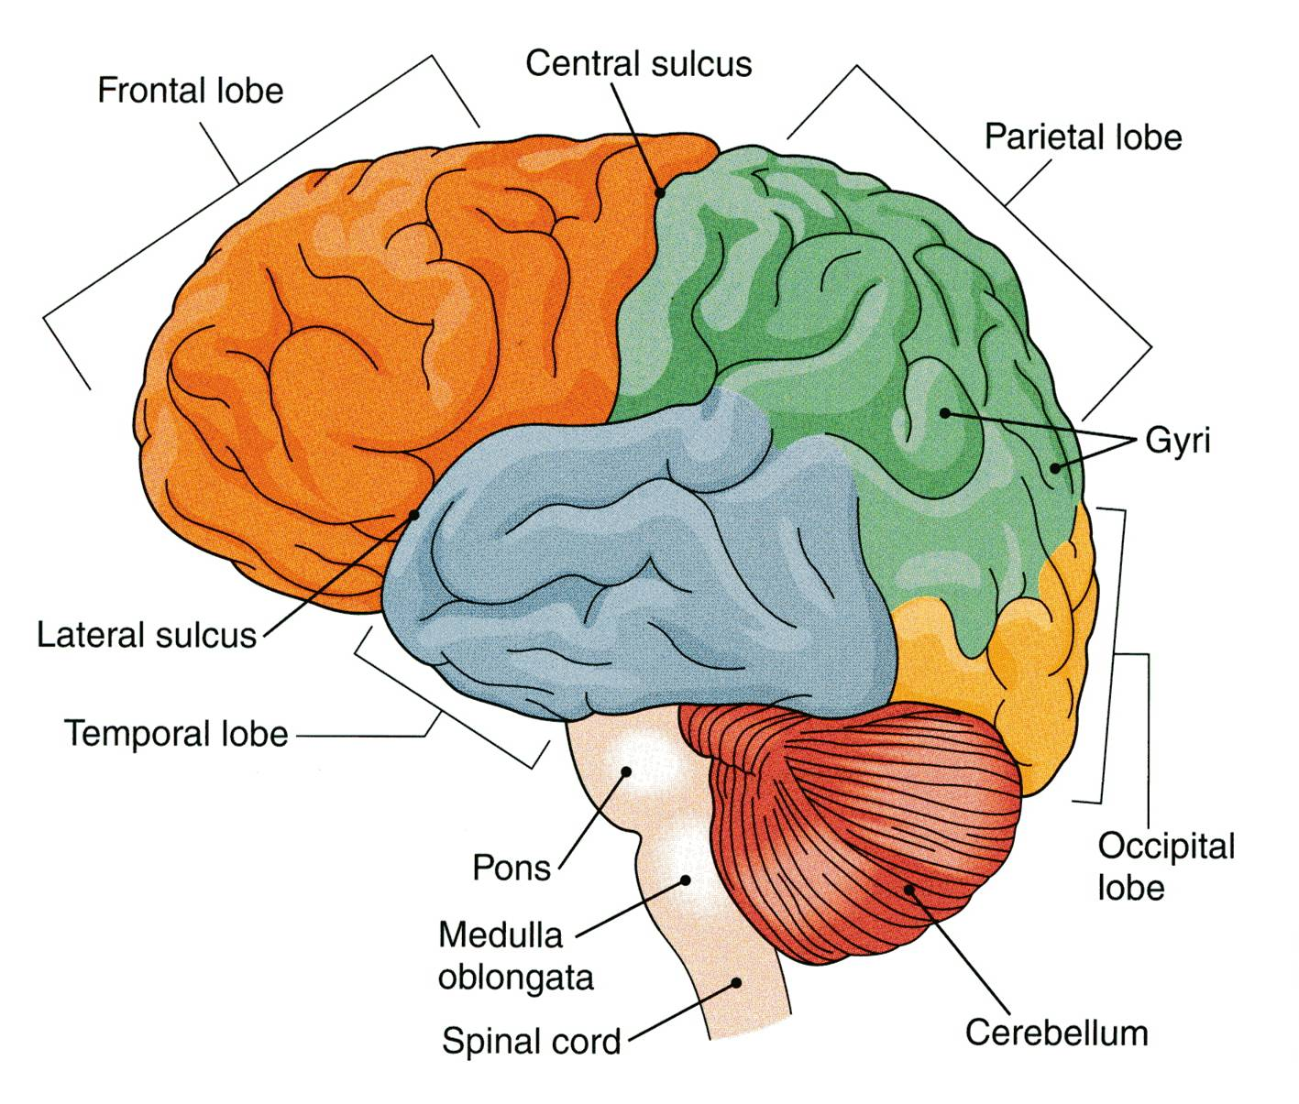
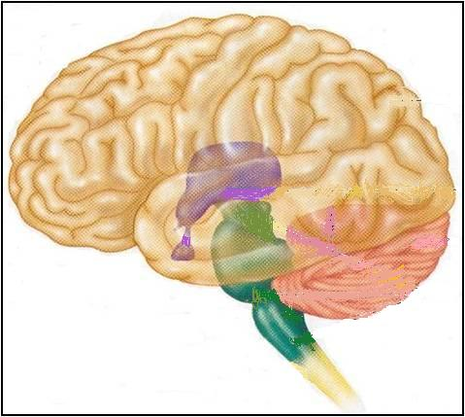
REVIEW: The Brain
Only on the boys’ slides
Large mass of nervous tissue located in cranial cavity.
Has four major regions.
Cerebrum
(Cerebral hemispheres)
The largest part of the brain, and has two hemispheres.
The surface shows elevations called gyri, separated by depressions called sulci.
Each hemispheres divided into four lobes by deeper grooves.
Lobs are separated by deep grooves called fissures.
Diencephalon: Thalamus, Hypothalamus, Subthalamus & Epithalamus
Cerebellum
Brainstem: Midbrain, Pons & Medulla oblongata

Slide 4
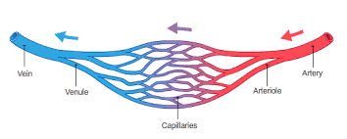
REVIEW: Blood Vessels & Histology
Only on the boys’ slides
Blood vessels are the part of the circulatory system that transports blood throughout the human body.
There are three major types of blood vessels:
Arteries, which carry the blood away from the heart.
Capillaries, which enable the actual exchange of water and chemicals between the blood and the tissues.
Veins, which carry blood from the capillaries back toward the heart.
The word vascular, meaning relating to the blood vessels, is derived from the Latin vas, meaning vessel.
Avascular refers to being without (blood) vessels.
The arteries and veins have three layers, but the middle layer is thicker in the arteries than it is in the veins:
Tunica Intima (the thinnest layer): a single layer of simple squamous endothelial cells.
Tunica Media (the thickest layer in arteries): is made up of smooth muscle cells and elastic tissue.
Tunica Adventitia (the thickest layer in veins) entirely made of connective tissue.
Capillaries consist of little more than a layer of endothelium and occasional connective tissue.

Slide 5
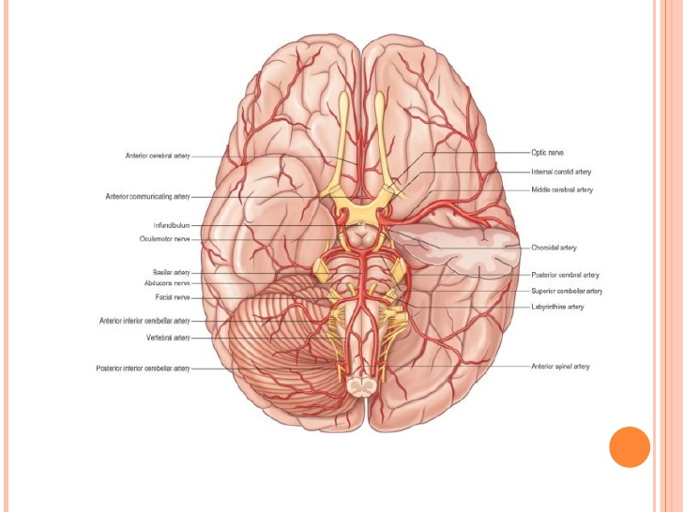
Only on the boys’ slides
REVIEW: Blood
Blood is the actual carrier of the oxygen and nutrients into arteries.
Blood is made mostly of plasma, which is a yellowish liquid that is 90% water.
Plasma contains also salts, glucose and other substances.
Most important, plasma contains proteins that carry important nutrients to the body’s cells and strengthen the body’s immune system.
Blood has main 3 types of blood cells that circulate with the plasma.
Cerebral Circulation
It is the movement of blood through the network of blood vessels to supply the brain.
The movement of blood in the cerebral circulation is called cerebral blood flow.
The arteries carry oxygenated blood and other nutrients to the brain.
The veins carry deoxygenated blood back to the heart removing carbon dioxide and other metabolic products.

Slide 6
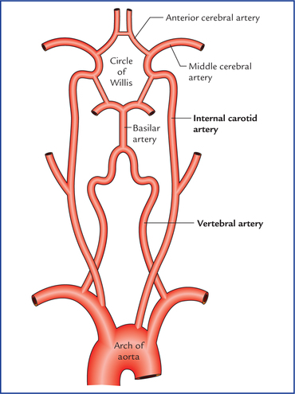
Cerebral Arterial supply
The arterial supply of the cerebrum is composed of/provided by 2 arterial systems:
1) Carotid System
Composed of:
Internal carotid artery and its branches:
Anterior cerebral artery*
Middle cerebral artery*
Supply anterior portion of brain
2) Vertebro-Basilar System
The two vertebral arteries (from the subclavian artery) unite to form basilar artery*.
It divides at the upper border of pons into two posterior cerebral arteries*
Supply posterior portion of brain
Extra
*We will talk about these in more detail later.

Slide 7
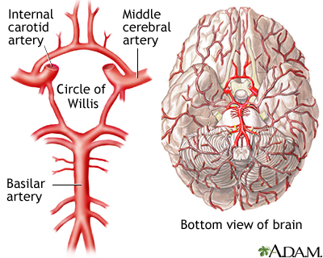
Cerebral Arterial supply
Only on the boys’ slides
The two anterior cerebral circulations (left and right) are connected to each other by 1 anterior communicating artery.
The anterior circulation (carotid) is interconnected to the posterior circulation (basilar) via bilateral (2) posterior communicating arteries.
Posterior communicating arteries are part of Circle of Willis.
Extra

Slide 8
Cerebral Arterial supply
Origin | Internal carotid artery |  | Basilar artery
Branch | Anterior Cerebral Artery (ACA) | Middle Cerebral Artery (MCA) | Posterior Cerebral Artery (PCA)
Supplies | Orbital and medial surfaces of frontal and parietal lobes. A narrow part on the superolateral surface. | Entire Superolateral surface*: Somatosensory Cortex Motor Cortex Language areas:. Broca's Area: linked to speech production. Wernicke’s Area: It is involved in the understanding of written and spoken language Auditory areas: Primary auditory area Heschl’s Gyrus: to process incoming auditory information | Anterior and inferior temporal lobes Uncus: Located on the tip end of the medial surface of the parahippocampal gyrus. Part of the olfactory cortex that processes information from the sense of smell. Inferior temporal gyri Inferior and Medial Occipital lobe (visual area)
*Except for a narrow part by the ACA, MCA supplies all the motor area except the leg area. (Snell) except foot and perinium

Slide 9
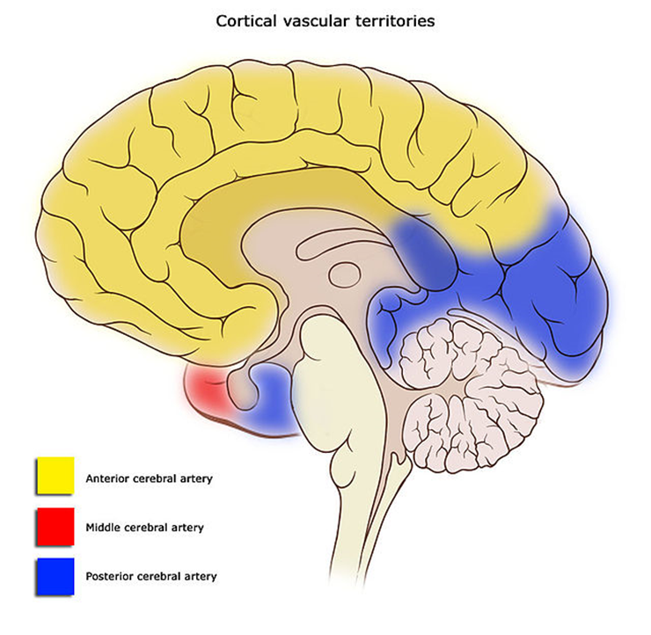
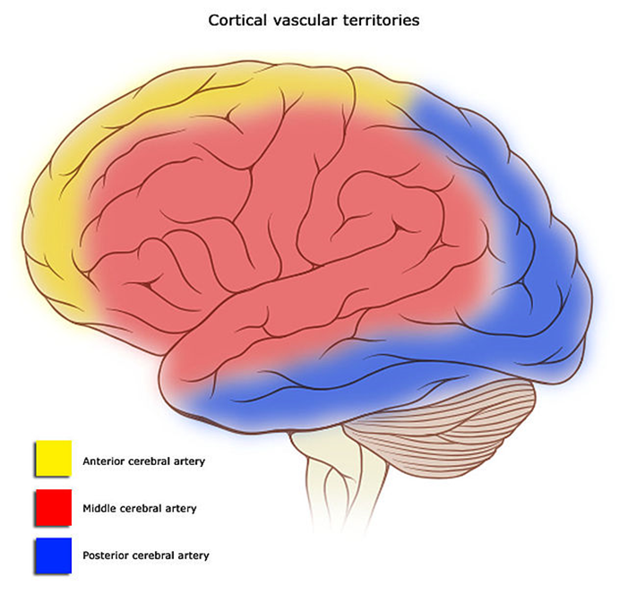
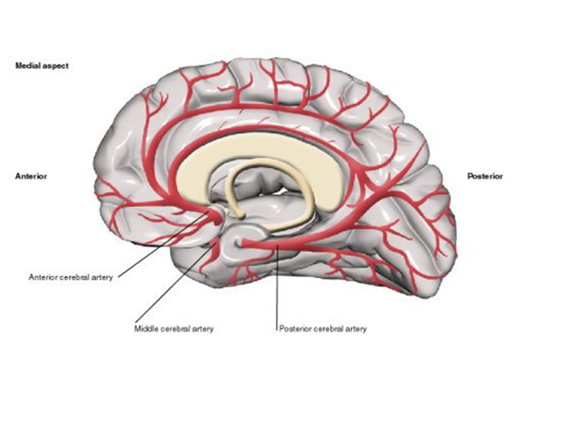
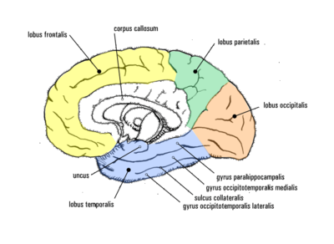
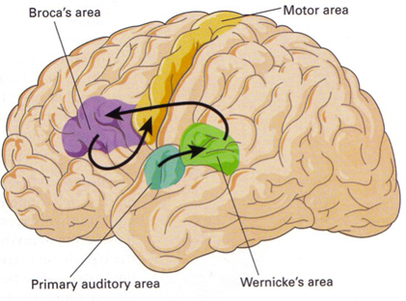
Medial Surface of Cerebral Hemisphere
Superolateral Surface of Cerebral Hemisphere

Slide 10
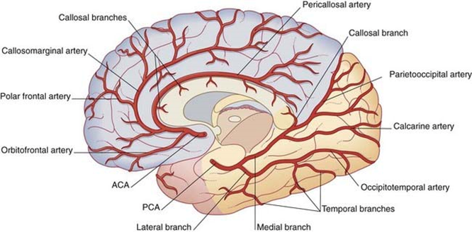
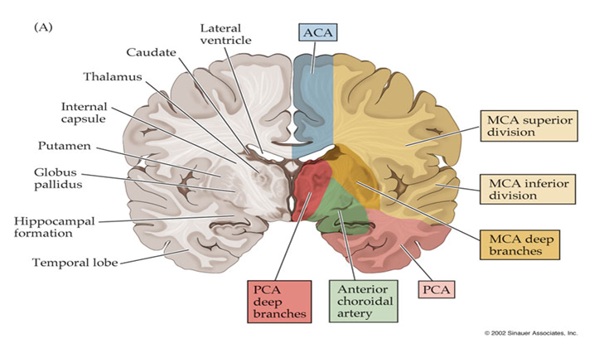
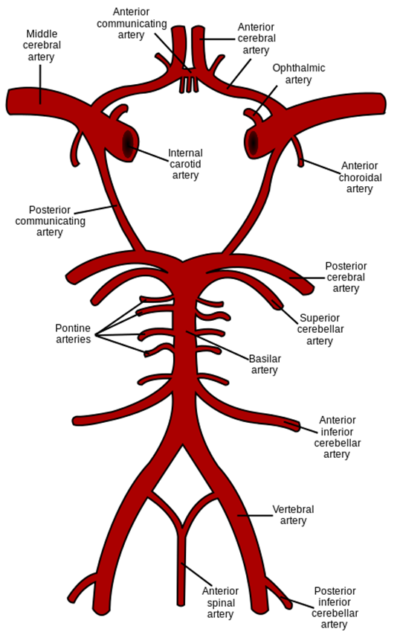
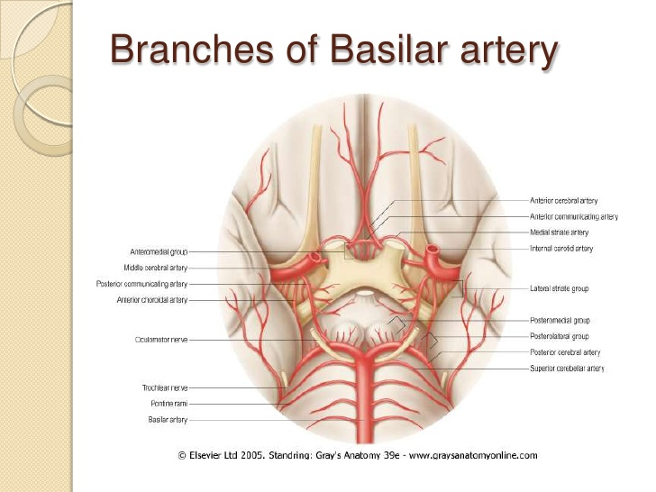
Basilar artery
Only on the boys’ slides
Supplies: | Mid brain and cerebellum
Branches: | Anterior inferior cerebellar artery. Pontine branches. Superior cerebellar artery.
Notes:
The vertebral arteries unite at the lower border of the pons to form the basilar artery.
Pontine: related to the pons.
Extra

Slide 11
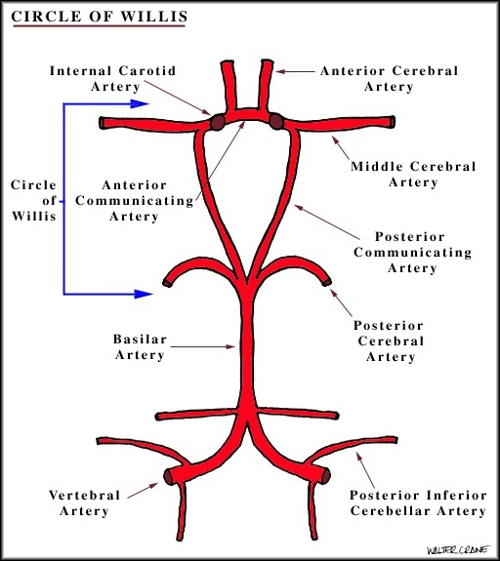
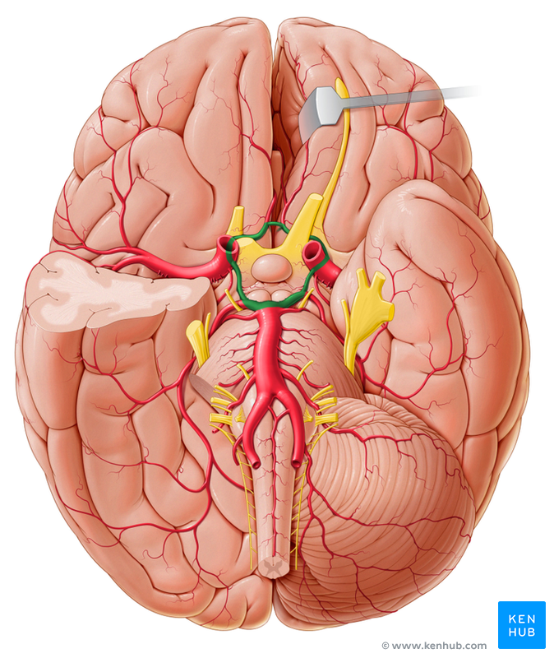
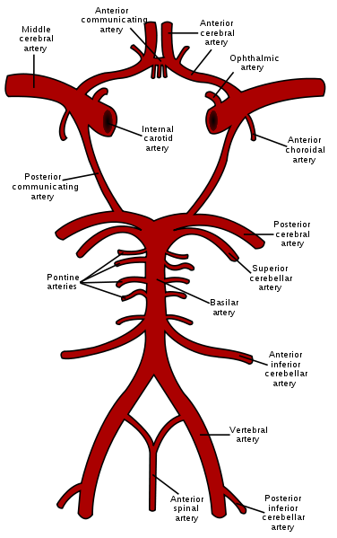
Circulus Arteriosus (Circle of wills*)
Playlist
It joins the carotid and vertebrobasilar systems**.
It is located on the base of the brain.
It encircles (surrounds):
Optic chiasma.
Hypothalamus.
Midbrain.
Pituitary gland.
Extra
Extra
It is formed by:
Two internal carotid arteries
Two anterior cerebral arteries
Two posterior cerebral arteries
Two posterior communicating arteries
One anterior communicating artery
*Named after Thomas Willis (1621–1675), an English physician.
** the circle of Willis is Formed by the anastomosis between the two internal carotid arteries and the two vertebral arteries. (Snell)

Slide 12
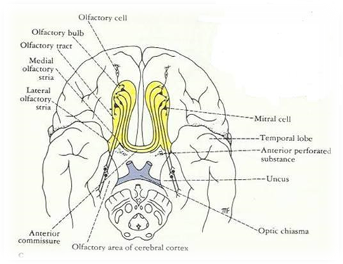
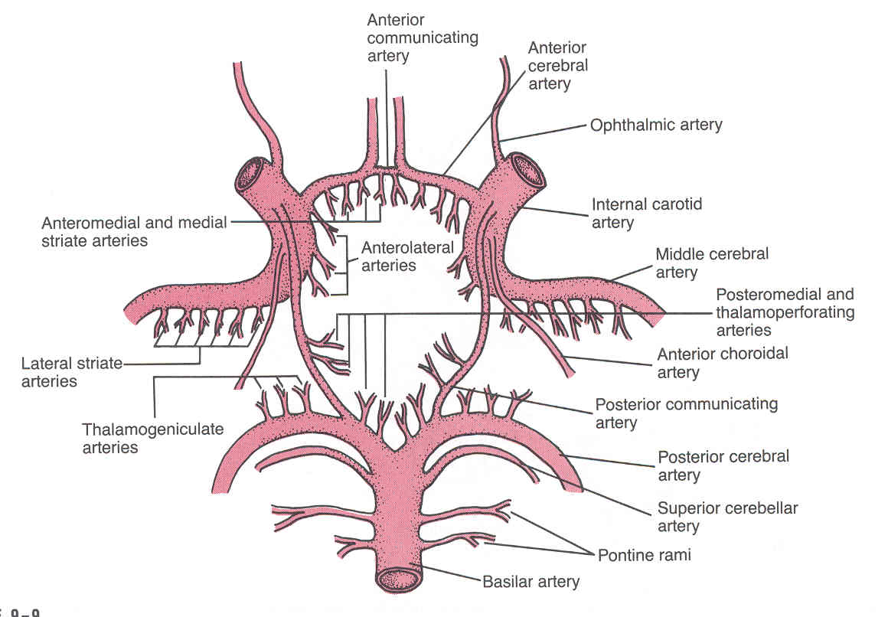
Circulus Arteriosus (Circle of wills)
Branches: Perforating arteries
numerous small vessels that penetrate the surface of the brain through the anterior and posterior perforating substances.
They are divided into:
 | Anterior Perforating Arteries | Posterior Perforating Arteries
Arise from: | Anterior cerebral artery. Anterior communicating artery. Middle cerebral artery. | Posterior cerebral artery . Posterior communicating artery.
Enter brain through: | Anterior perforated substance (an irregularly quadrilateral (having 4 sides) area in front of the optic tract and behind the olfactory trigone). | Posterior Perforated substance. (perforated substance: a layer of grey matter, that is pierced to allow blood vessels to pass)
Supplies | Large part of basal ganglia. Optic chiasma. Internal capsule ( a white matter structure). Hypothalamus . | Ventral portion of Midbrain. Parts of Subthalamus and Hypothalamus.
Notes:
Perforated substance: vessels pass through

Slide 13
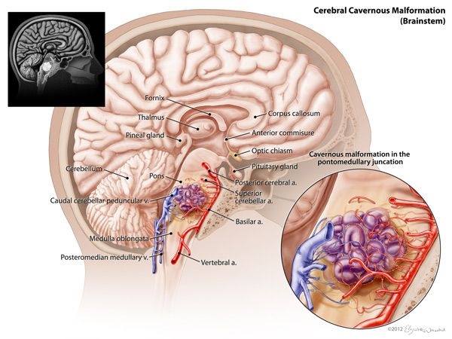
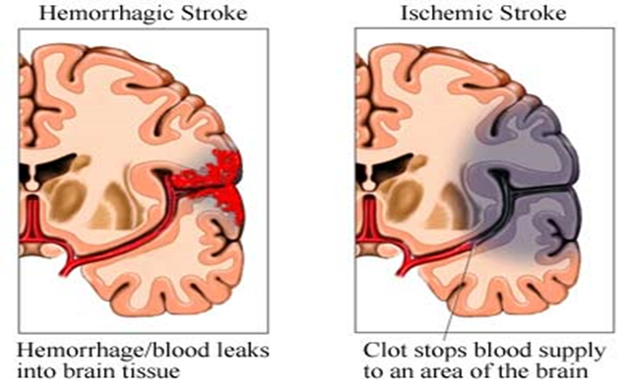
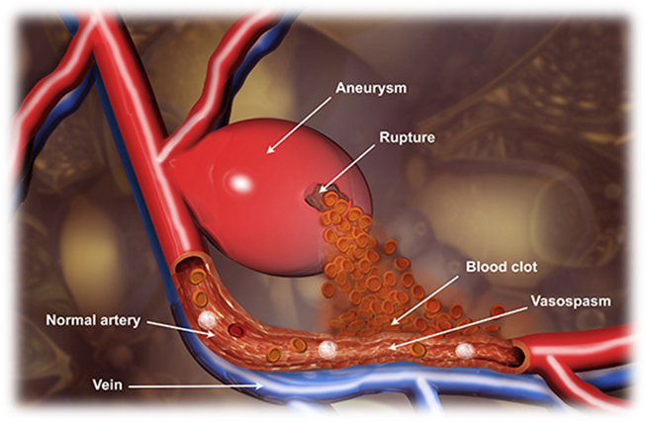
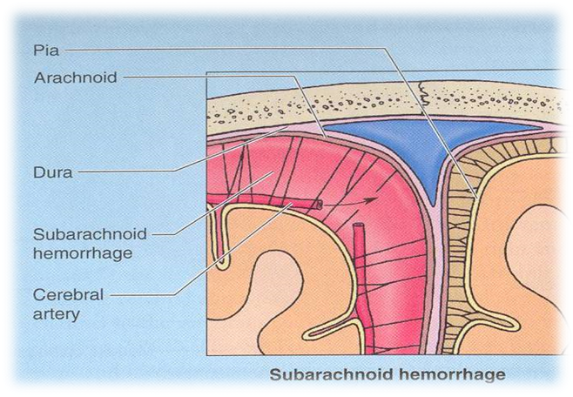
Arterial Disorders
Stroke
Aneurysm
Angioma
It happens when blood supply to the brain is interrupted or reduced.
Sudden occlusion
It can be: Ischemic or hemorrhagic.
localized, blood-filled balloon-like bulge in the wall of a blood vessel.
benign tumors derived from cells of the vascular or lymphatic vessel walls (epithelium) or derived from cells of the tissues surrounding these vessels.

Slide 14
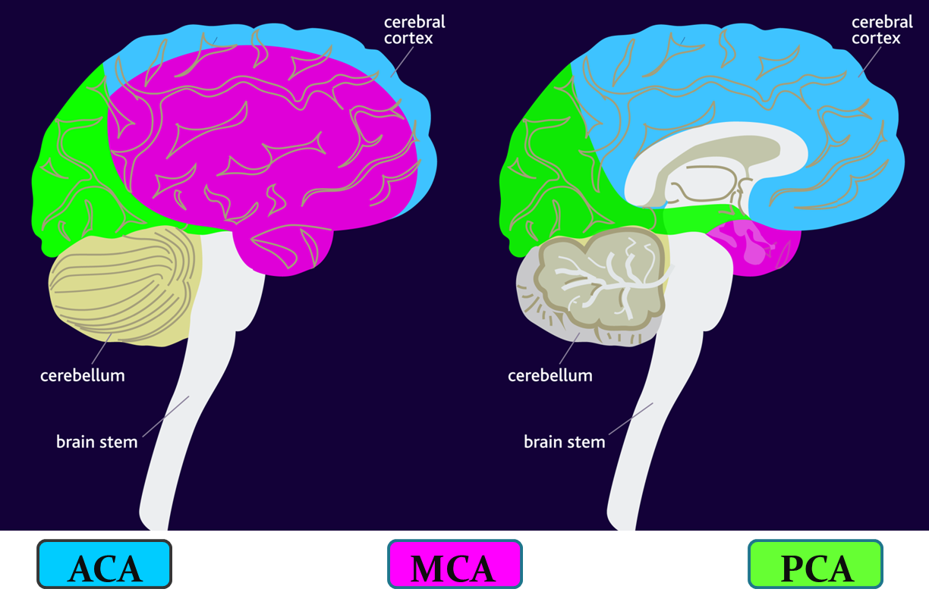
Effects of Occlusion of Cerebral Arteries

Slide 15
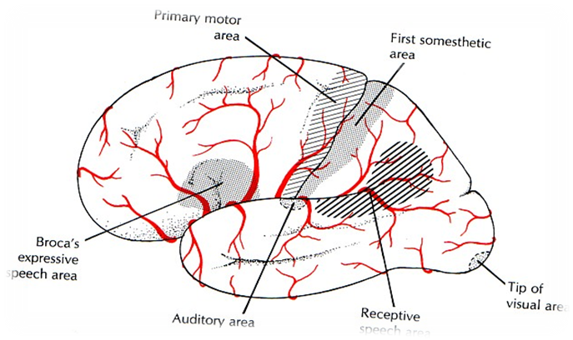
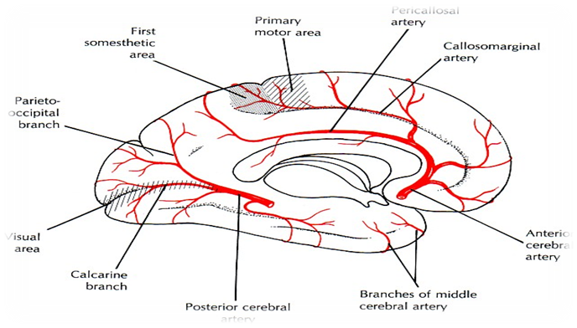
Effects of Occlusion of Cerebral Arteries (Manifestations)
(Important may come as scenario)
Artery | Anterior Cerebral Artery (ACA) | Middle Cerebral Artery (MCA) | Posterior Cerebral Artery (PCA)
Effect | Motor disturbance in contralateral distal leg Difficulty in prefrontal lobe functions: Cognitive thinking Judgement Motor initiation Self monitoring | Contralateral weakness of: face, arm, and hands more than legs Contralateral sensory loss of: face, arm, and hands more than legs Visual field cut (damage to optic radiation) Aphasia (language disturbance): In Broca’s area: production In Wernicke’s area: comprehension | Visual disturbances: Unilateral lesion: contralateral homonymous hemianopsia Bilateral lesions: cortical blindness, patients unaware they cannot see (Anton’s Syndrome) Memory impairment: if temporal lobe is affected
Anterior cerebral artery
Notes:
Optic radiation: axons from the neurons in the lateral geniculate nucleus to the primary visual cortex.
Hemianopsia: decreased vision or blindness in half the visual field.
Homonymous hemianopsia: the loss of half of the visual field on the same side in both eyes (see picture on right).
Cortical blindness: total or partial vision loss because of damage to the occipital cortex.
Extra

Slide 16
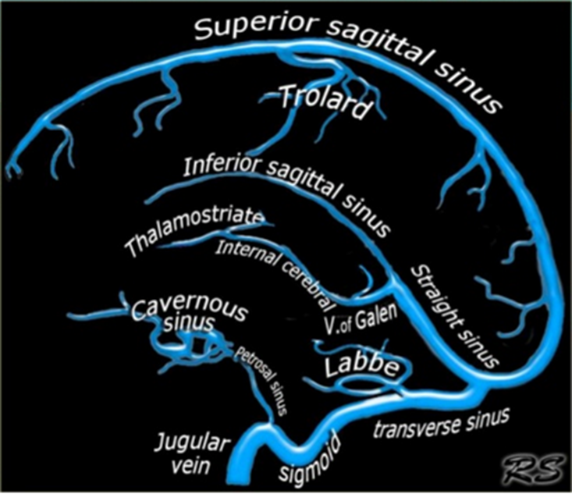
Cerebral Venous Drainage
The veins are thin walled and are devoid of (don’t have) valves.
The cortical veins are:
I. Superficial cortical veins
II. Deep veins
Found in the subarachnoid space
Drain the cortical surface
Drain the deep structures
These veins ultimately drain into:
Dural venous sinuses

Slide 17
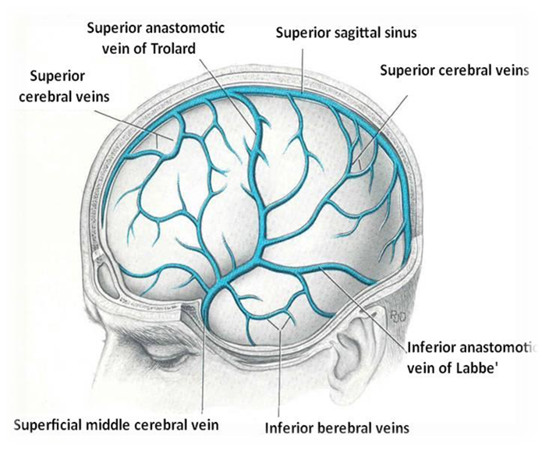
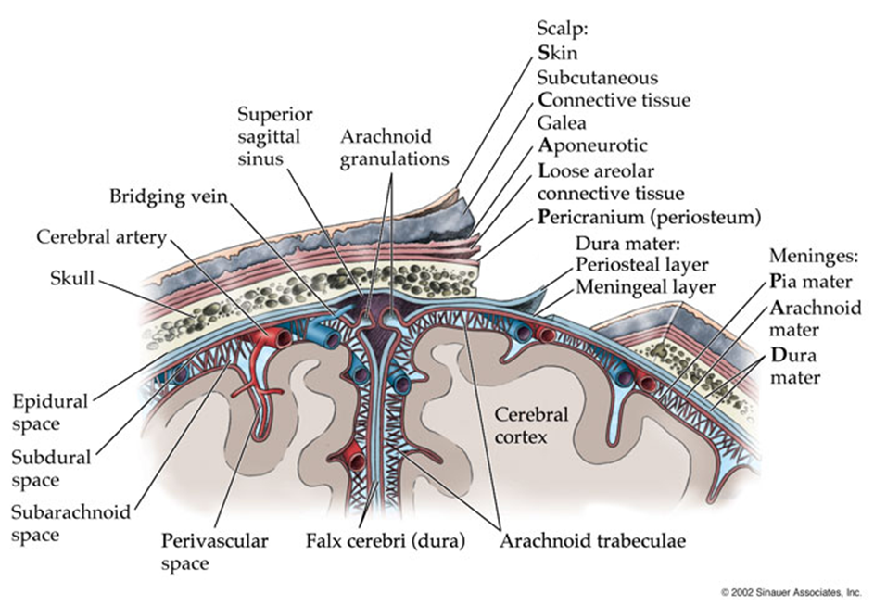
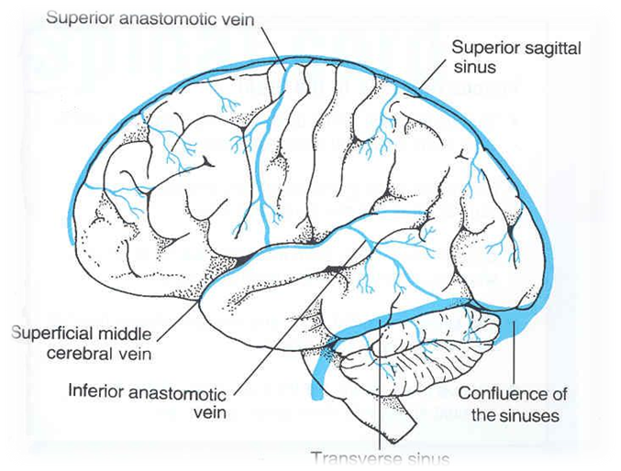
Cerebral Venous Drainage
I. Superficial Cortical Veins
Extra
They lie on the brain surface, in the subarachnoid space.
They are divided into:
 | Course | Termination | Notes
Superior cerebral veins | Drain lateral surface of brain above the lateral sulcus | Terminate mainly into the Superior Sagittal sinus, and partly into superficial middle cerebral vein. | 6 to 12 veins
Inferior cerebral veins | Run below the lateral sulcus | Terminate partly into superficial middle cerebral vein & partly into Transverse sinus. | Drain the lateral surface of the temporal lobe
Superficial middle cerebral veins | Runs along the lateral sulcus | Terminates into the Cavernous sinus | Connected posteriorly by Superior & Inferior anastomotic veins to Superior Sagittal & Transverse sinuses respectively
Superior anastomotic vein
Transverse sinus

Slide 18
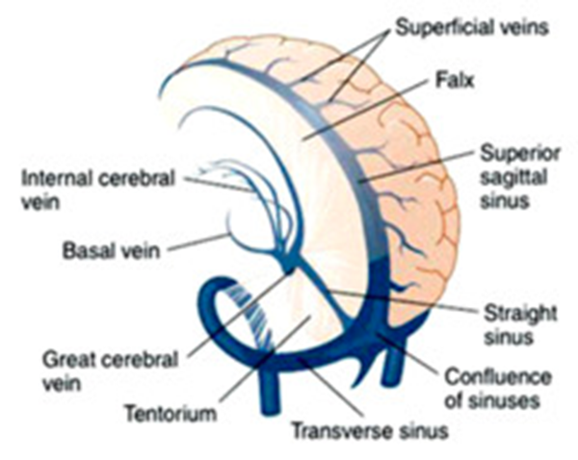
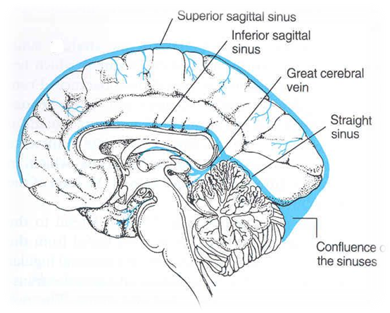
Cerebral Venous Drainage
II. Deep Cortical Veins
They drain the internal structures:
Basal ganglia
Internal capsule
Thalamus
Deep cerebral veins
Internal cerebral veins
Great cerebral vein
Straight sinus
They merge to form:
The two veins unit in the midline to form:
This short vessel joins the Inferior Sagittal sinus to form:

Slide 19
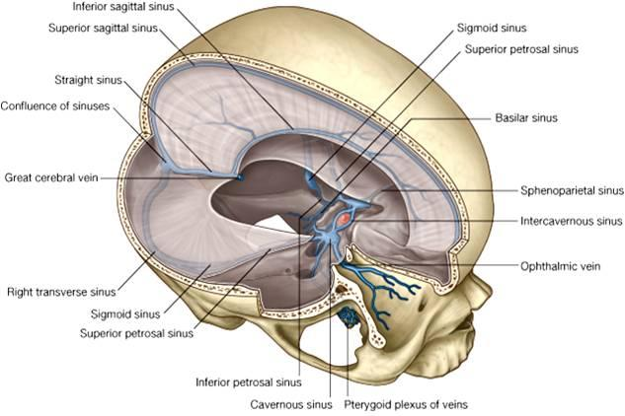
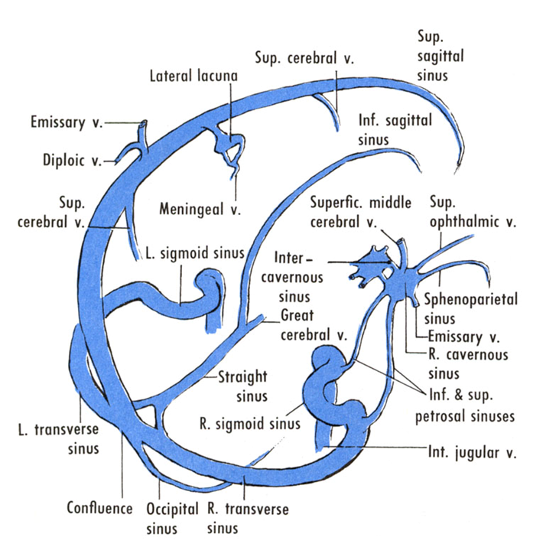
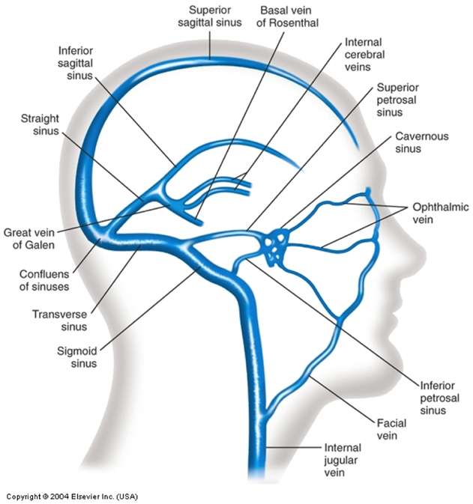
Cerebral Venous Drainage
Dural venous sinuses
The dural venous sinuses are grouped into:
Blood flows from transverse & sigmoid sinuses into IJV Internal Jugular Vein.
Paired:
Transverse
Sigmoid
Cavernous
Petrosal (superior & inferior)
Single:
Superior sagittal
Inferior sagittal
Straight
Occipital
Notes:
مخطط

Slide 20
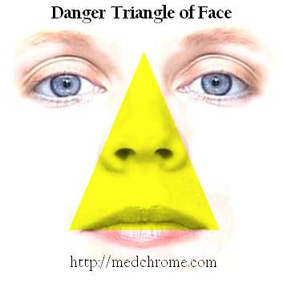
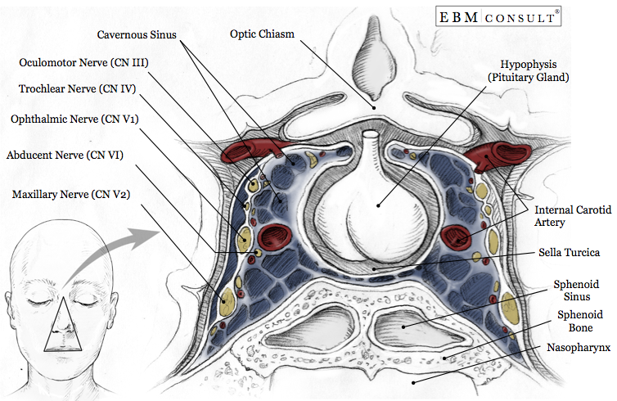
Venous Disorders
Infarction
refers to tissue death (necrosis) that is caused by a local lack of oxygen due to obstruction of the tissue's blood supply
Sinus thrombosis
SSS (superior sagittal sinus) thrombosis*: can complicate ear infection
Cavernous sinus thrombosis: As a complication of infection in the dangerous area of the face**
**
Obstruction of venous drainage of the brain leads to Cerebral swelling (edema) and raised Intracranial Pressure.
*Superior sagittal sinus thrombosis (SSST) is the most common type of dural venous sinus thrombosis and is potentially devastating
Extra

Slide 21
Only on the boys’ slides
These 2 videos summarize the lecture:
(to view them download the ppt version)
Duration: 01:42
Duration: 01:18

Slide 22
Summary
Cerebral arterial supply
Carotid system
Circulus arteriosus (of willis)
Vertebro basilar system
Internal carotid artery
Divides into two posterior cerebral A
Joins carotid and vertebrobasilar systems
Anterior cerebral A
Middle cerebral A
Supplies:
1.Anterior and inferior parts of temporal lobe
2.Inferior temporal gyrus
3.uncus
4.Inferior and medial parts of occipital lobe
Composed of :
2 anterior cerebral A
2 internal carotid A
2 posterior cerebral A
2 posterior communicating A
1 anterior communicating A
Branches :
Supplies : 1.orbital & medial surfaces of frontal and parietal lobes
3.Narrow part on the superolateral surface
Supplies entire superolatral surface:
1.Motor cortex
2.somatosensory cortex
3.Language areas (Broca & Wernicke)
4.primary auditory area + association (heschl)
APA
PPA
Supply :
Large part of basal ganglia
Optic chiasma
Internal capsule
hypothalamus
Supply :
1. Ventral portion
of midbrain
2. Parts of subthalamus and hypothalamus

Slide 23
Summary
Cerebral venous drainage
Superficial cortical veins
Deep cortical veins
Drain the internal structures (basal ganglia , internal capsule , thalamus)
Internal cerebral veins
Great cerebral vein
Straight sinus
Superior cerebral veins (6-12)
Inferior cerebral V
Superficial middle cerebral V
Drain lateral surface of brain above the lateral sulcus
Terminate mainly into superior sagittal sinus and partly into superficial middle cerebral vein
Drain the lateral surface of the temporal lobe
Terminate partly into superficial middle cerebral vein& partly into transverse sinus
Terminates into cavernous sinus
Connected posteriorly by superior & inferior anastomotic vein to superior sagittal & transverse sinuses respectively

Slide 24
Q1. What does the basilar artery supply? A. Mid brain B. cerebellum C. A&B D. motor cortex
MCQS
Q5. Which of the following is not a branch of the basilar artery
A. Anterior inferior cerebellar artery.
B. Pontine branches.
C. Superior cerebellar artery
Middle cerebral artery
Q6. What does the the circle of Willis NOT encircle?
A. Optic chiasma.
B. Hypothalamus.
C. Midbrain
D. Cerebellum
Q2. Which of the following are paired Dural sinuses?
A. Inferior sagittal
B. Straight
C. Cavernous
D. Occipital
Q3. Which of the following is the one of the effects that occur when the posterior cerebral artery is occluded?
A. Visual disturbances
B. Language disturbances
C. Motor disturbance in the contralateral distal leg
D. Contralateral sensory loss of face
Q7. What do the cerebral veins NOT drain?
A. Basal ganglia
B. Internal capsule
C. Thalamus
D. Hypothalamus
1.C
2.C
3.A
4.A
5.D
6.D
7.D
8.B
Q4. Which of the following supplies the Optic chiasma:
A. Anterior Perforating Arteries
B. Posterior Perforating Arteries
C. Middle Perforating Arteries
D. Anterior Cerebral Artery
Q8. Which of the following runs below the lateral sulcus:
A-Superficial cerebral veins
B-Inferior cerebral veins
C-Superficial cerebral artery
D-Inferior cerebral artery

Slide 25
SAQ
Q1. From which arteries do the anterior perforating arteries arise from?
Anterior cerebral artery.
Anterior communicating artery.
Middle cerebral artery.
Q2. Which parts do the posterior perforating arteries supply?
a. Ventral portion of Midbrain.
b. Parts of Subthalamus and Hypothalamus.
Q3. A 35 year old man came to the hospital complaining of impaired memory and cortical blindness.
Which cerebral artery is affected?
Posterior cerebral artery
Which side is most likely affected?
Bilateral lesion (affecting both sides) which will lead to Anton’s syndrome

Slide 26
Leaders:
Nawaf AlKhudairy
Jawaher Abanumy
Members:
Abdulmalek alhadlaq
Abdullah jammah
AbdulMohsen alghannam
Mohammed habib
Majed alzain
Abdulrahman almalki
Abdulmohsen alkhalaf
Alanoud Abuhaimed
Anwar Alajmi
Nourah Al Hogail
Nouf Aloqaili
Feedback
anatomyteam436@gmail.com
References:
1- Girls’ & Boys’ Slides
2- Greys Anatomy for Students
3- TeachMeAnatomy.com
@anatomy436
Anatomy Team

