Slide 1
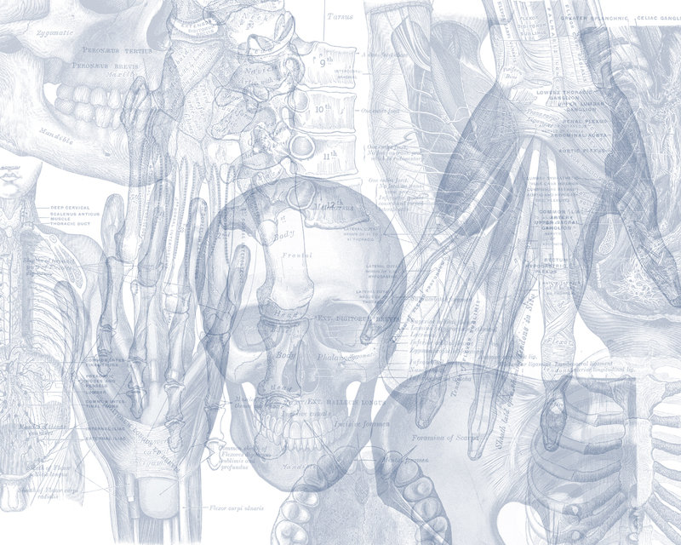
Thalamus and Limbic System
Color Code
Important
Doctors Notes
Notes/Extra explanation
Please view our Editing File before studying this lecture to check for any changes.

Slide 2
Objectives
At the end of the lecture, the students should be able to:
Describe the anatomy and main functions of the thalamus.
Name and identify different nuclei of the thalamus.
Describe the main connections and functions of thalamic nuclei.
Name and identify different parts of the limbic system.
Describe main functions of the limbic system.
Describe the effects of lesions of the limbic system.

Slide 3
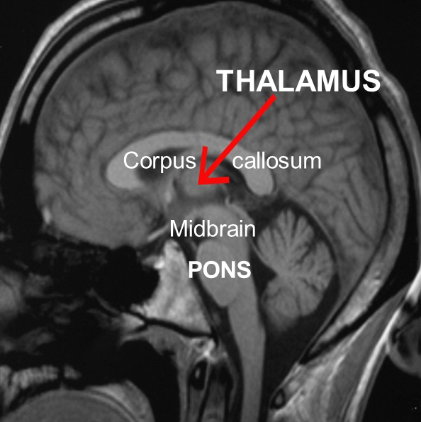
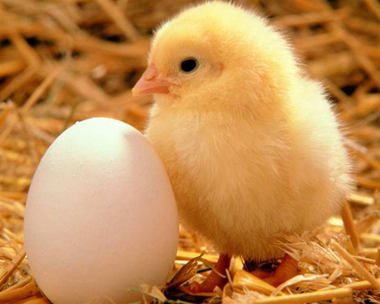
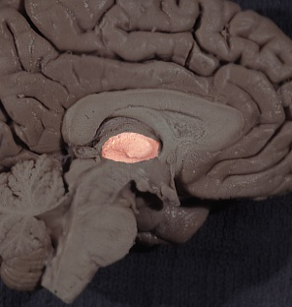
Thalamus
02:04
It is the largest nuclear mass of the whole body.
It is the largest part of the diencephalon
It is formed of: two oval masses of grey matter.
It is the gateway to the cortex.(the last station for sensory fibers before it project to the cortex)
Resemble a small hen.
Together with the hypothalamus they form the lateral wall of the 3rd ventricle.
The thalamus sends received information to the cerebral cortex from different brain regions.
Axons from every sensory system (except olfaction) synapse in the thalamus as the last relay site 'last pit stop' before the information reaches the cerebral cortex.
There are some thalamic nuclei that receive input from:
Cerebellar nuclei,
Basal ganglia
Limbic-related brain regions.

Slide 4
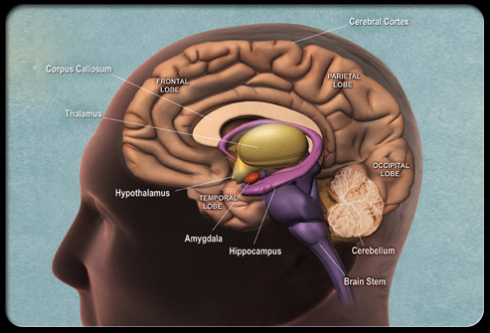
Thalamus
Relations
Relation = surfaces
S
T
L
It has 4 surfaces & 2 ends.
3
I
Surfaces:
Superior: (S)
Lateral ventricle and fornix.
Inferior: (I)
Hypothalamus, anteriorly & Subthalamus posteriorly.
Ends:
Anterior end:
Forms a projection, called the anterior tubercle. It lies just behind the interventricular foramen*.
Posterior end: (Broad عريض)
Forms a projection called Pulvinar which lies above the superior colliculus and the lateral & medial Geniculate bodies.
Medial: (3)
The 3rd ventricle In some people it is connected to the thalamus of the opposite side by the interthalamic connexus, (adhesion) or Massa intermedia.
Lateral:(L)
Posterior limb of the internal capsule
*the foramen between the lateral ventricle and the 3^{ed} ventricle.

Slide 5
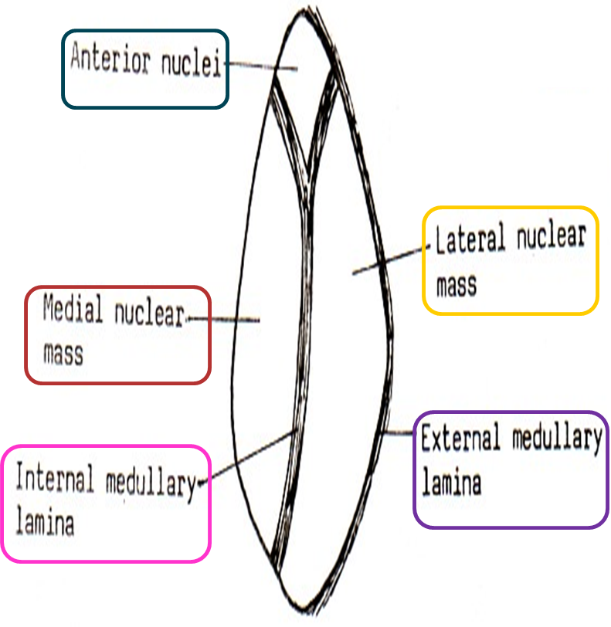
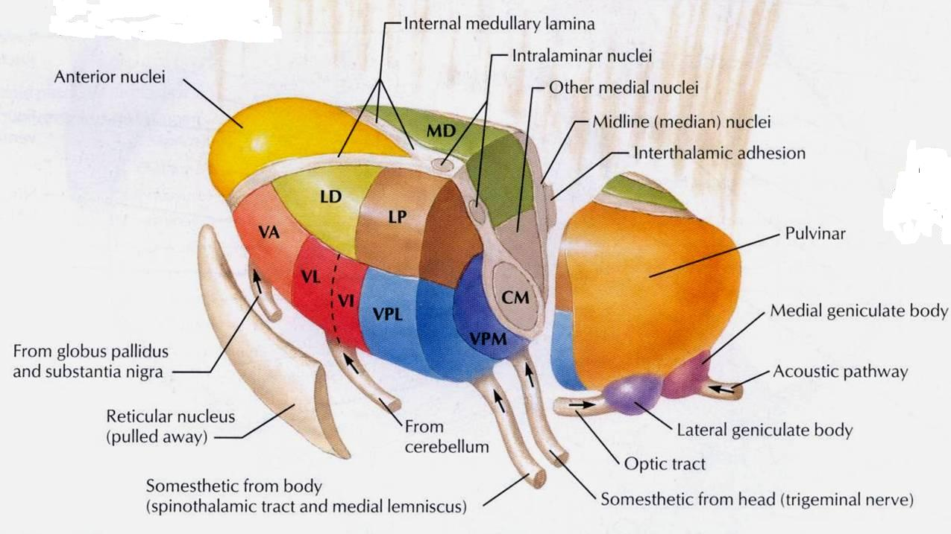
Thalamus
Internal Structure
White matter:
External medullary lamina:
Covers the lateral surface.
It consists of thalamocortical & corticothalamic fibers.
Internal medullary lamina:
Bundle of Y- shaped myelinated (afferent & efferent) fibers.
It divides the thalamus into: anterior* , medial, lateral nuclear groups.
Each of these group is subdivided into a number of named nuclei.
Lamina or fiber
*Has a relation with limbic system
Embedded within the internal medullary lamina lie the intralaminar nuclei.
The external medullary lamina covers the lateral surface; in which lies the reticular nucleus.
Only on the boys’ slides

Slide 6
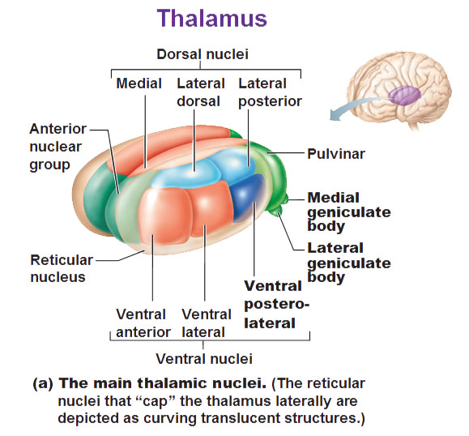
Thalamus
Lateral Nuclear Group
Extra
Lateral Nuclear Group is divided into: Dorsal & Ventral tiers
tier = group
Dorsal Tier | Ventral Tier
1. Lateral Dorsal (LD) | 1. Ventral Anterior (VA)
 | 2. Ventral Lateral (VL)
2. Lateral Posterior (LP) | 3. Ventral Intermediate (VI)
 | 4. Ventral Posterior (VP) (lateral: PLVNT & medial: PMVNT)
3. Pulvinar | 5. Medial geniculate nuclei
 | 6. Lateral geniculate nuclei
VL and VI are the same (have the same function)

Slide 7
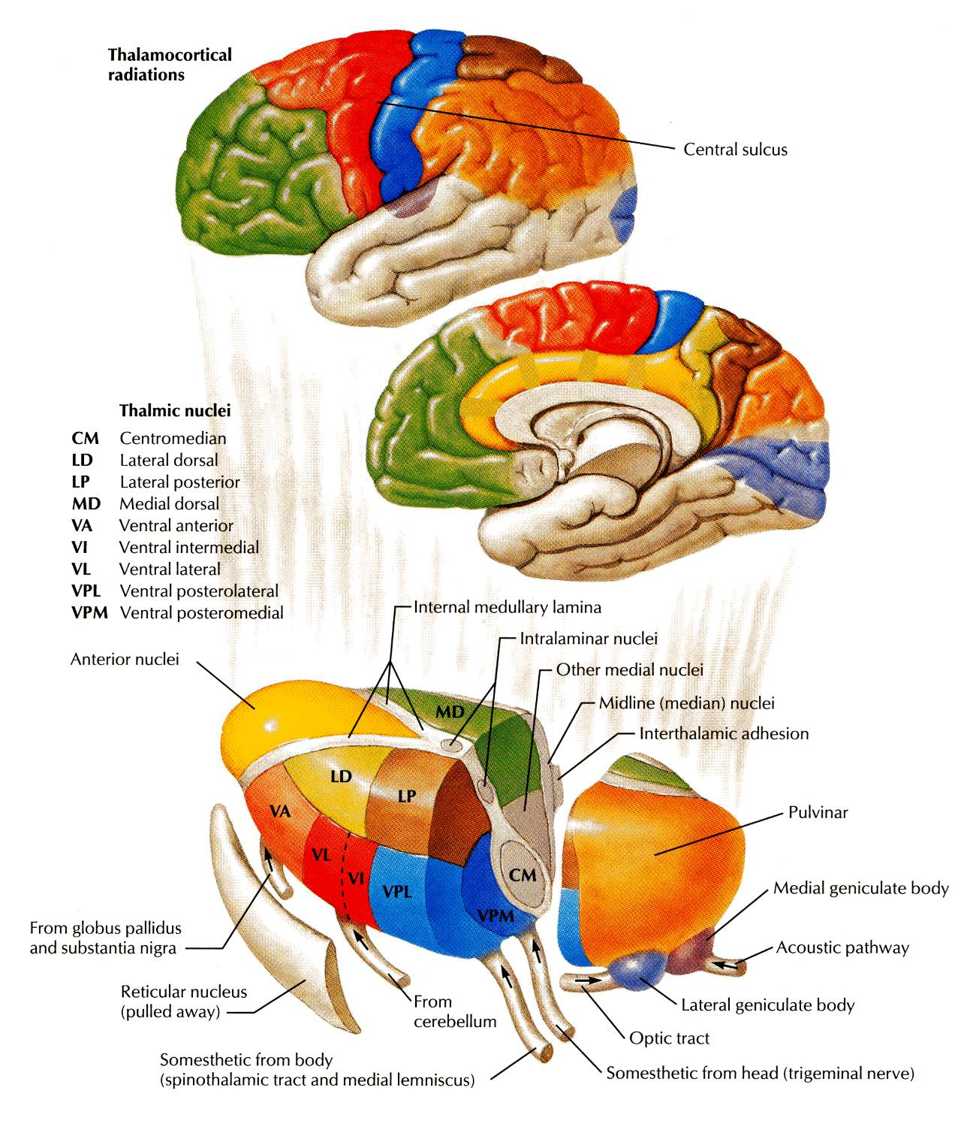
Thalamus
Projection of Nuclei
This slide is important!
 | Afferent | Efferent
Anterior Thalamic Nucleus | Mammillary body. Which is part from hypothalamus | Cingulate gyrus, (part of limbic system)
Medial Nucleus | Hypothalamus. | Prefrontal cortex & Frontal cortex
Ventral Anterior Nucleus | Globus pallidus body and substania nigra. | Premotor cortex. In frontal lobe
Ventral Lateral Nucleus and VI | Dentate Nucleus From cerebellum | Primary Motor Cortex. In frontal lobe in precentral gyrus
Ventral Posterior Lateral Nucleus | Medial and Spinal leminsci. | Sensory Cortex. Postcentral gyrus in partial lobe
Ventral Posterior Medial Nucleus | Trigeminal Leminiscus | Sensory Cortex.
Lateral Geniculate Nucleus | Optic tract | Visual Cortex. In occipital lobe
Medial Geniculate Nucleus | Lateral Leminiscus | Auditory Cortex. In superior temporal lobe
Only on the girls’ slides
Only on the boys’ slides

Slide 8
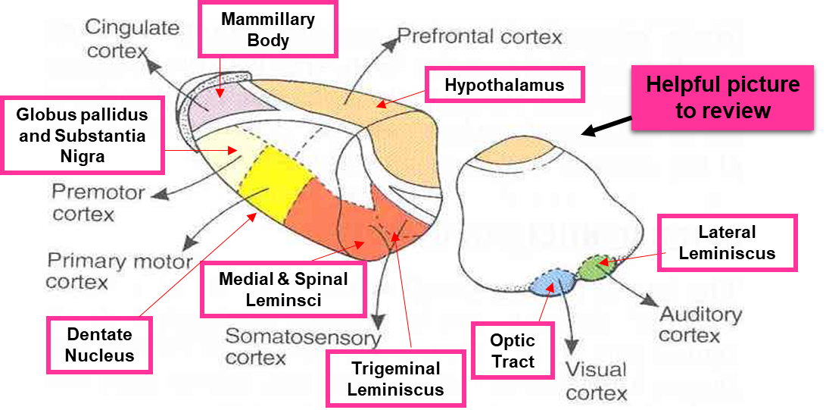

Slide 9
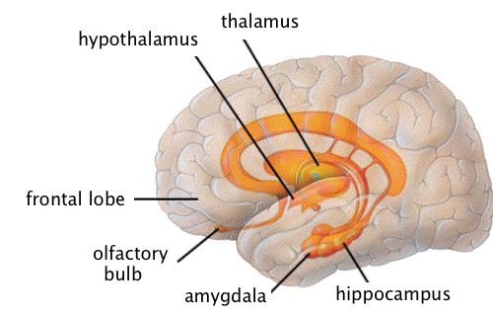
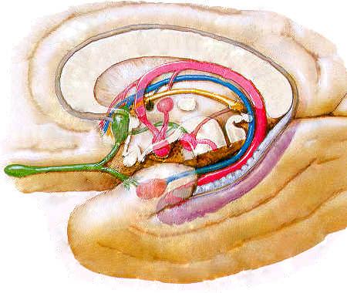
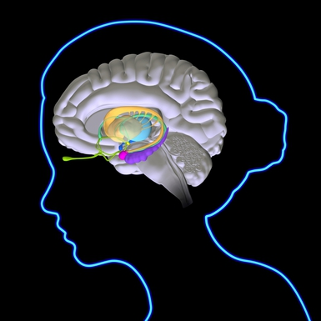
Limbic System
01:52
The term "limbic" is from the Latin word Limbus, for "border" or "edge".
It separates the medial surface of the cerebral cortex from the diencephalon
It consists of a number of cortical & subcortical structures with looped connections that all project to the hypothalamus (particularly mammillary bodies ).
Only on the girls’ slides
Extra

Slide 10
Limbic System
What is the function of the limbic system?
It controls a variety of functions including:
Emotions
Emotional responses
Behavior & Mood (happy, cry, laugh, sad, afraid, aggression, depression)
Motivation
Memory
Visceral & Motor responses involved in (sex, pleasure, hunger, and reproduction).
Olfaction
These are the general functions of the limbic system but certain parts are more responsible for certain things, ex: hippocampus and memory

Slide 11
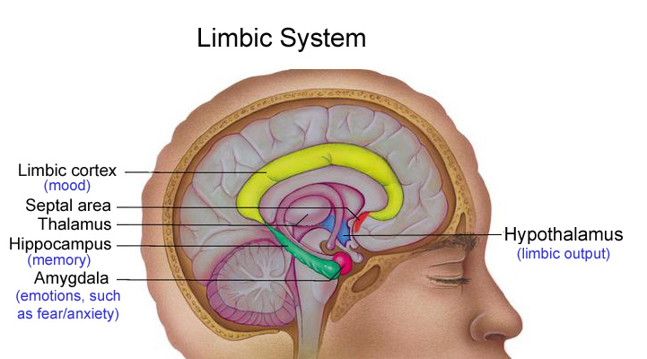
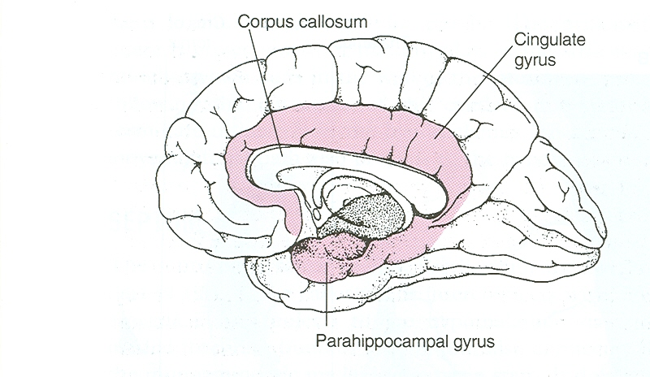
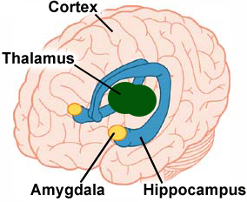
Limbic System
The limbic system is composed of four main structures:
1. Limbic cortex
2. Amygdala.
3. Hippocampus
4. Septal area.
These structures form connections between the limbic system and the hypothalamus, thalamus and cerebral cortex.
The hippocampus is important in memory and learning, while the limbic system itself is important in the control of the emotional responses.
Extra
Extra

Slide 12
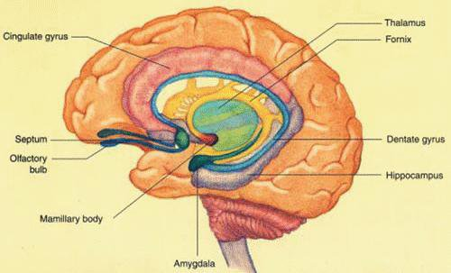
Limbic System
Limbic lobe.
Hippocampal formation.
Septal areas (Fornix, connecting the hippocampus with mammillary bodies and septal nuclei).
Prefrontal area (part of olfactory system).
CORTICAL STRUCTURES
Only on the boys’ slides
Note: Subcortical structures are like amygdala and hypothalamus
Limbic Lobe
C-shaped ring of grey matter on the medial side of each cerebral hemisphere, surrounding the corpus callosum.
It includes:
Subcallosal area
Cingulate gyrus
Isthmus
Parahippocampal gyrus
Uncus.

Slide 13
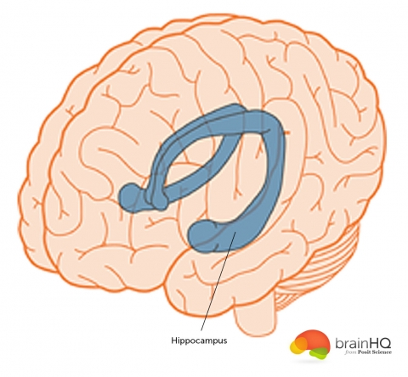
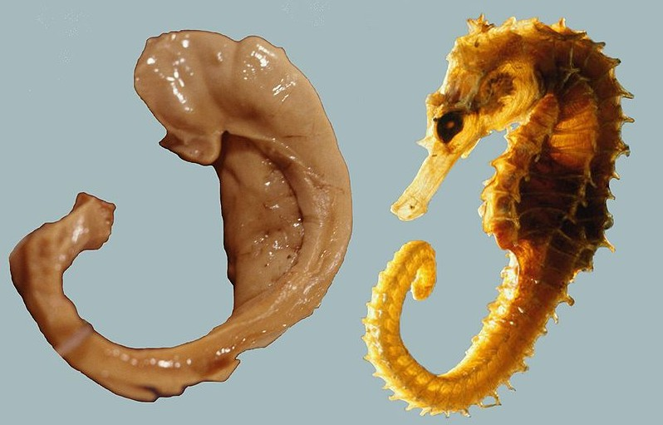
Hippocampus
02:00
It is a limbic system structure that is involved in:
Formation,
Organization, and
Storage of memories.
It is important in forming new memories and connecting emotions and senses, such as smell and sound, to memories.
Extra
It is a horseshoe paired structure, one in each cerebral hemisphere.
It acts as a memory indexer by sending memories to the appropriate part of the cerebral hemisphere for long-term storage and retrieving them when necessary.
The hippocampus got its name because it looks like a seahorse
Extra:
A patient once had his hippocampus removed as a treatment for seizures.
After the surgery the seizures stopped but the patient was not able retain or make any new memories. To learn more about this patient:
https://bigpictureeducation.com/brain-case-study-patient-hm
https://www.youtube.com/watch?v=KkaXNvzE4pk

Slide 14
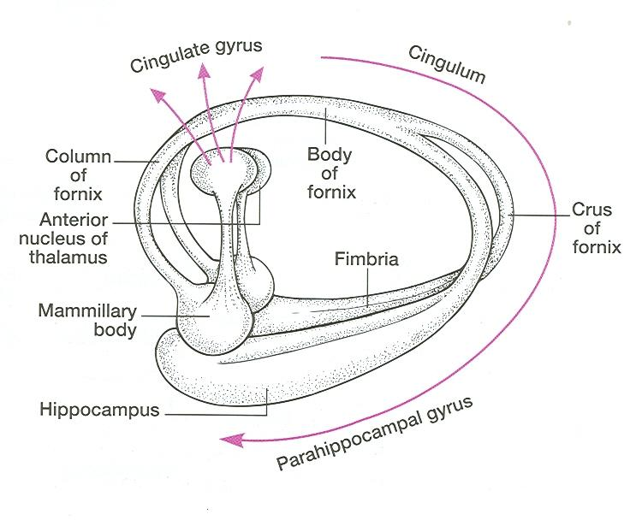
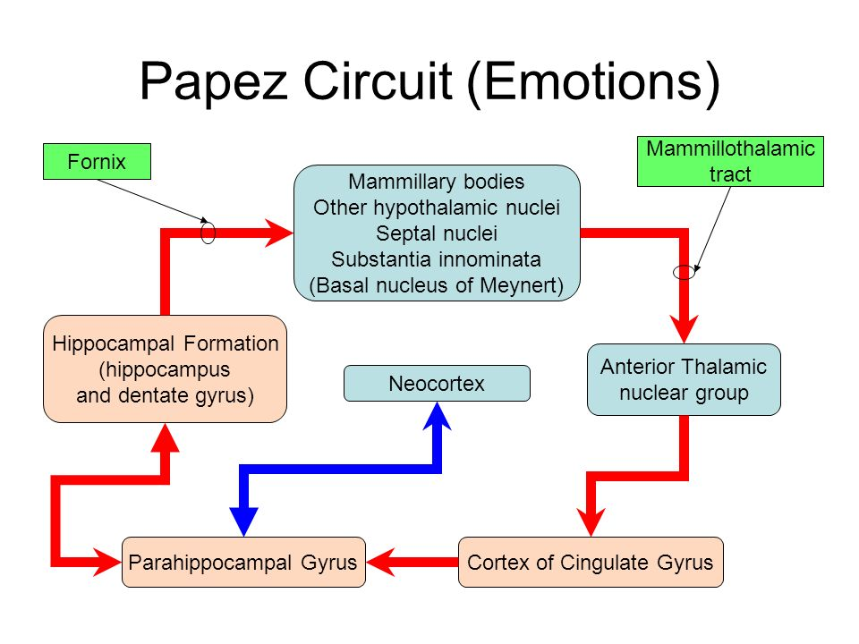
Hippocampus
SITE:
It is a scrolled (infolding) structure in the inferomedial part of the temporal lobe.
FUNCTION:
Memory (file new memories as they occur).
The hippocampus & its connections are necessary for consolidation of new short-term memories.
Its principal efferent pathway is called the: FORNIX:
It is C-shaped group of fibers connecting the hippocampus with mammillary body.
it consists of:
2 Fimbria, 2 Crus, 1 Body & 2 Column.
The Fornix is an important component of PAPEZ CIRCUIT (based on connecting the hypothalamus with limbic lobe to control emotions ).

Slide 15
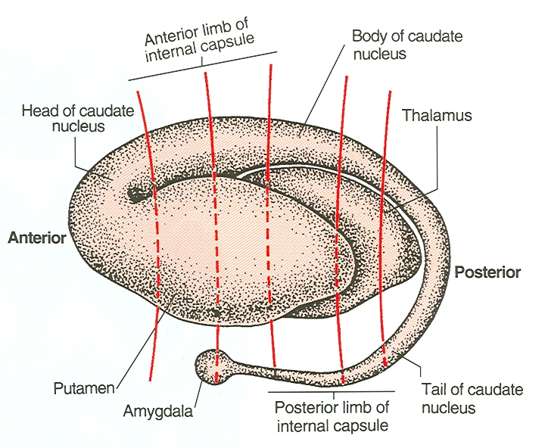
Amygdala
02:01
SITE:
almond shaped mass of nuclei that lies near (deep within) the temporal pole, close to the tail of the caudate nucleus.
FUNCTION:
It is involved in
Emotions
FEAR
Anger
Hormonal secretions
Connections of Amygdala
INPUTS:
Association areas of visual, auditory & somatosensory cortices.
OUTPUTS:
Hypothalamus &
Autonomic nuclei in the brain stem,
LESION: Lack of emotional responses* & docilityطاعة .
*Specifically fear and anger

Slide 16
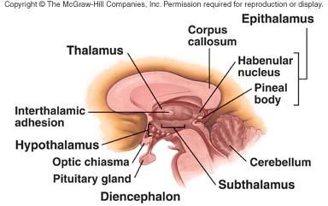
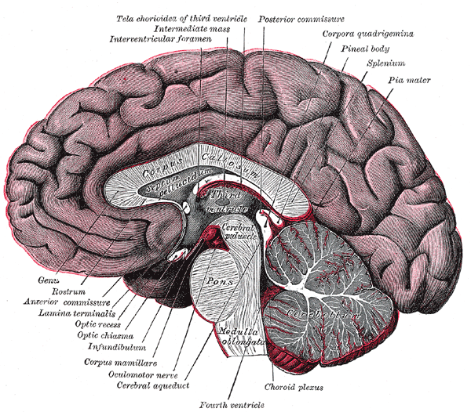
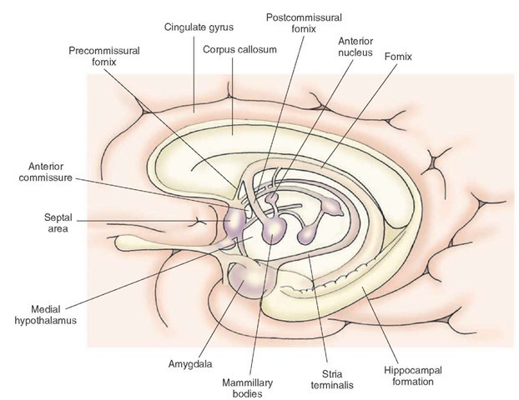
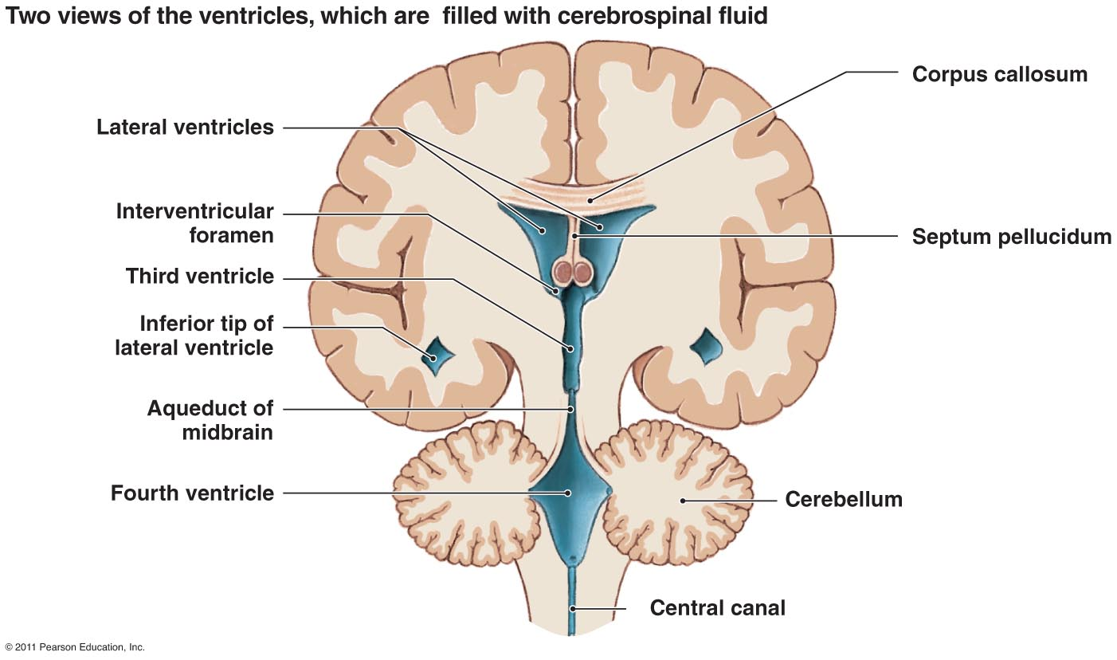
Septal Nuclei
تبع السعادة والهنا ☺
SITE:
Located anterior to the interventricular septum
MAIN CONNECTIONS:
To Hypothalamus
To Habenular nuclei*
FUNCTION:
It is the pleasure zone.
*located behind the thalamus
Extra
Extra
Extra

Slide 17
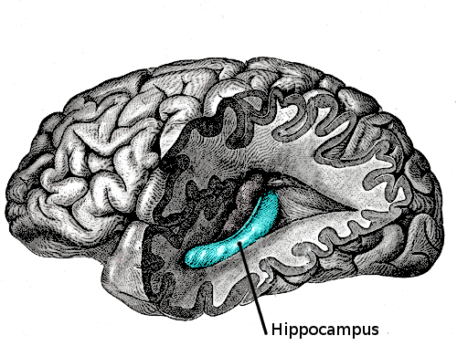
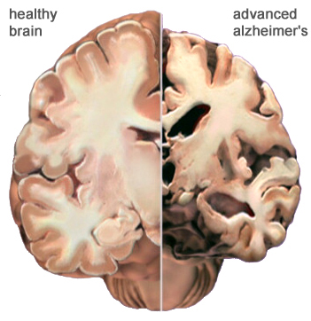
Lesions Associated with Limbic Lobe Disorders
Korsakoff’s psychosis
Korsakoff syndrome is a chronic memory disorder caused by severe deficiency of thiamine (vitamin B-1) & alcoholic intoxication.
(Retrograde = loss of new memories at the time of lesion with loss of retained old memories occurred before the injury & anterograde amnesia = inability to gain new memories)
Temporal lobe epilepsy
The hippocampus is a common focus site in epilepsy, and can be damaged through chronic seizures.
It is sometimes damaged in diseases such as herpes encephalitis.
Alzheimer’s disease:
The hippocampus is one of the first brain areas to show damage in Alzheimer's disease.
Schizophrenia:
mental disorder with inappropriate actions and feelings.
5. Anterograde amnesia
the inability to form and retain new memories.

Slide 18
Summary
Thalamus & limbic system
Thalamic Internal structures
 External medullary lamina -> consists of thalamocortical & corticothalamic fibers.
 Internal medullary lamina -> divides the thalamus into anterior , medial & lateral nuclear groups.
Thalamic Relations
Superior surface-> lateral ventricle, fornix
Inferior surface-> hypothalamus, subthalamus
Medial surface-> 3rd ventricle
Lateral surface-> internal capsule
Anterior end-> anterior tubercle
Posterior end-> pulvinar, superior colliculus, geniculate bodies
Thalamic Lateral nuclear group
 Ventral tier -> lateral dorsal , lateral posterior & pulvinar.
 Dorsal tier -> ventral anterior , ventral lateral , ventral intermediate , ventral posterior (medial & lateral) , medial geniculate nucleus , lateral geniculate nucleus.
The limbic system
Composed of : limbic cortex , amygdala , hippocampus & septal area.
Memories -> Hippocampus
Fear & Anger -> Amygdala
Hormonal secretions -> Amygdala
Pleasure -> Septal Area

Slide 19
1.Which one of these is NOT cortical structure?
Limbic lobe.
Hippocampal formation.
Septal areas.
Amygdala
2.Which one of these is a function of the limbic system?
Memory
Speech
Behavior
A and c
3. what is true about the amygdala?
almond shaped mass
lies far away from the temporal pole
close to the tail of the caudate nucleus.
A and c
5.Which of the following is a part of the dorsal tier of the lateral nuclear group?
Ventral Intermediate (VI)
Ventral Posterior (VP) (PLVNT, PMVNT)
Medial & Lateral geniculate nuclei
Lateral posterior
1.D 2.D 3.D 4.A 5.D
1. Limbic system is composed of four main structures mention 3 only:
1. Limbic cortex
2. Amygdala.
3. Hippocampus
2. The limbic lobe includes 5 parts, mention 2:
Subcallosal area
Cingulate gyrus
3. The amygdala has four functions mention them all:
FEAR
Emotions
Anger
Hormonal secretions
4. What is anterograde amnesia?
The inability to make new memories
The inability to retain old memories
Both a and b
None of the above

Slide 20
Leaders:
Nawaf AlKhudairy
Jawaher Abanumy
Members:
Abdulmalek alhadlaq
Abdullah jammah
AbdulMohsen alghannam
Mohammed habib
Majed alzain
Abdulrahman almalki
Abdulmohsen alkhalaf
Ameera Niazi
Do'aa abdulfattah
Nada Aldakheel
Shatha Alghaihb
Feedback
anatomyteam436@gmail.com
References:
1- Girls’ & Boys’ Slides
2- Greys Anatomy for Students
3- TeachMeAnatomy.com
@anatomy436
Anatomy Team

