Slide 1
Sensory Ascending Spinal Tracts
Color Code
Important
Doctors Notes
Notes/Extra explanation
Please view our Editing File before studying this lecture to check for any changes.

Slide 2
Objectives
By the end of the lecture, the student will be able to:
Define the meaning of a tract.
Distinguish between the different types of tracts.
Locate the position of each tract.
Describe the sensory pathway.
Identify the different sensory spinal tracts and their functions.
Identify the course of each of these tracts.
Know some associated lesions regarding the main tracts.

Slide 3
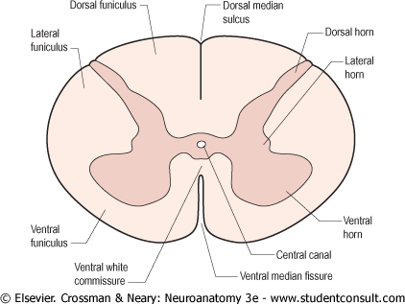
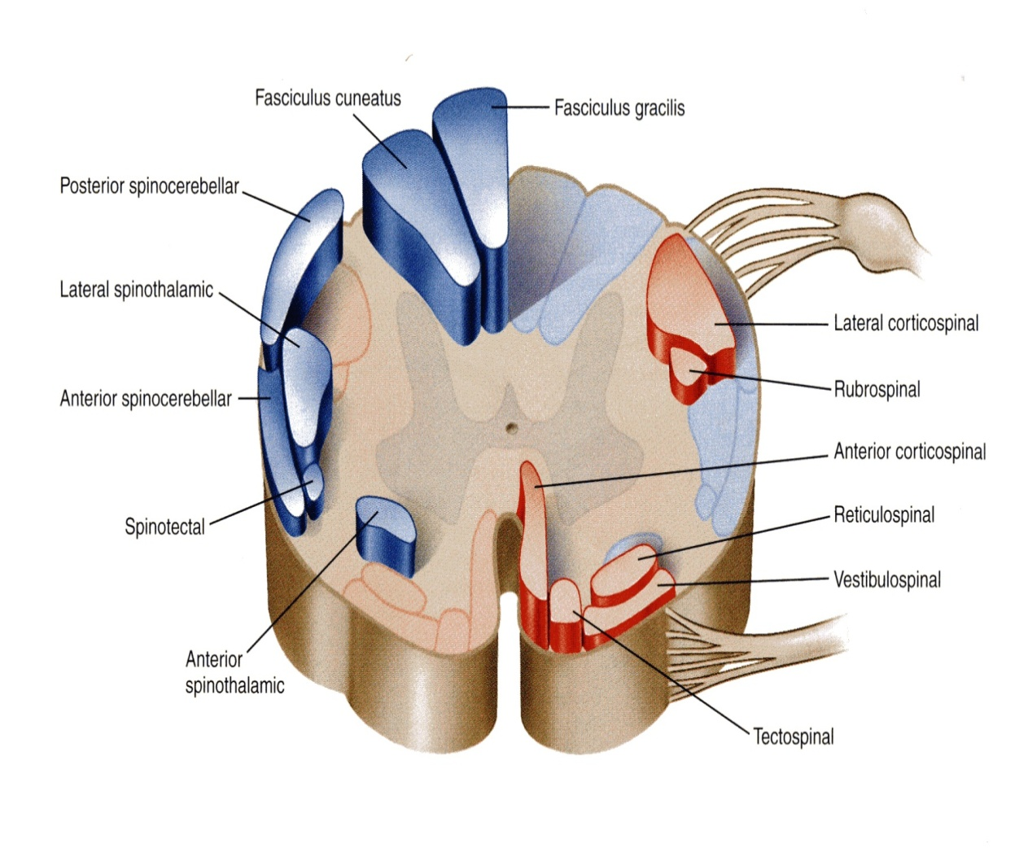
The grey matter of the spinal cord is completely surrounded by the white matter
The white matter of the spinal cord consists of Ascending and Descending Nerve Fibers.
It is divided into Dorsal, Lateral & Ventral Columns or Funiculi.
White matter tracts: bundles or fasciculi of fibers that occupy more or less definite positions in the white matter.
They have the same Origin, Termination and carry the same Function.

Slide 4
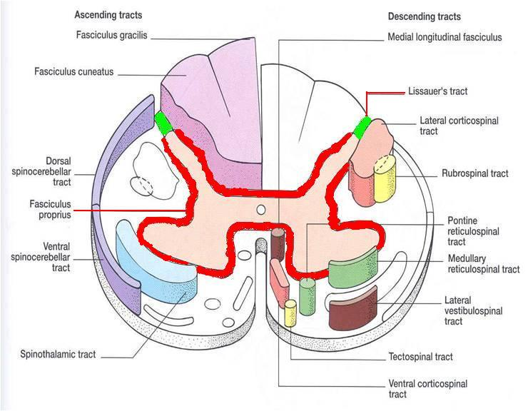
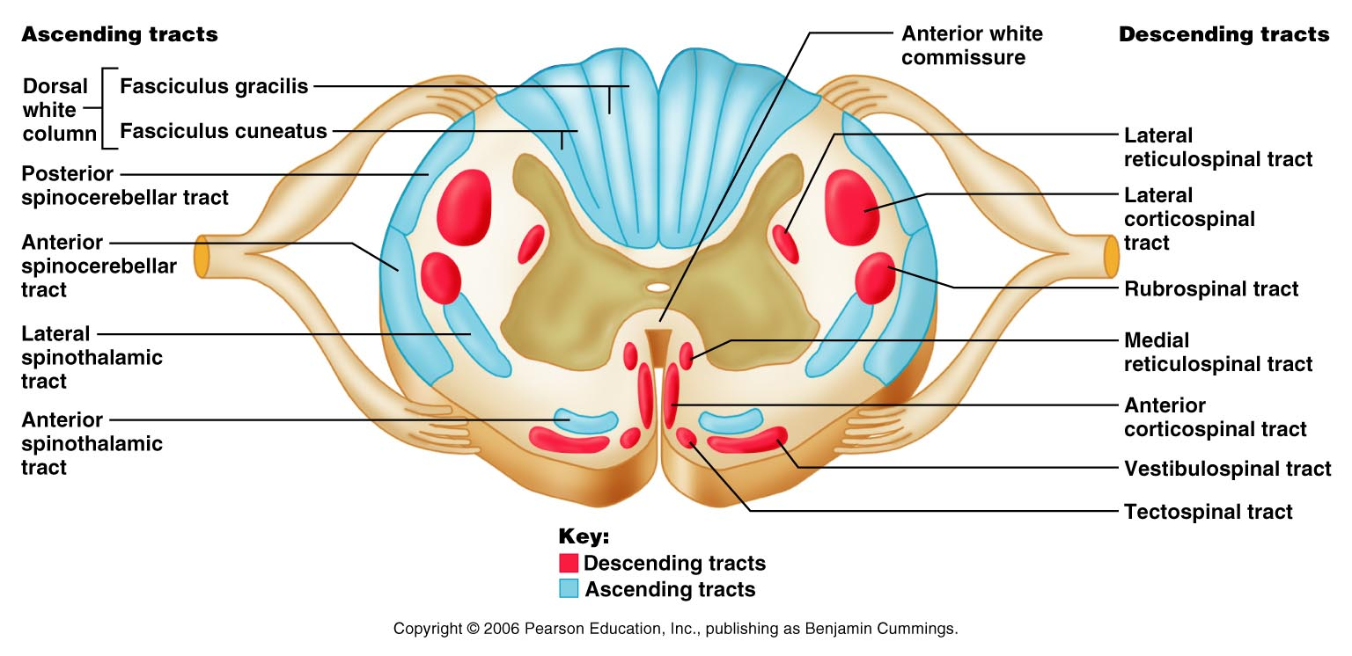
White matter tracts are classified into:
1. Short Tracts; intersegmental or propriospinal.
Fibers occupy narrow band immediately peripheral to the grey matter (fasciculus proprius).
They interconnect adjacent or distant spinal segments and permit intersegmental coordination. (they do not reach the brain)
2. Long Tracts; divided according to function into:
(a) Ascending (sensory or afferent). (b) Descending (motor or efferent).
They serve to join the brain to the spinal cord.
Note: In this lecture we will only discuss the ascending tracts

Slide 5
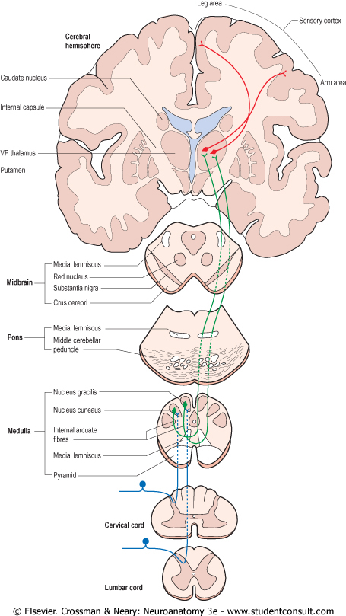
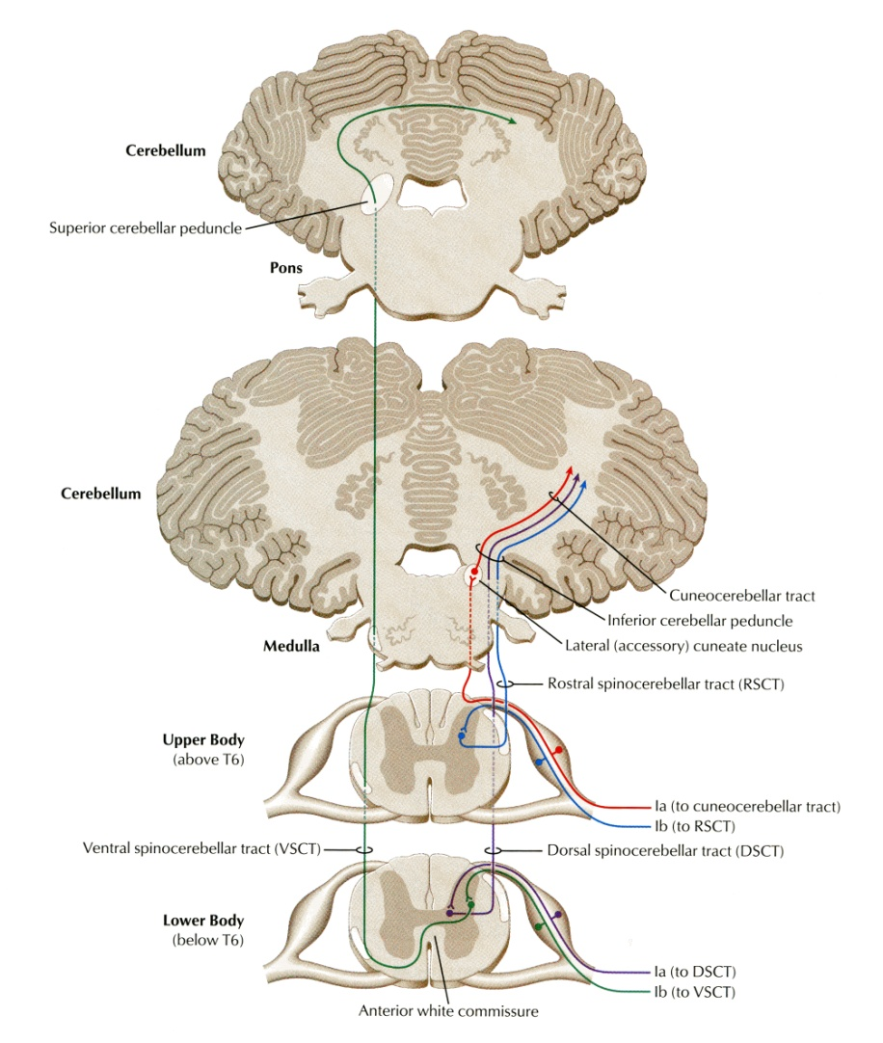
Ascending Tracts;
Carry impulses from pain, thermal, tactile, muscle and joint receptors to the brain.
Some of this information eventually reaches a conscious level (at the cerebral cortex),
while some is destined for subconscious centers (e.g at the cerebellum).
There are 2 types of sensation:
At the conscious level (which we feel): these sensations reach the cerebral cortex.
At the subconscious level (we can’t identify): the sensations only reach the cerebellum.

Slide 6
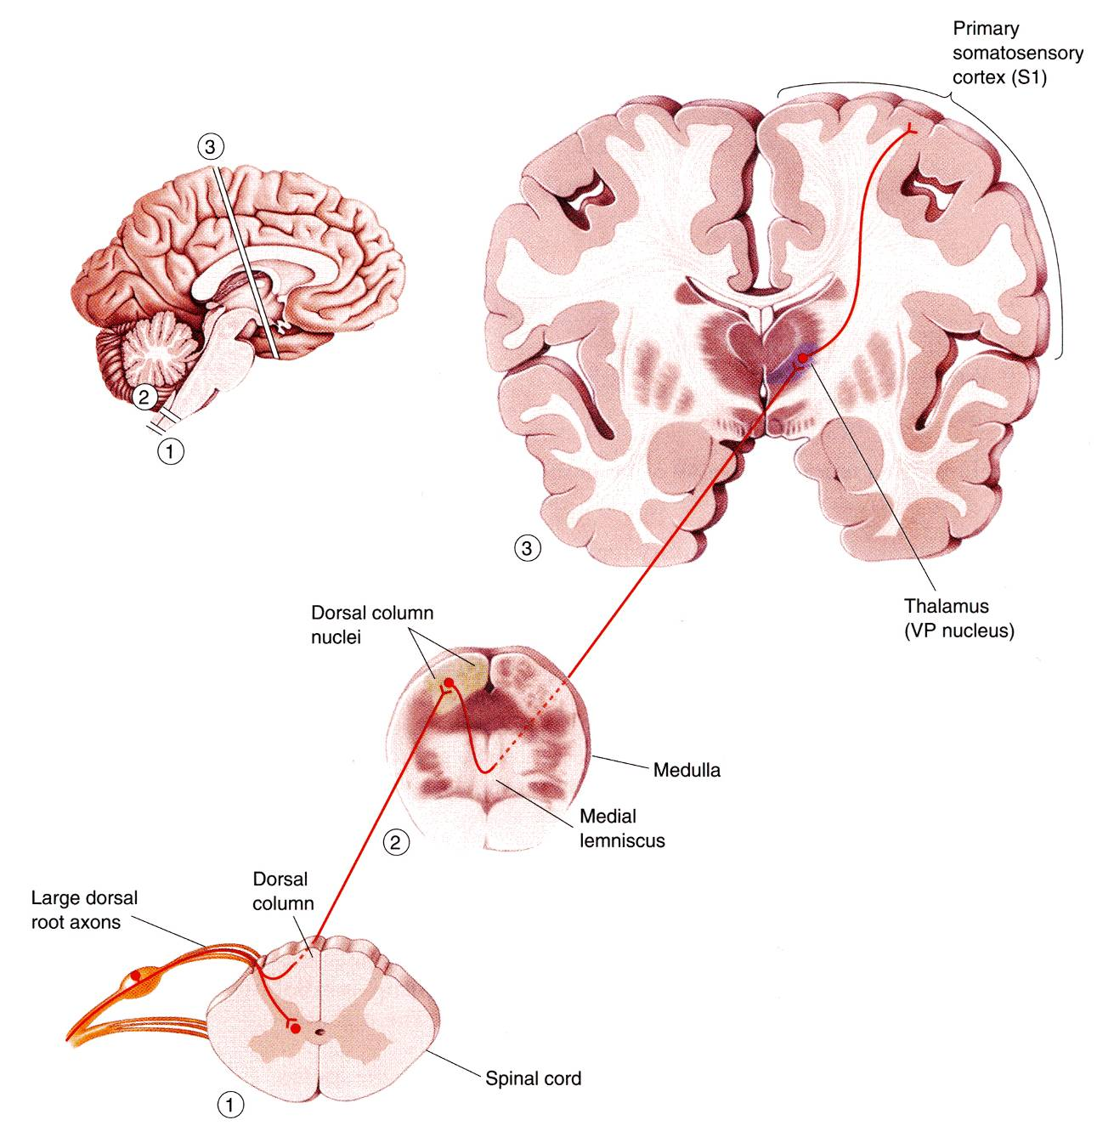
Pathways that carry information to a conscious level share certain common characteristics:
There is a sequence of Three Neurones between the peripheral receptors and the cerebral cortex. (for the information/signal to reach the brain it has to relay/synapse in 3 neurons)
The main fiber remains on the ipsilateral side of the cord and terminates in synaptic contact with the second neurone which lies either in the spinal grey matter or in the medulla oblongata of the brain stem.
2
The axon of the second order neurone crosses over (decussates) to the opposite side of the CNS and ascends to the thalamus, where it terminates.
The axons of the first-order neurone or primary afferent neurone) enters the spinal cord through the dorsal root of a spinal nerve and its cell body lies in the dorsal root ganglion.
1
3
The third-order neurone has its cell body in the thalamus.
Its axon passes to the somatosensory cortex of the parietal lobe of the cerebral hemisphere.

Slide 7
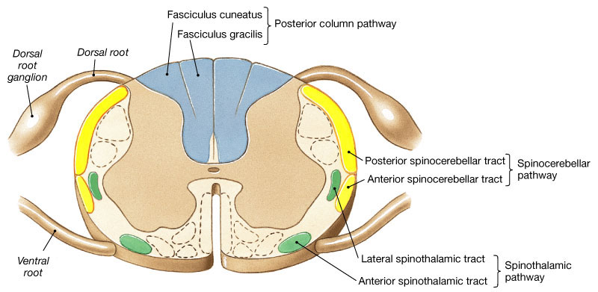
Three major* pathways carry sensory information:
Dorsal (Posterior) column (divided into Gracile & Cuneate fasciculi)
Anterolateral pathway (Spinothalamic)
Spinocerebellar pathway
Carry conscious sensation therefore they will follow the same pathway we discussed in the previous slide
Carries subconscious sensation.
*We will also discuss 3 minor ways: spinotectal, spino-olivary, and spinoreticular.

Slide 8
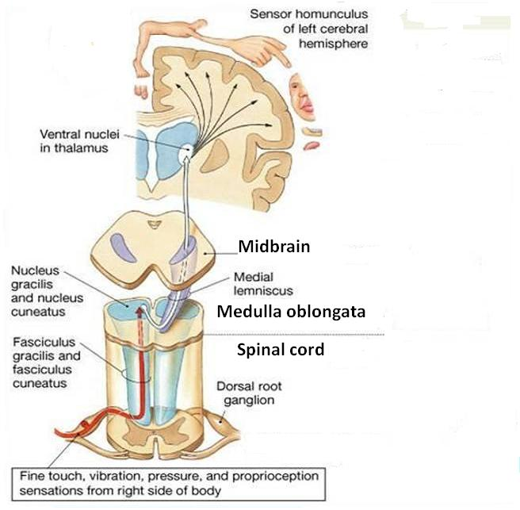
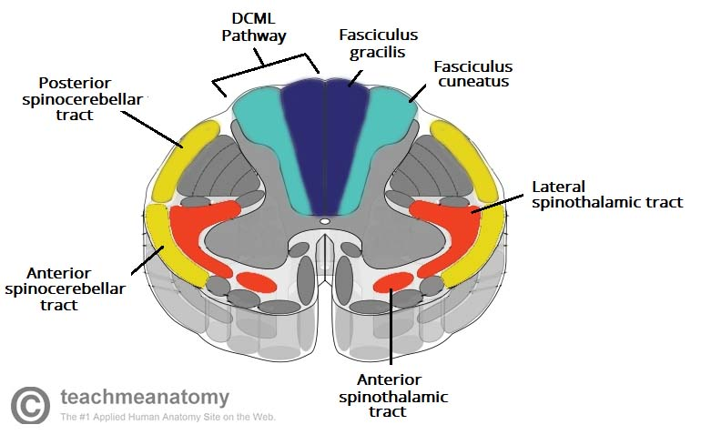
1. Dorsal Column
Contains two tracts;
Fasciculus Gracilis (FG) &
Fasciculus Cuneatus (FC)
Carry impulses concerned with proprioception (movement and joint position) , discriminative touch from ipsilateral* side of the body.
Contain the axons of primary afferent neurons that have entered cord through dorsal roots of spinal nerves.
Gracilis and cuneate have the same function, and travel in the same pathway but receive fibers from different segments of the spinal cord:
Fasciculus Gracilis contains fibers that are received at sacral, lumbar and lower thoracic levels,
Fasciculus Cuneatus contains fibers that are received at upper thoracic and cervical levels.
Which is medial/lateral?
Cuneatus supplies the upper limbs which are lateral to the lower limbs therefore cuneatus is lateral and gracilis is medial
Gracilis → Ground (lower limb)
Cuneatus → Cervical (next to upper limb)
Extra

Slide 9
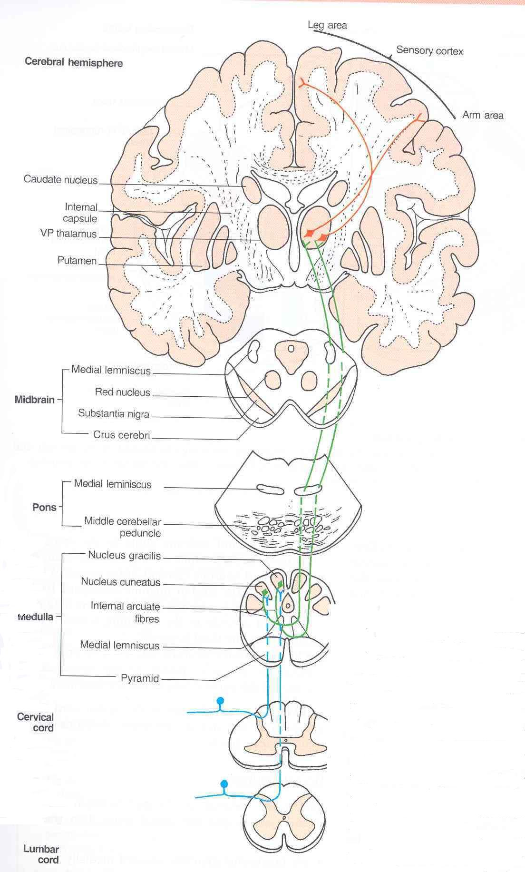
1. Dorsal Column
The primary afferent neurons relayed to the 1st order neurons in the dorsal root ganglion.
Fibers of the first order neurons ascend without interruption where they terminate upon 2nd order neurons in nucleus gracilis and nucleus cuneatus (in the medulla).
The axons of the 2nd order neurons decussate in the medulla as internal arcuate fibers. and ascend through the brain stem as Medial Lemniscus.
The medial lemniscus terminates in the ventral posterior nucleus of the thalamus (3rd order neurons), which project to the somatosensory cortex (thalamocortical fibers)

Slide 10
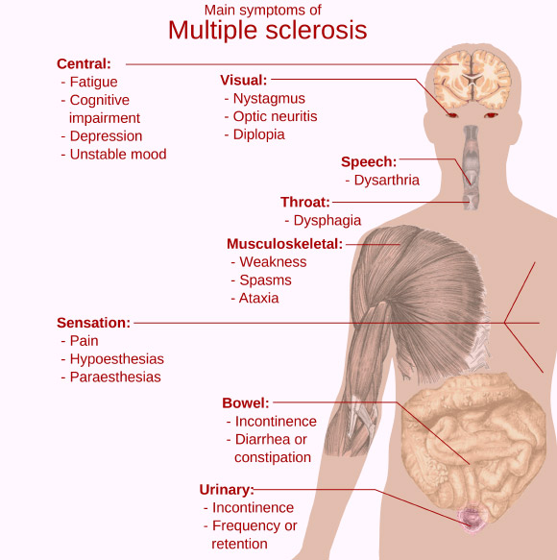
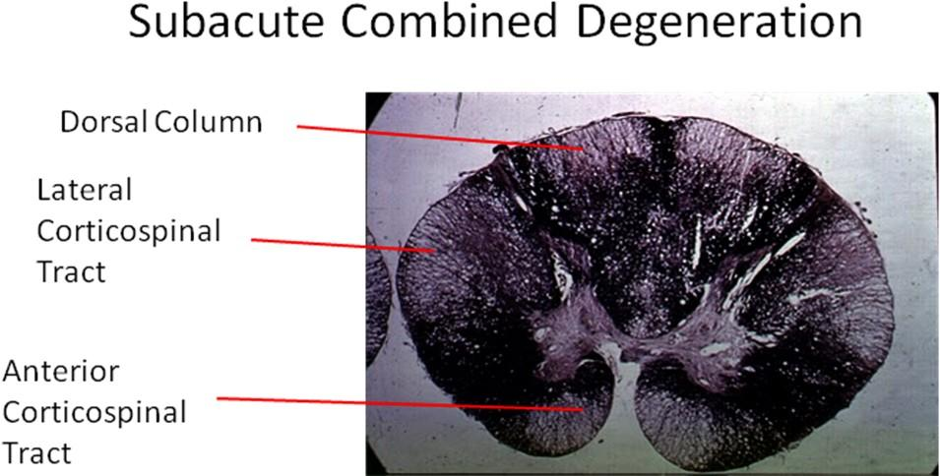
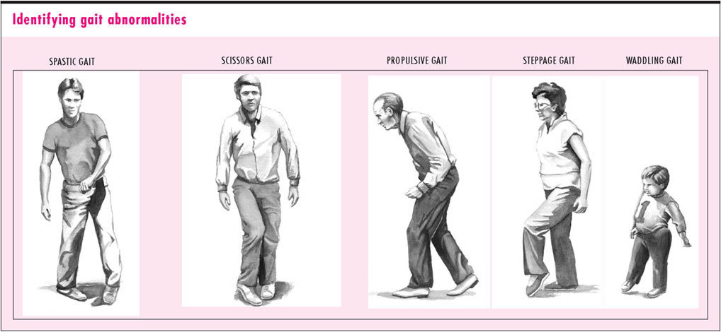
Tabes Dorsalis
A late manifestation of syphilitic infection on the CNS.
Affects the lumbosacral dorsal spinal roots and dorsal columns of the spinal cord.
Leads to loss of proprioception which is manifested by a high Step Page and unsteady gait (Sensory Ataxia).
Subacute Combined Degeneration of the spinal cord
A systemic disease results from B12 deficiency
It produces Sensory Ataxia
Lateral columns are also affected (combined) causing weak and spastic limbs
It is completely recovered by proper treatment with B12 .
Multiple Sclerosis
An immune disease affects specifically fasciculus Cuneatus of the cervical region. Leads to loss of proprioception in hands and fingers (Asteriognosis)
التصلب اللويحي
11:15
07:07
Notes:
Ataxia is a neurological sign consisting of lack of voluntary coordination of muscle movements that includes gait abnormality. Ataxia is a non-specific clinical manifestation implying dysfunction of the parts of the nervous system that coordinate movement, such as the cerebellum. Ataxia can be limited to one side of the body, which is referred to as hemiataxia. Several possible causes exist for these patterns of neurological dysfunction. Dystaxia is a mild degree of ataxia. Friedreich's ataxia has gait abnormality as the most commonly presented symptom.

Slide 11
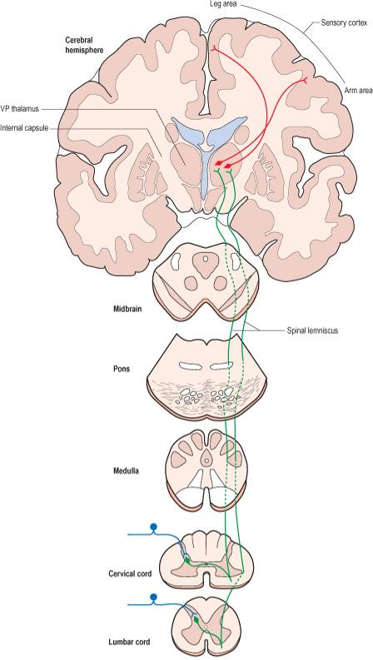
2. Spinothalamic (anterolateral) Tracts
The spinothalamic tracts contain axons of second-order neurones, the cell bodies of which lie in the contralateral* dorsal horn.
Located lateral and ventral to the ventral horn.
Carry impulses concerned with; pain and thermal sensations (Lateral tract) and Non- Discriminative touch (crude) and pressure (Anterior tract), from the contralateral side.
In brain stem, the two tracts constitute the Spinal Lemniscus (recall the medial lemniscus).
Information is sent to the primary sensory cortex on the opposite side of the body.
*ipsilateral: on the same side of the body.
contralateral: on the opposite side of the body.

Slide 12
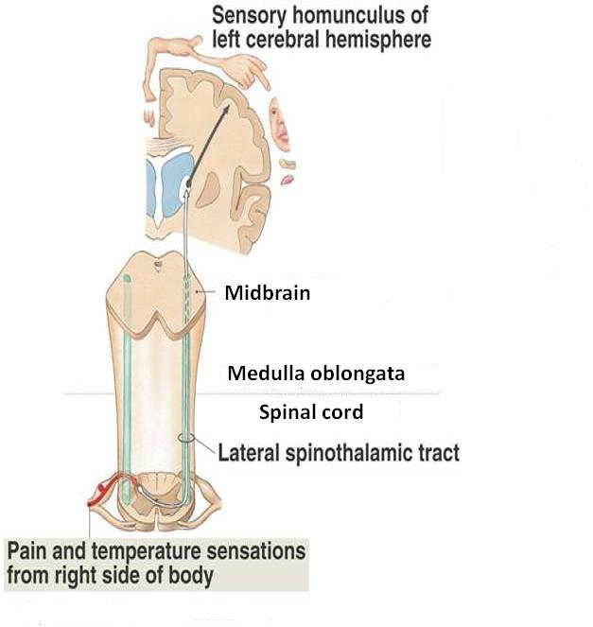
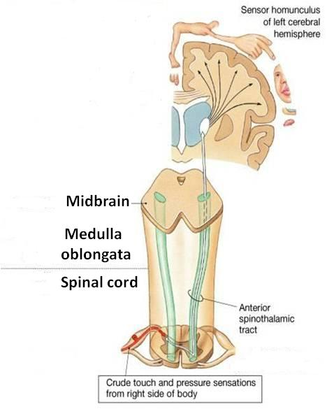
2. Spinothalamic Tracts
Lateral Spinothalamic Tract |  | Anterior Spinothalamic Tract
Carries pain & Temperature to thalamus and sensory area of the cerebral cortex. | Function | Carries crude touch (non discriminative) & pressure to thalamus and sensory cortex.
Neurone I: Small cells in the dorsal root ganglia. | Neurones: 3 Neurones | Neurone I: Medium sized cells in the dorsal root ganglia.
Neurone II: Cells of substantia gelatinosa of Rolandi in the posterior horn. |  | Neurone II: Cells of main sensory nucleus or (nucleus proprius).
Neurone III: Cells of (VP*) nucleus of the thalamus. |  | Neurone III: Cells of VP* nucleus of thalamus.
Fibers arising from Substantia Gelatinosa & Nucleus Proprius decussate in the Anterior White Commissar and ascend as Spinal Lemniscus
*Ventral Posterior

Slide 13
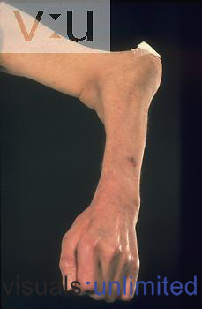
2. Spinothalamic Tracts
Lesions
The ventral commissure is close to the central canal. So when the central canal enlarges it presses on the fibers passing through it.
It is selectively damaged in Syringomyelia
The central canal becomes enlarged forming a cavity compressing the adjacent nerve fibres
Fibres serving pain and temperature are damaged as they decussate in the ventral white commissure close to the central canal causing selective loss of pain and temperature in the upper limbs (dissociate sensory loss)
Light touch and proprioceptive sensations are retained.
Joints of the limbs become disorganized without discomfort (Charcot's joint). (the joint looks misshapen but does not cause pain)

Slide 14
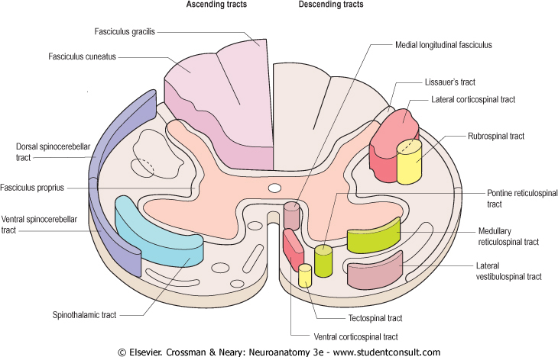
3. Spinocerebellar Tracts
The Spinocerebellar system consists of a sequence of only two neurons;
Neurone I:Large cells of dorsal root ganglia.
Neurone II: cells of the nucleus dorsalis; Clark's nucleus (column) .
Two tracts: Dorsal &Ventral
Located near the dorsolateral and ventrolateral surfaces of the cord
Contain axons of the second order neurons
Carry information derived from muscle spindles, Golgi tendon and tactile receptors to the cerebellum for the control of posture and coordination of movements. (it is responsible for subconscious sensations)

Slide 15
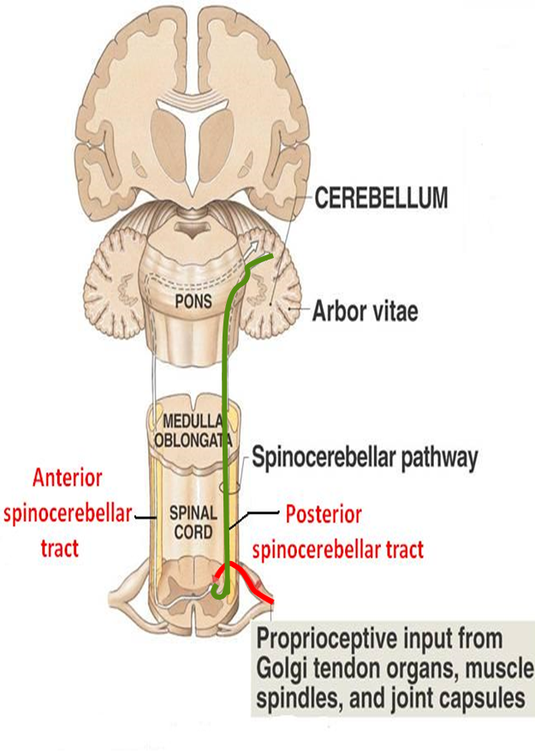
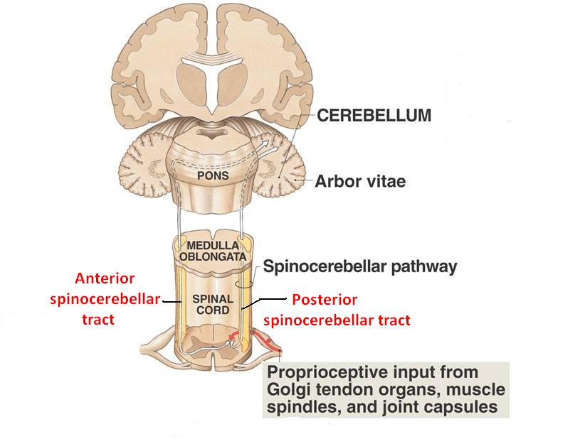
3. Spinocerebellar Tracts
Posterior (Dorsal) Spinocerebellar Tract | Ventral (Anterior) Spinocerebellar Tract
Present only above level L3 The cell bodies of 2nd order neuron lie in Clark’s column Axons of 2nd order neuron terminate ipsilaterally (uncrossed) in the cerebellar cortex by entering through the inferior cerebellar peduncle. Posterior spinocerebellar tract convey sensory information to the same side of the cerebellum | The cell bodies of 2nd order neuron lie in base of the dorsal horn of the lumbosacral segments Axons of 2nd order neuron cross to opposite side, ascend as far as the midbrain, and then make a sharp turn caudally (the fibers cross the midline for the second time) and enter the superior cerebellar peduncle to terminate in the cerebellar cortex So Ventral spinocerebellar tract conveys sensory information to the same side of the cerebellum

Slide 16
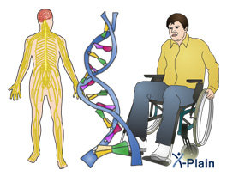
3. Spinocerebellar Tracts
Lesions
Friedrichs ataxia
An inherited degenerated disease
Affecting the spinocerebellar tracts
Leading to incoordination of arms, intense tremor, wide base reeling gait ataxia
It begins in child hood
Wheelchair is bound by 20 years of age
(ataxia = gait)

Slide 17
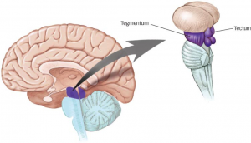
Spinotectal Tract
Ascends in the anterolateral part, in close association with spinothalamic system.
Primary afferents reach dorsal horn through dorsal roots and terminate on 2nd order neurons
The cell bodies of 2nd order neuron lie in base of the dorsal horn.
Axons of 2nd order neuron cross to opposite side, and project to the periaquiductal gray matter and superior colliculus in the midbrain.
Involved in reflexive turning of the head and eyes toward a point of cutaneous stimulation.
Spinotectal: the fibers travel from the spine (spino-) to a region in the midbrain called tectum (-tectal)
Extra

Slide 18
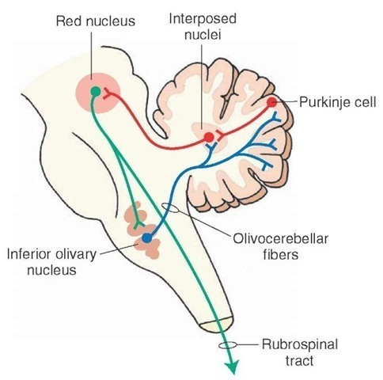
Spino-olivary Tract
Indirect spinocerebellar pathway (spino-olivo-cerebellar) meaning it connects the spinal cord with the cerebellum but indirectly through the olivary nucleus
Impulses from the spinal cord are relayed to the cerebellum via inferior olivary nucleus.
Conveys sensory information to the cerebellum.
Fibers arise at all levels of the spinal cord.
Contribute to movement coordination associated primarily with balance.

Slide 19
Spinoreticular Tract
Originates in the dorsal horn, and ascend in the ventrolateral region of the cord
Contains uncrossed fibers that end in medullary reticular formation & both crossed & uncrossed fibers that terminate in pontine reticular formation, finally to the thalamus; that activate the cerebral cortex
Forms part of the ascending reticular activating system (waking up).
Involved in perception of dull aching (slow pain)

Slide 20
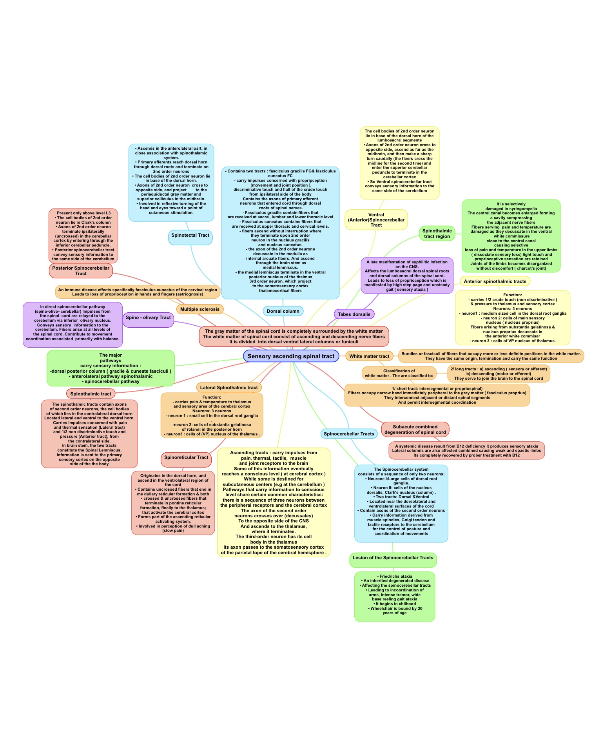
Summary
Special thanks to Jawaher Alkhayyal!

Slide 21
MCQs
1. Which of the following is a short white matter tract?
A- fasciculus proprius
B- fasciculus gracilis
C- fasciculus cuneatus
D- fasciculus thalamus
Answer: A
2. Pathways that carry information to a conscious level have:
A- 1 order neurons
B- 2 order neurons
C- 3 order neurons
D- 4 order neurons
Answer: C
3. The internal arcuate fibers ascend through the brain stem as:
A- lateral lemniscus
B- medial lemniscus
C- spinal lemniscus
D- dorsal lemniscus
Answer: B
4. Tabes dorsalis is a late manifestation of which infection?
A- Meningitis
B- Syphilis
C- Syringomyelia
Answer: B
5. Multiple sclerosis affects which tract?
A- fasciculus proprius
B- fasciculus gracilis
C- fasciculus cuneatus
D- fasciculus thalamus
Answer: C
6. Spinothalamic tracts send information to primary sensory cortex on the _____ of the body :
A- same side
B- opposite side
Answer: B
7. The posterior spinocerebellar tract passes through:
A- superior cerebellar peduncle
B- middle cerebellar peduncle
C- inferior cerebellar peduncle
Answer: C
8. Which of the following is involved in the perception of dull aching pain?
A- spinotectal tract
B- spino-olivary tract
C- spinoreticular tract
Answer: C

Slide 22
Leaders:
Nawaf AlKhudairy
Jawaher Abanumy
Members:
Talal alhuqayl
Abdulmohsen alghannam
Feedback
anatomyteam436@gmail.com
References:
1- Girls’ & Boys’ Slides
2- Greys Anatomy for Students
3- TeachMeAnatomy.com
@anatomy436
Anatomy Team

