Slide 1
Anatomy of the Brain Stem (External Features)
Color Code
Important
Doctors Notes
Notes/Extra explanation
Please view our Editing File before studying this lecture to check for any changes.

Slide 2
Objectives
At the end of the lecture, students should:
List the components of brain stem.
Describe the site of brain stem.
Describe the relations between components of brain stem & their relations to cerebellum.
Describe the external features of both ventral & dorsal surfaces of brain stem.
List cranial nerves emerging from brain stem.
Describe the site of emergence of each cranial nerve.

Slide 3
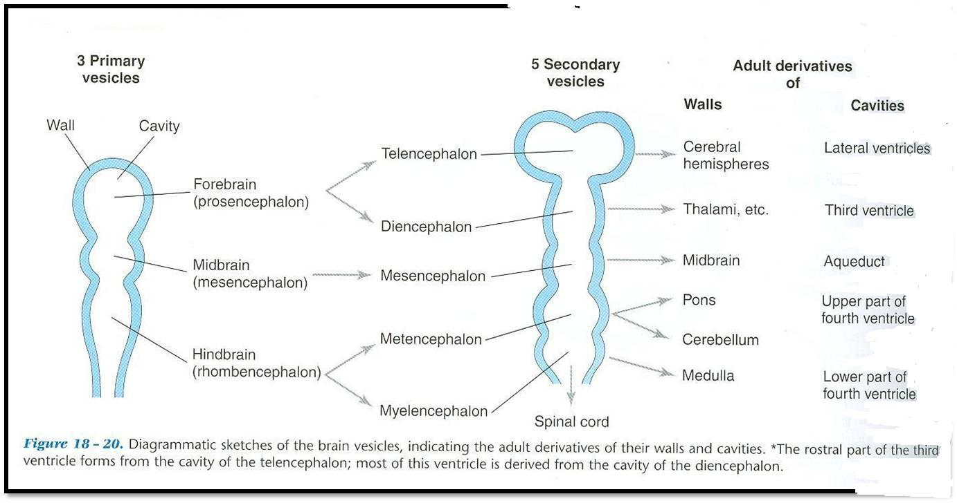
Development of the Brain
The brain develops from the cranial part of neural tube*.
The cranial part is divided into 3 parts:
*recall from embryology the caudal 2/3 forms the spinal cord and the cranial or upper 1/3 forms the brain
 | FOREBRAIN |  | MIDBRAIN | HINDBRAIN
Cavity | 2 lateral ventricles | 3rd ventricle | cerebral aqueduct | 4th ventricle
Subdivided into | Two cerebral hemispheres | Diencephalon: 1. thalamus, 2. hypothalamus, 3. epithalamus & 4. subthalamus | The midbrain is also called mesencephalon | 1- Pons. 2- Cerebellum. 3- Medulla oblongata.
Note: the brain stem develops from 2 different parts. The pons and medulla oblongata develop from the hindbrain where as the midbrain develops from the midbrain.

Slide 4
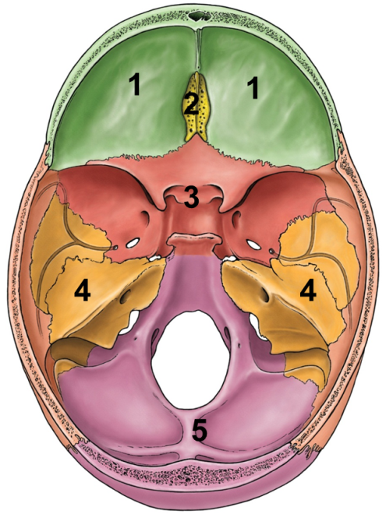
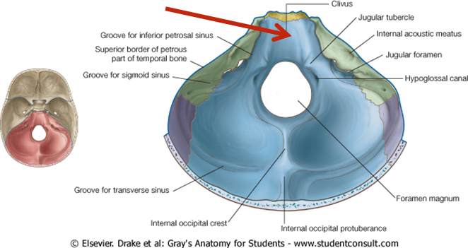
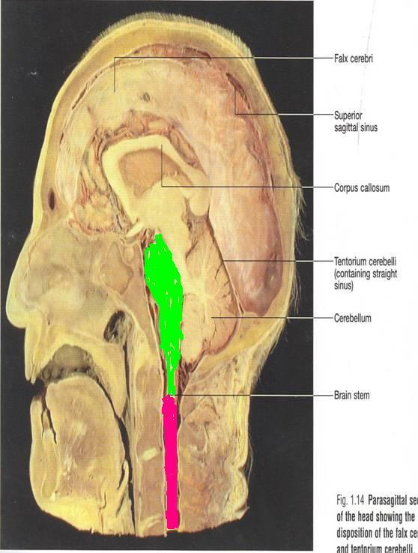
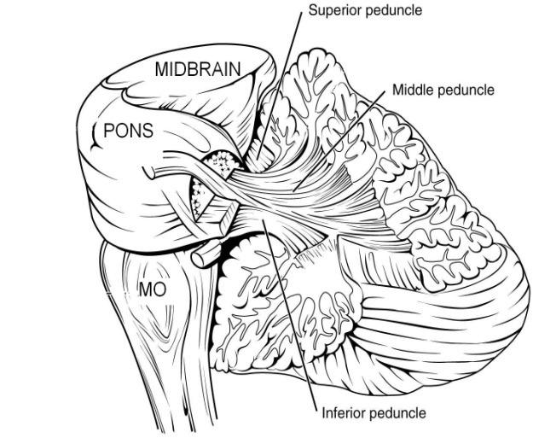
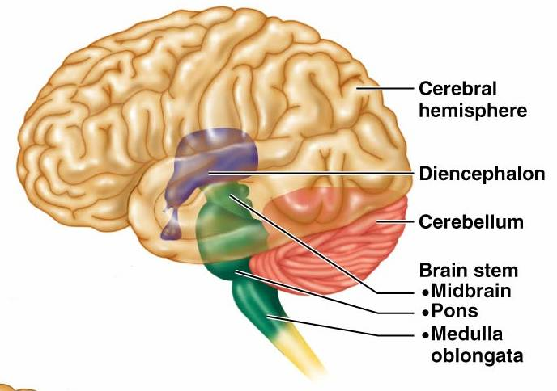
Brain Stem
01:58
The brainstem is the region of the brain that connects the cerebrum with the spinal cord
SITE:
It lies on the basilar part of occipital bone (clivus).
PARTS: From above downwards:
Mid brain, pons & medulla oblongata
CONNECTIONS WITH CEREBELLUM:
Each part of brain stem is connected to cerebellum by cerebellar peduncles (superior, middle & inferior).
Clivus
Superior peduncle connects midbrain with cerebellum
Middle peduncle connects pons with cerebellum
Inferior peduncle connects medulla oblongata with cerebellum

Slide 5
Sagittal Section Of Brain
Only on the boys’ slides
Thalamus
Cerebellum
Superior
cerebellar
peduncle
Mid brain
Pons
Medulla

Slide 6
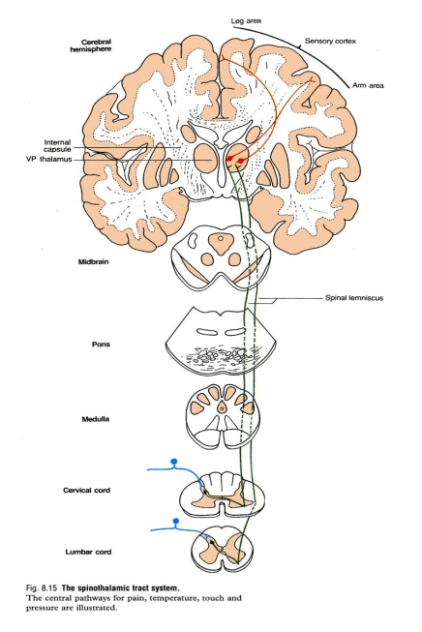
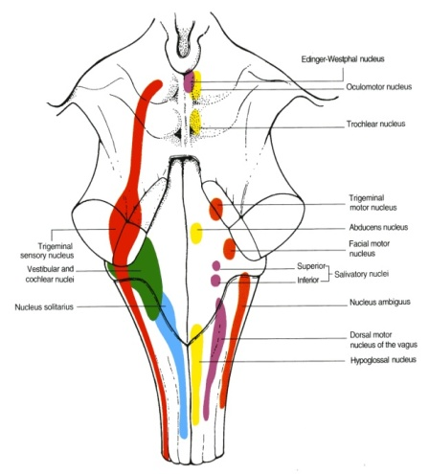
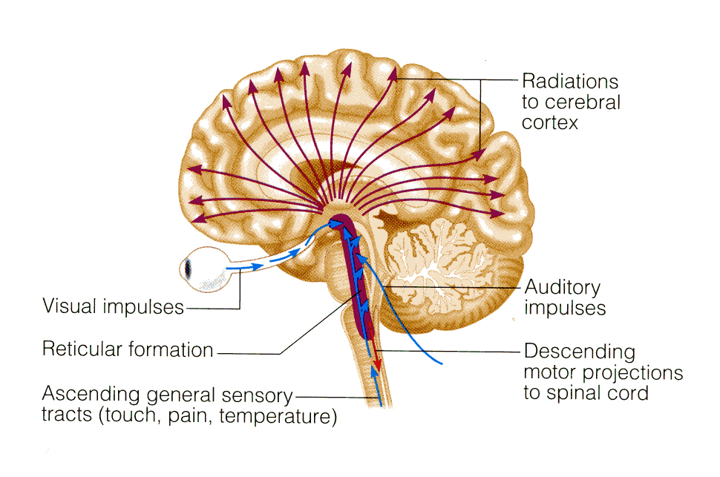
Functions of the Brain Stem
Pathway of tracts between cerebral cortex & spinal cord (ascending and descending tracts).
Site of origin of nuclei of cranial nerves (from 3rd to 12th).
Site of emergence of cranial nerves (from 3rd to 12th).
Contains groups of nuclei & related fibers known as reticular formation* responsible for: control of level of consciousness, perception of pain, regulation of cardiovascular & respiratory systems.
1
2 & 3
4
*Complex matrix of nuclei and related fibers/axons

Slide 7
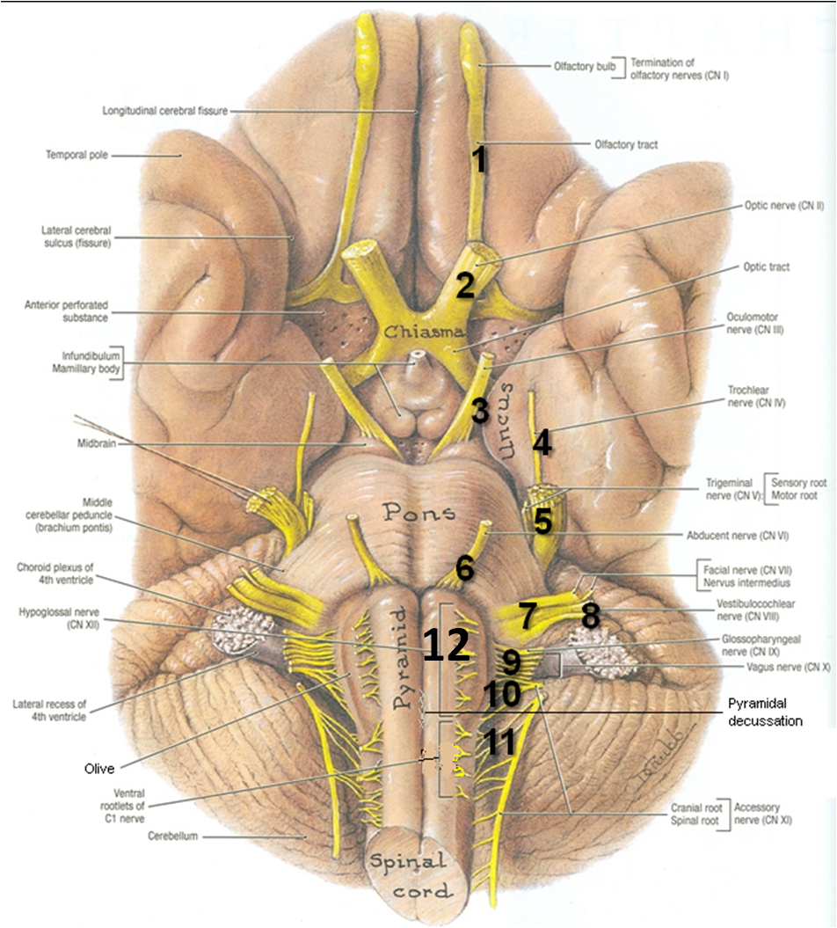
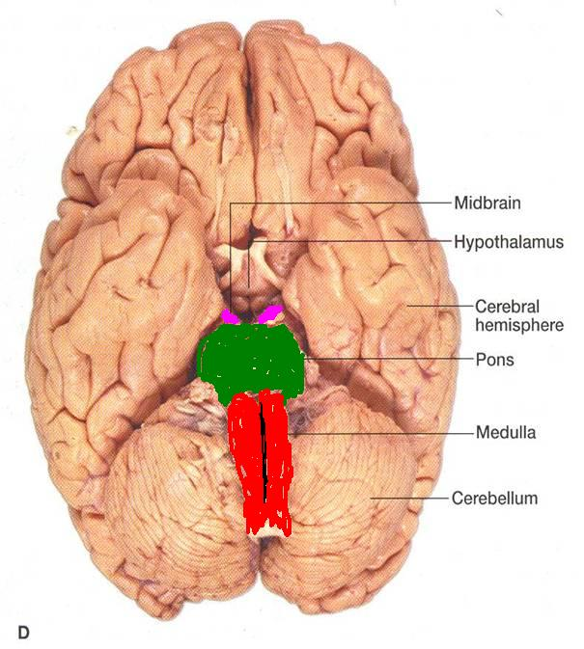
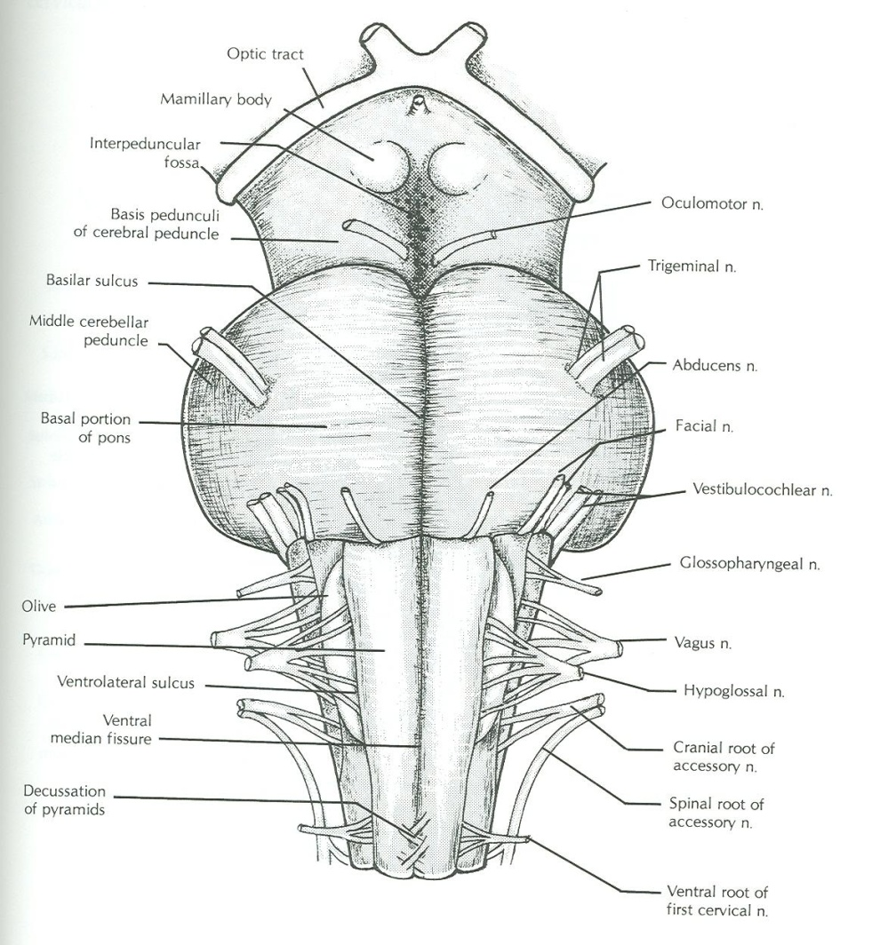
Brain Stem – Ventral Surface
Outline of the lecture
We will discuss the ventral surface of each part (medulla, pons, midbrain) then we will discuss the dorsal.
In each side (ventral/dorsal) we will see the general feature and the nerves coming out.
Note: the numbers refer to the cranial nerves

Slide 8
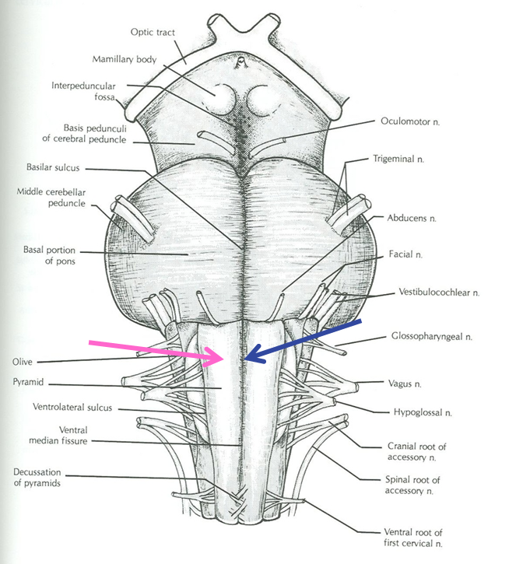
Medulla – Ventral Surface
Ventral median fissure:
Continuation of ventral median fissure of spinal cord.
Divides the medulla into 2 halves
Its lower part is marked by decussation of most of pyramidal (corticospinal) fibers (75%-90%).
Pyramid:
An elevation, lies on either (lateral) side of ventral median fissure
Produced by corticospinal tract.

Slide 9
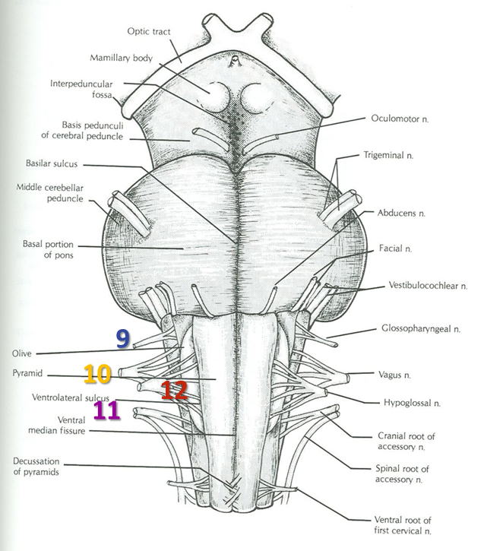
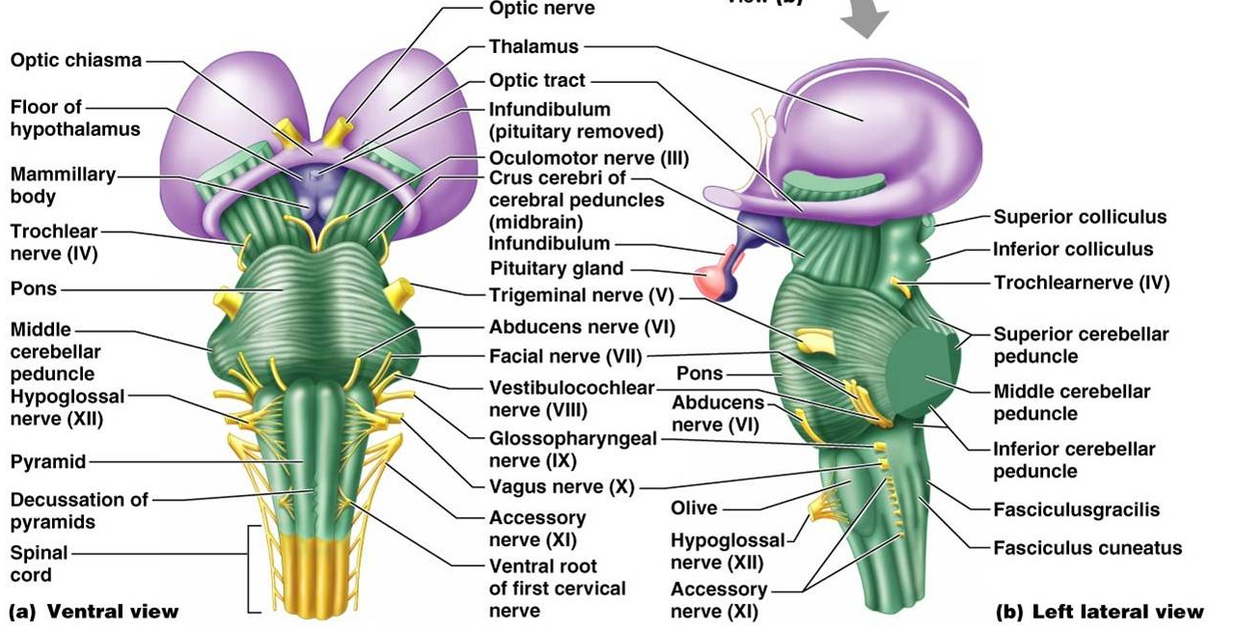
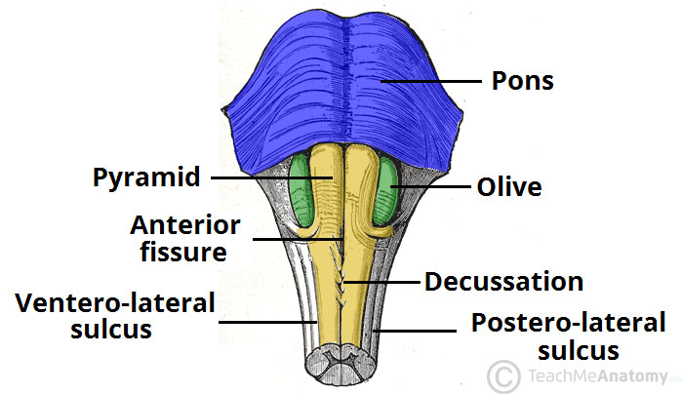
Medulla – Ventral Surface
Olive:
An elevation, lies lateral to the pyramid.
Produced by inferior olivary nucleus* (important in control of movement).
Nerves emerging from Medulla (4 nerves):
Hypoglossal (12th): from sulcus between pyramid & olive
Glossopharyngeal (9th), vagus (10th) & cranial part of accessory (11th): from sulcus dorsolateral to olive (from above downwards)
Extra
*Convoluted mass of grey matter
Extra

Slide 10
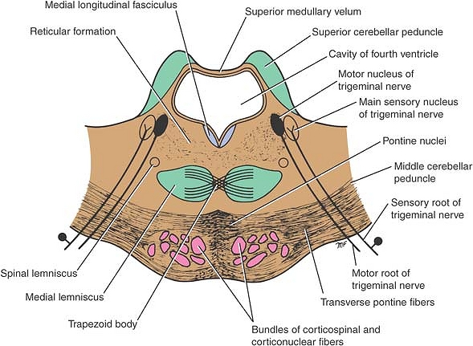
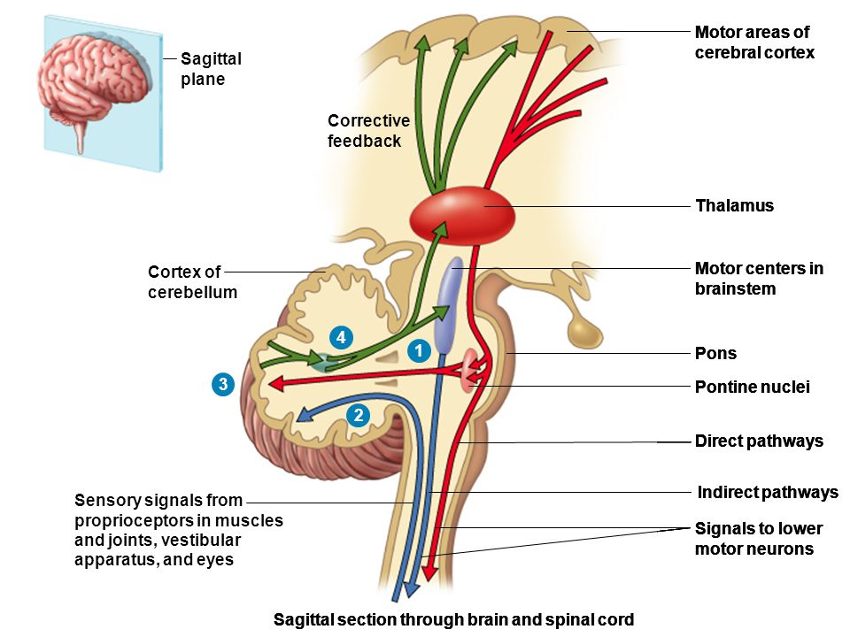
Pons – Ventral Surface
Basilar sulcus:
Divides the pons into 2 halves, occupied by basilar artery.
Transverse pontine (pontocerebellar) fibers:
Originate from pontine nuclei,
They cross the midline & pass through the contralateral middle cerebellar peduncle to enter the opposite cerebellar hemisphere.
*
*
Extra
Extra

Slide 11
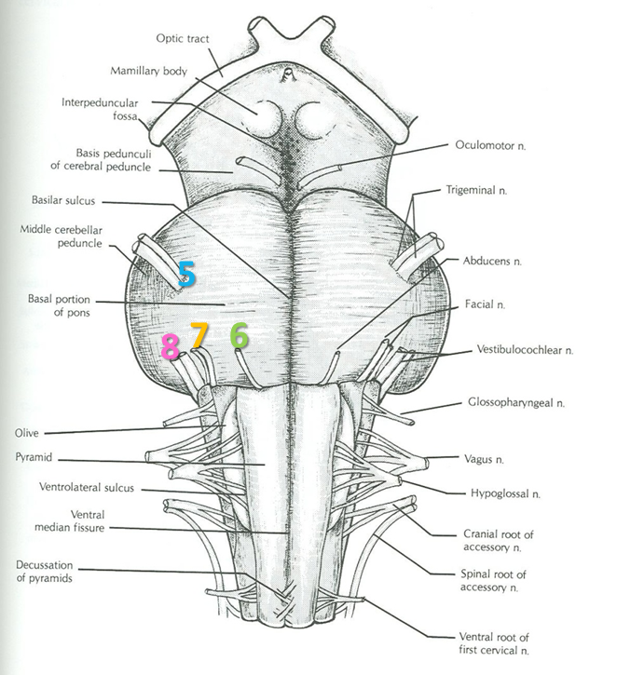
Pons – Ventral Surface
*to remember
small medial motor root & a large lateral sensory root
Nerves emerging from Pons (4 nerves):
Trigeminal (5th): from the middle of ventrolateral aspect of pons, as 2 roots: a small medial motor root & a large lateral sensory root*.
Abducent (6th): from sulcus/junction between pons & pyramid.
Facial (7th) & Vestibulocochlear (8th): at cerebellopontine angle (junction between medulla, pons & cerebellum). Both nerves emerge as 2 roots: from medial to lateral:
motor root of 7th, sensory root of 7th
vestibular part of 8th & cochlear part of 8th.
Vestibulo 1st since its first in the name then cochlear

Slide 12
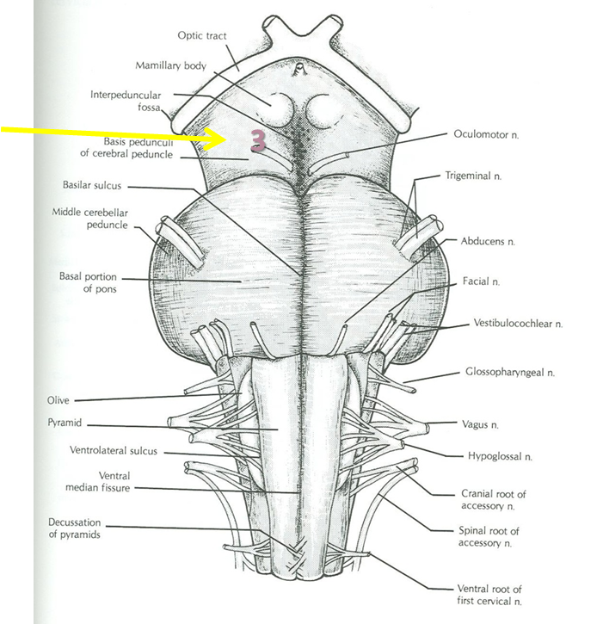
Midbrain – Ventral Surface
It is formed of a large column of descending fibers (crus cerebri or basis pedunculi), on either side.
The 2 crura cerebri are separated by a depression called the interpeduncular fossa.
Nerve emerging from Midbrain (one):
Occulomotor (3rd): from medial aspect of crus cerebri.
*
Crus Cerebri
Extra

Slide 13
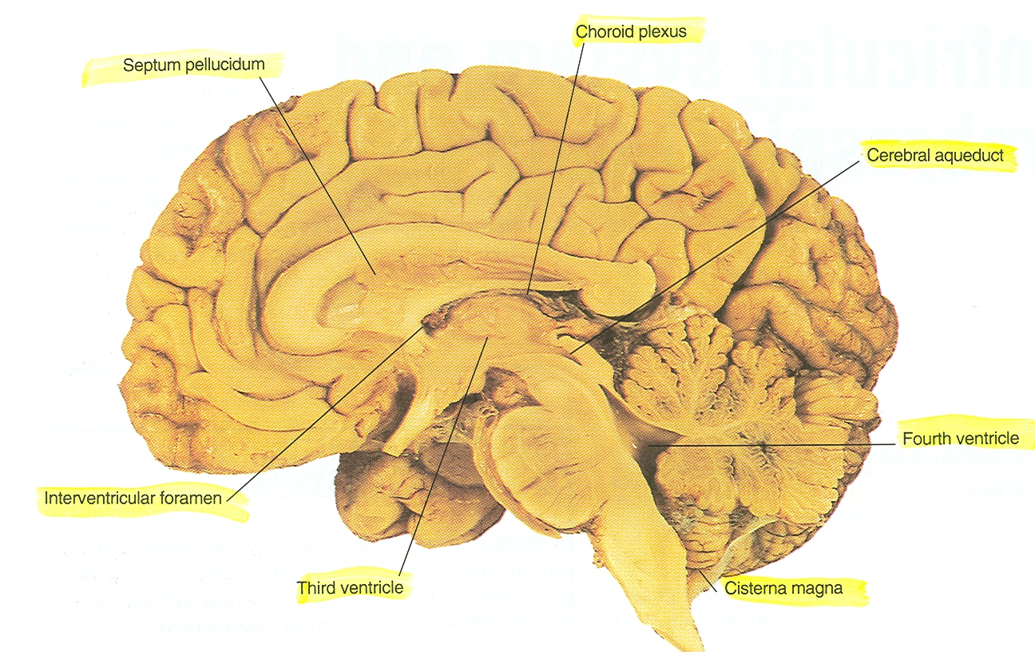
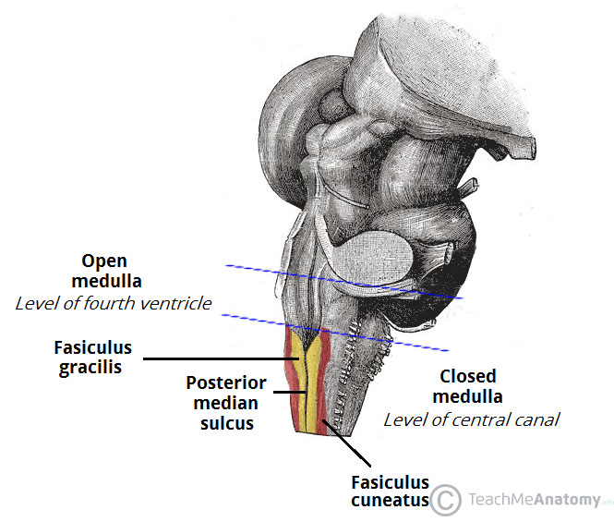
Medulla – Dorsal Surface
The features differ in the caudal part (closed medulla) and the cranial part (open medulla).
The caudal part closes around the fourth ventricle forming the central canal so it is called closed medulla.
open medulla
closed medulla
Extra

Slide 14
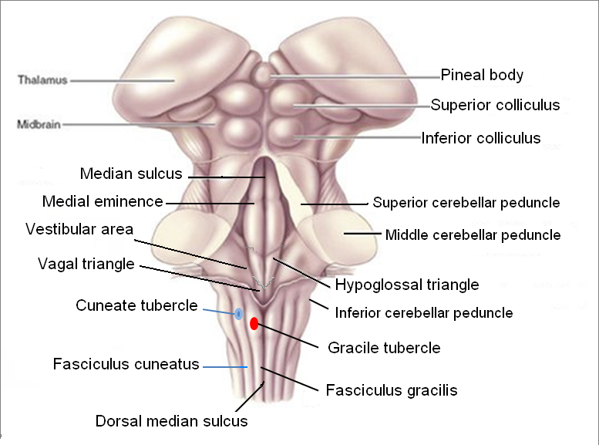
Medulla – Dorsal Surface Closed Medulla
Cavity: central canal.
Composed of:
Dorsal median sulcus: divides the closed medulla into 2 halves.
Fasciculus gracilis: on either side of dorsal median sulcus.
Gracile tubercle: an elevation produced at the upper part of fasciculus gracilis, marks the site of gracile nucleus.
Fasciculus cuneatus: on either side of fasciculus gracilis.
Cuneate tubercle: an elevation produced at the upper part of fasciculus cuneatus, marks the site of cuneate nucleus.
Recall: Fasciculus gracilis and fasciculus cuneatus are ascending tracts in the dorsal white column which terminate on their respective nuclei: gracile nucleus and cuneate nucleus.

Slide 15
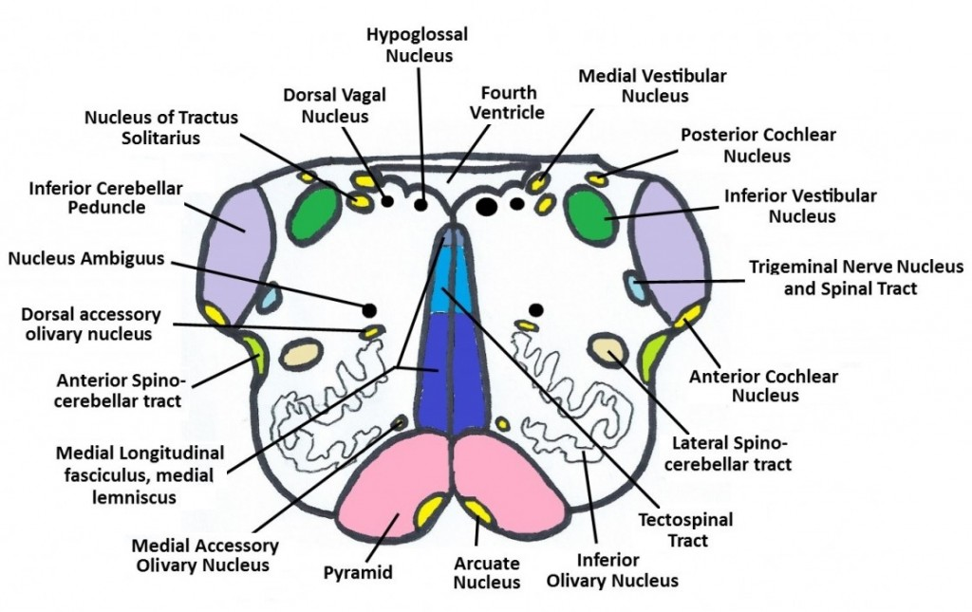
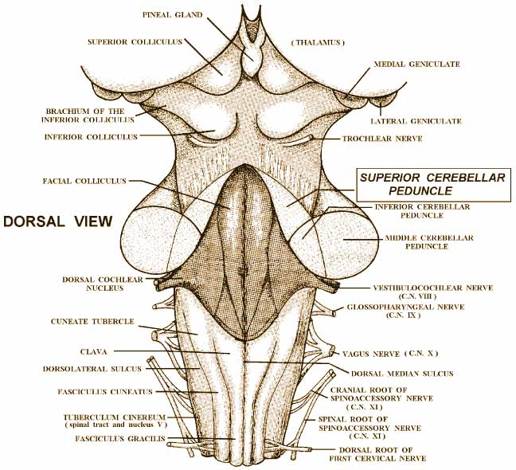
Medulla – Dorsal Surface Open Medulla
Cavity: 4th ventricle
On either side, an inverted V-shaped sulcus divides the area into 3 parts (from medial to lateral):
Hypoglossal triangle: overlies hypoglossal nucleus.
Vagal triangle: overlies dorsal vagal nucleus.
Vestibular area: overlies vestibular nuclei.
Extra

Slide 16
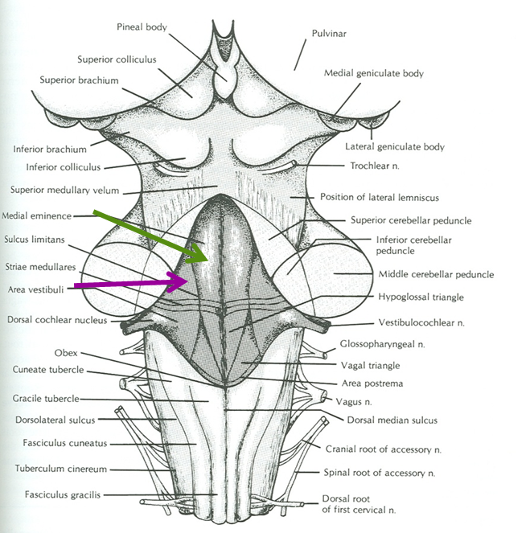
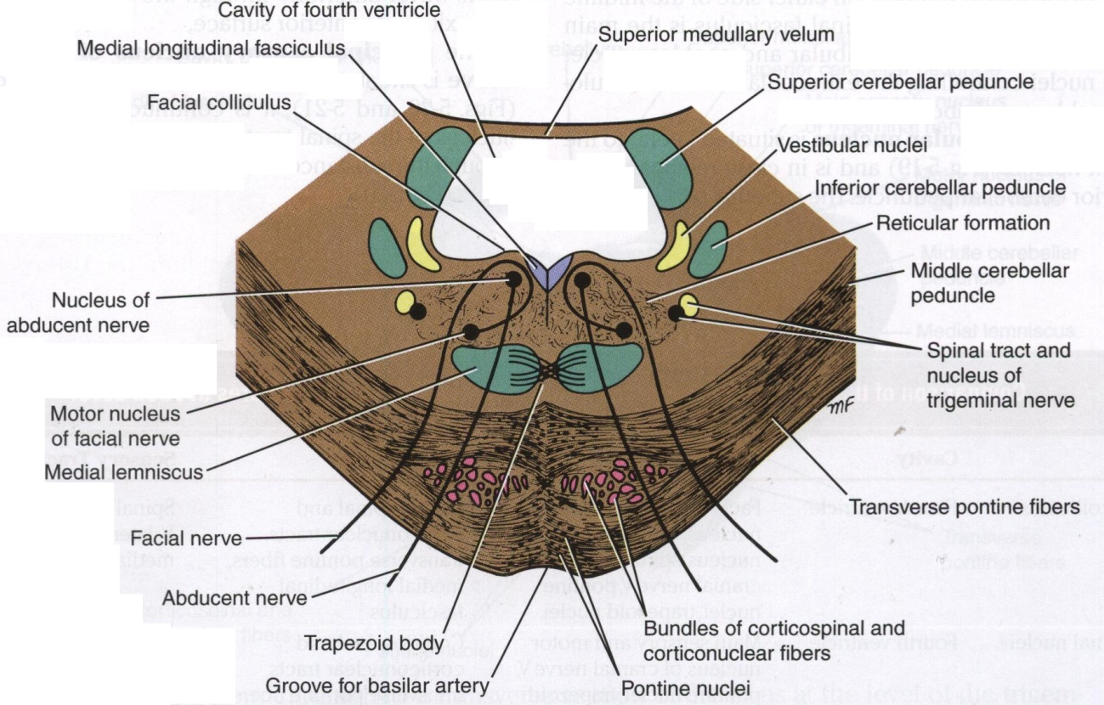
Pons – Dorsal Surface
Separated from open medulla by an imaginary line passing between the caudal margins of middle cerebellar peduncle.
On either side of median sulcus, it divides into 2 parts (from medial to lateral):
Medial eminence & facial colliculus: overlies abducent nucleus
The abducent nucleus lies medially, and below it is the fiber of the facial nerve which goes above and around it and forms the facial colliculus.
Vestibular area: overlies vestibular nuclei.
*
*
Extra

Slide 17
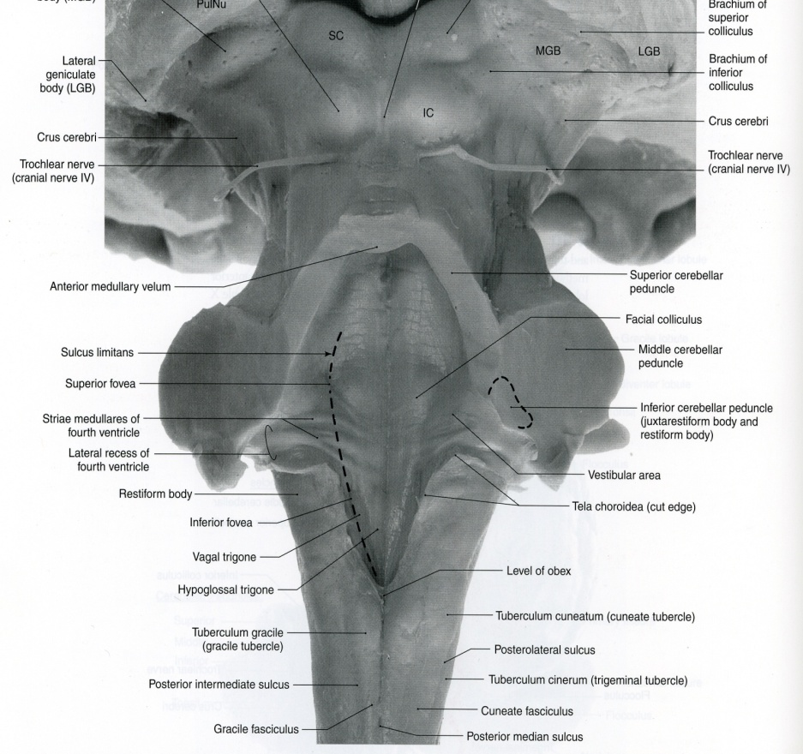
Only on the girls’ slides
The dorsal surfaces of open medulla and pons lie in the caudal 1/3rd and the rostral 2/3rd of the floor of the 4th ventricle respectively.
Dorsal surface of pons → rostral or cranial 2/3rd of 4th ventricle
Dorsal surface of open medulla → caudal 1/3rd of 4th ventricle
pons
P
Open M
MO
closed M

Slide 18
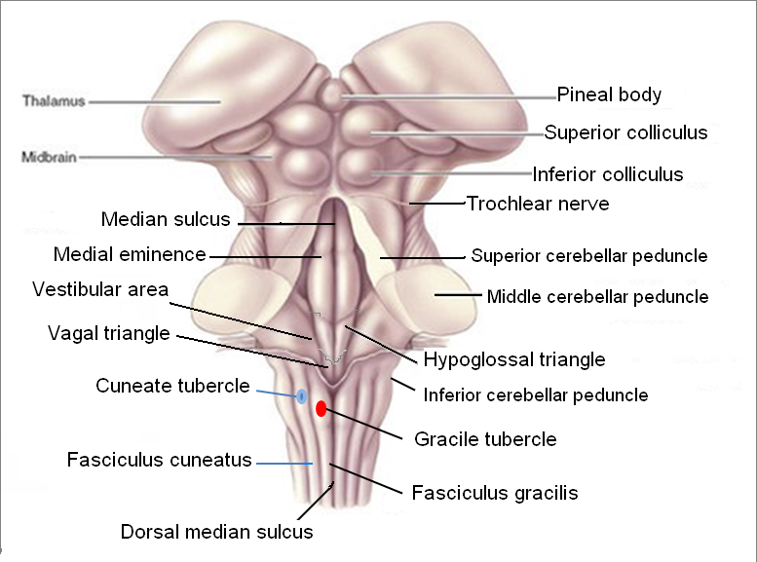
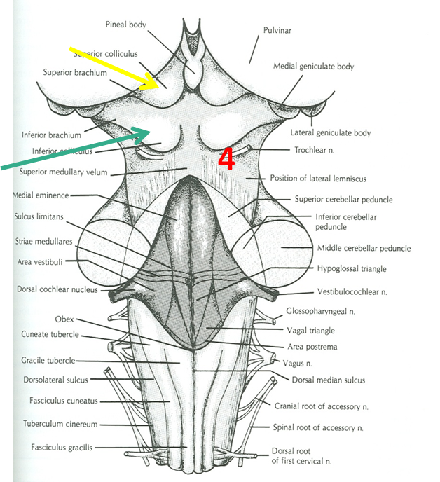
Midbrain – Dorsal Surface
*To remember: he superior colliculi is concerned with the eyes (auditory) & the eyes are at the top of the face (superior).
Marked by 4 elevations/colliculi:
Two superior colliculi: concerned with visual reflexes*.
Two inferior colliculi: forms part of auditory pathway.
Nerve emerging from Midbrain (one):
Trochlear (4th): just caudal to inferior colliculus (The only cranial nerve emerging from dorsal surface of brain stem, the rest were from the ventral).
To remember:
The trochlear is the only cranial nerve that emerges from the dorsal / posterior surface.
تركوه وراء!

Slide 19
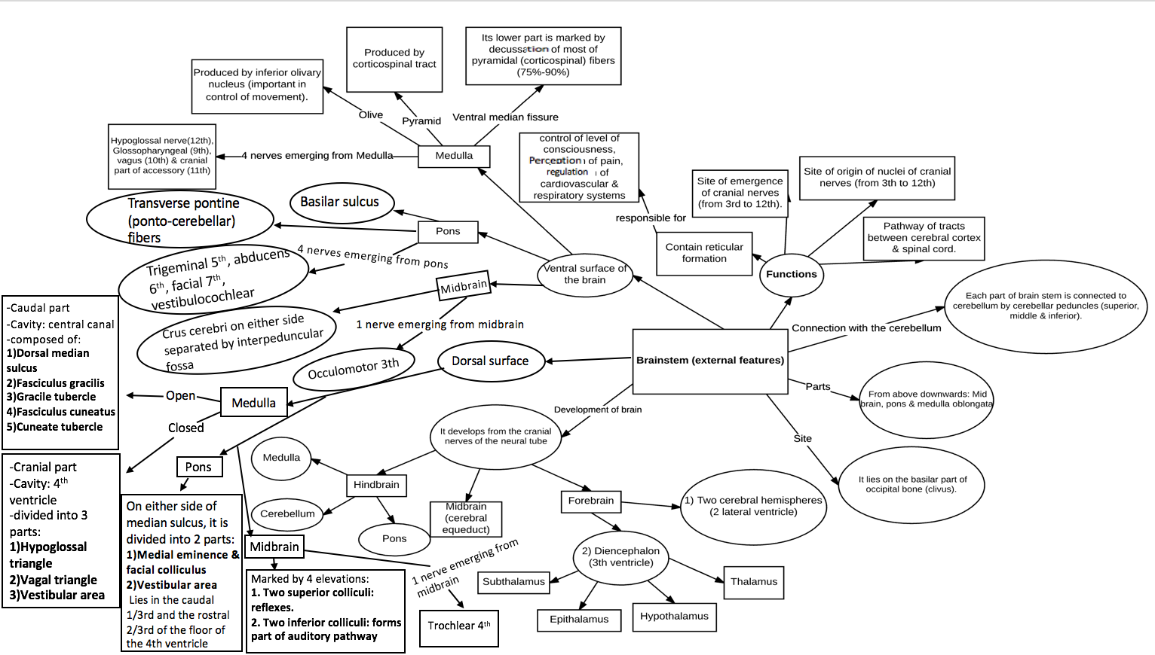
8th
closed
open
Dorsal surface of pons lies in rostral 2/3rd of 4th ventricle
visual reflexes

Slide 20
SUMMARY
The brain stem is composed (from above downwards) of: midbrain, pons & medulla oblongata which are continuous with each other, and with diencephalon above & with spinal cord below.
The brain stem is connected with cerebellum through three pair of cerebellar peduncles.
The brain stem is the site of (1) cranial nuclei, (2) the pathway of important ascending & descending tracts & (3) the site of emergence of cranial nerves (from 3rd to 12th).
Cranial nerves (with the exception of 4th) emerge from ventral surface of brain stem.

Slide 21
MCQs
1. The trigeminal nerve emerge from the …...... aspect of pons.
A- Ventrolateral
B- Ventromedial
C- Dorsolateral
D- Dorsomedial
Answer: A
2. This cranial nerve exits from the dorsal side of the brain:
A- CN 1
B- CN 2
C- CN 3
D- CN 4
Answer: D
3. The brainstem is the site of origin and emergence of the following cranial nerves:
A- All cranial nerves
B- From 3rd to 12th
C- From 1st to 10th
D- 7th nerve only
Answer: B
4. Nucleus of cranial nerve 3 is located in:
A- Intramedullary fossa
B- Pons
C- Midbrain
D- Spinal coed
Answer: C
5. The …......... part of medulla is marked by decussation of most of …....... fibers.
A- Middle, corticobulbar
B- Lower, corticospinal
C- Upper, corticospinal
D- Lower, corticobulbar
Answer: B
6. The cranial nerves originating from the cerebellopontine angle are:
A- 6th and 3rd
B- Trochlear nerve
C- 7th and 8th
D- None of the above
Answer: C
7. Basilar sulcus of the pons is occupied by:
A- Basilar vein
B- Basilar artery
C- Basilar nerve
D- Basilar nucleus
Answer: B
8. Cranial nerve 4 is located inferior to what landmark?
A- Lateral colliculus
B- Medial colliculus
C- Superior colliculus
D- Inferior colliculus
Answer: D

Slide 22
SAQs
1. Describe the pathway of the pontocerebellar fibers:
Originate from pontine nuclei → cross the midline and pass through the contralateral middle cerebellar peduncle → enter the opposite cerebellar hemisphere.
2. Mention the cavities located in the following structures: forebrain, midbrain, and hindbrain:
Forebrain: cerebral hemispheres → 2 lateral ventricles, Diencephalon → 3rd ventricle
Midbrain: cerebral aqueduct
Hindbrain: 4th ventricle

Slide 23
Leaders:
Nawaf AlKhudairy
Jawaher Abanumy
Members:
Allulu Alsulayhim
Deena AlNowiser
Lama AlTamimi
Reema Alshayie
Feedback
anatomyteam436@gmail.com
References:
1- Girls’ & Boys’ Slides
2- Greys Anatomy for Students
3- TeachMeAnatomy.com
@anatomy436
Anatomy Team

