Slide 1
Internal Structures of the Brain Stem
Color Code
Important
Doctors Notes
Notes/Extra explanation
Please view our Editing File before studying this lecture to check for any changes.

Slide 2
Objectives
By the end of the lecture, students will be able to :
Distinguish the internal structure of the components of the brain stem in different levels and the specific criteria of each level.
1. Medulla oblongata (closed, mid and open medulla)
2. Pons (caudal, mid “Trigeminal level” and rostral).
3. Mid brain ( superior and inferior colliculi).
Describe the Reticular formation (structure, function and pathway) being an important content of the brain stem.

Slide 3
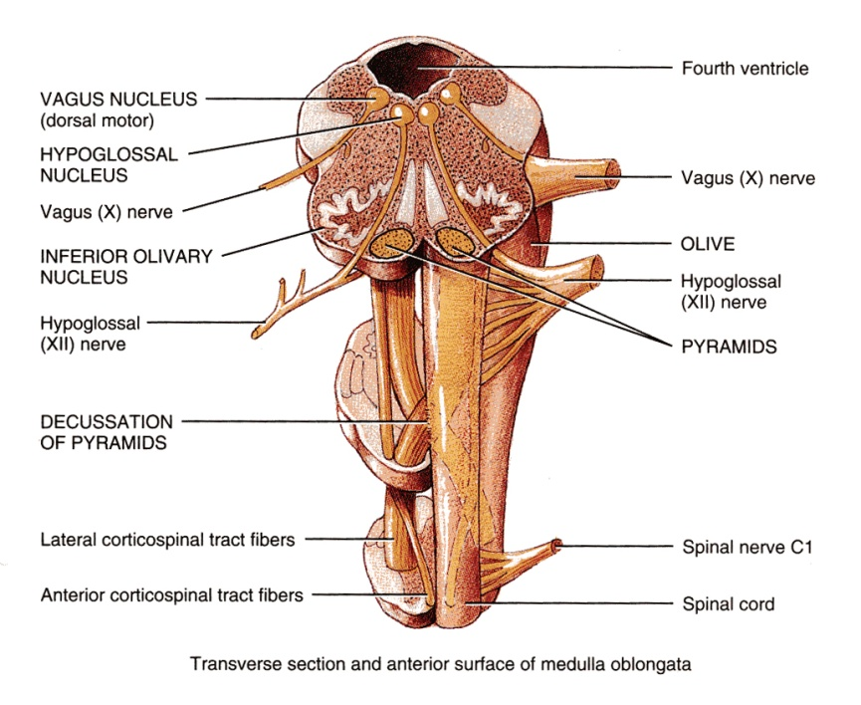
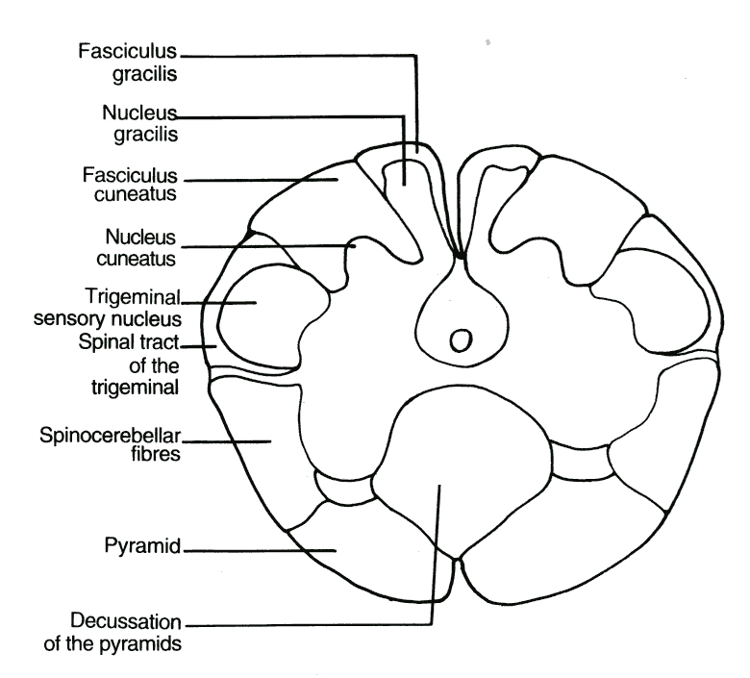
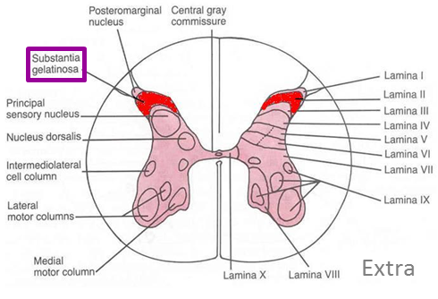
1. Medulla Oblongata Caudal (closed) Medulla
Traversed* by the Central Canal.
Motor Decussation**.
Spinal Nucleus of Trigeminal nerve (Trigeminal sensory nucleus):
It is a larger sensory nucleus.
It is the brain stem continuation of the Substantia Gelatinosa of spinal cord.
* Traversed = travel across or through
**Decuss- = crossing
Doctor’s note: the major thing we see in the closed Medulla is The Motor Decussation.
T.S of Caudal part of M.O.

Slide 4
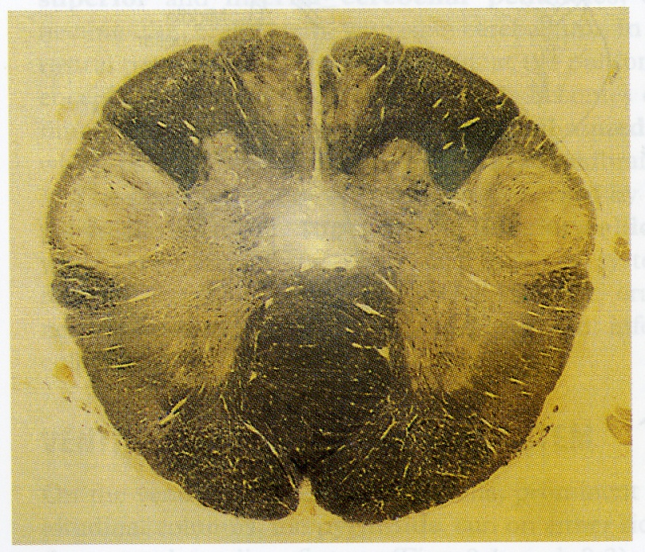
1. Medulla Oblongata Caudal (closed) Medulla
Trigeminal Sensory Nucleus & Tract
The Nucleus Extends :
Through the whole length of the brain stem and into upper segments of spinal cord.
It lies in all levels of medulla oblongata, medial to the spinal tract of the trigeminal.
It receives pain and temperature from face and forehead (recall this was the function of substantia gelatinosa).
Its tract present in all levels of M.O. is formed of descending fibers that terminate in the trigeminal nucleus.

Slide 5
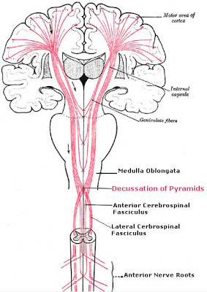
1. Medulla Oblongata Caudal (closed) Medulla
Pyramidal Decussation
Pyramidal decussation is Motor Decussation*.
Formed by pyramidal fibers, (75-90%) cross to the opposite side
They descend in the lateral white column of the spinal cord as the lateral corticospinal tract.
The uncrossed fibers (the remaining 10-25%) form the ventral corticospinal tract.
Extra
*Decuss- = crossing

Slide 6
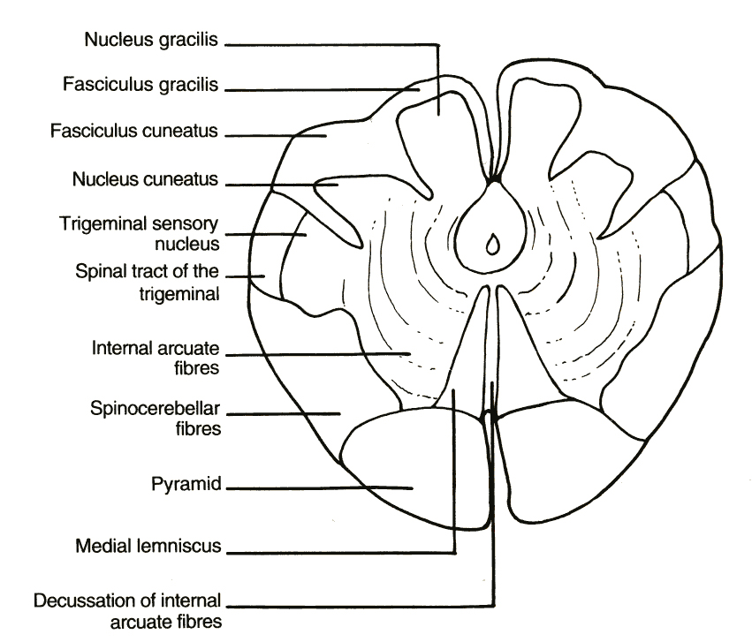
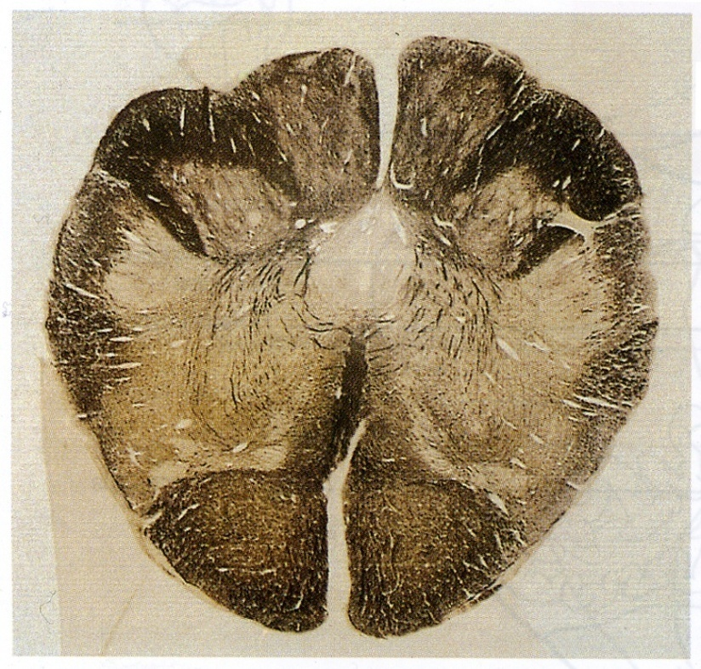
1. Medulla Oblongata Mid Medulla
Traversed by Central Canal.
Larger size Gracile & Cuneate nuclei, concerned with proprioceptive (knowing the normal body position) deep sensations of the body.
Axons of Gracile & Cuneate nuclei form the internal arcuate fibers; (they form arch like structure) Sensory Decussation.*
Pyramids are prominent ventrally.
Motor decussation (pyramids): Closed/Caudal Medulla
Sensory decussation (internal arcuate fibers): Mid Medulla

Slide 7
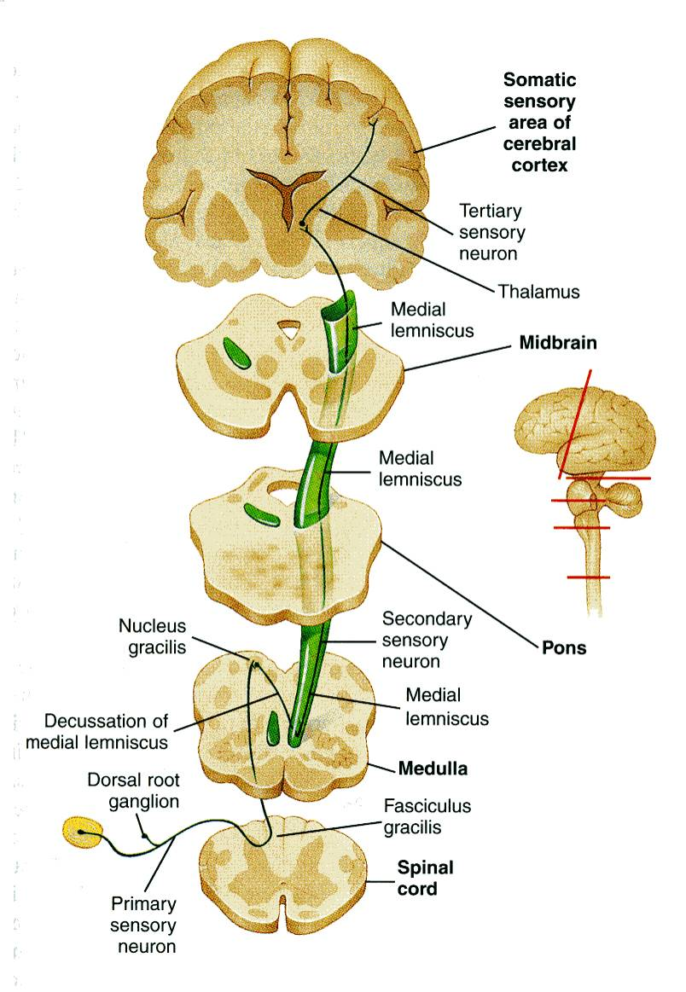
1. Medulla Oblongata Mid Medulla
Doctor’s note: don’t be confused about Tracts , Fasciculus , Leminiscus . They are all tracts with different locations and shapes.
After crossing and they ascend and form the medial leminsicus.
Sensory Decussation
Formed by the crossed internal arcuate fibers.
Medial Leminiscus*:
Composed of the ascending internal arcuate fibers after their crossing.
Lies adjacent to the middle line ventral to the central canal
Terminates in thalamus.
Concerned with proprioceptive deep sensation.
At the level of the crossing it is called sensory decussation
Before they cross they are the internal arcuate fibers from gracile and cuneate nuclei
Medial Lemniscus
*lemniscus = ribbon

Slide 8
1. Medulla Oblongata Rostral (open) Medulla
On the ventral aspect :
The pyramid is clear, with medial lemniscus on either sides of middle line dorsal to the pyramid
Inferior Olivary Nucleus:
A convoluted mass of gray matter., lies posterolateral to the pyramids & lateral to the medial leminiscus.
It is concerned with the control of movement. The fibers in here will come from the cerebellum.
Its dorsal surface forms:
Lower part of the floor of the 4th ventricle.
The Inferior Cerebellar Peduncle is, connecting Medulla Oblongata with cerebellum.
Dorsal and lateral to the Inferior cerebellar peduncle lie the Cochlear nuclei (dorsal and ventral).
Doctor’s Note: we call it open medulla because the central canal will open at this level into the 4th ventricle.

Slide 9
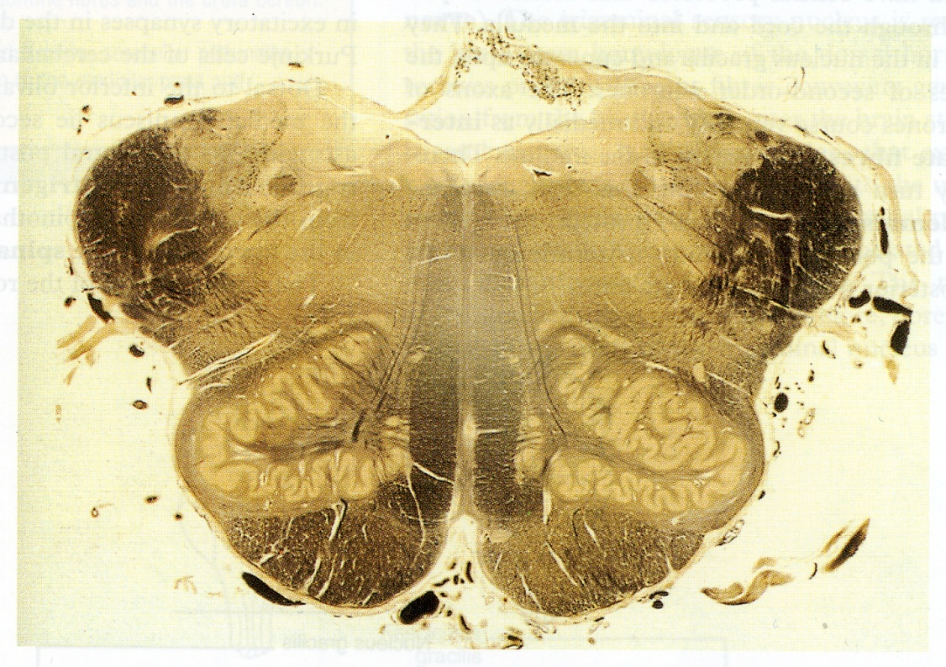
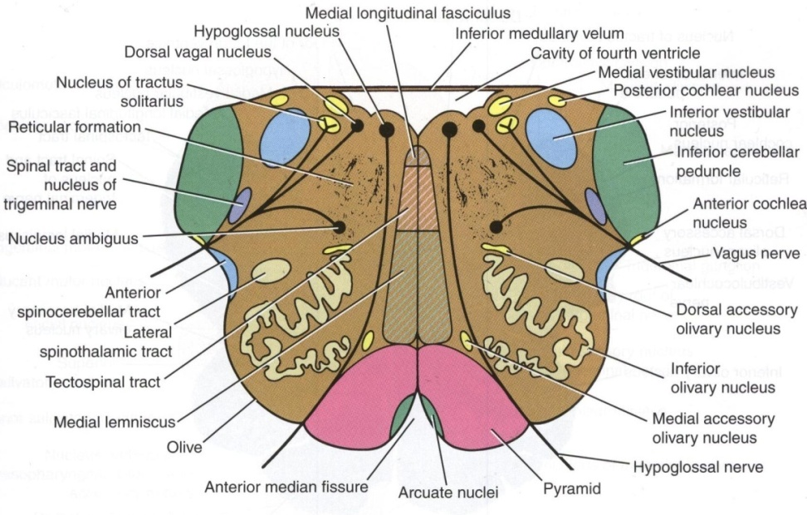
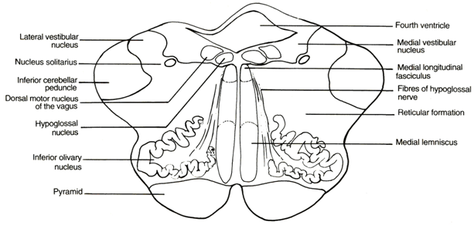

Slide 10
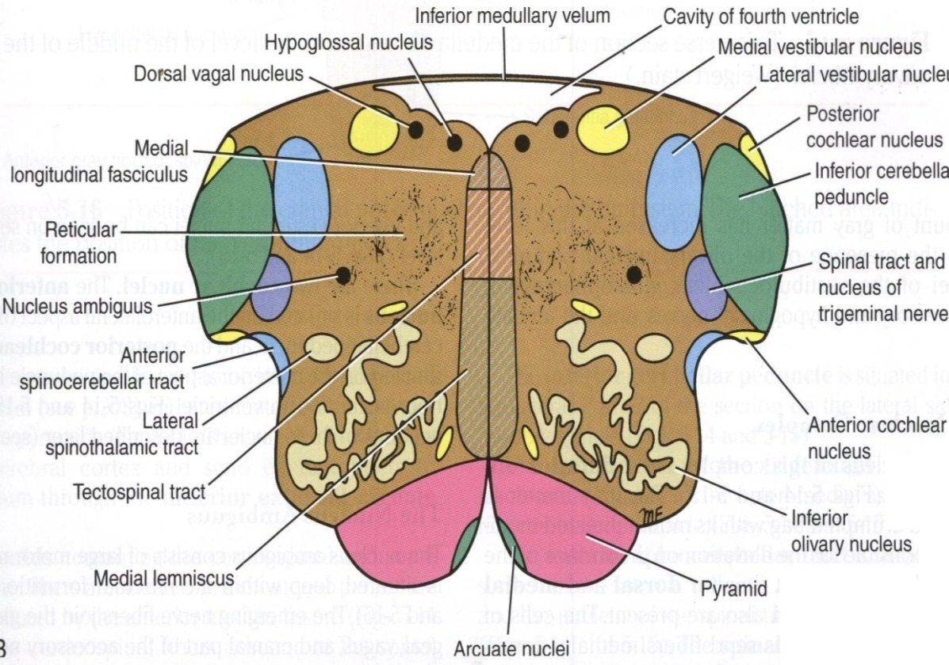
1. Medulla Oblongata Rostral (open) Medulla
Beneath the floor of 4th ventricle lie :
1. Hypoglossal Nucleus.
2. Dorsal Nucleus of Vagus
lateral to the hypoglossal nucleus, contains preganglionic parasympathetic fibers.
3. Medial longitudinal fasciculus,
it is important association tract, lies close to the midline, ventromedial to the hypoglossal nucleus. Function:
Upwards :
It links the vestibular nuclei with nuclei of extraocular muscles (in CN 3,4&6) as (vestibulo-ocular tract) to help coordination of eye movements with head movements.
Downwards :
It links vestibular nuclei with anterior horn cells of spinal cord (cervical & upper thoracic segments) as (vestibulo-spinal tract)---so, the neck & trunk move with head movements.

Slide 11
1. Medulla Oblongata Rostral (open) Medulla
4. Vestibular nuclei complex :
concerned with equilibrium.
5. Nucleus Ambiguus: (motor nucleus) :
lies dorsal to olivary nucleus gives motor fibers along glossopharyngeal N. & vagus N. to motor supply of the constrictors of the pharynx, intrinsic muscles of the larynx & palate.
6. Solitary nucleus (sensory nucleus) :
lies ventrolateral to dorsal nucleus of vagus, receive taste sensation from the tongue along the facial (VII), glossopharyngeal (IX) and vagus (X).
7. Tectospinal tract :
between tectum of midbrain and spinal cord (involved in head movements during visual and auditory tracking).
Extra

Slide 12
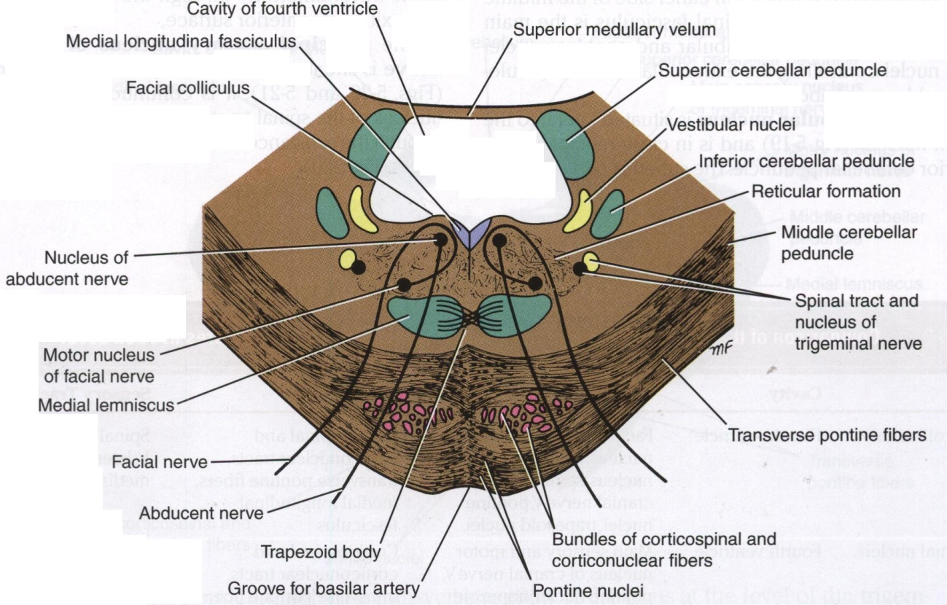
2. Pons
Caudal Part of Pons
Divided into an anterior part (Basis Pontis) & a posterior part (Tegmentum) by the Trapezoid Body.
The trapezoid body consists of acoustic fibres (hearing fibers) from cochlear nuclei to ascend into midbrain as lateral lemniscus and terminate in inferior colliculus.
The ventral(anterior) portion is marked by numerous transversely oriented fascicles of pontocerebellar fibres that originate from scattered cell groups, the pontine nuclei(black dots) and that pass to the contralateral side of the cerebellum through the massive middle cerebellar peduncle.
Compare:
Medial lemniscus | Lateral lemniscus
Ascending internal arcuate fibers | Acoustic fibres from cochlear nuclei
Terminates in thalamus | Terminate in inferior colliculus

Slide 13
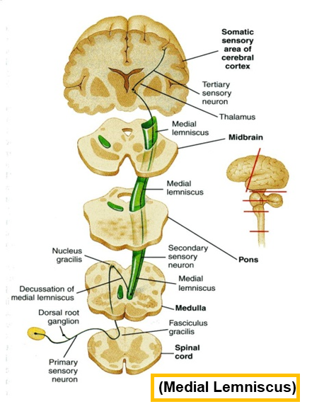
2. Pons
Caudal Part of Pons
5. Deep origin of cranial nerve nuclei :
Abducent nucleus
Facial motor nucleus
3. The ascending fibres of the medial lemniscus
become separated from the pyramid and displaced dorsally.
The Medial Lemniscus rotates 90 degrees and lies almost horizontally.
4. Spinal tract & nucleus of Trigeminal. (they become smaller)
2. Bundles of corticospinal & corticonuclear fibres (Pyramidal fibres)
1. Pontine Nuclei:
Are small masses of nerve cells, receive corticopontine fibers (involved in motor activity).
Their axons form the transverse pontocerebellar fibers which pass to the contralateral side of the cerebellum through Middle Cerebellar peduncles.

Slide 14
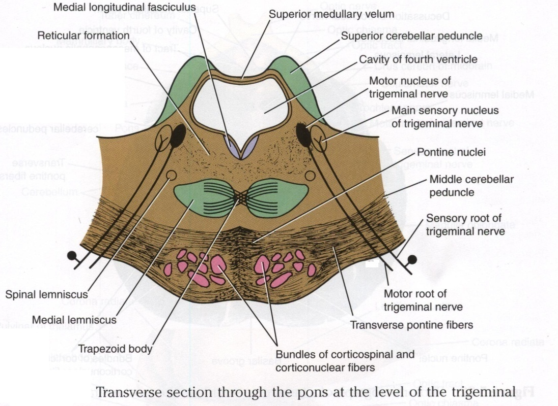
2. Pons
Level of Trigeminal Nerve (Mid Pons)
Motor nucleus of the trigeminal nerve: Lies in the lateral part of the floor of the 4th ventricle.
Main sensory nucleus of the trigeminal nerve: Reaches its maximum extent in the pons and it lies lateral to the motor nucleus.
Superior cerebellar peduncles form the lateral boundary of the 4th ventricle.
Rostral Pons
Superior Medullary Velum:
Passes between the two peduncles & forms the roof of the 4th ventricle.
Medial longitudinal fasciculus:
Lies close to the midline beneath the floor of the 4th ventricle.

Slide 15
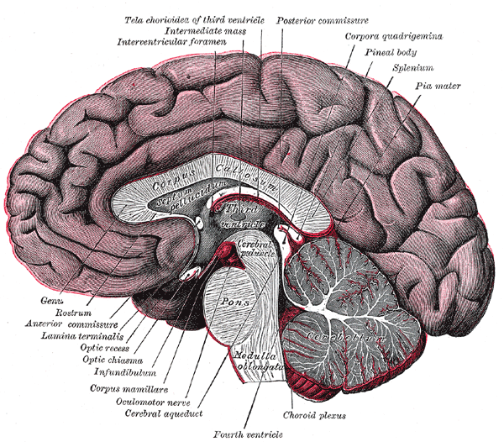
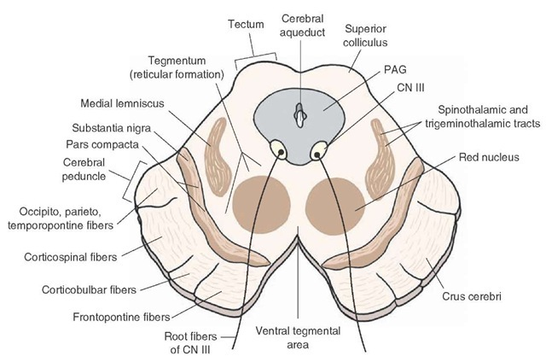
3. Midbrain
It is divided at the level of the cerebral aqueduct into :
a dorsal part (Tectum) and
a ventral part (Tegmentum)
In pons it will be the opposite.
The cerebral aqueduct is surrounded by a pear shaped periaqueductal (central) gray matter.
The most ventral part of the tegmentum is the massive fibrous mass (Crus Cerebri).
Extra

Slide 16
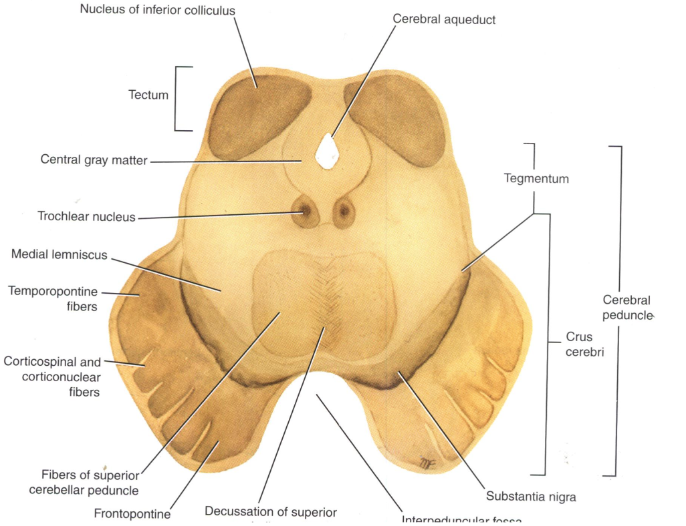
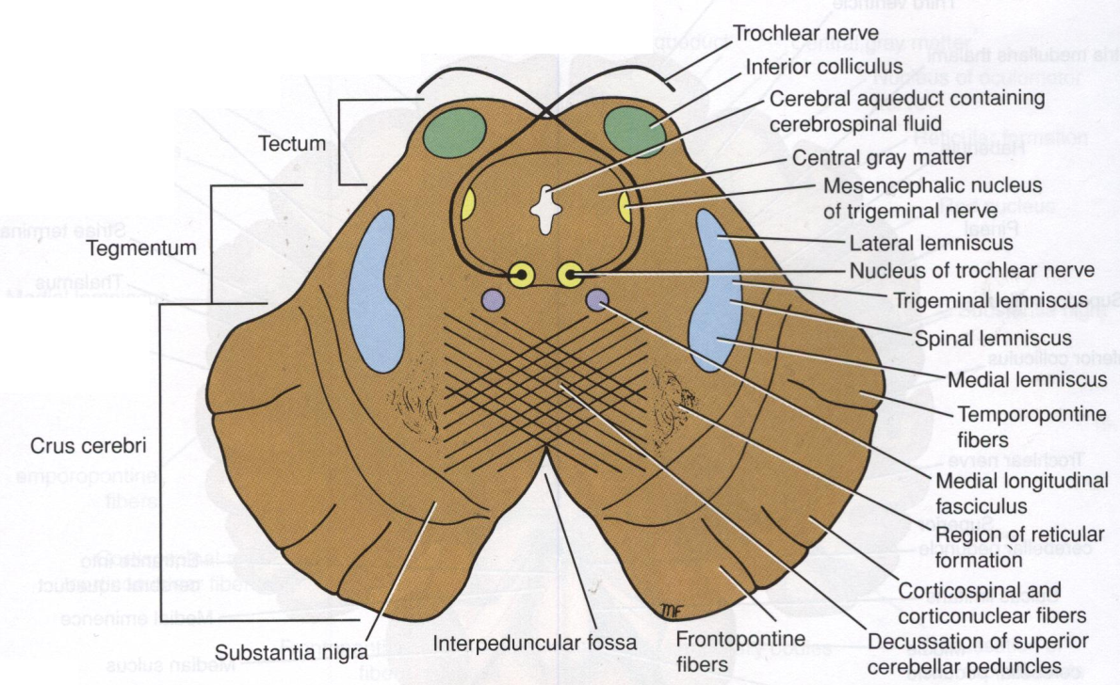
3. Midbrain
Inferior Colliculus Level
Inferior colliculus is a large nucleus of gray matter that lies beneath a corresponding surface elevation.
It is part of the auditory pathway.
It receives fibers from the lateral lemniscus.
Its efferent fibers pass to the thalamus.
Extra
Structures:
1. Trochlear nucleus:
lies in the central gray matter close to the median plane just posterior to the medial longitudinal bundle.
The fibers of the trochlear nerve decussate in the superior medullary velum.
2. Decussation of the superior cerebellar peduncles in the mid line.

Slide 17
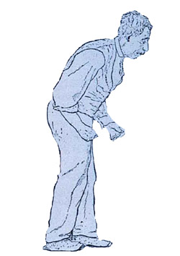
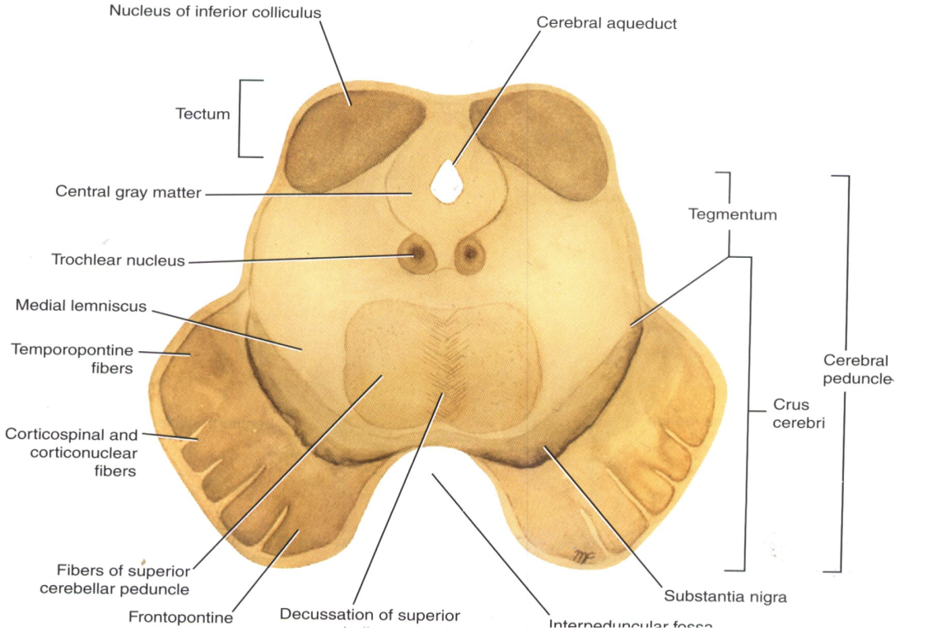
3. Midbrain
Inferior Colliculus Level
08:59
Mask Face
Extra
Flexion of the Trunk
3. Substantia nigra :
Occupies the most ventral part of the tegmentum.
It consists of pigmented, melanin containing neurones.
It projects to the basal ganglia. Its degeneration is associated with Parkinson’s disease*.
Tone of the muscle will be lost.
4. Ascending Leminisci:
Composed Of:
Medial lemniscus.
Spinal (Lateral & anterior spinothalamic tracts)
Trigeminal (Lateral & medial).
Lateral lemniscus.
Pill-Rolling Tremors
*
Slow Shuffling Feet movement

Slide 18
3. Midbrain
Crus Cerebri
It is a massive mass ventral to the substantia nigra.
It consists entirely of descending cortical efferent fibers (Frontopontine, Corticospinal & corticobulbar and Temporopontine Fibres) to the motor cranial nerve nuclei and to anterior horn cells.
Involved in the coordination of movement.
Present in both levels of colliculi (inferior and superior).

Slide 19
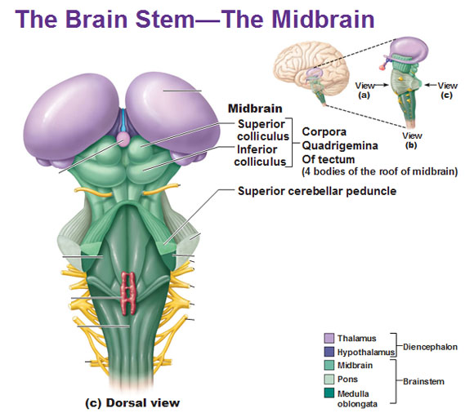
3. Midbrain
Superior Colliculus Level
*to remember:
The eyes are on top so the superior colliculus → visual
A large nucleus of gray matter that lies beneath corresponding elevation.
It forms part of the visual reflexes*.
Its efferent fibers go to the anterior horn cells & to cranial nuclei 3, 4, 6, 7 & 11.
It is responsible for the reflex movements of the eyes, head and neck in response to visual stimuli, as in following a moving object or altering the direction of the gaze.

Slide 20
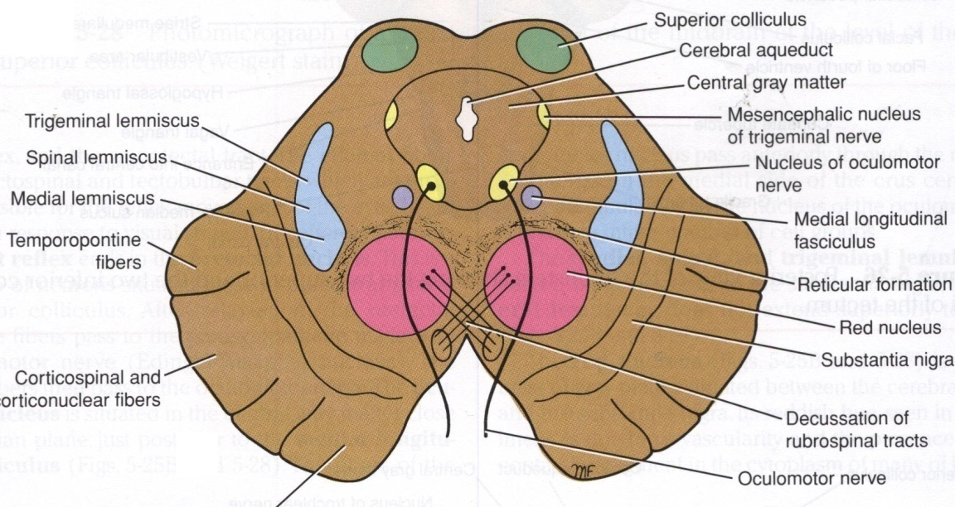
3. Midbrain
Superior Colliculus Level
1. Oculomotor nucleus:
Situated in the central gray matter close to the median plane.
The fibers of the oculomotor nerve passes anteriorly through the red nucleus to emerge on the medial side of the crus cerebri.
2. Red nucleus :
A rounded mass of gray matter that lies in the central portion of the tegmentum.
Its red coloration is due to its vascularity and the presence of an iron containing pigment in the cytoplasm of its neurons. (Important)
It is involved in motor control.
Interpeduncular fossa

Slide 21
Reticular Formation (these are important fibers and mostly unnamed)
It is a complex matrix of nerve fibers & small groups of nerve cells that extends throughout the brain stem.
It has a number of important functions i.e. Respiratory and Cardio- vascular centers are located in the medullary and caudal pontine reticular formation.
MIDBRAIN
PONS
MEDULLA

Slide 22
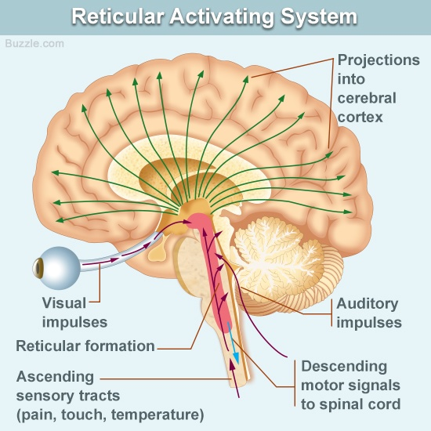
Reticular Formation
Reticular Tract
Reticulo spinal tracts:
Influence a muscle tone & posture
Reticular Activating system:
Formed of some of the ascending fibers of the reticular formation.
They activate the cerebral cortex through the thalamus.
Extra

Slide 23
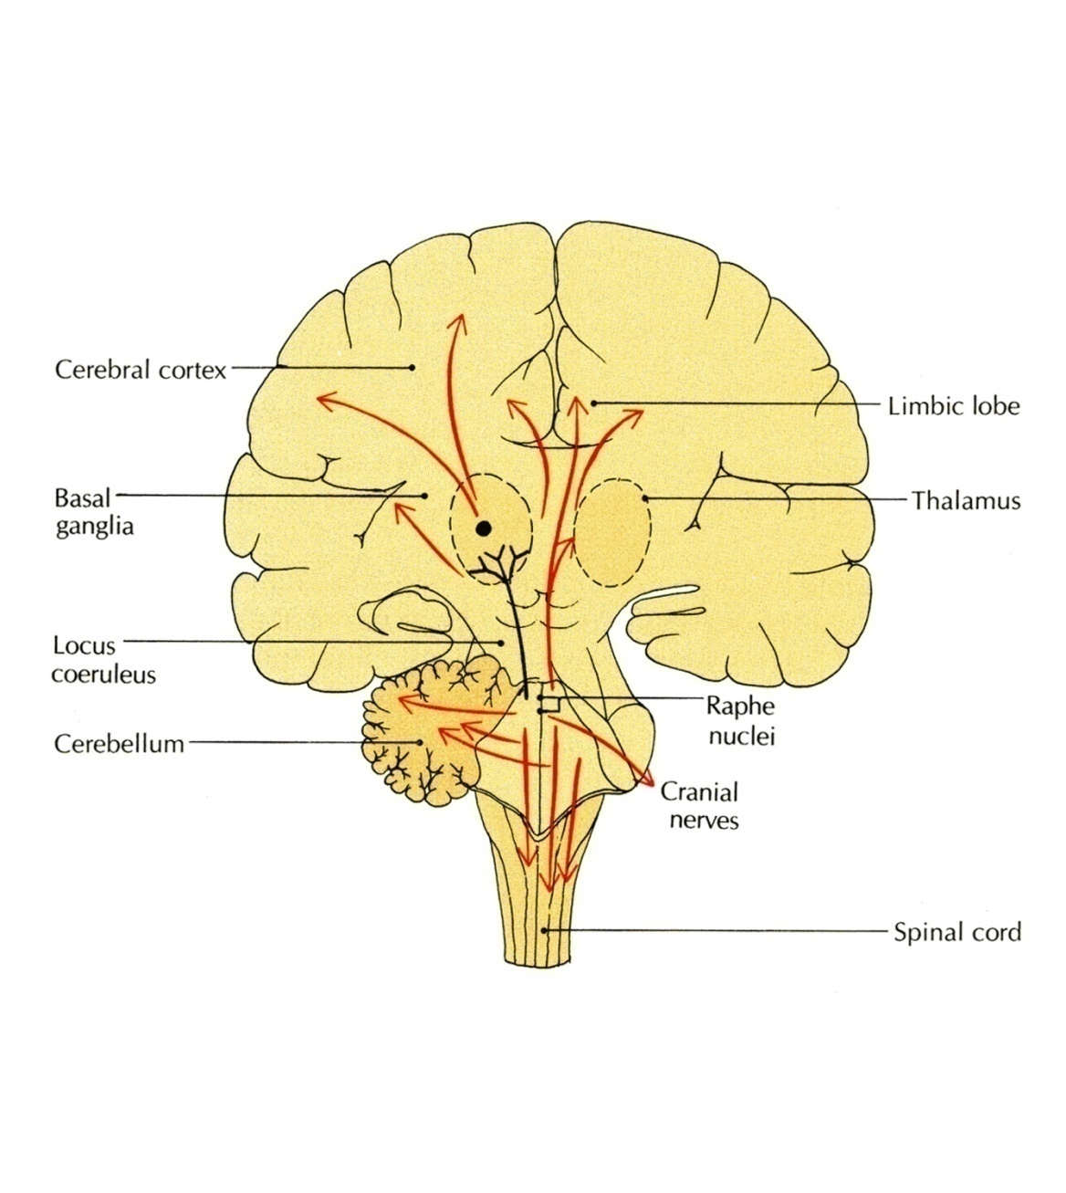
Reticular Formation
Reticular Neurones
Raphe Nuclei:
Midline reticular nuclei.
They are serotonergic* (serotonin producing)
Its ascending fibers to the cerebral cortex are involved in the mechanisms of sleep.
Its descending fibers to the spinal cord are involved in the modulation of Pain.
Locus Ceruleus:
Pigmented neurons that lie in the tegmentum of the caudal midbrain & rostral pons
It is the main noradrenergic cell group of the brain.
Helps in arousal and sleep-wake cycles.
Extra
*A serotonergic or serotonergic agent is any chemical that modifies the effects of serotonin in the body

Slide 24
Pons | Caudal | Trapezoid body (divides it into basis pontis and tegmentum) Transverse pontocerebellar fibers Pontine nuclei Bundles of corticospinal & corticonuclear fibers. Medial lemniscus Spinal tract & nucleus of trigeminal Deep origin of CN 6 & 7
 | Mid (level of trigeminal) | Motor nucleus of trigeminal Main sensory nucleus of the trigeminal Superior cerebellar peduncle (forms lateral boundary of 4th ventricle)
 | Rostral | Superior medullary velum Medial longitudinal fasciculus
Summary of levels and structures:
Medulla | Caudal / Closed | Traversed by central canal Motor decussation Trigmenial sensory nucleus
 | Mid | Traversed by central canal Gracile and cuneate nuclei Internal arcuate fibers Sensory decussation Medial leminiscus
 | Rostral / Open | Dorsal surface forms lower part of floor of 4th ventricle Cochlear nuclei (dorsal and ventral) Hypoglossal nucleus Dorsal nucleus of vagus Medial longitudinal fasciculus Vestibular nuclei complex Nucleus ambiguus Solitary nucleus Tectospinal tract
Midbrain | Inferior colliculi (auditory) | Trochlear nucleus Decussation of cerebellar peduncle sin the midline Substantia nigra (parkinsons) Ascending lemnisci
 | Crus cerebri | Descending cortical efferent fibers (present in superior and inferior colliculi)
 | Superior colliculi (visual) | Occulomotor nucleus Red nucleus

Slide 25
MCQs
1. Most axons of cochlear nuclei cross the midline of pons forming:
A- the medial lemniscus
B- the red nucleus
C- trapezoid body
D- the medial longitudinal fasciculus
Answer: C
2. The axons of the cochlear nuclei are represented in:
A- trapezoid body
B- medial longitudinal bundle
C- tectospinal tract
D- spinal lemniscus
Answer: A
3. Which of the following lies in the tegmentum of the midbrain:
A- oculomotor nuclei
B- trochlear nucleus
C- red nucleus
D- fascial nucleus
Answer: C
4. Parkinsons disease results from degeneration of:
A- red nucleus
B- substantia nigra
C- inferior olivary nucleus
Answer: B
5. Solitary nucleus is responsible for which of the following?
A- hearing
B- taste sensation
C- vision
D- fine touch
Answer: B
6. The caudal pons give have deep nuclei of which nerve?
A- vagus
B- facial
C- trigeminal
Answer: B
7. The reticular formation is found in:
A- midbrain
B- pons
C- medulla oblongata
D- all of the above
Answer: D
8. Which nerve fibers emerge on the medial side of the crus cerebri:
A- occulomotor
B- opthalmic
C- vestibulocochlear
Answer: A

Slide 26
Leaders:
Nawaf AlKhudairy
Jawaher Abanumy
Members:
Alanoud Abuhaimed
Feedback
anatomyteam436@gmail.com
References:
1- Girls’ & Boys’ Slides
2- Greys Anatomy for Students
3- TeachMeAnatomy.com
@anatomy436
Anatomy Team

