Slide 1
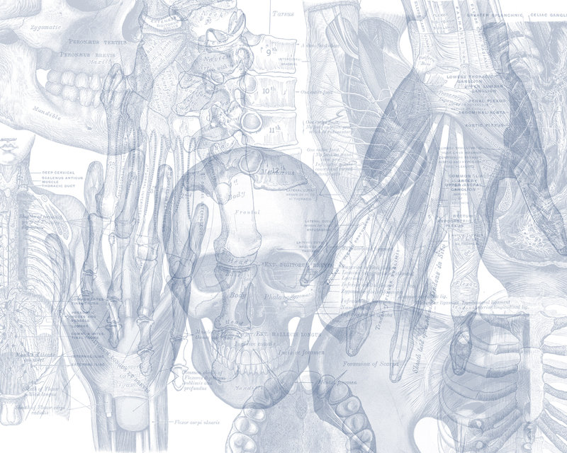
Cranial Nerves IX-X (Glossopharyngeal & Vagus Nerves)
Color Code
Important
Doctors Notes
Notes/Extra explanation
Please view our Editing File before studying this lecture to check for any changes.

Slide 2
Objectives
By the end of the lecture, the student will be able to:
Define the deep origin of both Glossopharyngeal and Vagus Nerves.
Locate the exit of each nerve from the brain stem.
Describe the course and distribution of each nerve .
List the branches of both nerves.

Slide 3
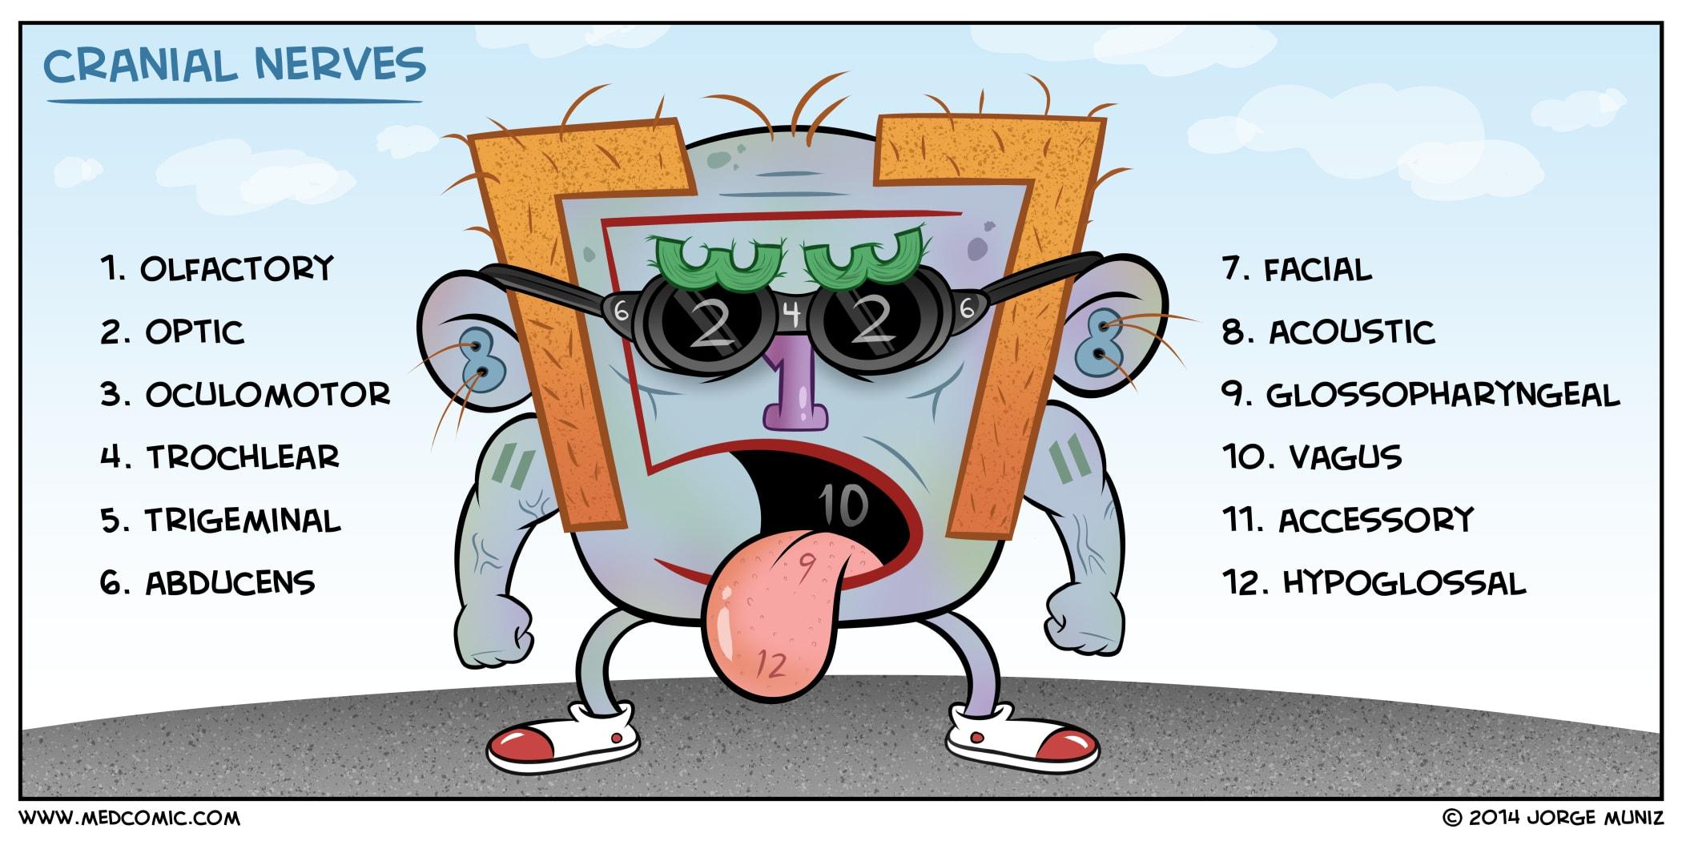
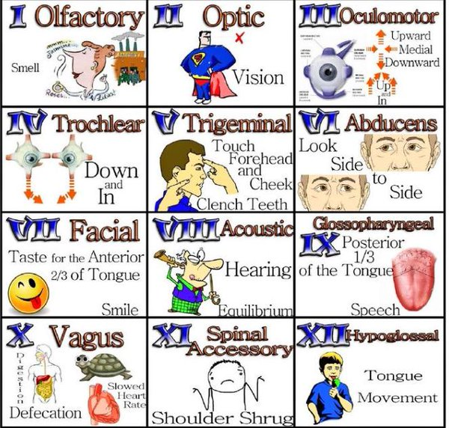
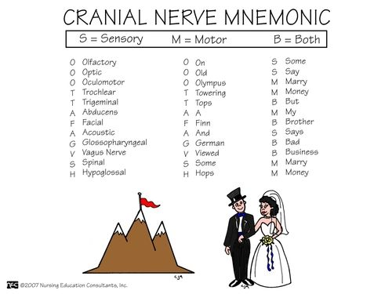
Extra Slide:
Mnemonics And Pictures To Help Memorise The Cranial Nerves
04:07
Big
Brains
Matter
More

Slide 4
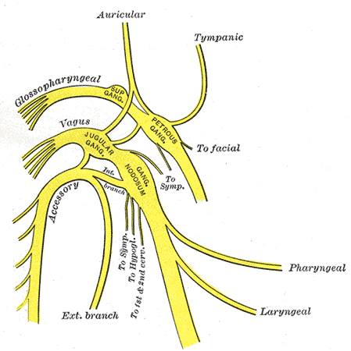
Glossopharyngeal (IX) 9th Cranial Nerve
It is principally a Sensory nerve with preganglionic parasympathetic and few motor fibers (it is a mixed nerve but most of the fibers are sensory).
It has no real nucleus to itself. Instead it shares nuclei with VII (facial) and X (vagus).

Slide 5
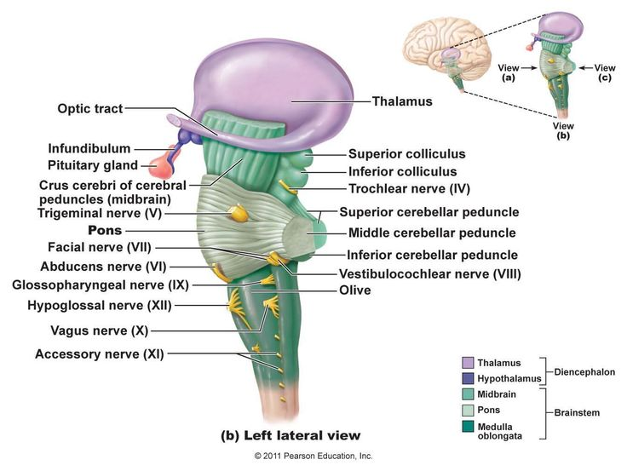
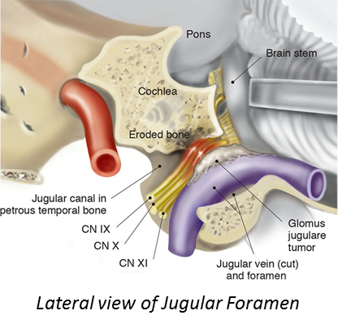
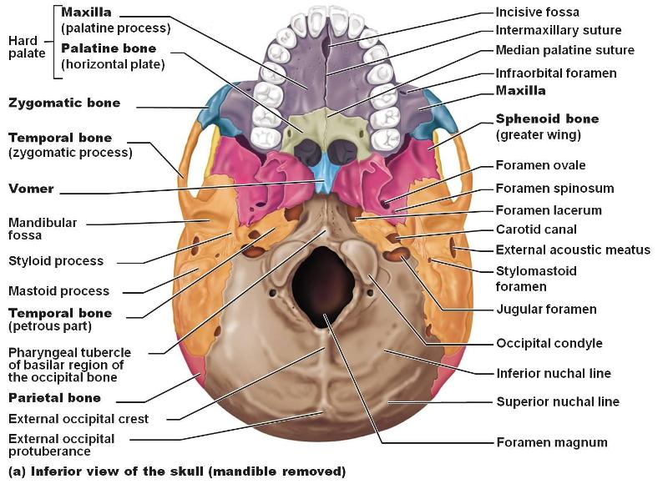
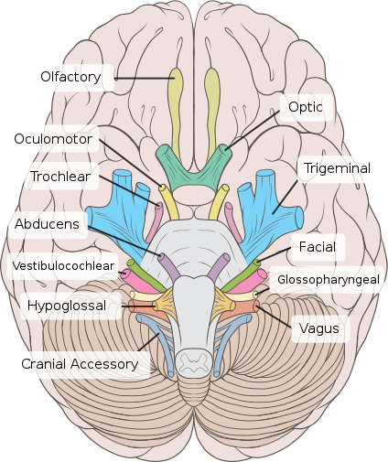
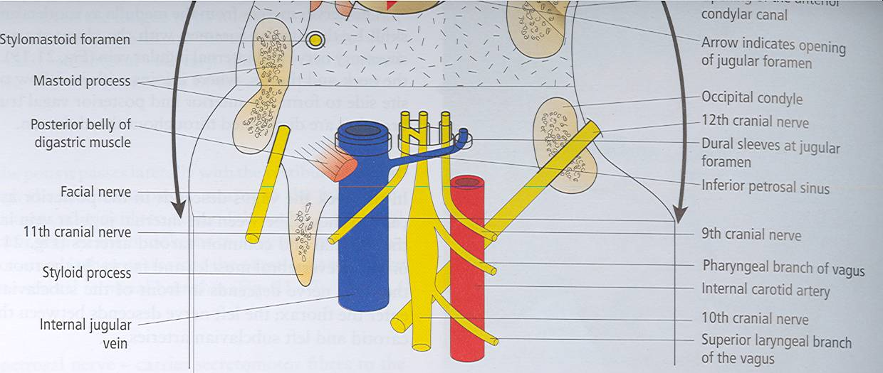
Glossopharyngeal (IX) 9th Cranial Nerve Superficial Attachment
It arises from the ventral aspect of the medulla by a linear series of small rootlets, in groove between olive and inferior cerebellar peduncle.
It leaves the cranial cavity by passing through the jugular foramen in company with the Vagus (10), Acessory (11) nerves and the Internal jugular vein.
Extra
Extra
Extra

Slide 6
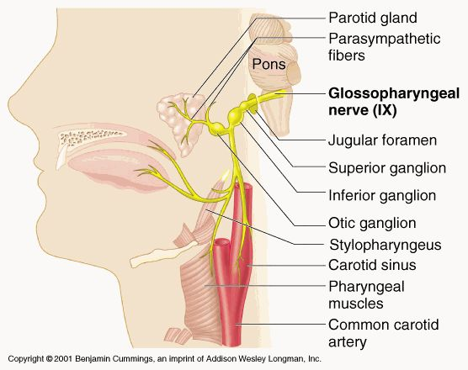
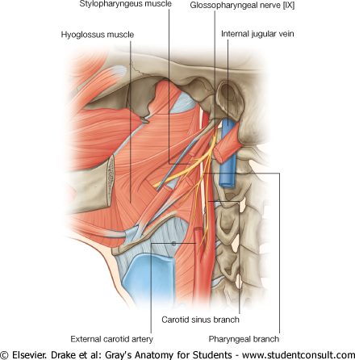
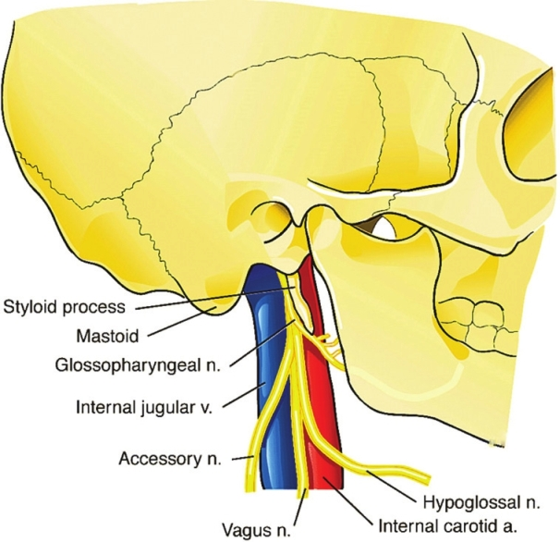
Glossopharyngeal (IX) 9th Cranial Nerve Course (extracranial)
It Passes forwards between Internal jugular vein and External carotid artery.
Lies Deep to Styloid process.
Passes between external and internal carotid arteries at the posterior border of Stylopharyngeus then lateral to it.
Extra
It reaches the pharynx by passing between middle and inferior constrictors, deep to Hyoglossus, where it breaks into terminal branches.
Extra

Slide 7
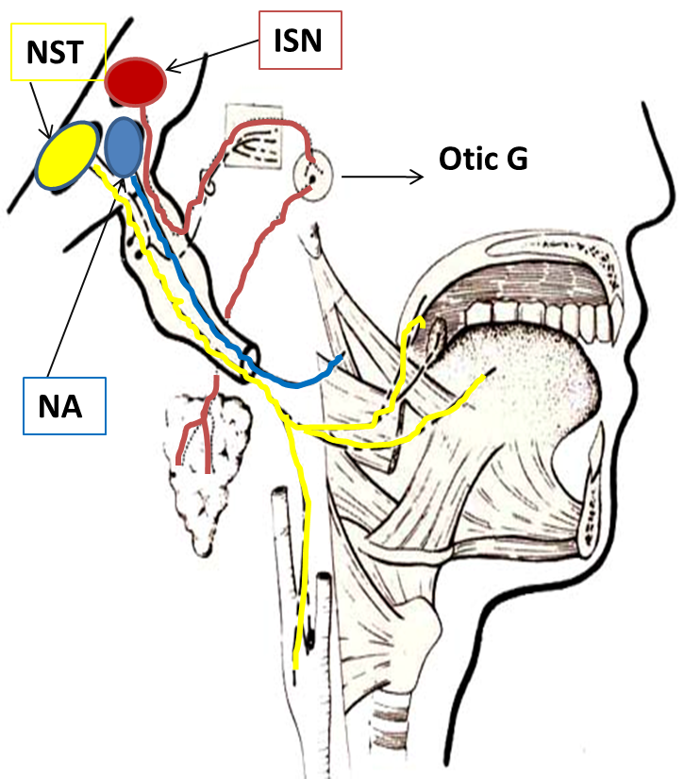
Glossopharyngeal (IX) 9th Cranial Nerve Component of fibers & Deep origin
Recall: SAME
Sensory → Afferent
Motor → Efferent
(Deep origin = nuclei)
SVE fibers: Special Visceral Efferent | originate from nucleus ambiguus (NA) | supply stylopharyngeus muscle
GVE fibers: General Visceral Efferent | arise from inferior salivatory nucleus (ISN) | relay in otic ganglion, the postganglionic fibers supply parotid gland
SVA fibers: Special Visceral Afferent | arise from the cells of inferior ganglion, their central processes terminate in nucleus of solitary tract (NST) | the peripheral processes supply the taste buds on posterior third of tongue.
GVA fibers: General Visceral Afferent | end in nucleus of solitary tract. | visceral sensation (pain and temp.) from mucosa of posterior third of tongue, pharynx, auditory tube and tympanic cavity, carotid sinus

Slide 8
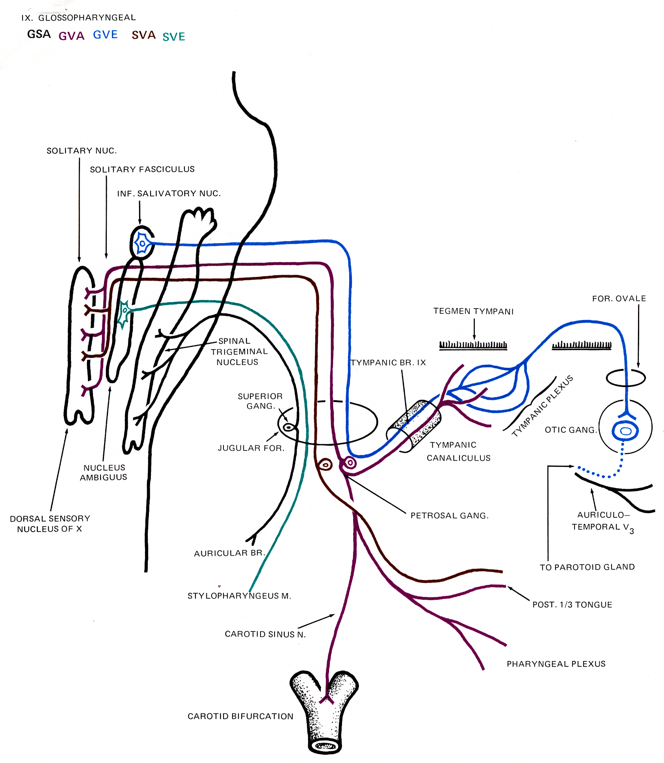

Slide 9
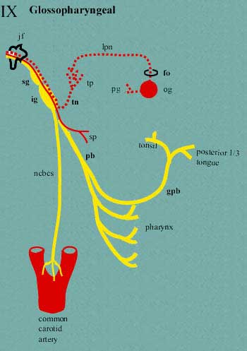
Glossopharyngeal (IX) 9th Cranial Nerve Ganglia & Communications
It has two ganglia:
Superior ganglion:
Small, with no branches.
It is connected to the Superior Cervical sympathetic ganglion.
Superior → Small
Inferior ganglion:
Large and carries general sensations from pharynx, soft palate and tonsil.
It is connected to Auricular Branch of Vagus.
The Trunk of the nerve is connected to the Facial nerve at the stylomastoid foramen

Slide 10
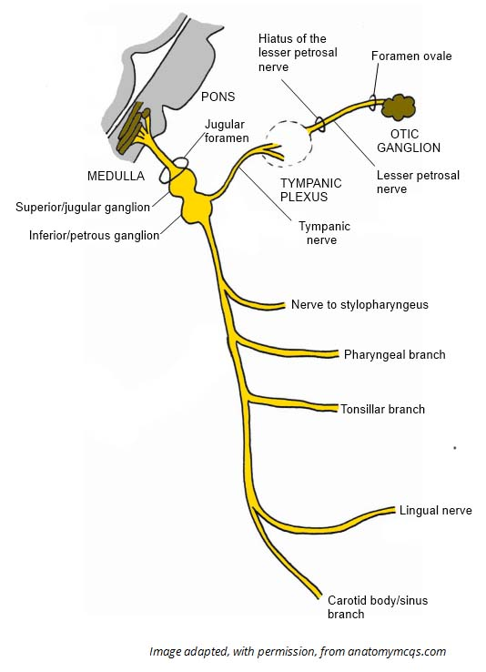
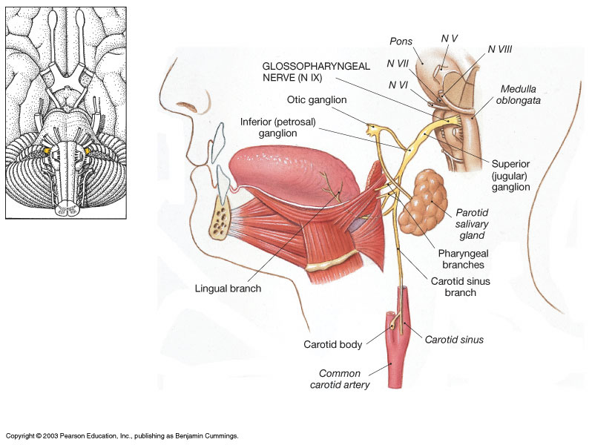
Glossopharyngeal (IX) 9th Cranial Nerve Branches
Tympanic:
relays in the otic ganglion and gives secretomotor to the parotid gland
Nerve to Stylopharyngeus muscle. (SVE fiber)
Pharyngeal: to the mucosa of pharynx .
Tonsillar.
Lingual :
carries sensory branches, general and special ( taste) from the posterior third of the tongue. (SVA fiber)
Sensory branches from the carotid sinus and body (pressoreceptors and chemoreceptors).
Extra
(GVE fiber)

Slide 11
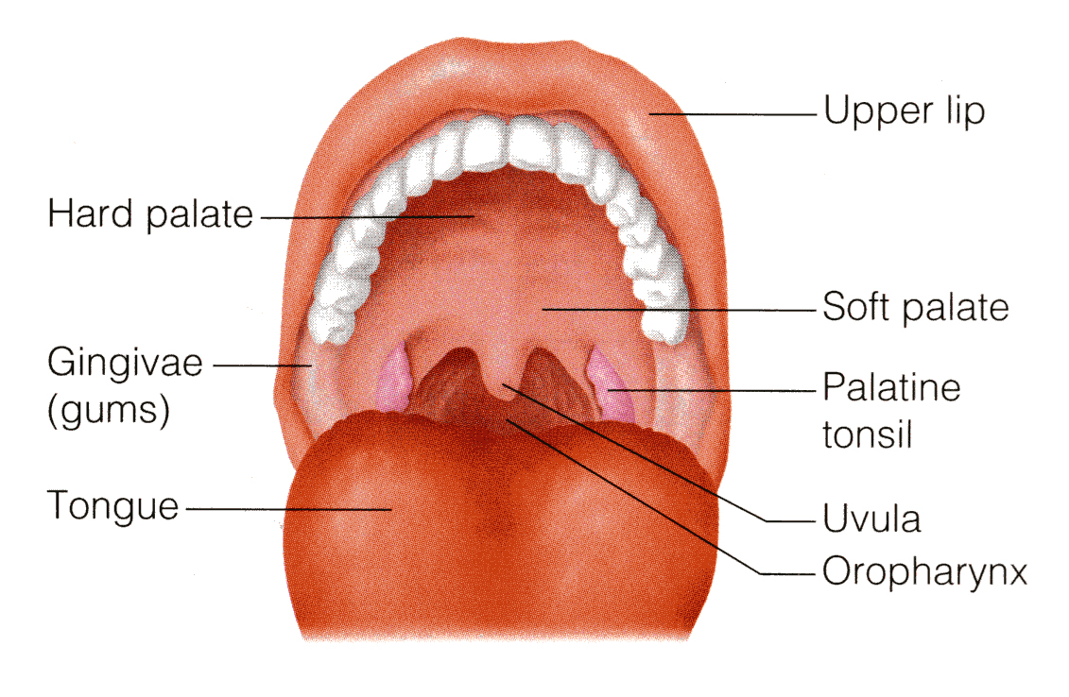
Glossopharyngeal (IX) 9th Cranial Nerve Nerve Lesions
It produces:
Difficulty of swallowing; Impairment of taste and sensation over the posterior one-third of the tongue ,palate and pharynx.
Absent gag reflex. Dysfunction of the parotid gland (it is salivary gland, dysfunction will lead to dry mouth).
How to test for IX injury?
Have the patient open the mouth and inspect the palatal arch on each side for asymmetry.
Use a tongue blade to depress the base of the tongue gently if necessary.
Ask the patient to say "ahhh" as long as possible. Observe the palatal arches as they contract and the soft palate as it swings up and back in order to close off the nasopharynx from the oropharynx.
Normal palatal arches will constrict and elevate, and the uvula will remain in the midline as it is elevated. With paralysis there is no elevation or constriction of the affected side.
warn the patient that you are going to test the gag reflex. Gently touch first one and then the other palatal arch with a tongue blade, waiting each time for gagging.

Slide 12
Glossopharyngeal (IX) 9th Cranial Nerve Summary

Slide 13
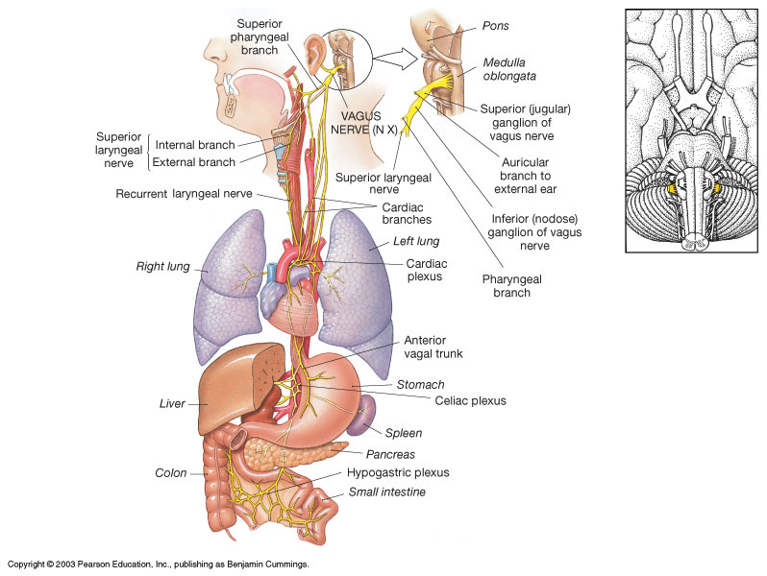
Vagus (X) 10th Cranial Nerve
It is a Mixed nerve.
Its name means wandering حائر it goes all the way to the abdomen)
So it is the longest and most widely distributed cranial nerve.
The principal role of the vagus is to provide parasympathetic supply to organs throughout the thorax and upper abdomen.
It also gives sensory and motor supply to the pharynx and larynx.

Slide 14
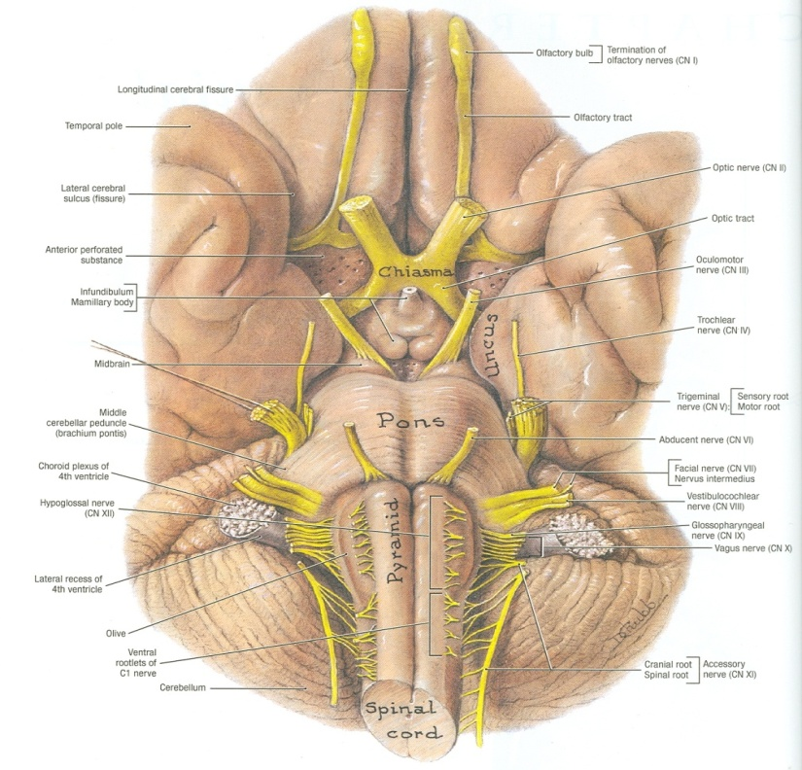
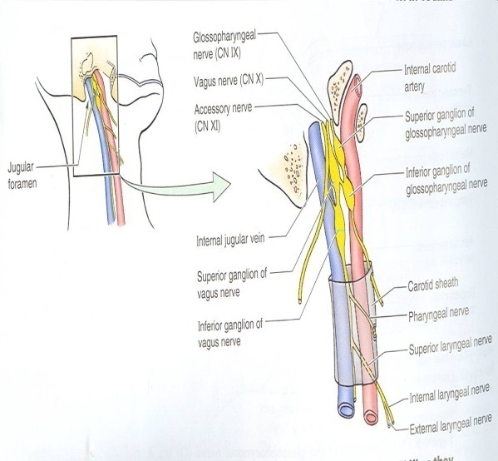
Vagus (X) 10th Cranial Nerve Superficial Attachment & Course
Its rootlets exit from medulla between olive and inferior cerebellar peduncle.
Leaves the skull through jugular foramen.
It occupies the posterior aspect of the carotid sheath between the internal jugular vein laterally and the internal and common carotid arteries medially.
It has two ganglia:
Superior ganglion in the jugular foramen
Inferior ganglion, just below the jugular foramen
Extra
The sensory fibers end in the ganglion before continuing just like the dorsal root ganglion

Slide 15
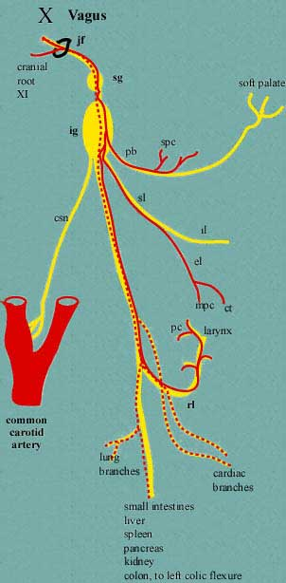
Vagus (X) 10th Cranial Nerve Communications
Superior ganglion with:
Inferior ganglion of glossopharyngeal nerve,
Superior cervical sympathetic ganglion &
Facial nerve.
Inferior ganglion with:
Cranial part of accessory nerve,
Hypoglossal nerve,
Superior cervical sympathetic ganglion.
1st cervical nerve.

Slide 16
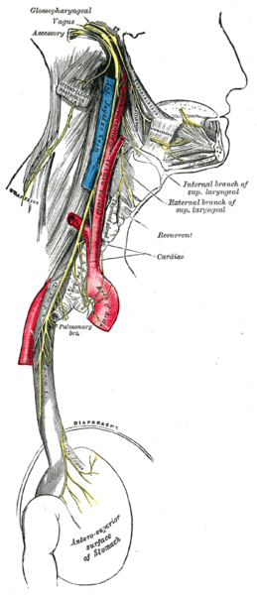
Vagus (X) 10th Cranial Nerve Course (extracranial)
The vagus runs down the neck on the prevertebral muscles and fascia.
The internal jugular vein lies behind it, and the internal and common carotid arteries are in front of it, all the way down to the superior thoracic aperture.
It lies on the prevertebral muscles and fascia.
Enters thorax through its inlet:
Right Vagus descends in front of the right subclavian artery.
Left Vagus descends between the left common carotid and subclavian arteries.

Slide 17
Vagus (X) 10th Cranial Nerve Components of fibers & Deep origin
Recall: SAME
Sensory → Afferent
Motor → Efferent
SVE fibers: Special Visceral Efferent (Motor) | originate from Nucleus Ambiguus, | to muscles of pharynx and larynx
GVE fibers: General Visceral Efferent (Preganglionic parasympathetic) | originate from Dorsal Nucleus of Vagus synapses in parasympathetic ganglia, | short postganglionic fibers innervate cardiac muscle, smooth muscles and glands of viscera.
SVA fibers: Special Visceral Afferent | to Spinal Tract & Nucleus of Trigeminal | sensation from auricle, external acoustic meatus and cerebral dura mater*,
GVA fibers: General Visceral Afferent (sensory) | to Nucleus of Solitary Tract | carry impulse from viscera in neck, thoracic and abdominal cavities
When stretches causes headache*

Slide 18
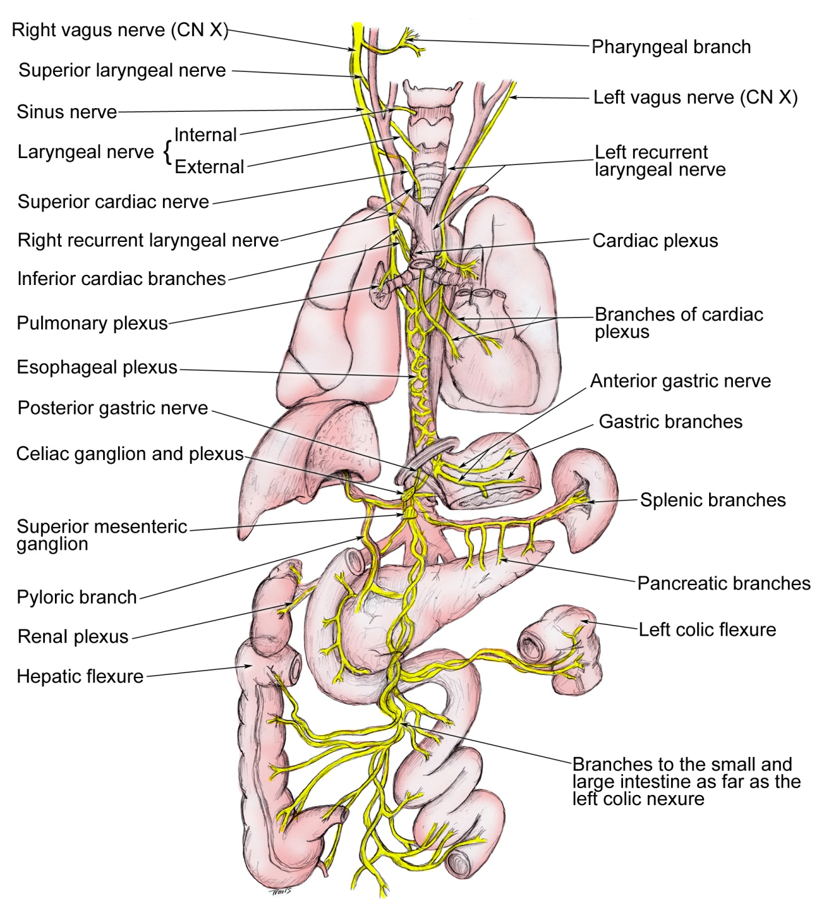
Vagus (X) 10th Cranial Nerve Branches
stimulation of auricular will also stimulate cardiac branch to heart so trauma to the ear may lead to tachycardia and cardiac arrest
(The fibers will give branches)
1. Meningeal | Dura (SVA)
2. Auricular nerve | external acoustic meatus, and tympanic membrane.
3. Pharyngeal (enters the wall of the pharynx) | mucous membrane of the pharynx, superior and middle constrictor muscles, all the muscles of the palate except the tensor palate.
4. To carotid body
5. Superior Laryngeal: It divides into: (1) Internal Laryngeal : | provides sensation to the hypopharynx(back), the epiglottis, and the part of the larynx that lies above the vocal folds
(2) External Laryngeal : | supplies the cricothyroid muscle

Slide 19
Vagus (X) 10th Cranial Nerve Branches
6. Recurrent Laryngeal : it goes round the subclavian artery on the right, and round the arch of the aorta on the left It runs upwards and medially alongside the trachea, and passes behind the lower pole of the thyroid gland. | motor supply to all the muscles of the larynx, except the cricothyroid. It also provides sensation to the larynx below the vocal folds. Injury will in thyroidectomy will lead to hoarseness of voice or complete loss of voice

Slide 20
Vagus (X) 10th Cranial Nerve Lesions
Vagus nerve lesions produce palatal and pharyngeal and laryngeal paralysis.
Abnormalities of esophageal motility, gastric acid secretion, gallbladder emptying, and heart rate; and other autonomic dysfunction.
How to diagnose X nerve Injury?
Listen to the patient talk as you are taking the history.
Hoarseness, whispering, nasal speech, or the complaint of aspiration or regurgitation of liquids through the nose (since soft palate is not working) should make you especially mindful of abnormality.
Give the patient a glass of water to see if there is choking or any complaints as it is swallowed.
Laryngoscopy is necessary to evaluate the vocal cord (to assess movement).

Slide 21
Vagus (X) 10th Cranial Nerve Summary
X is a mixed nerve.
It contains afferent, motor , and parasympathetic fibers.
The afferent fibers convey information from:
esophagus, tympanic membrane , external auditory meatus and part of chonca of the middle ear.
End in trigeminal sensory nucleus .
Chemoreseptors in aortic bodies and baroreseptors in aortic arch.
Receptors from thoracic & abdominal viscera, end in nucleus solitarius.
The motor fibers arise from nucleus ambiguus of medulla to innervate muscles of soft palate, pharynx, larynx, and upper part of esophagus.
The parasympathetic fibers originate from dorsal motor nucleus of vagus in medulla distributed to cardiovascular, respiratory, and gastrointestinal systems (up to right 2/3 the rest is from sacral fibers s2-s4).

Slide 22
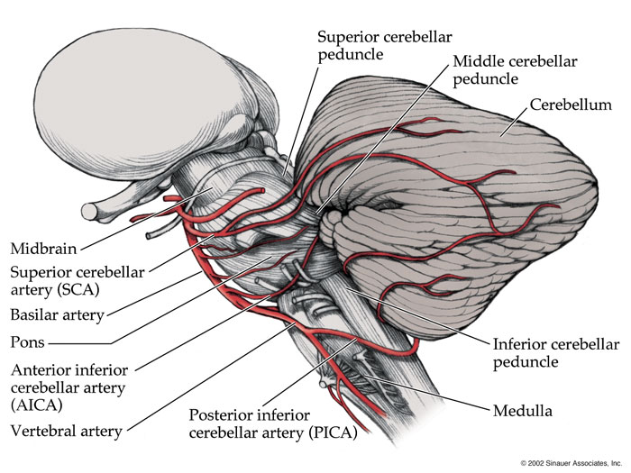
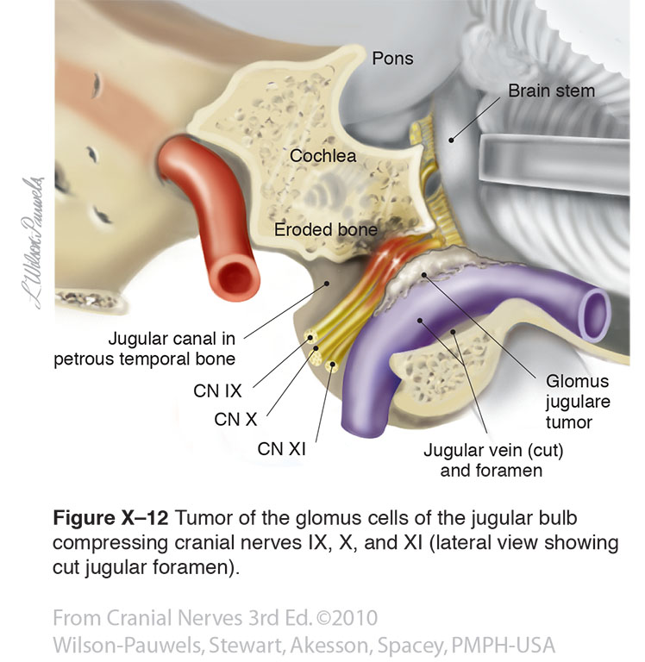
Causes of both IX & X nerve lesions:
1. Lateral medullary syndrome:
A degenerative disorder seen over age of 50 mostly due to Thrombosis of the Inferior Cerebellar Artery.
2. Tumors compressing the cranial nerves in their exiting foramina from the cranium via the skull base
Manifested by:
Ipsilateral* paralysis of the muscles of the Palate, Pharynx and Larynx.
Ipsilateral loss of Taste from the Posterior Third of tongue.
Extra
*the same side of the body
Extra

Slide 23
Nerve | Glossopharyngeal (9th) | Vagus (10th)
Type | Sensory (mainly) | Mixed
Exits from | Ventral medulla (b/w olive and inferior cerebellar peduncle) | Ventral medulla (b/w olive and inferior cerebellar peduncle)
Leaves cranial cavity via | Jugular foramen | Jugular foramen
Nuclei | Nucleus ambiguous Inferior salivatory nucleus Nucleus of solitary tract | Nucleus ambiguous Dorsal nucleus of vagus Spinal tract & nucleus of trigeminal Nucleus of solitary tract
Branches | Tympanic Nerve to stylopharyngeus muscle Pharyngeal Tonsillar Lingual Sensory (from carotid sinus and body) | Meningeal Auricular nerve Pharyngeal To carotid body Superior laryngeal (internal and external laryngeal) Recurrent laryngeal
Nerve lesion manifestation | Difficulty swallowing Impairment of taste and sensation of posterior 1/3 of the tongue, palate and pharynx. Absent gag reflex Dysfunction of parotid gland | Palatal, pharyngeal, and laryngeal paralysis. Abnormalities of: esophageal motility gastric acid secretion gall bladder emptying heart rate Other autonomic dysfunction
Cause of nerve lesion | Lateral medullary syndrome 2. Tumors compressing the cranial nerves in their exit

Slide 24
MCQs
1. Glossopharyngeal shares its nuclei with:
A- CN 7 & 8
B- CN 7 & 10
C- CN 8 & 10
D- CN 11
Answer: B
2. Cranial nerves 9 and 10 exit the cranial cavity through:
A- foramen magnum
B- foramen ovale
C- jugular foramen
D- carotid foramen
Answer: C
3. The tympanic branch of glossopharyngeal supplies:
A- parotid gland
B- pineal gland
C- pituitary gland
D- sublingual gland
Answer: A
4. A patient was shown to have absent gag reflex. Which nerve is most likely affected:
A- facial
B- vagus
C- glossopharyngeal
Answer: C
5. The right vagus nerve descends:
A- in front right subclavian artery.
B- in front of right subclavian vein .
C- between left common carotid and subclavian arteries.
D- between right common carotid and subclavian arteries.
Answer: A
6. Which of the following nuclei give fibers to muscles of pharynx and larynx?
A- nucleus solitarus
B- nucleus ambiguus
C- nucleus of trigeminal
Answer: B
7. Cricothyroid is supplied by which branch of the vagus nerve:
A- internal laryngeal
B- external laryngeal
C- recurrent laryngeal
Answer: B
8. CN 9 & 10 lesions can be caused by:
A- lateral medullary syndrome
B- medial medullary syndrome
C- anterior medullary syndrome
D- posterior medullary syndrome
Answer: A

Slide 25
Leaders:
Nawaf AlKhudairy
Jawaher Abanumy
Members:
Hamad alkhudairy
Abdulaziz alsalman
Feedback
anatomyteam436@gmail.com
References:
1- Girls’ & Boys’ Slides
2- Greys Anatomy for Students
3- TeachMeAnatomy.com
@anatomy436
Anatomy Team

