Slide 1
Biochemistry
Important
Extra Information
Doctors slides
Doctors notes
ما دمـت قررت ذلك
كن قويــًا
SPHINGOLIPIDS AND MYELIN STRUCTURE
Editing file

Slide 2
By the end of this lecture, the students should be able to:
•Recognize the Sphingolipids class of lipids as regard their chemical structure, tissue distribution and functions.
•Be familiar with the biochemical structure and function of myelin.
•Learn the basics of biosynthesis of sphingolipids.
•Be introduced to Sphingolipidosis
(lysosomal lipid storage diseases) .
Key principles :
Chemical structure of Sphingolipids.
Types:
Glycosphingolipids (Glycolipids).
Sphingophospholipids, e.g. Sphingomyelin.
Myelin structure and function.
Sphingolipidosis.

Slide 3
There are 2 classes of phospholipids based on the backbone:
Glycerol (from glucose)
Glycerophospholipids or phosphoglyceride
Sphingosine (from serine and palmitate)اللي هي محاضرة اليوم
Sphingophospholipids (Hydrophilic group = phosphate) “ has phosphate and lipid can be put with phosphides or glycolipids”
Glycerosphingolipids ( hydrophilic group = carbohydrate)
Background about Phospholipids:
Recall what you studied in foundation!
Phospholipids: Are cell membrane make up
Major structure of it is: Amphipathic
Which is:
Hydrophilic portion = phosphate group
Hydrophobic portion = lipid

Slide 4
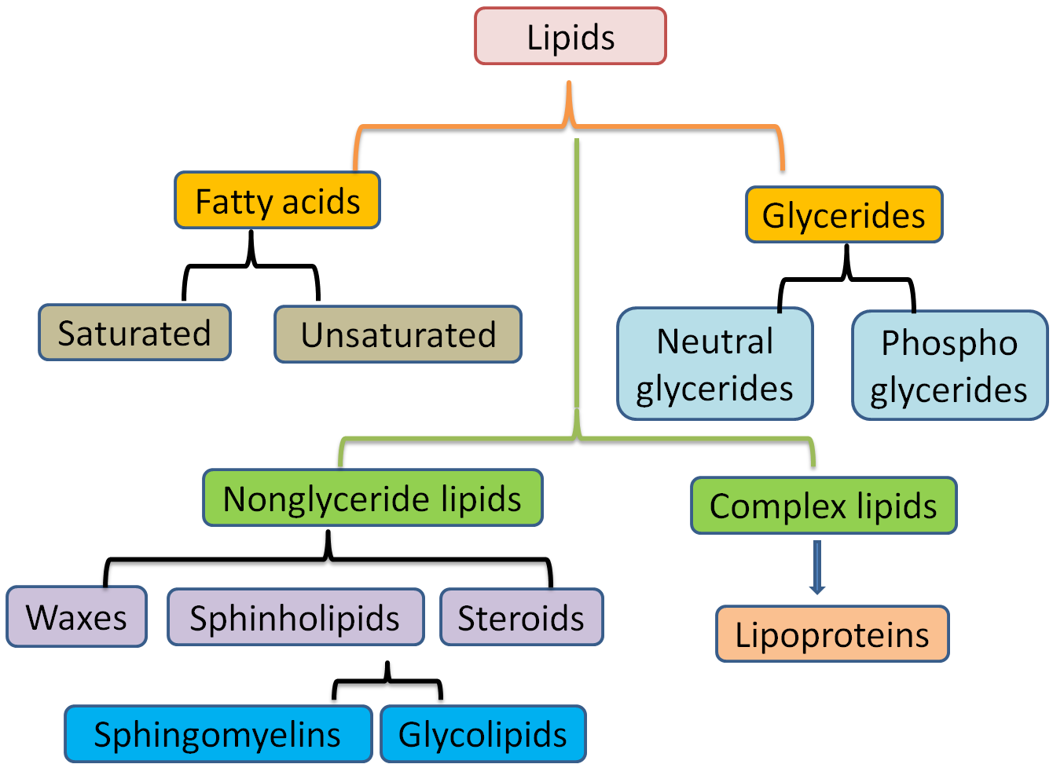
Background about Phospholipids:
Essential component of membranes.
Abundant in nervous tissue.
Plays a role in regulation of growth and development
Also exist extra-nervous tissue:
e.g. Receptors (recognition) for :
Cholera toxins, diphtheria toxins & Viruses.
Very antigenic:
Blood group antigen, embryonic antigen & tumor antigen
Plays a role in cell transformation .
The only physiological significant of Sphingophospholipids present in our body is the sphingomyelin
What is the role of it ? It is one of the components of myelin sheath (not the main one)
Role other than structural (usually present in extra cellular fluid) : involved in recognition, cellular interaction , adhesion and could serve as antigens (glycosphingolipids)very antigenic
Tumor antigens: because carbohydrates that are attached these sphingolipids they keep on changing. So, when the cell is going under transformation, say it becomes cancerous the carbohydrates in the top of the carbohydrate arrangement and the composition of the top layer in cell membrane keeps changing, and that’s the marker for cell transformation. That’s how they act as tumor antigen

Slide 5
Sphingolipids structure and types:
Sphingosine:
Ceramide:
CH₃ (CH2)₁₂ CH CH CH CH CH₂OH
OH NH₂
Long chain, unsaturated amino alcohol
CH₃ (CH₂)₁₂ CH CH CH CH CH₂OH
OH NH
CH₃ (CH₂) C
O
Parent molecule for all of the sphingolipids
Ceramide = Sphingosine + Fatty acid
Long chain fatty acid
Sphingosine is formed from serine which is an amino acid polar uncharged it has oh2 and palmitoyl acid (fatty acid)
Ceramide play a key role in maintaining the skin’s water-permeability barrier. (it’s present in some creams and lotions)
Decreased ceramide levels are associated with a number of skin diseases.
The backbone of sphingolipids
And for the following each time we’ll add a group that changes the name of the compound

Slide 6
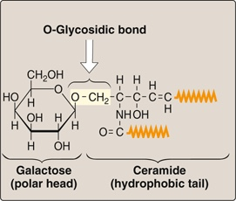
Sphingolipids structure and types:
Two types of glycosphingolipids:
1) Neutral (like these in the slide)
2) acidic
Sphingomyelin:
Cerebrosides:
Cerebrosides = ceramide + monosaccharides
eg. Galactocerebroside
is the most abundant in nervous
tissue ..
Sphingomyelin = Ceramide + phosphorylcholine
Or Sphingosine + Fatty acid + Phosphorylcholine, choline is an amino acid alcohol
CH₃ (CH₂)₁₂ CH CH CH CH CH₂O phosphorylcholine
OH NH
Ch₃ (CH₂)_{n} C
O
Long chain fatty acid
What brings this galactose or glucose? By the carrier UDP
(uridine diphosphate)
Uridine is nitrogenous base ..
Sphingomyelin is the only significant sphingolipid in humans

Slide 7
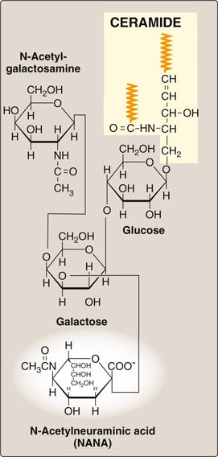
Sphingolipids structure and types:
Gangliosides = Ceramide + Oligosaccharides
+
NANA
example : G_{m2}
Gangliosides
Oligo = 3 or more
For Gm2: G=ganglioside; M=mono molecule of NANA; 2=the monomeric sequence of the carbohydrate attached to the ceramide
It is important to memorize the name of each compound and to know that the origin of each compound is sphingosine
N-Acetylneuraminic acid “NANA” is the predominant sialic acid found in mammalian cells.

Slide 8
Sphingolipids synthesis:
Galactocerebroside + sulfate = Sulfatide (which is a negatively charged cerebroside).
By the carrier phosphoadenosine phosphosulfate (PAPS).

Slide 9
Myelin structure:
Each Schwann cell serve a single axon
While oligodendrocyte serve multiple axons at once
Myelin is a specialized cell membrane that ensheathes an axon to form a myelinated nerve fiber.
Myelin is produced by:
Schwann cells: Peripheral nerves.
Oligodendrocytes: CNS.
Myelin composition: Lipids (80%): Main component: Cerebrosides
Other component: Sphingomyelin
Proteins (20%): e.g. Myelin basic protein
Fatty acid that is present in brain grey matter: stearic acid.
Fatty acid of Sphingomyelin:
Myelin sheath: Very long chain fatty acids
Lignoceric 24:0
Nervonic 24:1(15)

Slide 10
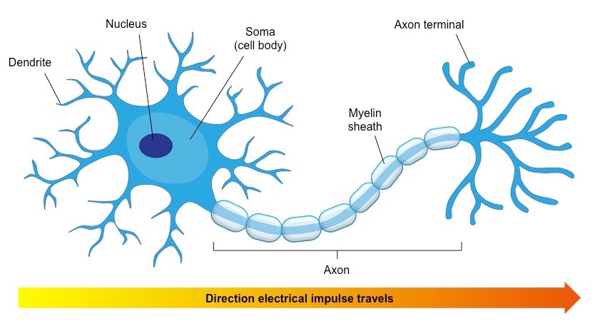
Myelin structure and function:
Myelin sheath insulates the nerve axon to avoid signal leakage and greatly speeds up the transmission of impulses along axons.
Direction of nerve impulse
Multiple sclerosis “MS” :
Neuro-degenerative, auto-immune disease.
Breakdown of myelin sheath (demyelination).
Defective transmission of nerve impulses.

Slide 11
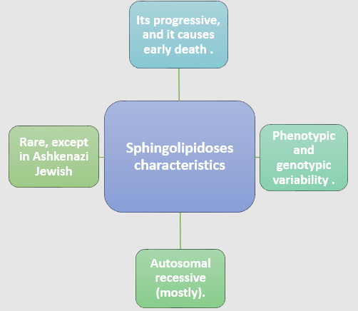
Sphingolipidoses (lysosomal lipid storage diseases) أغلب أنواعه وراثية وهي اللي بنركز عليها ..
What is it ?
Lysosomal lipid storage diseases caused by these deficiencies are called sphingolipidoses, A partial or total missing of a specific lysosomal acid hydrolase leads to accumulation of a sphingolipid.
When the synthesis is normal and degradation is defective Substrate accumulates in organs .
Usually only a single sphingolipid accumulates in the involved organs in each disease
*Mainly liver and spleen responsible for that
The breakdown of the sphingolipid is defected not the synthesis
في الإنسان الطبيعي عملية التصنيع والهدم للـ glycosphingolipids متزنة
الهدم = البناء فكمياتها بالميمبرينز ثابتة لكن لما يكون أنزيم
acid hydrolase
الموجود باللايسوسومز مفقود بتكون عندنا مشكلة في عملية الهدم وتتراكم المواد
Hepatosplenomegaly, because liver is involved in lipid’s storage
Fabry & Tay-Sachs are examples for lysosomal lipid storage diseases but they are rare
Sphingolipidoses are autosomal recessive diseases, except for fabry disease which is X linked

Slide 12
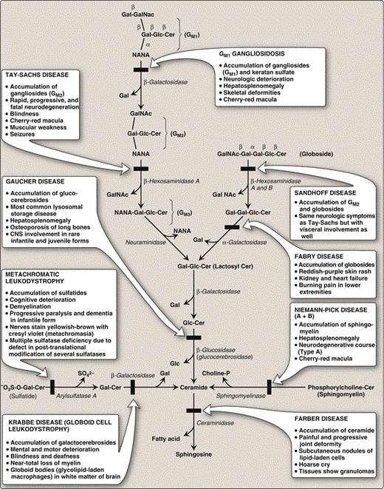
Sphingolipidoses
Diagnosis :
By measuring the enzyme activity :
Cultured fibroblasts or peripheral leukocytes.
Cultured aminocytes with chronic villi ( Prenatal )
Histological examination
DNA analysis
Treatment e.g. Gaucher disease
Replacement therapy
e.g. Recombinant human enzyme.
Bone marrow transplantation
In DNA analysis first you must know which mutation is specific for which disease
Recombinant human enzyme is not broadly used because its expensive ..

Slide 13
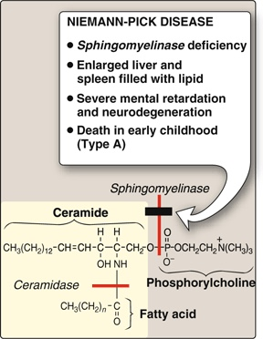
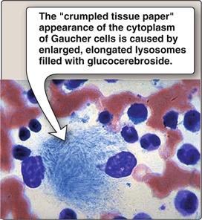
Sphingolipidoses
Niemann-pick disease
sphingomyelinase deficiency
Gaucher disease

Slide 14
From 435 team
Disease | Tay-sachs | Gaucher | Niemann-pick (A+B)
Deficient Enzyme | β-Hexosaminidase (α subunit) | β-glucosidase (glucocerebrosidase) | Sphingomyelinase
Lipid accumulated | Gangliosides (Gm2) | glucocerebrosides | Sphingomyelin
Clinical Features | Blindness. -Cherry-red macula.* -muscular weakness and seizures. -Deficiency of activator protein (Gm2 Activator) | The most common one. - Hepatosplenomegaly - Osteoporosis of long bones. - CNS involvement in rare infantile (in infants) and juvenile (in children) forms. - Enzyme Replacement therapy is usually successful for this disease. Cytoplasm looks like crumbled tissue paper due to accumulation of Galactocerebrosides | Type A : -Enzyme Activity is reduced to 1% and less than normal. -Fatal Disease | Type B : - Little enzyme act - Chronic Disease.
 |  |  | -More severe. -Death in early childhood. - Hepatosplenomegaly -Neurodegenerative course. -*Cherry red macula | -Less severe form type A -Later onset - Little enzyme act -Hepatosplenomegaly -*Cherry red macula
*Cherry-red macula is: There is an area in the retina that is called macula, it acts as a natural sun-block (it blocks ultraviolet rays that enter and harm the eye), usually it’s yellow in color but when it’s affected it becomes red under the light. Examples of Sphingolipidoses

Slide 15
Summary
Types and Structures of Sphingolipids
Type | 1. Sphingosine | 2. Ceramide | 3. Sphingomyelin | 4. Cerebrosides | 5. Gangliosides
Structure | Long chain, unsaturated amino alcohol | = Sphingosine + Fatty acid | = Ceramide + phosphorylcholine | = ceramide + monosaccharides | = Ceramide + Oligosaccharides + NANA
Example | - | - | - | Galactocerebroside | Gm2
Myelin Structure and Function
Structure | It is the membrane around the axon that forms a myelinated nerve fiber. Myelin is produced by Schwann cells and Oligodendrocytes. It is composed of 80% lipids and 20% proteins.
Function | Nerve insulation: to avoid signal leakage, and to increase velocity of impulse transmission.
Sphingolipidoses: Lysosomal Lipid Storage Diseases
How? | The substrate is synthetized normally but there’s a defect in its degradation, so it accumulates in the organs.
Facts | Autosomal recessive disease. |  |  | Progressive disease. |  | Rare, except in Ashkenazi Jewish.
Diagnosis | 1. Measuring enzyme activity |  | 2. Histological examination |  |  |  | 3. DNA Analysis
Treatment | 1. Replacement therapy |  |  |  | 2. Bone marrow transplantation
Examples | 1. Tay Sachs disease | 2. Fabry disease |  |  | 3. Gaucher disease |  |  | 4. Niemann Pick disease

Slide 16
Take home messages
Sphingolipids are complex lipids that includes sphingo-phospholipids and glycolipids.
Ceramide is the precursor of all sphingolipids.
Sphingolipids are present mainly in nerve tissue, but they are also found extra-neural.
Myelin sheath insulates the nerve axon to avoid signal leakage and speed up impulse transmission.
Sphingolipidoses are rare genetic diseases due to defective degeneration of sphingolipids.
Good luck

Slide 17
Quiz
1) Which of the following consist of " ceramide + phosphorylcholine “ ?
Sphingomyelin
Cerebrosides
Gangliosides
None of them
2) In peripheral nerves myelin is produced by ..........................
Astrocytes
Oligodendrocytes
Schwann cells
None of them
3) Replacement Therapy is a way to treat multiple sclerosis .
True
False
4) Myelin is composed of high amount of proteins and low amount of lipids .
True
False
Q : Discribe the characterstics of Niemann-pick disease ?
Q : What is the reason behind the crumpled tissue paper appearance in gaucher disease ?
1-A
2-C
3-B
4-B
Suggestions and recommendations

Slide 18
Haifa bin taleb
Leen Altamimi
Ghadah Alhadlaq
Rawan Alwadee
Muneerah Aldufayan
Bushra Quqandy
Rana Barasain
Muneerah Alzayed

Slide 19
https://www.youtube.com/watch?v=7udUG8KkN_E
Don’t forget to review the notes

