Slide 1
Biochemistry
Important
Extra Information
Doctors slides
Doctors notes
Vitamin A & Visual Cycle
Editing file

Slide 2
By the end of this lecture, the students should be able to:
understand the function and transport of vitamin A.
To know the role of vitamin A in vision and
deficiency can lead to blindness
Key principles:
Fat-soluble vitamins
Biochemistry and types of vitamin A
Absorption and transport
Functions
Functions in the visual cycle
Deficiency and diseases
Background of the lecture:
Vitamin A is often used as a collective term for several related biologically active molecules. The term retinoids includes both natural and synthetic forms of vitamin A that may or may not show vitamin A activity. The retinal a family of molecules that are related to retinol (vitamin A), are essential for vision, reproduction, growth, and maintenance of epithelial tissues.
Retinal is a component of visual pigment and derived from oxidation of dietary retinol, responsible for vision.

Slide 3
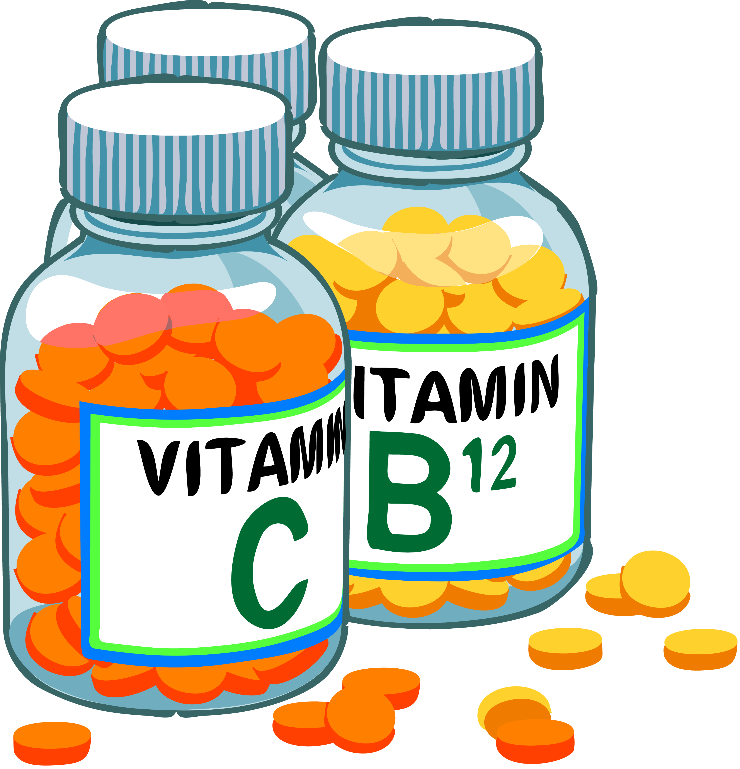
Vitamins ”The word vitamin came from 2 words: Vital and minerals”
Interesting introductive video
Vitamins
Organic compounds present in small quantities in different types of food.
Important for growth and maintaining good health.
Required in very small amounts.
Essential and non-caloric.
Therefore, must be supplied by the diet.
Most act as coenzymes.
Help in various biochemical processes in cell.
(we need Vitamin A in very small amounts.
If the person didn’t get them he’ll be having deficiency diseases, they’re helping in growth and maintaining body physiology so they don’t provide calories)
Vitamins are indirect source of energy. They help the body to obtain enough energy from the other sources
(fats, carbohydrates …)

Slide 4
Vitamins - Classified Based on Solubility:
Fat-soluble vitamins
A,D,E and K
Water-soluble vitamins
ascorbic acid (vitamin C)
thiamin (vitamin B1)
riboflavin (vitamin B2)
Niacin (Vitamin B3)
pyridoxine (vitamin B6)
biotin
pantothenic acid
folate
cobalamin (vitamin B12)
They are released, absorbed, and transported with dietary fat (not excreted by urine) and excess use can accumulate and cause toxicity.
Mnemonic: KADE (Name of a girl)
Fat soluble vitamins are stored inside the body while water soluble are not so developing vitamin deficiency in water soluble is more prominent
* Please don’t just memorize the number of the vitamin, memorize the name of it so when you are asked in the exam you don’t get confused
They are readily excreted in urine and the toxicity is rare. But their deficiency can occur quickly

Slide 5
Fat-soluble Vitamins:
Stored in the liver and adipose tissue.
Excess may accumulate and cause toxicity.
Cases of toxicity with vitamin A and D have been reported.
Do not need to be consumed each day due to storage in the body.
Absorbed slowly with fats.
Diseases due to deficiency are rare as large amounts are stored in the body.
they’re stored in other tissues as well but in very small amounts. They can cross the membrane and stay in the body, their deficiency is commonly developed.
And they are not needed in daily amounts thus rarely get deficient
because the liver is a big organ and can provide vitamins (as they are stored in it) when the person’s not taking them for that day.

Slide 6
Vitamin A:
Vitamin A from animal sources (Preform)
“Preform: means already formed” and it’s the main source
Three preformed compounds called retinoids “which are the other 2 forms (with aldehyde > retinal, with acid> retinoic acid)”
that are metabolically active and found in animal products:
retinol – alcohol form found in animal tissue (can be converted to other forms)
retinal or retinaldehyde – aldehyde form derived from the oxidation of retinol (essential in vision)
retinoic acid – acid form derived from the oxidation of retinal (for skin and bone growth)
can not be reduced back or converted to retinol or retinal, they have experienced this by giving only retinoic acid to mice and when they grow up they were blind and sterile since they don’t have the other types
Vitamin A from plant sources (Pro-vitamin)
“Pro-vitamin: means that this form is not metabolically active . It get activated in the body”
This source is mainly available in carrots and yellow or orange fruits and vegetables .
Carotenoids (β-carotene) and cryptoxanthin can yield retinoids when metabolized in the body.
These are from plant sources
One molecule of β -carotene can be cleaved into two molecules of retinal in the intestine.

Slide 7
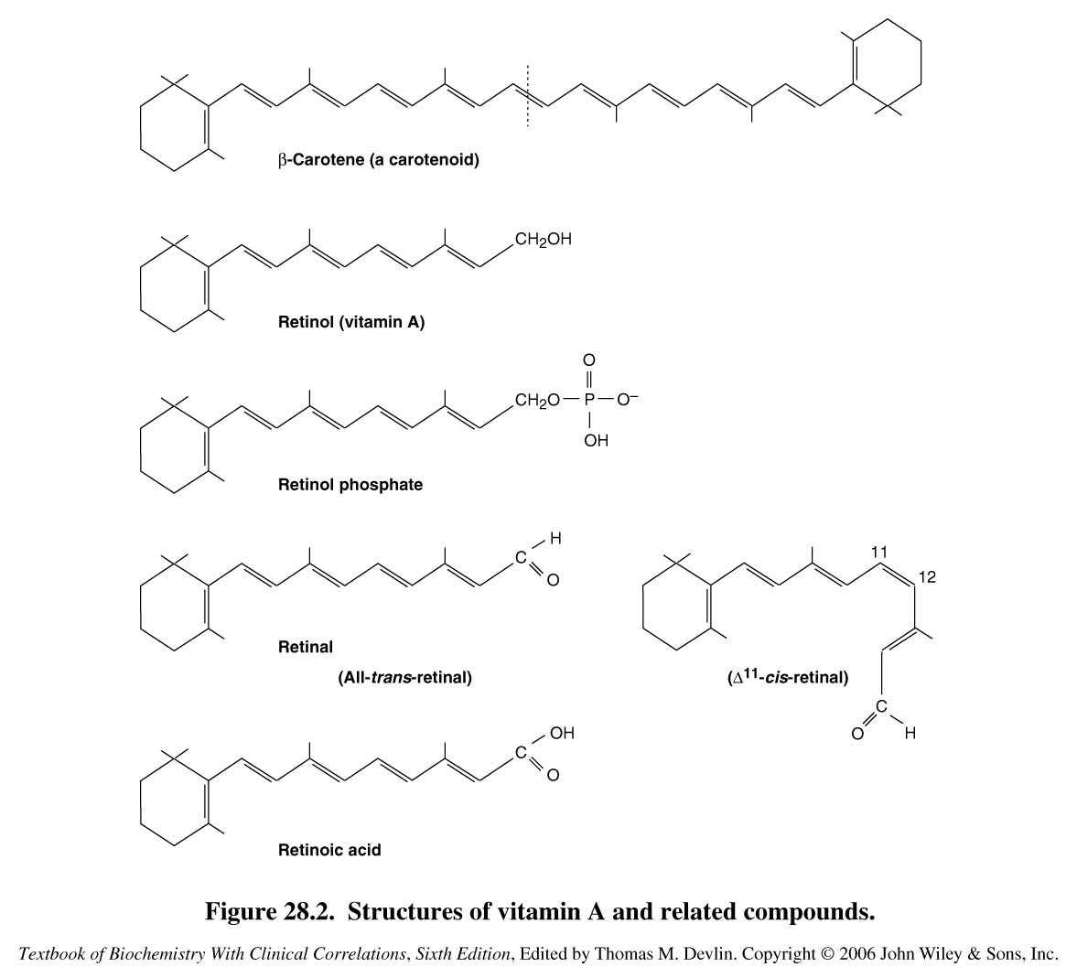
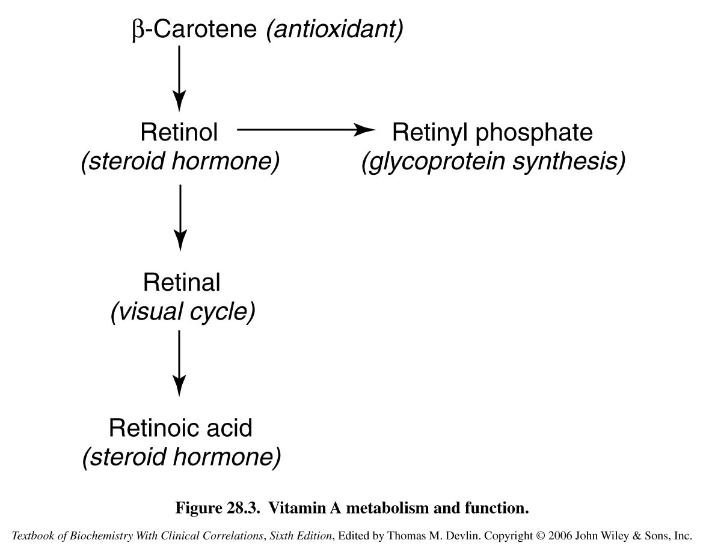
Forms Vitamin A
Obviously each β-carotene will split into 2 Retinols
Retinol is the type that is stored in our body.
Stored as Retinyl ester
Retinal has two types which are all-trans-retinal and 11-cis-retinal which has a cis in its 11th carbon ( the one having a double bond ).
All-trans-retinal has a straight form. Both all-trans-retinal and 11-cis-retinal are important in the visual cycle.

Slide 8
Functions of Vitamin A:
Supports spermatogenesis in male and prevent fetal resorption in female
Essential role in vision and normal cell differentiation.
Deficiency is the most significant cause of blindness in the developing world.
Large doses over a prolonged period of time can produce intoxication and eventually lead to liver disease.
Excessive carotenoids intake can result in yellowing of the skin, but appears to be harmless.
Functions
Vision: Vitamin A is a component of the visual pigment rhodopsin. Retinal is bound to the protein opsin.
Reproduction: Retinol and retinal are essential for normal reproduction
Bone metabolism, immune functions, Skin health, and Antioxidant activity
Growth: Vitamin A deficiency causes loss of appetite. Slow bone growth. Affects CNS.
Gene transcription
and Embryonic development and reproduction
Maintenance of epithelial cells: Essential for normal differentiation of epithelial tissues and mucus secretion.
(Skin health)
Vitamin A exert its function through gene processing within the nucleus ..

Slide 9
Extra Notes about Vitamin A:
Large doses:
there are specialized cells in the liver called stellate cells or the ito cells which store Vitamin A – 80-90% of Vitamin A get stored here) so if there is an excessive stimulation, it will lead to toxicity, and there are acute toxicity symptoms like (diarrhea, blindness, nausea) and chronic symptoms like (pruritus, increased cranial pressure which mimics the symptoms of a brain tumor) but this is caused by synthetic forms, so for example when you eat too much carrots your skin’s pigmentation will change but as soon as you reduce or stop eating them your skin will go back to it’s normal color.
Vitamin A Controls the production of B-carotene (so if retinoic acid is deficient it will lead to overproduction of B-carotene, and if there’s a toxicity it will lead to less production of B-carotene).
(increases the immunity, sometimes it is written as anti-infective vitamin so it prevents infections)

Slide 10
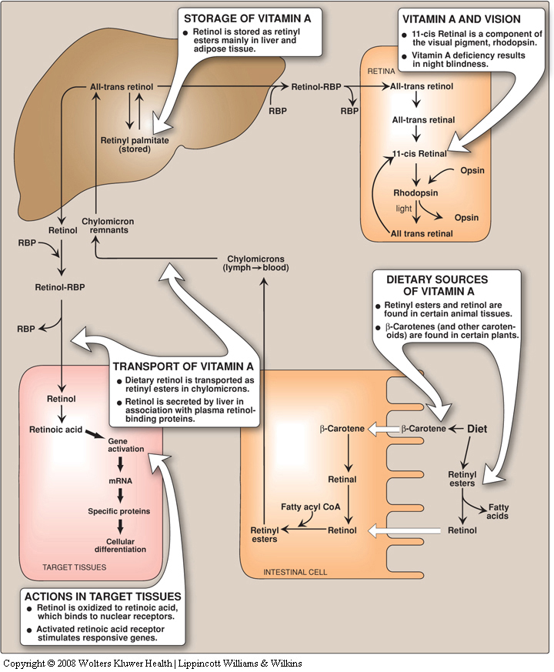
Vitamin A “Metabolic pathway”
شرحنا لكم الباثواي هنا:
مهم في الصورة يحفظ الصورة التي تم تخزينها في كل مكان سواءً من كبد او اديبوس تيشو وغيره
Retinol is converted to Retinal in the eyes , and to retinoic acid in other tissues .
When we eat vitamin A in the “pre” form the fatty acid gets removed and it becomes a free retinol in order to be absorbed in intestine , after absorption it get combined to fatty acid again and get transported to the liver by chylomicrons ..
Retinyl palmitate is the stored form of Vit.A . Vit.A cant be stored freely so it’s comined with a fatty acid .
It carries the fat through the body . (Transporter)
When we eat meat from animal source , our bodies will be supplied with retinyl ester that is exclusive for animals . So , this ester when it enters the body it will be converted to RETINOL to enter the intestine , then it will be converted again to Retinyl ester that is exclusive for human . Which will go to the liver and be stored there .
RBP takes retinol to the targeted tissue within the blood, then ONLY retinol goes inside and gets converted into retinoic acid which will go to the nucleus and bind to specific receptors (retinoid receptors / RAR) there and makes it active which will affect gene transcription.

Slide 11
Explanation for Vitamin A pathway in the Body : (Previous slide) 435 team
لما احنا ناكل لحم مثلا ، ناخذ من اللحم Retinyl ester “الخاص بالحيوان” هذ الاستر بيخسر واحدfatty acid و يتحول الى Retinol . هذا الريتينول بيدخل الأمعاء و يتفاعل مع Acetyl CoA عشان يرجع و يسوي لنا ريتنايل استر و لكن هذه المرة الخاص بالإنسان وليس الحيوان !
هذا الاستر بيركب علىChylomicron لأنه طبعا ما يقدر يتمشى بالجسم لحاله لانهhydrophobic فيحتاج ترانسبورتر . المهم اذا ركب بيروح عبر lymphatic system للكبد و يتحول هناك الىAll trans retinol ، و يتخزن في الكبد علي هيئةretinyl palmitate ، و يضل هناك إلى ما تحتاجه الأعضاء . مثلا العين تحتاجه الحين ، بيتحول مرة ثاني إلى trans retinol بحيث انه يشيل الفاتي أسيد اللي كانت لاصقة فيه و يركب التاكسي حقه اللي بيوصل العين ، اللي هو RBP (Retinol binding protein) ، التاكسي بيوصله للعين ثم يروح . إذا وصل الريتينول للعين بيتحول هناك إلى ريتينال ، which is the active form in the eyes .
إذا مثلا في عضو ثاني غير العين يحتاج ريتينول زي epithelial tissue ؛ وش بيصير ؟؟؟
بيسافر الريتنول من الكبد بنفس الطريقة و يركب التاكسي اللي هو RBP و اذا وصل للابيثيليال تيشو راح يتحول الى RETINOIC ACID مو retinal لانه زي ما قلنا لو ترجع ورا الريتينال يشتغل للرؤية و الريتينويك اسيد يشتغل لصحة الجلد .
المهم .. الريتنويك اسيد بيلصق بالرسيبتور الموجود بالابيثيليال اللي هو retinoic acid receptor عشان يسويله أكتفيشن . هذا الكومبلكس اللي هو الآسيد و الرسبتور بيرتبط بال chromatin و يسوي ترانسكريبشن لجين معين .

Slide 12
Role of Vitamin A in Vision
Visual Cycle
A process by which light impacting on the retina of the eye is converted to an electrical signal.
The optic nerve carries the electrical signal to the brain (nerve impulse).
The brain processes the signal into an image.
Retina
is a light-sensitive layer of cells at the back of the eye where an image is formed.
Retina consists of: Rod and cone cells (photosensitive cells).
Rod cells process black & white image. (they have rhodopsin)
Cone cells process colored image.
(they have three types of iodopsin for colored vision: red, green and blue.)
It’s a cyclical process so there are molecules which stay there.
Input: Light.
Output: Nerve impulse
Vitamin A (Retinal) combine with “opsin” in order to make the pigment photosensitive

Slide 13
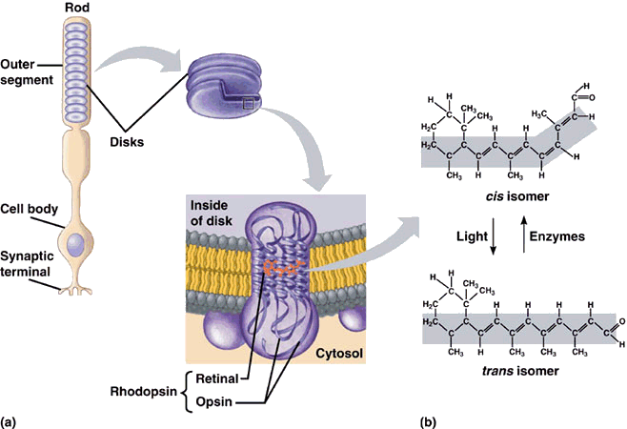
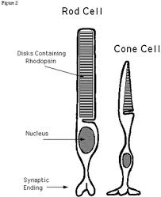
Rhodopsin and retinal structures
Rods and cones have disks that contain rhodopsin.
If we take a transverse section from these disks we will see a transmembrane complex (opsin is a transmembrane protein and it makes a complex with the aldehyde form (11-cis-retinal) of Vitamin A
Then in presence of light it gets converted into the isomerased form or straight form which is all-trans-retinal.

Slide 14
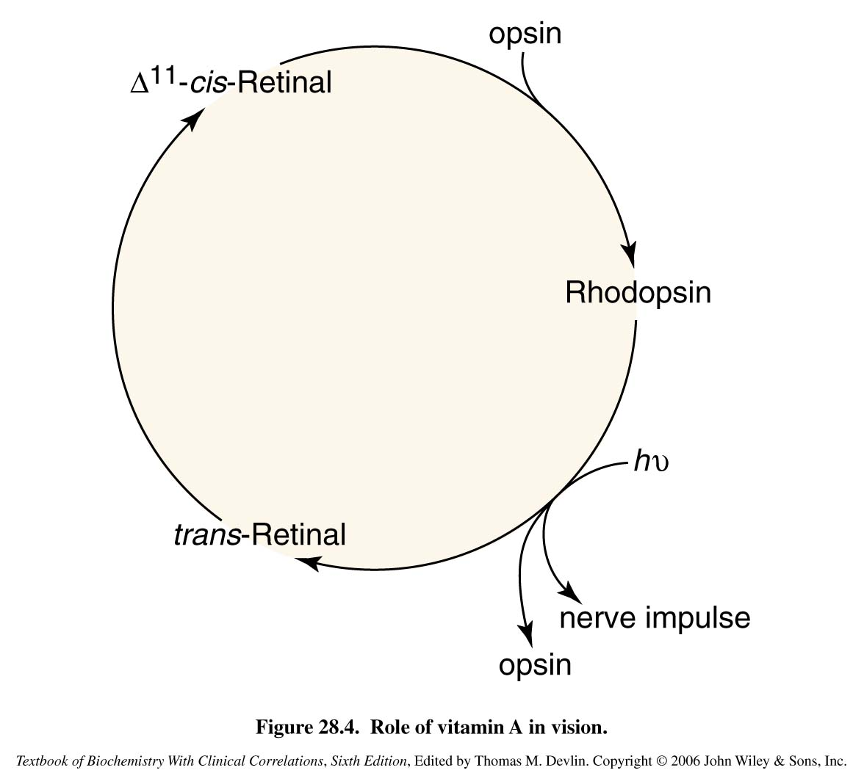
Role of Vitamin A in Vision
Normal vision depends on the retina and on adequate vitamin A.
First discovered by George Wald in 1967 (a Nobel Laureate).
In the retina, vitamin A in the form of retinal binds to a protein called opsin to make rhodopsin (in rod cells) and iodopsin (in cone cells).
Rhodopsin and iodopsin are light-sensitive pigments.
When stimulated by light vitamin A isomerizes from its bent ‘cis’ form to a straighter ‘trans’ form and detaches from opsin
The opsin molecule changes shape, which sends a signal to the brain via optic nerve and an image is formed
Most retinal released in this process is quickly converted to trans-retinol and then to cis-retinal, to begin another cycle
So rhodopsin is the molecule being used (by light) and regenerated (by enzymes).

Slide 15
Role of Vitamin A in Vision
Dark Adaptation time
It is the time needed to regenerate rhodopsin, it depends on the amount of Vitamin A, so for example if you have a high amount of Vitamin A, adaptation will be faster, and if we have low amount of Vitamin A, adaptation will be prolonged. And if there isn’t Vitamin A at all > night blindness occur
Bright light depletes rhodopsin and called (photobleaching).
Sudden shift from bright light to darkness causes difficulty in seeing.
“temporary deficiency of rhodopsin”
Rhodopsin is synthesized in a few minutes and vision is improved in the dark.
The time required to synthesize rhodopsin in the dark is called dark adaptation time.
It is increased in vitamin A deficiency.

Slide 16
Recommended Dietary Allowance (RDA) Vitamin A for Adults
Women: 700 µg or 2,330 IU
UL Men or Women: 3,000 µg or 10,000 IU
Men: 900 µg or 3,000 IU
(because it causes toxicity symptoms, so molecules that do not have toxicity symptoms will not have upper limit)
Upper limit in men or women 3000µg or 10,000 IU . Above this they will have toxicity.

Slide 17
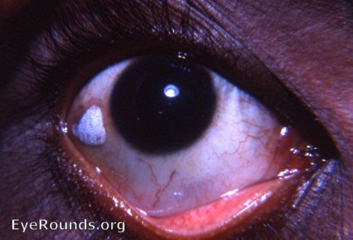
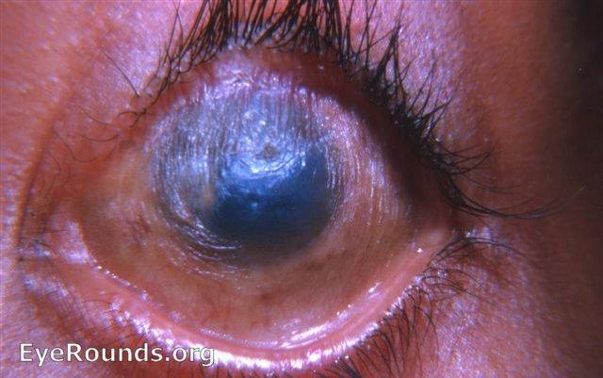
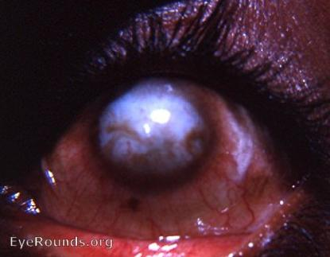
Vitamin A Deficiency and Diseases
Xerophthalmia: (Vitamin A affects gene transcription and one of the genes is (repressors I think) so when there is a deficiency in Vitamin A, too much of carotene is being produced. So in the lacrimal gland, instead of secreting fluids it gets keratinized so it stops producing lacrimal fluid which leads to dryness of the cornea)
Vitamin A associated diseases
Nyctalobia (night blindness): patient cannot see in low light or near darkness conditions.
Xerophthalmia
dryness of the conjunctiva and cornea.
Bitot’s spot
localized increased thickness of the conjunctiva.
Complete blindness
(in severe deficiency).
Keratomalacia
prolonged xerophthalmia leads to drying and clouding of cornea.
Nyctalobia: is one of the first signs of vitamin A deficiency. Visual threshold increases leading to the difficulty in seeing in dim light.
Xerophthalmia: most effects children and people in tropical areas. And it could lead to permanent blindness.

Slide 18
Take home messages
Vitamin A plays a major role in visual cycle and color vision.
Its deficiency can lead to vision impairment and blindness.
Good luck doctors

Slide 19
Quiz
1) Which ONE of the following is a fat soluble protein?
Vitamin B12
Vitamin B6
Vitamin C
Vitamin E
2) Which of the is the plant source of vitamin A ?
Pyridoxine
Retinoids
β-carotene
Biotin
3) Which ONE of the following best describes Xerophthalmia ?
Localized increased thickness of the conjunctiva.
Inability see in low light or near darkness conditions
Dryness of the conjunctiva and cornea.
None of the above
4) Excessive carotenoid intake lead to skin discoloration but in what colour ?
Blue
Red
Yellow
Pink
Q : Describe the role of vitamin A in vision and visual cycle?
Q : List the functions of vitamin A ?
1- D
2- C
3- C
4- C
Suggestions and recommendations

Slide 20
Amal AlQarni
Hanin Bashaikh
Heba Alnasser
Najd Altheeb
Hanin Alsubki
Allulu Alsulaiehem
Maha Alghamdi

Slide 21
https://www.youtube.com/watch?v=nnCrnWOiKG4
Don’t forget to review the notes

