Slide 1

Biochemistry
Important
Extra Information
Doctors slides
Doctors notes
Vitamins B6 and B12
Editing file

Slide 2

Upon completion of this lecture, the students should be able to:
Understand the types and functions of vitamins B6 and B12
Recognize the role of these vitamins in maintaining the myelin sheath of nerves and their function
Discuss the consequences of vitamin B6 and B12 deficiency that can lead to nerve degeneration and irreversible neurological damage

Slide 3

This lecture contains the following
Types and functions of vitamins B6 & B12
Disorders due to their deficiency
Vitamin B12 deficiency and folate trap
Demyelination neuropathy and neuropsychiatric symptoms of vitamin B12 deficiency
Overview
The lecture contains a lot of notes but as long as you focus while you are reading them, you will understand the lecture rapidly

Slide 4
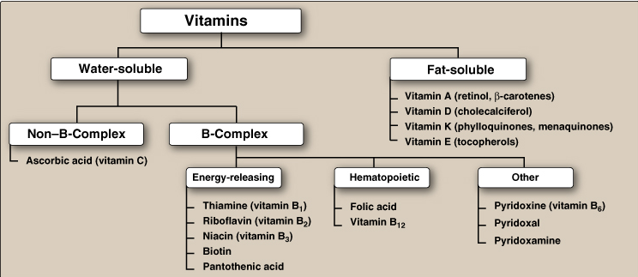
Classification of vitamins

Slide 5
Water Soluble Vitamins:
Characteristics of B complex:
Types of Vitamin B :
Thiamine ( B1 )
riboflavin ( B2 )
niacin ( B3 )
pantothenic acid ( B5 )
pyridoxine ( B6 )
biotin ( B7 )
cobalamin (B12) can be stored in the body.
Folate.
The eight vitamins B types together (with folic acid) are called : B complex.
They function as coenzymes.
Most Vitamins in vitamin B complex act as precursors for coenzymes (involved with enzymes that catalyse the reactions involved in energy synthesis).
-There are two types of enzymes: holoenzyme and apoenzyme.
-What are coenzymes? Holoenzyme: some enzymes require a non protein part to become active, this part can either be a cofactor or a coenzyme.
-The coenzyme is bound transiently (not permanent) with the enzyme.
Must be supplied regularly in the diet.
Not significan-tly stored in the body.
Excess excreted
Present in small quantities in different types of food
Help in various biochemical processes in cell
Important for growth and good health

Slide 6
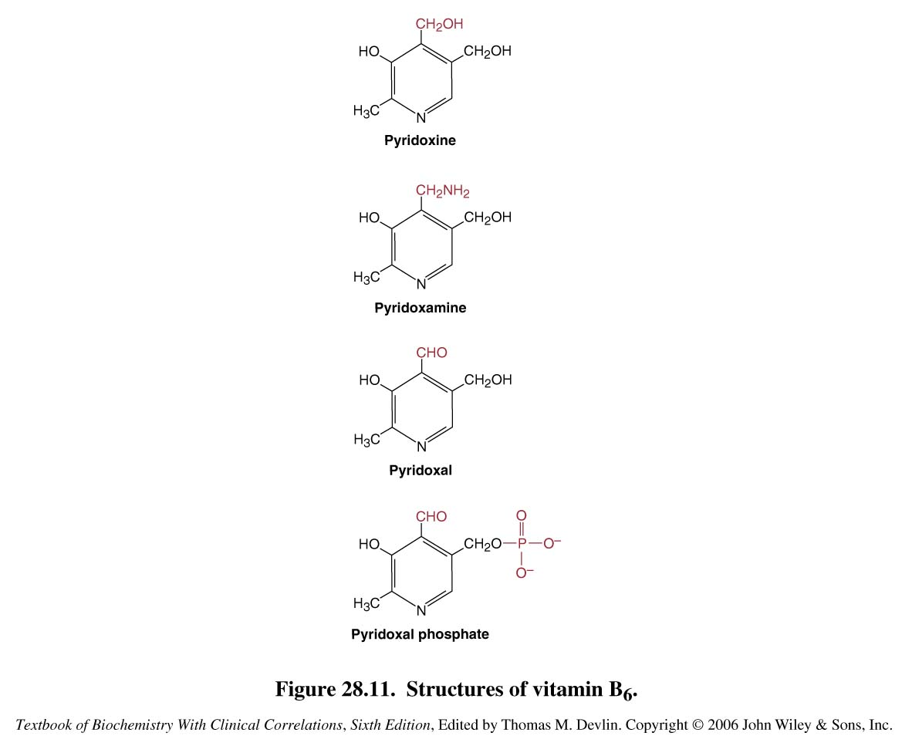
Vitamin B6:
Functions:
As coenzyme for: Transamination, Deamination, Decarboxylation and Condensation reactions
Pyridoxine: From plants.
Pyridoxal: From animal proteins such as eggs and meat.
Pyridoxamine: Same source as pyridoxal.
All 3 are converted to pyridoxal phosphate (PLP)
Active Form:
Three Forms:
Transamination :the amino group is being transported from one molecule to another.
Deamination is the removal of the amino group from a molecule.
Decarboxylation :is the removal of CO2 from a molecule.
Condensation reactions of two molecules combining together to form a third molecule.
these 4 forms differ only in the nature of the functional group attached to the ring and they are derivatives of pyridine

Slide 7
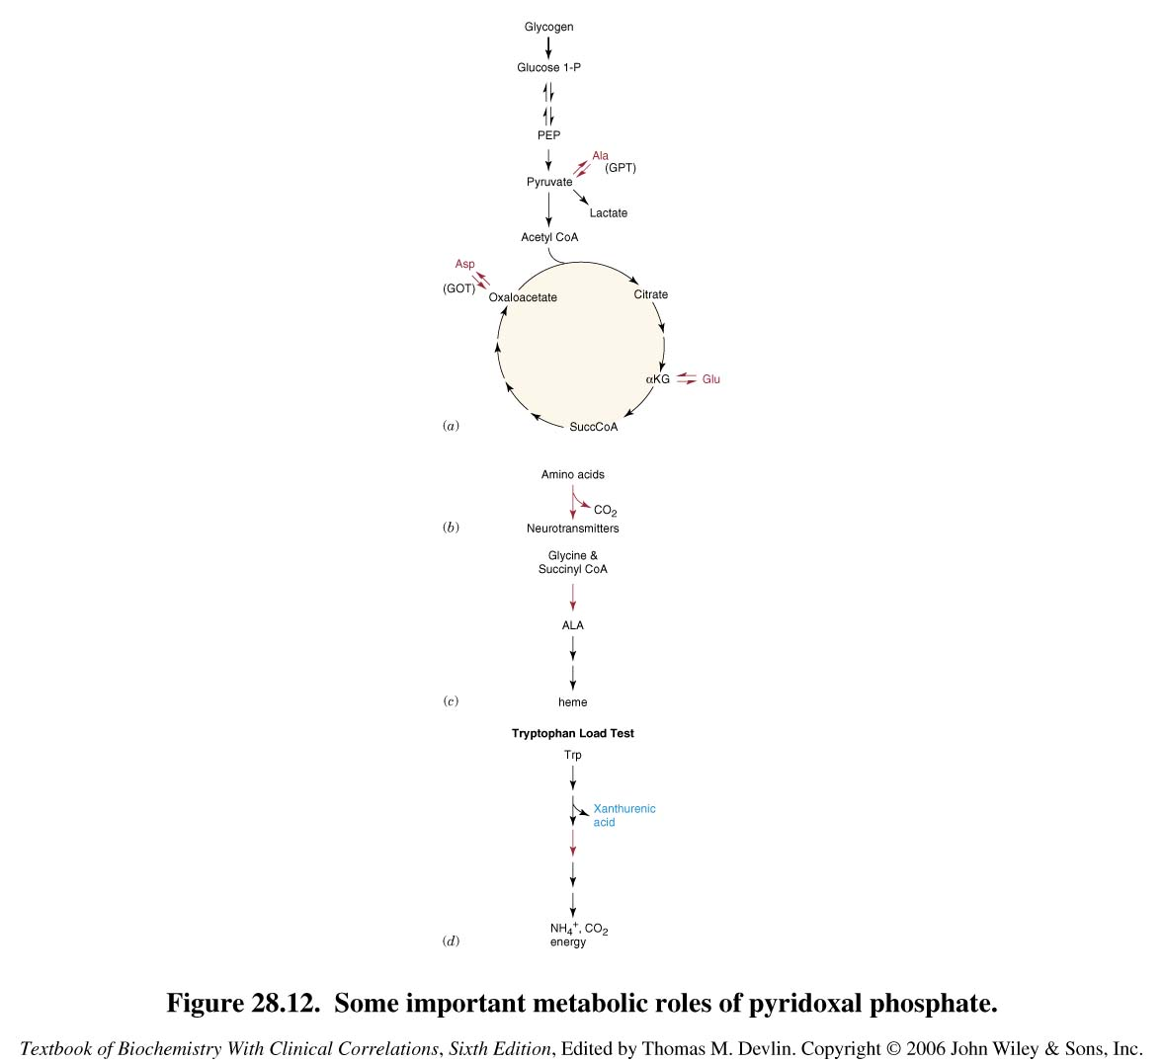
Metabolic roles of pyridoxal phosphate:
In this image we find some of the important roles which pyridoxal plays in metabolic reactions:
glycogen is giving you glucose phosphate and then finally giving you pyruvate .
So glycogenolysis and finally entering Kreps cycle.
The transamination reactions are involved in both the synthesis and breakdown of amino acids because they are reversible reactions, these reactions are also involved in energy synthesis because the resulting molecules enter Kreps.
In order to form neurotransmitters ,decarboxylation must occur. Glycine and succinyl coA join to form aminoluvilinic acid which then forms heme.
What is the principle concept for the test used to diagnose for B6 deficiency ?
When tryptophan is degraded it gives you ammonium and carbon dioxide and energy, but this reaction needs vitamin B6 to occur. This reaction actually makes the basis of the test used to check for vitamin B6 deficiency. So if vitamin B6 is deficient you will have a build up of a molecule called xanthurenic acid, this molecule is found (accumulated) in the blood of the patients who have vitamin B6 deficiency. Note that at the beginning of the test you give the patient tryptophan (to check if xanthurenic acid will accumulate or not).

Slide 8
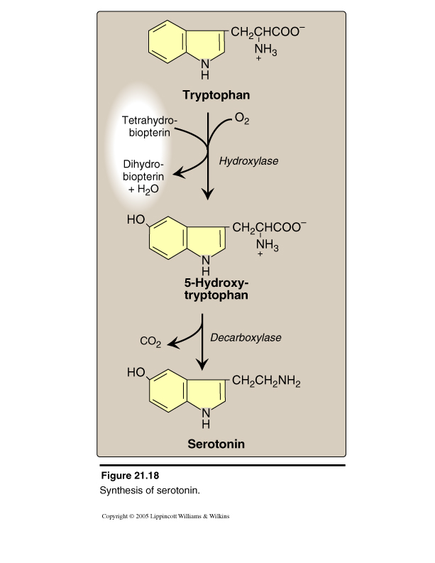
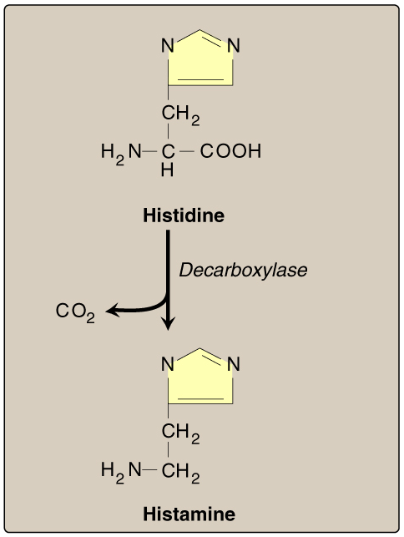
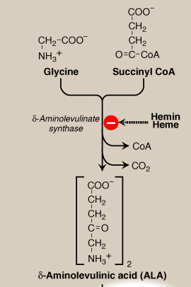
Reactions of Vitamin B6
decrease B6 may lead to depression
Condensation Reaction :
Formation of ALA by ALA synthase, The regulatory step in haemoglobin synthesis
Decarboxylation Reaction: Formation of Histamine
Decarboxylation Reaction: Formation of Serotonin
The decarboxylation of histidine yields histamine.
The decarboxylation of tryptophan yields serotonin.
Note that this reaction requires glycine and succinyl CoA to join together.

Slide 9
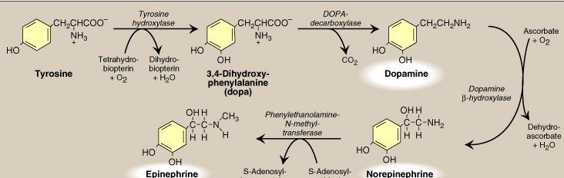
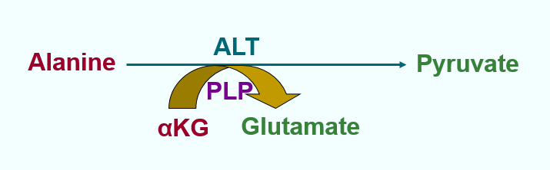
Reactions of Vitamin B6
Decarboxylation Reaction: Formation of Catecholamine “Dopamine, norepinephrine and epinephrine” .
Tyrosine is the parent compound here ,then it gets decarboxylated into dopamine which is then converted into epinephrine and norepinephrine So if there is a deficiency is vitamin B6 ,the catecholamine synthesis will decrease or stop.
Transamination Reaction
Alanine transfers its amino group to alpha keto glutarate which then turns into glutamate (catalyzed by alanine transaminase which needs PLP) What is left from alanine? Pyruvate
The transfer of amino groups is important when a nonessential amino acid (alanine) is converted into an essential amino acid (pyruvate). *Essential Amino Acids: are those that can’t be synthesized by the body so we must get it in the diet.

Slide 10
Disorders of Vitamin B6 deficiency

Slide 11
Disorders of Vitamin B6 deficiency

Slide 12
Vitamin B12
Doctor mentioned this

Slide 13
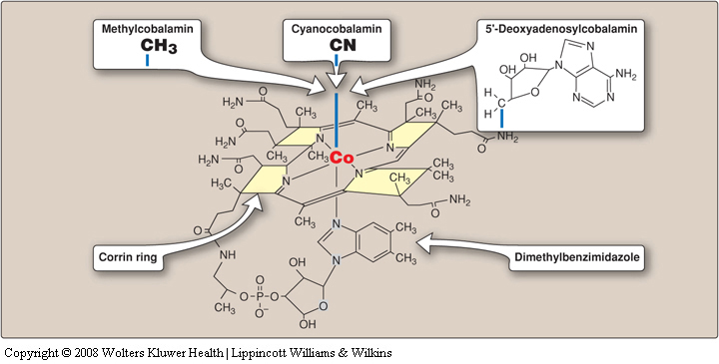
Vitamin B12
In the centre of the Corrin ring ,we have cobalt And cobalt can make six bonds. Four of the these bonds can attach to the nitrogen found in the Corrin ring, and one is attached to the dimethylbenzimidazole, and the sixth bond : If it is made with cyanide it is called cyanocobalamin.
If a methyl group is attached ,its methylcobalamin. Or if adenosyl group is attached it is called adenosylcobalamine. So the form of cobalamin changes according to the change in the sixth group while the other 5 bonds remain the same

Slide 14
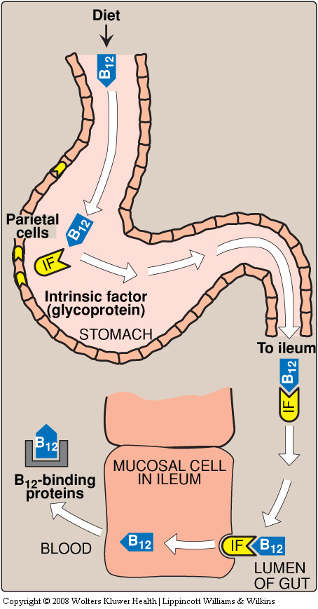
Vitamin B12 ( Cobalamine )
Mainly found in animal liver bound to protein as: “ Methylcobalamin” or
“ 5’-deoxyadenosylcobalamin”
Essential for:
1.Normal nervous system function .
2.Red blood cell maturation .
* Note that folic acid and vitamin B 12 are both required in haematopoiesis . Deficiency in B12 leads to megaloblastic macrocytic anemia.
Not synthesized in the body and must be supplied in the diet.
Binds to intrinsic factor “a protein secreted by cells in the stomach “ and absorbed by the ileum.
* If a condition in which GIT flora are decreased such as in people taking antibiotics, vitamin B12 deficiency may occur .
* It may also occur in older people because their stomach acidity is decreased which impairs the absorption of vitamin B12 [Further information in the next slide]
synthesized by parietal cells of stomach, then it get attached to intrinsic factors in intestine, then it binds to ileum mucosal cells , then it get absorbed in the ileum as trans-cobalamin protein, deficiency in intrinsic factors due to autoimmune destructions or undergoing sleeve gastrectomy will reduce absorption of B12

Slide 15
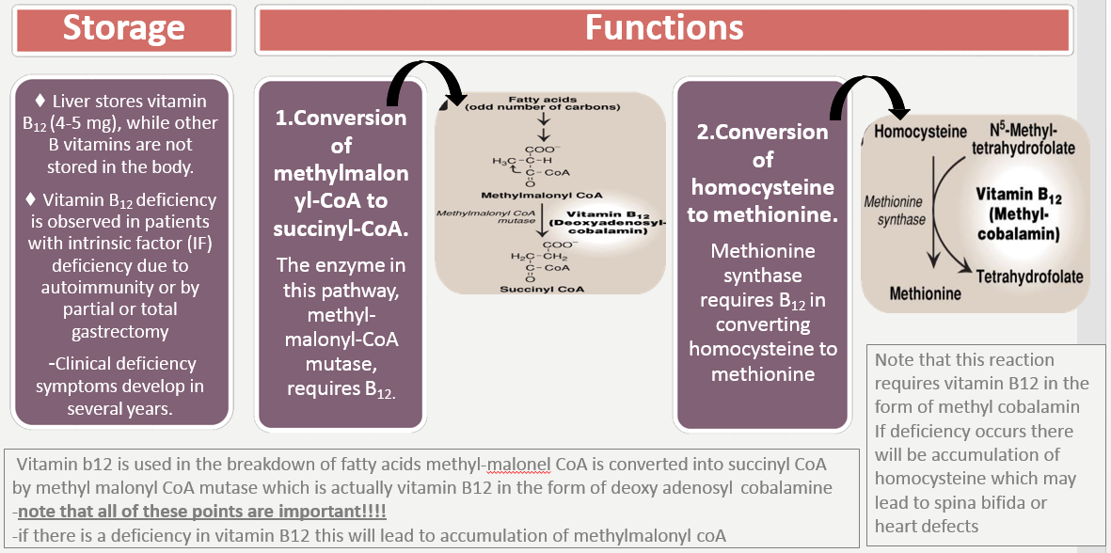
Vitamin B12:
IMPORTANT

Slide 16
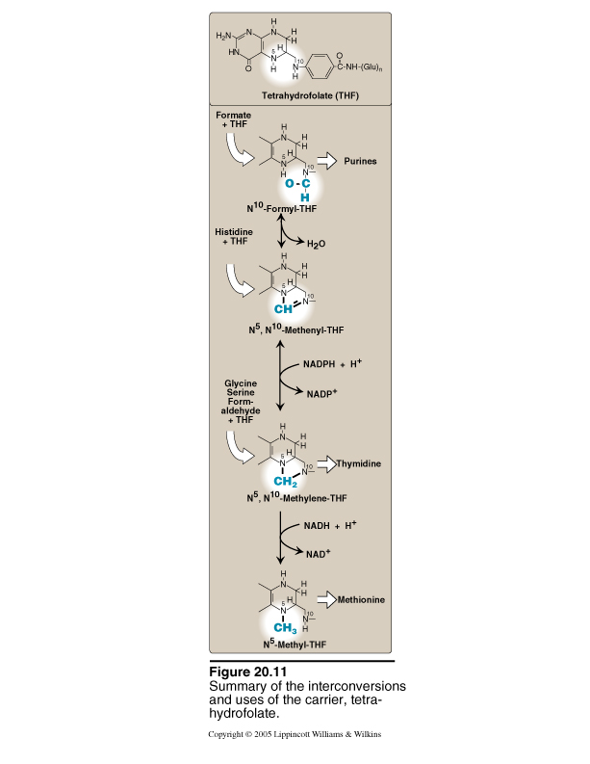
B12 Deficiency And Folate Trap
“IMPORTANT”
Homocysteine re-methylation reaction is the only pathway where N₅-methyl TH4 can be returned back to tetrahydrofolate pool
Hence folate is trapped as
“ N₅-methyltetrahydrofolate (folate trap) “
This leads to folate deficiency and deficiency of other TH4 derivatives (N₅ -N₁₀ methylene TH4 and N10 formyl TH4) required for purine and pyrimidine syntheses
TH4: Tetrahydrofolate
• Due to trapping of TH4 all of these reactions can’t go on.
-The functional form of folate is tetrahydrofolate.
Folate is trapped because it can not be converted to the active form while it exists as inactive form
B12 deficiency can be determined by the level of methylmalonic acid in blood, Which is elevated in individuals with low intake or decreased absorption of the vitamin
liver disease leads to elevation of vitamin B12 levels , its required for synthesis of proper red blood cell.
Fatty acid degradation also requires B12 , homocysteine > methionine reaction also requires B12 as a co-factor .
Deficiency of folic acid can lead to anemia since it’s requires for RBC’s maturation .

Slide 17
Disorders of Vitamin B12 Deficiency

Slide 18
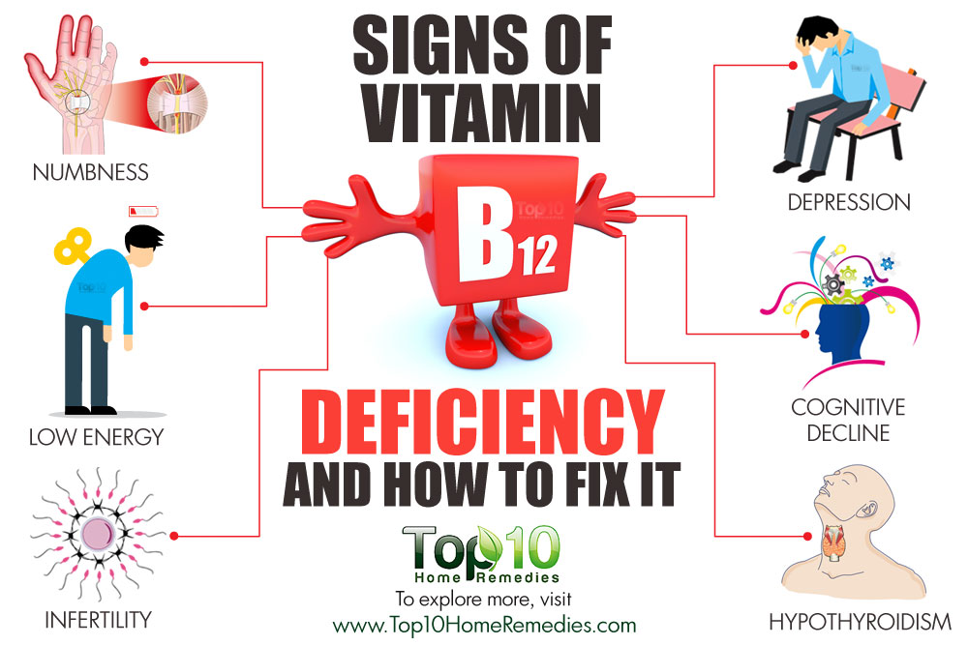
Symptoms of B12 deficiency
FOCUS ON THE SYMPTOMS IT CAN PRESENT AS CLINICAL CASE
Neurological symptoms
Psychological symptoms
Unsteady gait and balance (ataxia)
Depression
EXTRA
Neurological symptoms of B12 deficiency
Unstable mood
Absence of reflexes
Confusion and memory loss
Paresthesia (abnormal sensation of hands and feet)
Reduced perception of vibration and position

Slide 19
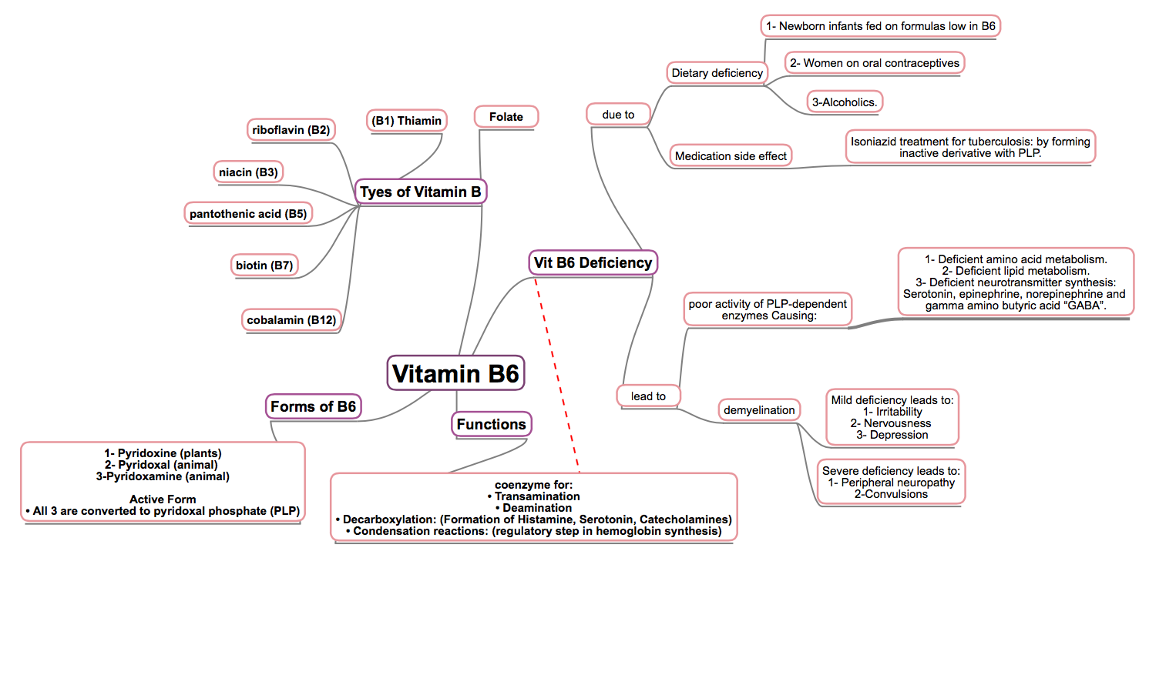
Summary

Slide 20
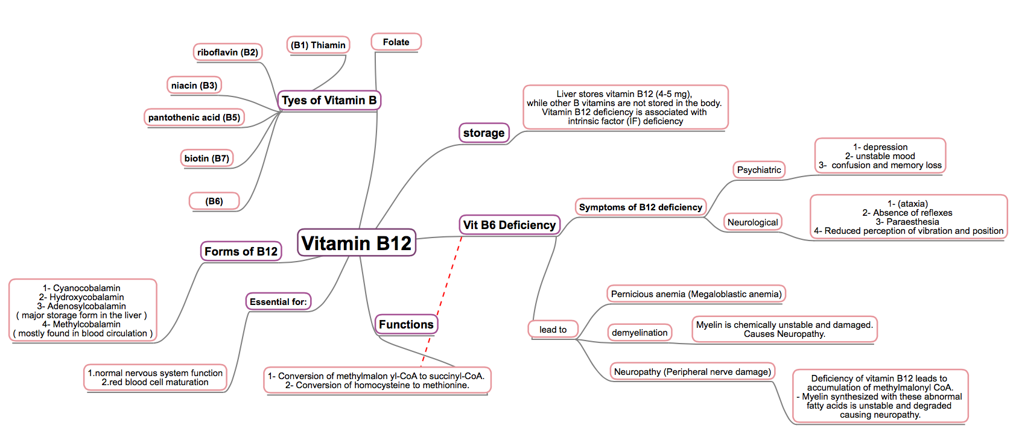
Summary

Slide 21
Quiz
1) The active form of vitamin B6 is:?
Pyridoxine
Pyridoxal
Pyridoxamine
PLP
2) Which one of the following is a psychiatric symptom of vitamin B12 deficiency?
Paresthesia
Reduced perception of vibration and position
Confusion and memory loss
Ataxia
3) Which one of the following symptoms is caused by severe deficiency of
vitamin B6?
Irritability
Depression
Convulsions
Nervousness
4) Which one of the following is the major storage form of vitamin
B12 in the liver?
Cyanocobalamin
Hydroxycobalamin
Adenosylcobalamin
Methycobalamin
Q : Describe the process through which folate is trapped as
N5–methyltetrahydrofolate causing vitamin B12 deficiency ?
Q : List the functions of vitamin B6 as a coenzyme ?
1- D
2- C
3- C
4- C
Suggestions and recommendations

Slide 22
Faisal alfawaz
Saud alshunaifi
Jawaher Alkhayyal
Ghaida Alsaeed
Ashwaq Almajed

Slide 23
Don’t forget to review the notes

